Slide 1

Square Kilometre Array – (3D-) Science Goals
Robert Braun
SKA Science Director
14th March 2014

Slide 2
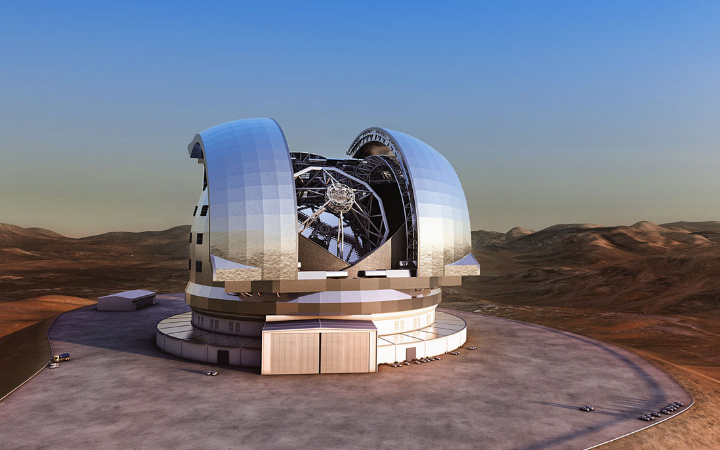
Great Observatories for the coming decades
E-ELT optical/IR
Construction approved
E-ELT optical/IR
Program approved

Slide 3
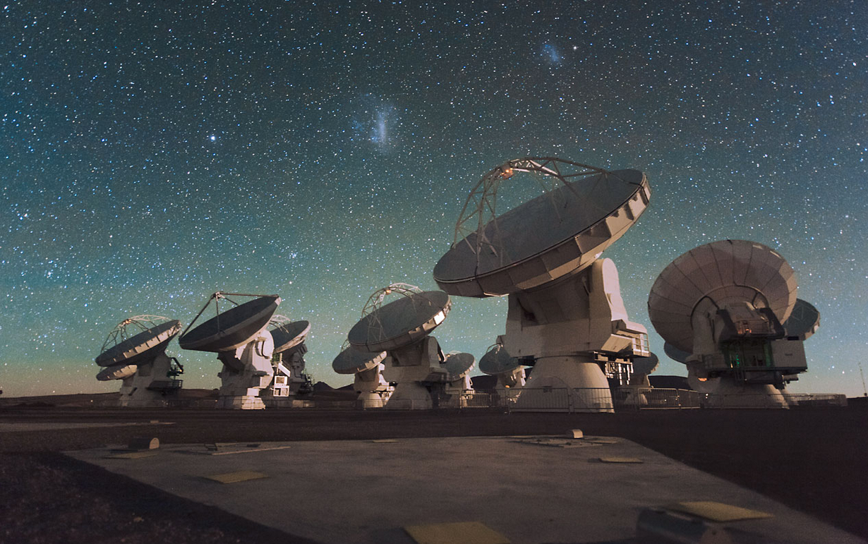
Great Observatories for the coming decades
Atacama Large Millimetre Array (ALMA): mm/submm
Chajnantor Plateau @ 17,000 ft
Operational now

Slide 4
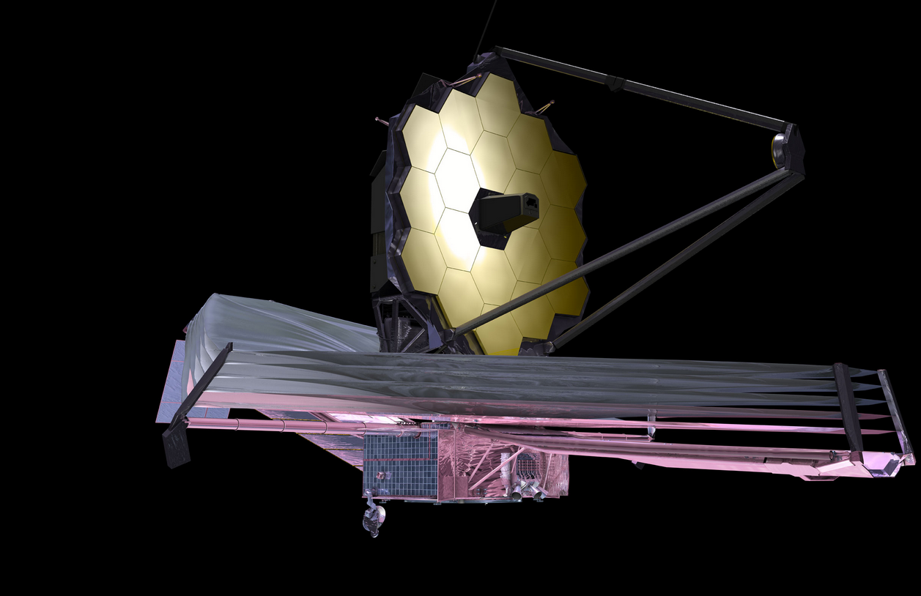
Great Observatories for the coming decades
James Webb Space Telescope: due for launch in 2018

Slide 5
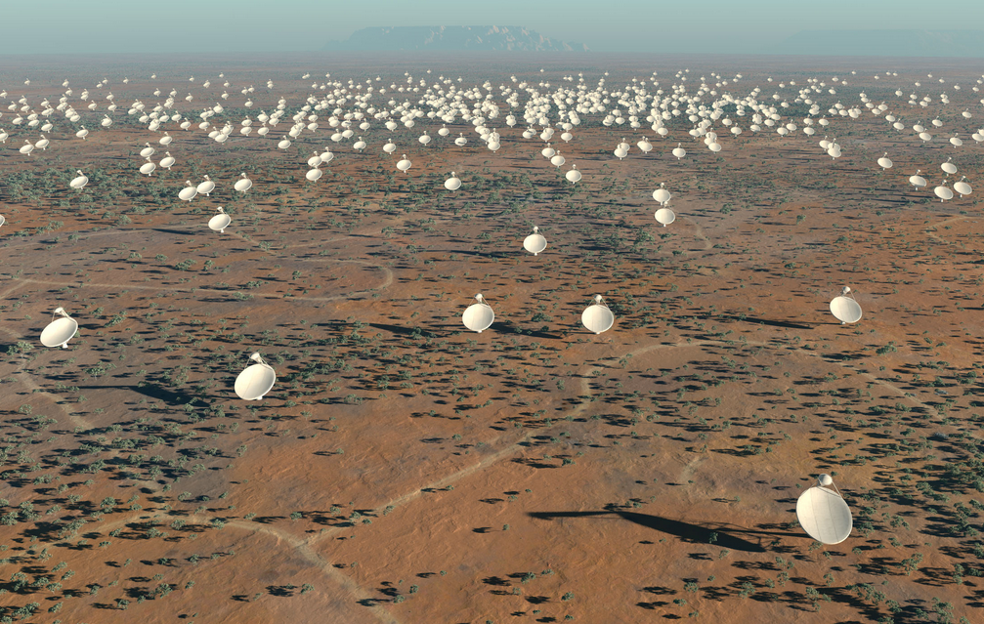
Great Observatories for the coming decades
Square Kilometre Array: radio
Construction start 2017/18

Slide 6
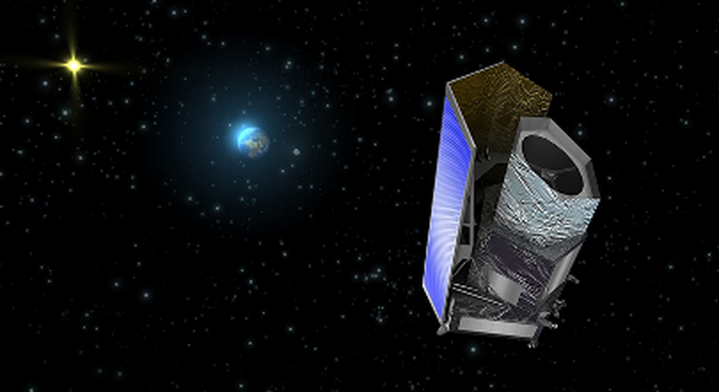
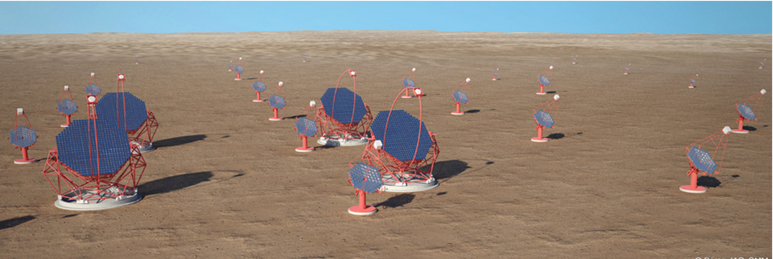
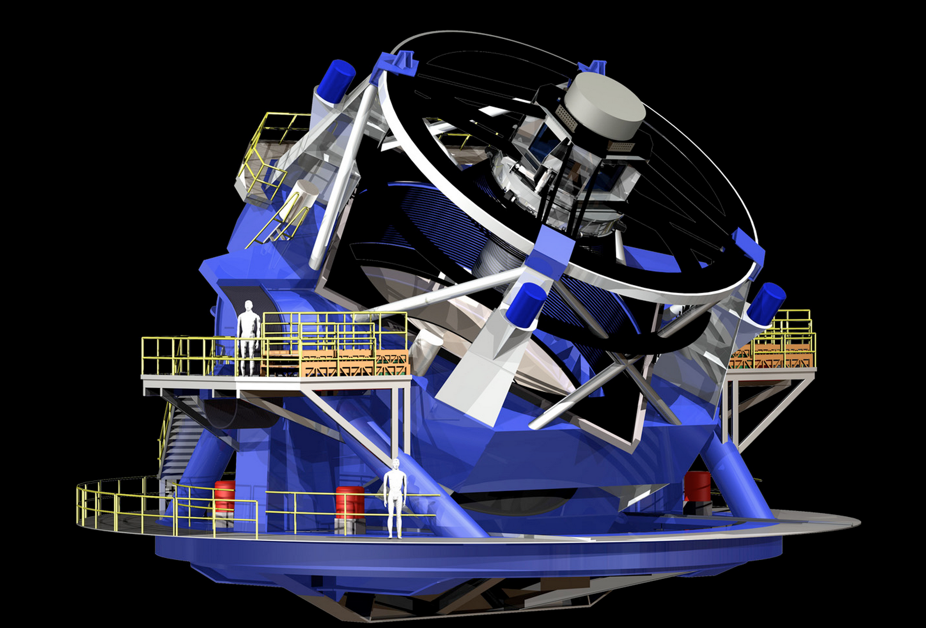
More specialised “experiments”
CTA
~€200-300M, operational 2015??
EUCLID:
~€1B, launch 2020
LSST
~$750M, operational ~2020

Slide 7
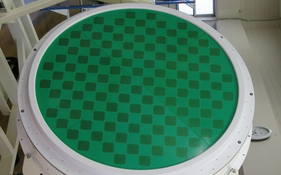
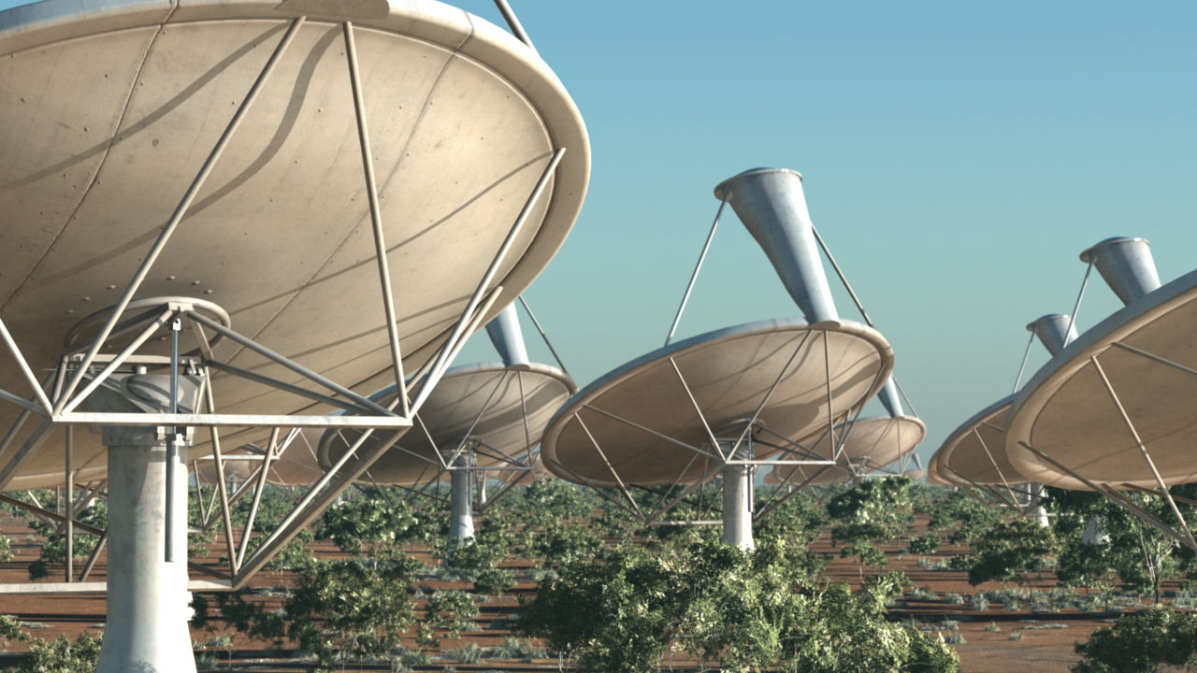



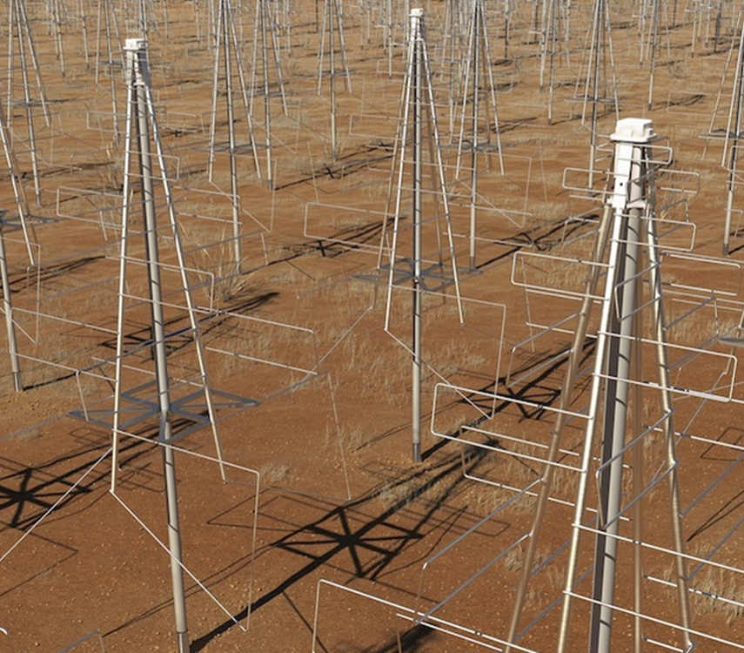


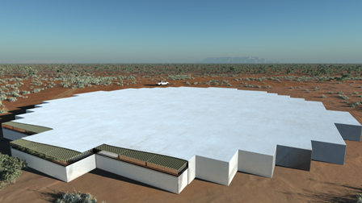
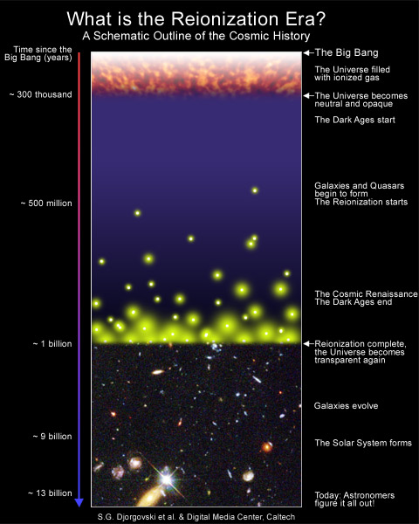
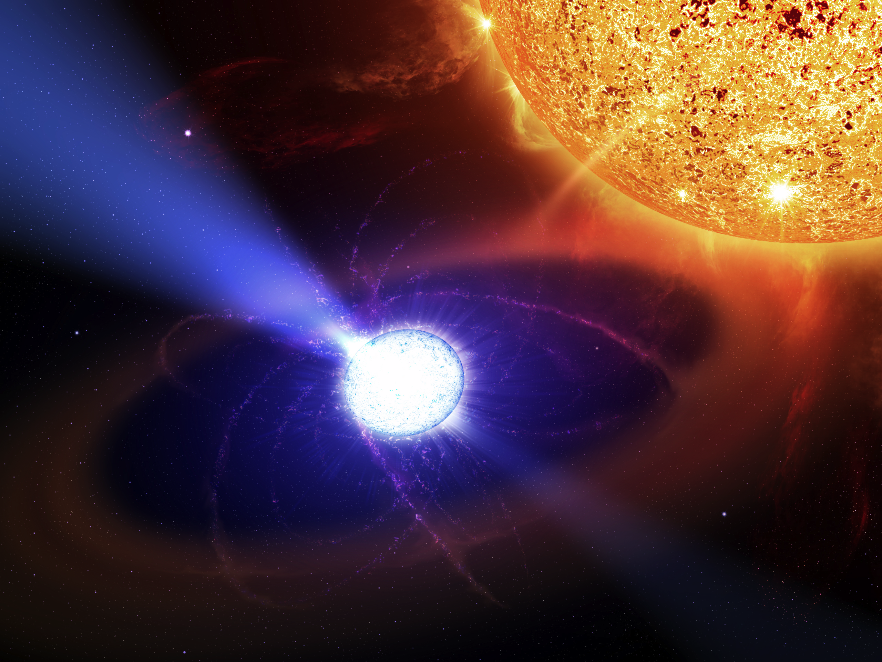
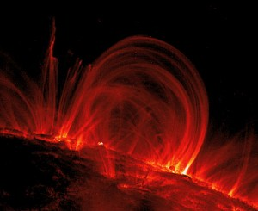
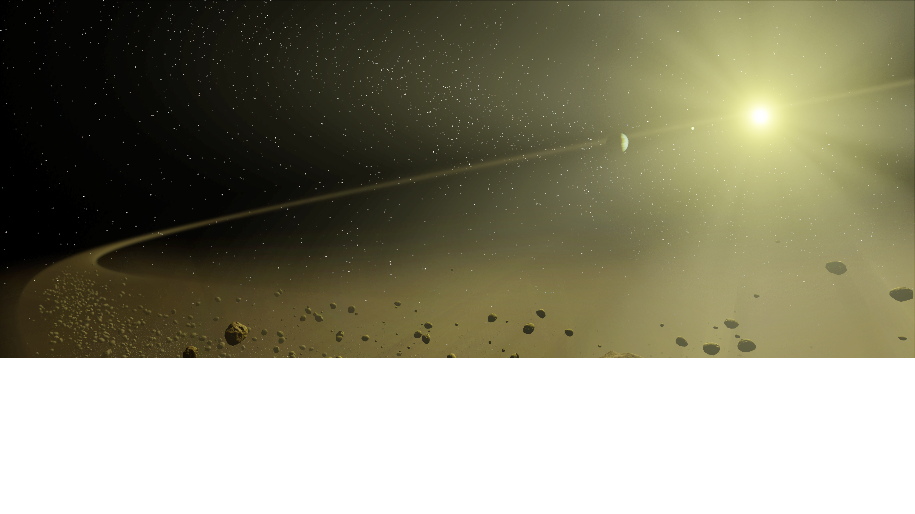
Exploring the Universe with the world’s largest radio telescope
250,000 element
Low Frequency Aperture Array
Phase I : 2020
96 survey enabled dishes
254 dishes
>250,000 element
Low Frequency Aperture Array
Mid Frequency Aperture Array
Phase II : 2024
2500 dishes
Cosmic Dawn & Reionization
Cosmology &
Galaxy Evolution
Pulsars
Cosmic Magnetism
Cradle of Life
Science
50 MHz 100 MHz 1 GHz 10 GHz

Slide 8
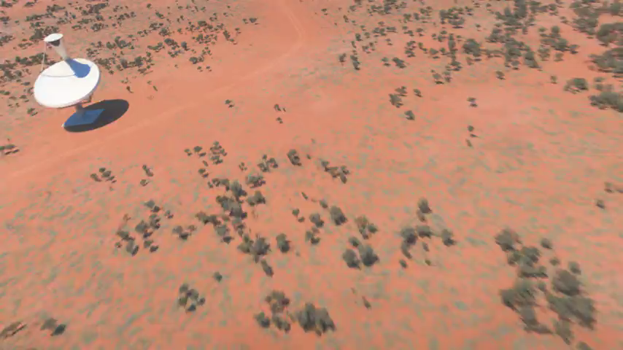
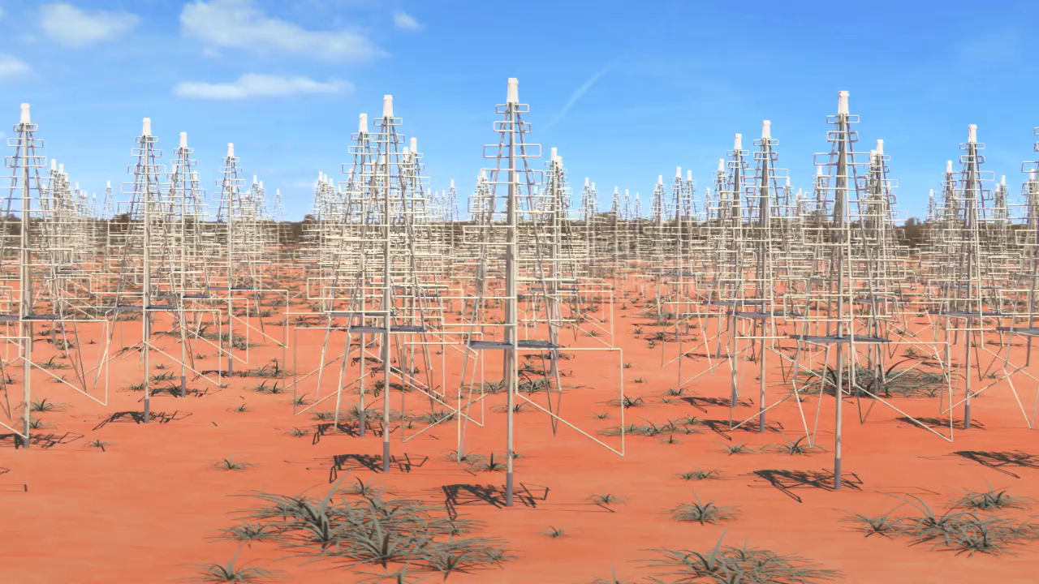
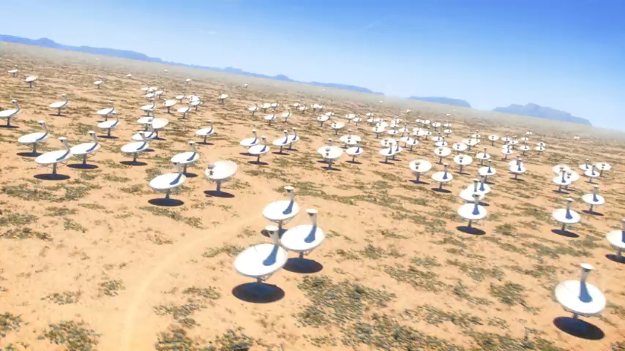
Exploring the Universe with the world’s largest radio telescope
250,000 element
Low Frequency Aperture Array
Phase I : 2020
96 survey enabled dishes
254 dishes
>250,000 element
Low Frequency Aperture Array
Mid Frequency Aperture Array
Phase II : 2024
2500 dishes
Cosmic Dawn & Reionization
Cosmology &
Galaxy Evolution
Pulsars
Cosmic Magnetism
Cradle of Life
Science
50 MHz 100 MHz 1 GHz 10 GHz

Slide 9
SKA Members and Governance
Australia (DIISRTE) Canada (NRC-Herzberg)
China (MOST) Germany (BMBF)
Italy (INAF) Netherlands (NWO)
New Zealand (MED) South Africa (DST)
Sweden (Chalmers) UK (STFC)
India (Tata/DAE)
UK Company Limited by Guarantee
(Expedient solution to enable SKA project to proceed; long-term governance structure under review)

Slide 10
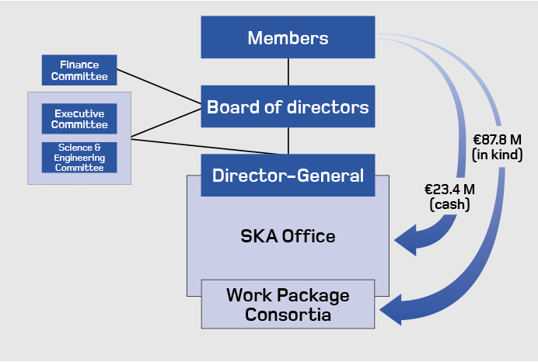
SKA Members and Governance
Finance
Committee
Executive
Committee
> €97.2M
Science & Engineering
Committee
Strategy &
Bus. Dev.
Committee
Science
Working
Group
Science
Working
Group

Slide 11
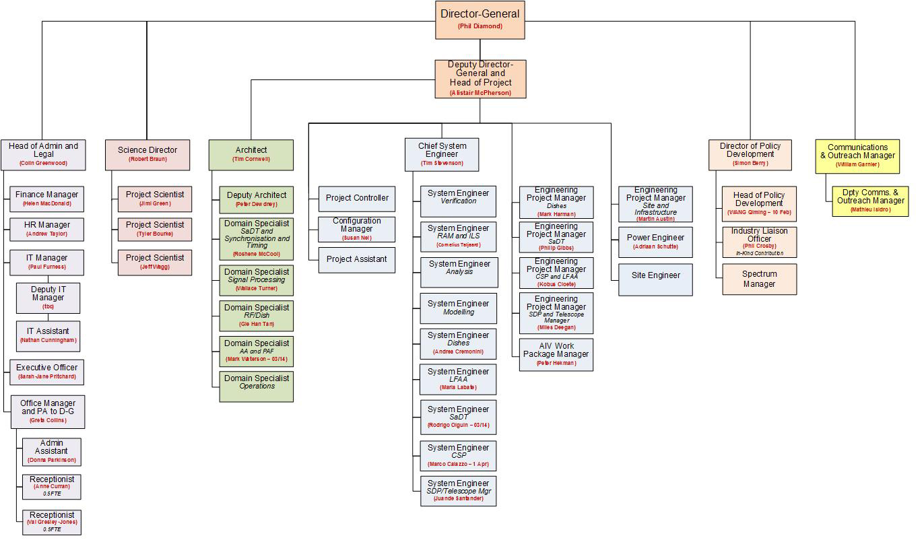
SKA Office Organisational Chart
SKA Office: 48
Design consortia: > 350

Slide 12

The Work Package Consortia
Project Scientist: Jimi Green Project Scientists: Jeff Wagg & Tyler Bourke Project Scientist: Tyler Bourke
Project Scientist: Jeff Wagg Project Scientists: Jimi Green & Tyler Bourke Project Scientist: Jimi Green
Project Scientist: Jimi Green Project Scientist: Tyler Bourke Project Scientist: Tyler Bourke
Project Scientist: Tyler Bourke Project Scientists: Jeff Wagg & Tyler Bourke

Slide 13
SKA Recent Milestones
Board sets cost-cap of €650M capital for construction of SKA Phase 1
  Imposes discipline on design process
  Design consortia will be given target unit costs (where appropriate)
  Evolution of design guided by scientific and engineering assessments
  Provides solid basis on which to raise construction funding.
Top-level principles of Concept of Operations approved
Design Consortium Agreements signed

Slide 14
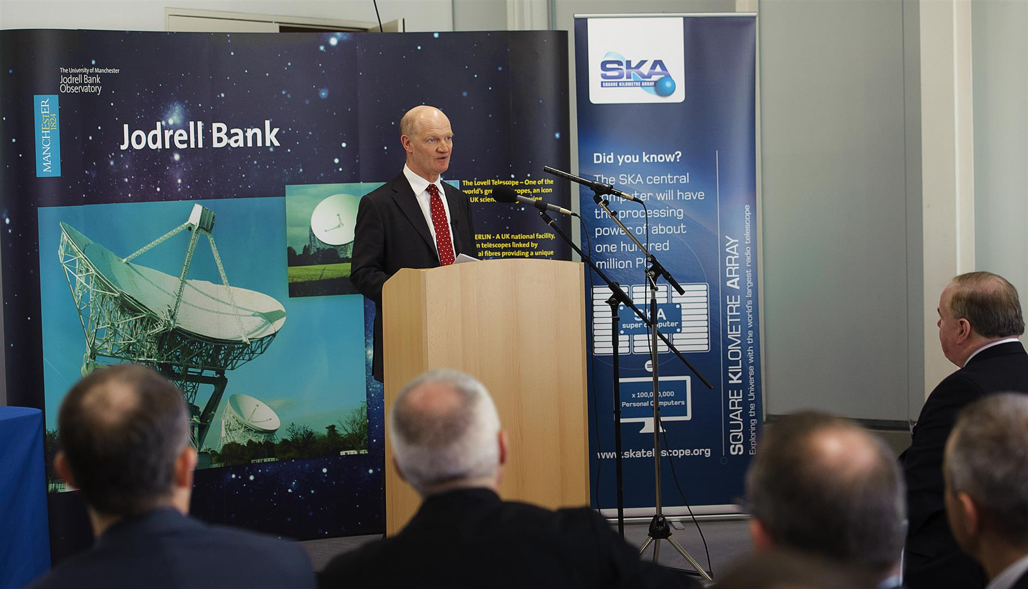
SKA Recent Milestones
11 March Announcement by UK Science Minister: £100M toward construction and early operations

Slide 15
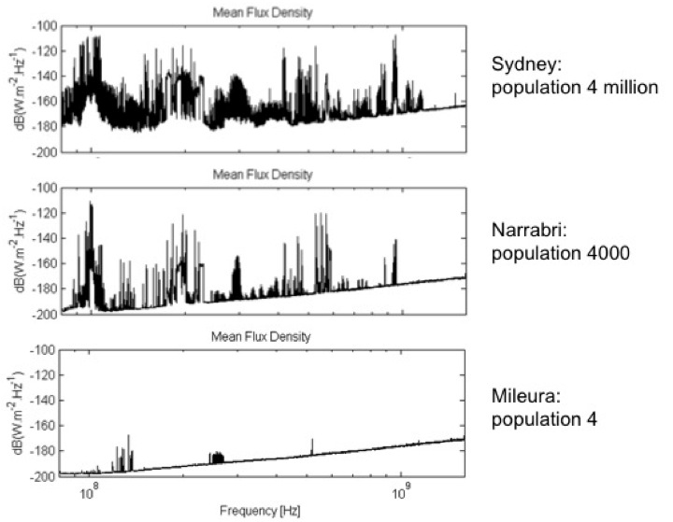
How did we choose the sites?

Slide 16
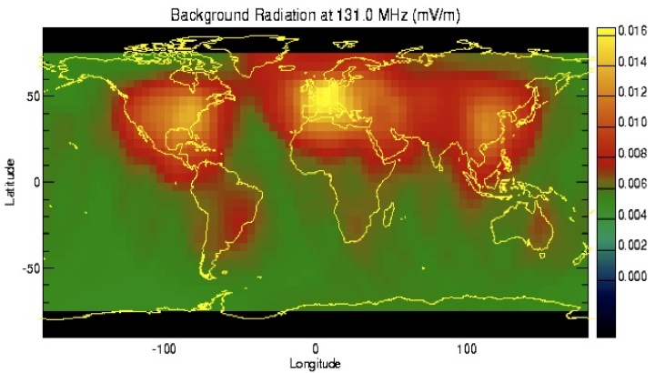
How did we choose the sites?

Slide 17
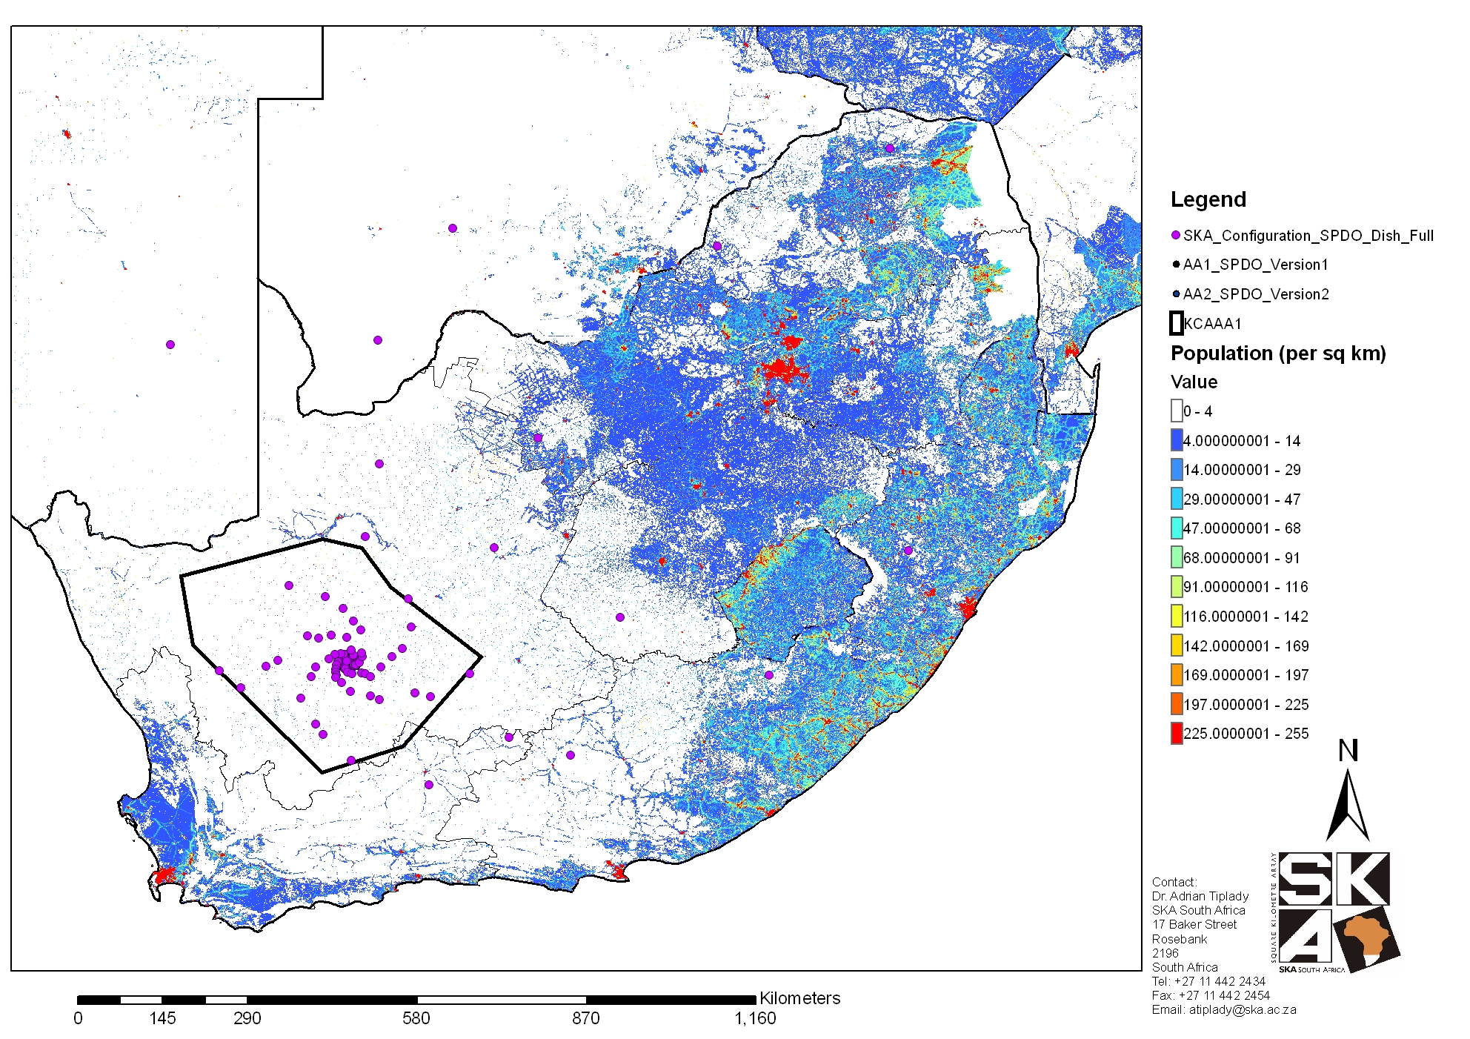
Karoo Radio Astronomy Reserve
500 km

Slide 18
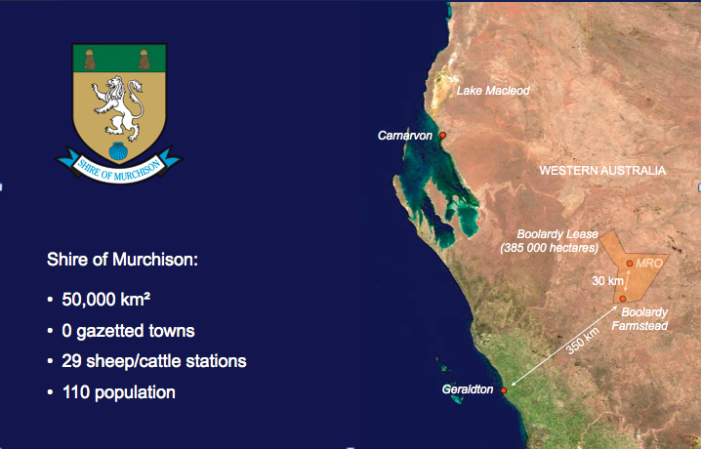
Murchison Radio Astronomy Observatory
; size of the Netherlands
=> 0.002 km⁻²

Slide 19
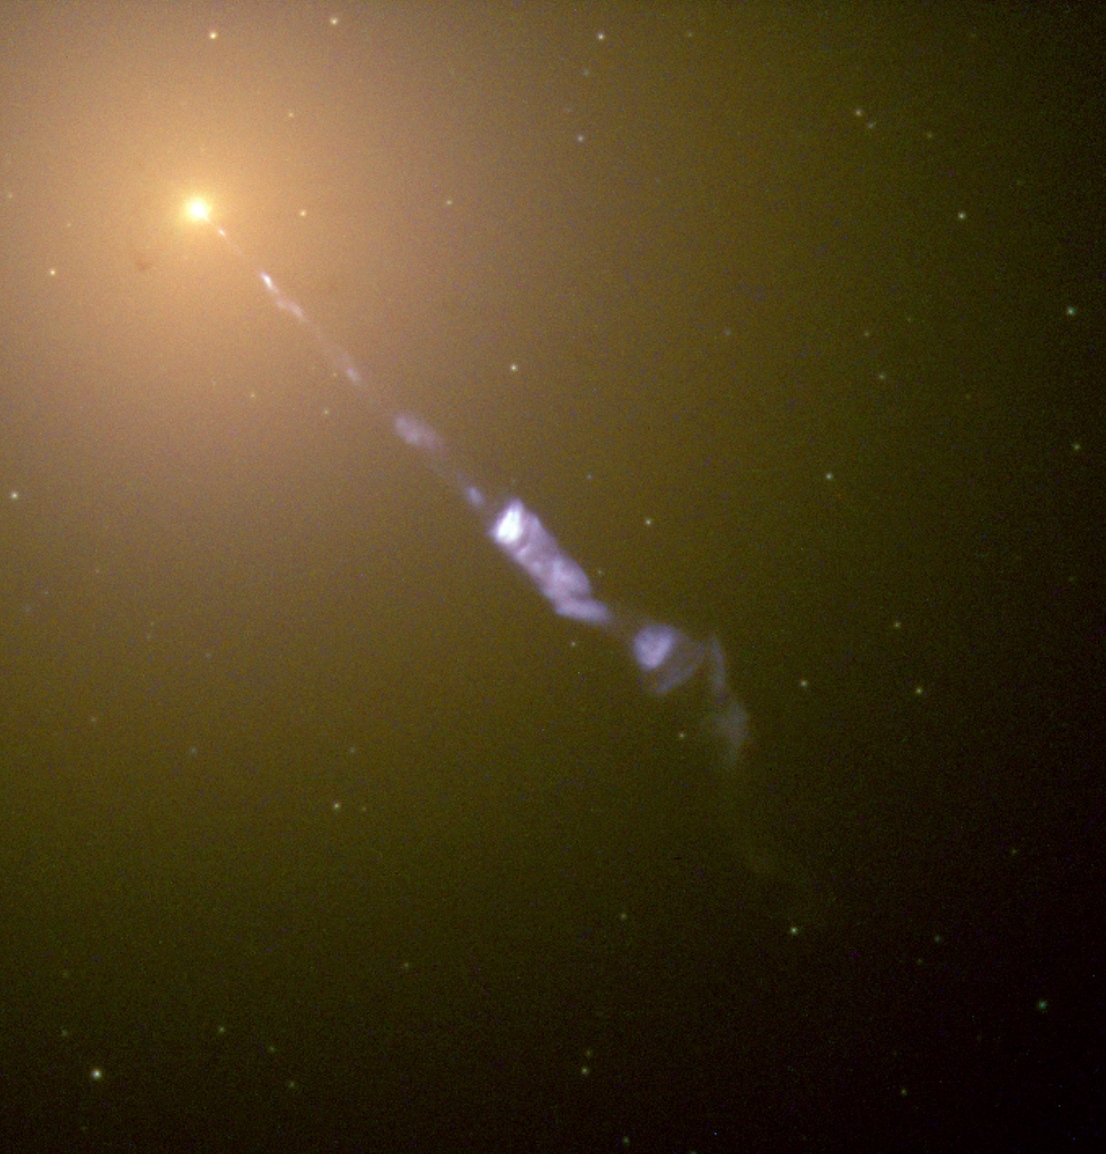
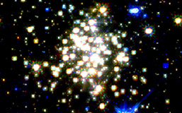
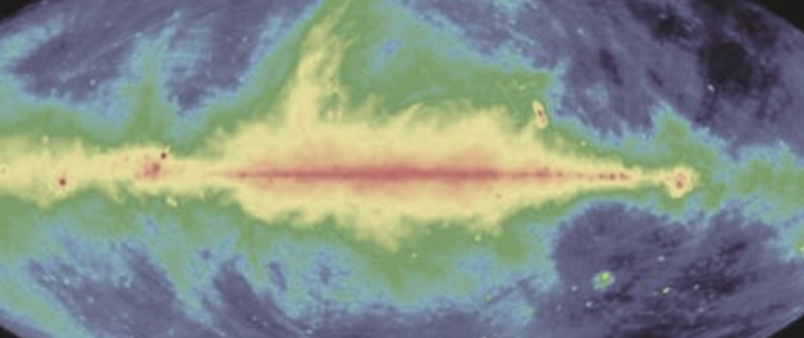
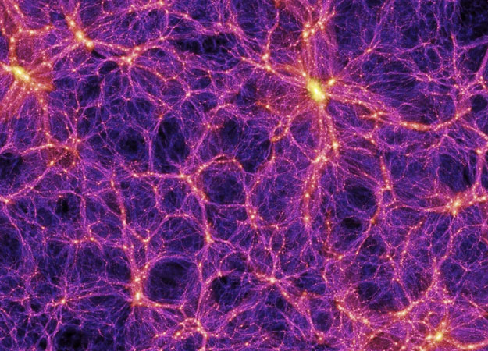
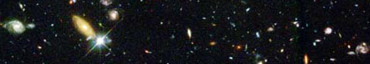
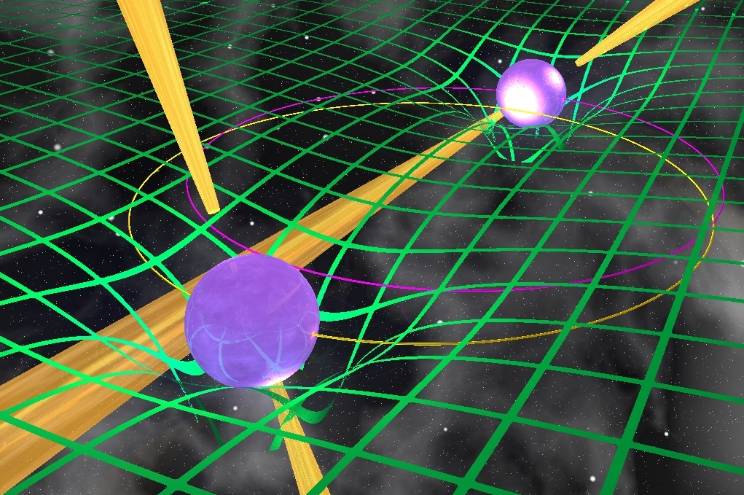
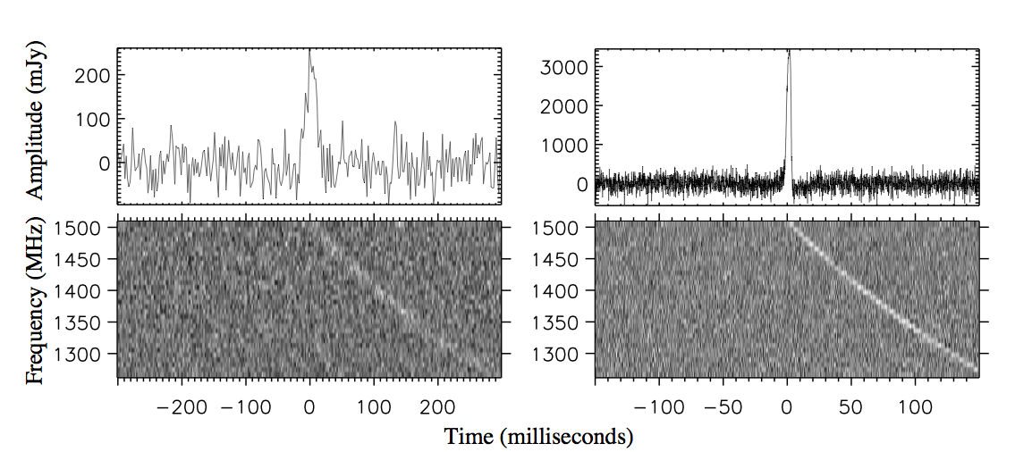
The Science Working Groups
Astrobiology (“The Cradle of Life”)
  Project Scientist: Tyler Bourke
  Working Group Chair: Melvin Hoare
Galaxy Evolution – Continuum
  Project Scientist: Jeff Wagg
  Working Group Chairs: Nick Seymour & Isabella Prandoni
Cosmic Magnetism
  Project Scientist: Jimi Green
  Working Group Chairs: Melanie Johnston-Hollitt & Federica Govoni
Cosmology
  Project Scientist: Jeff Wagg
  Working Group Chair: Roy Maartens
Epoch of Reionisation & the Cosmic Dawn
  Project Scientist: Jeff Wagg
  Working Group Chair: Leon Koopmans
Galaxy Evolution – HI
  Project Scientist: Jimi Green
  Working Group Chairs: Lister Staveley-Smith & Tom Osterloo
Pulsars (“Strong field tests of gravity”)
  Project Scientist: Jimi Green
  Working Group Chairs: Ben Stappers & Michael Kramer
Transients
  Project Scientist: Tyler Bourke
  Working Group Chair: Rob Fender

Slide 20
How does SKA1 baseline redefine state-of-art?
A_{eff}/T_{sys:} 6xJVLA 6xASKAP 16xLOFAR
Survey Speed: 100x 22xASKAP 270x
280xJVLA

Slide 21
Sensitivity comparison

Slide 22
Survey speed comparison

Slide 23
SKA1 3-D Capabilities
Wide-field continuum imaging or Deep line cubes with milliKelvin sensitivity with SKA1-LOW

Slide 24
SKA1 3-D Capabilities
Wide-field continuum or line cubes using SKA1-SUR

Slide 25
SKA1 3-D Capabilities
All-sky versus wide-field HI surveys using SKA1-SUR
  Contours of detected galaxy density per 0.3 dex of z as function of z and beam

Slide 26
SKA1 3-D Capabilities
Deep continuum imaging or line cubes using SKA1-MID with sub-arcsecond resolution (as good as 30 mas, ν > 10 GHz)

Slide 27
SKA1 3-D Capabilities
Deep line cubes using SKA1-MID with Kelvin sensitivity at ~arcsecond resolution

Slide 28
SKA Key Science
Strong-field Tests of Gravity with Pulsars and Black Holes
  Phase 1 headline science
Galaxy Evolution, Cosmology, & Dark Energy
  Phase 1 headline science
Emerging from the Dark Ages and the Epoch of Reionization
  Phase 1 headline science
The Cradle of Life & Astrobiology
The Origin and Evolution of Cosmic Magnetism
With design philosophy of Exploration of the Unknown

Slide 29
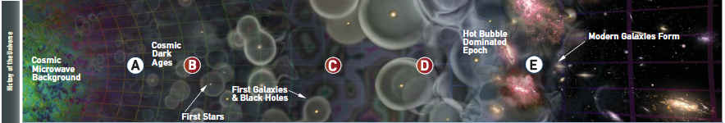
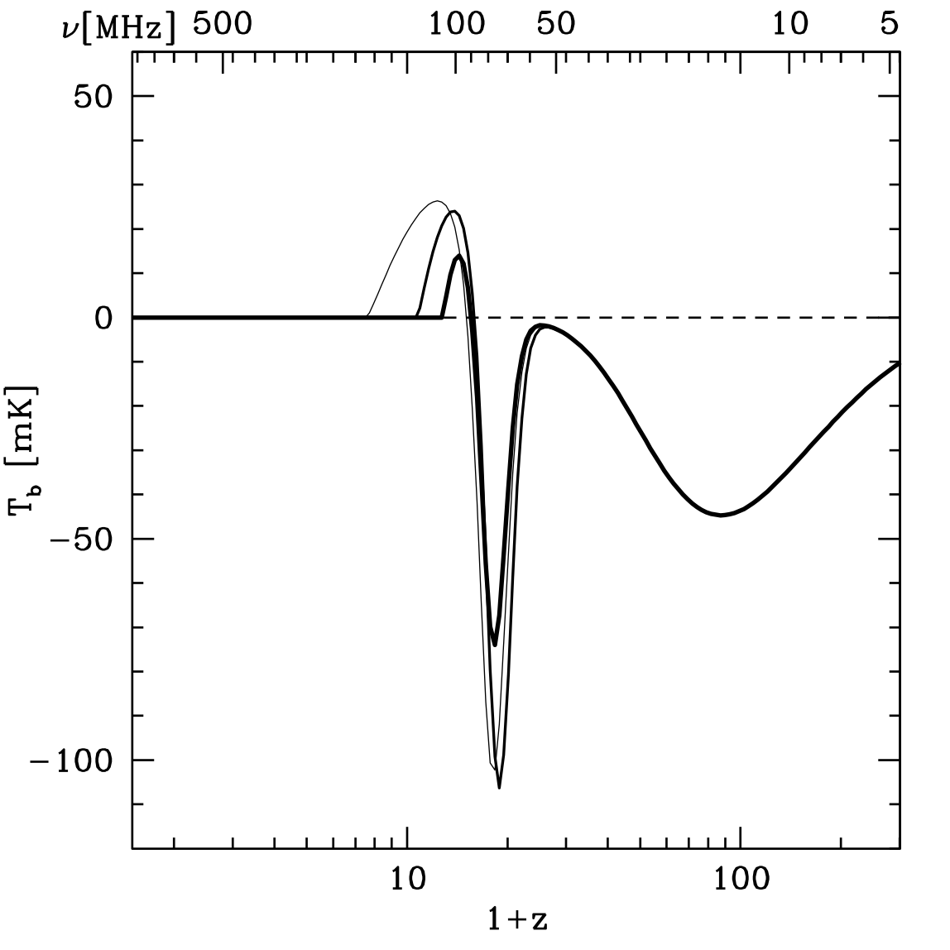
Cosmic Origins
Probing the early universe with the 21cm HI Line
EoR
5
10
50
100
500 MHz
50
Neutral Hydrogen 21 cm spin-flip transition provides probe of neutral intergalactic medium before and during formation of first stars
Cosmic Dawn
T_{b} (mK)
Dark Ages
−50
−100
= 1420 MHz/(1 + z)
λ = 21 cm (1 + z)
100
10
1 + z

Slide 30
HI surveys of the EoR/Cosmic-Dawn Universe
Detecting EoR structures in imaging mode (as distinct from statistically) on 5 arcmin scales with 1 mK RMS
Probing the Cosmic Dawn statistically or possibly even imaging in ultra-deep

Slide 31
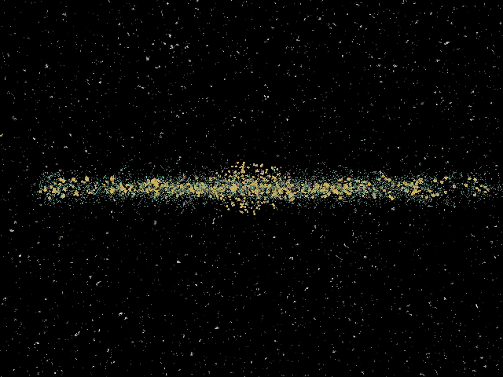
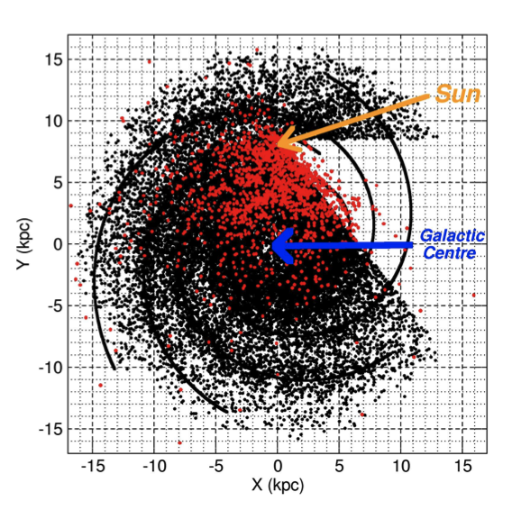
Finding all pulsars in the Milky Way…
(Cordes et al. 2004, Kramer et al. 2004, Smits et al. 2008)
- ~30,000 normal pulsars
- ~2,000 millisecond psrs
- ~100 relativistic binaries
- first pulsars in Galactic Centre
- first extragalactic pulsars
Timing precision is expected to increase by factor ~100
Rare and exotic pulsars and binary systems: including PSR-BH systems!
Testing cosmic censorship and no-hair theorem
Current estimates are that ~50% of entire Galactic population in reach of SKA1

Slide 32
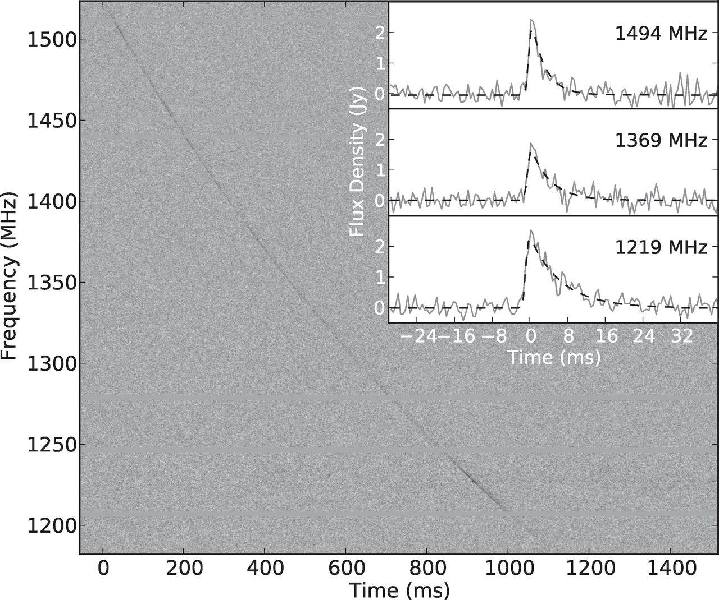
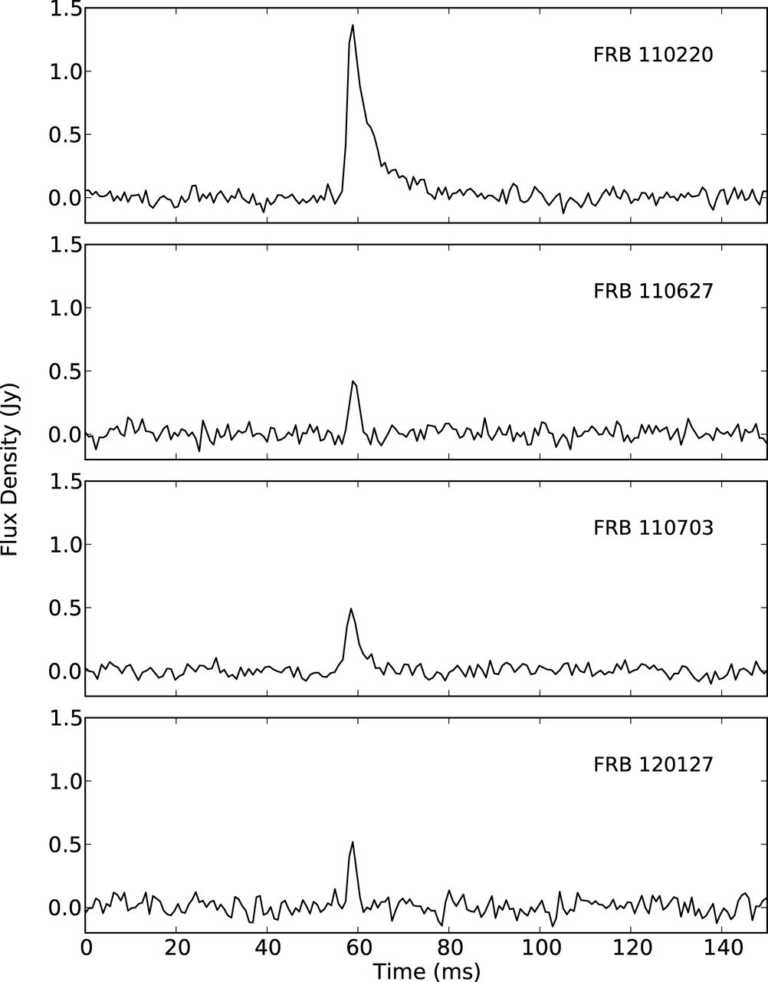
The transient radio sky
Four celestial “FRB” events now detected (after first “Lorimer” burst): S = 0.5 – 1.3 Jy, Δt = 1 – 6 msec, DM = 550 – 1100 cm⁻³ pc
Estimated event rate: 1x10⁴ sky⁻¹ day⁻¹
Completely unknown origin, possibly at cosmological distances

Slide 33
A daily SKA1 all-sky transient survey
Integration of ≈50 seconds per position
Sensitivity for 2 msec bursts is 160x worse: 27 mJy, 8 mJy rms
Computing strategy most still be developed for such a mode!
Predicted FRB detections: 5 per day, with localisation to a fraction of arcsec

Slide 34
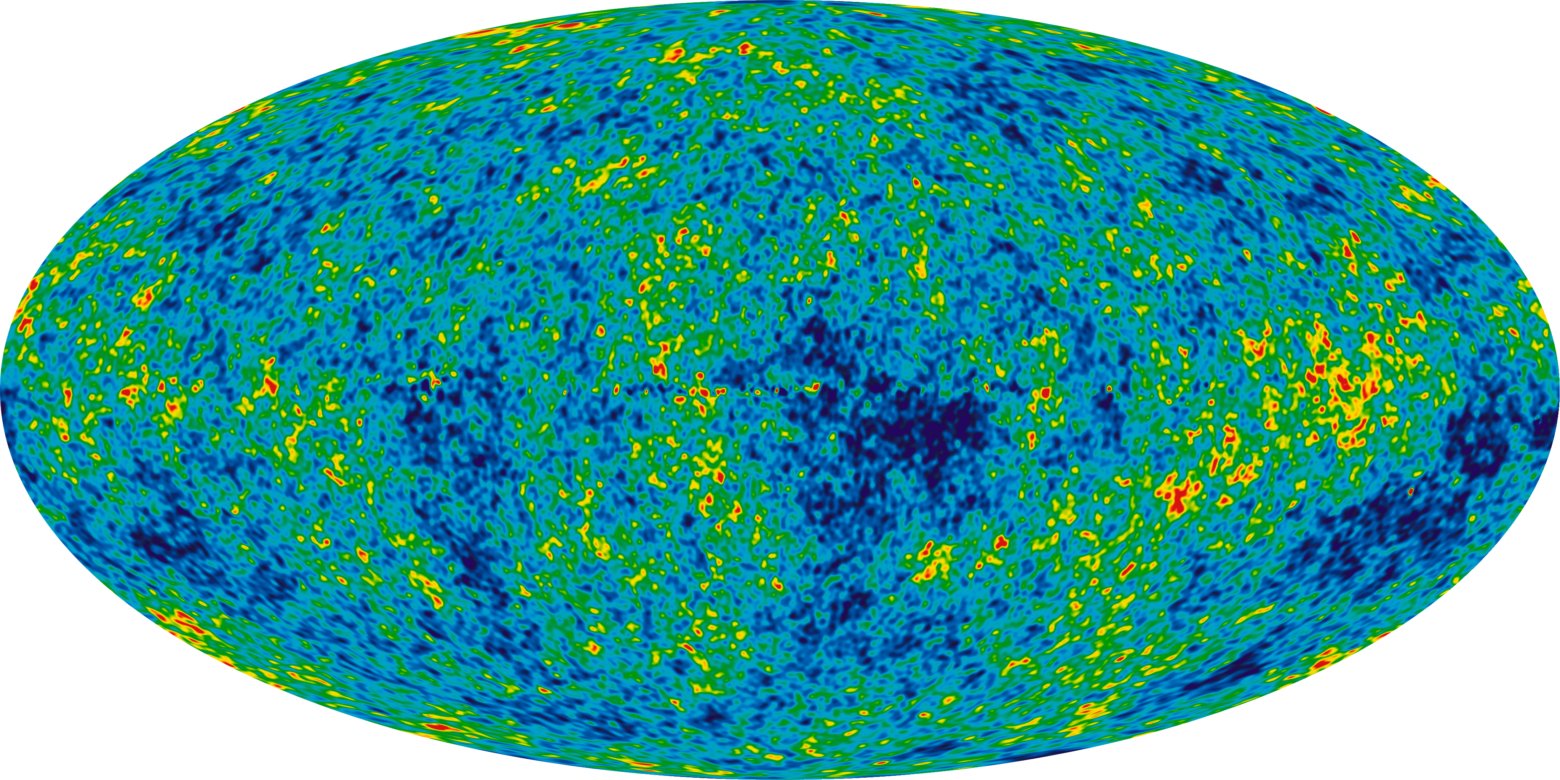
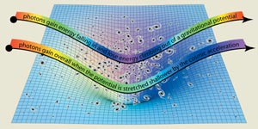
Cosmology with SKA1:
Integrated Sachs-Wolfe effect
Constraining non-Gaussianity of primordial fluctuations with the Integrated Sachs-Wolfe effect: correlation of foreground source populations with CMB structures

Slide 35
Cosmology with SKA1:
Complementarity with Euclid
(Bacon 2013)
Constraining non-Gaussianity of primordial fluctuations with the Integrated Sachs-Wolfe effect
Achieving 2 μJy rms would provide ≈4 galaxies arcmin⁻² (>10σ)
Almost uniform sky coverage of 3π sr is exceptional
Major enhancement over Euclid alone

Slide 36
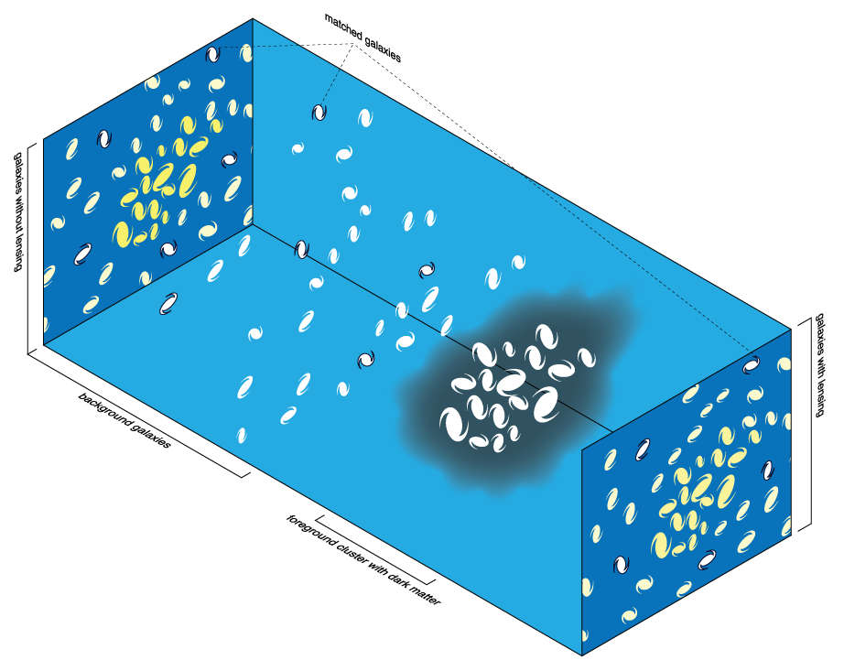
Cosmology with SKA1:
Weak Gravitational Lensing
Constraining the Dark Energy Equation of State with Weak Gravitational Lensing

Slide 37
Cosmology with SKA1: Complementarity with Euclid
(Bacon 2013)
Constraining the Dark Energy equation of state with a weak gravitational lensing measurement of cosmic shear
Achieving 1 μJy rms would provide ≈6 galaxies arcmin⁻² (>10σ)
PSF is excellent quality circular Gaussian from about 0.6”
Major enhancement in DE Figure-of-Merit

Slide 38
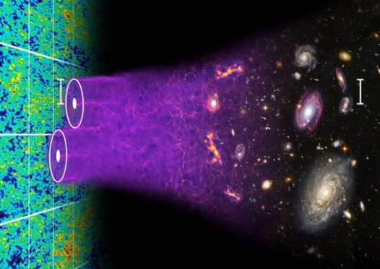
Cosmology with SKA1:
Baryon Acoustic Oscillations
(Blake & Moorfield)
Constraining Dark Energy models with redshift-resolved BAO measurements

Slide 39
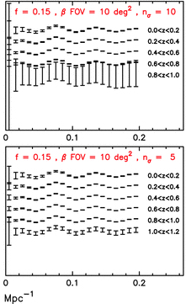
A wide-field HI emission survey for BAO and Ω_{HI}(z)
(Abdalla et al 2010)
Detect 10^{7.1} galaxies <z> ≈ 0.3, 10^{5.1} galaxies <z> ≈ 1
Density ≈ 2500 galaxies deg⁻² , 1 arcmin⁻²
Compare SDSS: 10^{6.2} galaxies with <z> ≈ 0.1 over 15,000 deg²
Compare WigglesZ 10^{5.2} galaxies with <z> ≈ 0.6
Major contribution to BAO science, complementary systematics versus Opt/IR

Slide 40
Cosmology with SKA1: complementarity with optical
(Papasterigis et al. 2013) ALFALFA HI versus SDSS blue and red samples
Correlation functions of HI detections demonstrate much lower bias and excellent prospects for Redshift-space distortion measurements once interesting sample sizes are achieved with SKA1

Slide 41
An SKA2 HI emission survey for precision Cosmology
Detect 10^{8.9} galaxies with <z> ≈ 1, 10^{7.9} with <z> ≈ 2
Compare Euclid (2020+5?) target of 10⁸ spectra with <z> ≈ 1
SKA2 will provide an unrivaled capability for precision cosmology!

Slide 42
SKA Key Science
Strong-field Tests of Gravity with Pulsars and Black Holes
  Unique GR constraints, major contributions in Phase 1 and Phase 2
Galaxy Evolution, Cosmology, & Dark Energy
  Cutting edge contributions in non-Gaussianity and Dark Energy
  Complementarity to Euclid, LSST in Phase 1 (reduced systematics)
  Unmatched performance in Phase 2 (Billion Galaxy Surveys)
Emerging from the Dark Ages and the Epoch of Reionization
  Unique EoR imaging capability in Phase 1
  Reaching to Cosmic Dawn in Phase 2
The Cradle of Life & Astrobiology
The Origin and Evolution of Cosmic Magnetism
With design philosophy of Exploration of the Unknown
  Unmatched prospects (complement to LSST) in Phase 1 and Phase 2

Slide 43
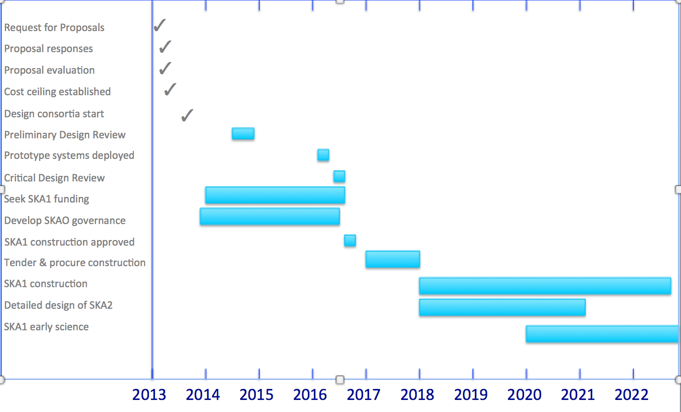
Timeline
3 years

Slide 44
ASKAP Timeline

Slide 45
ASKAP Survey Science
EMU: Evolutionary Map of the Universe
WALLABY: Widefield ASKAP L-Band Legacy All-Sky Blind Survey
FLASH: The First Large Absorption Survey in HI
VAST: An ASKAP Survey for Variables and Slow Transients
GASKAP: The Galactic ASKAP Spectral Line Survey
POSSUM: Polarization Sky Survey of the Universe's Magnetism
CRAFT: The Commensal Real-time ASKAP Fast Transients survey
DINGO: Deep Investigations of Neutral Gas Origins
VLBI: The High Resolution Components of ASKAP: Meeting the Long Baseline Specifications for the SKA
COAST: Compact Objects with ASKAP: Surveys and Timing

Slide 46
MeerKAT Timeline

Slide 47
MeerKAT Survey Science
Radio Pulsar Timing: Testing Einstein's theory of gravity and gravitational radiation
LADUMA (Looking at the Distant Universe with the MeerKAT Array)
MESMER (MeerKAT Search for Molecules in the Epoch of Re-ionisation)
MeerKAT Absorption Line Survey MHONGOOSE (MeerKAT HI Observations of Nearby Galactic Objects: Observing Southern Emitters)
TRAPUM (Transients and Pulsars with MeerKAT)
A MeerKAT HI Survey of the Fornax Cluster
MeerGAL (MeerKAT High Frequency Galactic Plane Survey)
MIGHTEE (MeerKAT International GigaHertz Tiered Extragalactic Exploration Survey)
ThunderKAT (The Hunt for Dynamic and Explosive Radio Transients with MeerKAT)

Slide 48
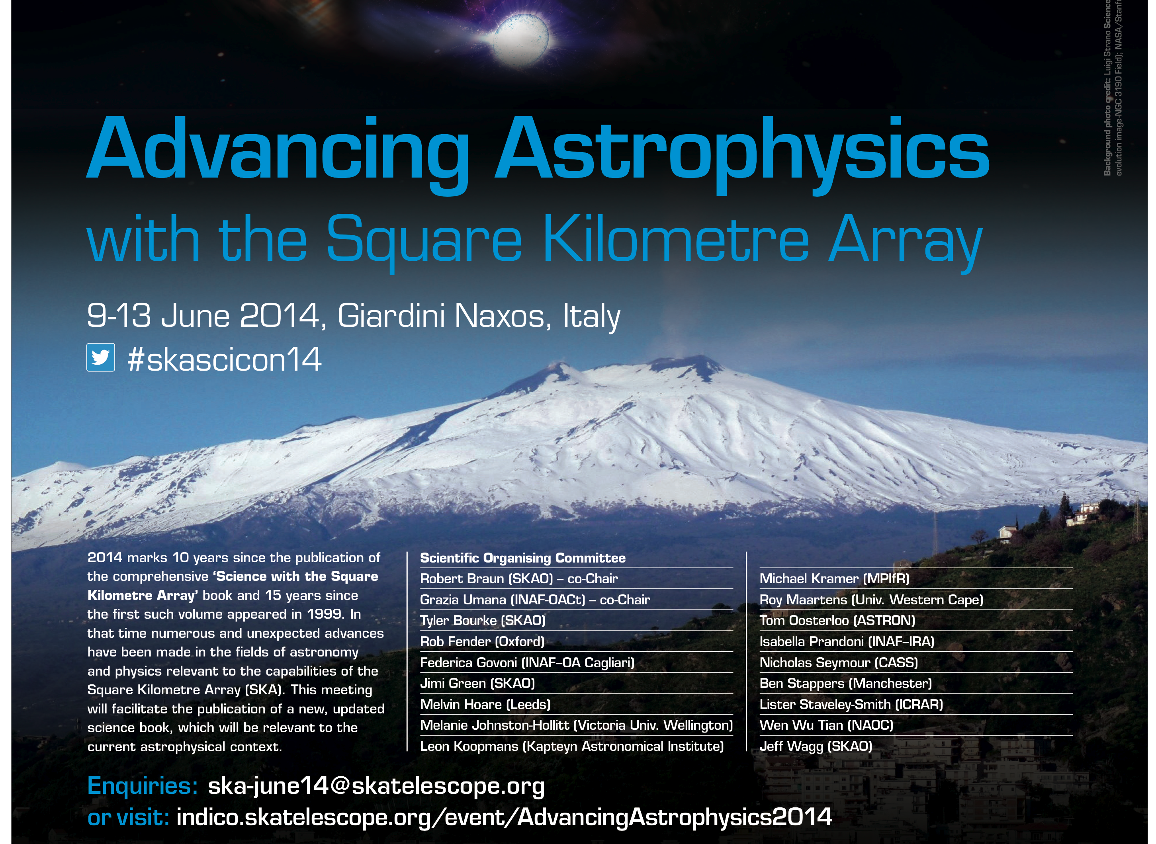
SKA Science Book:
Science Director’s Report, BD-12-17

Slide 49
Thank you
www.skatelescope.org

