Slide 1
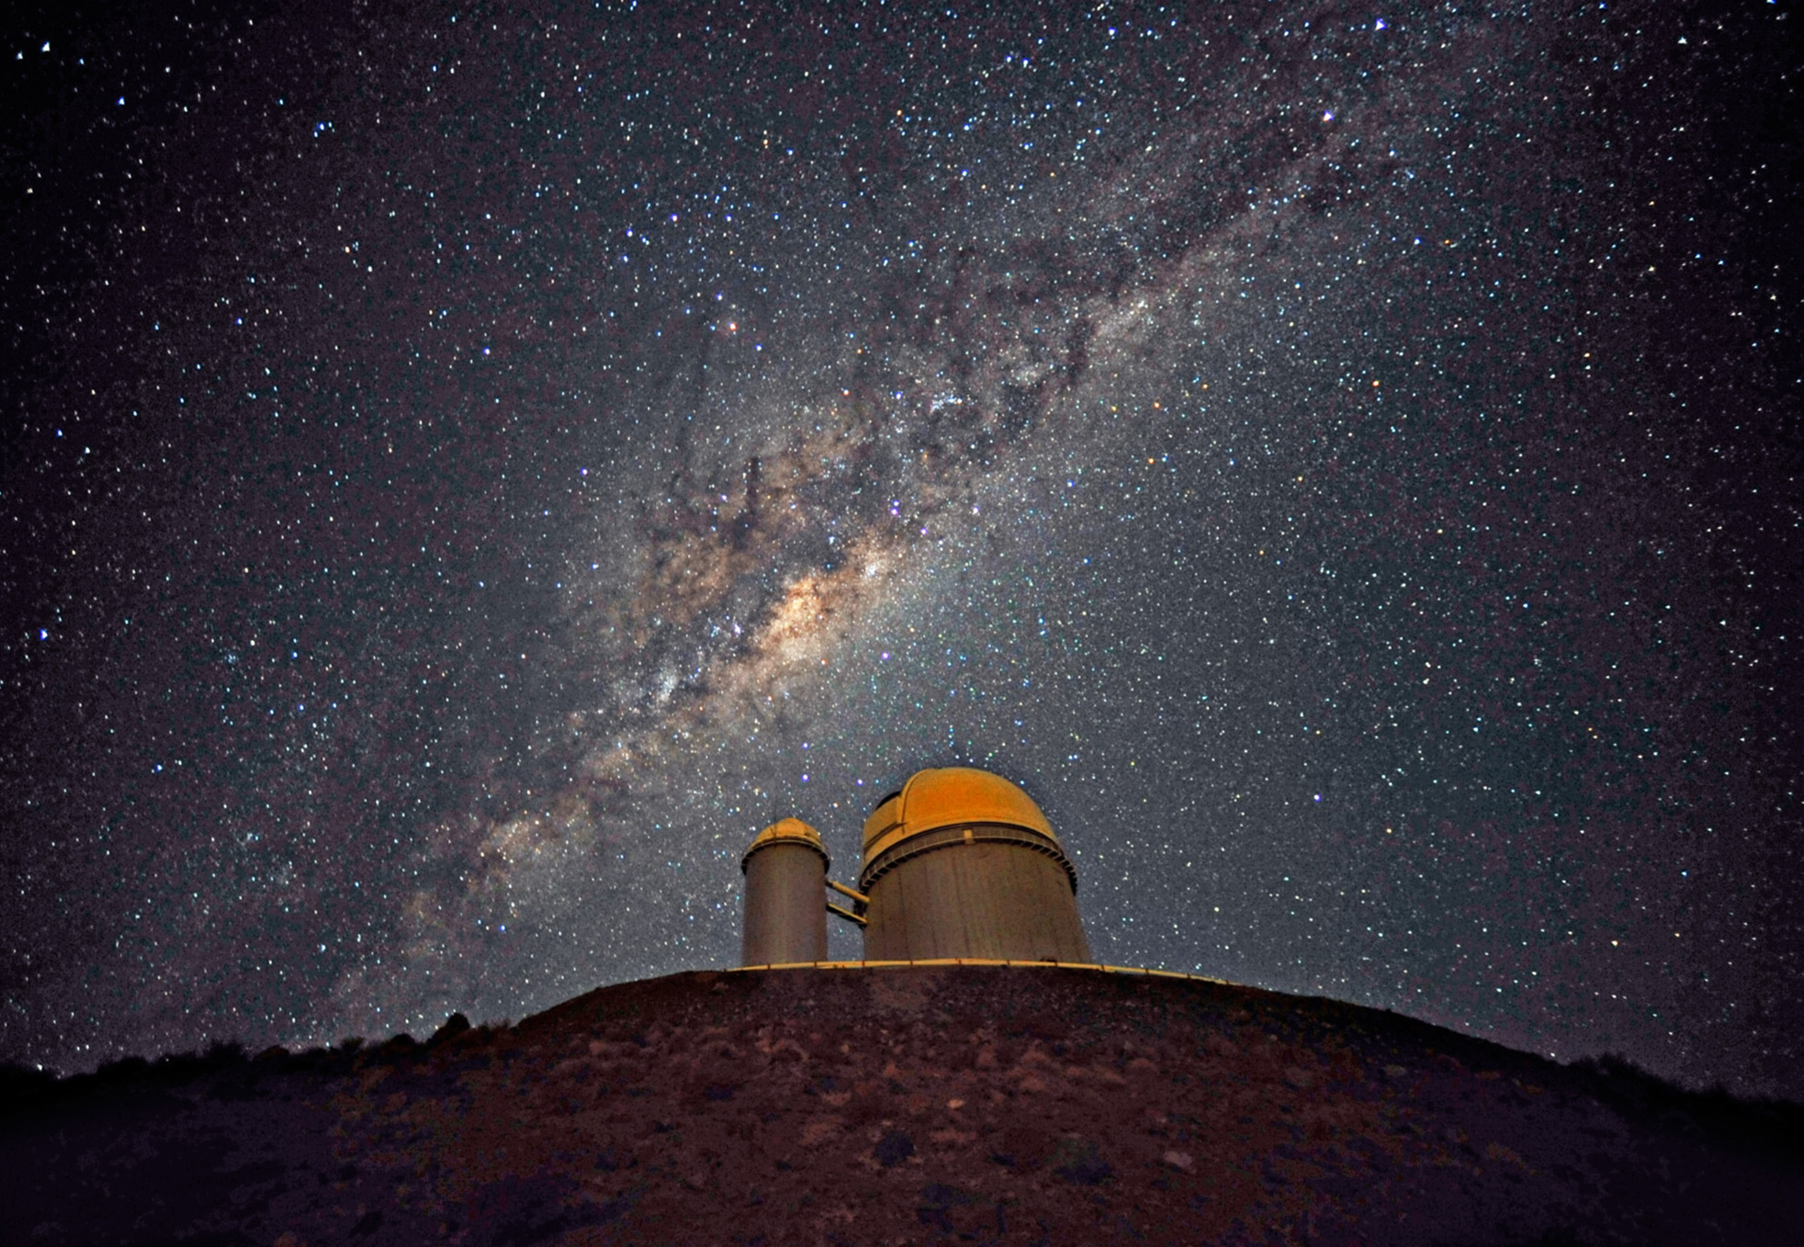

The 3.6m telescope in La Silla
and its jewels:
HARPS & NIRPS
the quest for other worlds
Emanuela Pompei
Gaspare Lo Curto

Slide 2
A bit of History
First binary orbit reconstructed in 1889 by Vogel for the star Algol.

Slide 3
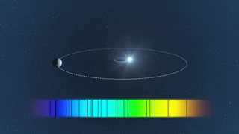

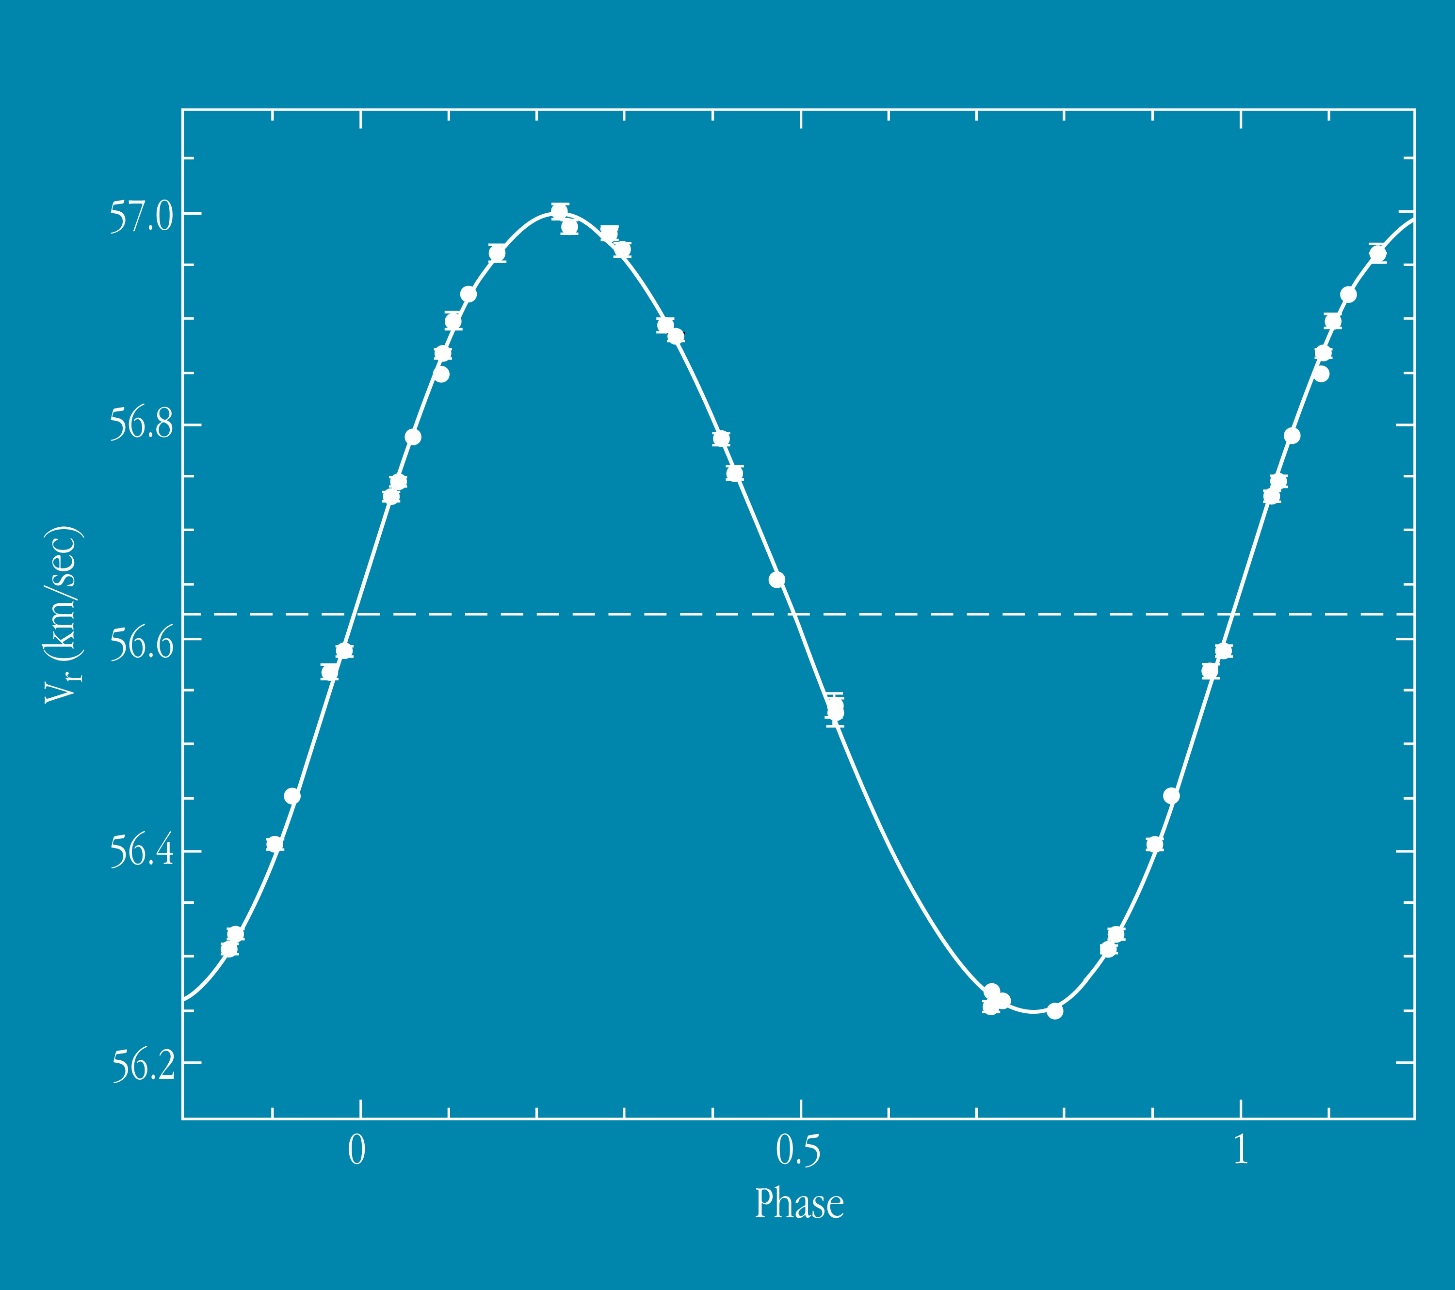
HARPS & NIRPS: how do they detect planets ?
Radial velocity
measured via
Doppler effect

Slide 4
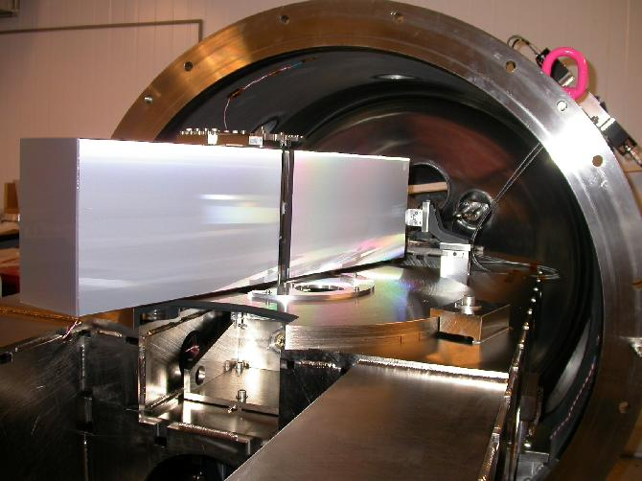
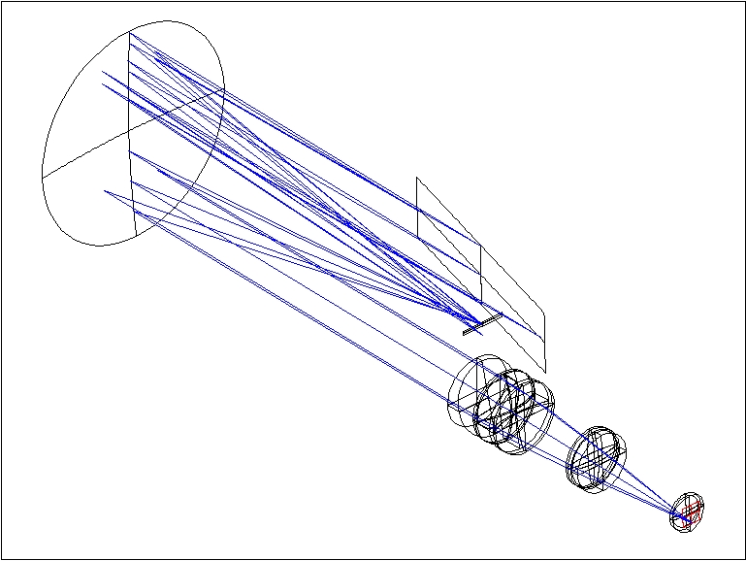
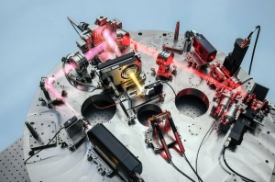
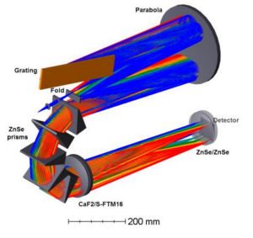
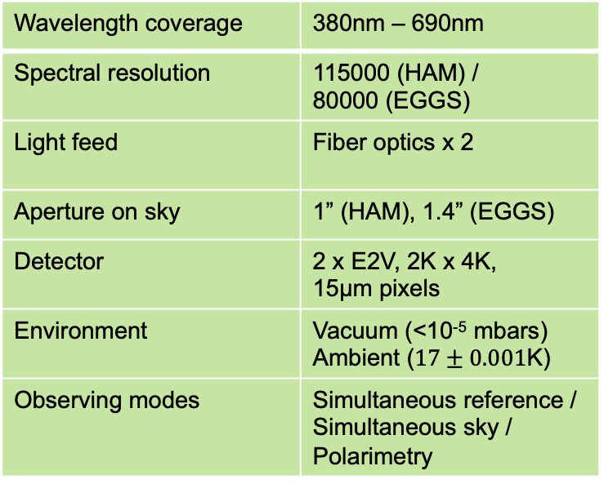
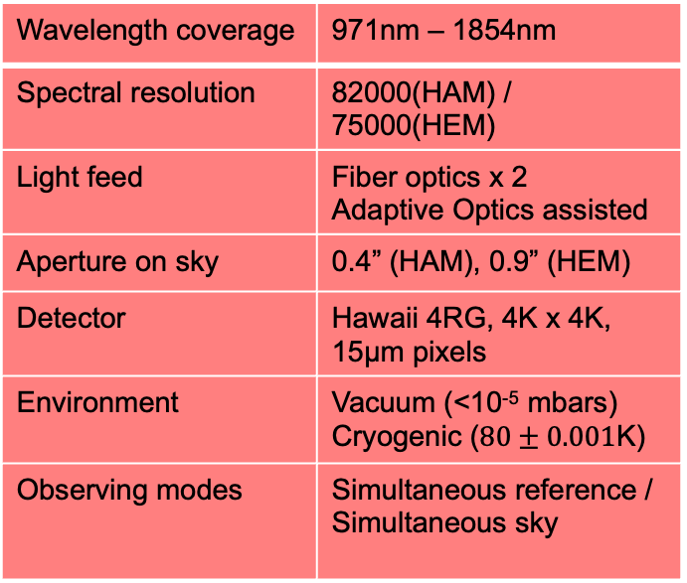
Basics of HARPS & NIRPS high resolution spectrographs
HARPS
NIRPS
Wavelength coverage | 380nm – 690nm
Spectral resolution | 115000 (HAM) / 80000 (EGGS)
Light feed | Fiber optics x 2
Aperture on sky | 1” (HAM), 1.4” (EGGS)
Detector | 2 x E2V, 2K x 4K, 15µm pixels
Environment | Vacuum (<10⁻⁵ mbars) Ambient ($17±0.001$K)
Observing modes | Simultaneous reference / Simultaneous sky / Polarimetry
Wavelength coverage | 971nm – 1854nm
Spectral resolution | 82000(HAM) / 75000(HEM)
Light feed | Fiber optics x 2 Adaptive Optics assisted
Aperture on sky | 0.4” (HAM), 0.9” (HEM)
Detector | Hawaii 4RG, 4K x 4K, 15µm pixels
Environment | Vacuum (<10⁻⁵ mbars) Cryogenic ($80±0.001$K)
Observing modes | Simultaneous reference / Simultaneous sky

Slide 5
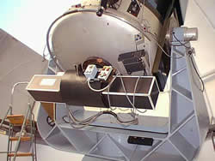
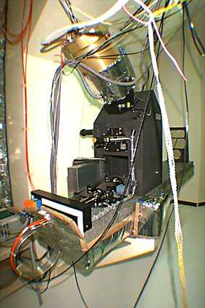
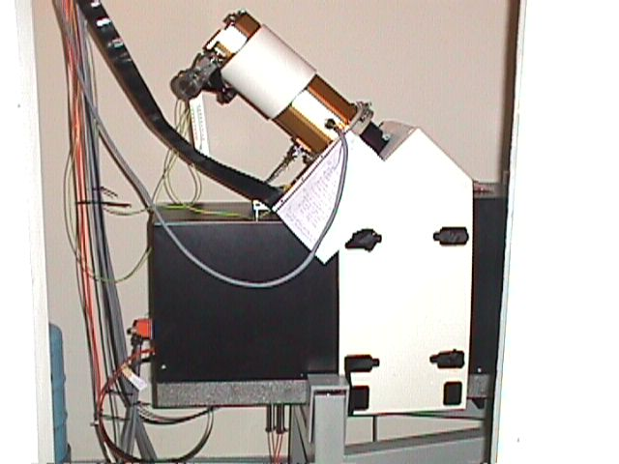
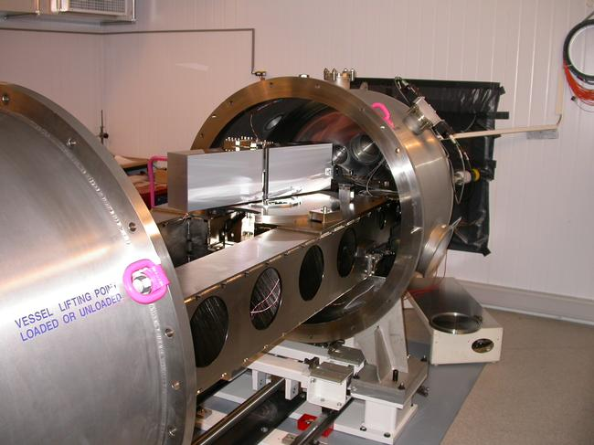
HARPS & NIRPS Inherit from a rich past
CORAVEL
250m/s
ELODIE
10m/s
1981
1993
CORALIE
5m/s
1998
HARPS
1m/s
2003

Slide 6
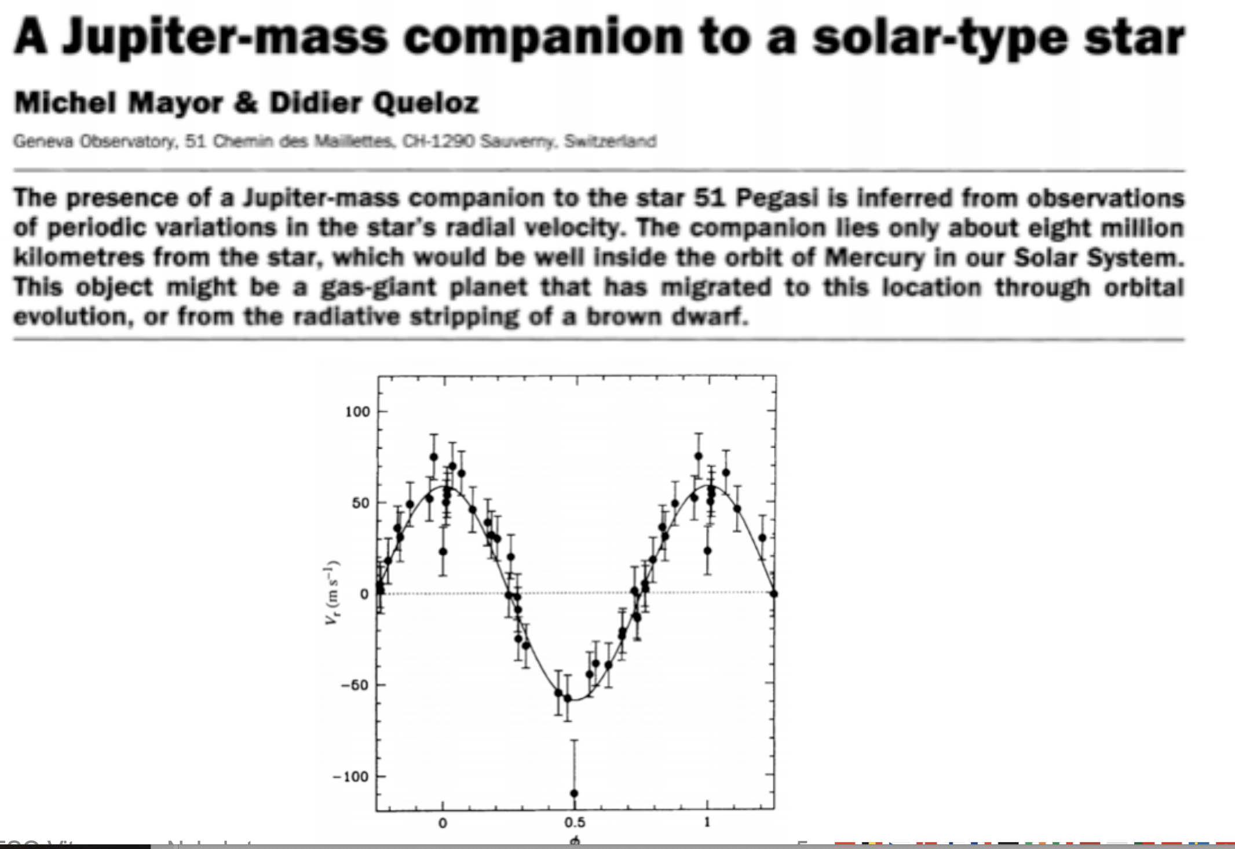

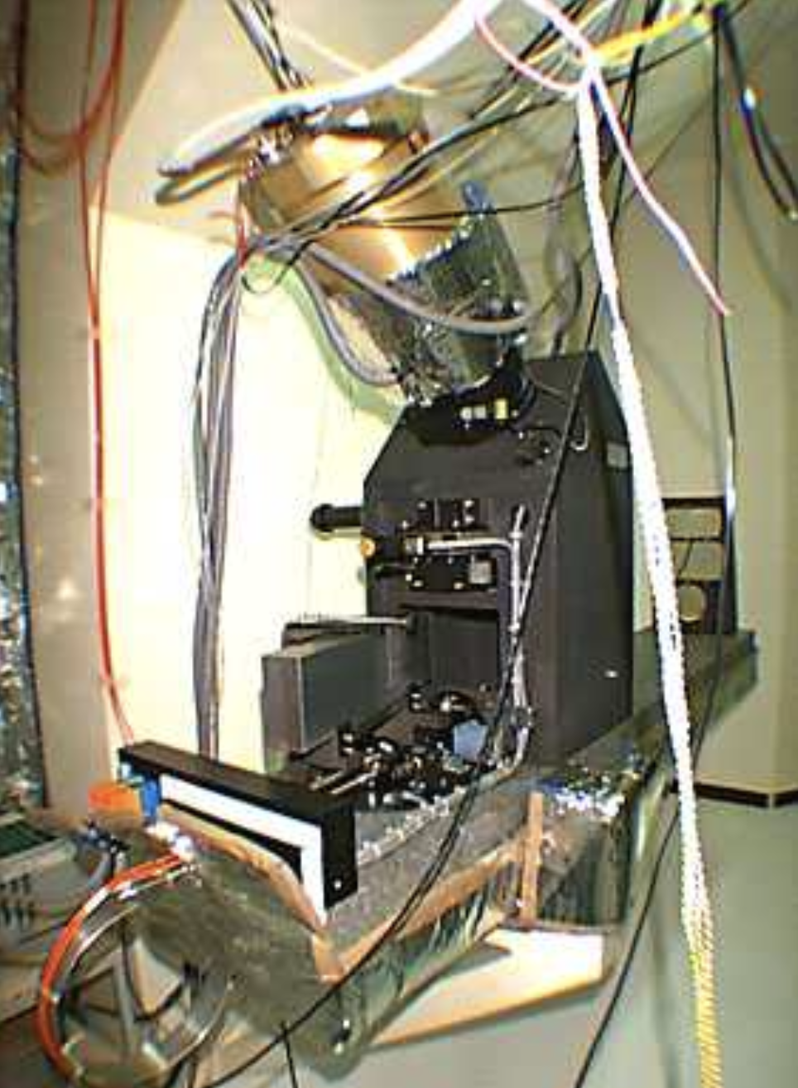
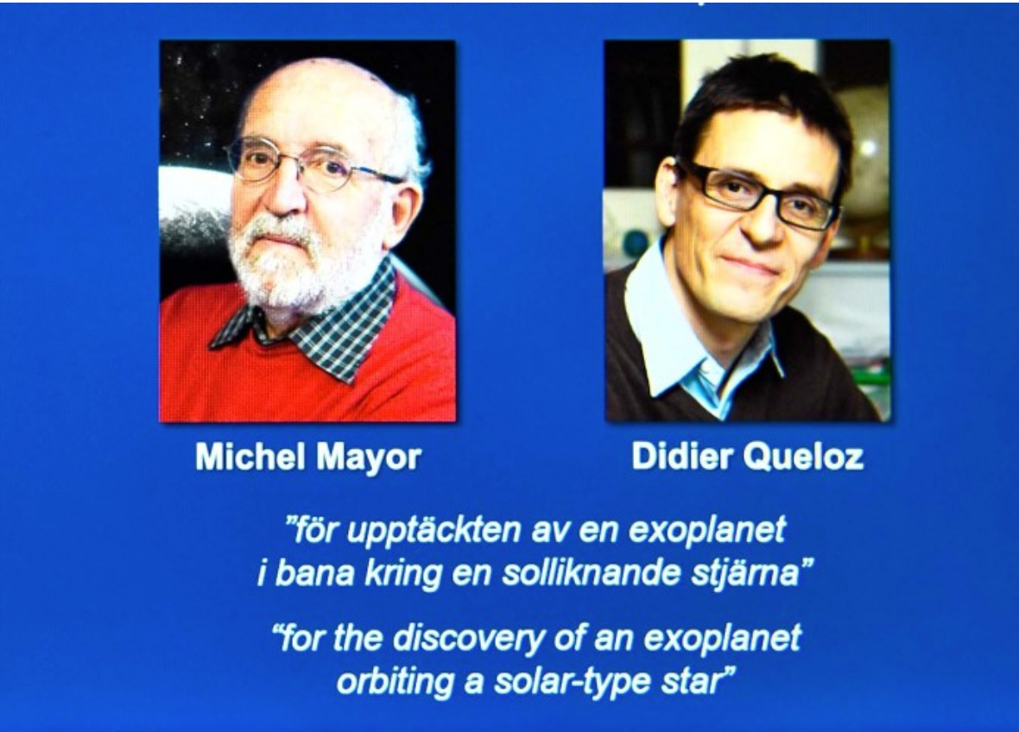
Nobel prize
in Physics
2019

Slide 7
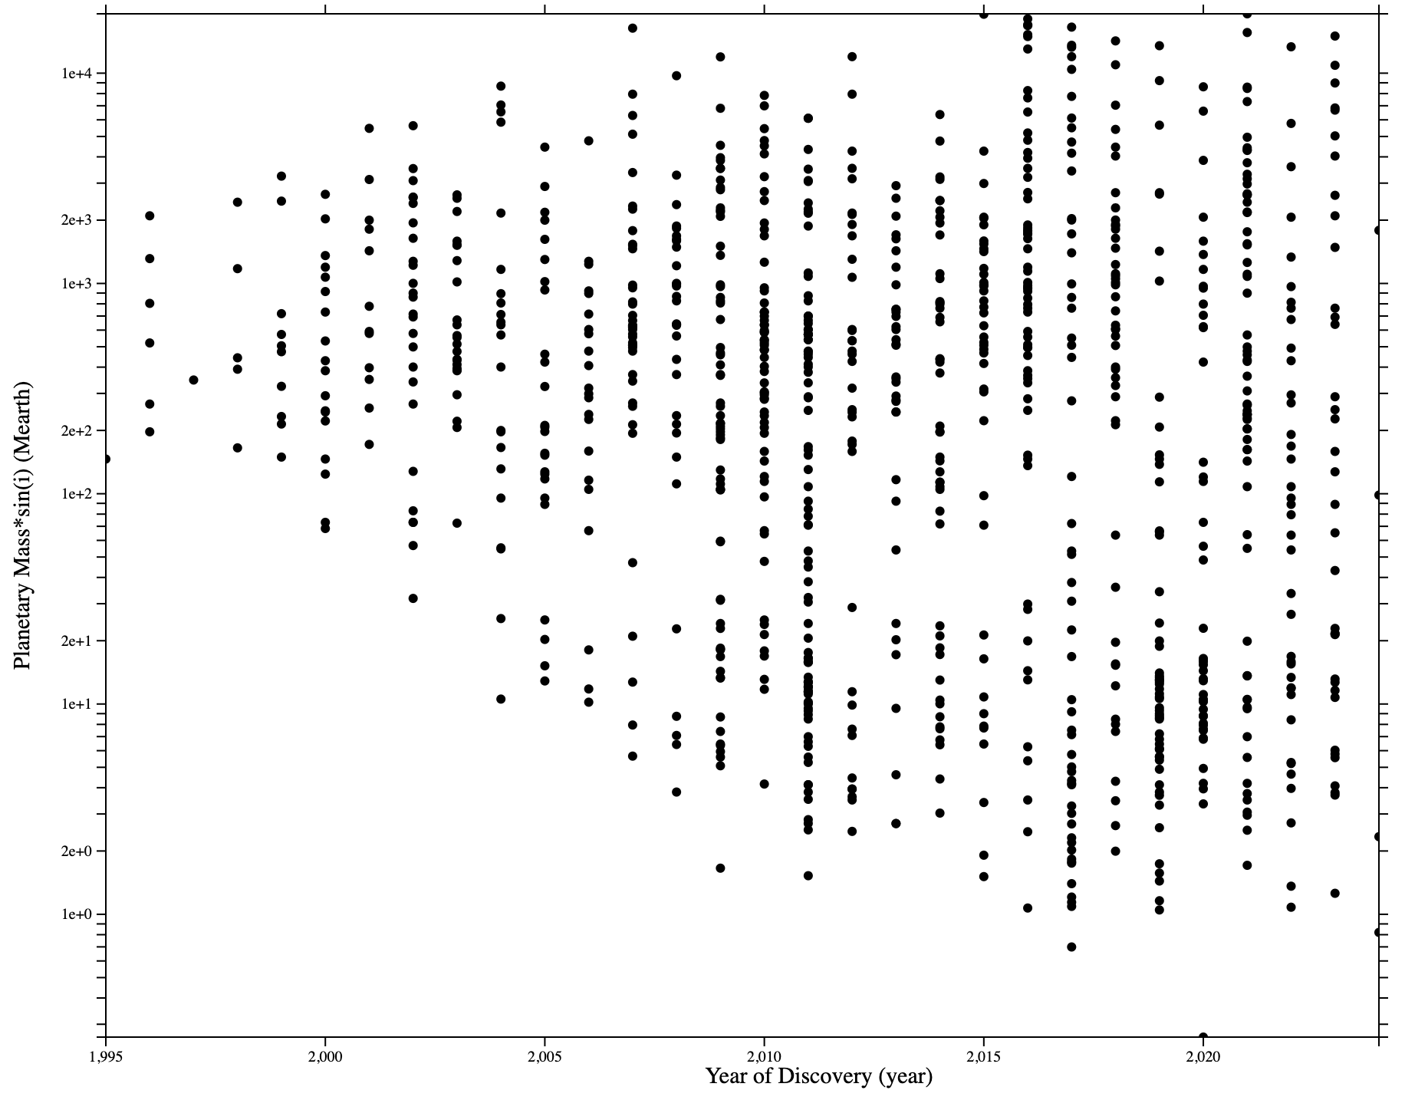
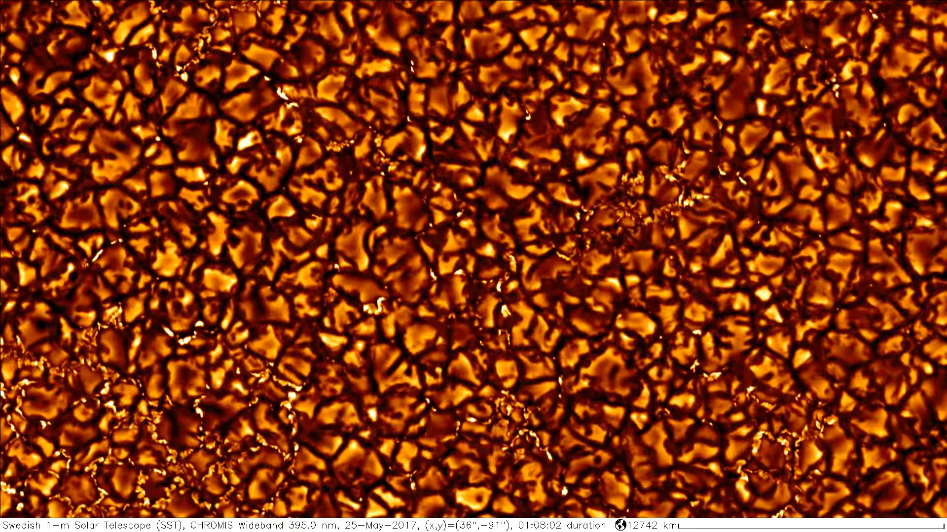
Planets detections (RV only)
Moore’s law for
Exo-planets ?
Flattening ?
There is more
than just the planet…
?

Slide 8
The “planetary signature” ...
The inclination angle “i”
is unknown => only the
minimum mass can be
determined
It is easier to detect planets
around colder, smaller stars
Motivation for a NIR
planet searcher
Jupiter @ 5 AU : 12.7 m s⁻¹
Super-Earth (5 M⊕) @ .1 AU : 1.4 m s⁻¹
Super-Earth (5 M⊕) @ 1 AU : 0.45 m s⁻¹
Earth @ 1 AU : 9 cm s⁻¹
Orbiting a
Solar-type
star

Slide 9
Constraints on spectrograph design
Metrological stability
Silicon lattice constant: 0.54nm
Planet | Mass (M_{Jup}) | K (m/s) | HARPS/NIRPS shift (nm) | ESPRESSO shift (nm)
Mercury | 1.74 x 10⁻⁴ | 0.008 | 0.14 | 0.25
Venus | 2.56 x 10⁻³ | 0.086 | 1.6 | 2.7
Earth | 3.15 x 10⁻³ | 0.089 | 1.6 | 2.8
Mars | 3.38 x 10⁻⁴ | 0.008 | 0.14 | 0.25
Jupiter | 1.0 | 12.4 | 227 | 388
Saturn | 0.299 | 2.75 | 50 | 86
Uranus | 0.046 | 0.297 | 5.4 | 9.3
Neptune | 0.054 | 0.281 | 5.1 | 8.8
HARPS/NIRPS requirem. |  | 1 | 18 | 31
ESPRESSO requirement |  | 0.1 | 1.8 | 3.1

Slide 10
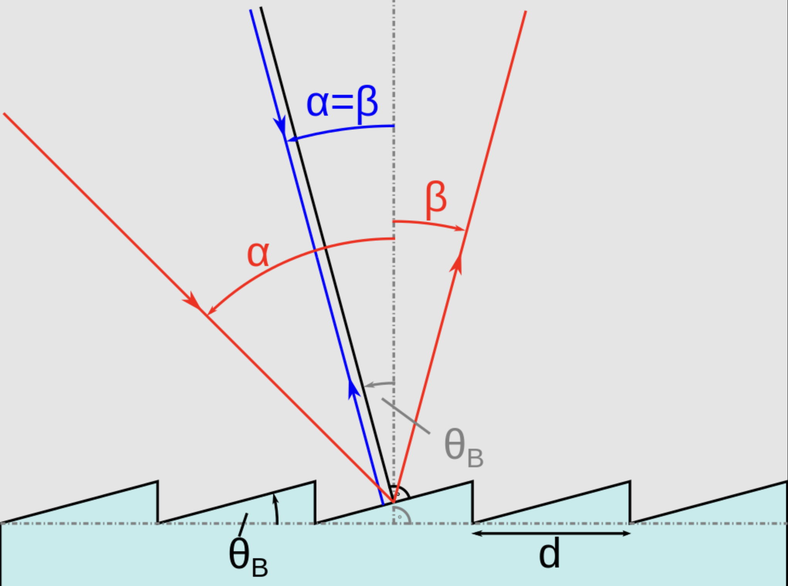
Constraints on spectrograph design
Spectral resolution:
R = λ/Δλ =
2*tan(blaze)*beam/(slit”*M1)

Slide 11
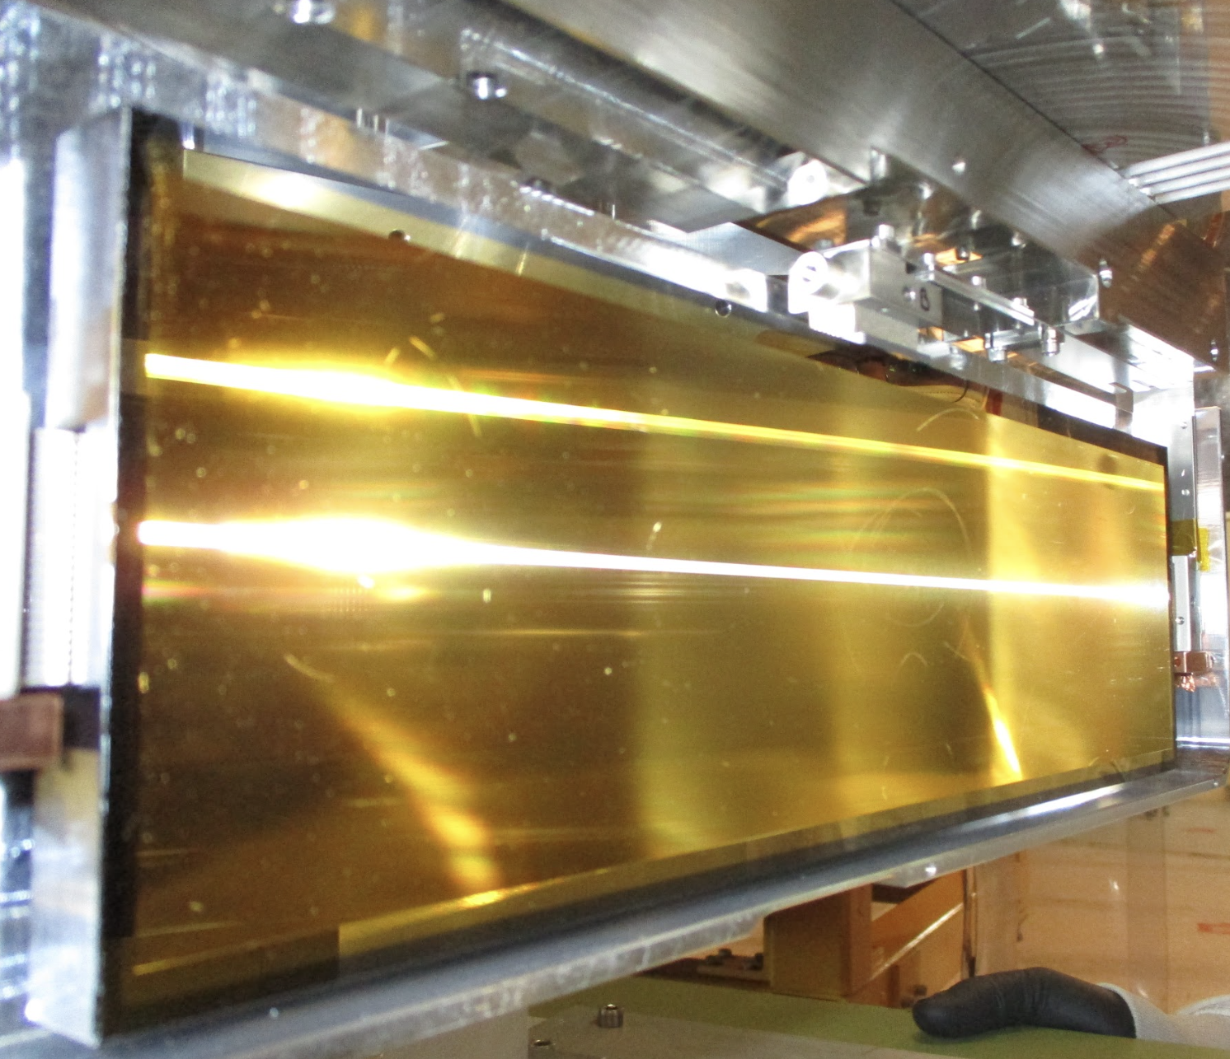
Constraints on spectrograph design
Spectral resolution:
R = λ/Δλ =
2*tan(blaze)*beam/(slit”*M1)
“Small” beam size thanks to A.O.
HARPS grating: Al, R4, 20cm x 80cm
NIRPS grating: Au, R4, 9cm x 32cm

Slide 12
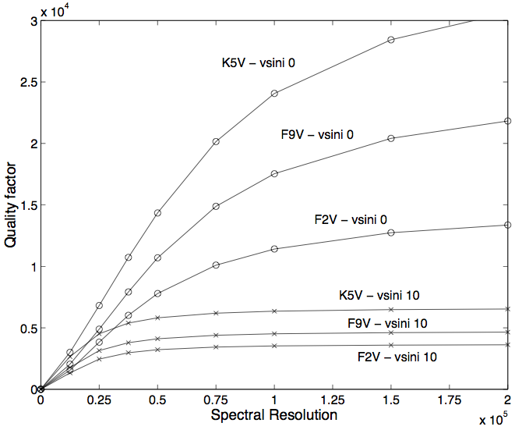
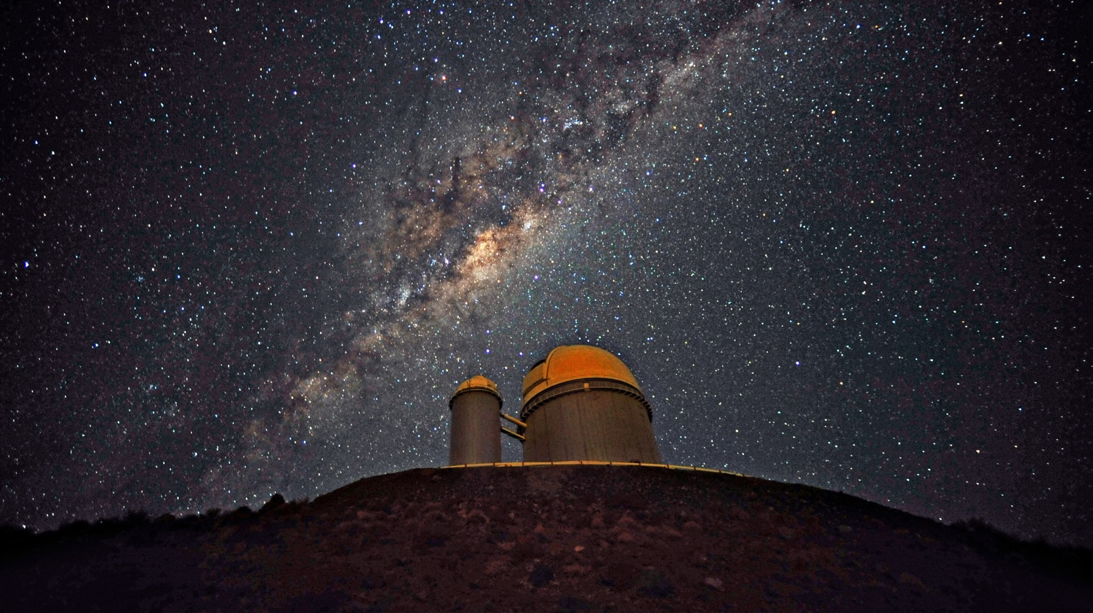
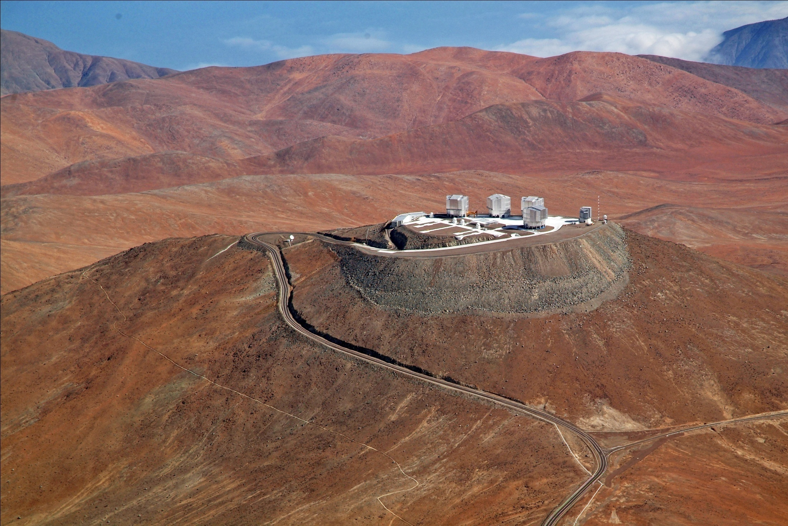
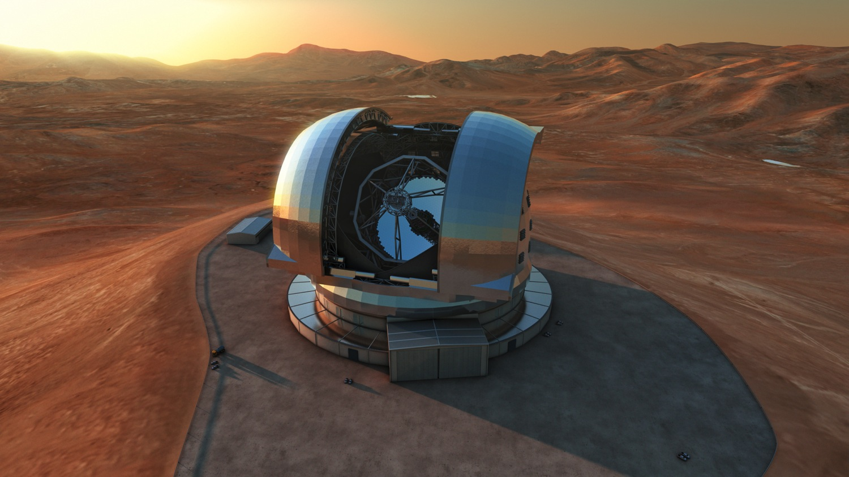

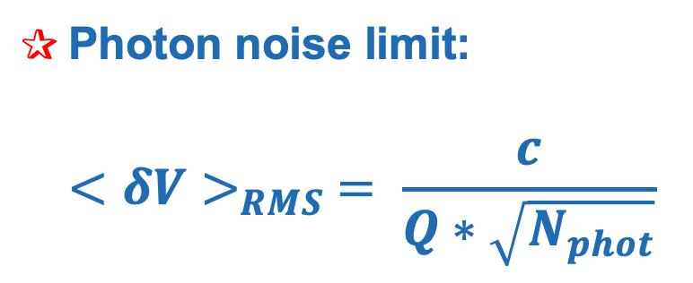
Constraints on spectrograph design
Photon noise limit:
$${<δV>}_{RMS} = \frac{c}{Q∗\sqrt{N_{phot}}}$$
Bouchy et al., 2001

Slide 13
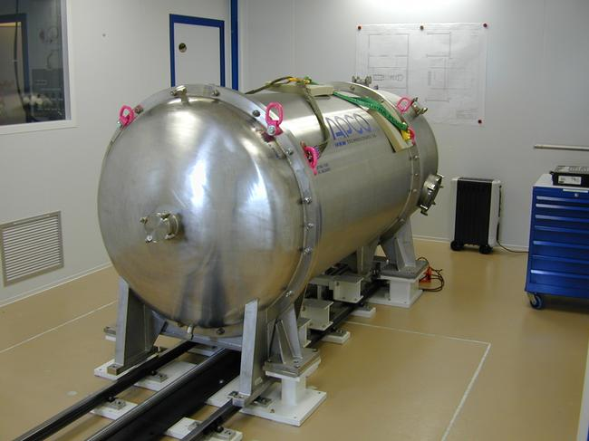
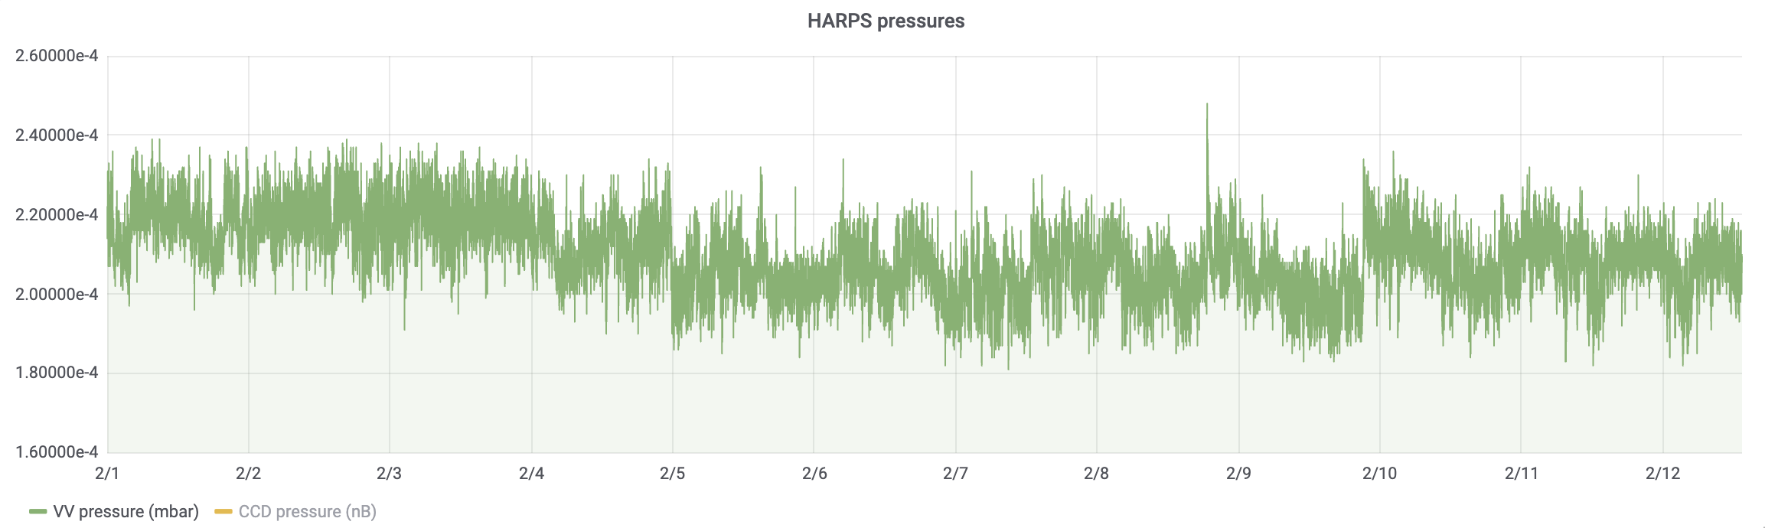
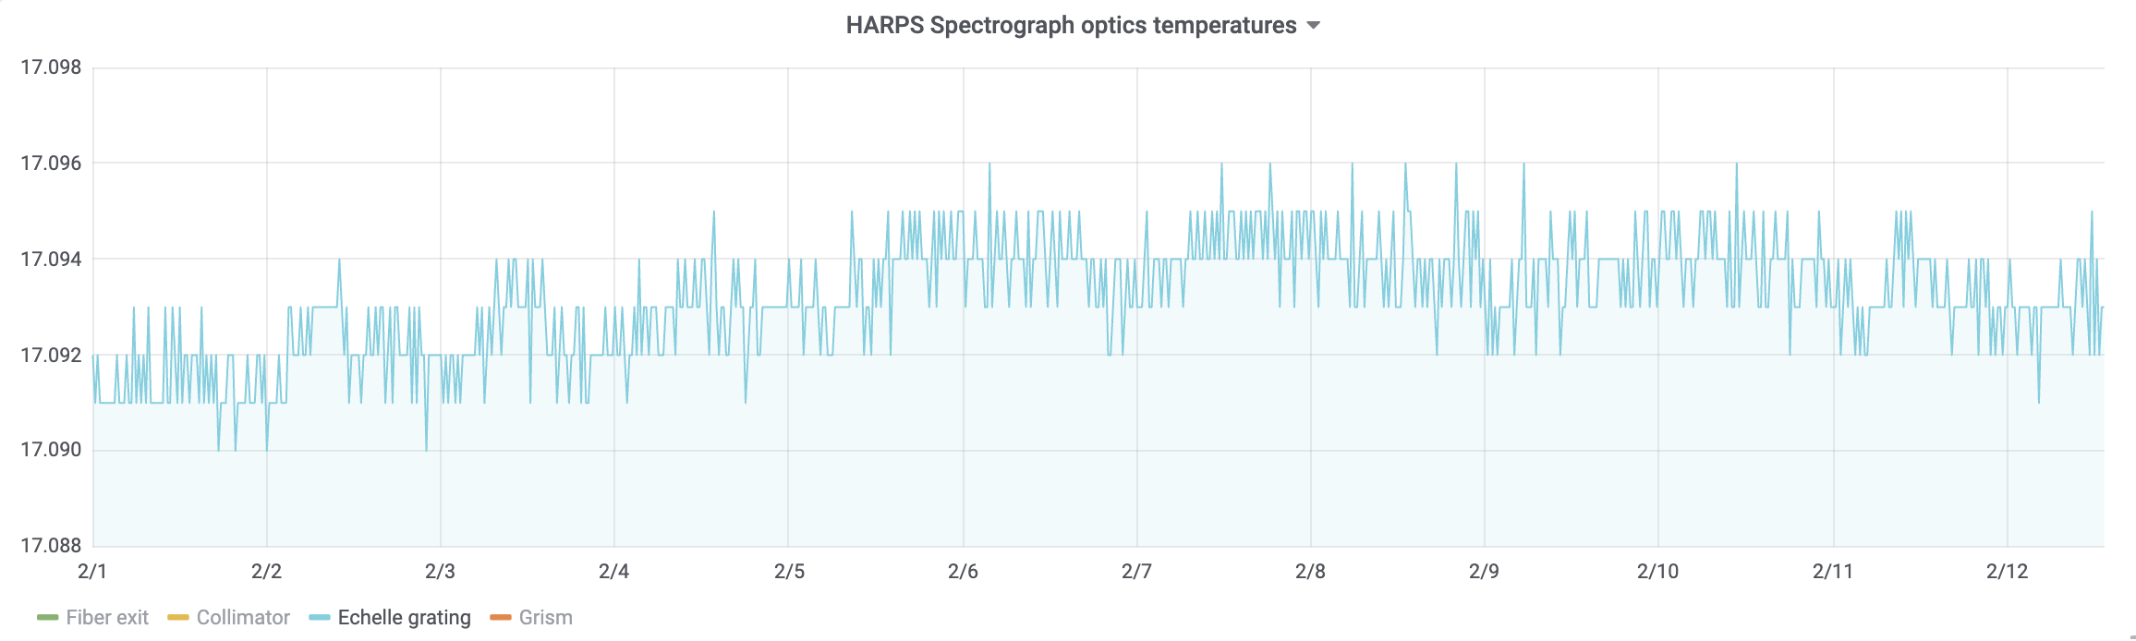
Metrological stability I: spectrograph
No moving parts inside the spectrograph
Stability of the index of refraction ➔ Instrument under vacuum (<10⁻³ mbar)
Strict temperature control (grating RMS <1mK / day)

Slide 14
Metrological stability II: light injection
Variations of light distribution at the entrance slit ➔
variation in the lines shapes & positions
Use fiber optics to increase stability of the light injection
Fiber optics are good “scramblers” in the near field,
Not so in the far field.
Use a “Double scrambler” at spectrograph’ entrance
to exchange the near & far field.

Slide 15
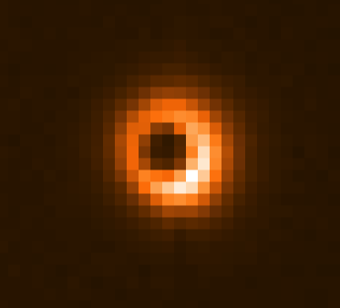
Guiding (without octagonal fibers)
“Bad” guiding, 0.5” de-centering,
~3 m/s contribution to RV
“Good” guiding, 0.1” RMS,
~30 cm/s contribution to RV
Bad centering
Good centering
Fiber entrance Fiber exit
Fiber entrance Fiber exit

Slide 16
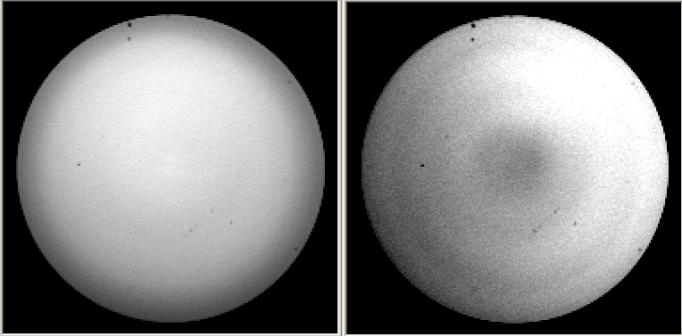
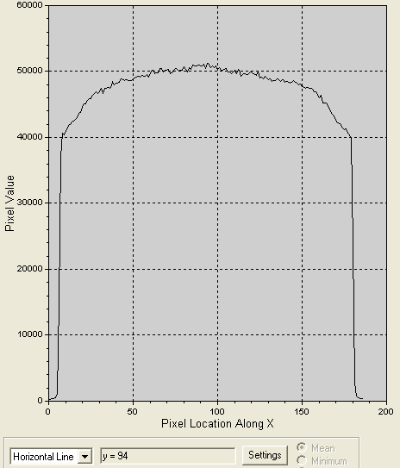
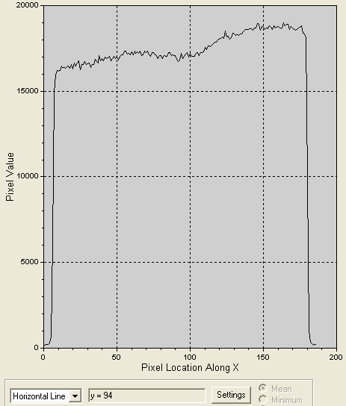
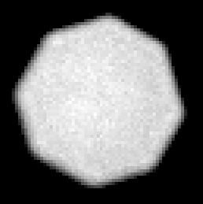
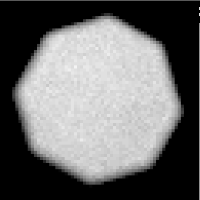
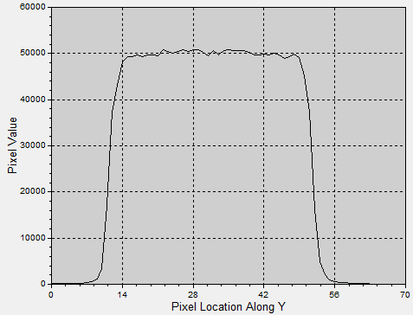
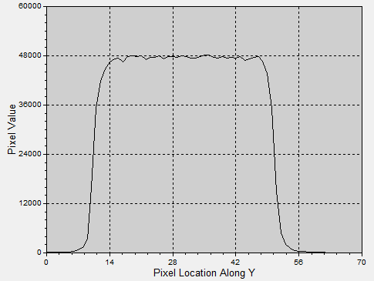
Octogonal fibers (near field)
Centered
De-centered
Centered (section)
De-centered (section)
From G. Avila
De-centering errors are within photon noise after double scrambler and octogonal fibers.

Slide 17
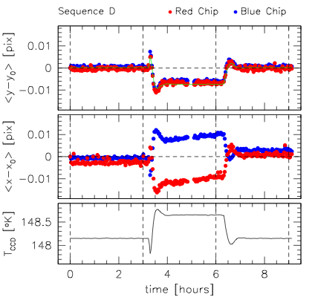
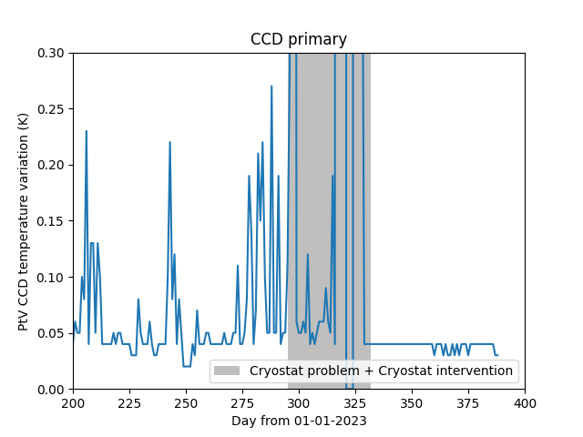
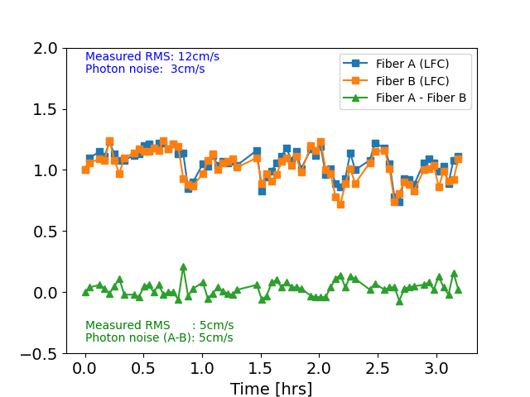
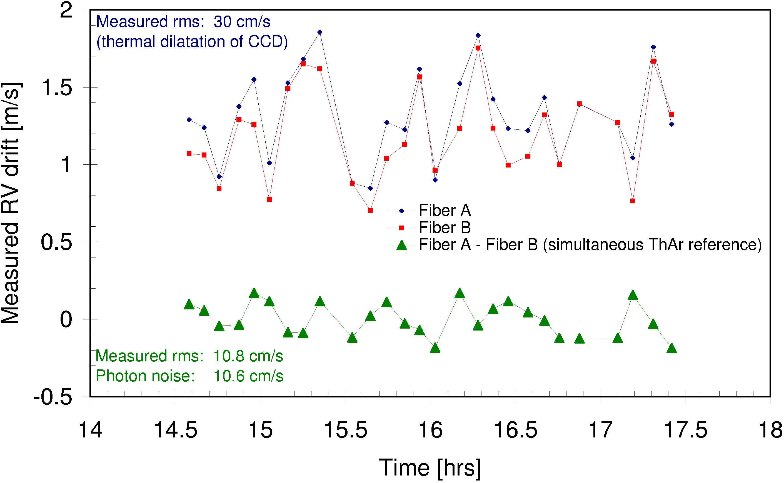
Metrological stability III: Detector Thermal stability
CCDs thermal expansion
makes the lines move in
pixel space, i.e. simulates
a RV effect, that could in
principle be corrected by
simultaneous calibration.
Nov. 2023
Maintenance
mission
2003
2023

Slide 18
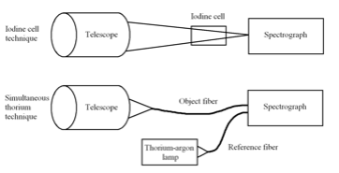
Metrological stability IV: track the unavoidable
Instrument variations are unavoidable…
… track them !
Simultaneous calibration
Absorption cells
The HARPS experience:
the instrument drift is generally
less than 0.5m/s overnight.
the RMS of the temperature is
less than 1mK in 24 hours
a 1m/s RV drift was measured
simultaneously to a 7mK
temperature variation at the echelle
Fabry-Perot /
HC lamp

Slide 19
Constraints on spectrograph design
Technology:
Gratings: groove density, quality, dimension, available blaze angles;
Detectors: detector noise, efficiency, pixel size;
Fibers: transmission and scrambling properties
Calibration sources: ThAr, Fabry-Perot, LFCs.

Slide 20
Daily Calibrations
Bias
Spectroscopic flat field (localization / blaze)
Wavelength calibrations
ThAr hollow cathode lamps
Fabry-Perot etalon
Laser Frequency Comb (LFC)

Slide 21
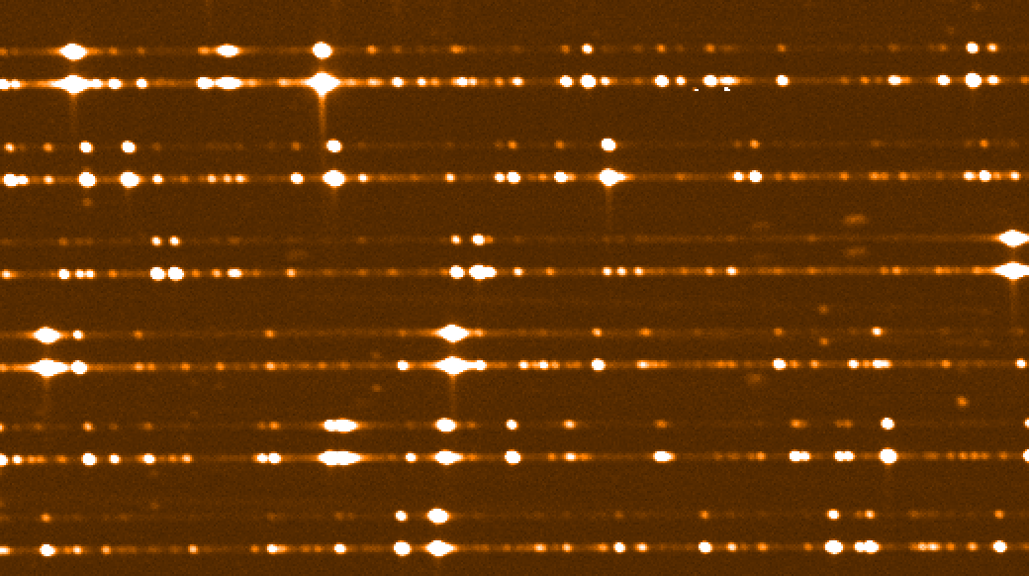
Wavelength calibration
Associate pixels to wavelengths.
Use lines atlas (e.g. Palmer & Englmann, 1983 / Redman 2014).
Associate patterns in the spectrum with the line list.
5000.2463 ThI
5002.0972 ThI
5002.8933 ThI
5003.5981 ThI
5004.1279 ThI
5005.9752 ThI
5008.1897 ThII
5009.3344 ArII
5009.9367 ThI
5010.4174 ThI
5011.4774 ThI
5012.2754 ThI
5013.1647 Th

Slide 22
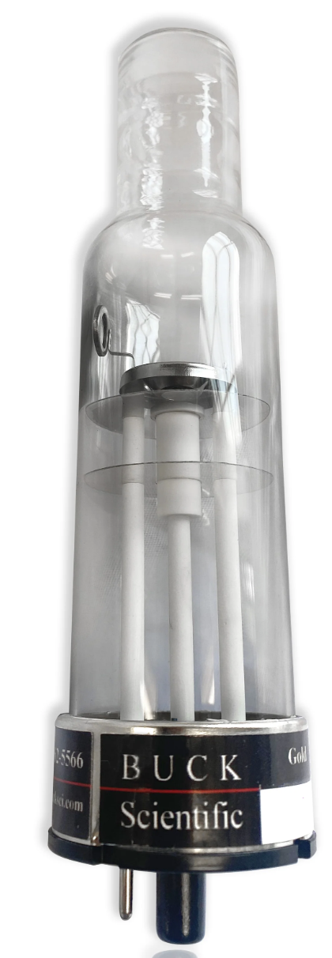
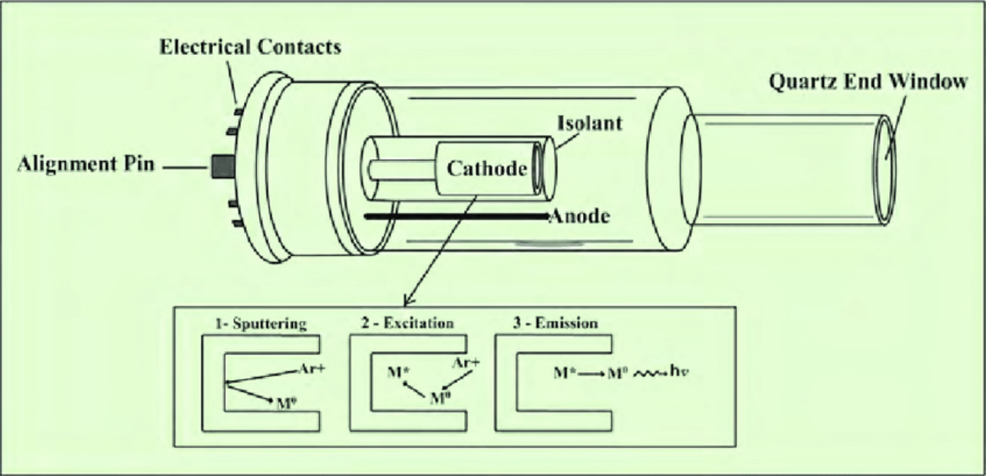
Hollow cathod lamps (ThAr)

Slide 23
Limitation of traditional calibrators
Lines randomly spaced ➔ wavelength range not uniformly sampled
Lines intensities highly variable ➔ reduction of the photon noise of the calibration
Lines have variable width ➔ line profile variations

Slide 24
The “ideal calibrator”
Many lines, equally spaced
Line intensities can be regulated to increase dynamical range and decrease photon noise
Lines are not resolved ➔ the instrumental line profile is directly measurable.

Slide 25

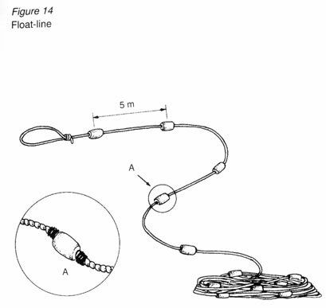
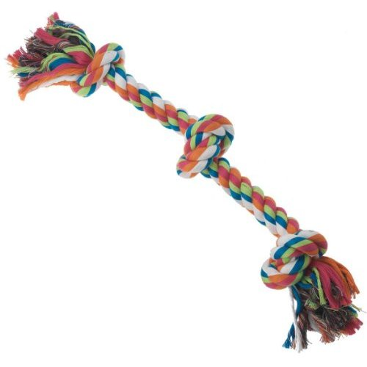
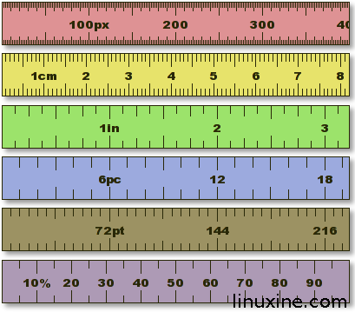
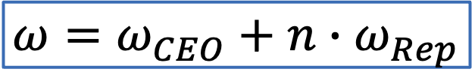
Laser Frequency Combs
$$ω=ω_{CEO}+n∙ω_{Rep}$$
LFC lines equation

Slide 26
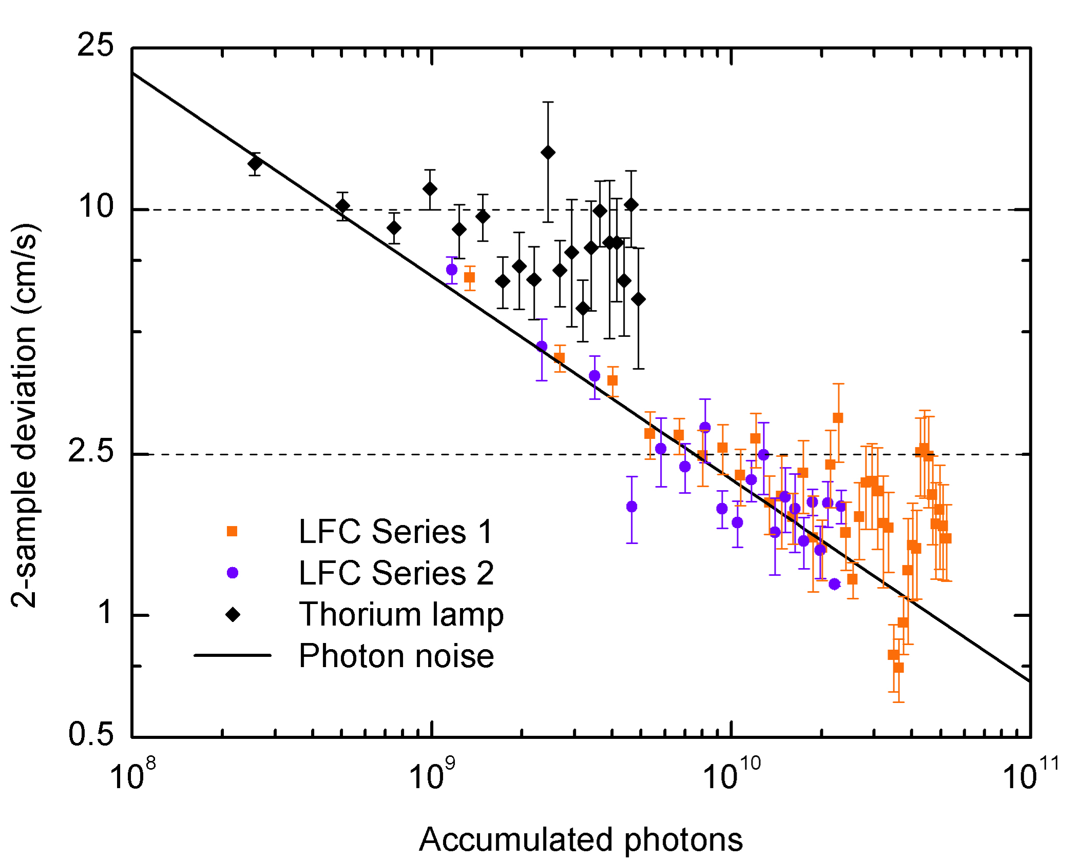
Laser Frequency Comb
LFC on HARPS
Noise in the LFC data is
statistical only down to
below 2.5 cm/s !!!
(Wilken et al., Nature, 2012)

Slide 27
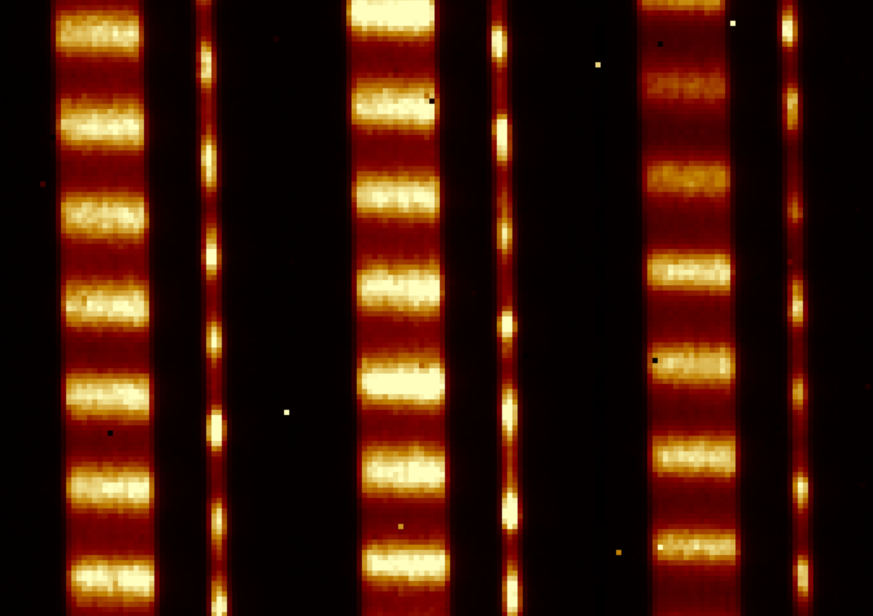
Laser Frequency Comb
LFC on NIRPS

Slide 28




Fabry-Perot
$$δ=phase difference=\left(\frac{2∙π}{λ}\right)2∙n∙l∙\cos{θ}$$

Slide 29
Basics of HARPS & NIRPS high resolution spectrographs
HARPS
NIRPS
Wavelength coverage | 380nm – 690nm
Spectral resolution | 115000 (HAM) / 80000 (EGGS)
Light feed | Fiber optics x 2
Aperture on sky | 1” (HAM), 1.4” (EGGS)
Detector | 2 x E2V, 2K x 4K, 15µm pixels
Environment | Vacuum (<10⁻⁵ mbars) Ambient ($17±0.001$K)
Observing modes | Simultaneous reference / Simultaneous sky / Polarimetry
Wavelength coverage | 971nm – 1854nm
Spectral resolution | 82000(HAM) / 75000(HEM)
Light feed | Fiber optics x 2 Adaptive Optics assisted
Aperture on sky | 0.4” (HAM), 0.9” (HEM)
Detector | Hawaii 4RG, 4K x 4K, 15µm pixels
Environment | Vacuum (<10⁻⁵ mbars) Cryogenic ($80±0.001$K)
Observing modes | Simultaneous reference / Simultaneous sky

Slide 30


Basics of HARPS & NIRPS high resolution spectrographs
HARPS
NIRPS
CCD: total number of counts
Up-the-ramp sampling: counts per second
5.573s/sample

Slide 31


Modal noise
Optical fibers are wave-guides,
the number of propagating modes depends on
the ratio of the fiber core to the wavelength.
In the IR there are much less modes,
and “modal noise” (interference between the modes)
plays an important role.
This is why NIRPS (but not HARPS) has a fiber-stretcher to “scramble” the modes and
reduce the measurable effect of the modal noise.
By Yolanda Frensch

Slide 32

Pipeline
The same pipeline supports:
HARPS, HARPS-N, SOPHIE, CORALIE, ESPRESSO, NIRPS
with optimized instrument-dependent configuration files.
NIRPS only:
Added telluric corrections
OH subtraction

Slide 33




Pipeline
Wavelength

Slide 34
Operations
Very smooth operation strategy
NIRPS & HARPS can be operated either together, or individually.
NIRPS acquisition is always performed with the support of adaptive optics.
An image quality of up to 0.1” is routinely obtained in the acquisition camera.
HARPS centering and guiding is preliminary to the start of NIRPS acquisition.
Both instrument pipelines are running at the telescope and are distributed to users

Slide 35

HARPS acquisition

Slide 36

HARPS SCIENCE

Slide 37

HARPS OB

Slide 38

NIRPS + HARPS ACQUISITION

Slide 39

NIRPS + HARPS SCIENCE

Slide 40

NIRPS + HARPS OB

Slide 41

NIRPS Operation panels
Center
& guide
BOB
OS
Adaptive Optics

Slide 42

NIRPS AO panel

Slide 43
Final remarks
Both instruments are at the top of their rank,
inherit an experience several decades long,
and are the product of continuous innovation.
The ensemble HARPS + NIRPS is the first Extreme-Precision RV instrument
ranging from 380nm to 1850nm.
HARPS is the spectrograph with the longest baseline for LFC calibrations to date.
Despite the overall complexity the operation scheme is very easy.
Both instruments have online pipelines that supply final science data products.

