Slide 1
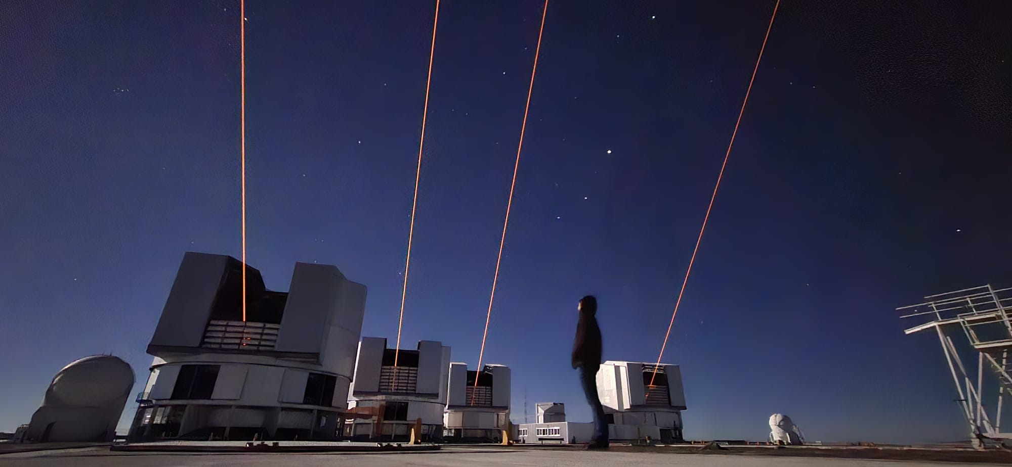
An Introduction to Interferometry
Dr. Aaron Labdon

Slide 2
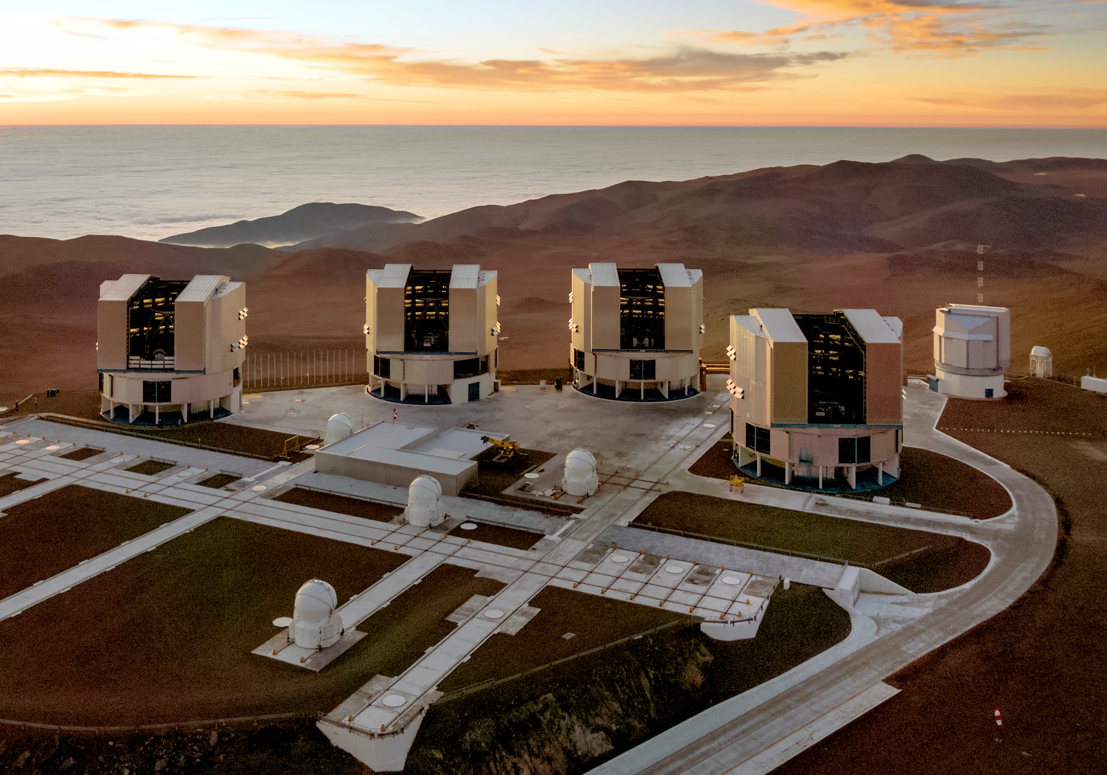
Why Do We Need Interferometry?

Slide 3


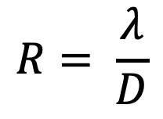
The Bigger the Telescope the Smaller the Object you can see
$$R= \frac{λ}{D}$$
5570 km

Slide 4
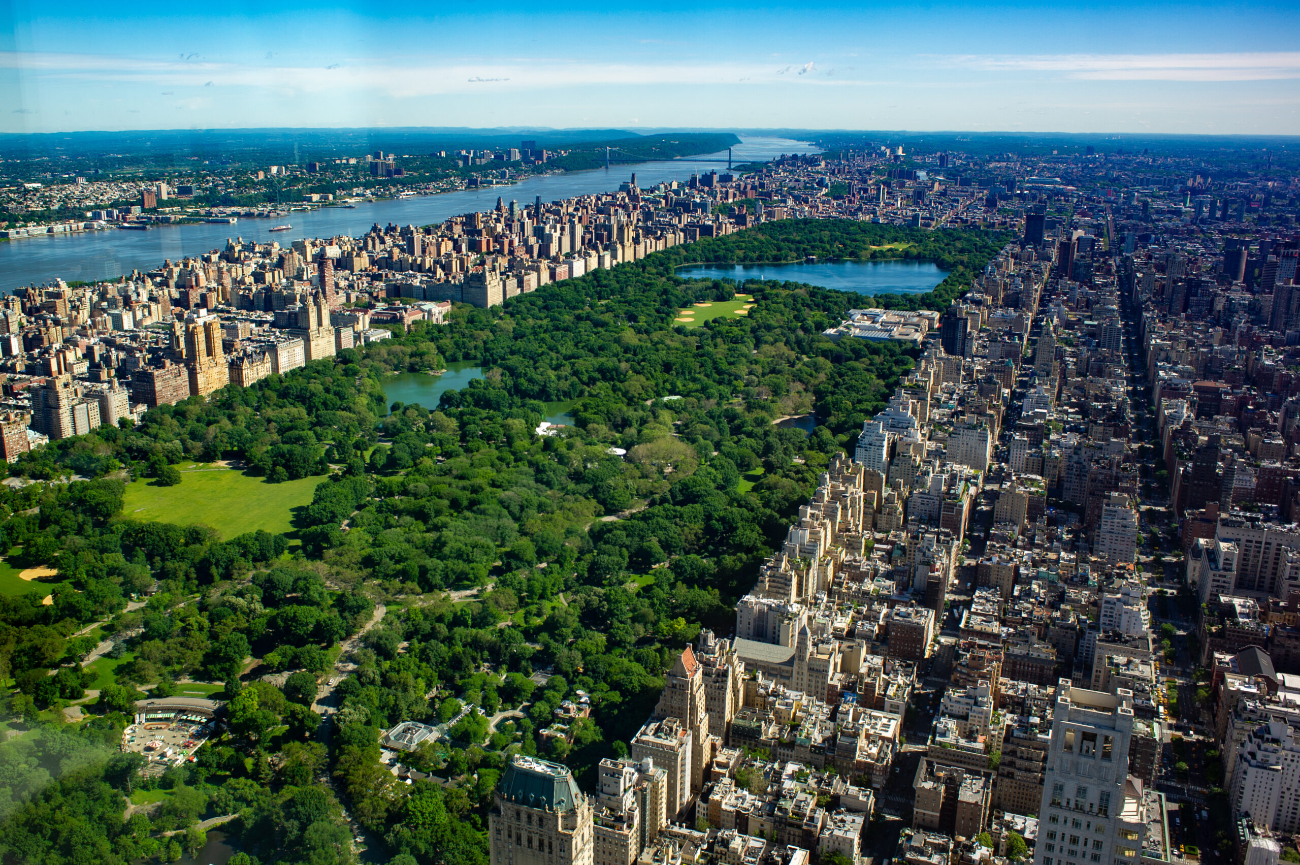
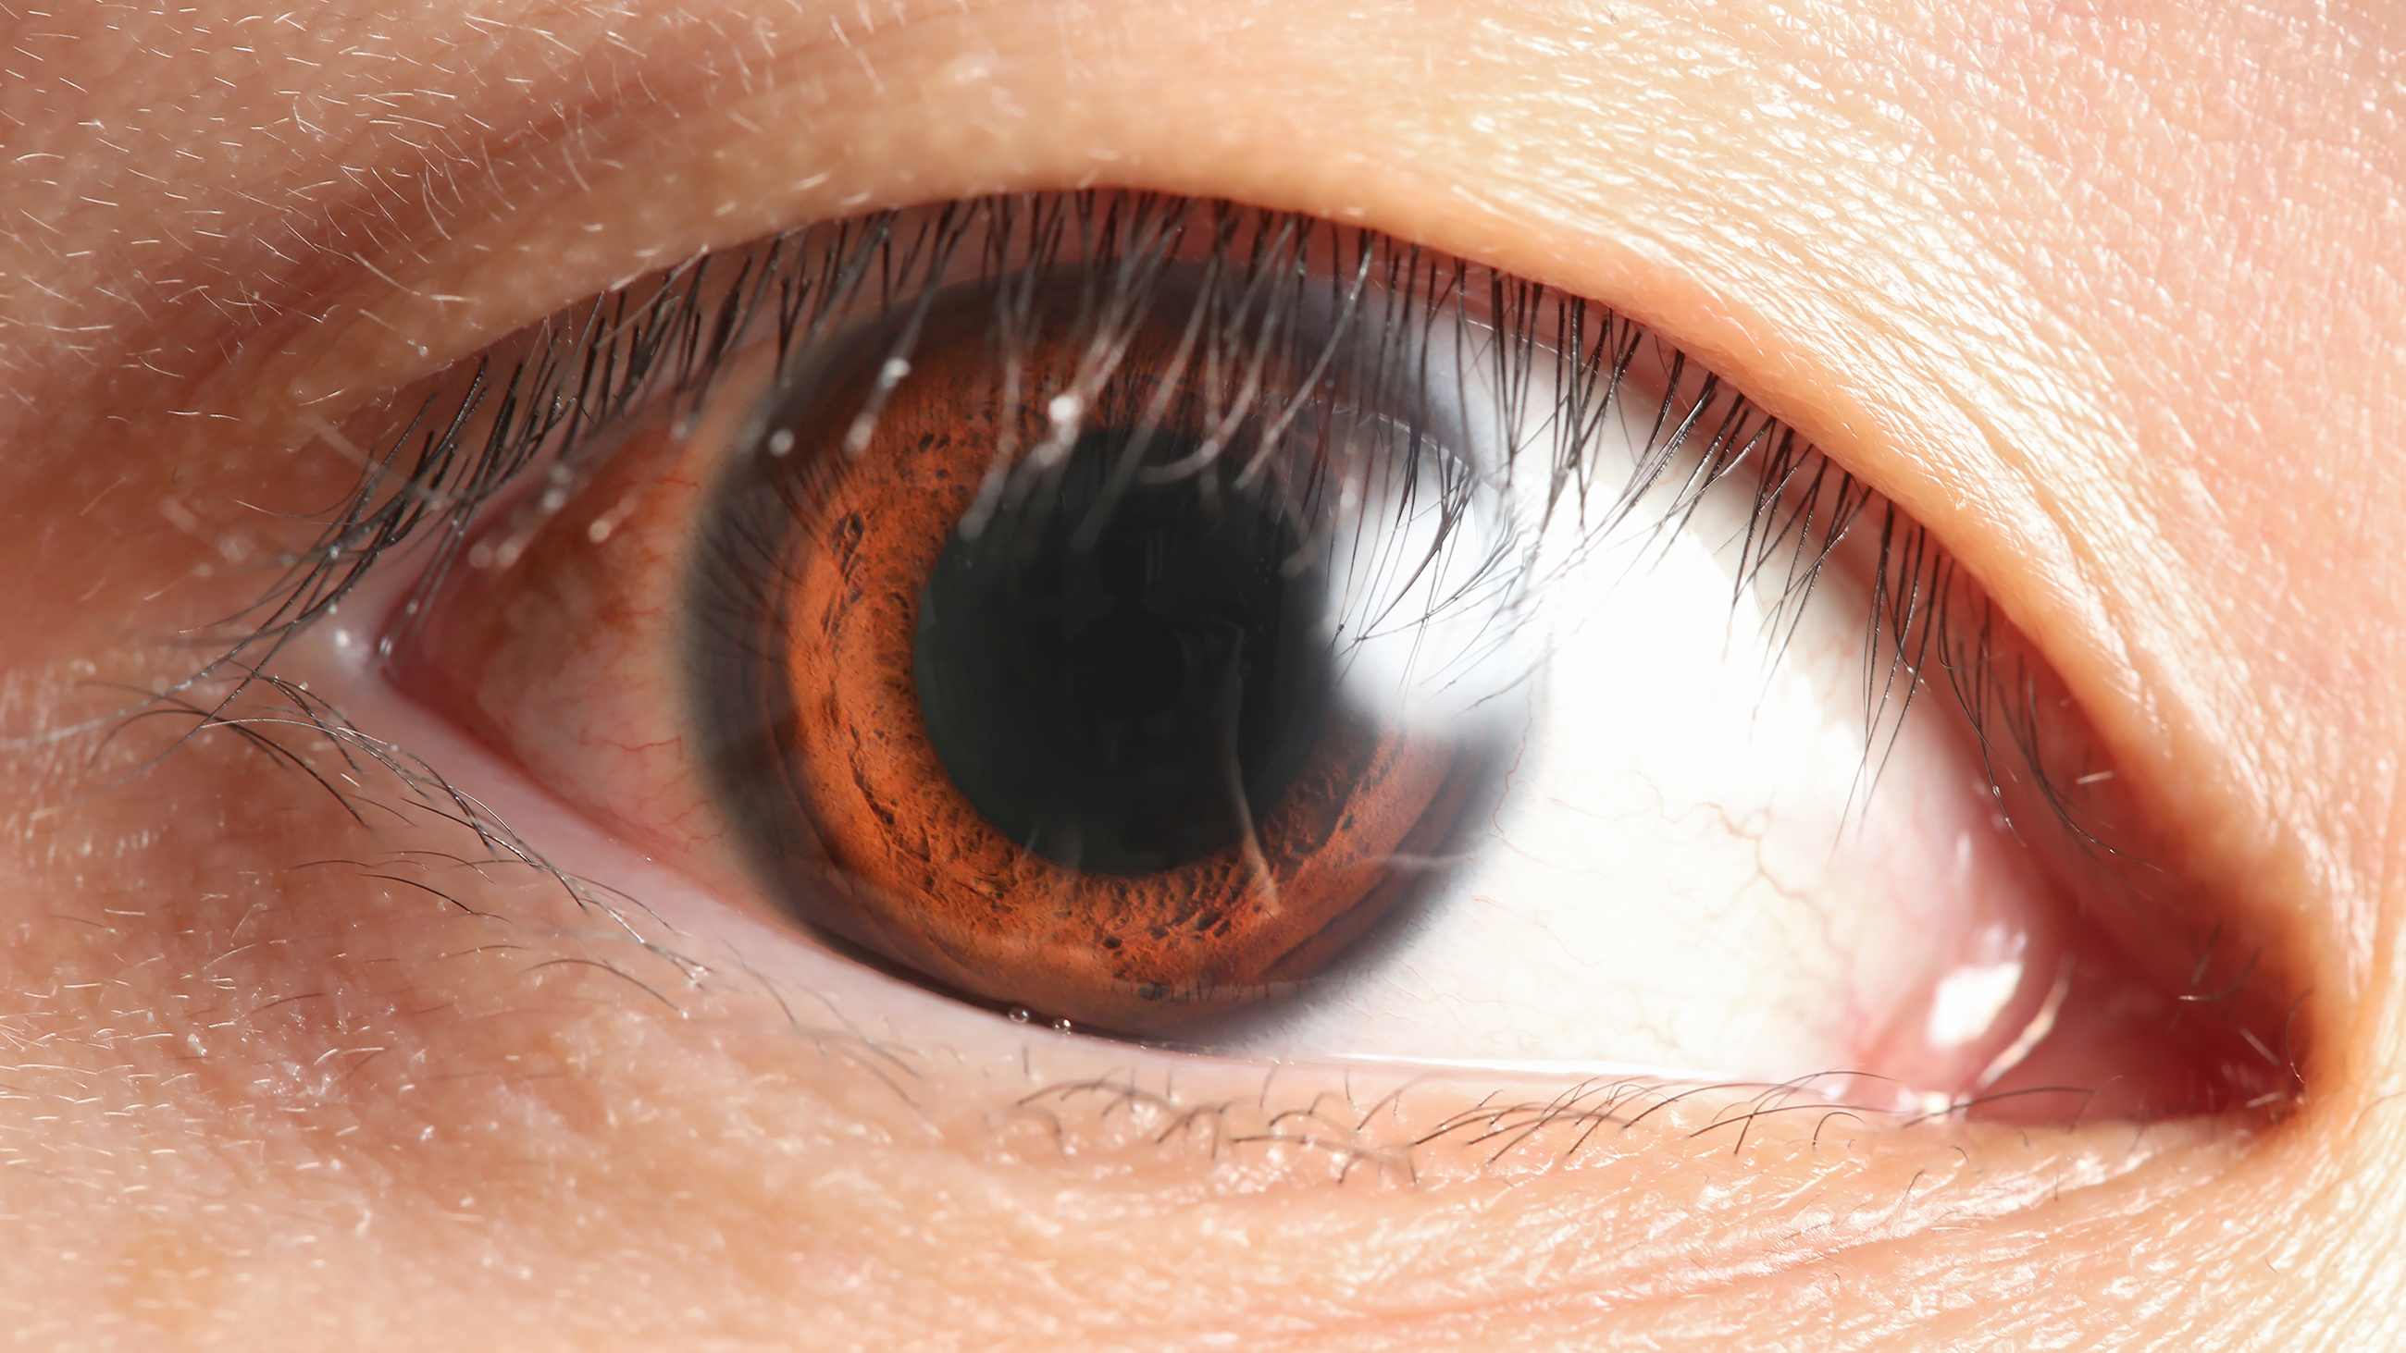
The Bigger the Telescope the Smaller the Object you can see
$$R= \frac{λ}{D}$$
1.6 km
5570 km

Slide 5
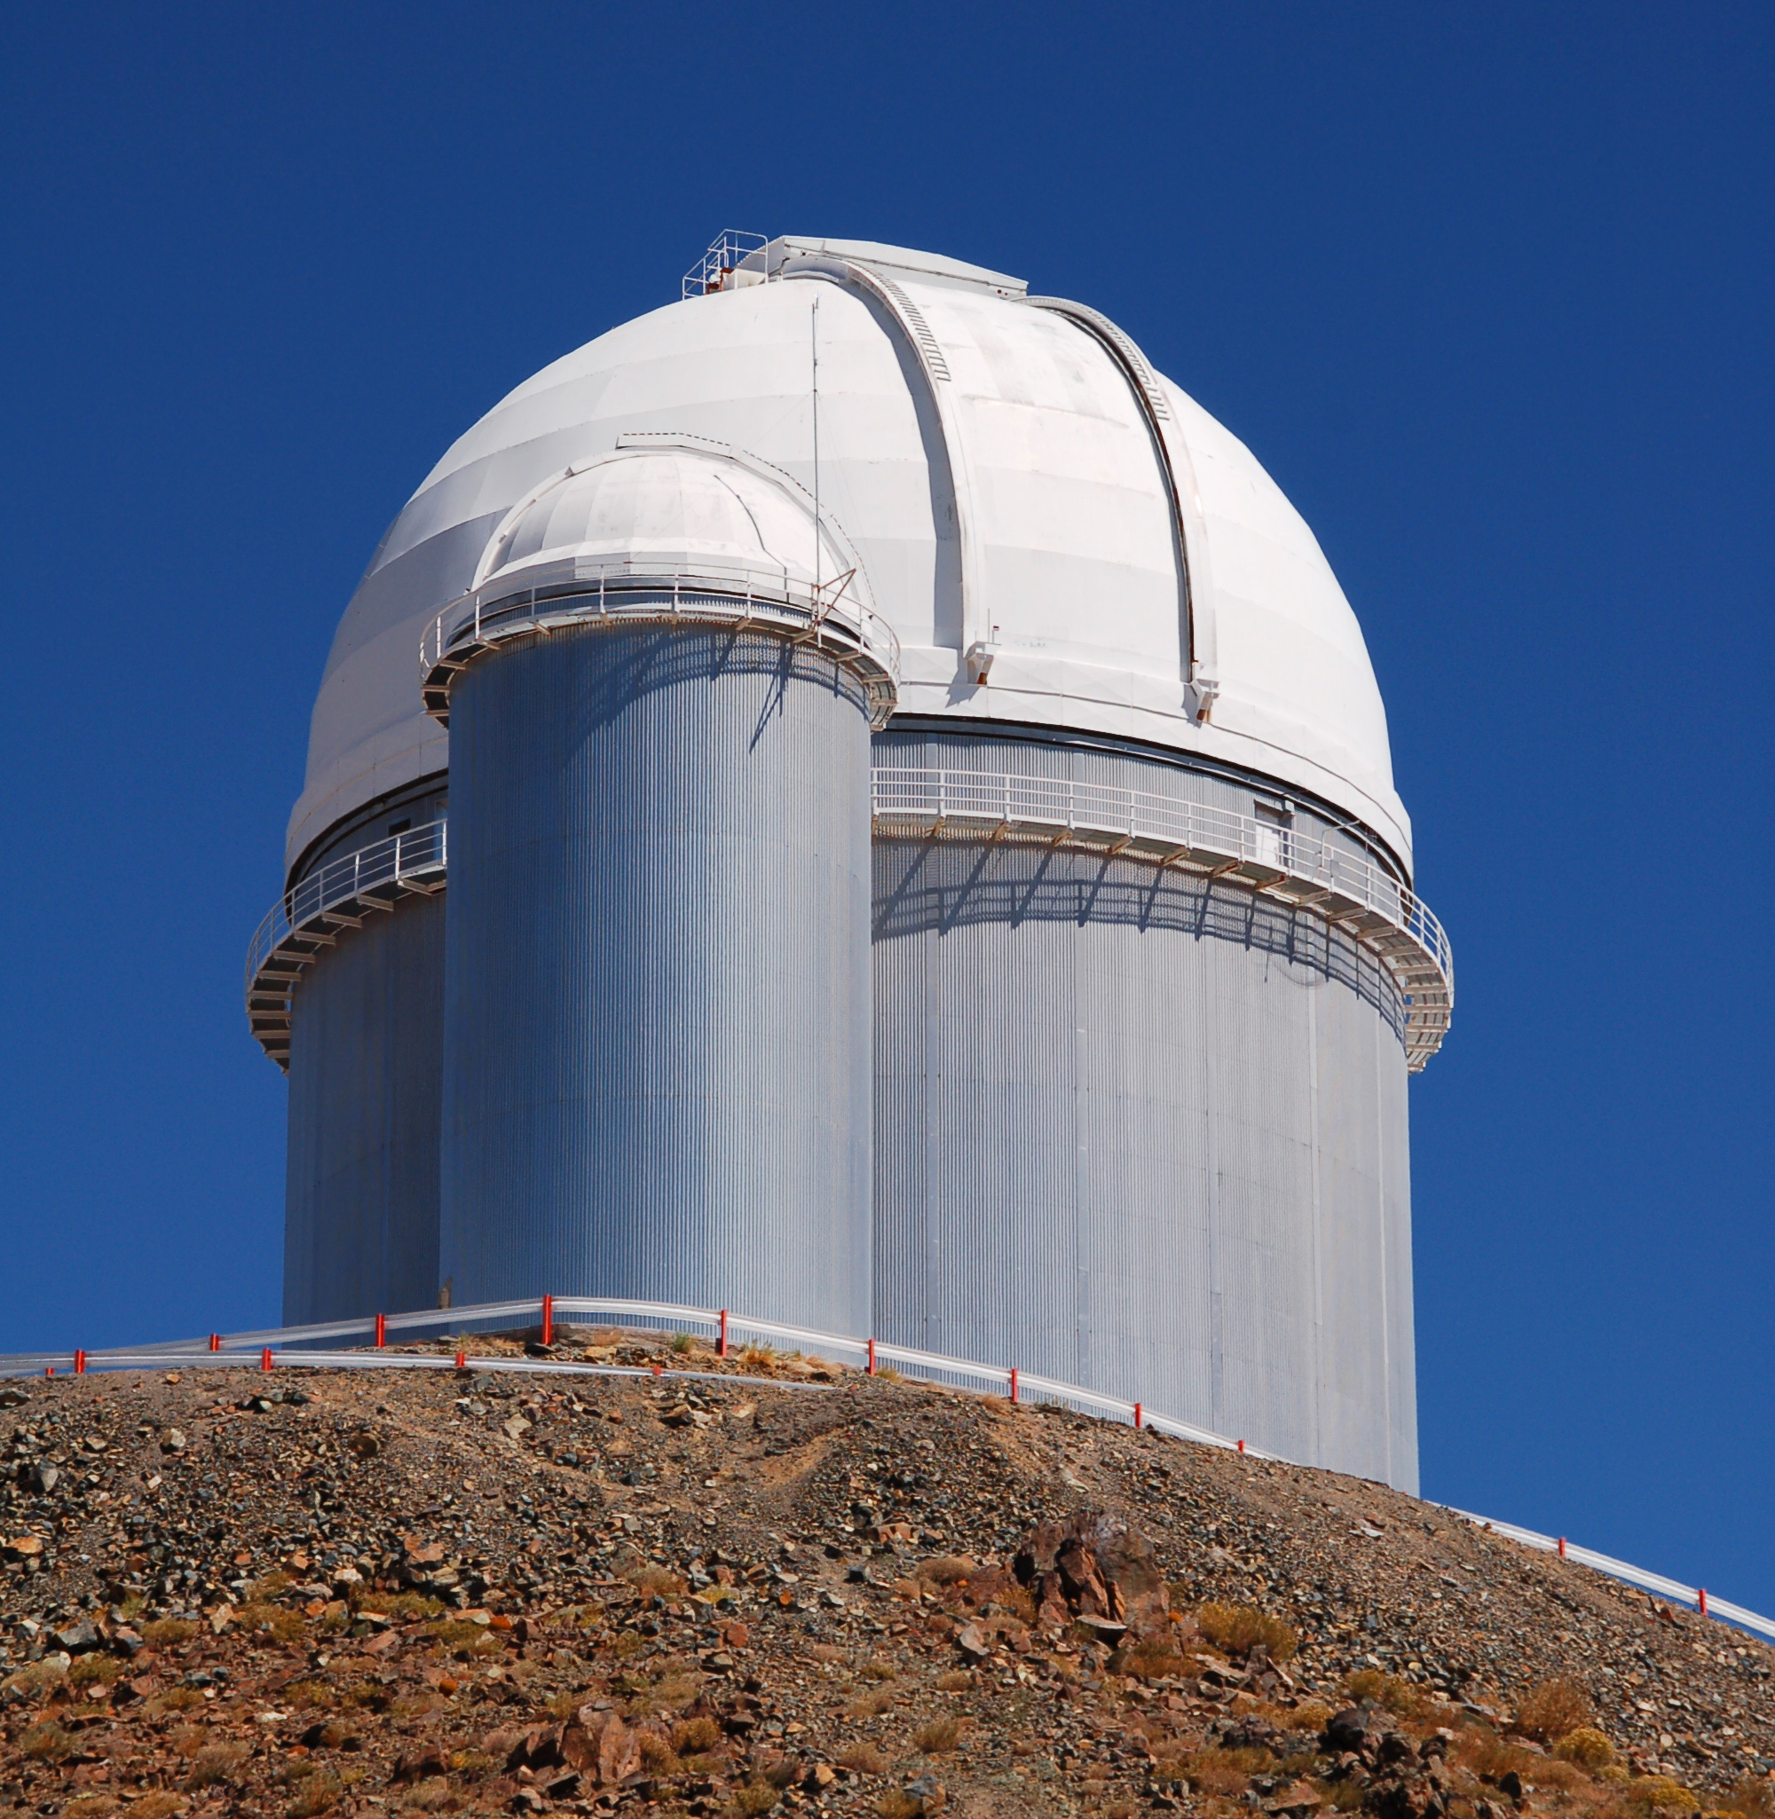

The Bigger the Telescope the Smaller the Object you can see
$$R= \frac{λ}{D}$$
90 cm
5570 km

Slide 6
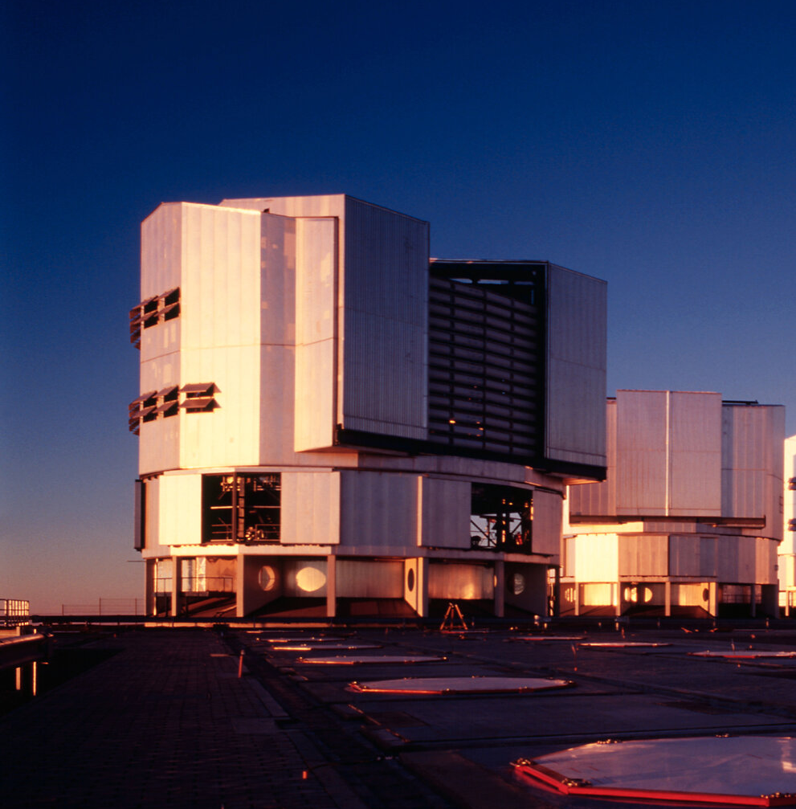

The Bigger the Telescope the Smaller the Object you can see
$$R= \frac{λ}{D}$$
40 cm
5570 km

Slide 7
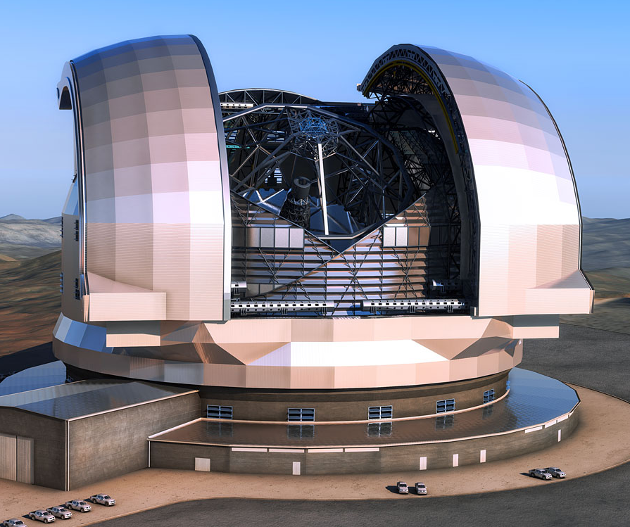
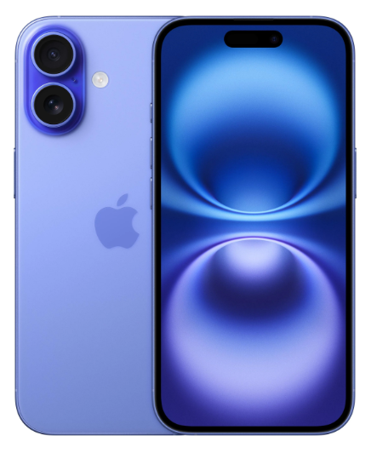
The Bigger the Telescope the Smaller the Object you can see
$$R= \frac{λ}{D}$$
8 cm
5570 km

Slide 8
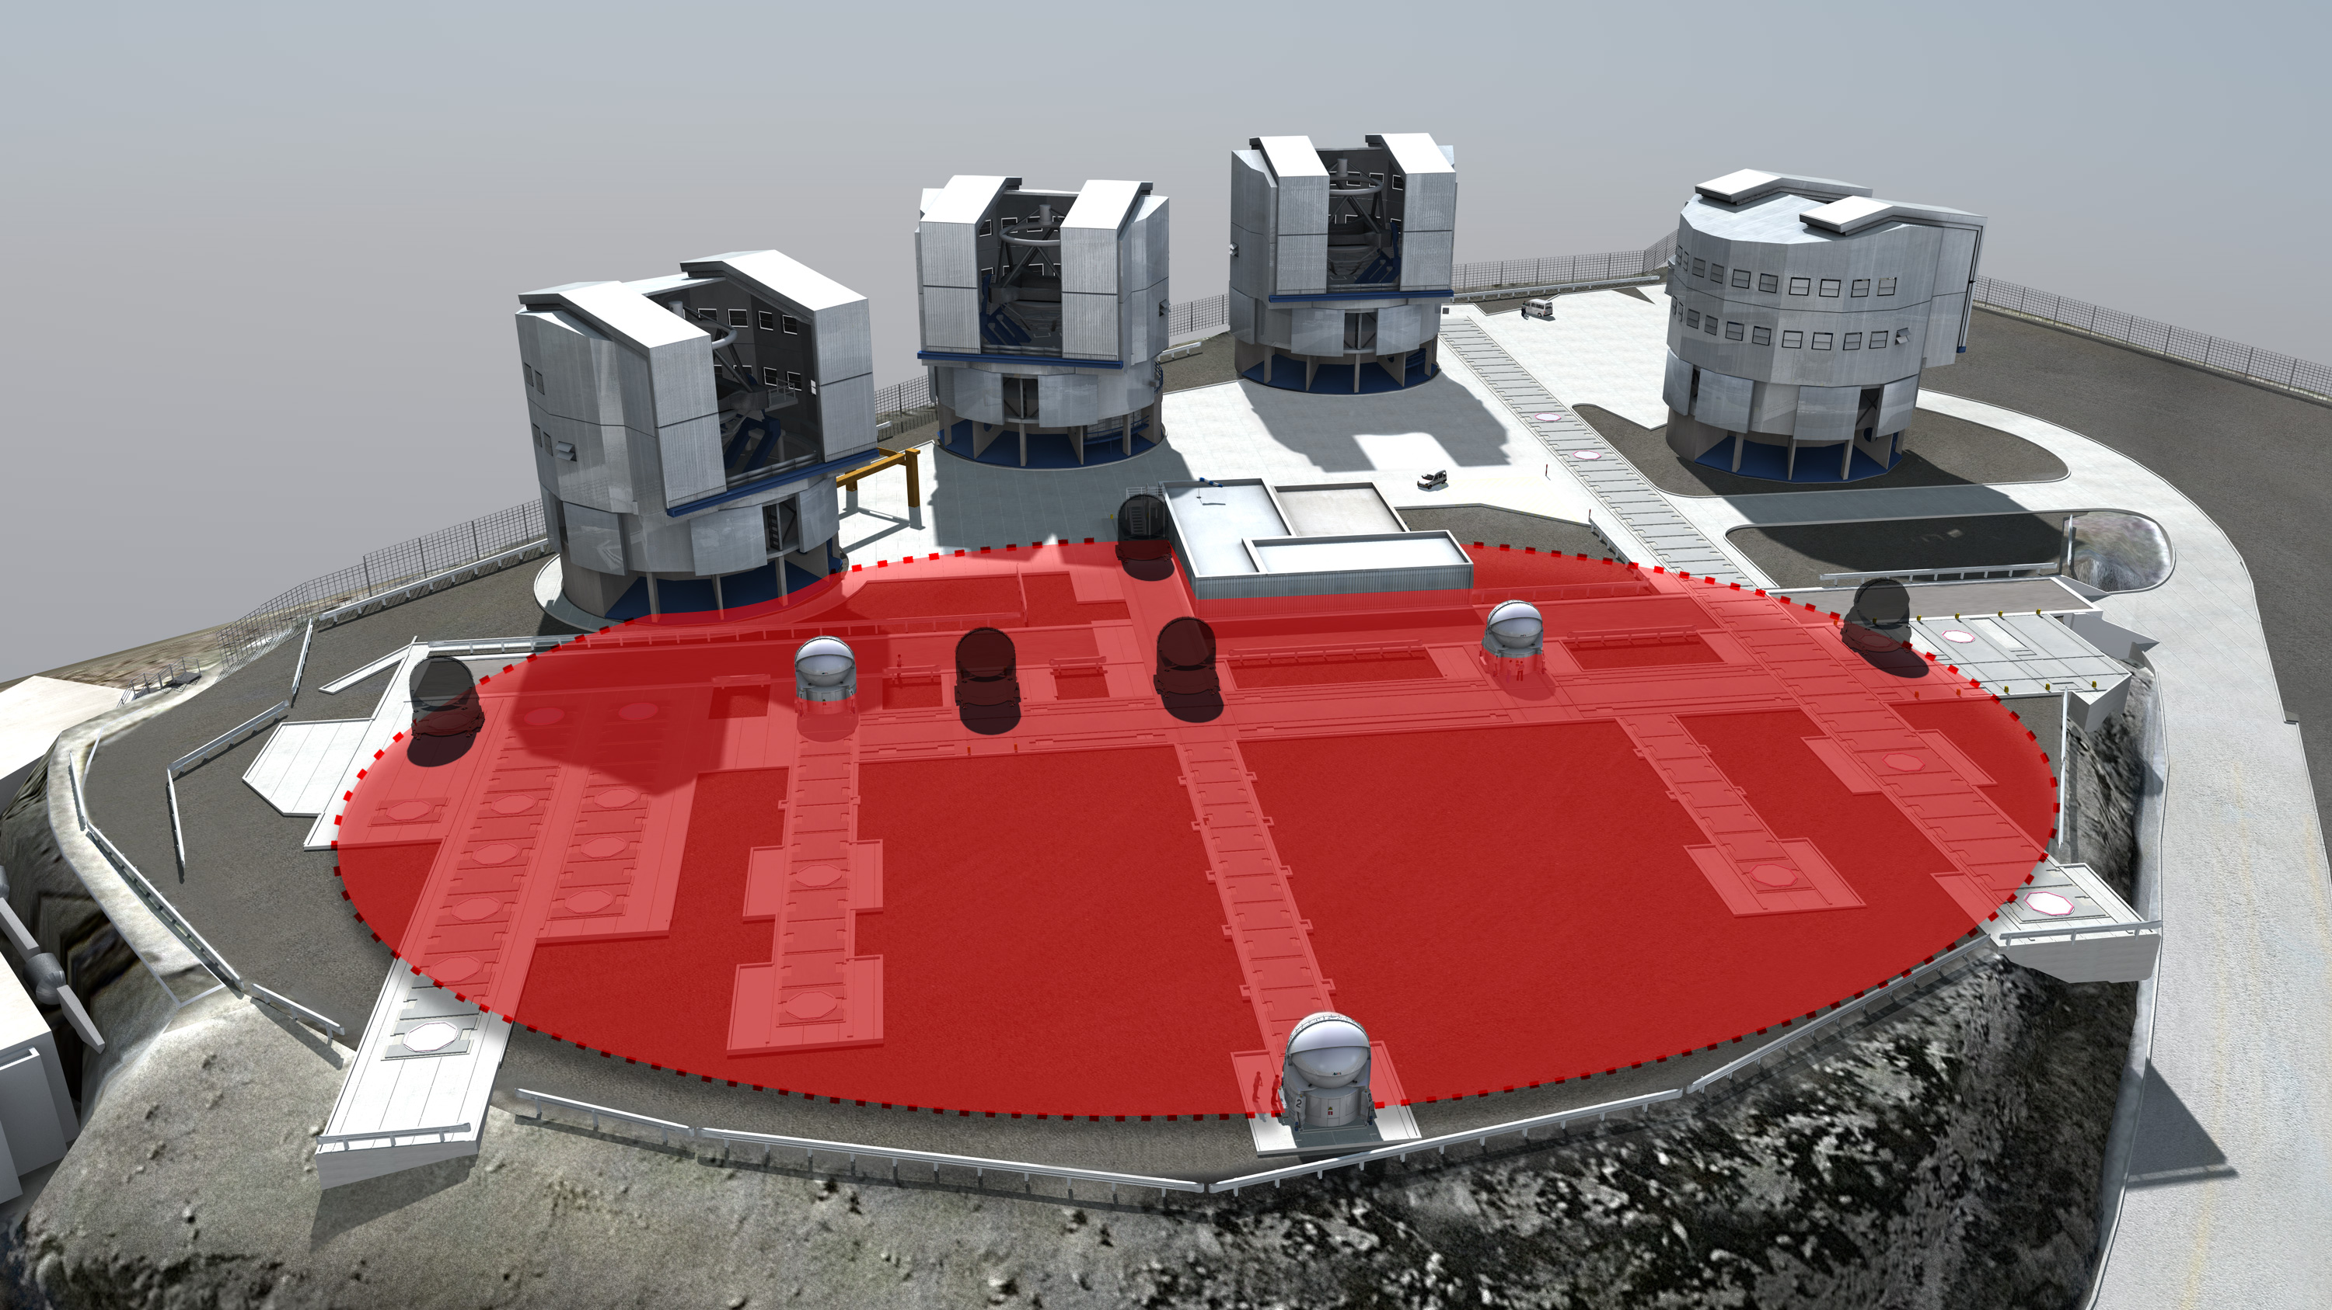
Unless you have an array…
$$R= \frac{λ}{D}$$
5570 km

Slide 9

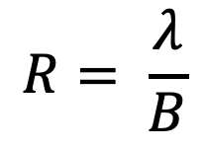
Unless you have an array…
$$R= \frac{λ}{D}$$
$$R= \frac{λ}{B}$$
At VLTI $B_{max}=200 m$
5570 km

Slide 10
Unless you have an array…
$$R= \frac{λ}{D}$$
$$R= \frac{λ}{B}$$
1.6 cm
Max B = 200 m
5570 km

Slide 11
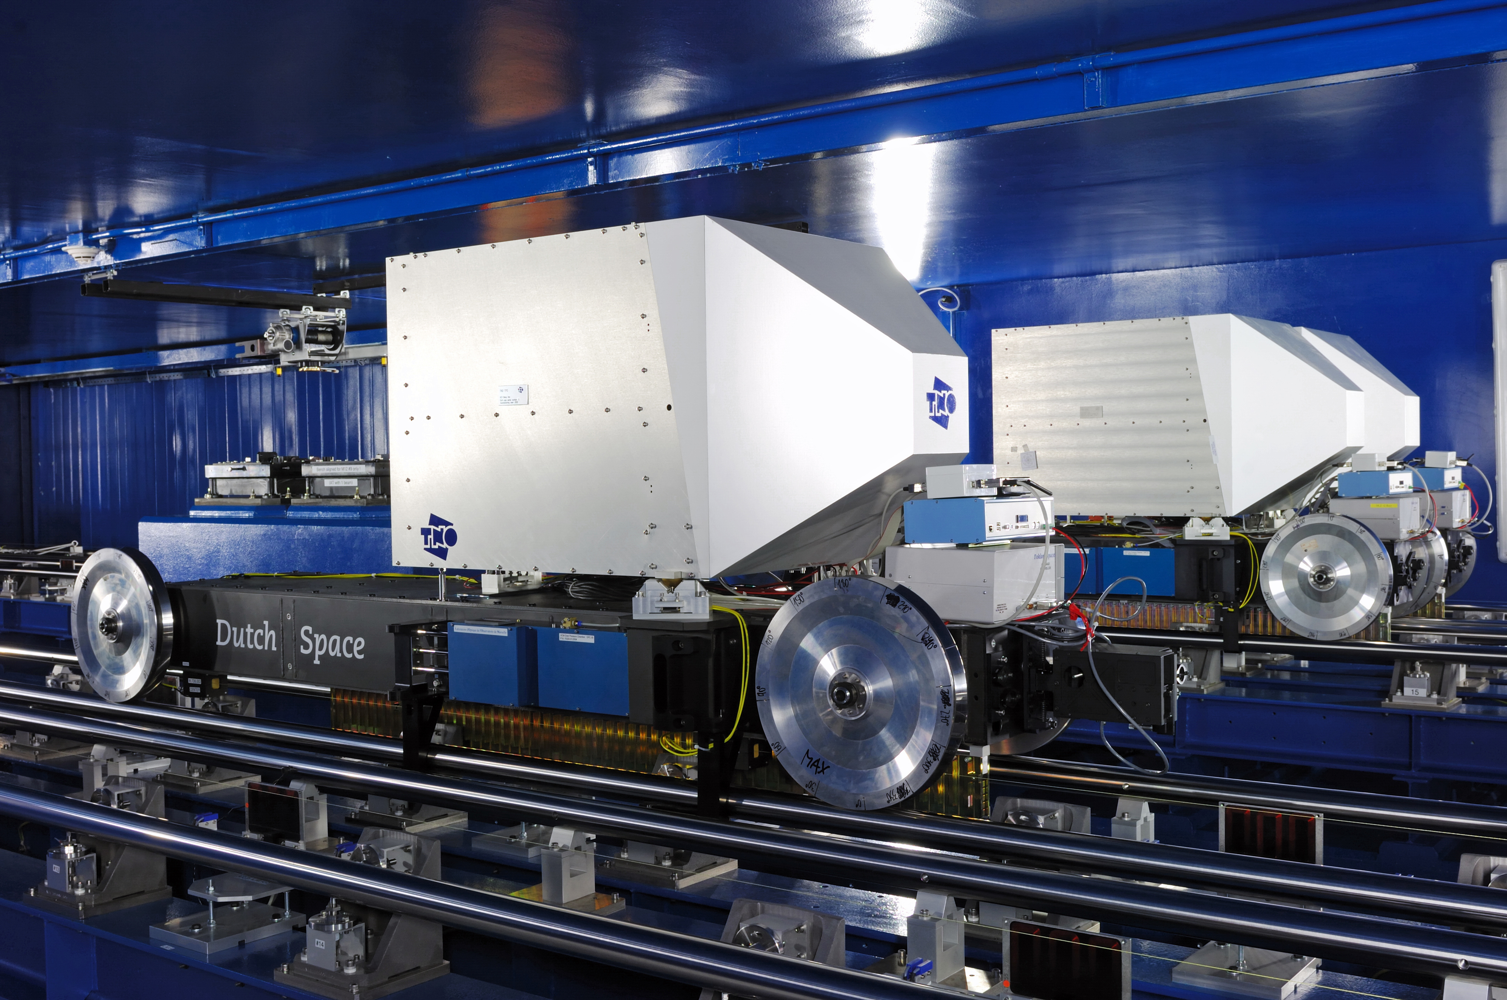
How Does It Work?

Slide 12
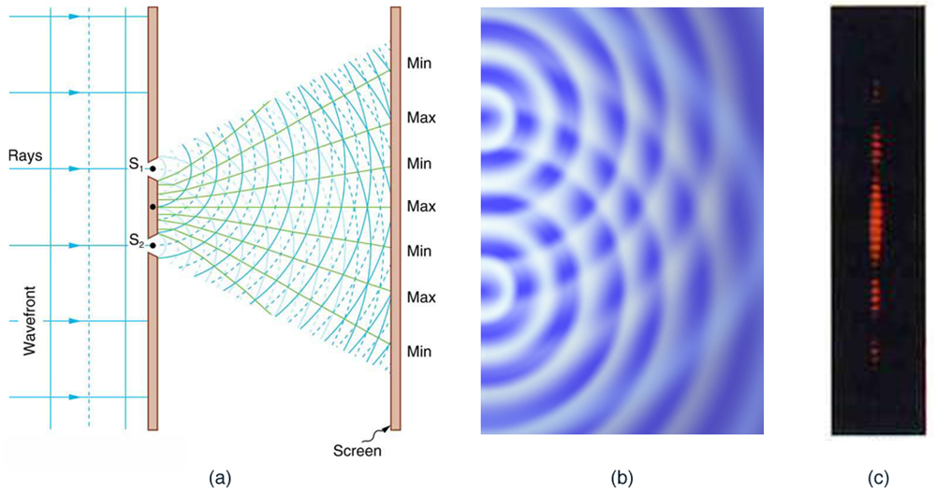
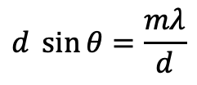
Youngs Double Slit Experiment
$$d \sin{θ}=\frac{mλ}{d}$$

Slide 13
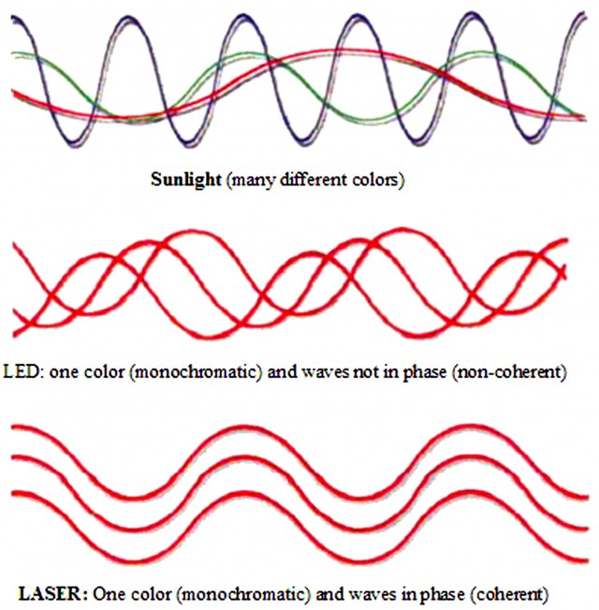
Youngs Double Slit Experiment
There is a direct relation between
The source properties
The distance between the slits/telescopes (d or B)
The interference fringes

Slide 14
Youngs Double Slit Experiment
There is a direct relation between
The source properties
The distance between the slits/telescopes (d or B)
The interference fringes
But…
The sources are assumed to be uniform
Point Source
The sources must be coherent
Or cannot interfere

Slide 15
How to Achieve Coherence
Telescope 1
Telescope 2
Delay Line 1
Delay Line 2
Combiner Lab

Slide 16
The Delay Lines – An Engineering Wonder
Notes:
Show the delay lines and explain

Slide 17
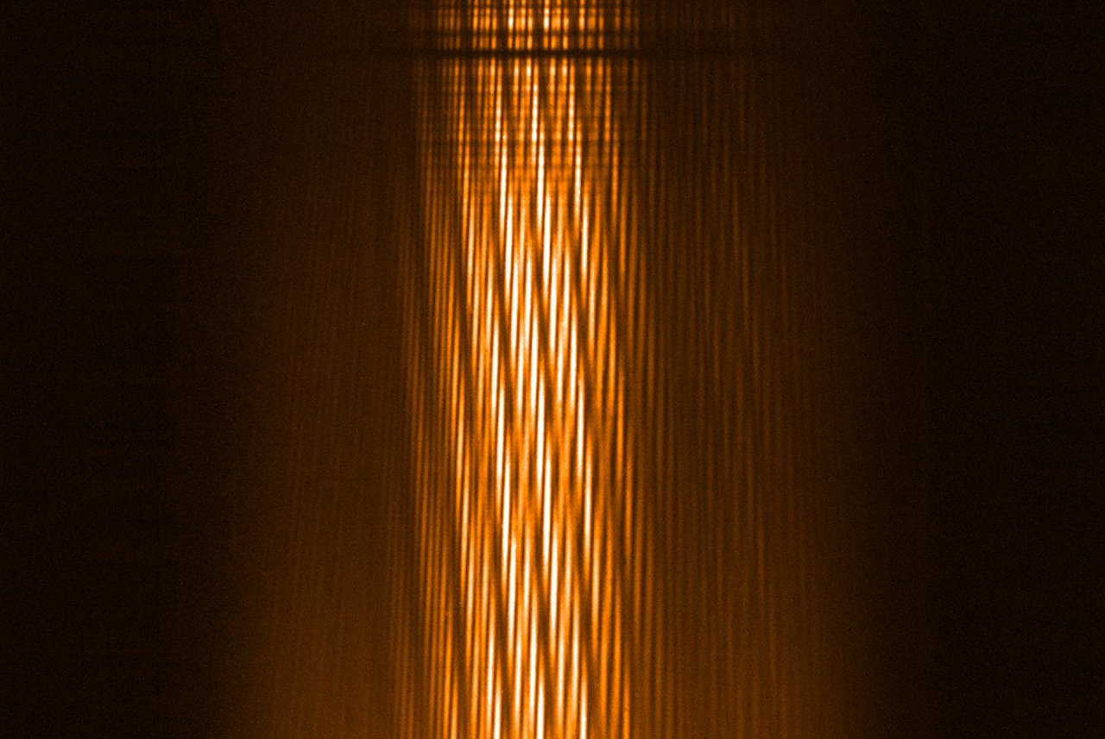
What are the Observables?

Slide 18
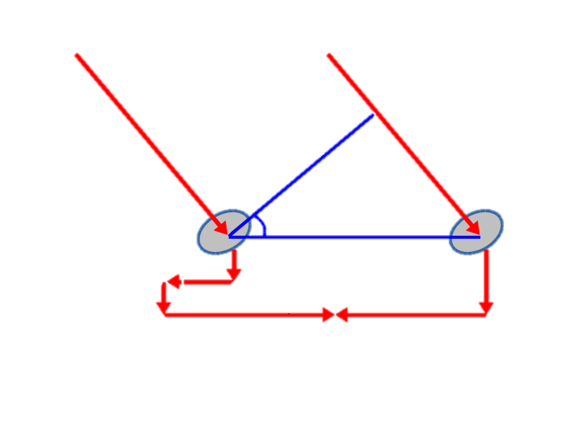

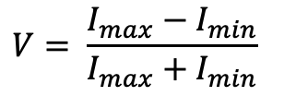
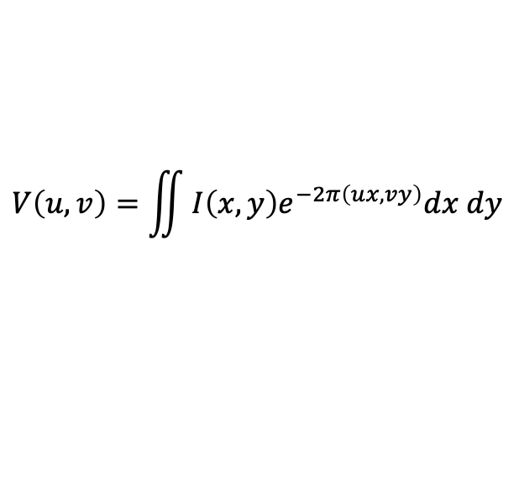


Now you have an Interference Pattern
Delay = Bsin$θ$
$$V= \frac{I_{max}−I_{min}}{I_{max}+I_{min}}$$
T1
$$θ$$
T2
Baseline = B
$$V\left(u,v\right)=\iint{I\left(x,y\right)e^{−2π\left(ux,vy\right)}dx dy}$$
Optical Path Length Compensation
Just a Fourier Transform

Slide 19
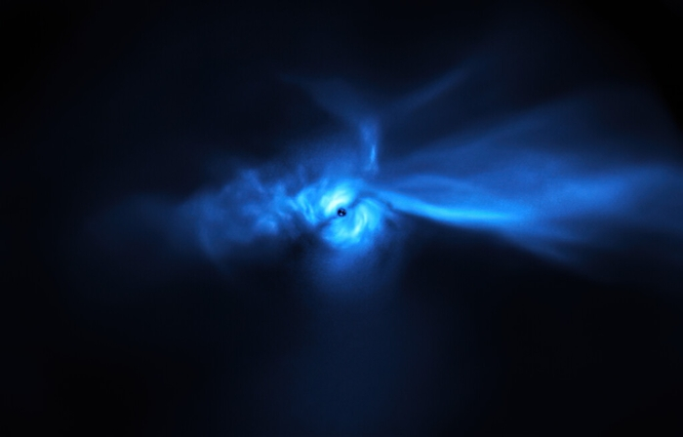

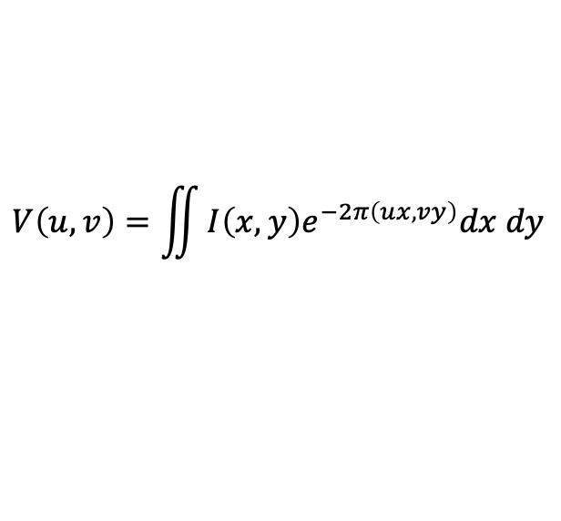

$$V\left(u,v\right)=\iint{I\left(x,y\right)e^{−2π\left(ux,vy\right)}dx dy}$$
$$I\left(x,y\right)$$
$$V\left(u,v\right)$$

Slide 20
How to Fill in the Gaps
Telescopes (u,v)
Image (x,y)

Slide 21
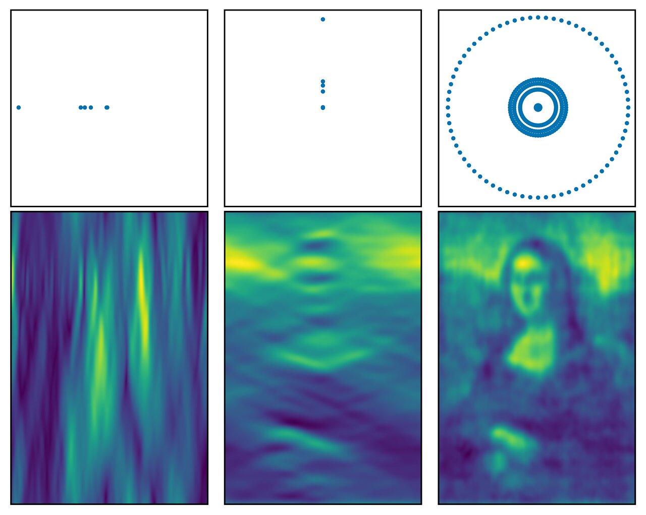

Slide 22
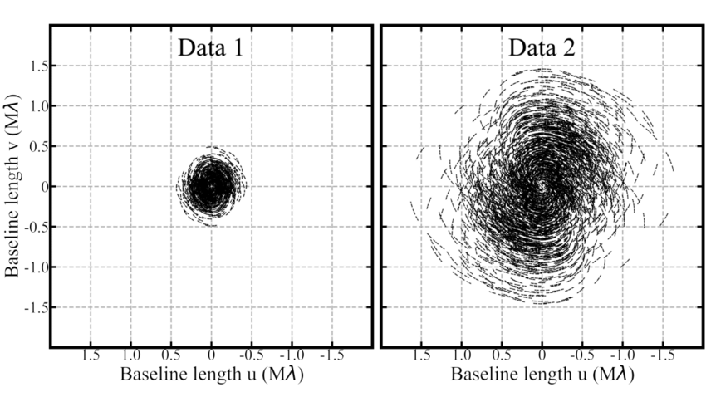
Radio/Sub-mm
Optical
66 Antennas – 3 hrs of Observations
6 Telescopes 9hrs of Observations

Slide 23
How to Interpret a Visibility
D
1
V
0
B
Baseline (B)

Slide 24
How to Interpret a Visibility

Slide 25
How to Interpret a Visibility
1.5 um
1.6 um
1.7 um

Slide 26
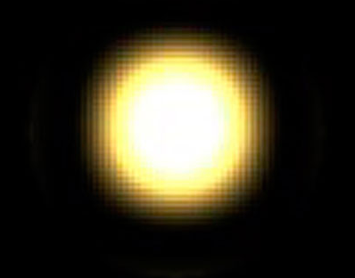
To Conclude
Fringe contract (visibility) contains information about the object
For Simple Objects
A few telescopes
Small amount of time
For Complex Objects
Lots of Telescopes
Lots of time

Slide 27
The VLTI
Very Large Telescope Interferometer

Slide 28
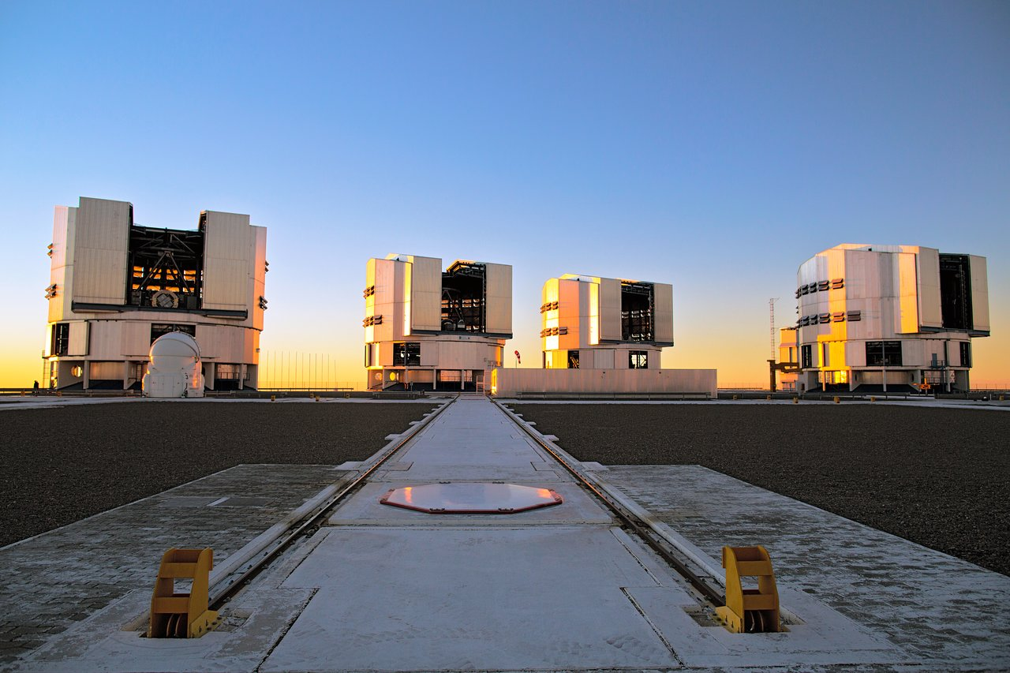
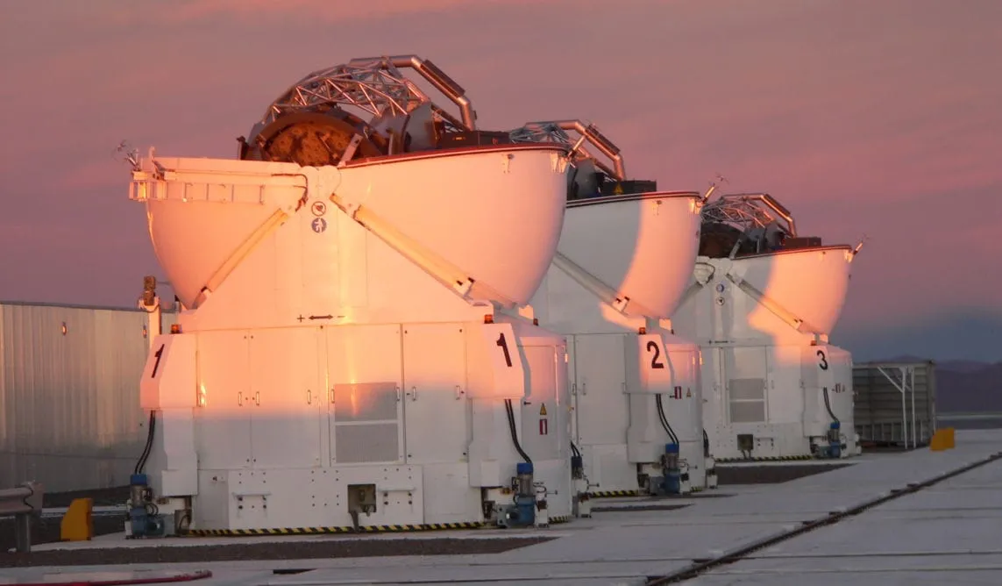
UTs
ATs
4 x 8.2m Telescopes
4 x 1.8m Telescopes
B = 45 to 140 m
B = 20 to 200 m
1 week per Month
3 weeks per Month

Slide 29
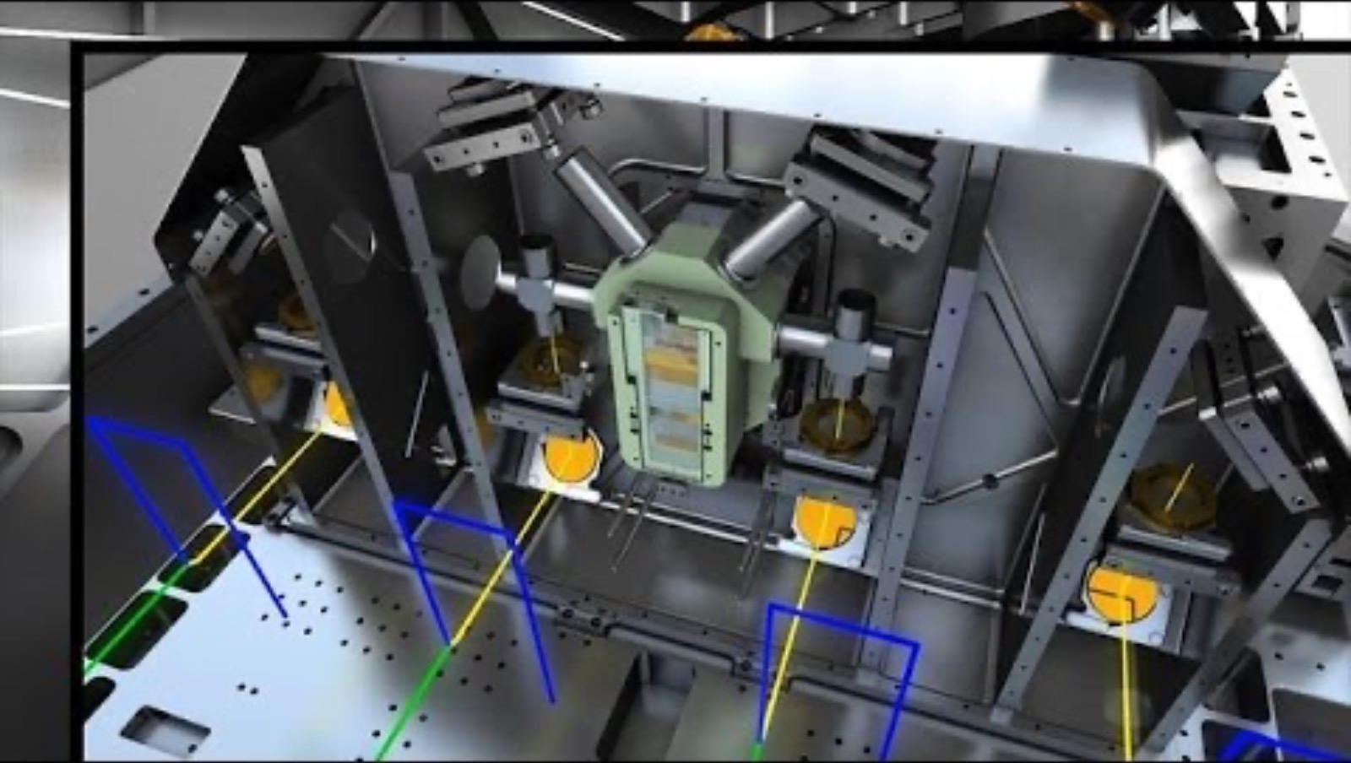

Slide 30
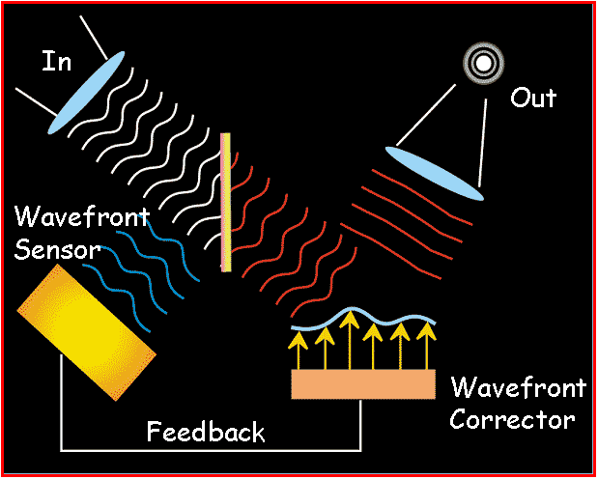
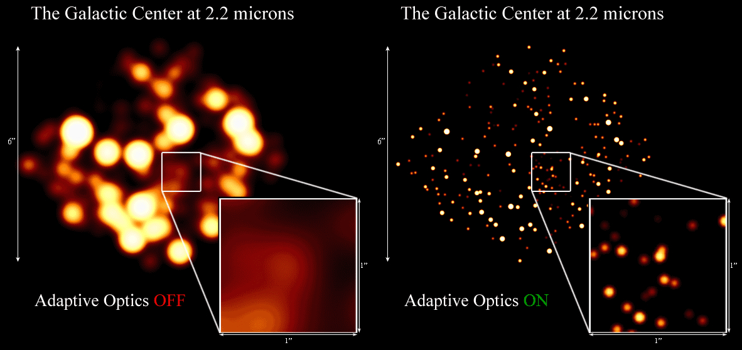
Adaptive Optics on Every Telescope

Slide 31
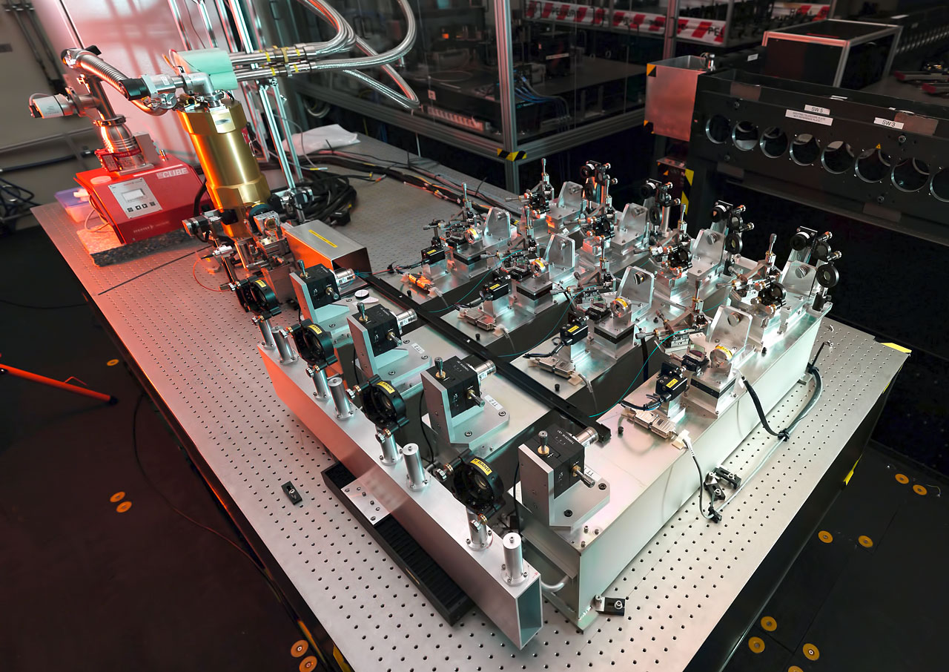
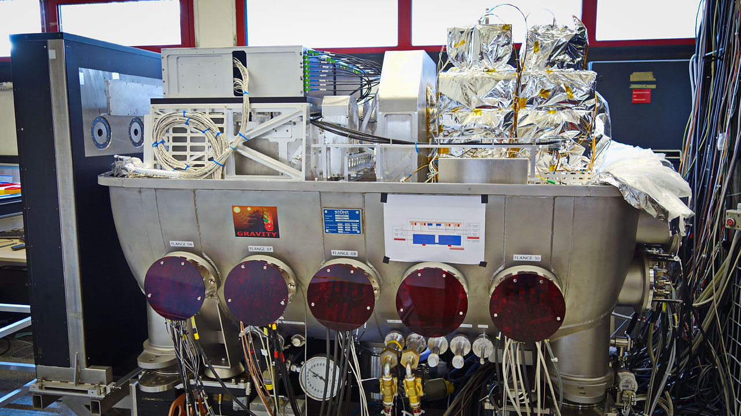
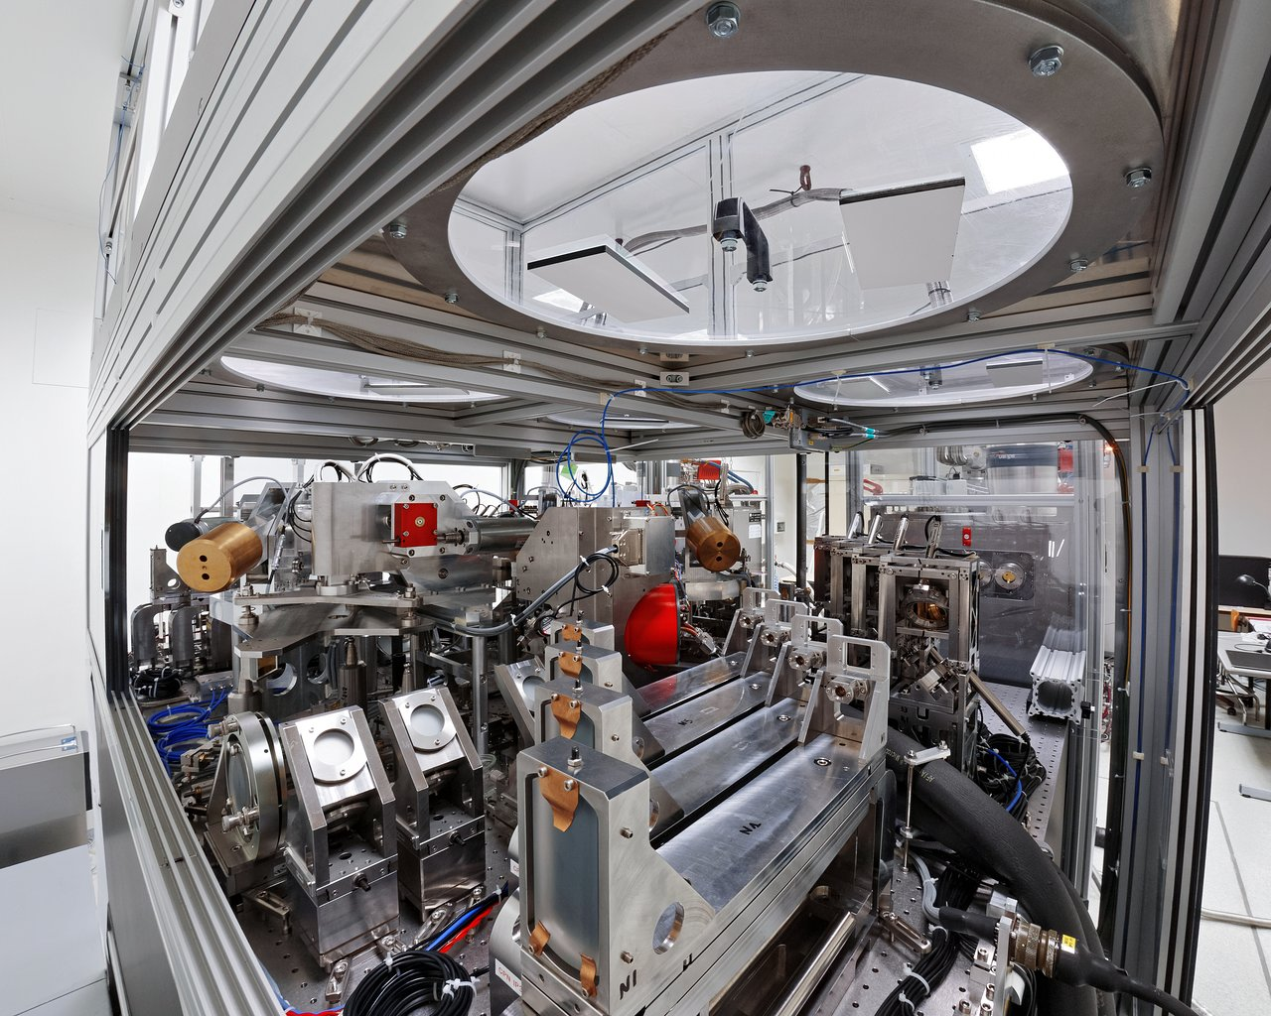
The Instruments
Telescopes
Adaptive Optics
Delay Lines
Instruments
PIONEIR
GRAVITY
MATISSE

Slide 32




PIONEIR
GRAVITY
MATISSE
$$λ=1.6 μm$$
$$λ=2.2 μm$$
$$λ=3−5 μm$$
$$λ=8−12 μm$$
Low Spectral Resolution
Medium Spectral Resolution
Medium Spectral Resolution
Notes:
Show Around the Lab

Slide 33
Science at the VLTI

Slide 34
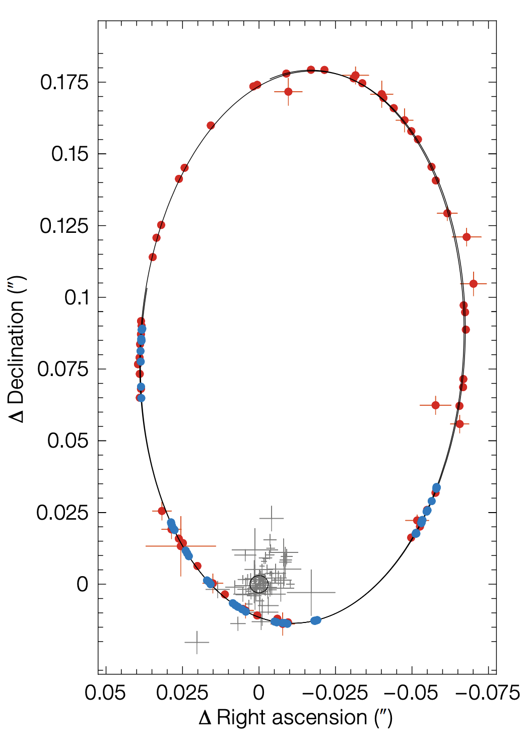
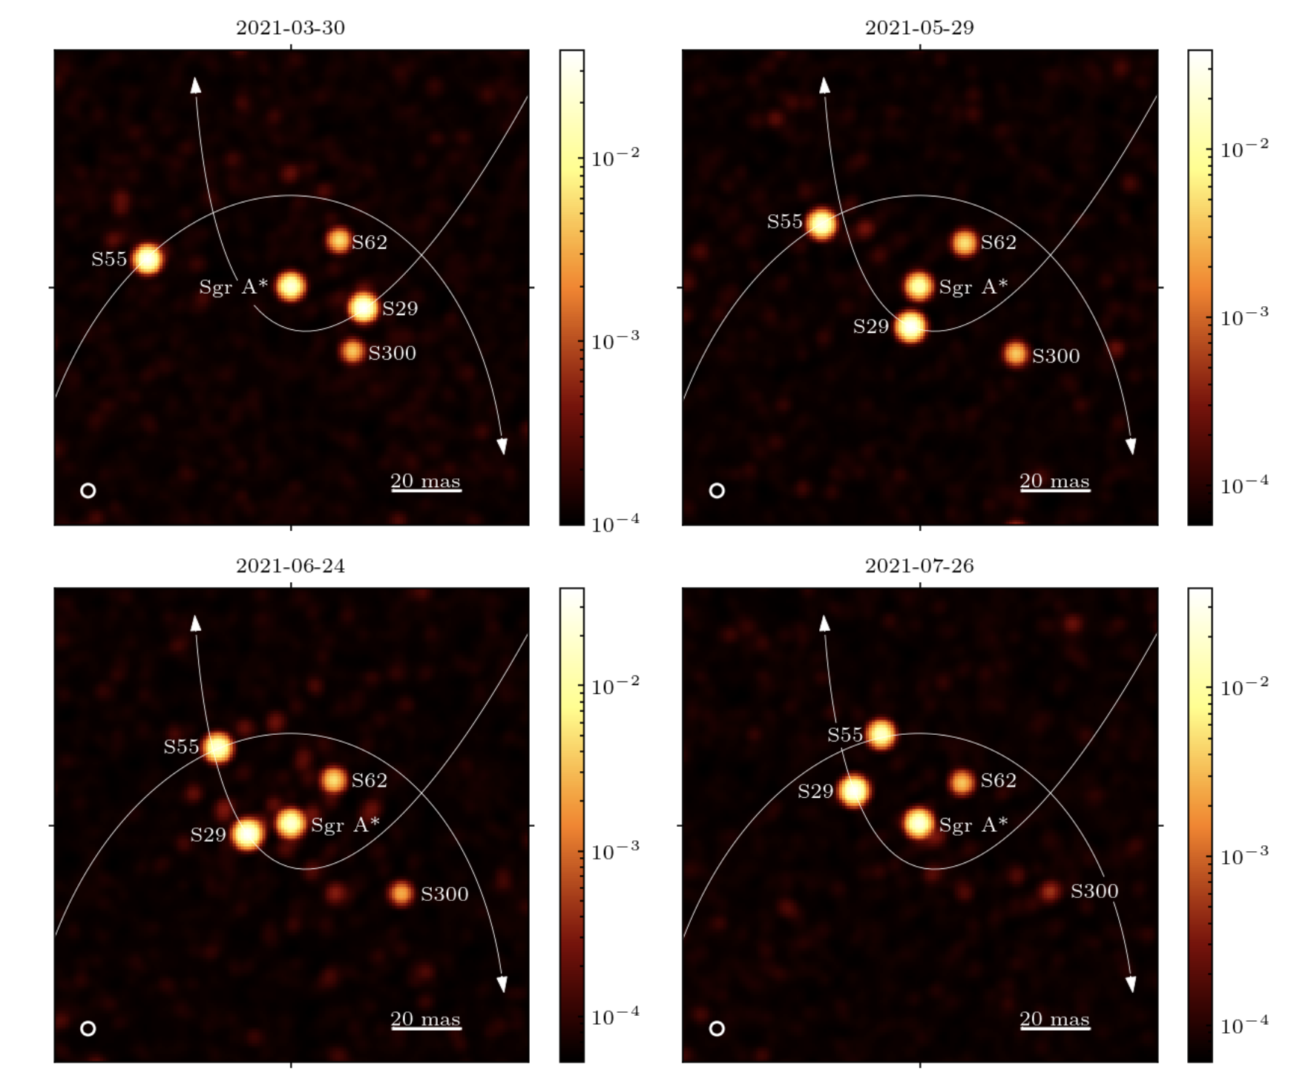
Galactic Center
GRAVITY Collaboration, et al. 2022

Slide 35
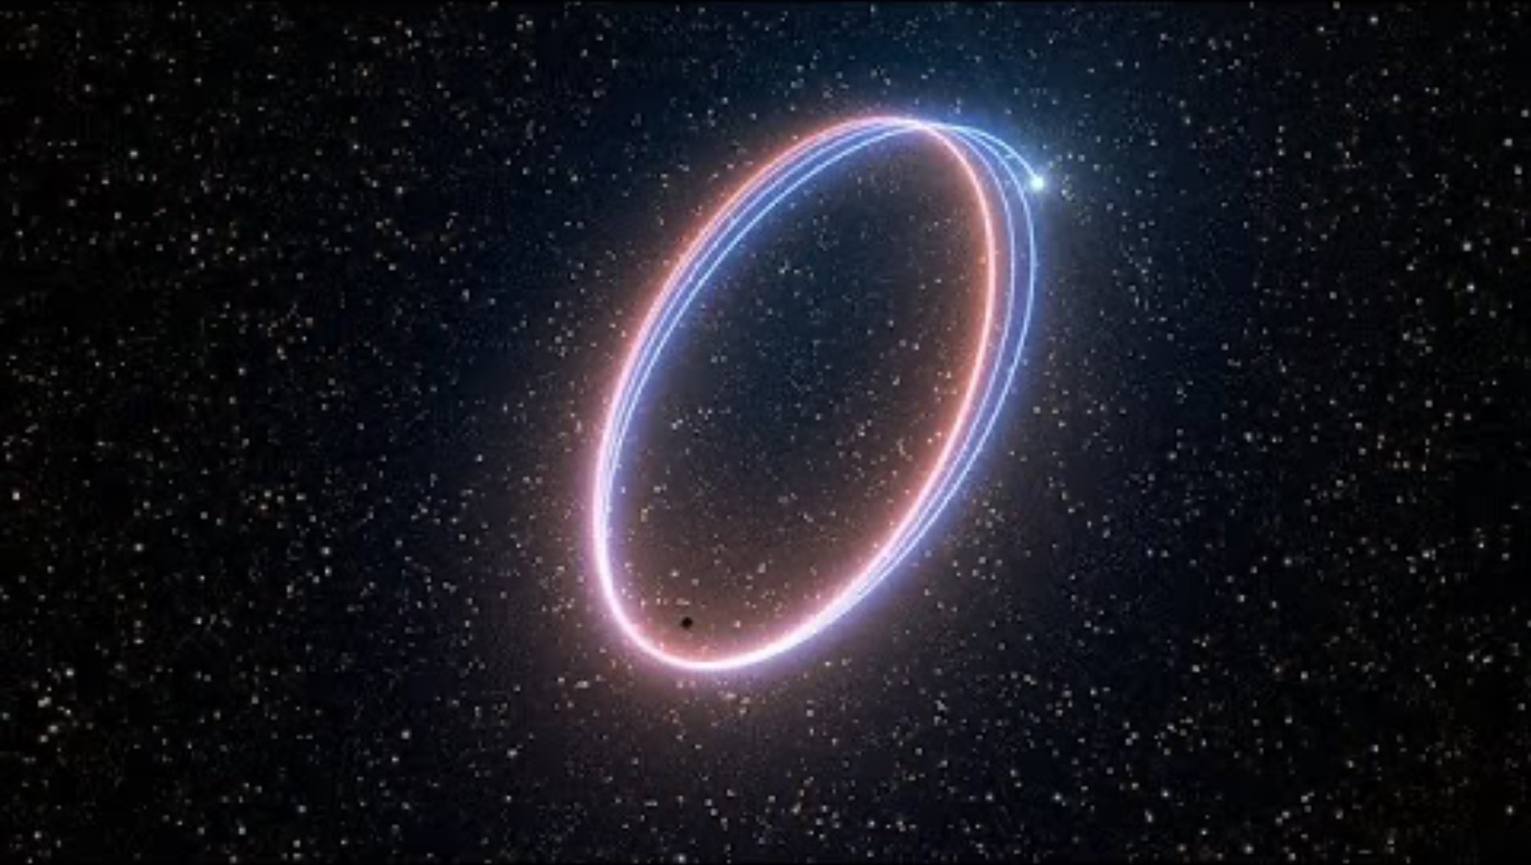
Galactic Center
GRAVITY Collaboration, et al. 2022

Slide 36
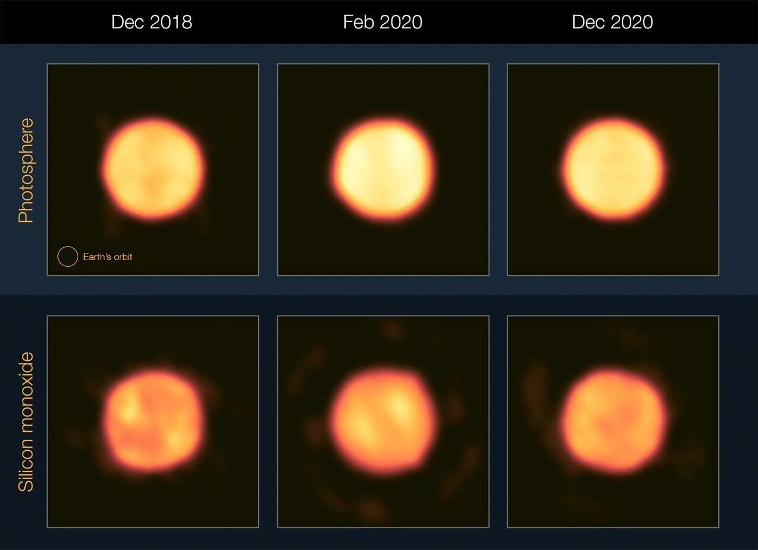
Red Super Giants - Betelgeuse
Drevon, J. et al. 2024

Slide 37
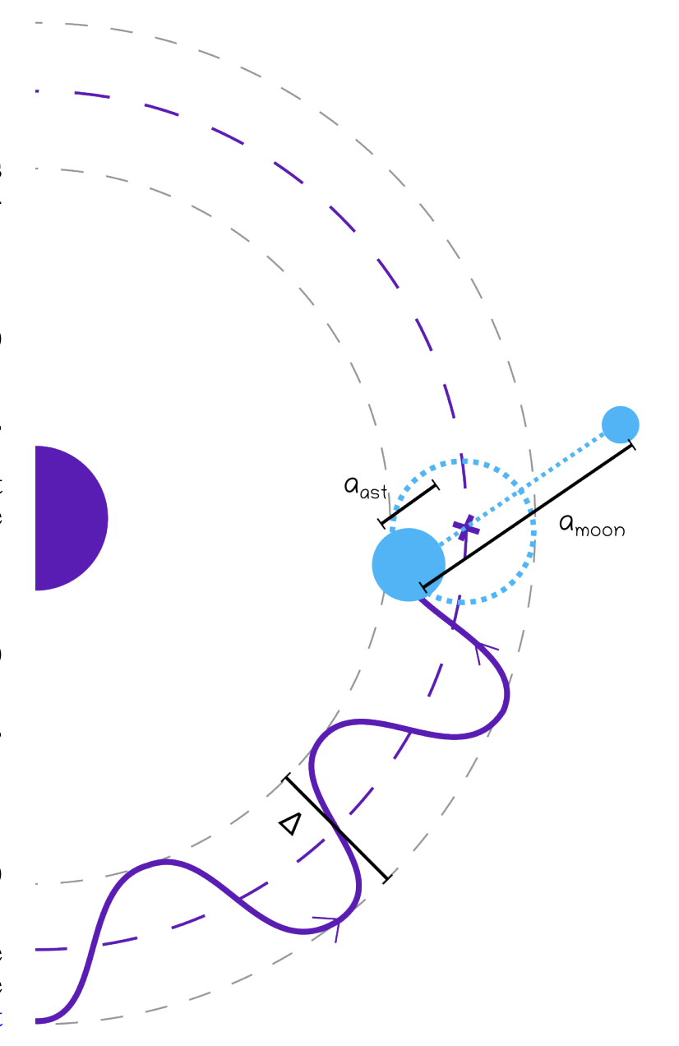
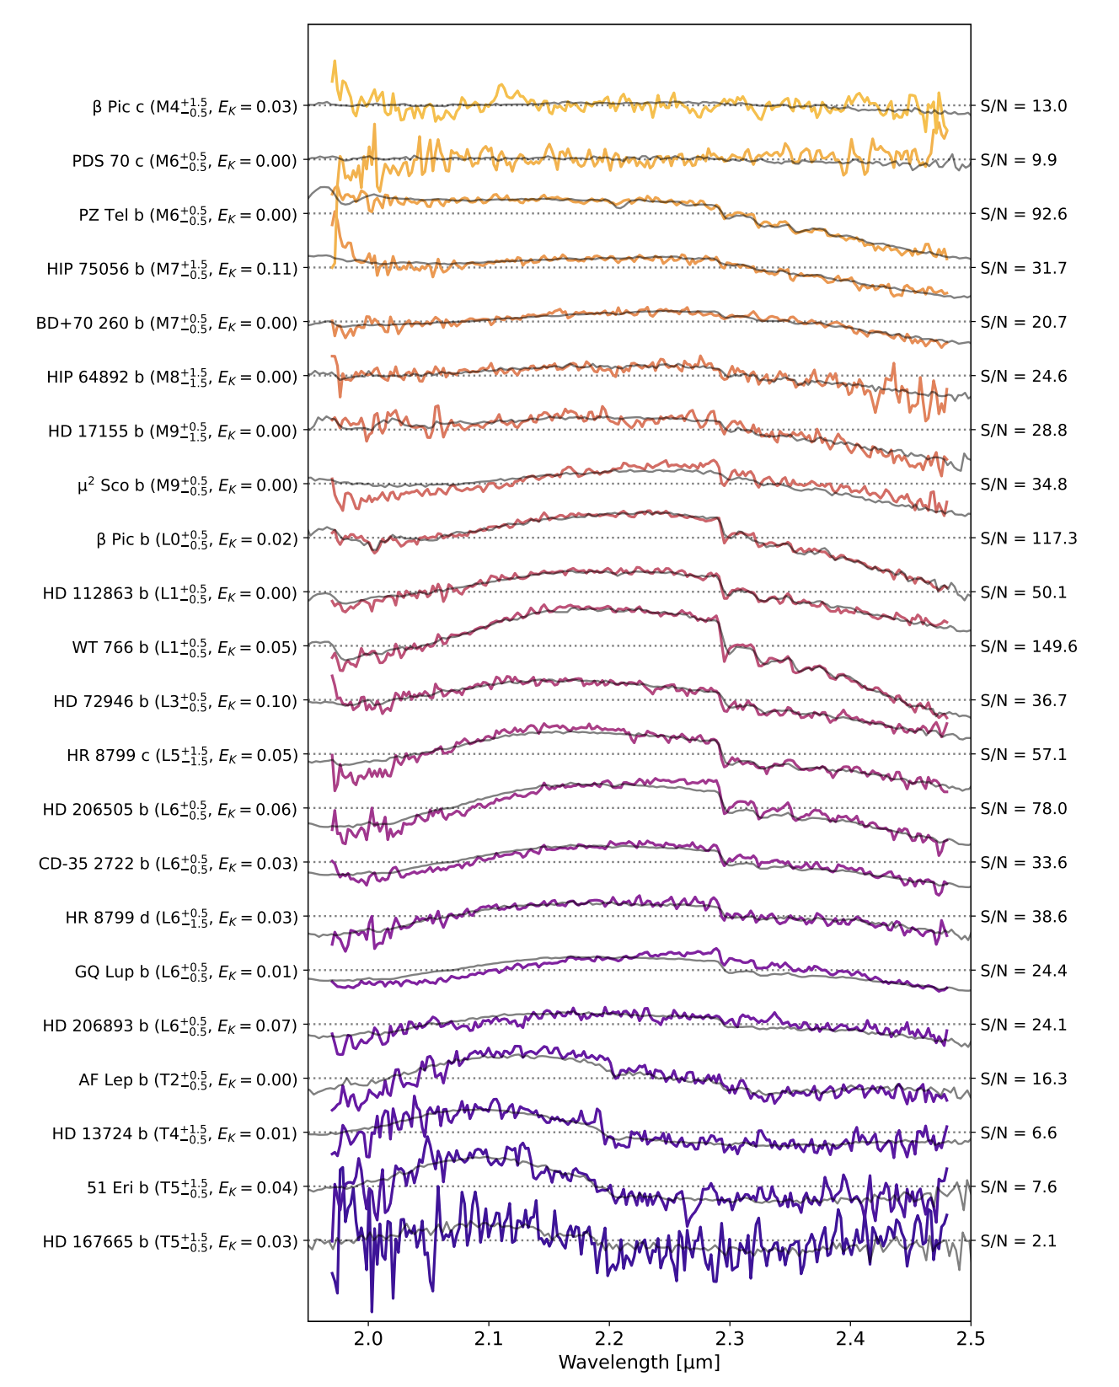
Exoplanets
Kammerer, J. et al. 2025

Slide 38
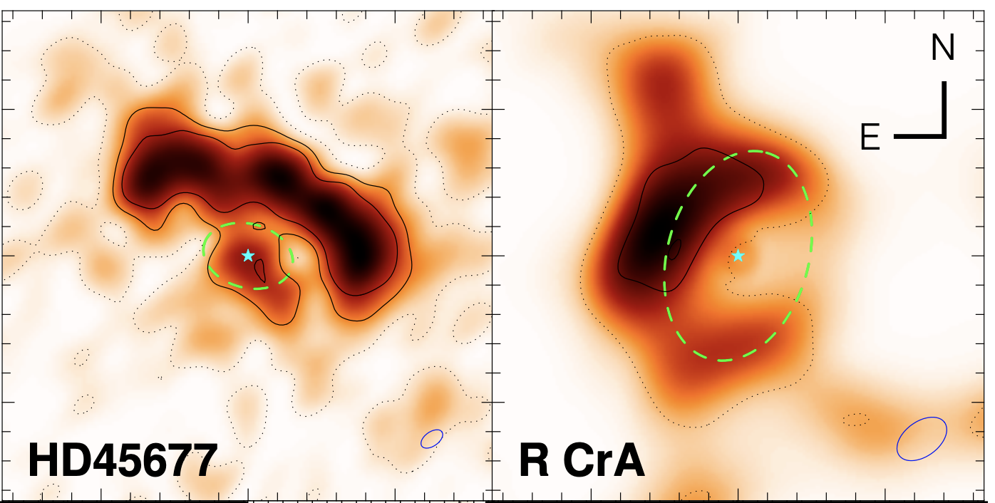
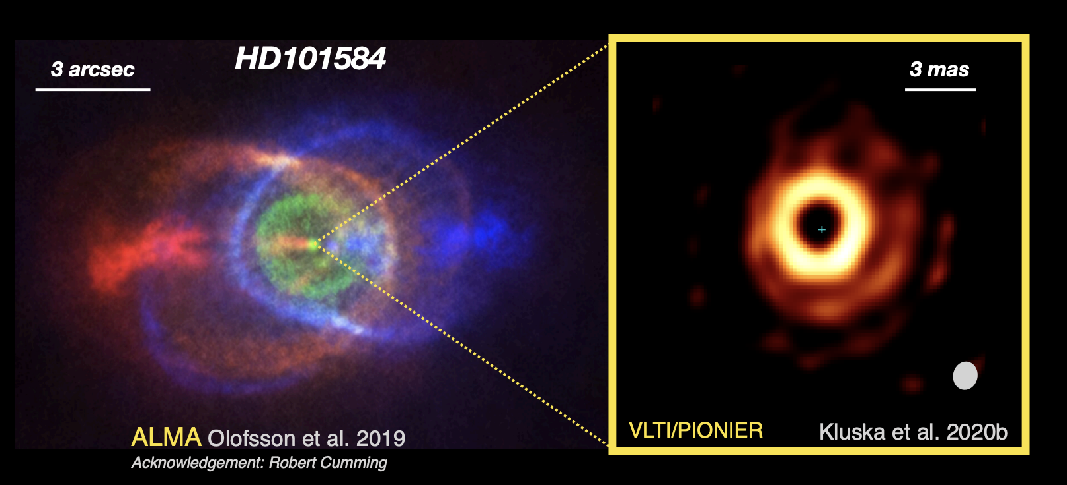
Planet Forming Disks

Slide 39
Thank you for Listening
Don’t be scared to use VLTI for your science!

