Slide 1
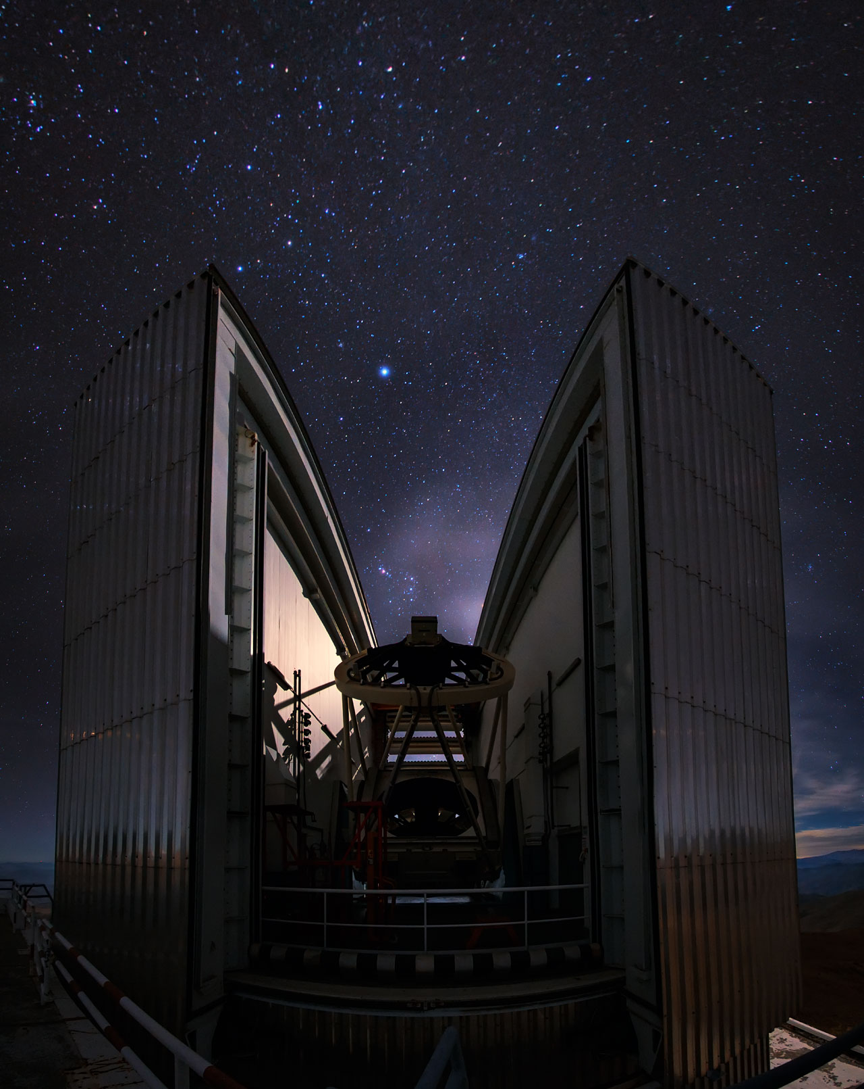
SOXS (Son Of Xshooter)
EFOSC2
ESO Faint Object Spectrograph &
Camera 2
The two sides of NTT (plus ULTRACAM and AstraLux)

Slide 2
EFOSC2
ESO Faint Object Spectrograph &
Camera 2

Slide 3
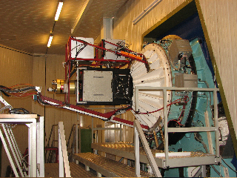
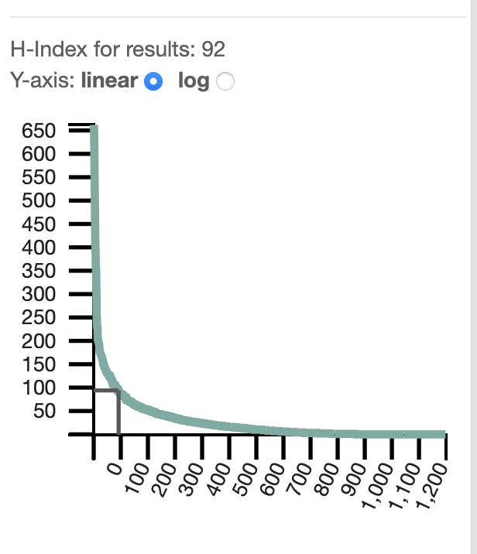
EFOSC2 brief timeline
Starts operations at NTT in 11/05 1989, moved to the 2.2m telescope in 1990;
Moved to the 3.6m in 1997, replacing EFOSC1
Moved in 2008 to NTT to replace the ESO Multi
Mode Instrument (EMMI)
Lost the MOS mode in 2023
1000+ papers so far, highest normalized citation
count: 232 (source: ADS service)
Buzzoni et al. 1984, ESO Messenger 38, 9 .

Slide 4
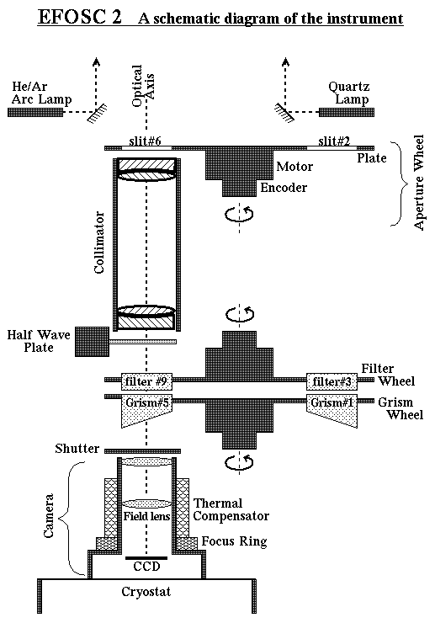
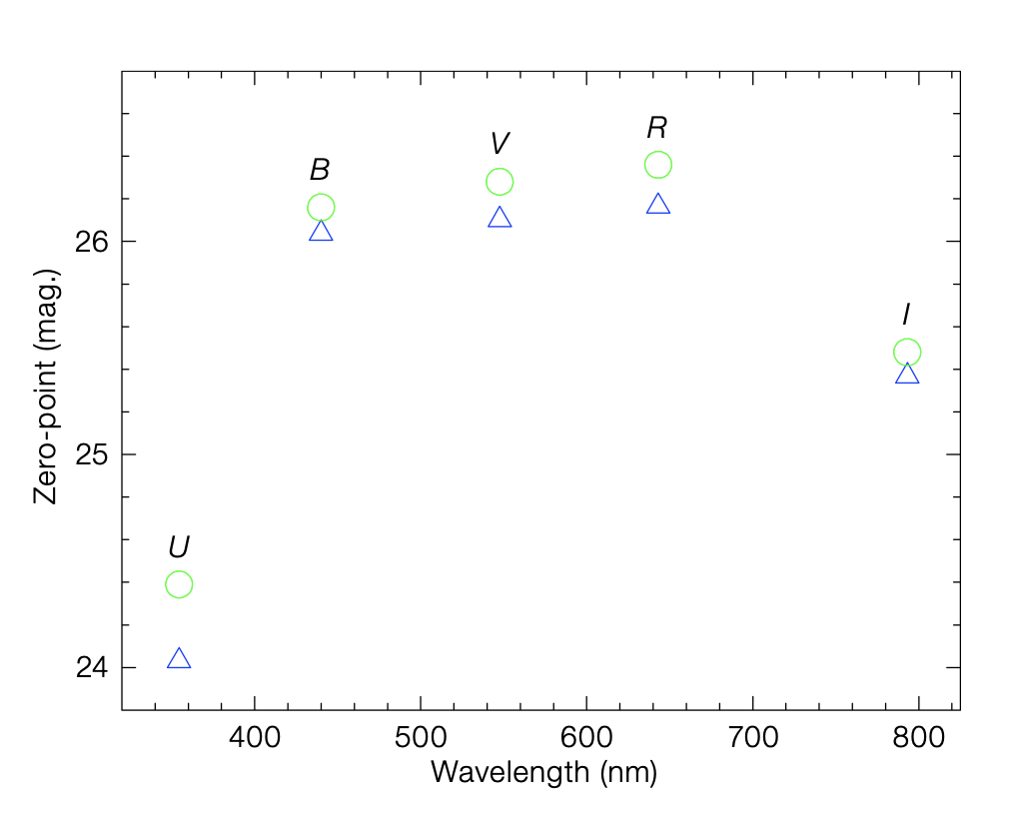
EFOSC2 in a nutshell
FOCAL REDUCER
Broad band spectroimager 350-1100 nm
<R> ~1000
Imaging with broad and narrow band filters (filters.ls.eso.org) (FOV:4.1’x 4.1’)
Imaging and spectroscopic polarimetric modes available
https://www.eso.org/sci/facilities/lasilla/instruments/efosc/inst.html
Notes:
f/11 NTT → canera → f/4.9 in the CCD; pixel size (unbinned)=0.12” Basically EFOSC2 is what is familiarly called a “workhorse” instrument, i.e. an instrument with multiple capabilities and able to support many science cases.

Slide 5
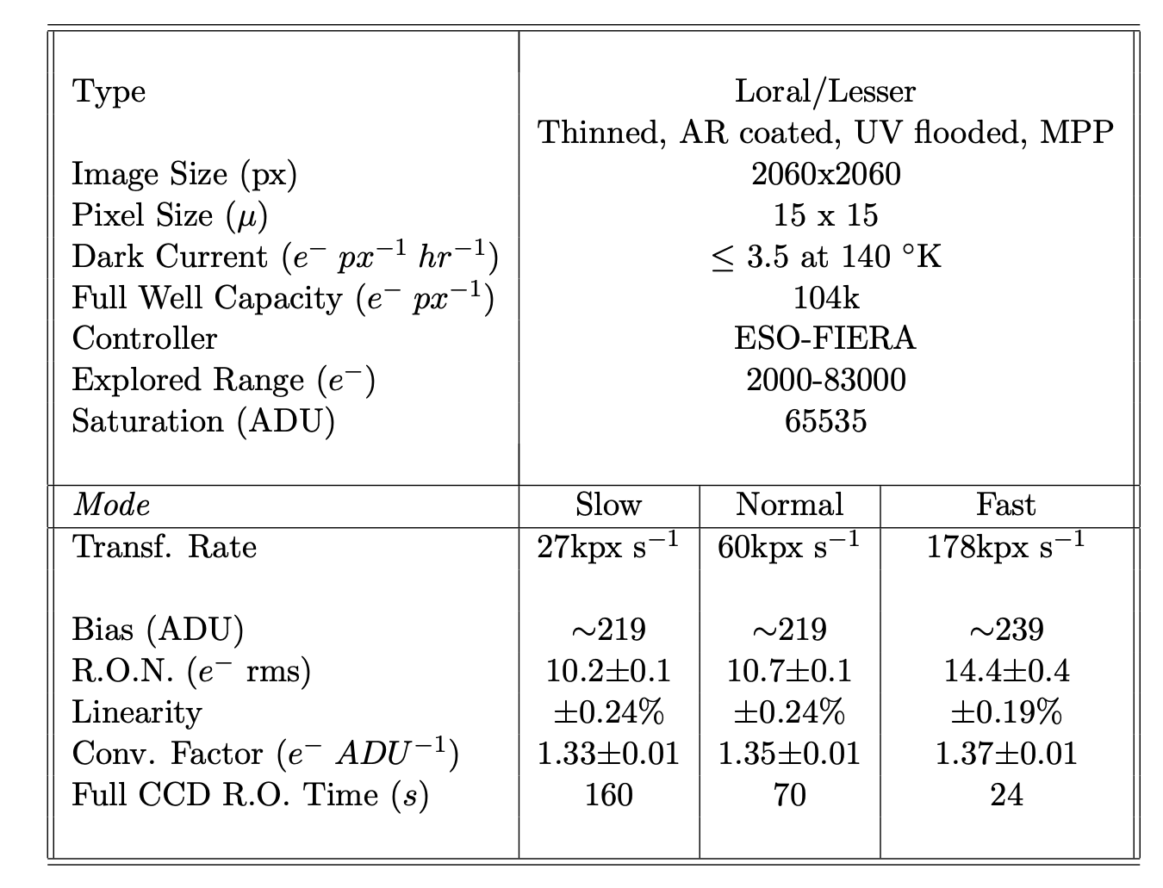
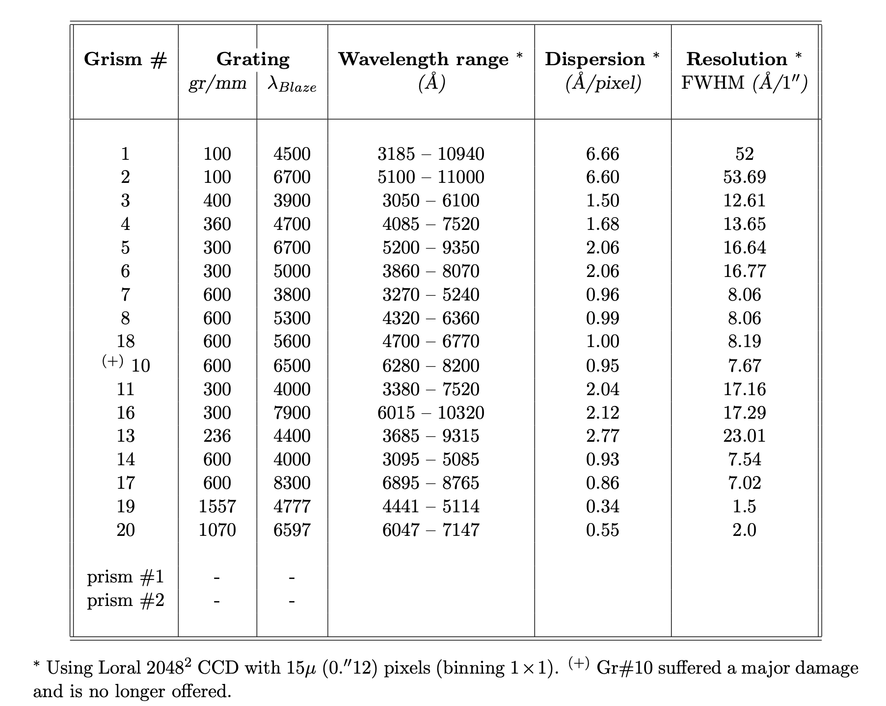
EFOSC2 in a nutshell
CCD detector, 2048 x 2048 pixels, UV flooded
Broad and narrow band imaging filters
0.5” to 5” slits for spectroscopy;
many grisms
Notes:
UV flooding is a technique used to significantly increase the quantum efficiency (QE) of back-thinned, backside-illuminated CCD sensors, particularly for detecting Ultraviolet (UV) and blue light. It involves exposing the CCD's backside surface to intense UV light, often in the presence of oxygen, to charge the surface negatively. It boosts UV and blue sensitivity by creating an accumulation layer of positive charge in the native oxide layer on the back surface, which directs photoelectrons toward the charge-collecting pixel wells
.Mechanism: UV photons generate electrons that become trapped in the oxide, creating a negative potential that mitigates surface trapping effects, thus improving QE.

Slide 6
Observing with EFOSC2 (and with any other instrument…)
READ the User Manual: https://www.eso.org/sci/facilities/lasilla/instruments/efosc/doc.html
Choose the instrument set-up: https://www.ls.eso.org/sci/facilities/lasilla/sciops/bin/efosc1.cgi and submit it the day before your observations
Use the Exposure Time Calculator to estimate your exposure times: https://www.eso.org/observing/etc/
https://www.eso.org/sci/facilities/lasilla/instruments/efosc/inst.html
Notes:
f/11 NTT → canera → f/4.9 in the CCD; pixel size (unbinned)=0.12” Basically EFOSC2 is what is familiarly called a “workhorse” instrument, i.e. an instrument with multiple capabilities and able to support many science cases.

Slide 7
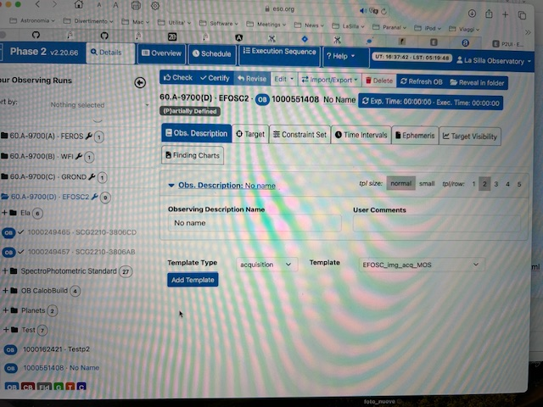
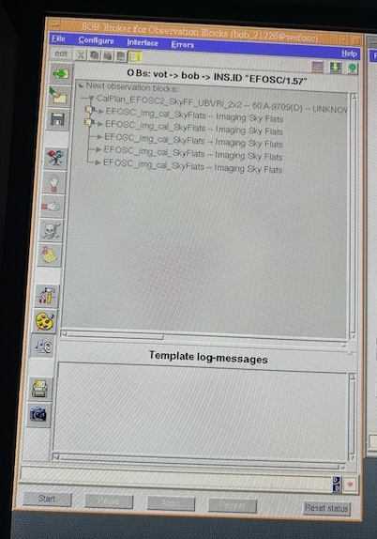
EFOSC2: how to observe, a.k.a. phase 2
Preparation of the observations using a dedicated web interface (p2ls): Observing Blocks (OBs) creation.
https://www.eso.org/p2ls
The Broker of Observing Blocks (BOB) fetches the OBs from p2ls and, by running them, sends instructions of presetting the telescope to the desired position and to set-up the instrument with the requested elements (NTT AO; overheads)
Once everything is set, the integrations are
running
https://www.eso.org/sci/facilities/lasilla/instruments/efosc/inst.html
Notes:
Visitor mode only; raw data to the archive; pipeline at the Observatory meant for quick look only but it can be used to reduce science data when using the correct calibration frames

Slide 8
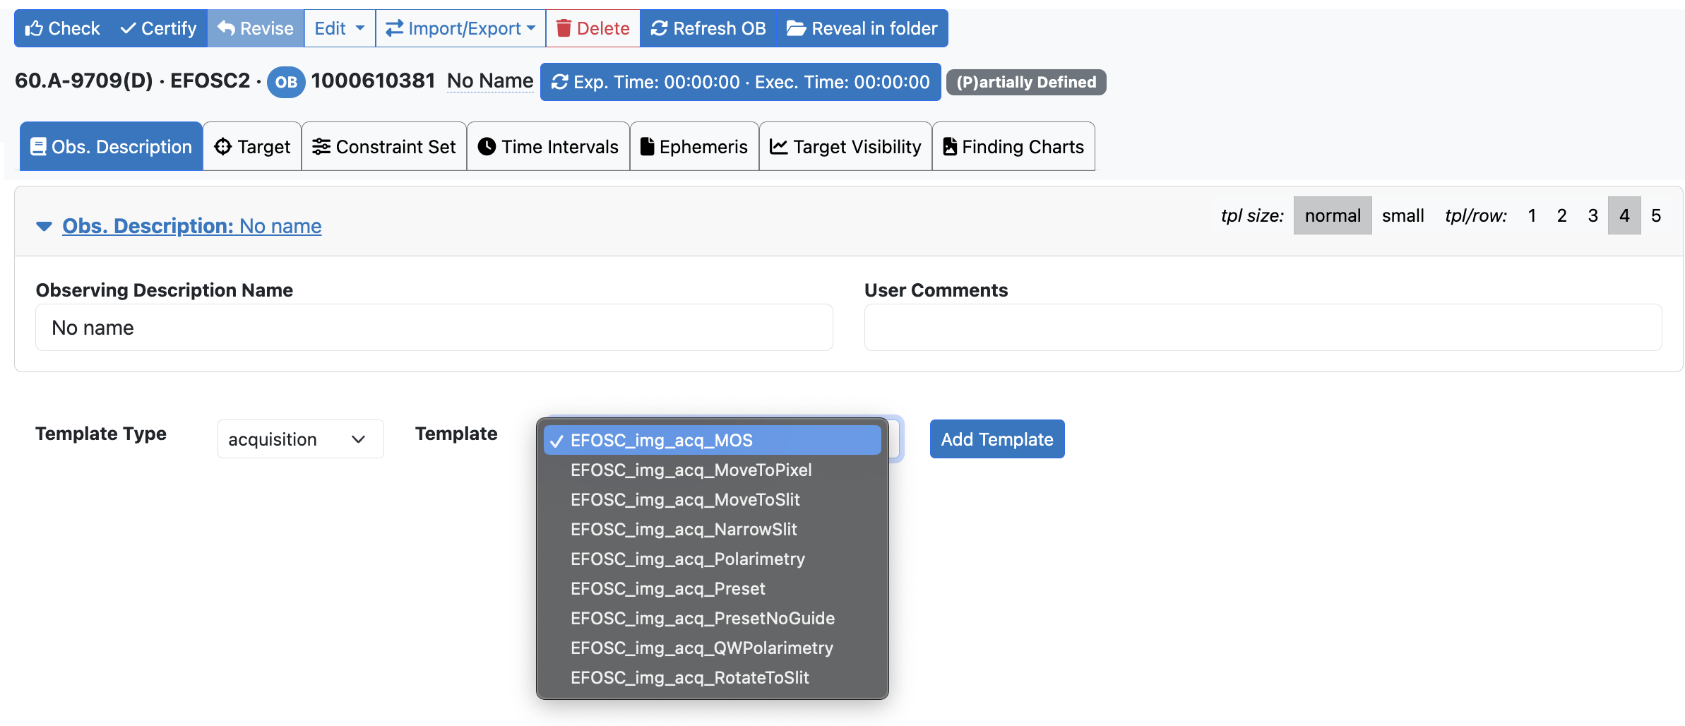
EFOSC acquisitions

Slide 9
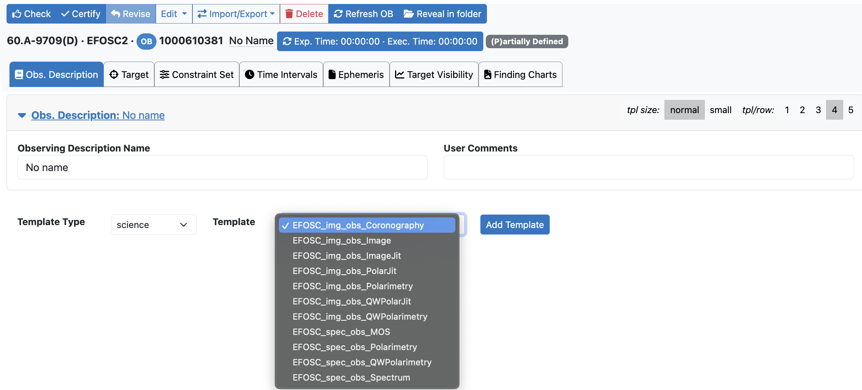
EFOSC science

Slide 10
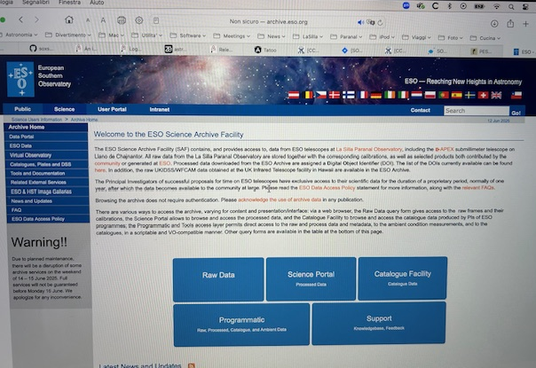
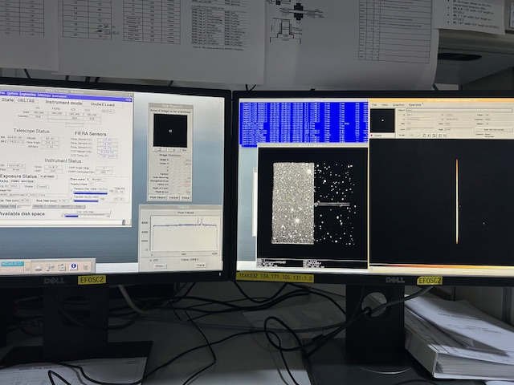

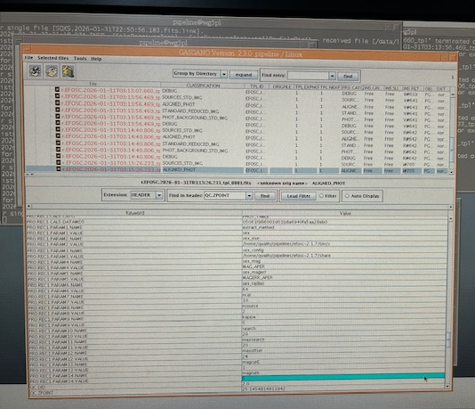
EFOSC2 observations: the data (flow)
Raw data to:
archive.eso.org
INStrument workstation
Raw data
Data
Handling
System
Raw data to:
Pipeline machine
https://www.eso.org/sci/facilities/lasilla/instruments/efosc/inst.html
Notes:
Visitor mode only; raw data to the archive; pipeline at the Observatory meant for quick look only but it can be used to reduce science data when using the correct calibration frames. When the reduced data are science ready (NIRPS/HARPS), they are also sent to the archive.

Slide 11
Emanuela Pompei
epompei@eso.org
Gaspare Lo Curto
glocurto@eso.org
@ESOAstronomy
@esoastronomy
@ESO
european-southern-observatory
@ESOobservatory

