Slide 1
Astronomical Data Reduction Basic concepts & ESO pipelines
Elyar Sedaghati
La Silla Observing School 2026
ESO Chile

Slide 2
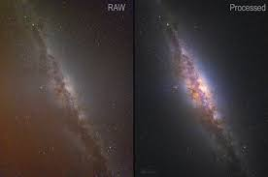
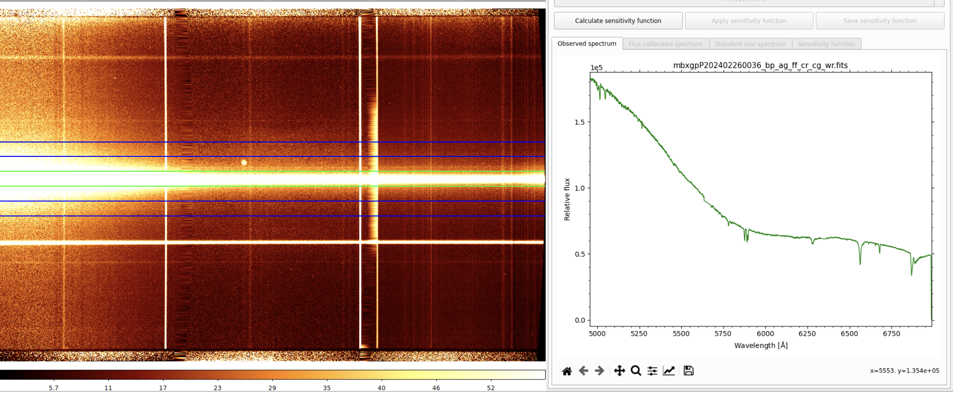
What is data reduction & why is it needed?
Astronomical data reduction is the process of converting raw data, obtained using an instrument mounted at a telescope (which includes a camera), into calibrated and science-ready frames by reducing or removing various sources of noise, atmospheric effects and/or instrumental (telescope or instrument) signatures imprinted upon observed data.

Slide 3
BIAS

Slide 4
BIAS subtraction
Detector electronics are set up to add a ~constant voltage to all pixels, thereby avoiding negative counts due to poisson nature of photon counting.
This signal is known as the BIAS, which changes its base value and shape across the detector slightly, and needs to be removed.
In-situ bias values is determined used some rows of the detector reserved for this, known as the pre- or over-scan regions.
The overall shape of this signal is measured using BIAS frames, which are 0s exposures with the shutter closed.

Slide 5
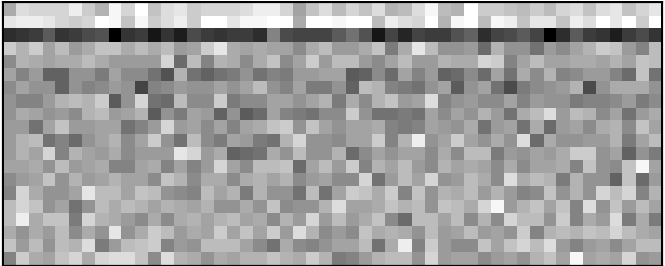
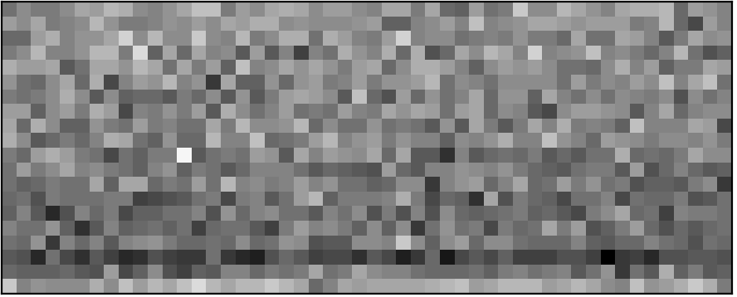
Pre- or over-scan subtraction
Spectroscopy enables astrophysics!!
1 – 4
We remove the overscan by
fitting a constant value to it
1021 – 1024

Slide 6

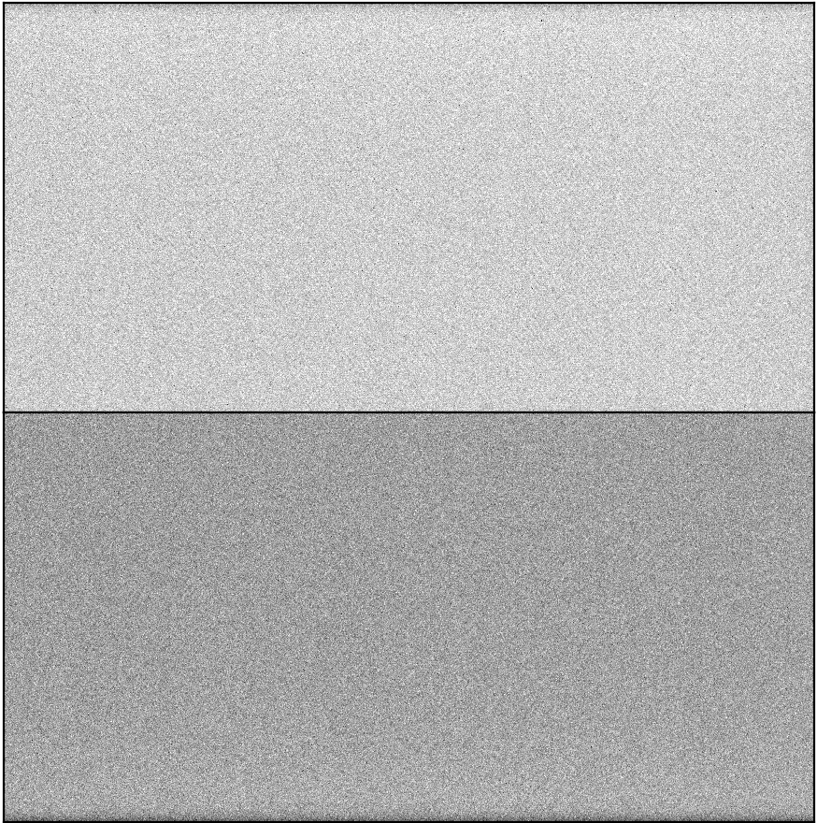
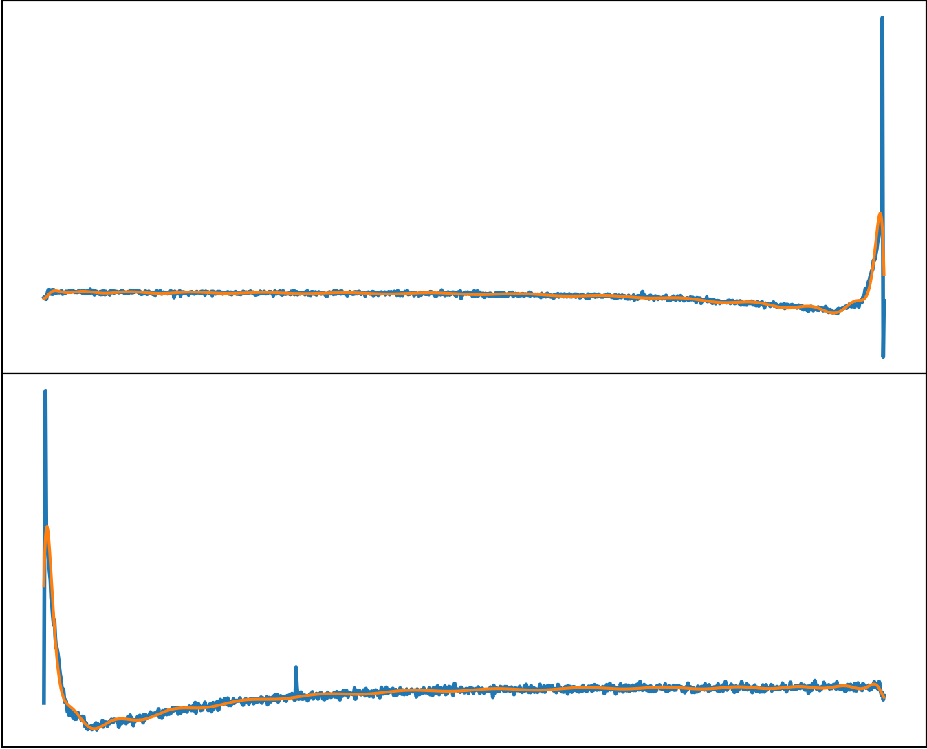
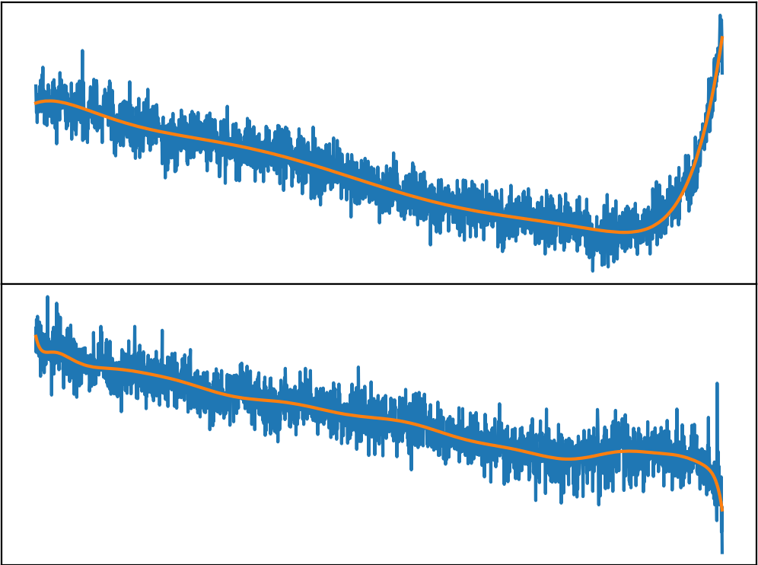
BIAS subtraction
Combined Bias
cr_reject
Individual Bias Frames
Master Bias
Line-by-line fit along both axes

Slide 7
DARK

Slide 8
DARK subtraction
Atoms in the silicon lattice vibrate and jostle each other due to their thermal energy, which excite electrons into the conduction band, even in the absence of light. The result is a pool of electrons which appears in every pixel. This signal is dark current.
Some pixels collect many more of these thermal electrons due to local imperfections in the crystal lattice: we call them hot pixels.
The level of the dark current depends on the temperature of the silicon. The colder the chip, the smaller the thermal motions, and the fewer the electrons knocked free by collisions.
Dark current is an additive source of signal, and its removal is referred to as dark subtraction.

Slide 9
FLATFIELD

Slide 10
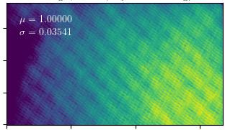
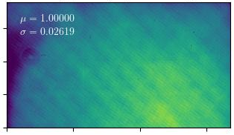
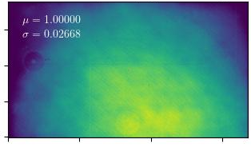
Flatfield correction
The purpose of flat corrections is to compensate for any nonuniformity in the response of the CCD to light. There can be several reasons that the response is not uniform across the detector:
Variations in the sensitivity of pixels in the detector
Dust on either the filter or the glass window covering the detector
Vignetting, a dimming in the corners of the image
Anything else in the optical path that affects how much light reaches the sensor
u-band
b-band
R-band

Slide 11
Flatfield correction
A flatfield frame is obtained by pointing the instrument to a brightly and uniformly lit, homogeneous surface, using white light. This is achieved through:
Screen or dome illumination
Twilight flat, by pointing to an empty field just after sunset or before sunrise
Astronomical skyflat by pointing to the sky at night, dithering and taking the median.
Flatfield is a multiplicative process, and there the master flat is divided through.
The master flat (combination of individual flats) should be normalized to unity.
u-band
b-band
R-band

Slide 12
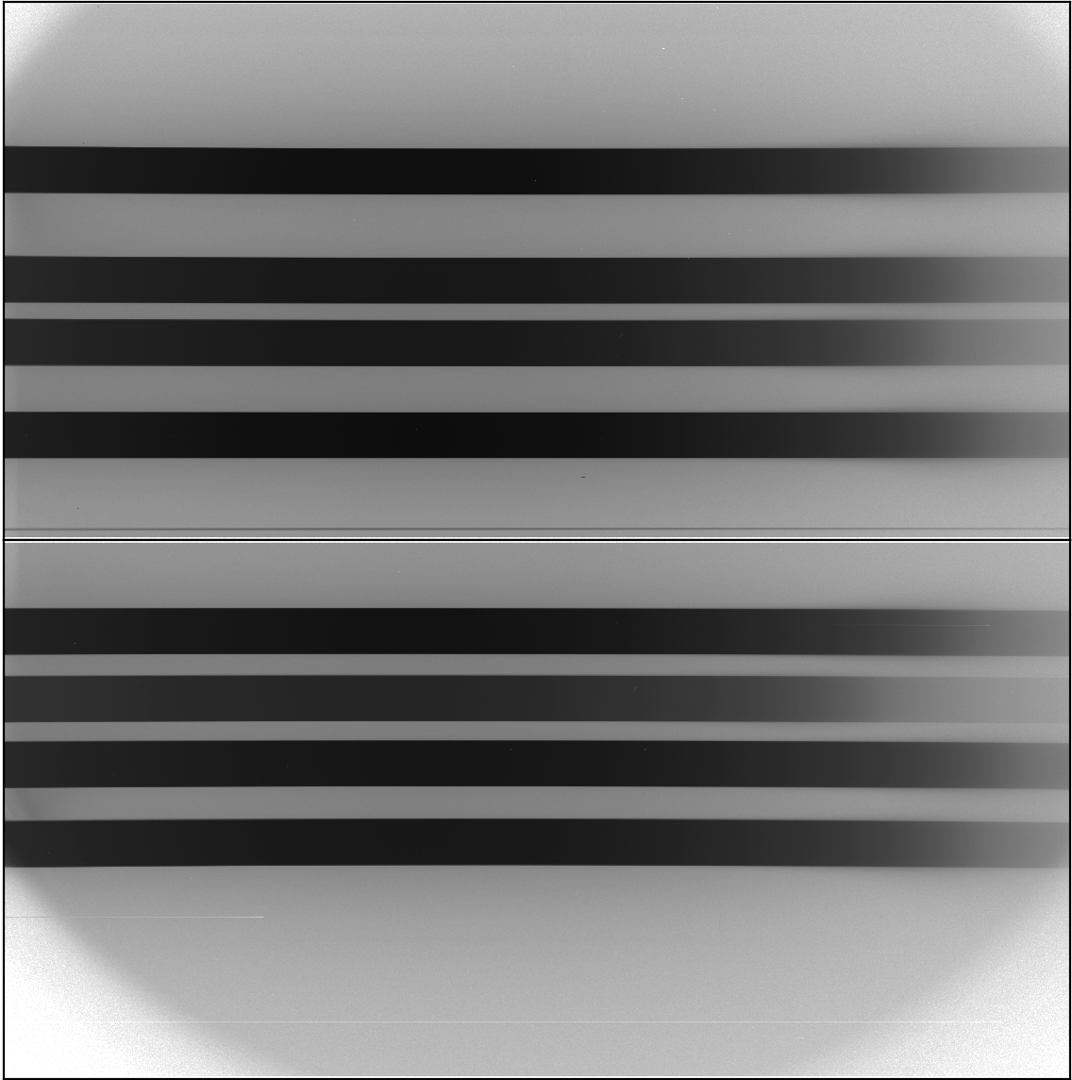
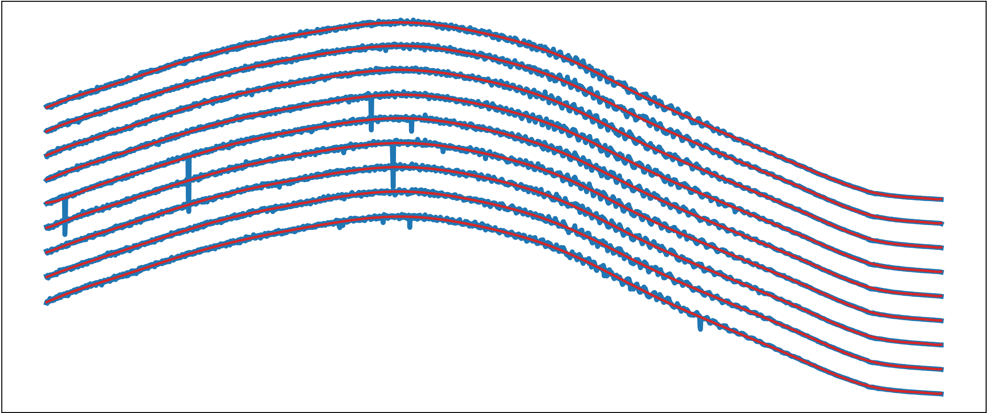
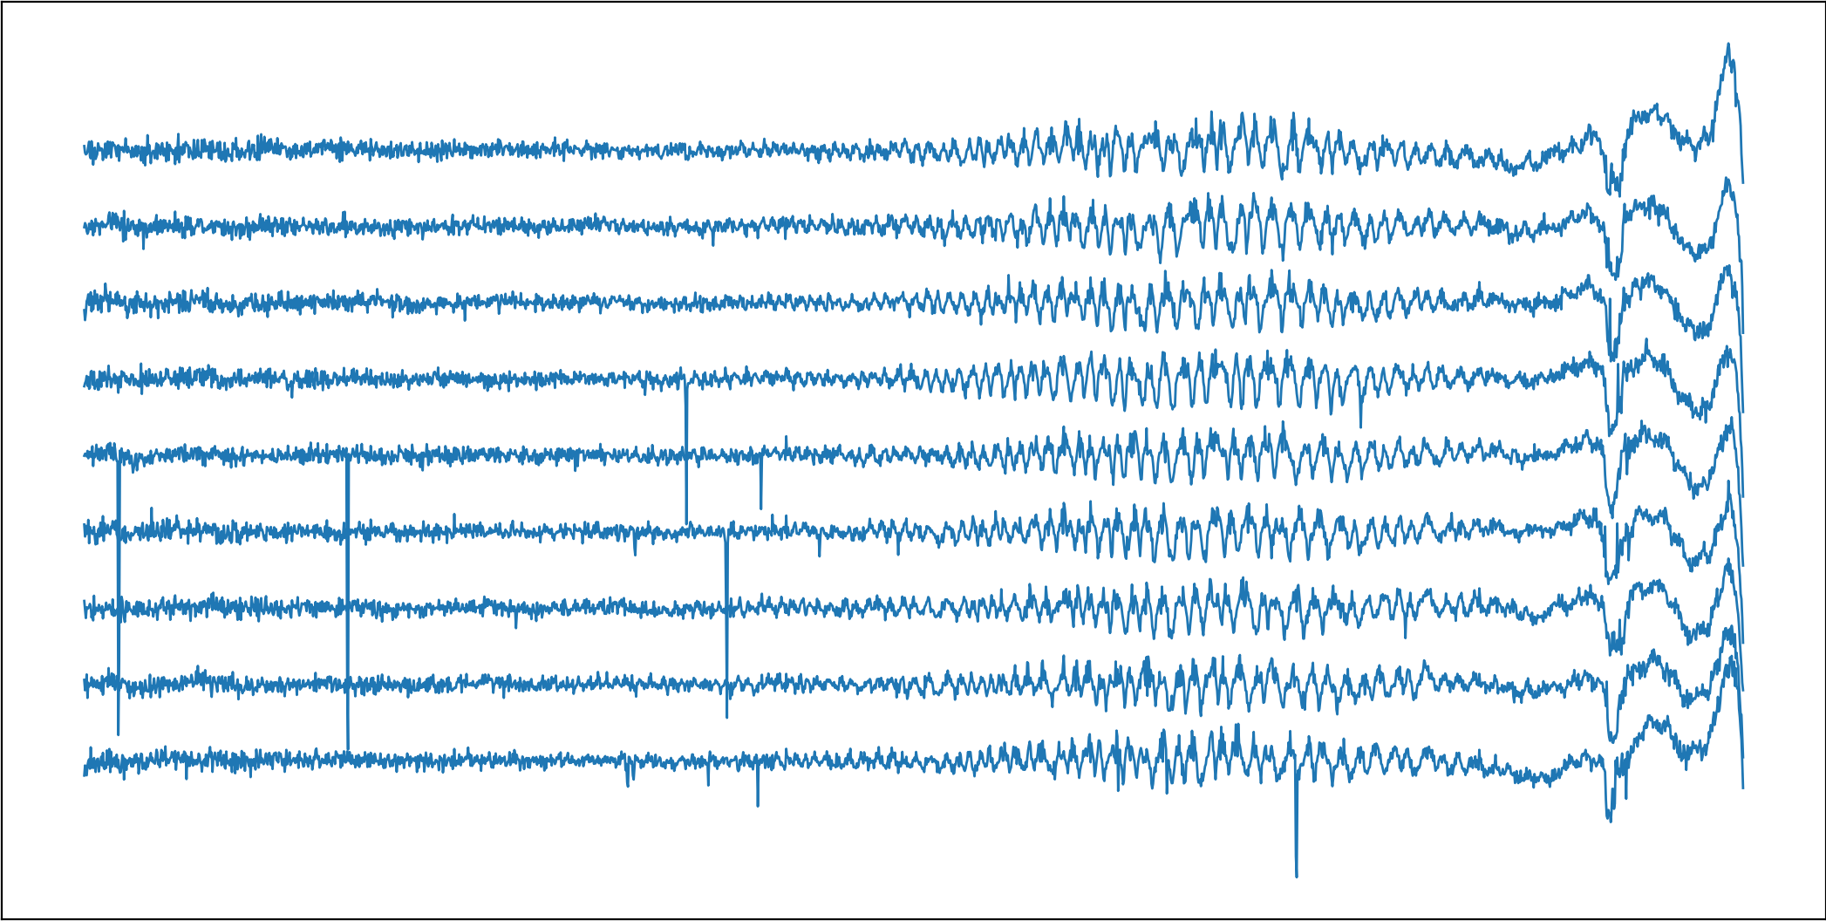
Spectroscopic flatfielding
Slice
Combine
Line-by-line normalization
Master Flat-field

Slide 13
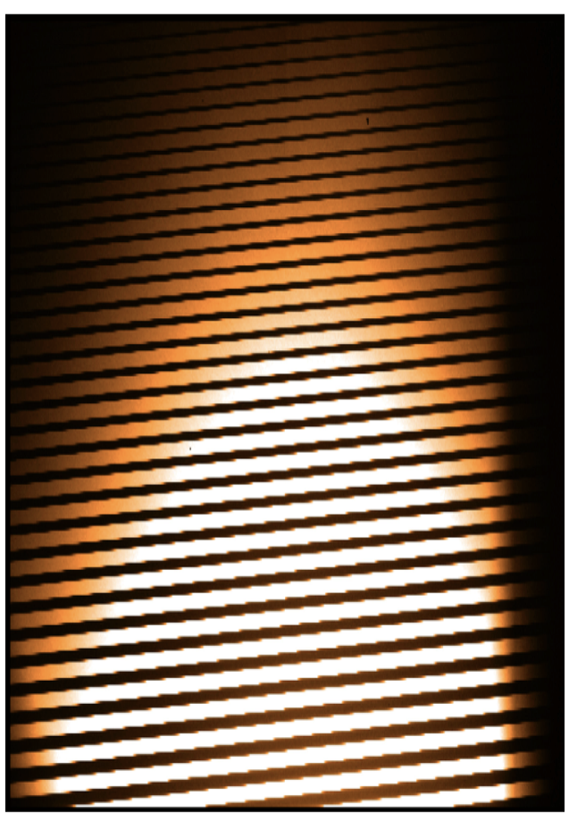
Flatfield for echelle
u-band
b-band
R-band

Slide 14
Wavelength calibration (spectroscopy)

Slide 15
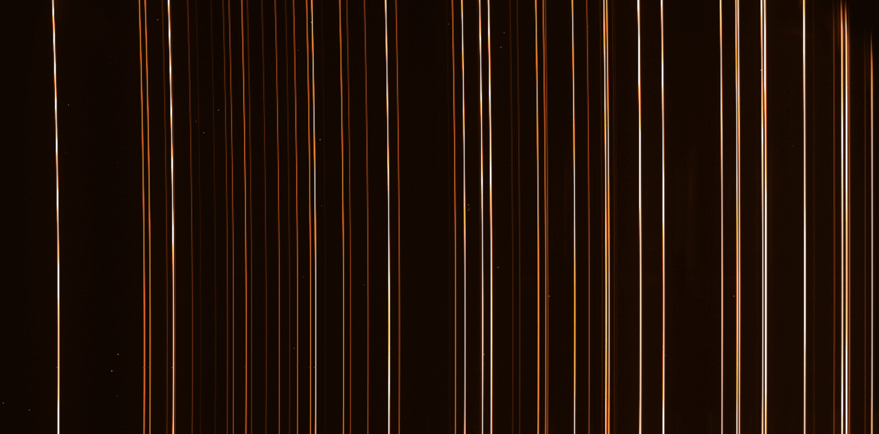
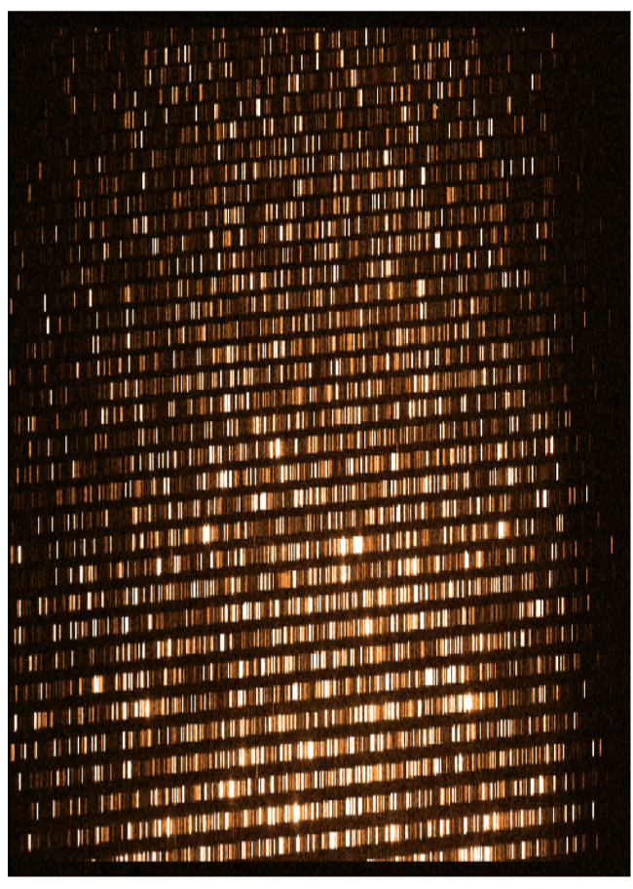
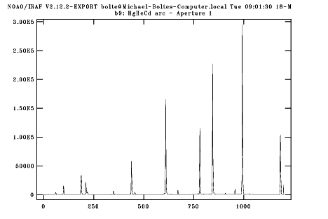
Arc line lamps
Common types: He, Ne, Ar, Hg (+Cd) and ThAr for high resolution.
Echelle
LongSlit

Slide 16
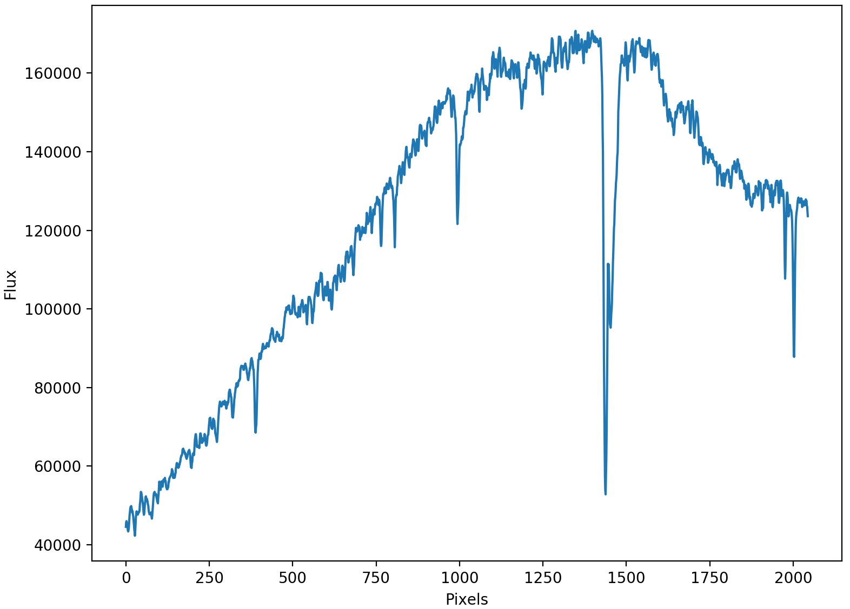
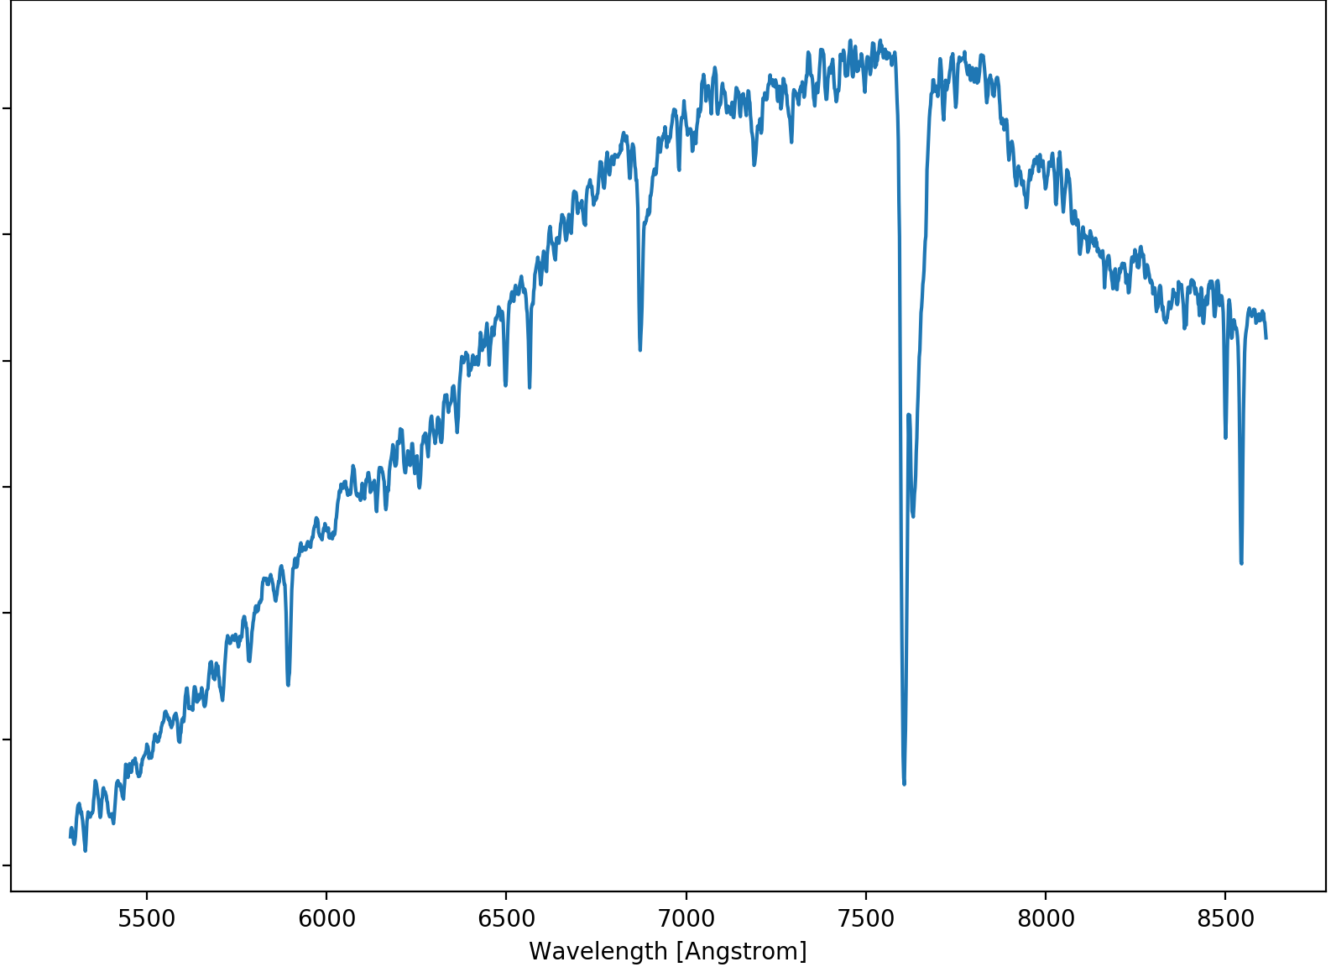

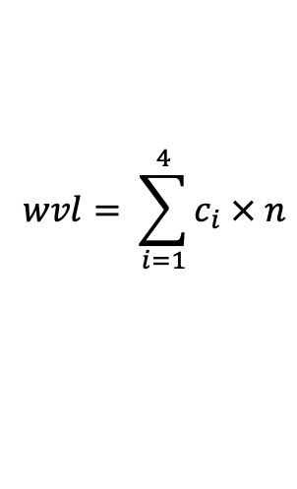
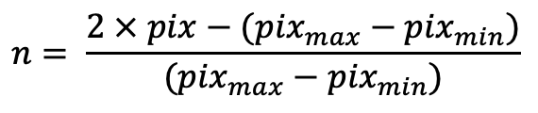
The dispersion solution
Chebyshev Polynomials
$$wvl= \sum_{i=1}^{4}{c_{i} × n}$$
$$n= \frac{2 × pix−({pix}_{max}−{pix}_{min})}{({pix}_{max}−{pix}_{min})}$$
with
$$c_{i}=2n × c_{i−1}− c_{i−2}$$
Normalized pixel values
Chebyshev coefficients

Slide 17
Extraction & sky subtraction (spectroscopy)

Slide 18

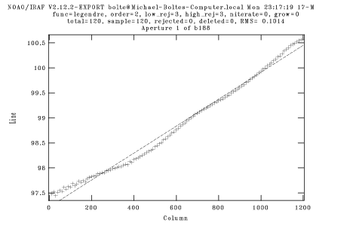
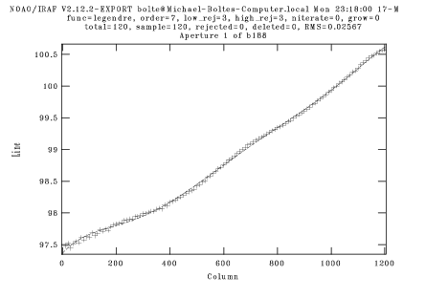
Spectrum extraction: from 2D to 1D
Tracing the spectrum
Extraction:
Simply add up the flux within a defined box after subtracting the sky.
An optimal S/N-based approach, approximating the object intensity profile (PSF)
Order 2
Order 7
Sky Subtraction:
Fit a low-order poly to the sky bands
Get a sigma-clipped median in sky bands
Use a sliding-window, sigma-clipped median

Slide 19
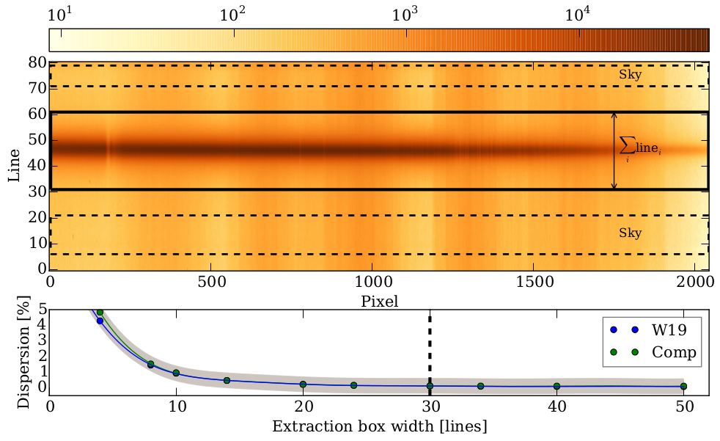
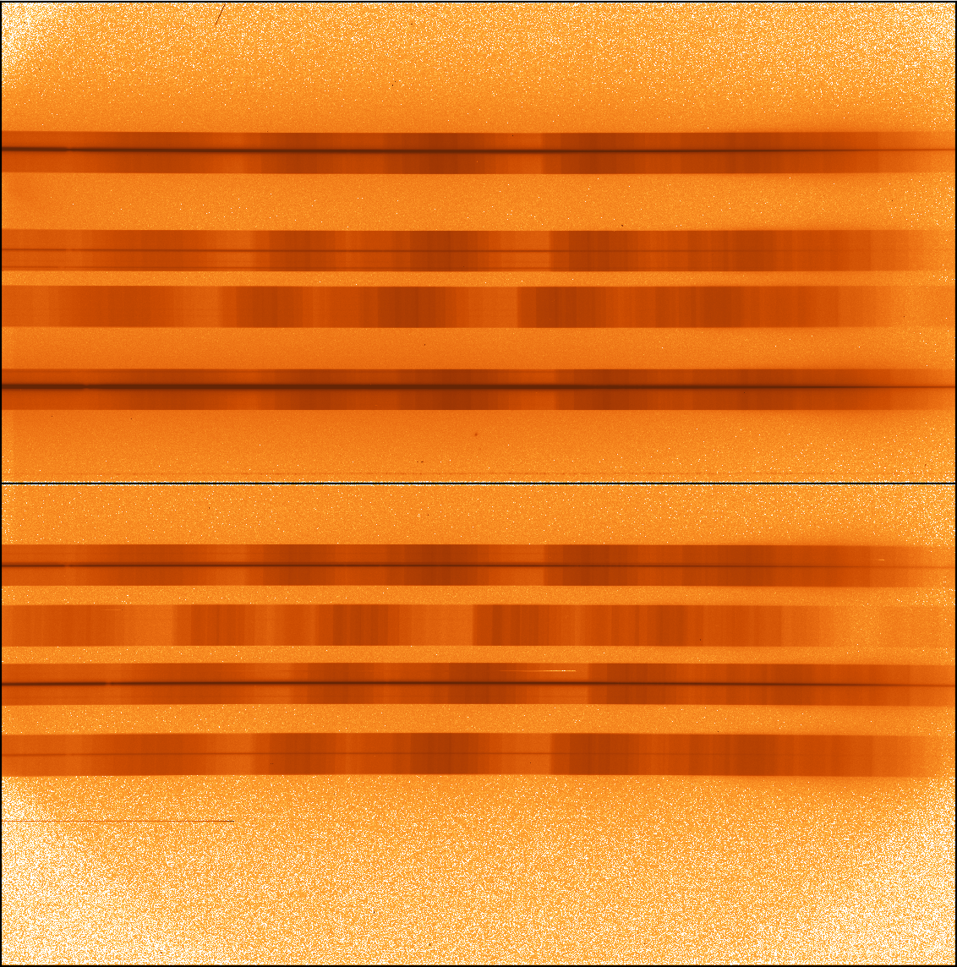
Spectral extraction
Overscan & Bias-shaped subtracted
Flat-fielded
Sliced same as flats
Stellar spectra
Control Sky spectra

Slide 20
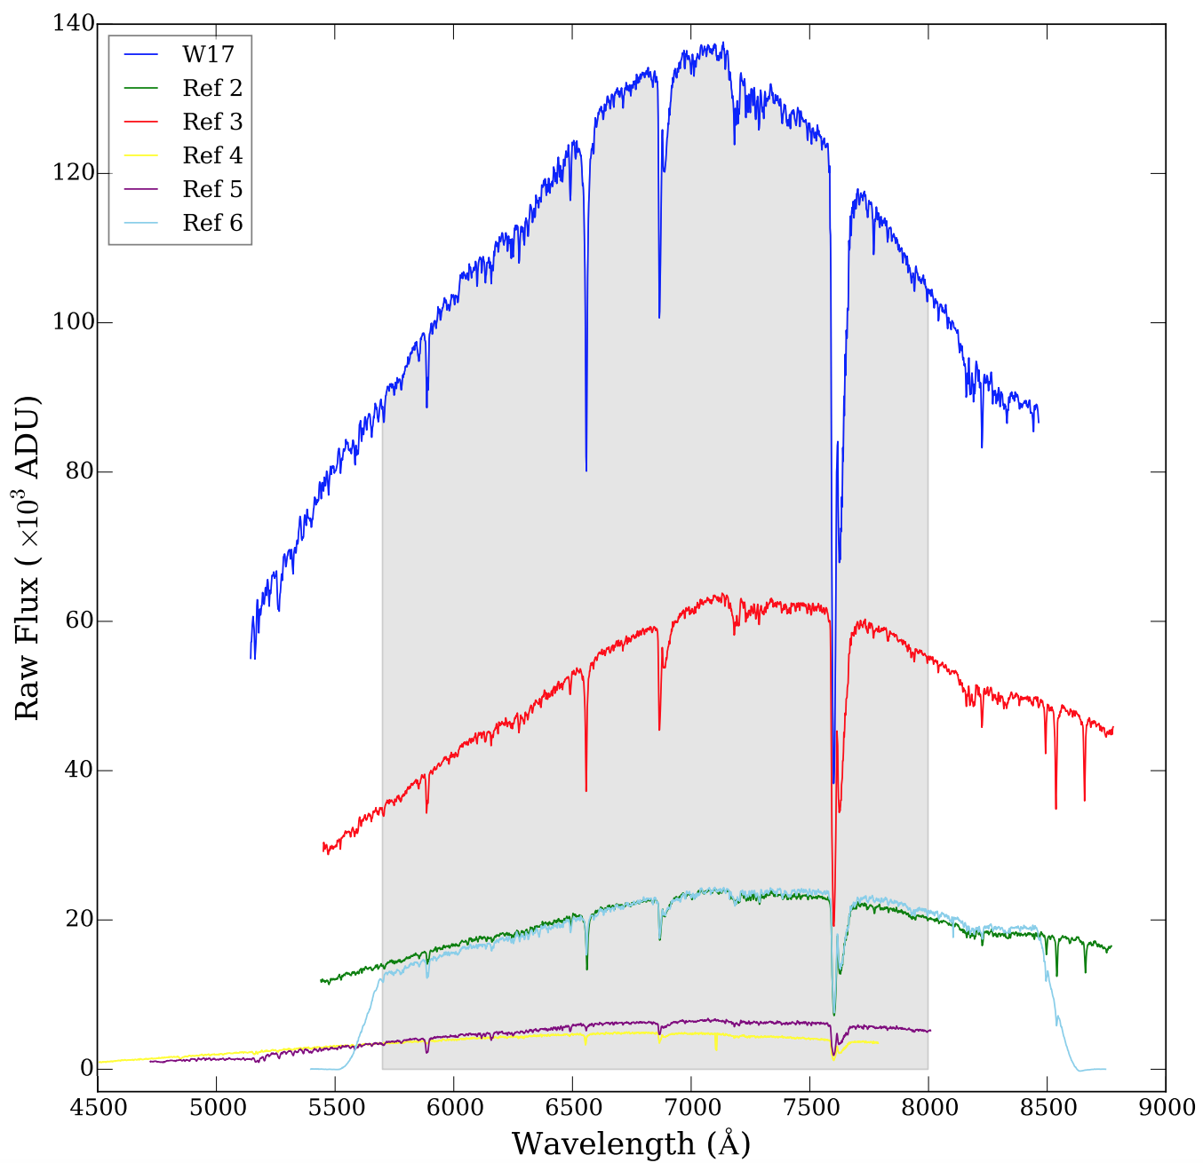
Extracted spectra

Slide 21
Flux calibration

Slide 22
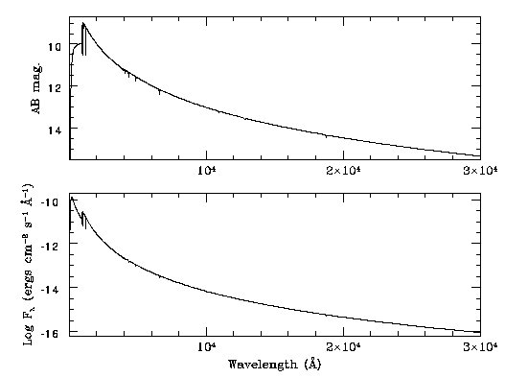
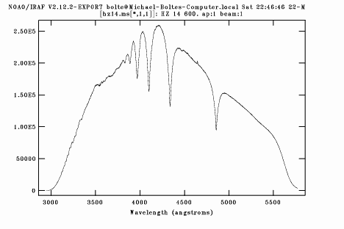
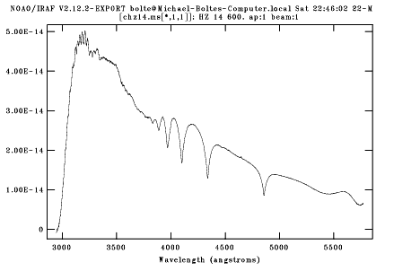
Photometric or Spectrophotometric standards
raw
Flux cal.

Slide 23
Putting it all to practice

Slide 24
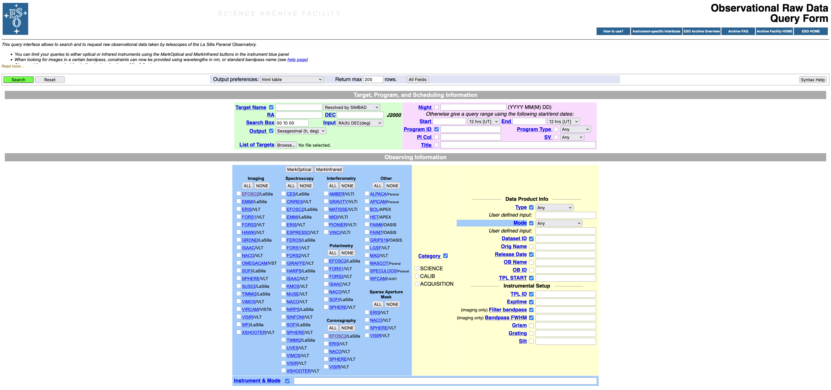
The ESO archive
https://archive.eso.org/eso/eso_archive_main.html

Slide 25
ESO recipes, workflows & pipelines
Installation from https://www.eso.org/sci/software/pipe_aem_main.html
There are different platforms on which you can run them:
esorex: command line interface, allows for running of individual recipes. Needs creation of .sof
edps: command line interface of the new platform. No need for .sof
esoreflex: GUI for running recipes together as a pipeline. Allows for manipulating parameters.
edps_gui: running pipeline on a browser-based GUI, no possibility of interactivity for now.

Slide 26
Elyar Sedaghati
esedagha@eso.org
@ESOAstronomy
@esoastronomy
@ESO
european-southern-observatory
@ESOobservatory

