Slide 1
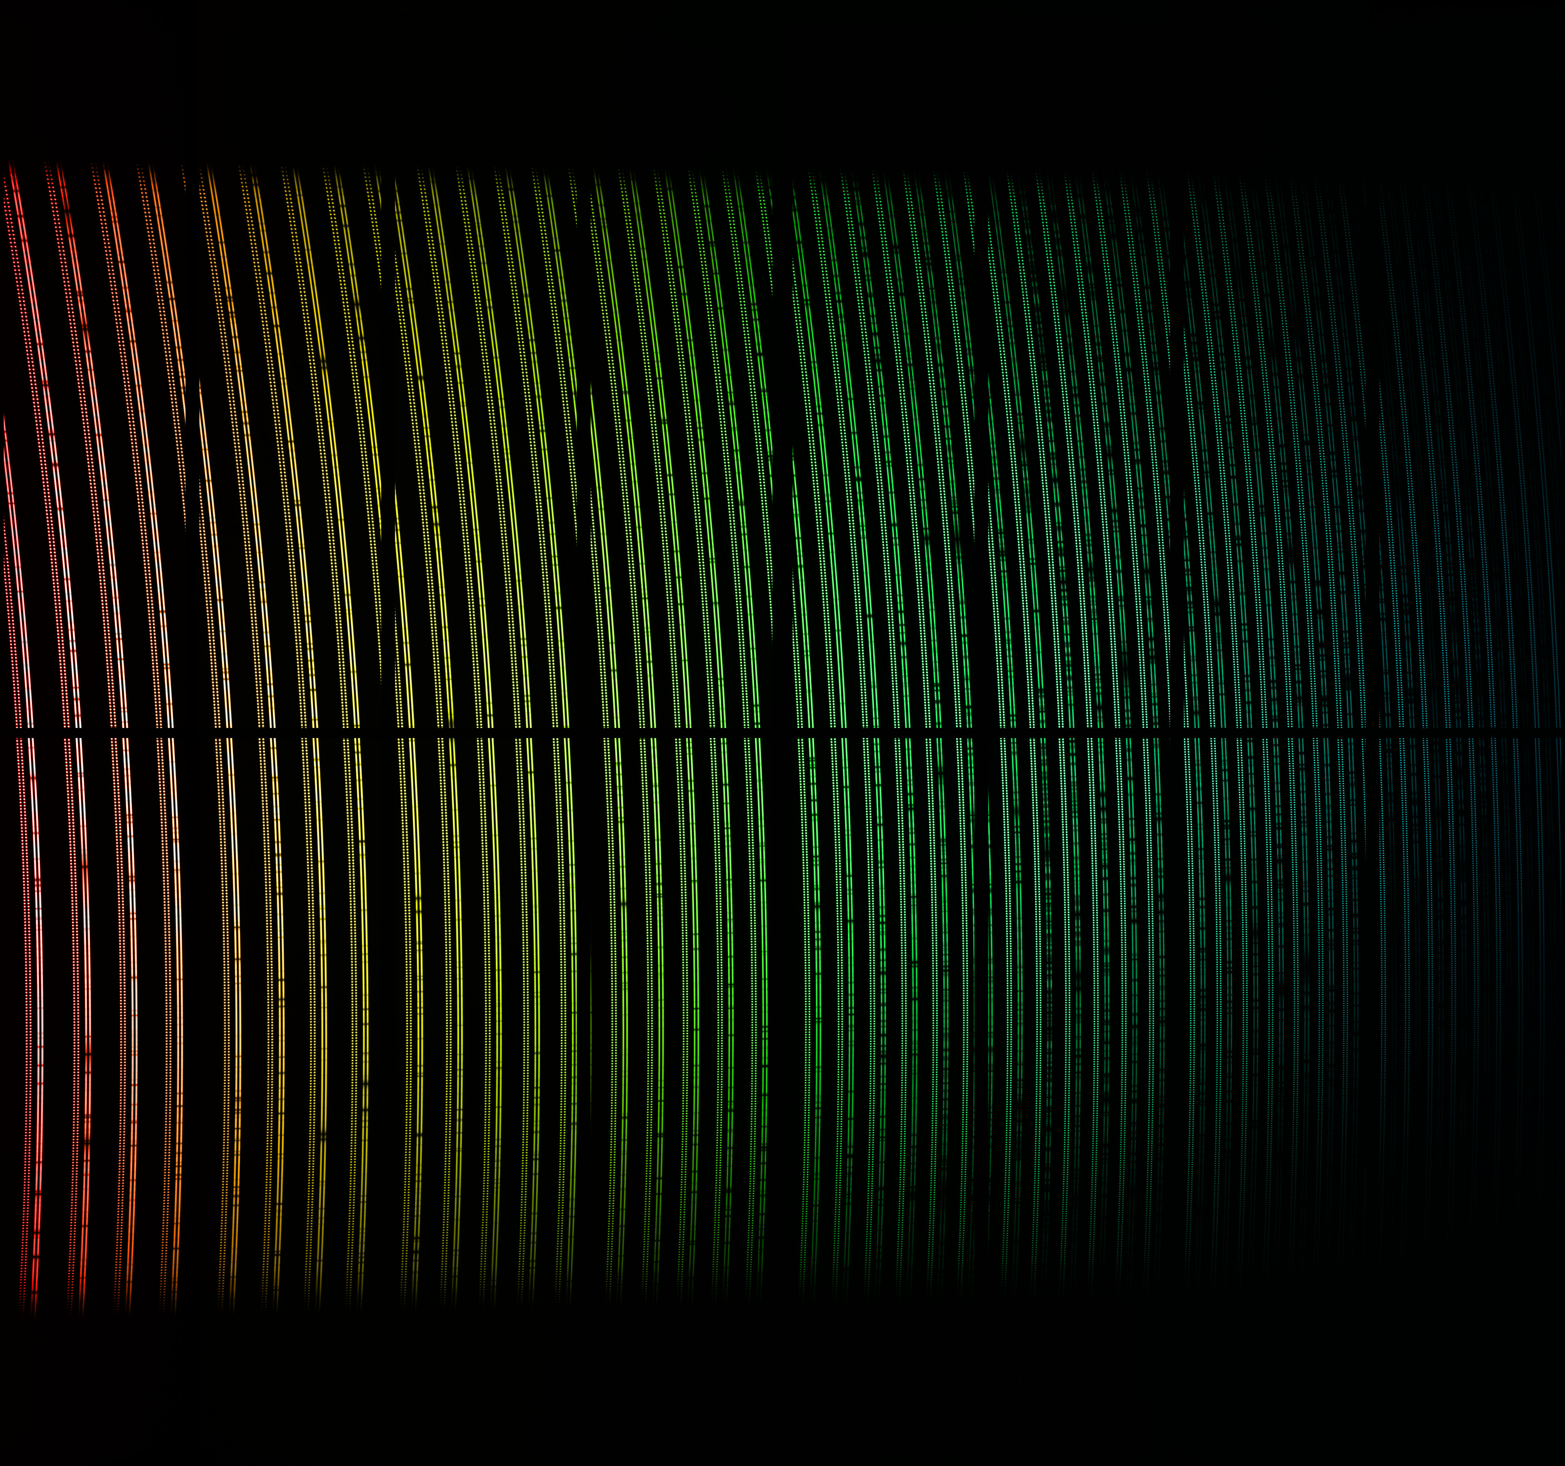
An Introduction to Spectroscopy & Spectrographs
Elyar Sedaghati
ESO Chile

Slide 2
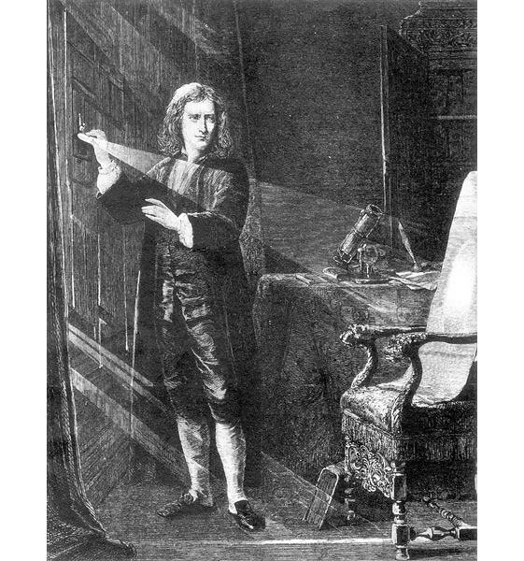
The purposes of spectroscopy
  To measure accurate wavelengths of emission and absorption lines
    Radial velocities, red shifts, etc…
  To measure relative strengths and/or EW of those lines
    Abundances, temperatures, etc…
  To measure shapes of those lines
    Density, pressure, rotation, B-fields
  To measure SED of the continuum radiation
    Physical mechanisms, temperature
Spectroscopy enables astrophysics!!

Slide 3
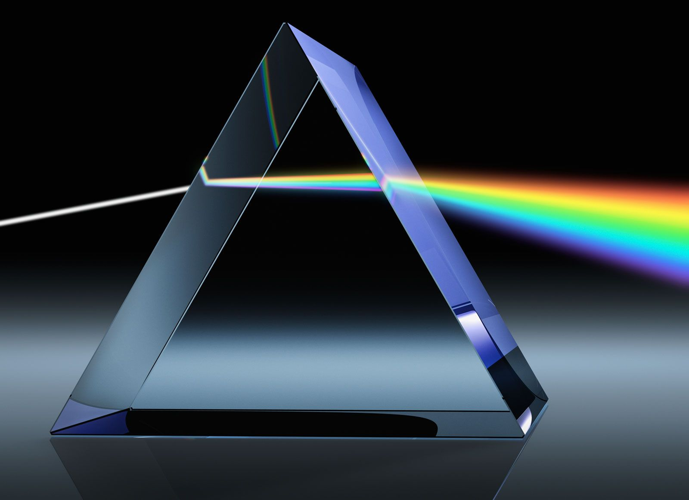
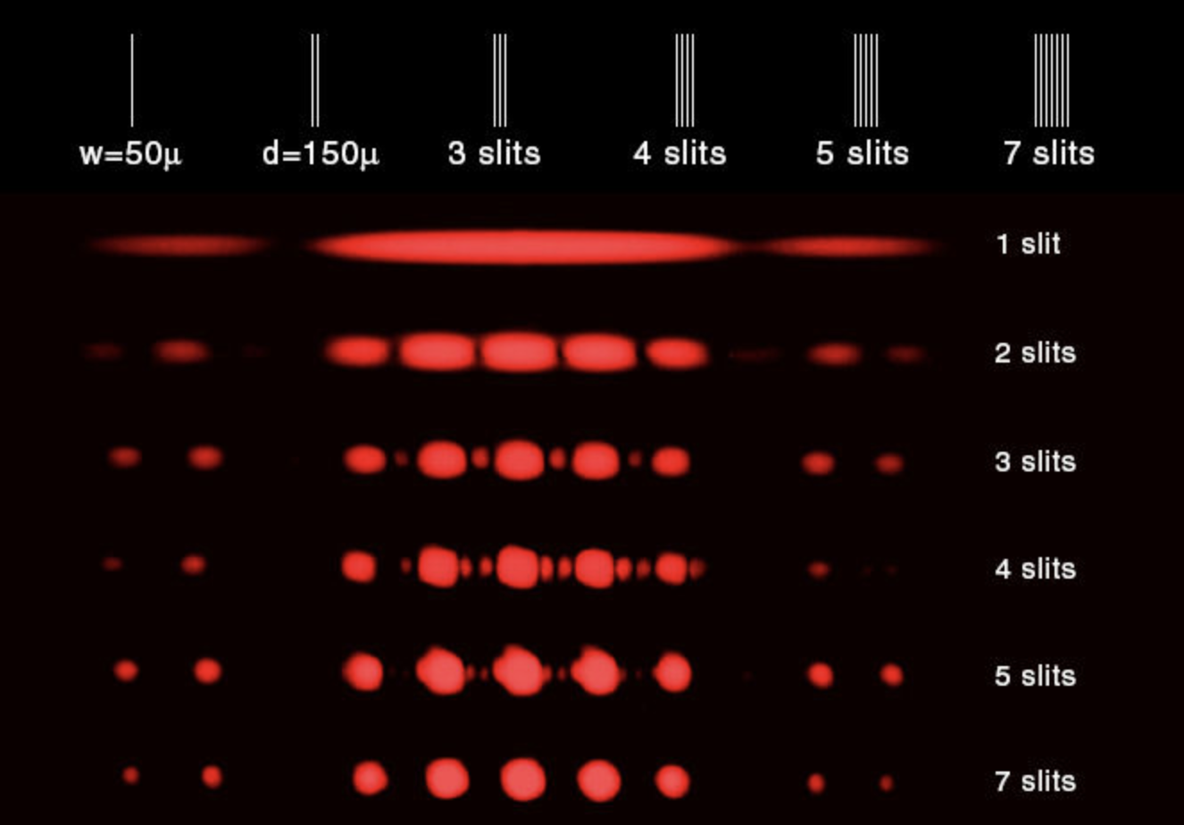
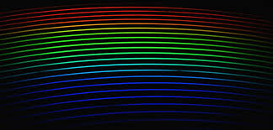
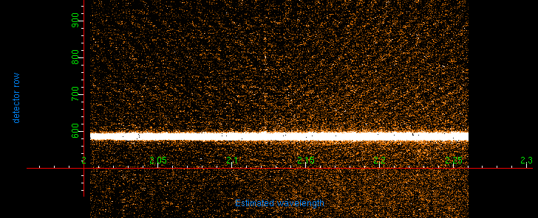
How to achieve dispersion of light
  Prism (rarely used, except as cross-dispersor)
  Single-slit or grating of slits
  Transmission grating
  Grism (grating on a prism)
  Volume Phase Holographic grating
  Reflection grating
Spectroscopy enables astrophysics!!

Slide 4
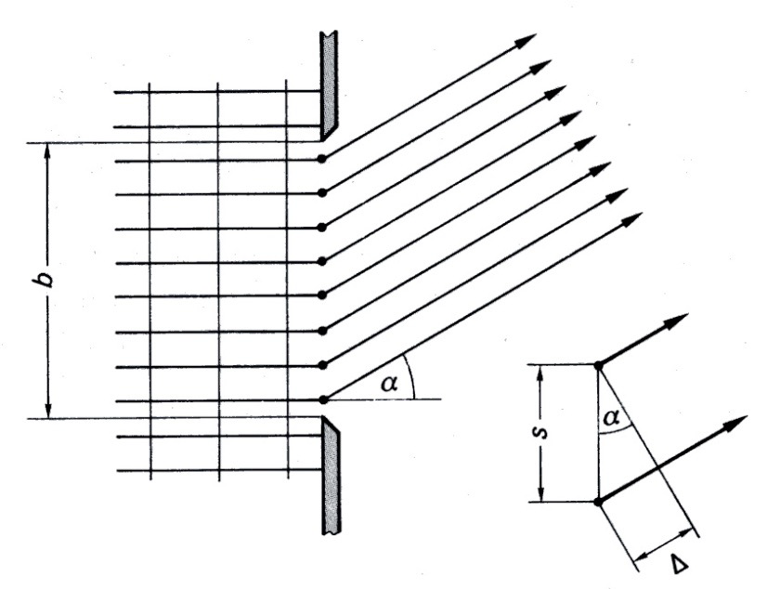
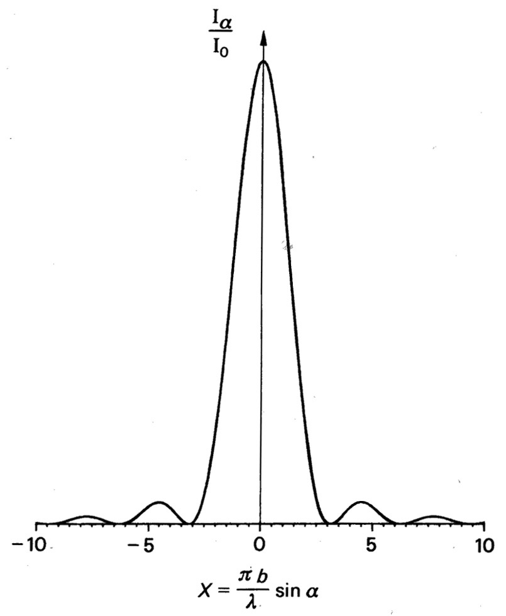
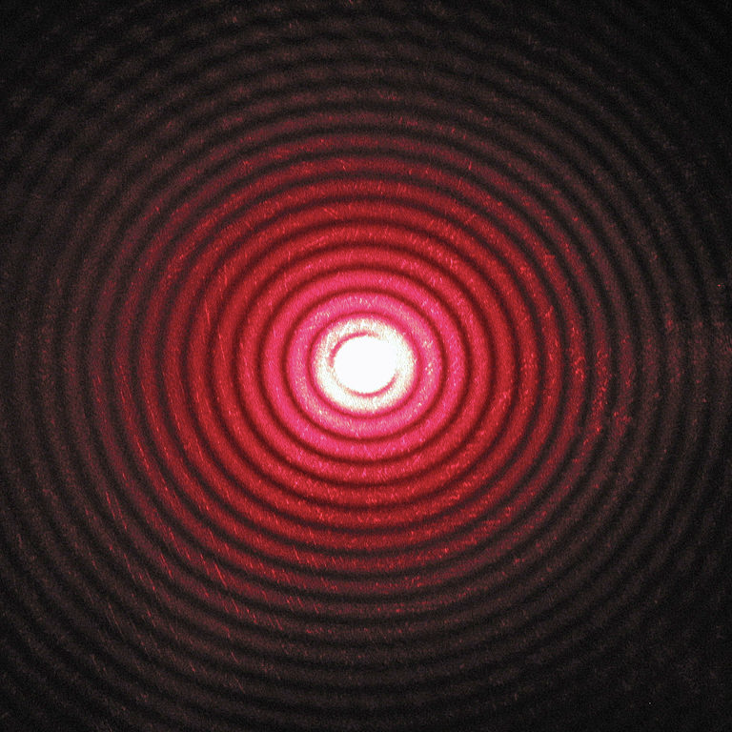
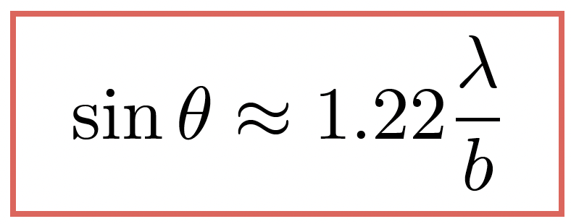
Single slit diffraction (Huygens’ principle)
Laser through a single pinhole
Angle of 1st zero intensity

Slide 5
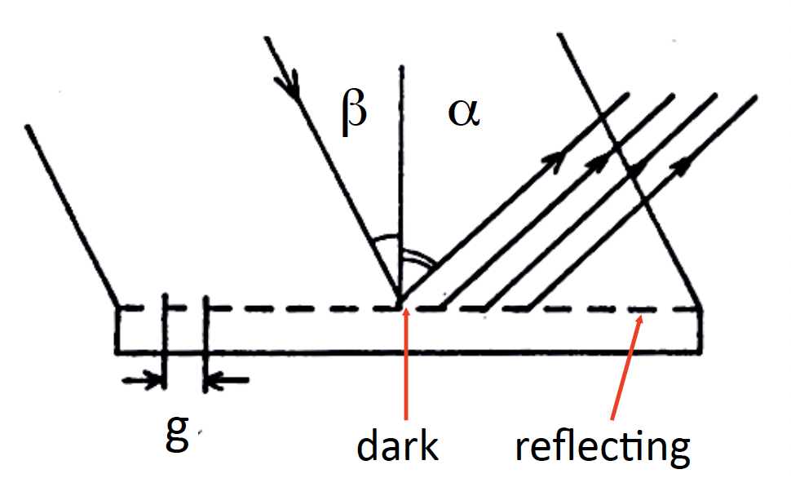
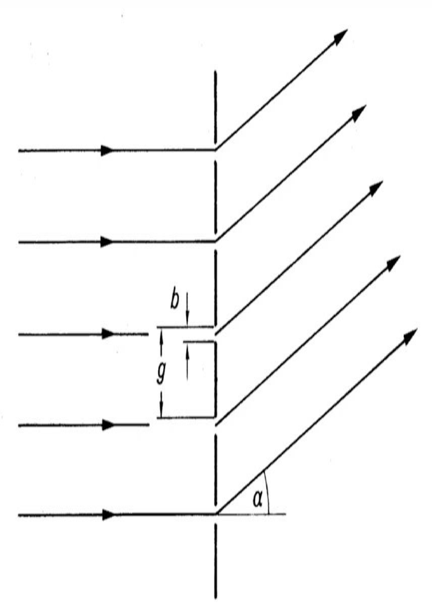
Multiple slit interference
b: slit width
g: period
α: diffraction angle
β: angle of incidence

Slide 6
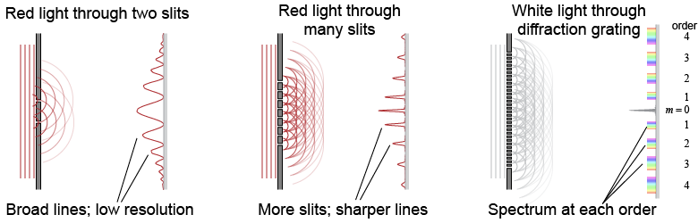
Multiple slit interference & diffraction grating
  Superposition of diffraction and interference
  Pattern the same for each wavelength, but spacing changes, hence dispersion.
  Gratings generate multiple dispersion orders of increasing dispersion

Slide 7
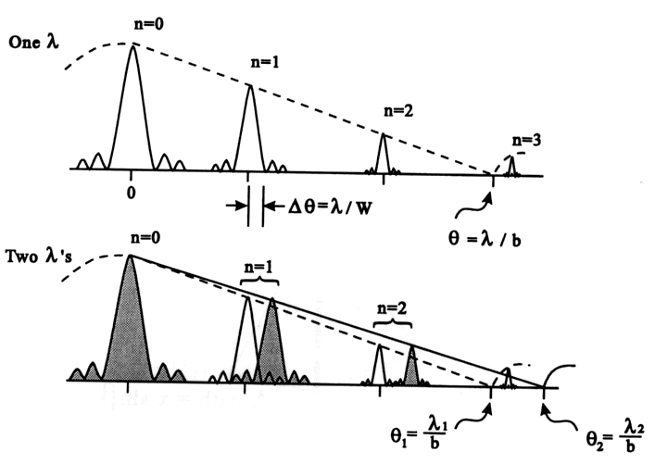
Multiple slit interference & diffraction grating

Slide 8
Diffraction Gratings

Slide 9
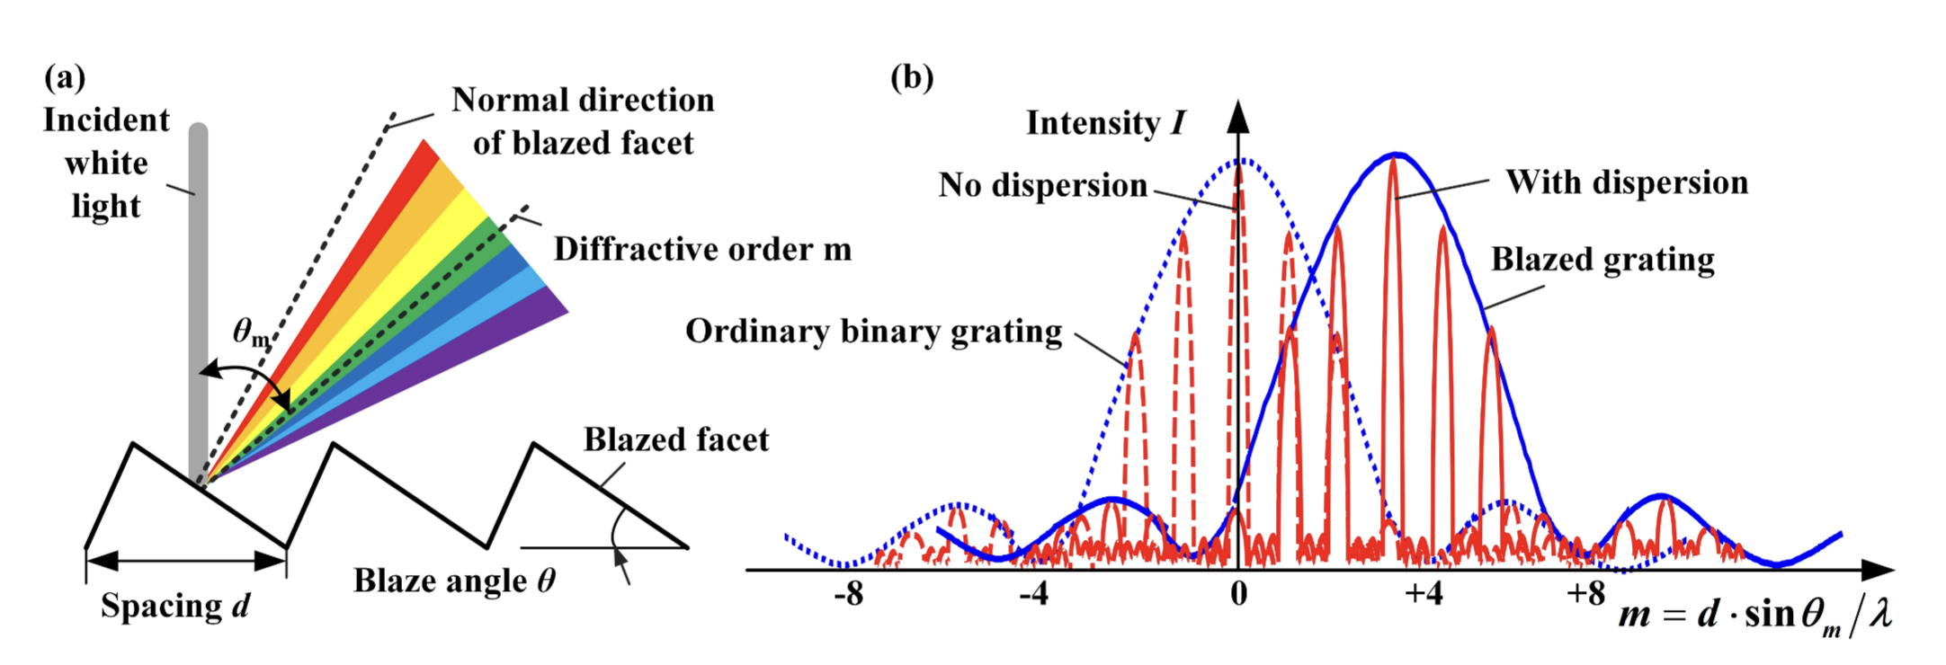
The diffraction grating (reflection)
  The “zeroth-order” is of no use, since it does not provide any dispersion with wavelength.
  Gratings are designed to deflect light away from this zeroth order. The further away it is deflected, the higher dispersion is achieved.
  This is done by blazing the grating, which achieves to shift the peak of grating efficiency towards higher orders.
  This also allows for the whole surface to be reflecting (as compared to slits or reflecting surfaces), which means higher throughout.
  But if a grating is blazed to be efficient at
  a particular wavelength with m=1, then it
  is also efficient at half that wavelength with
  m=2, so order overlap will occur!!

Slide 10
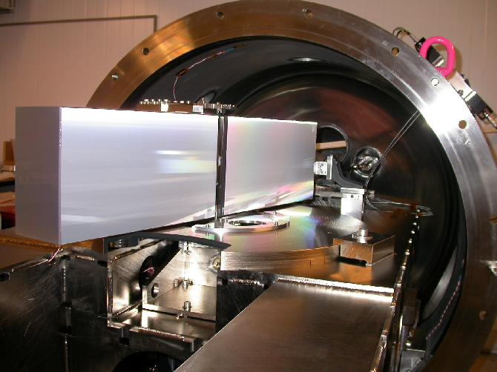
HARPS echelle grating

Slide 11
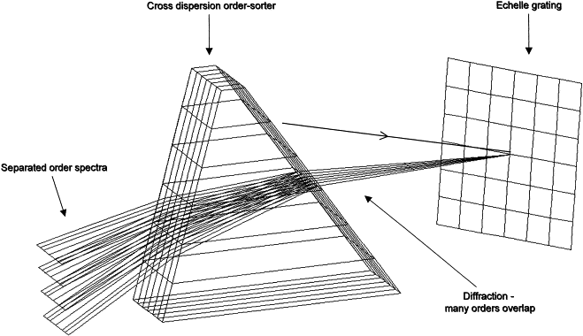
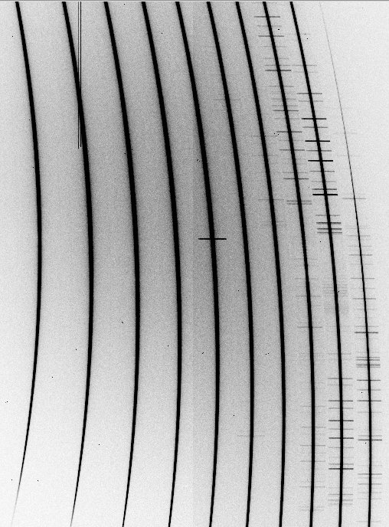
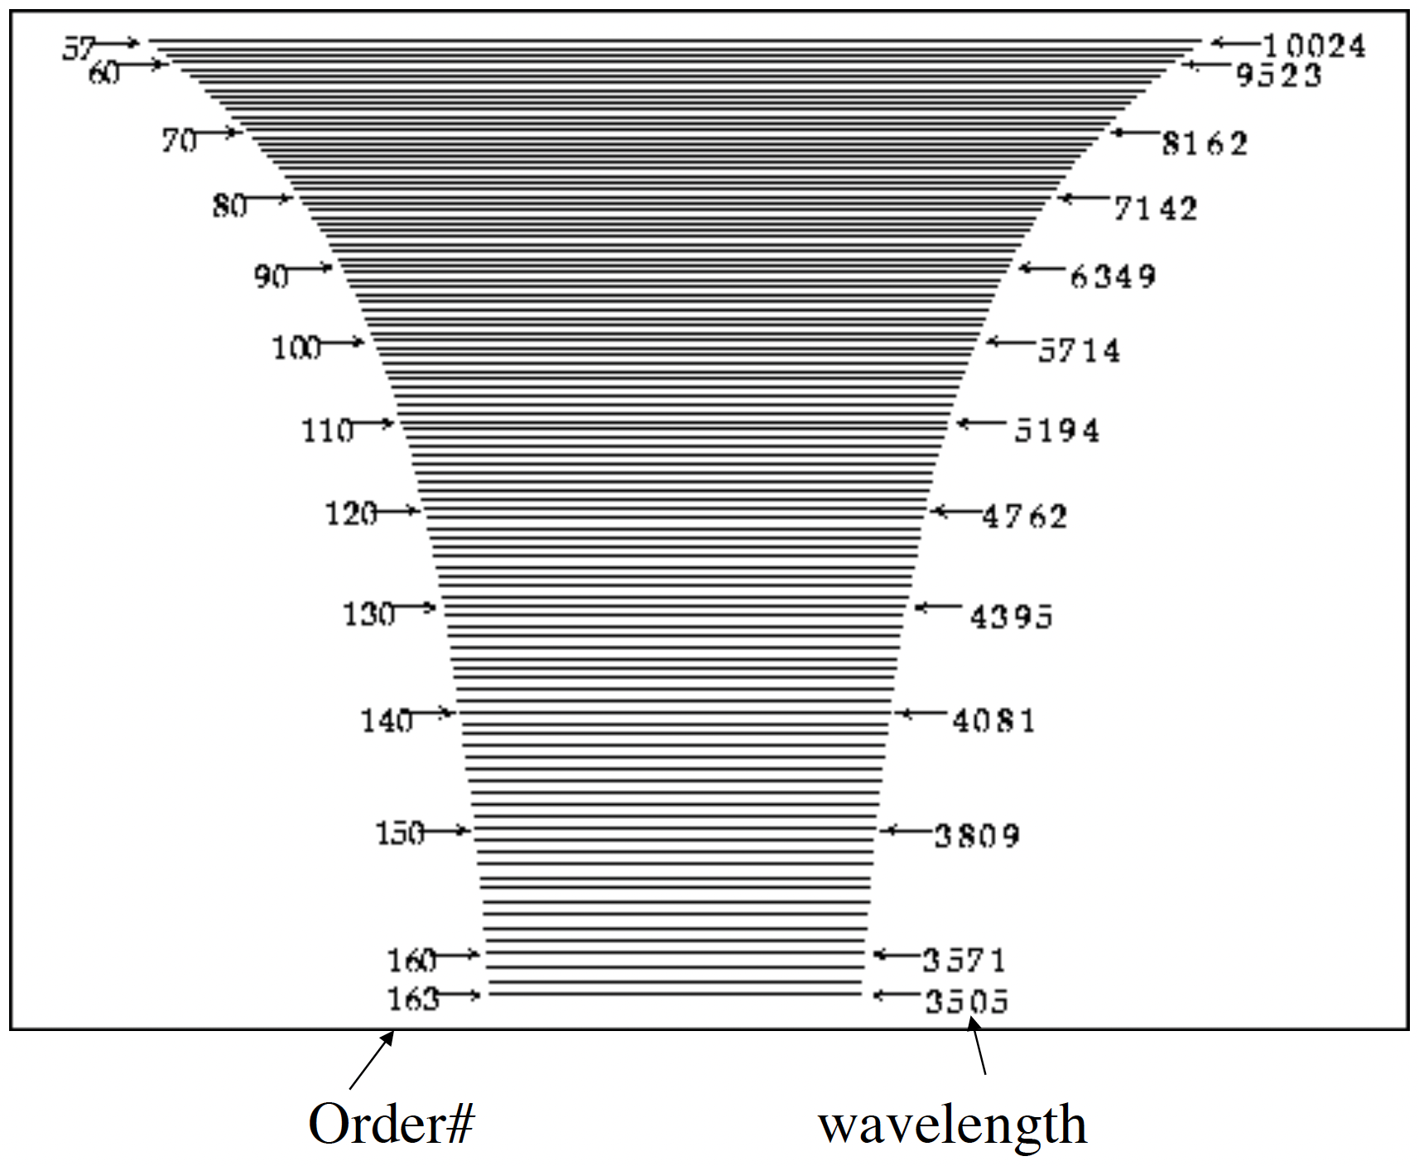
Overlap problem? Solution: Cross-dispersion

Slide 12
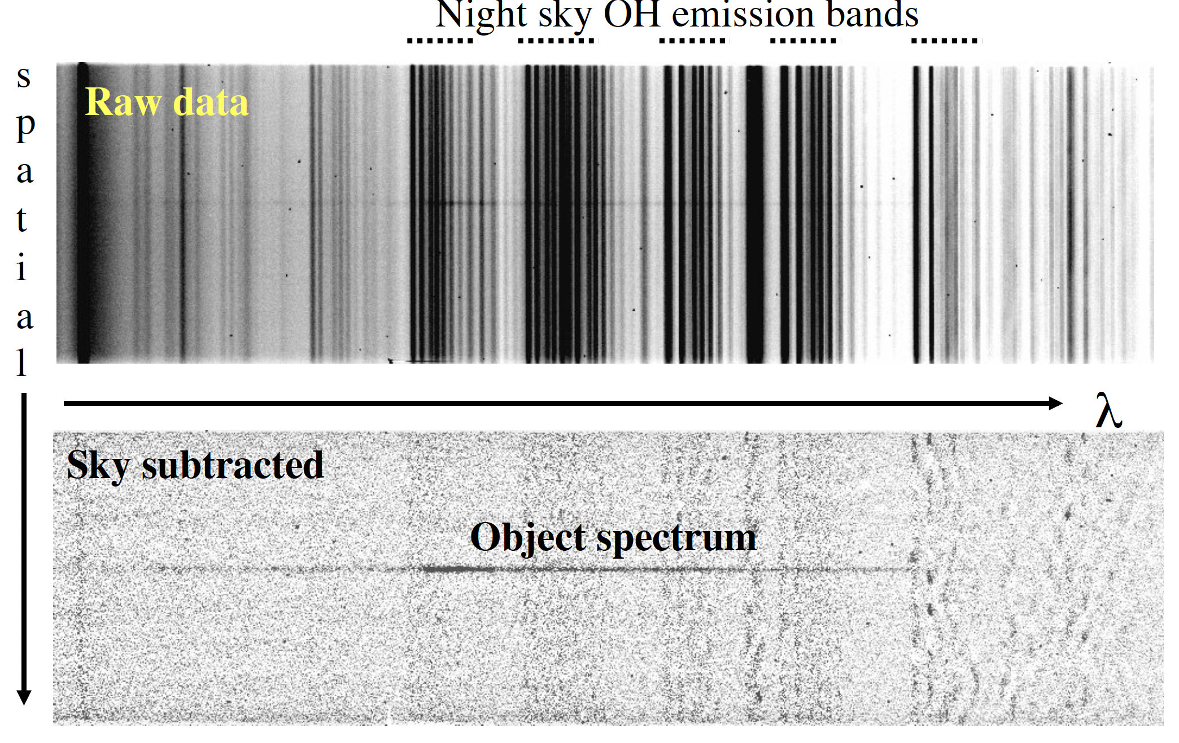
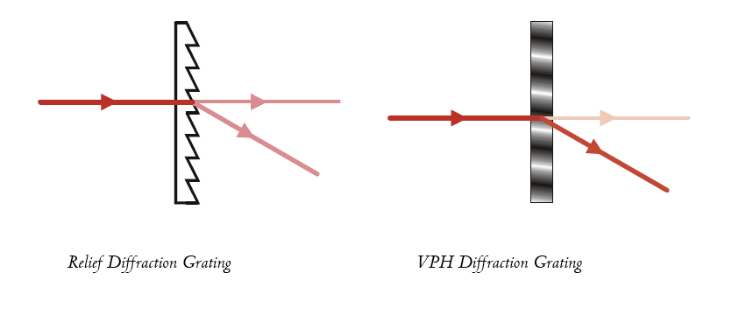
The diffraction grating (transmission)
  Gratings also work through transmission, which come in different flavours:
  Simple transmission diffraction grating
  Grisms: add a prism to the transmission grating for zero-deviation dispersion
  Volume Phase Holographic gratings (VPH): they use modulations of the refractive index to achieve dispersion. They have very high efficiency!!

Slide 13
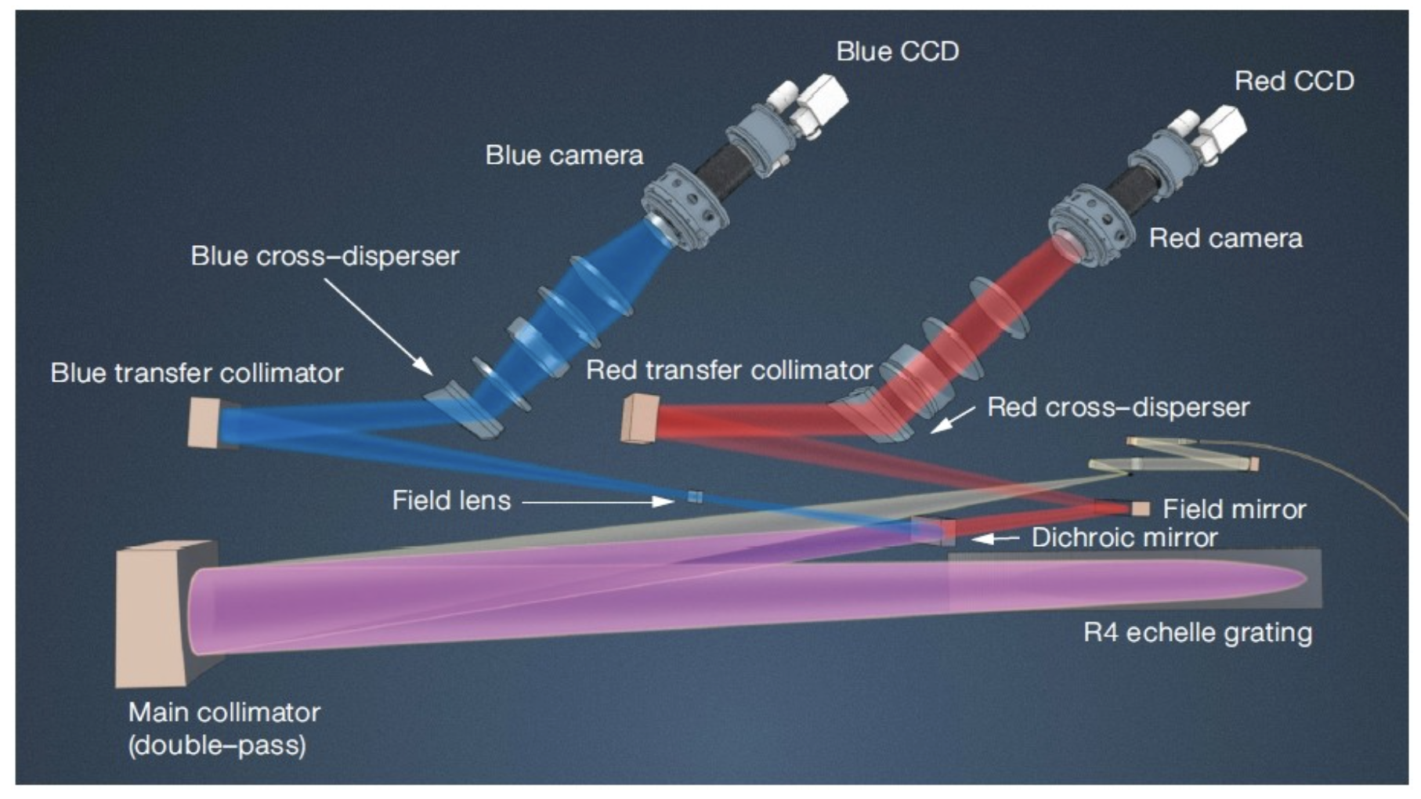
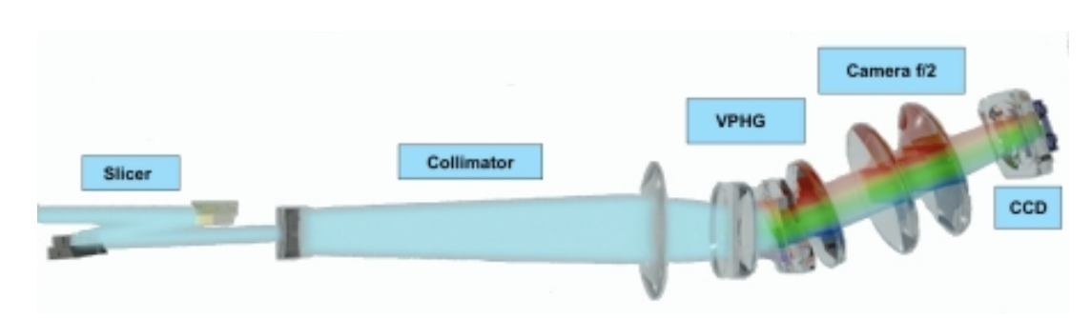
Examples
  Cross-dispersed echelle spectrographs:
    HARPS+NIRPS (3p6)
    ESPRESSO (VLT/UT)
    UVES (VLT/UT2)
  Transmission grating spectrographs:
    FORS2 (VLT/UT1) – Grism + VPH
    EFOSC (NTT) – Grism
    MUSE (VLT/UT4) -- VPH

Slide 14
Spectrographs

Slide 15
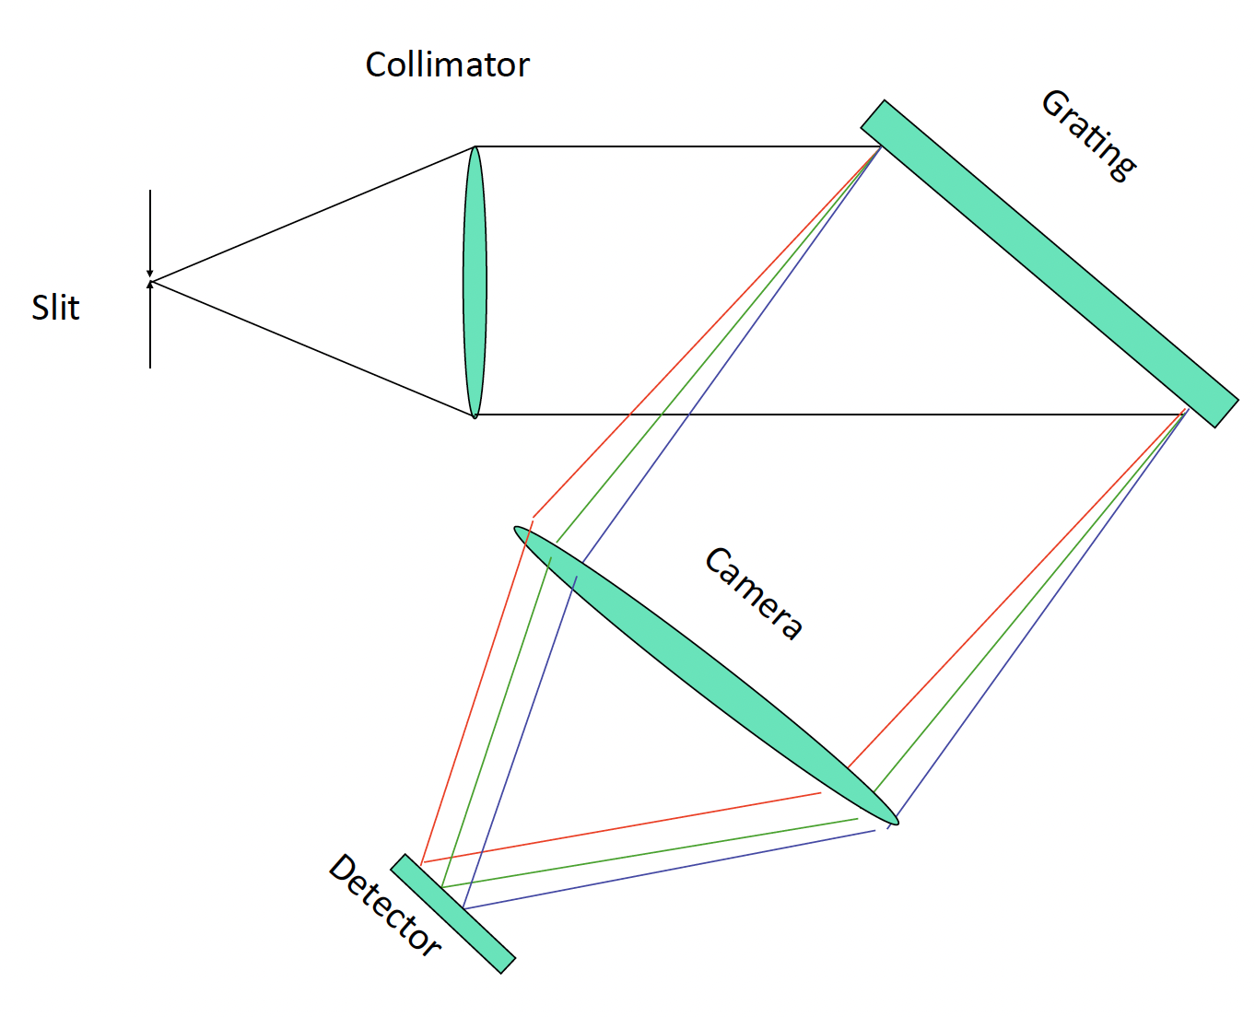
Spectrographs
A spectrograph is a camera coupled with a dispersing element.
  By geometry
    Long-slit or multi-slit
    Single or multi-fiber
    Integral Field Units (IFU): lenslets or fiber bundles

Slide 16
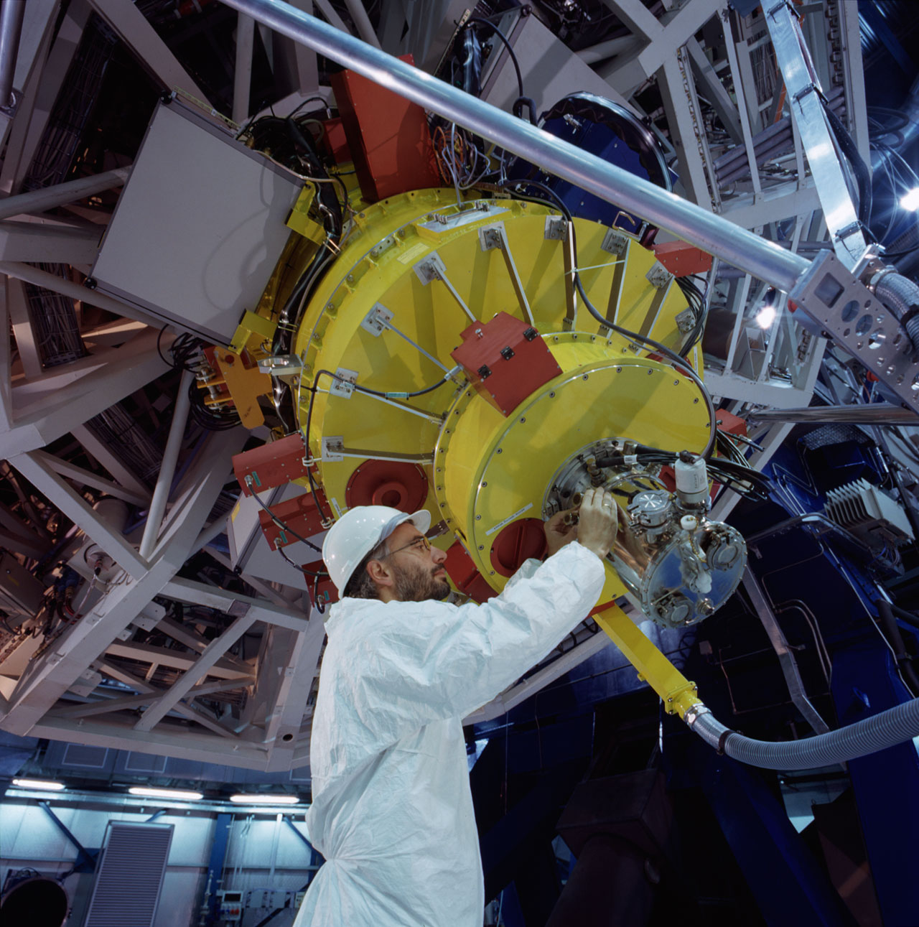
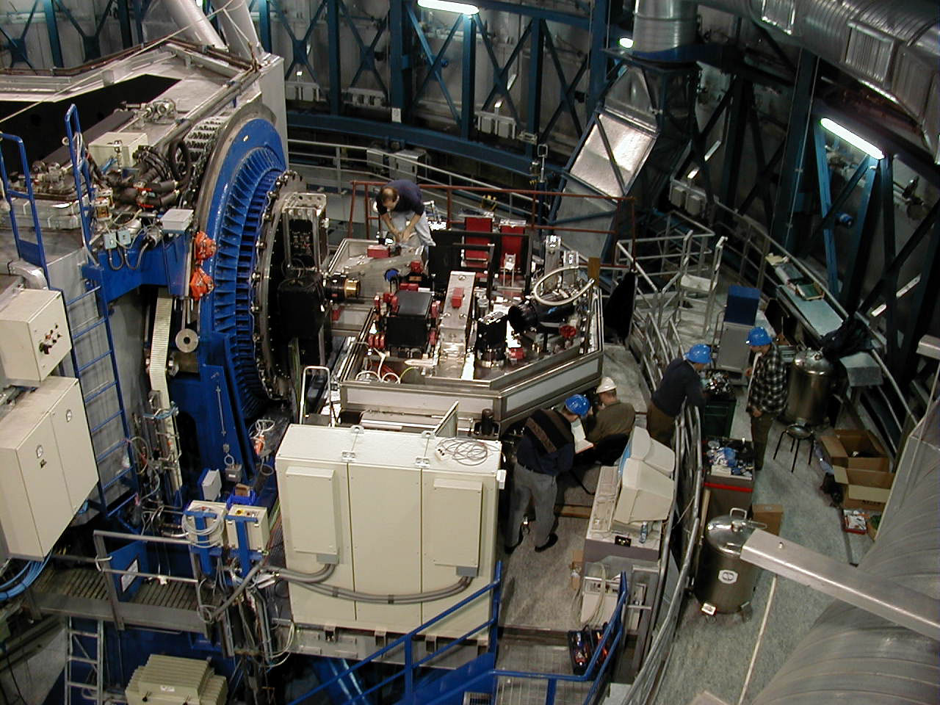
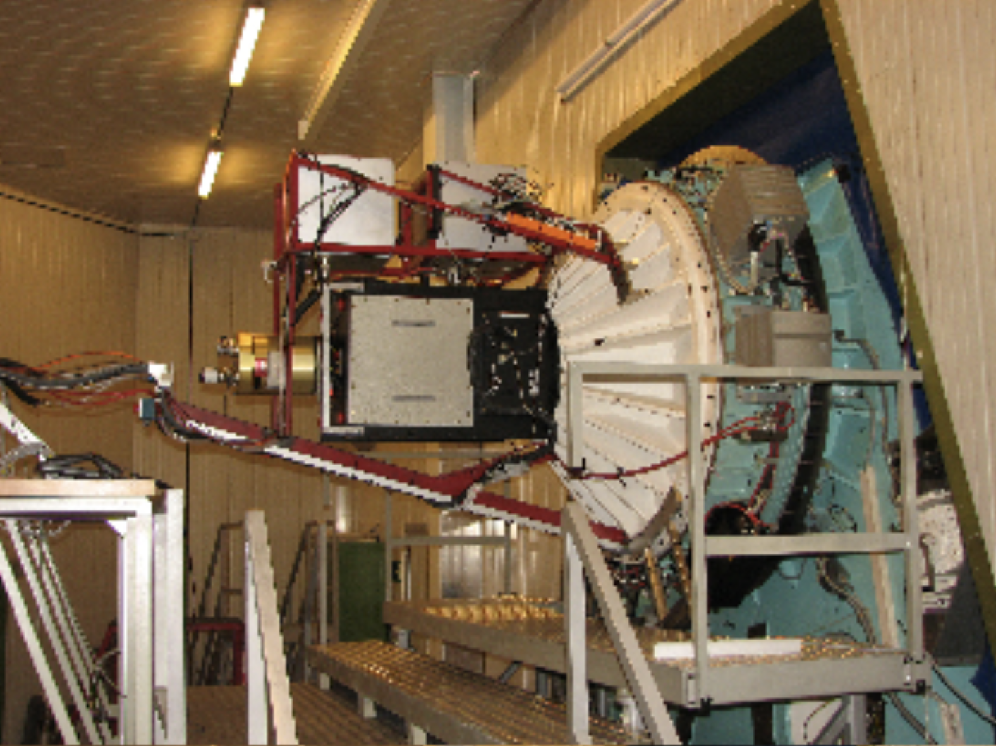
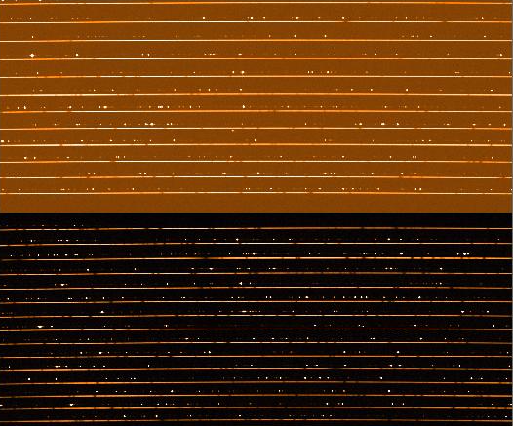
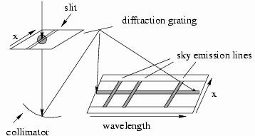

Single Object Spectrographs
Long-slit + grism/VPH
Long-slit + echelle grating
FORS2
UVES
Fiber + echelle grating
EFOSC2
ESPRESSO, HARPS+NIRPS

Slide 17
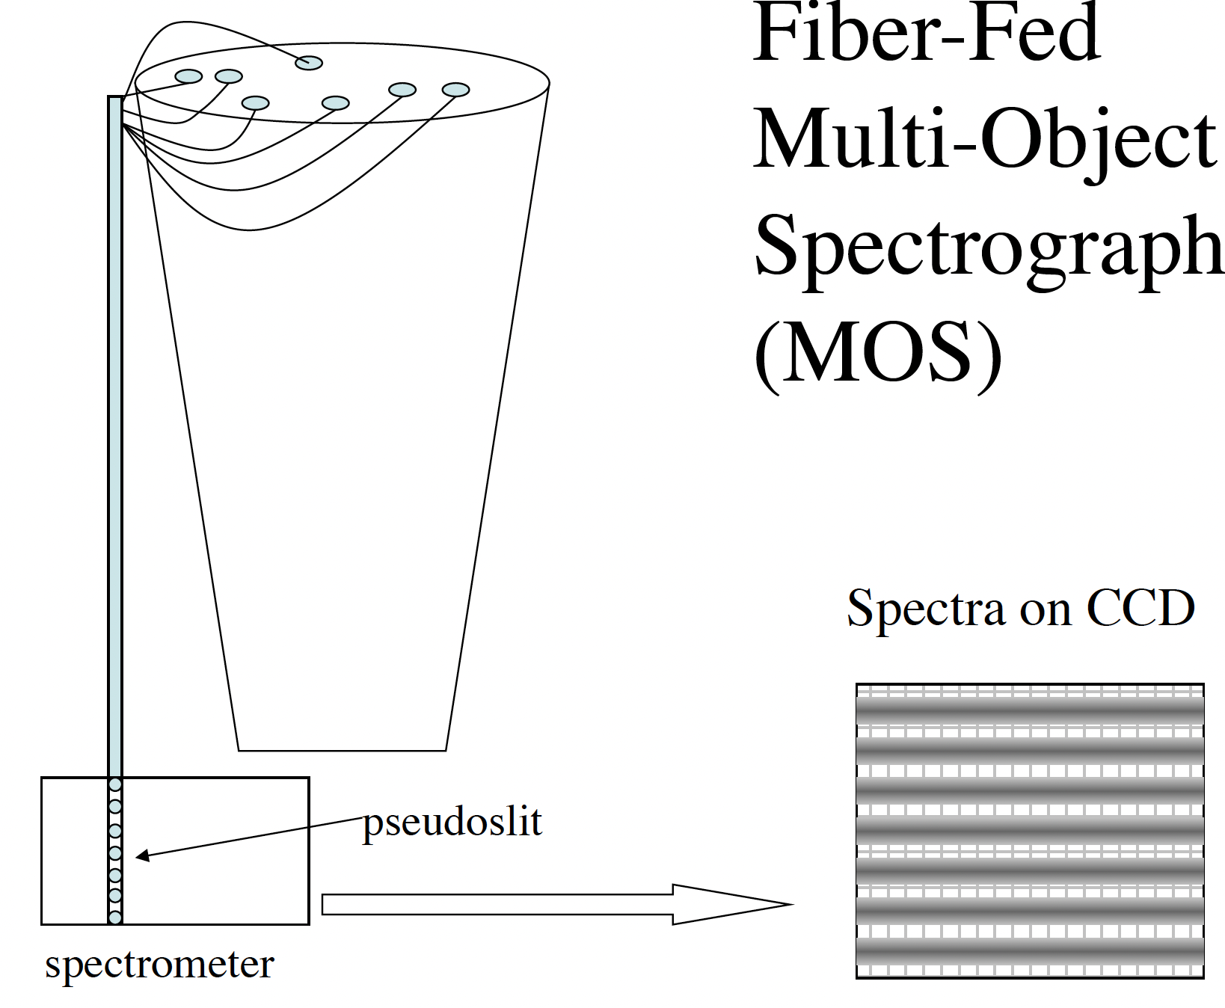
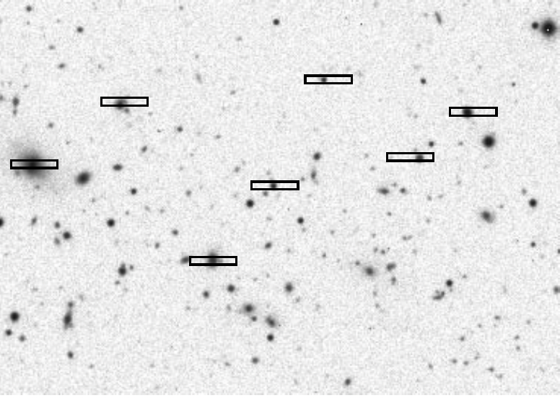
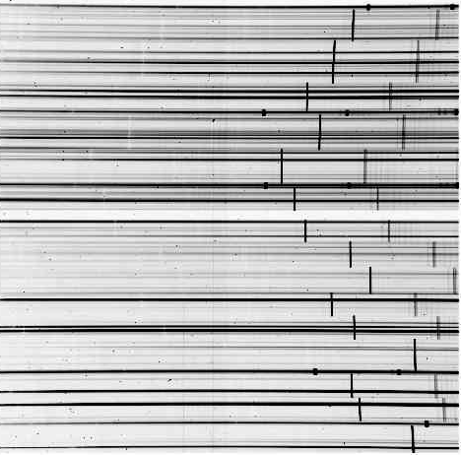
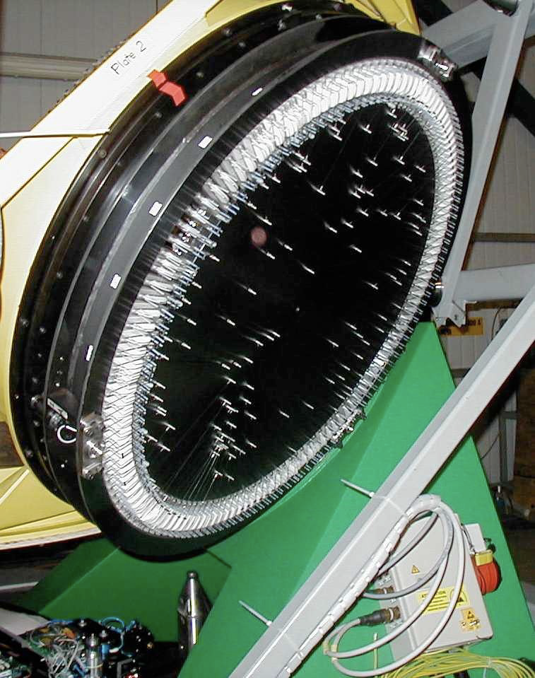
Multi-Object Spectrographs
Multi-fiber + grism/VPH
Multi-slit + grism/VPH
FLAMES/MEDUSA (VLT/UT2)
4MOST
MOONS

Slide 18
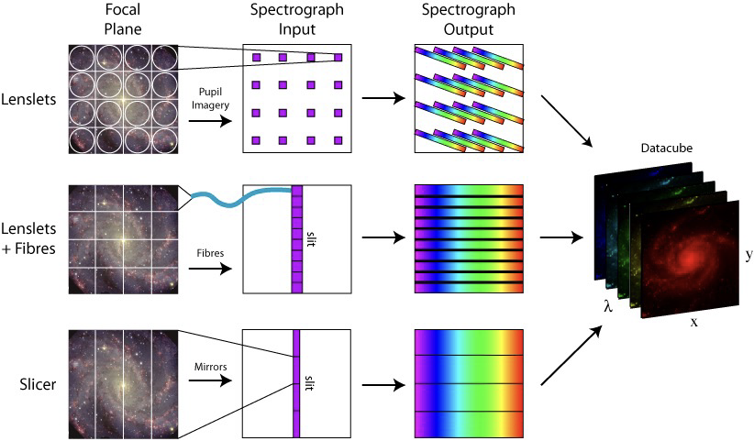
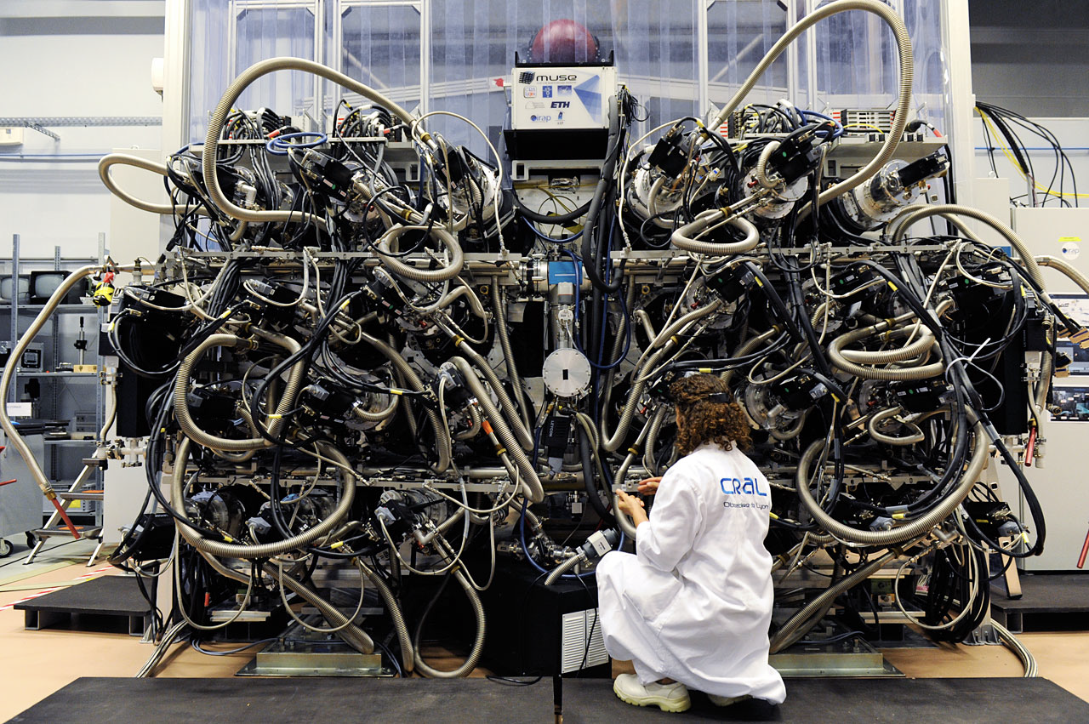
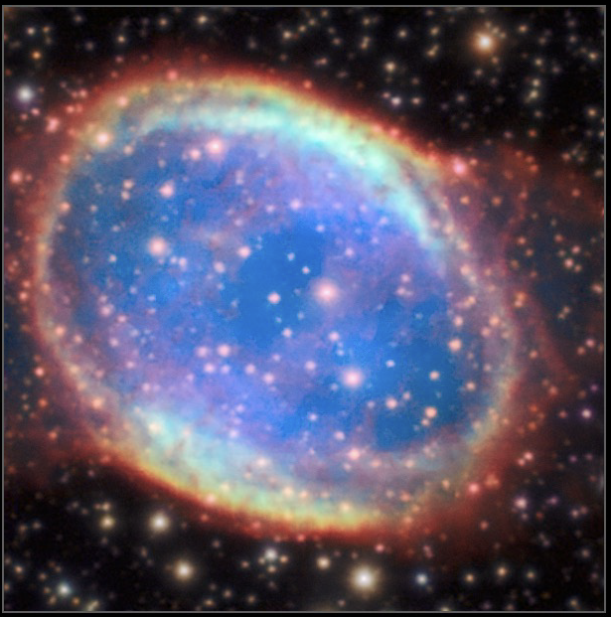
Integral Field Spectrographs
FLAMES/ARGUS-IFU (VLT/UT2)
MUSE (VLT/UT4)
KMOS (VLT/UT1)

Slide 19
Spectral Properties

Slide 20
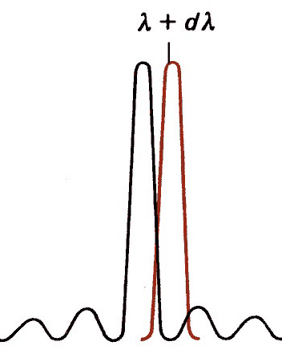
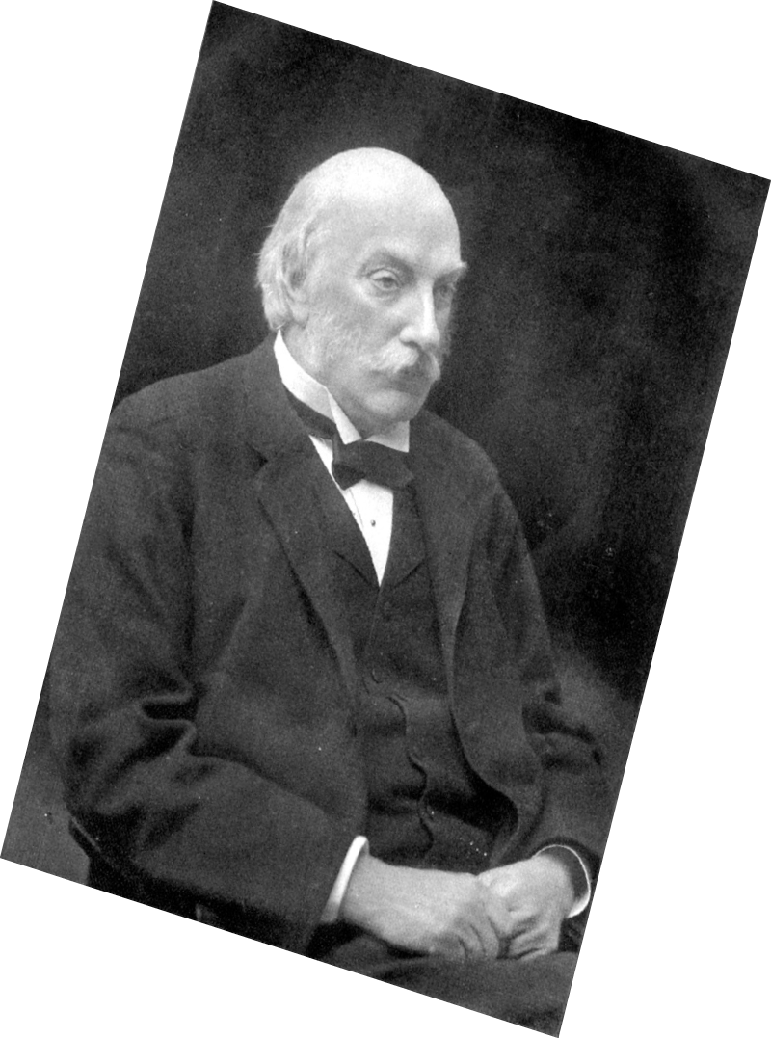
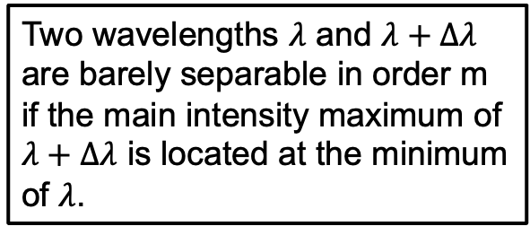
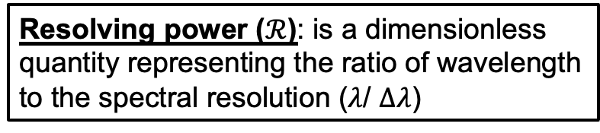
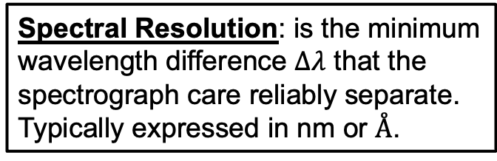
From Dispersion to Resolution
The Rayleigh criterion…
Two wavelengths $λ$ and $λ+Δλ$
are barely separable in order m
if the main intensity maximum of
$λ+Δλ$ is located at the minimum
of $λ$.
Spectral Resolution: is the minimum
wavelength difference $Δλ$ that the
spectrograph care reliably separate.
Typically expressed in nm or $Å$.
Resolving power ($ℛ$): is a dimensionless
quantity representing the ratio of wavelength
to the spectral resolution ($λ$/ $Δλ$)

Slide 21
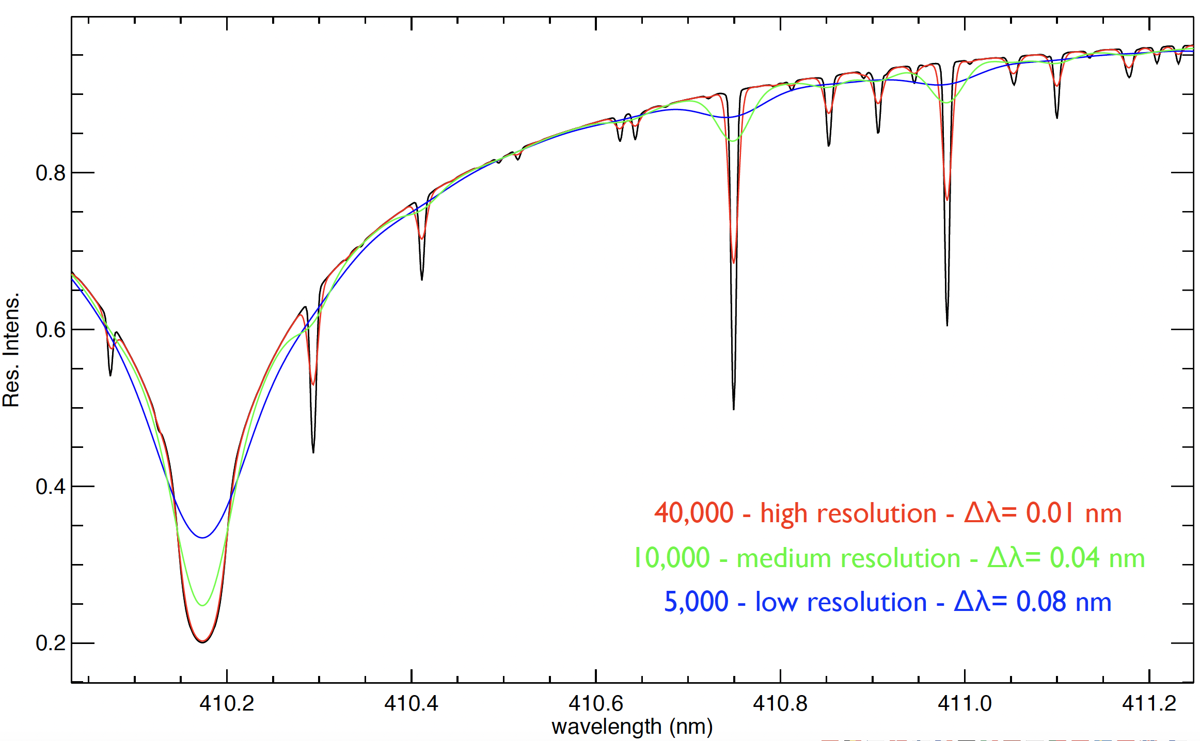
Resolving power in practice

Slide 22
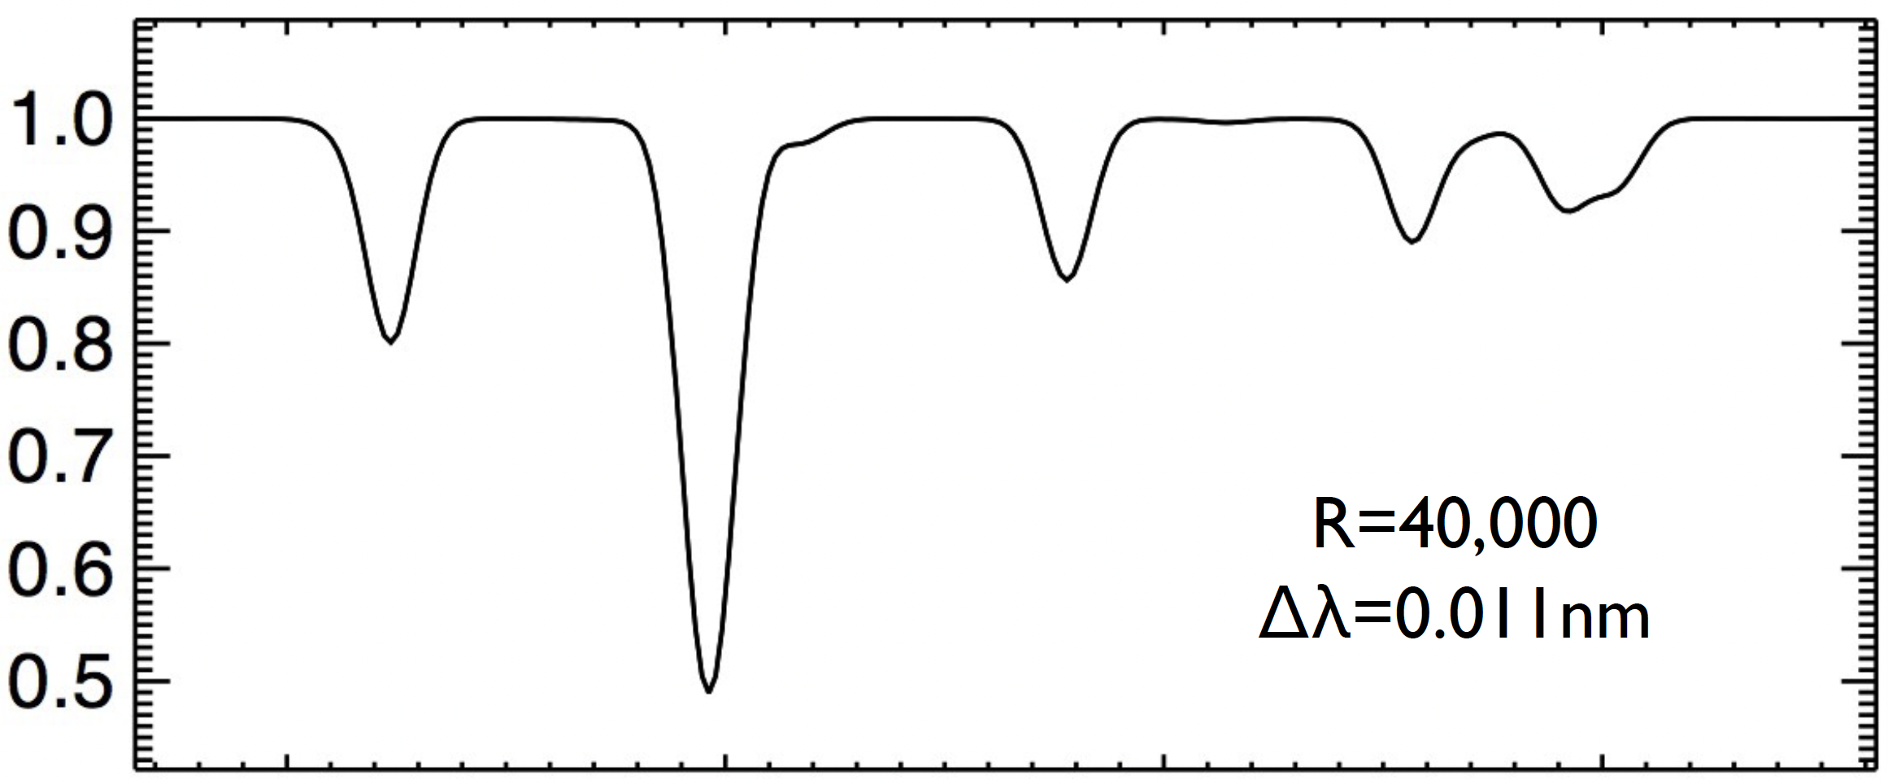
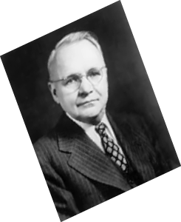
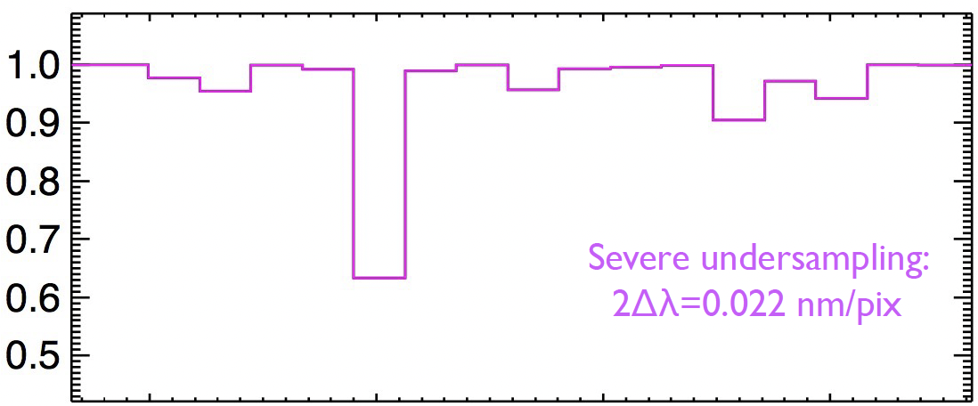
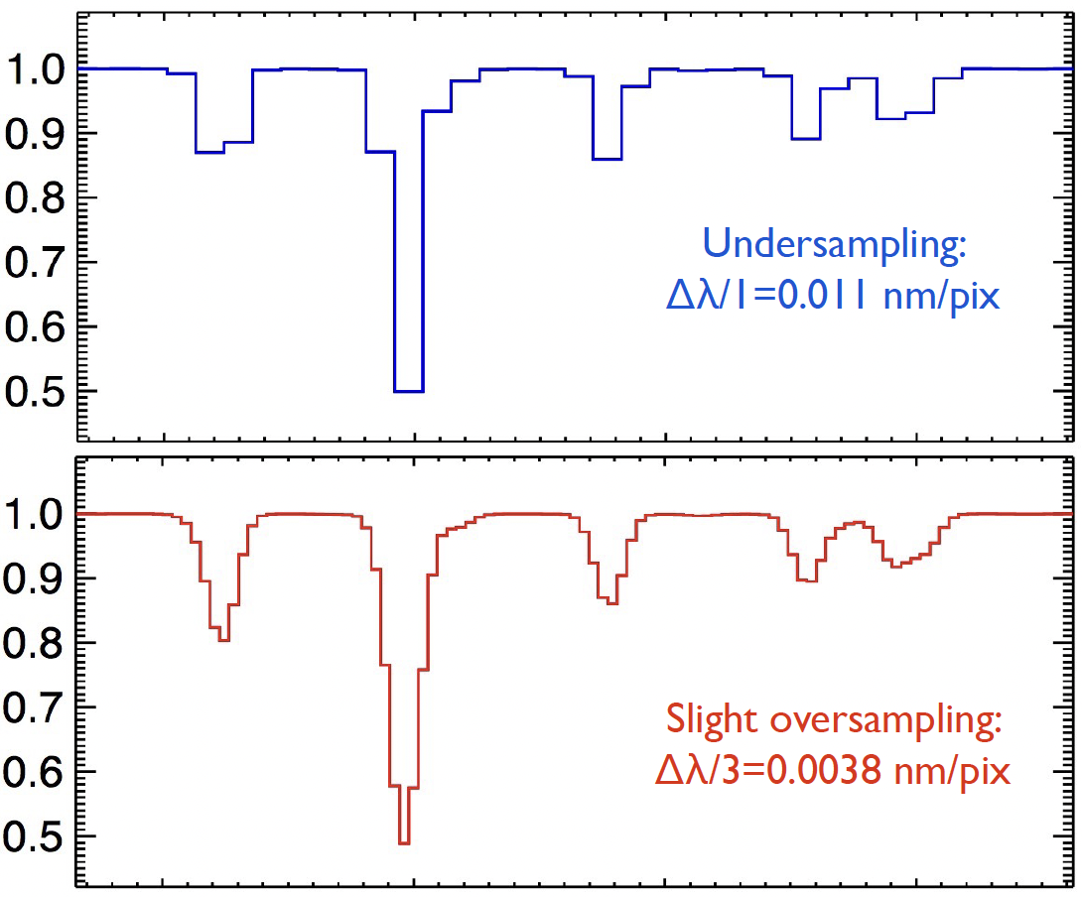
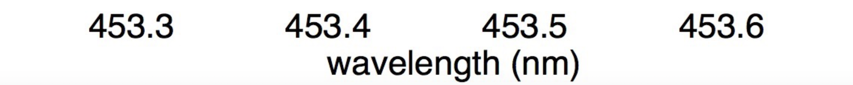
The role of the detector
Nyquist Criterion:
In order to properly recover (sample) the
spectrograph line profile, an absolute
minimum of 2 samples (pixels) per
resolution element are required.
While 2 pixels per FWHM of LSF is the critical sampling, 2.5 – 4.0 pixels per resolution element are desired for reliable inference of various physical parameters.
The limitation here is physical restrictions on the
availability of small enough pixels and opto-mech.
constraints.

Slide 23
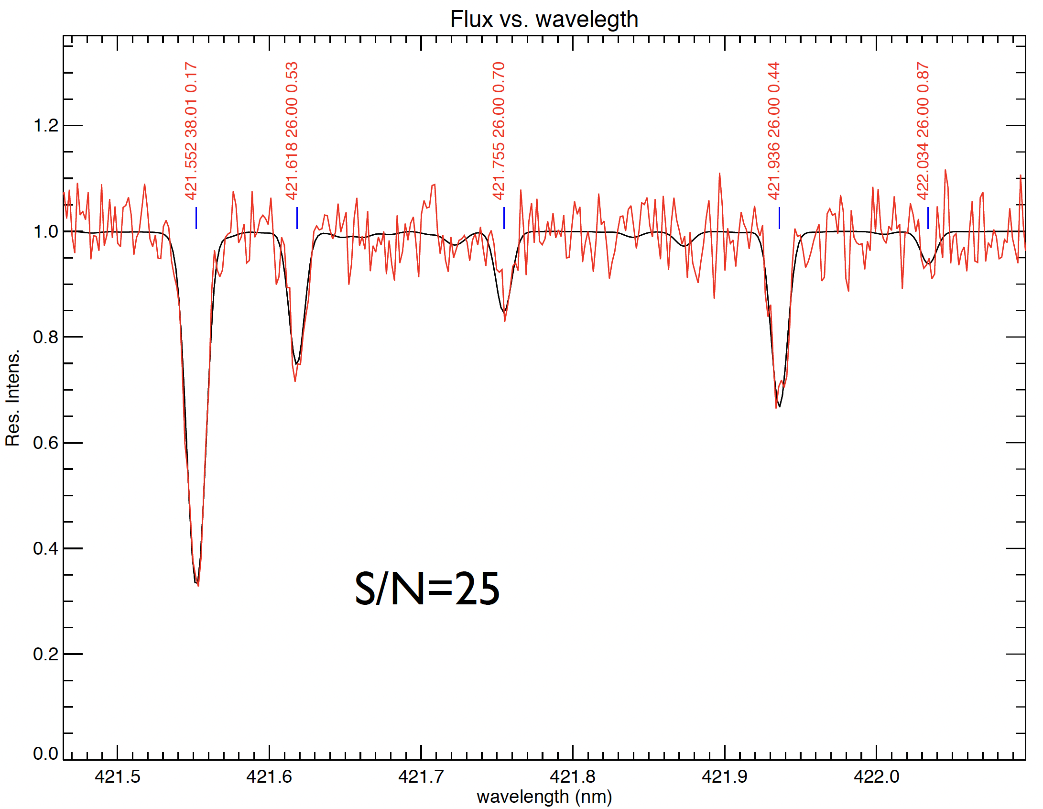
Signal-to-Noise ratio (S/N)

Slide 24
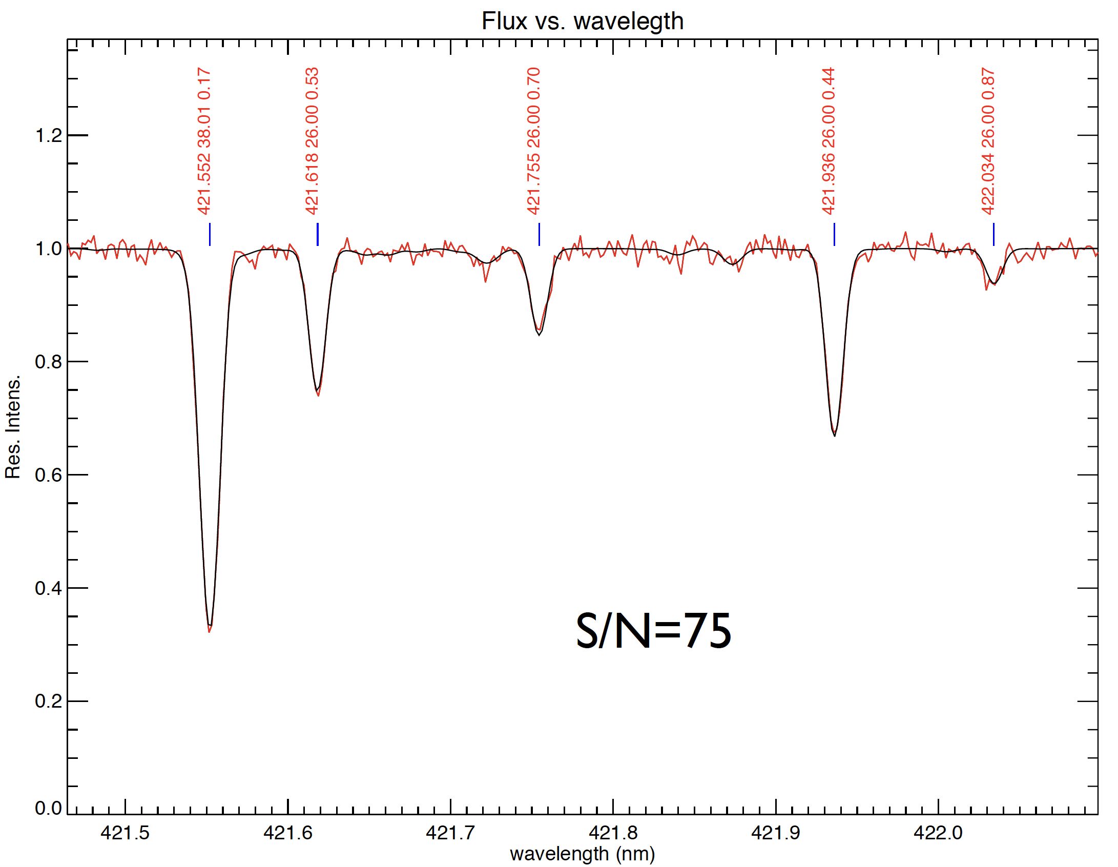
Signal-to-Noise ratio (S/N)

Slide 25
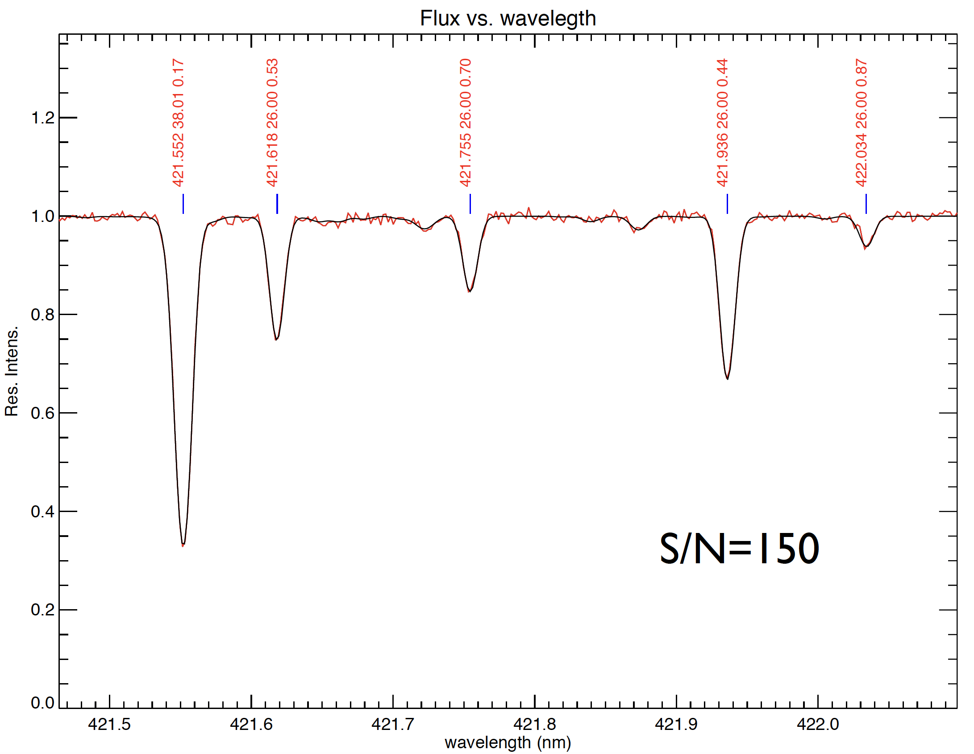
Signal-to-Noise ratio (S/N)

Slide 26
Quality of a Spectrum
  S/N, Resolving Power and Sampling are the main three parameters defining spectral quality:
    S/N depends on the brightness of the source, sky, telescope aperture size, etc…
    Resolving power is a characteristic of the dispersing element
    Sampling depends on the pixel size of the detector & the spectral resolution
  These together determine the uncertainty with which features can be measured.
  Optimal or over-sampling must be maintained. Higher sampling decreases S/N per pixel, but fitting more points will compensate for this.
  Same goes for S/N and resolution.
  Be mindful of line blending!!!

Slide 27







Atmospheric Dispersion
  Differential atmospheric dispersion causes chromatic distortion of images that gets larger at blue wavelengths at fixed airmass and larger with airmass at a fixed central wavelength
Two solutions:
1) align slit along the parallactic angle
2) Build an Atmospheric
Dispersion Corrector (ADC)

Slide 28
Elyar Sedaghati
esedagha@eso.org
@ESOAstronomy
@esoastronomy
@ESO
european-southern-observatory
@ESOobservatory

