Slide 1
Extragalactic Archeology
Galaxies in 14D
Charlie Conroy
UC Santa Cruz

Slide 2
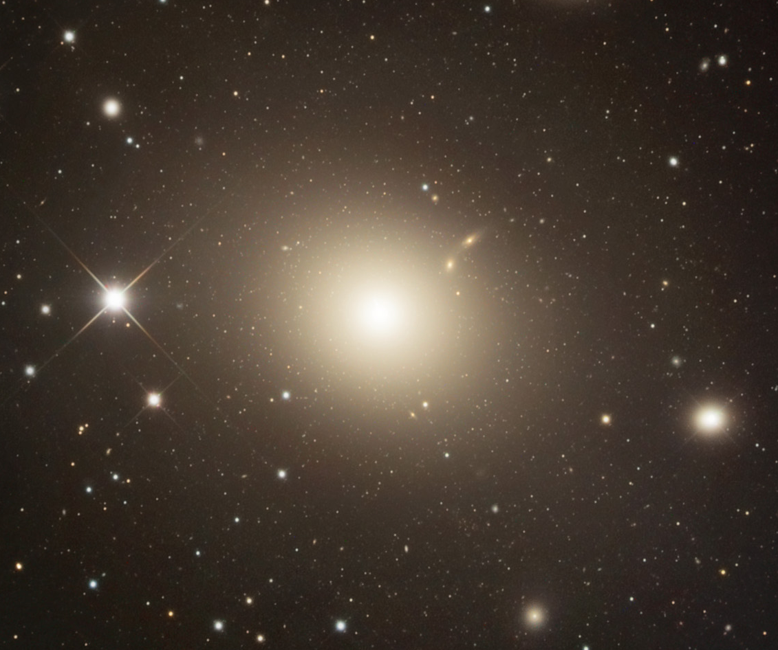
Early-Type Galaxies: Formation & Evolution
Big Questions
  How do they form?
  How do remarkably uniform objects emerge from such violent histories?
  What information is stored in the radial variation in stellar properties?
  What do their present-day properties tell us about their formation epochs?
    “extragalactic archeology”
  How do we connect galaxies across epochs?
    “extragalactic chemical tagging”

Slide 3
FeI
TiO
MgH
Hα
NaI
FeI
Hβ
NaI
CaII
σ=300 km/s
flux
MgI
Stellar Population Synthesis (SPS):
From light to physical properties
CH
CaII
wavelength
σ=1 km/s

Slide 4
Turning Light Into Astrophysics
Simple stellar populations

Slide 5
Stellar Population Synthesis: SSPs
Estimate stellar masses for every star in library from L_{bol}
Compute integrated light models (SSPs):
13 Gyr, Z_{sol}
IMF stellar spectrum
New Model Characteristics:
Ages: 1-13 Gyr
Arbitrary IMF
0.35μm < λ < 2.4μm
Variable C, N, O, Na, Mg, Si, Ca, Ti, V, Cr, Mn, Fe, Ni, Sr, Ba
~5-7 “nuisance” parameters
Isochrones
Conroy & van Dokkum (2012a)

Slide 6
Information Content of Low Resolution Spectra

Slide 7
Element Fingerprints:
Change in model galaxy due to 2x abundance increase:

Slide 8
Element Fingerprints:
The Iron Peak Elements:

Slide 9
Full Spectral Fitting of Galaxies
Data:
  SDSS stacked spectra of early-type galaxies
Covariance between parameters for the fit to one galaxy (S/N~1000/A)
Fitting Technique:
  40 model parameters (!)
    16 elements
    2-part power-law IMF
    2-component SFH
    v_{z}, σ
    11 emission lines
    5 nuisance parameters
  Exploration of parameter space with MCMC (emcee)

Slide 11
SDSS stack
rms=0.25%

Slide 12
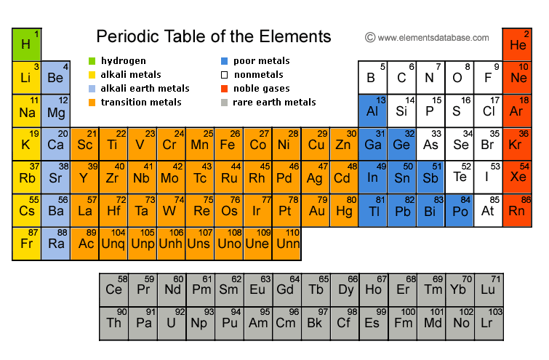
SN II
AGB
SN Ia
? (r-process)

Slide 13
Insights from Abundance Patterns
SNe II
(α)
Rate
AGB
(main s-process, CN, F)
SNe Ia
(Fe-peak)

Slide 14
The α-elements
SDSS early-type galaxies
[O/Fe]
[Mg/Fe]
[Si/Fe]
[Ti/Fe]
[Ca/Fe]
Conroy, Graves, van Dokkum 2014

Slide 15
The iron-peak elements
[Co/Fe]
[Ni/Fe]
[Mn/Fe]
[V/Fe]
0.05 dex sys uncertainty
[Cr/Fe]
Conroy, Graves, van Dokkum 2014

Slide 16
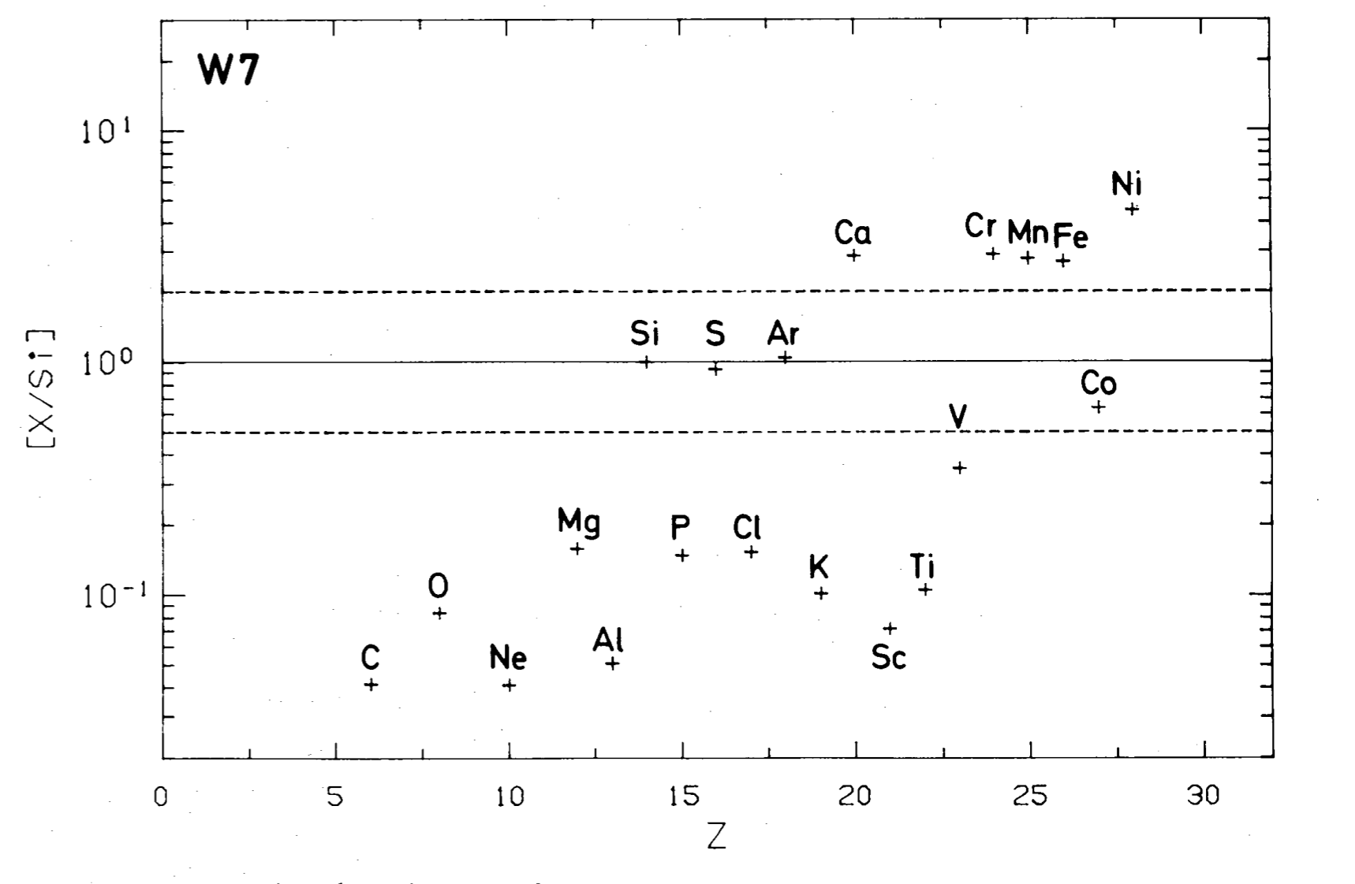
SN Ia Yields
Nomoto et al. 1984

Slide 17
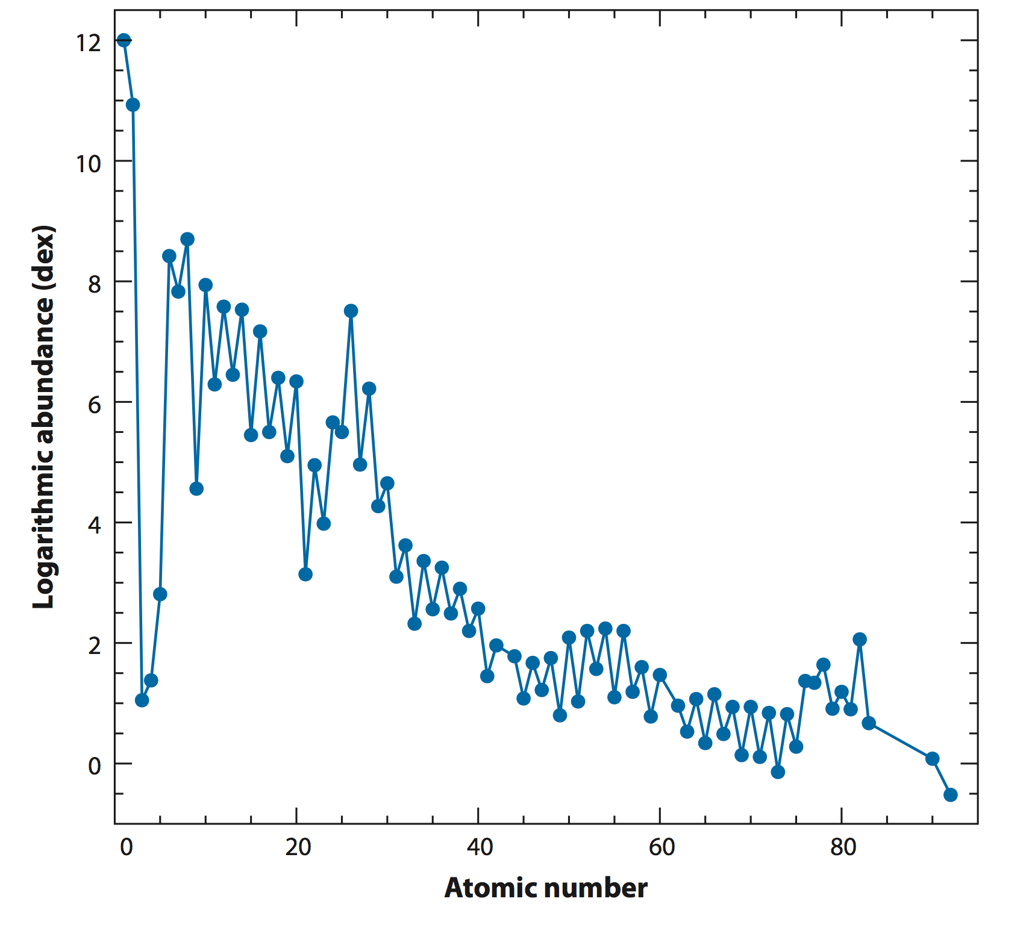
The abundance pattern of the Sun
Based on data of extraordinary quality (R>100,000 spectra)
Asplund et al. 2009 (ARAA)

Slide 18
Based on R~1000 spectra

Slide 19
The Low(er) S/N Frontier
Prior limitation was S/N (previous techniques required S/N~100)
Full spectrum fitting allows us to extract parameters at much lower S/N
  Precise age and [Fe/H] to S/N=10, Mg, C, N, Ca to S/N=20
Opens up many new frontiers:
High redshift universe
Low surface brightness galaxy outskirts (relevant for this conf.)
>100,000 “low S/N” SDSS/BOSS, etc. spectra

Slide 20
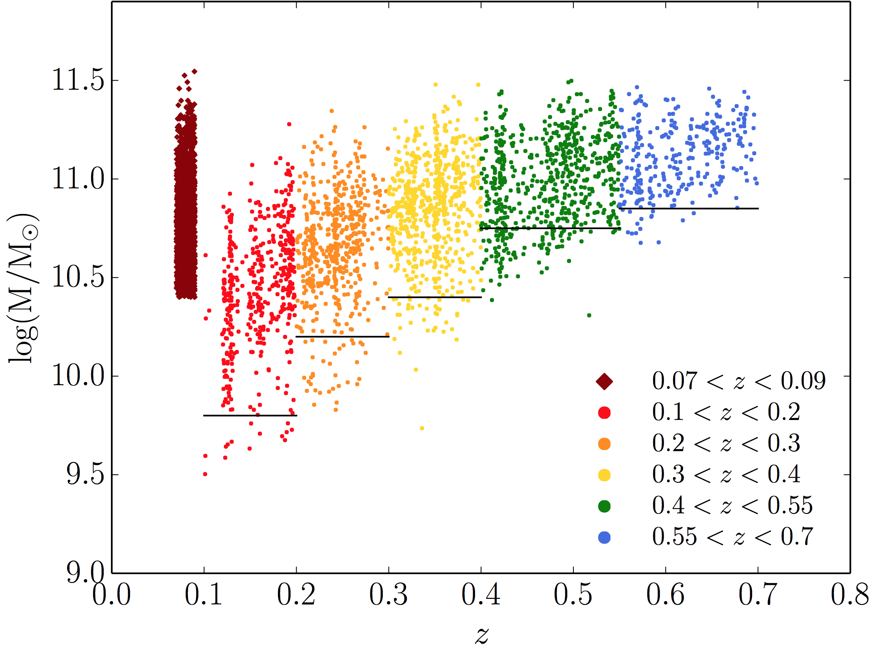
The AGES Survey
7.7 sq deg spectroscopic survey of the Bootes field in the NOAO Deep-Wide Field Survey
I<20 selection; 0.1<z<0.7
23,000 redshifts via MMT/Hectospec
13 band photometric SED fitting
(GALEX, SDSS, IRAC, etc.)
Typical continuum S/N of 5-10
Stack spectra in bins of z, logM
quiescent selection

Slide 21
Quiescent Galaxies at z~0.7
Ratio (%)

Slide 22
Passive Evolution of Massive Galaxies
Massive galaxies have been passively evolving since z=0.7 (half the age of the universe)
J. Choi, Conroy et al. in prep

Slide 23
Passive Evolution of Massive Galaxies
Massive galaxies have been passively evolving since z=0.7 (half the age of the universe)
J. Choi, Conroy et al. in prep

Slide 24
Evolution of Quiescent Galaxies to z=0.7
No evidence for evolution in abundance patterns at fixed mass since z=0.7
Abundance patterns also consistent with passive evolution
Age
Iron
Magnesium
Carbon
Nitrogen
Calcium
J. Choi, Conroy et al. in prep

Slide 25
The DEEPER Survey
  9 nights this semester on Keck/DEIMOS
  Very deep exposures of quiescent galaxies over 0.4<z<1.2
    8-32 hr exposures
    GOODS-N, COSMOS, EGS
  Plans to extend the survey for 1-2 years
  ~500 spectra with >8 hr exp
  (~100 with ~32 hr exp)
Key Science Goals
  Evolution of stellar ages, metallicities, and abundance patterns over half of cosmic time
  Redshift evolution of stellar population gradients
  Characterize restframe UV spectra of quiescent galaxies

Slide 26
What are We Learning?, Whereto From Here?
The cores of massive galaxies are special places that seem to be passively evolving since at least z=0.7
  How do we reconcile this with hierarchical growth?
    Inside-out growth: material being added at large radius
    Expect gradients in stellar populations. Observations support this. More data forthcoming
Abundance patterns offer a new opportunity for both theorists and observers
  Frontier: a dedicated deep spectroscopic survey of galaxies at z>0.5
    Requires long integration times! (~10-20 hrs)
    The DEEPER Survey: ~500 early-type galaxies at 0.5<z<0.9 with Keck/DEIMOS
  Frontier: abundance pattern gradients to large R/Re for statistical samples
  Integrate chemical evolution models into fully cosmological simulations
  Develop detailed SPS models for star-forming galaxies

Slide 28
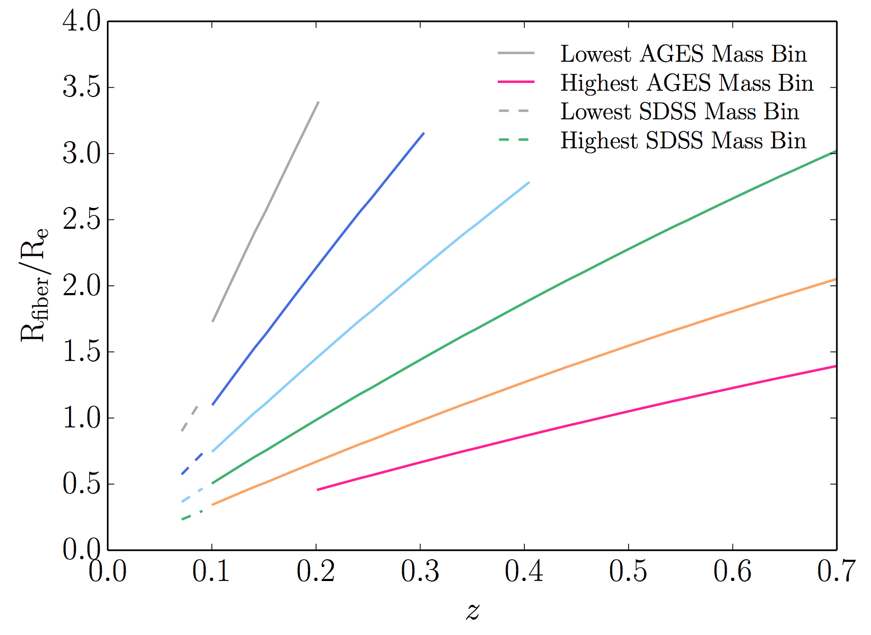

Slide 29
Fitting for T_{eff}
13 Gyr
DSEP database
Solar
[a/Fe]=+0.2
[Fe/H]=-0.1
[a/Fe]=+0.4
Single ΔT offset for each isochrone

Slide 30
Fitting for T_{eff}
early-type galaxies
theory

Slide 32
Model Validation: MW Star Clusters

