Slide 1
The Astronomical Landscape in 2020
Patrick Roche
Oxford University

Slide 2
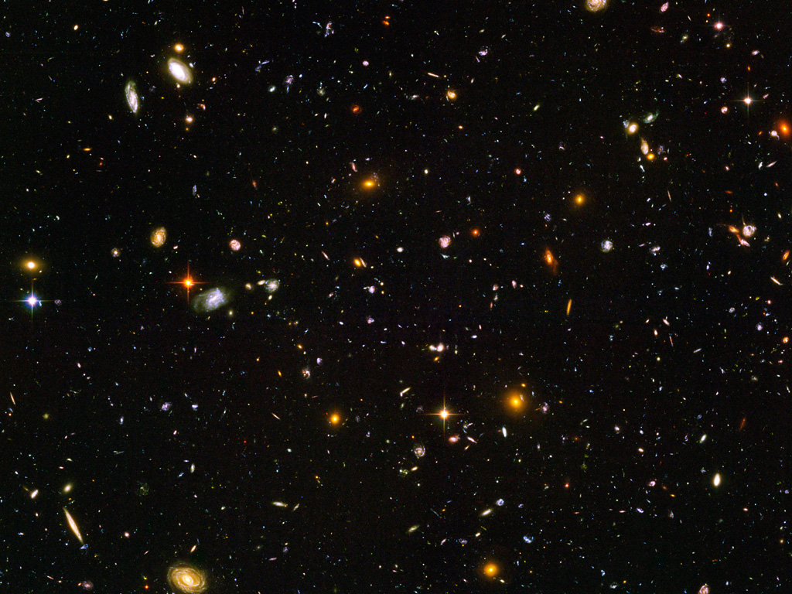
An Awesome Arsenal of Astronomical Facilities
Enormous scientific power
Formidable Data rates giving real challenges in efficient exploitation and community access
International and global projects
Require huge investment giving high visibility and raised profiles and bringing
Opportunities for promotion and influence
Risks if we fail to deliver or to maintain public and political support
Timescale for development of major instruments is ~10years

Slide 3
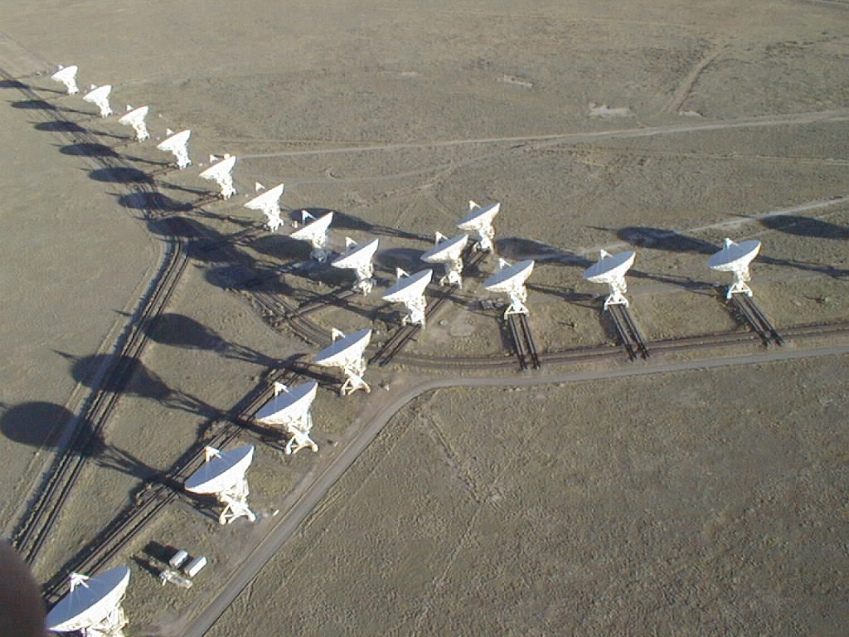
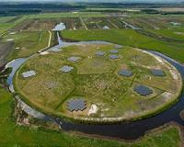
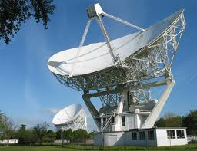
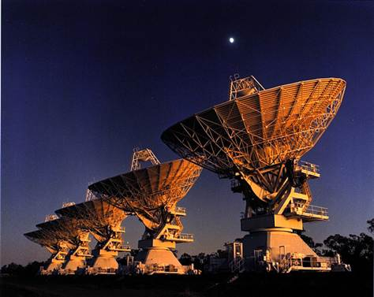
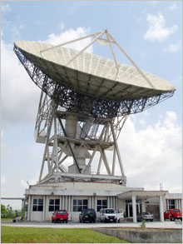
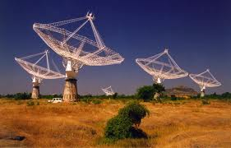
Radio Astronomy
VLA - ATCA – e-Merlin
GMRT
Large Radio Dishes :
GBT, Effelsberg, Bonn, Parkes, Westerbork, Jodrell, Medicina
VLBA, EVN/JIVE VLBI
LOFAR : sub-mJy sensitivity over the northern sky

Slide 4
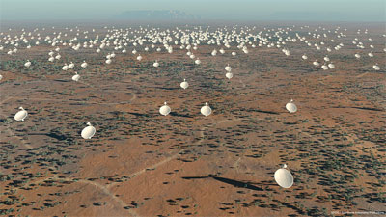
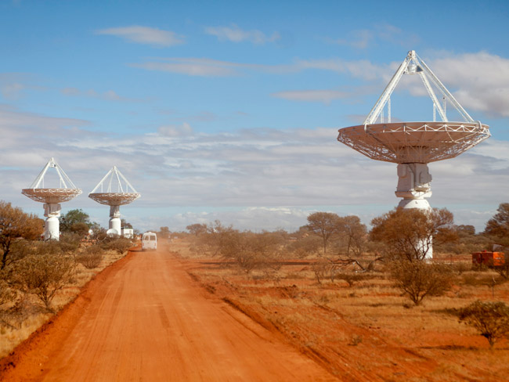
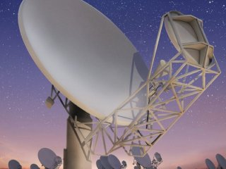
Revolutionary Capabilities at low-frequencies
EVLA 1 – 50GHz 27 x 25-m antennas 2-6μJy sensitivity
LOFAR 30-250MHz NL/European Array Phased arrays baseline 100m -1500km
SKA Pathfinders and Phase I: Phased array feeds
ASKAP 36 x 12-m dishes in WA
MeerKat 64 x 13.5-m dishes 1-15GHz
Africa Telescope
Plans to connect surplus communication dishes across Africa

Slide 5
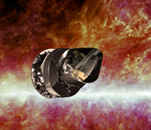
Microwave Astronomy
WMAP and Planck Legacy,
CMB intensity and polarization maps, Galactic foregrounds and point sources :
ACT, PolarBear, QUIJOTE, SPT, GEM, CBASS ….
APEX and JCMT : Scuba-2 LaBoca

Slide 6
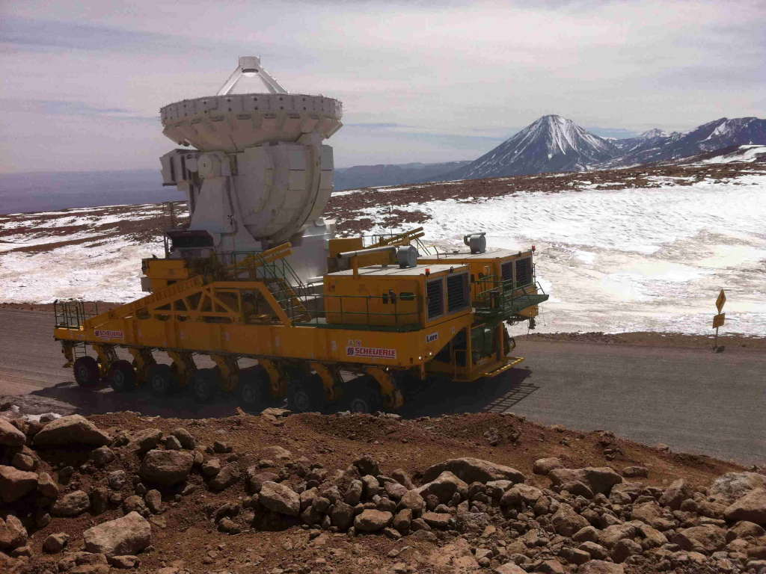
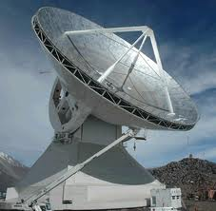
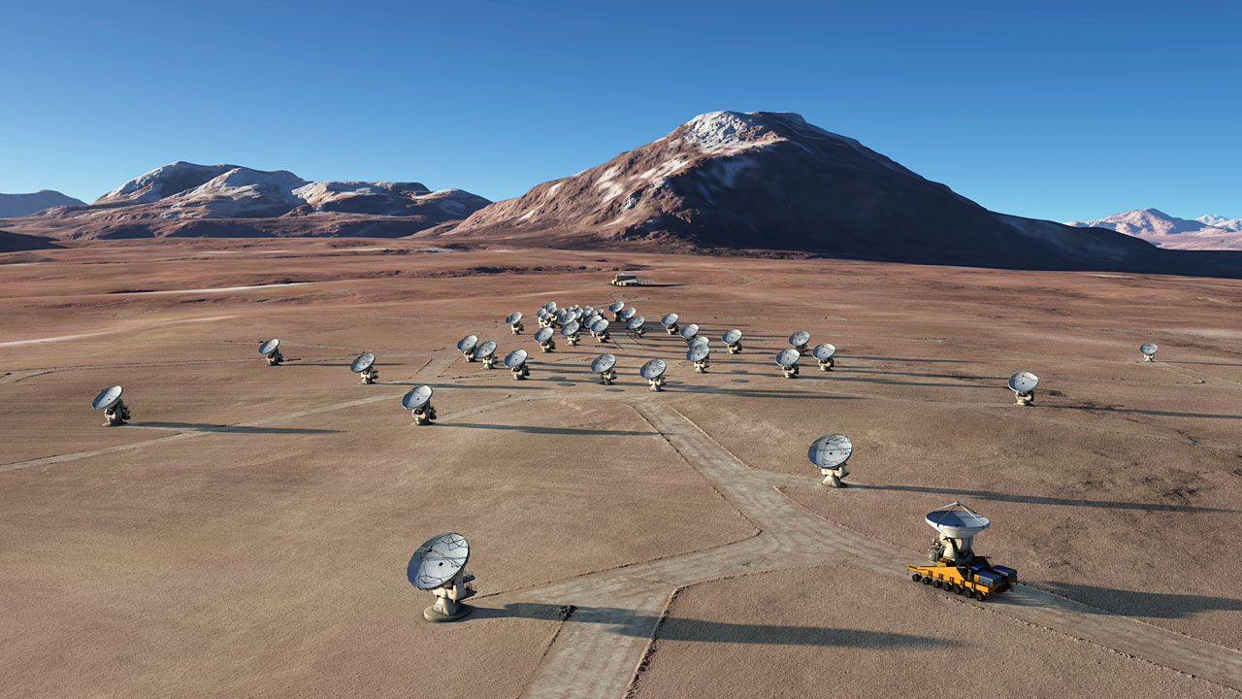
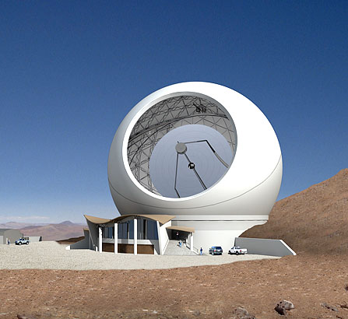
Major New mm Facilities
LMT US-Mexico 50-m Dish, mm-wave astronomy at 4600-m
ALMA 50 x 12-m +16 compact array antennas + 1st development projects
VLBI? Other wavebands?
CCAT : Cerro Chajnantor Atacama Telescope, 25-m at 5600m

Slide 7
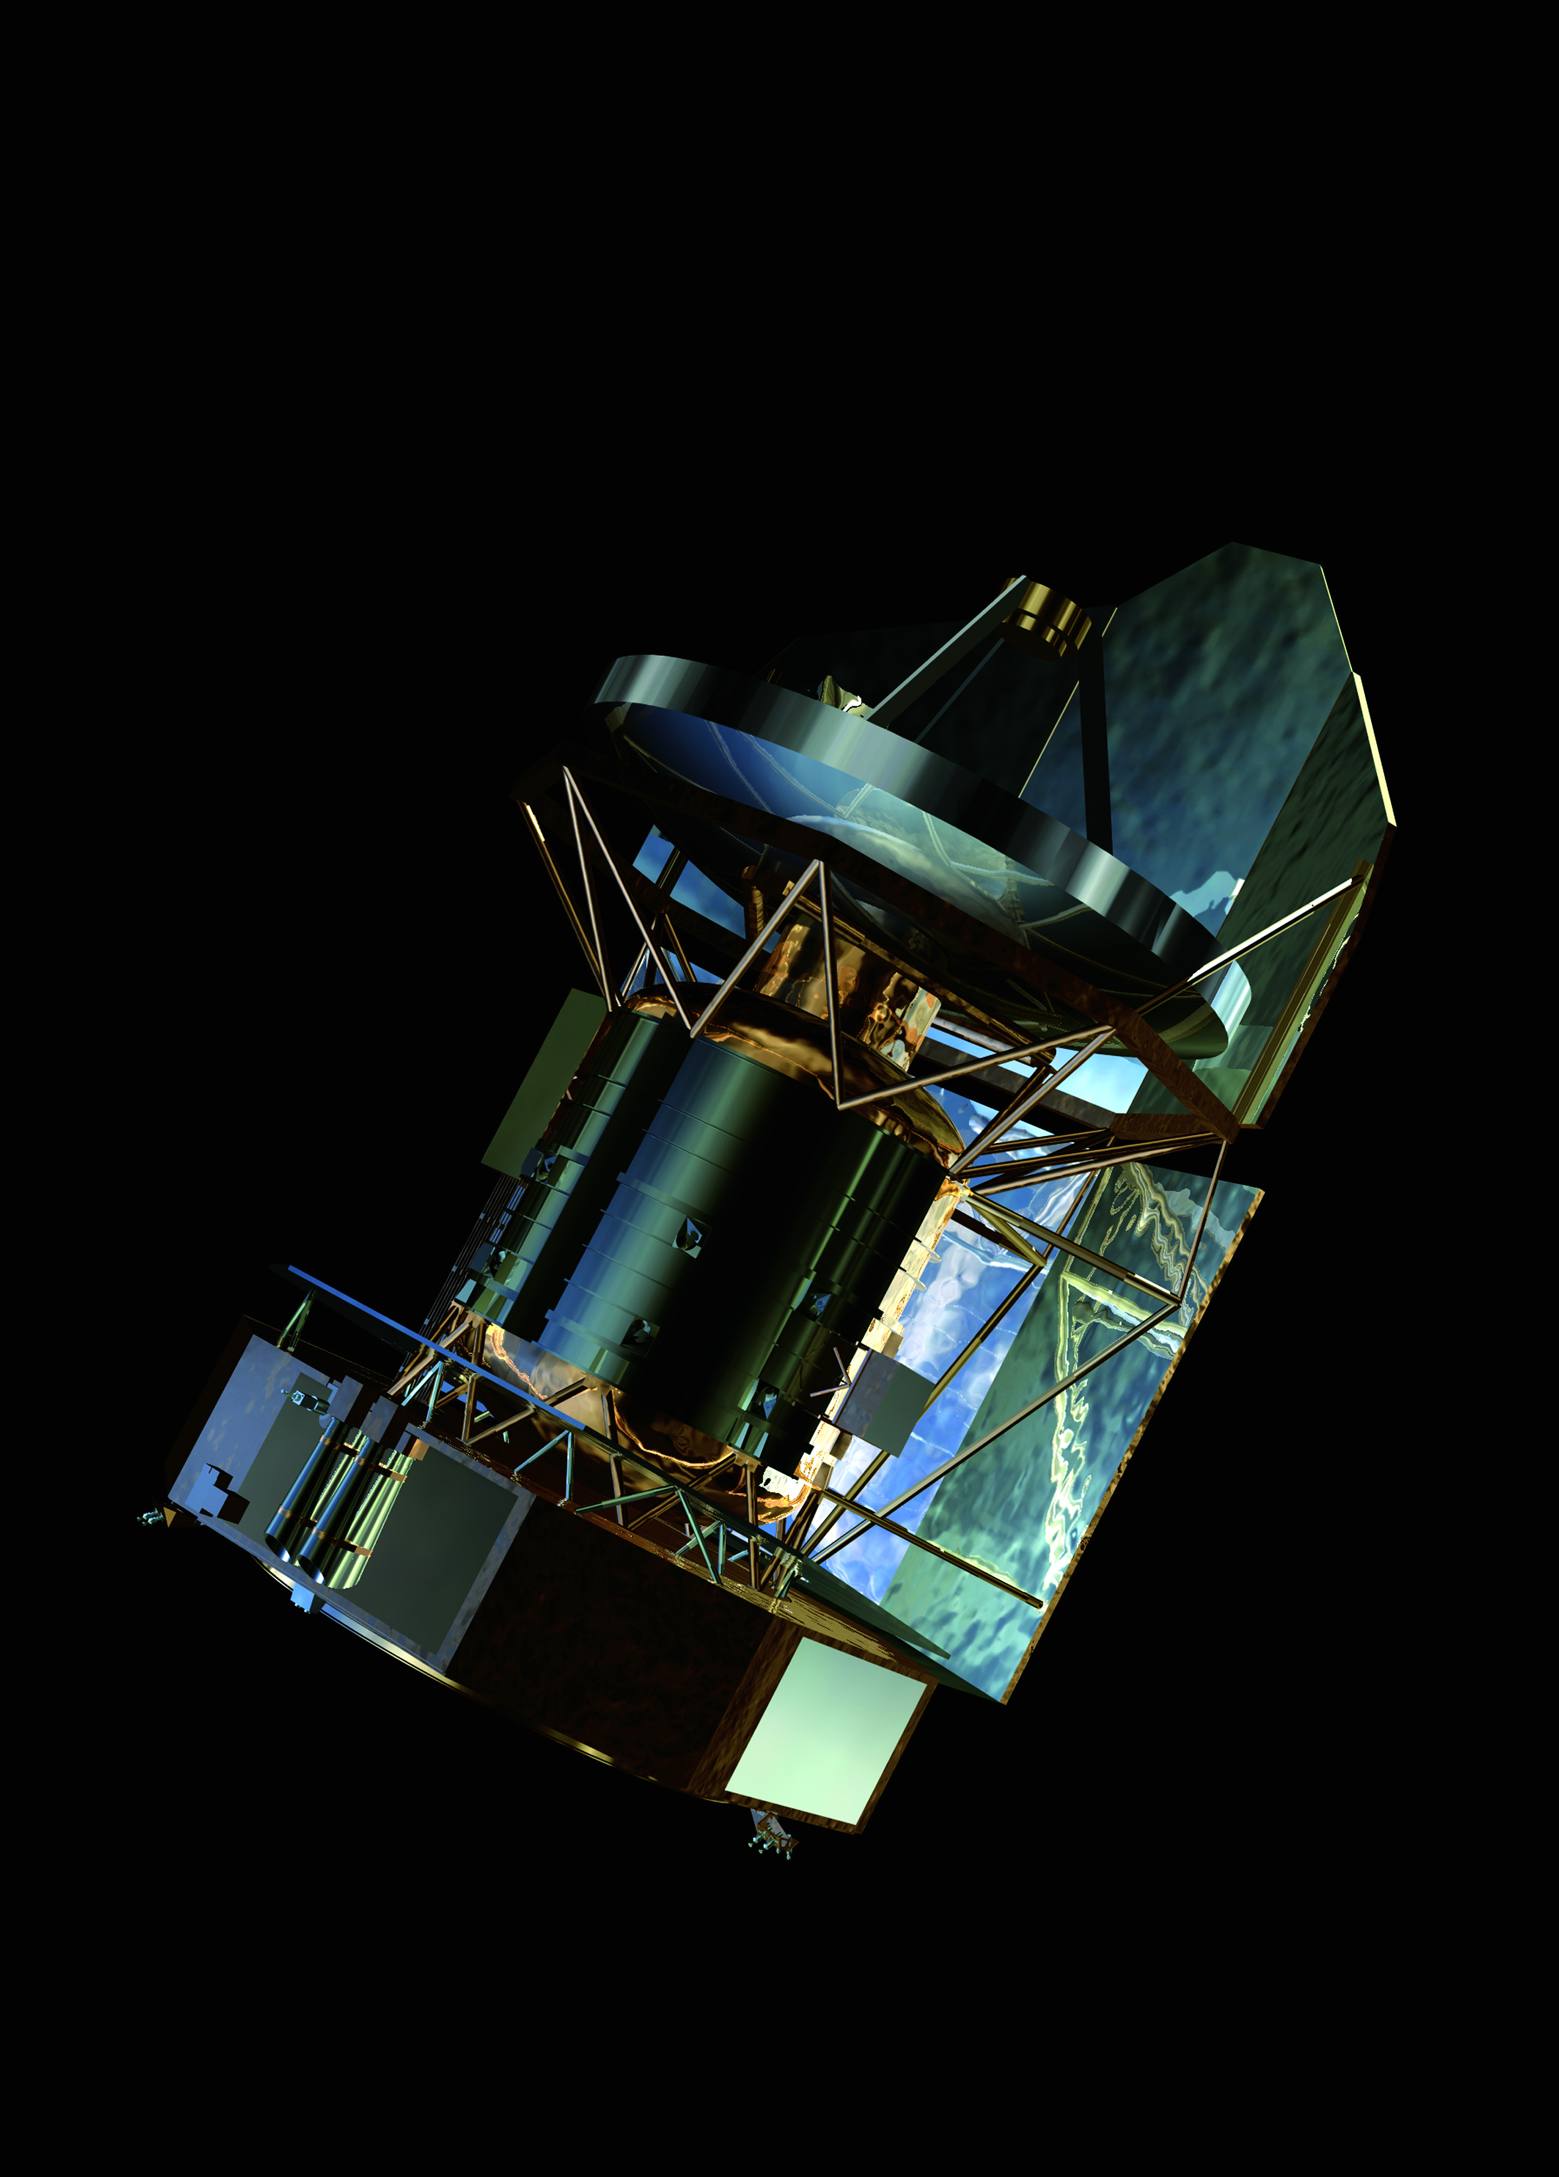
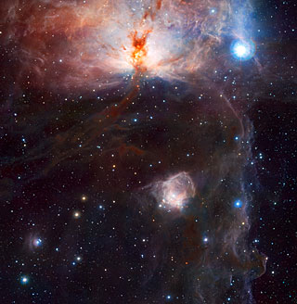
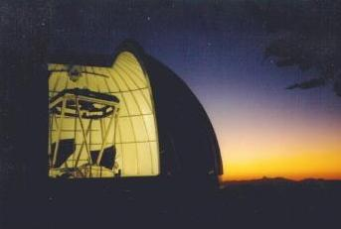
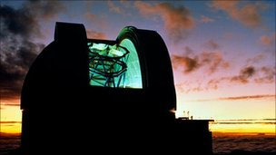
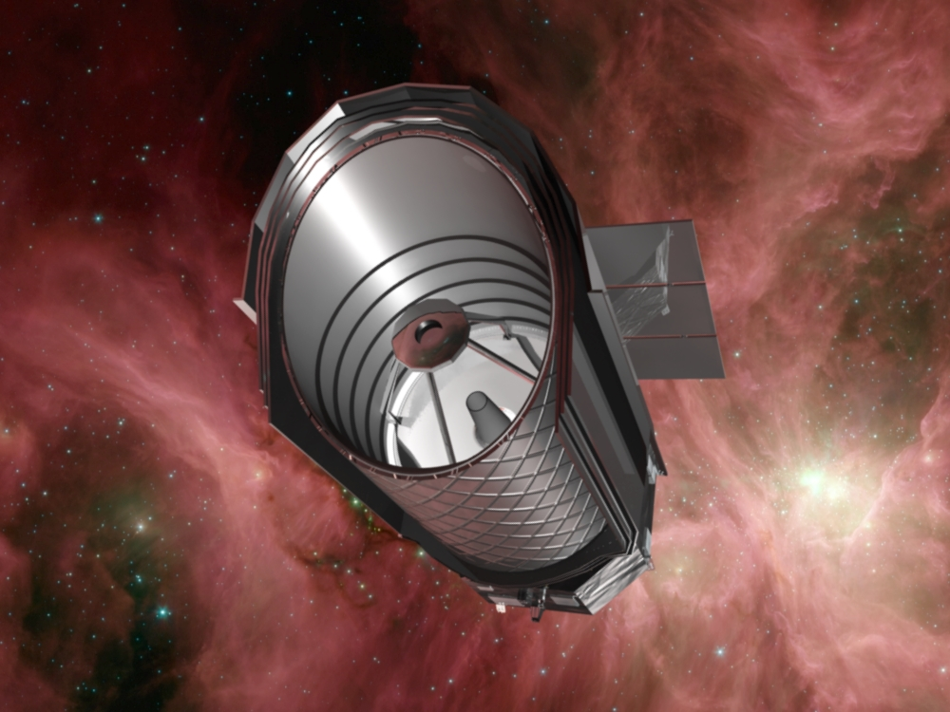
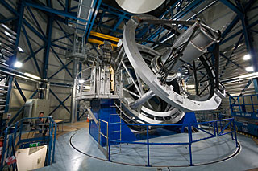
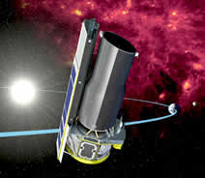
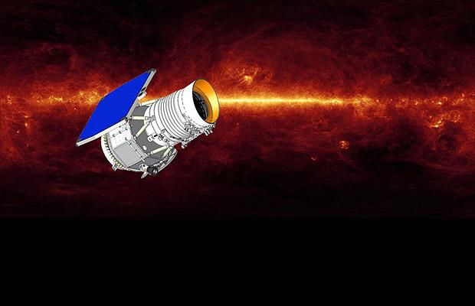
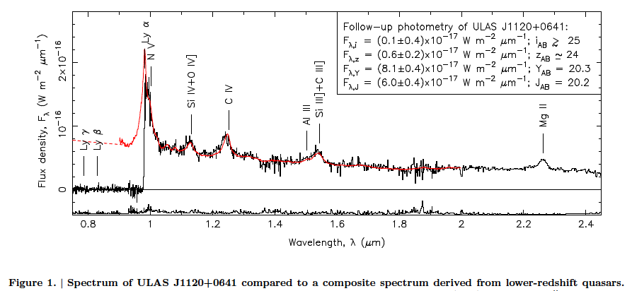
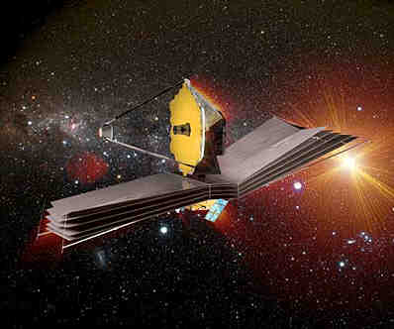
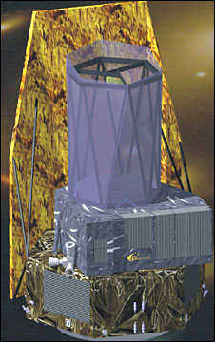
Infrared Surveys
Herschel – SPICA
Spitzer – Akari - JWST
2MASS - UKIRT – VISTA – SASIR
WISE – EUCLID = WFIRST?
WISE Y-dwarfs Cushing et al 2011
IR Spectrum of ULAS J1120+0641 at a redshift z=7.08 (Mortlock et al 2011)

Slide 8
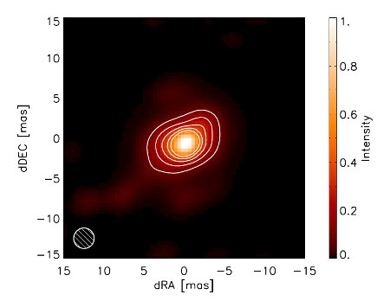
Infrared Interferometry
Lower sensitivity but higher resolution than the ELTs by factors of 5+
Phase-referencing to allow longer integrations
Astrometric and Imaging programmes with ~10 microarcsecond precision and milli-arcsec resolution
Near- and mid-IR images and Spectroscopy
Chara, Keck, LBT, Magdalena Ridge, VLTI
VLTI/AMBER image of the disk in IRAS 13481-6124
Chara image of ε Aur in Eclipse

Slide 9
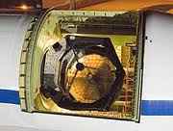
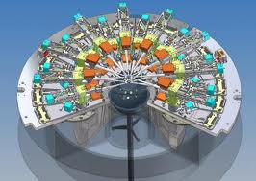
New IR Facilities
SOFIA
Ground- based MOS and multi-IFU instruments
Wider field and higher order AO
JWST
Synergies in the near-IR
Complementarity in the mid-IR
Resolution from the ground for the brightest objects
Sensitivity from Space

Slide 10
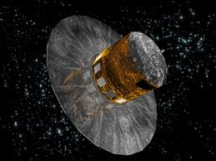
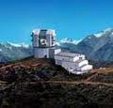
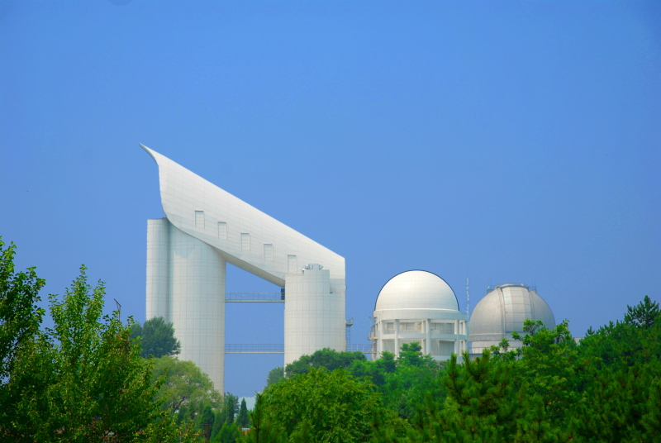
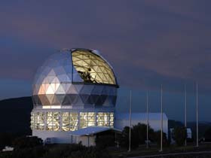
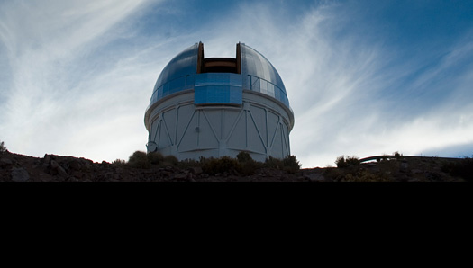
Optical Surveys
HST, Galex Legacy
Imaging Surveys
PanStarrs, Skymapper, VST, DES
LSST 8.4-m Large Synoptic Survey Telescope
Multifilter, deep maps of the southern sky every 3 days
NSF PDR this week
Large Spectroscopic Surveys
2DF – SDSS – BOSS - LAMOST – HETDEX
GAIA

Slide 11
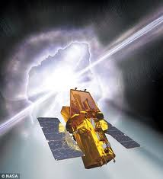
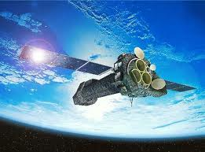
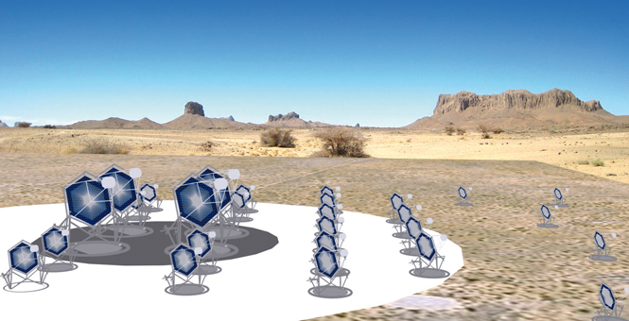
High Energy Facilities
Chandra - XMM-Newton – SWIFT
LOFT – Astro-H - GEMS – NuStar
Cosmic ray telescopes
Auger + Enhancements
Cerenkov Telescope Arrays
Hess, Magic, CTA

Slide 12
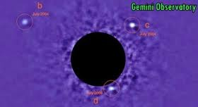
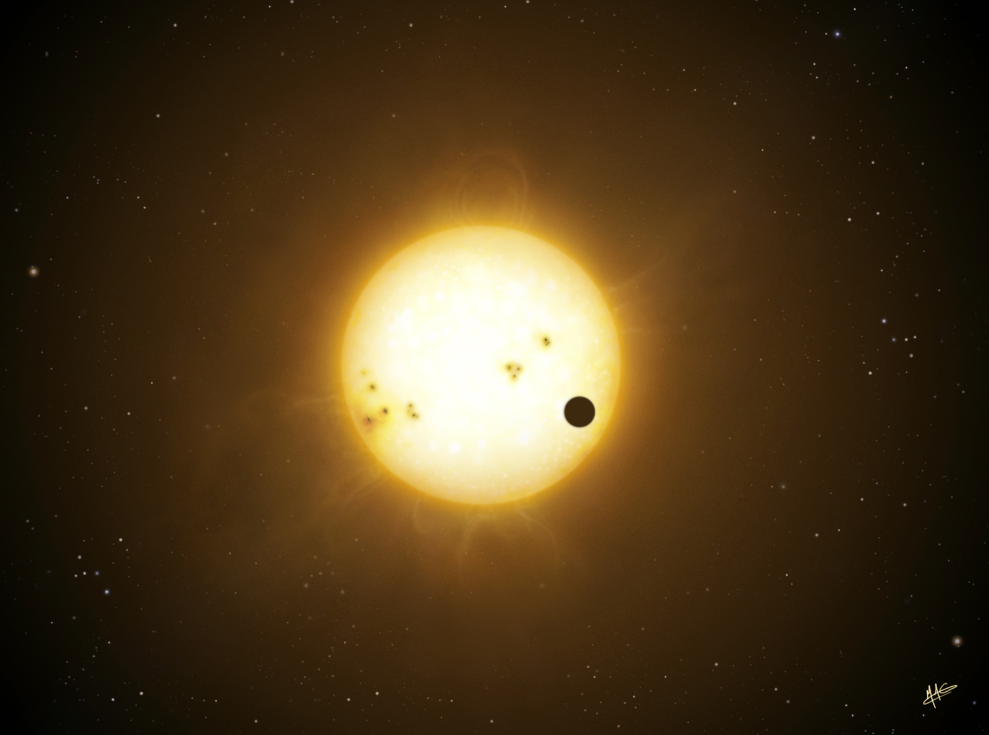
Exoplanet detection and characterization
RV Spectrographs :
Keck, Lick, AAT, HARPS-S and -N, Carmenes, Spirou….
Transit Searches and spectroscopy
Corot, Kepler, Echo, Plato…. coordination with ground-based facilities
Superwasp, TrES……
Hubble, Spitzer, JWST + ground-based telescopes
High contrast AO Planet Imagers
VLT/Sphere, Gemini/GPI, EPICS
Astrometric Searches
VLTI/Prima,
magnetopheric radio emission : LOFAR and SKA
microLensing detections

Slide 13
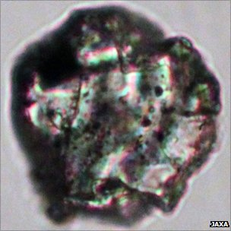
+ a host of other facilities
General purpose ground-based telescopes
Workhorses for most programmes
Next generation 8 and 10-m telescope instruments aimed at ambitious programmes with large time allocations
Solar system exploration and exoplanet synergies
Meteoritics and Interplanetary /interstellar dust particles
Laboratory studies – molecular and atomic physics and chemistry

Slide 14
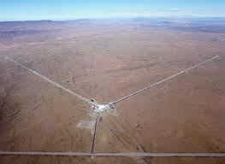
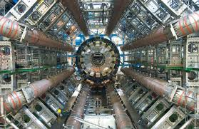
Beyond the Electromagnetic Spectrum
VIRGO – GEO600 - LIGO – LISA-Pathfinder
Gravitational wave detectors may open up a new window in the coming years.
Astronomical target identification and follow-up?
Direct Dark Matter detection
Neutrinos and other Particle Physics

Slide 15
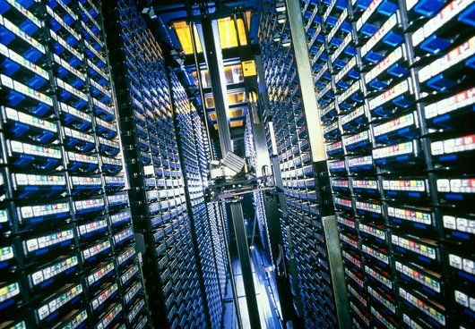
Opportunities in the Time Domain
Quasi-continuous monitoring of large areas of sky provides new opportunities for discovery with SKA and LSST from 2020 onwards
Poorly sampled variability parameter space may yield surprises
Rapid follow-up required via automated systems
Data digestion or indigestion
Serious collaboration with computer science and engineering departments

Slide 16
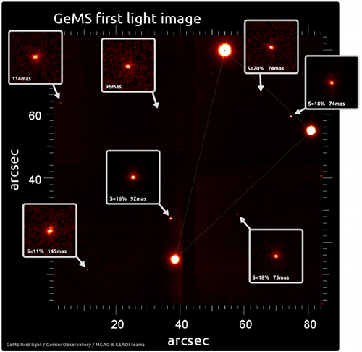
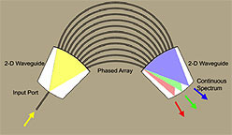
Technology Developments
Resolution, Sensitivity and multiplex gains
Mass-production : VLT/MUSE HET/VIRUS
Detectors
larger format IR detectors
multi-pixel heterodyne receivers, phased arrays
Adaptive Optics,
more actuators, more lasers
faster reconstructors/electromechanics,
higher reliability/availability
Photonic instruments
Integrated optics
Background suppression via notch filters
Energy-resolving detectors?

Slide 17
Public and Political support
Public education and student inspiration
Citizen science
Galaxyzoo and its offspring
Growing communities – Africa, Asia, South America and elsewhere
More representative communities
Political engagement

Slide 18
Sustainability
Energy costs – big facilities in remote areas
Must
Deliver outstanding, inspirational science,
Ensure that we deliver on promises
Complete facilities on schedule and budget
How do we maintain diversity of facilities and community in the face of hugely ambitious and expensive flagship projects?

Slide 20
he four proposals chosen to proceed for assessment are EChO, LOFT, MarcoPolo-R and STE-QUEST.The Exoplanet Characterisation Observatory (EChO) would be the first dedicated mission to investigate exoplanetary atmospheres, addressing the suitability of those planets for life and placing our Solar System in context. Orbiting around the L2 Lagrange point, 1.5 million km from Earth in the anti-sunward direction, EChO would provide high resolution, multi-wavelength spectroscopic observations. It would measure the atmospheric composition, temperature and albedo of a representative sample of known exoplanets, constrain models of their internal structure and improve our understanding of how planets form and evolve. The Large Observatory For X-ray Timing (LOFT) is intended to answer fundamental questions about the motion of matter orbiting close to the event horizon of a black hole, and the state of matter in neutron stars, by detecting their very rapid X-ray flux and spectral variability. LOFT would carry two instruments: a Large Area Detector with an effective area far larger than current spaceborne X-ray detectors, and a Wide Field Monitor that would monitor a large fraction of the sky. With its high spectral resolution, LOFT would revolutionise studies of collapsed objects in our Galaxy and of the brightest supermassive black holes in active galactic nuclei. MarcoPolo-R is a mission to return a sample of material from a primitive near-Earth asteroid (NEA) for detailed analysis in ground-based laboratories. The scientific data would help to answer key questions about the processes that occurred during planet formation and the evolution of the rocks which were the building blocks of terrestrial planets. The mission would also reveal whether NEAs contain pre-solar material not yet found in meteorite samples, determine the nature and origin of the organic compounds they contain, and possibly shed light on the origin of molecules necessary for life. The Space-Time Explorer and Quantum Equivalence Principle Space Test (STE-QUEST) is devoted to precise measurement of the effects of gravity on time and matter. Its main objective would be to test the Principle of Equivalence, a fundamental assumption of Einstein's Theory of General Relativity. STE-QUEST would measure space-time curvature by comparing the tick rate of an atomic clock on the spacecraft with other clocks on the ground. A second primary goal is a quantum test of the Universality of Free Fall – the theory that gravitational acceleration is universal, independent of the type of body.

Slide 21
The missions flown as part of ESA's Cosmic Vision 2015-2025 plan will tackle some of the major outstanding scientific questions about the Universe and our place in it:What are the conditions for planet formation and the emergence of life?How does the Solar System work?What are the fundamental physical laws of the Universe?How did the Universe originate and what is it made of?There are currently three missions - Euclid, PLATO and Solar Orbiter - which are undergoing competitive assessment for selection as the first and second medium class missions under Cosmic Vision. The final selection for M1 and M2 will be made later this year, with launches expected in 2017-18.

Slide 22
Cosmic Vision Timeline
Selection of four M-class candidate missions for assessment study (**) February 2011
Three missions in competitive Definition Phase April 2010 - September 2011
Working group/SSAC evaluation and recommendation for adoption of 2 missions September 2011 - October 2011
SPC decision on 2 missions for ITT release November 2011
SPC adoption of missions (Cost-at-Completion and Payload Formal Agreement) July 2012
Missions enter Implementation Phase September 2012
Mission launch slots (M1, M2, M3) 2017, 2018, 2022
End of joint Europe-US mission studiesStart of European-led mission studies March 2011
Recommendation on mission selection to SPC February 2012
Mission launch (L1) 2020
In February 2009 a down-selection took place between the two L-class candidate missions Laplace (Jupiter) and TandEM (Saturn). Both missions had been proposed as collaborations with NASA, and a joint decision was taken to retain the mission to the Jupiter system as candidate for the L1 launch slot in 2020. In March 2011 ESA announced a new way forward for the L-class candidate missions (IXO, Laplace, LISA) that took account of developments with ESA's international partners. This resulted in the termination of the studies into joint missions and the start of studies into European-led missions.

Slide 23
DIVISION NAME LAUNCH DATE PHASE
Astrophysics Astro-HAstro-H is a powerful orbiting observatory being developed by the Japan Aerospace Exploration Agency (JAXA) for studying extremely energetic processes in the universe. NASA and the JAXA/Institute of Space and Astronautical Science have teamed up to develop a high resolution ... 20140215February 15, 2014 2Development
Astrophysics GEMSGEMS will use an X-ray telescope to explore the shape of space that has been distorted by a spinning black hole's gravity, and probe the structure and effects of the formidable magnetic field around magnetars, dead stars with magnetic fields ... 20140701July 2014 2Development
Astrophysics JWSTJames Webb Space Telescope (formerly the Next Generation Space Telescope) is designed for observations in the far visible to the mid infrared part of the spectrum. JWST will probe the era when stars and galaxies started to form; it will ... 20140601June 01, 2014 2Development
Astrophysics LBTIThe Large Binocular Telescope Interferometer (LBTI) is part of NASA's overall effort to find planets and ultimately life beyond our solar system. It will combine the light from the twin telescope mirrors to make high resolution measurements of stars and ... 2Development
Astrophysics NuSTARThe Nuclear Spectroscopic Telescope Array is a pathfinder mission that will open the high energy X-ray sky for sensitive study for the first time. This mission is part of SMD's Astrophysics Explorers program. 20120203February 03, 2012 2Development
Astrophysics SOFIASOFIA is an airborne observatory that will study the universe in the infrared spectrum. This mission is part of SMD's Cosmic Origins program. 2Development
Astrophysics ST-7 / Lisa PathfinderSpace Technology 7 project will flight test a Disturbance Reduction System (DRS) that will aid scientists in their quest to detect and measure gravitational waves in space. 20120630June 30, 2012 2Development

