Slide 1
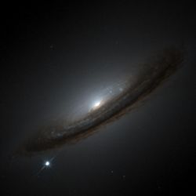
The Hubble Constant and the never-ending story of the expansion rate of the Universe
Bruno Leibundgut
ESO

Slide 2
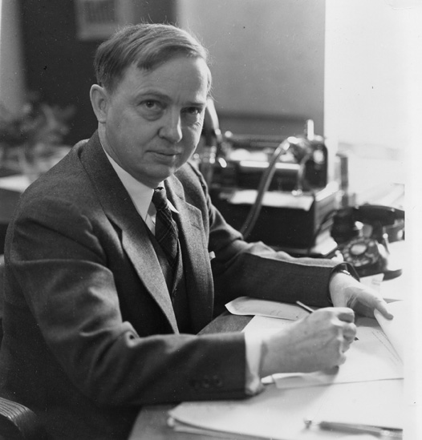
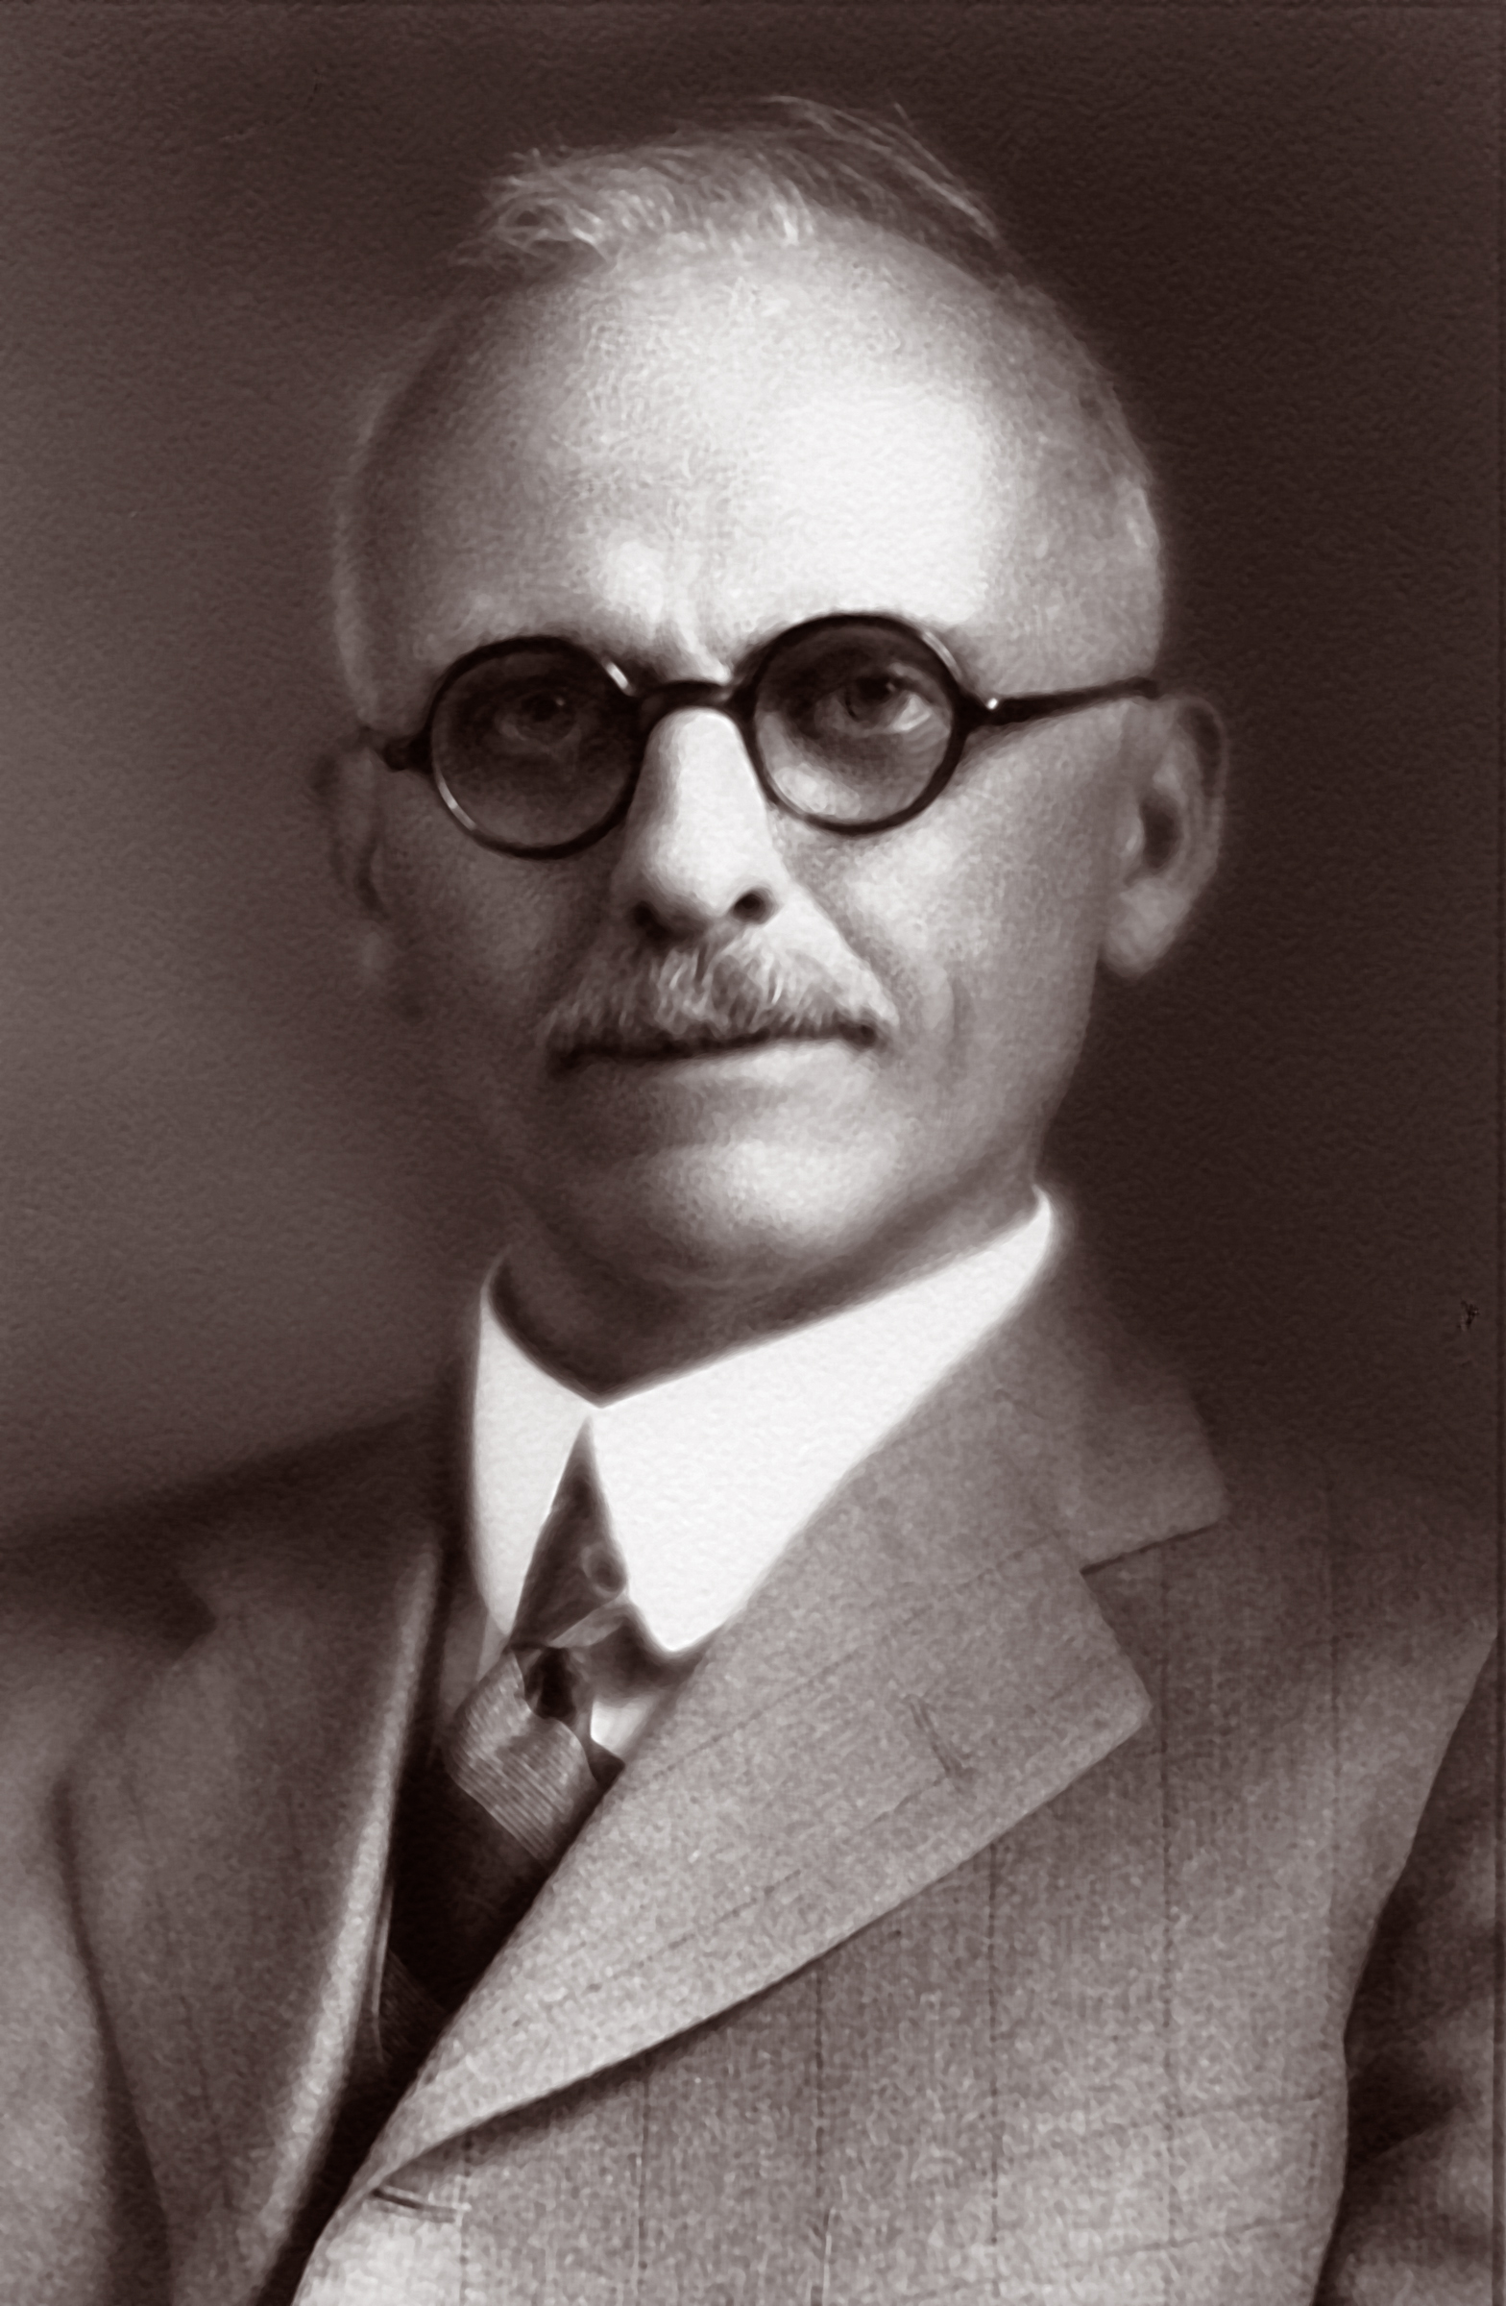
Great Debate: What is the size of the Universe?
Presentations at the Annual Meeting of the National Academy of Sciences in Washington DC, 26. April 1920
Harlow Shapley vs. Heber Curtis
http://incubator.rockefeller.edu/geeks-of-the-week-harlow-shapley-heber-curtis/

Slide 3
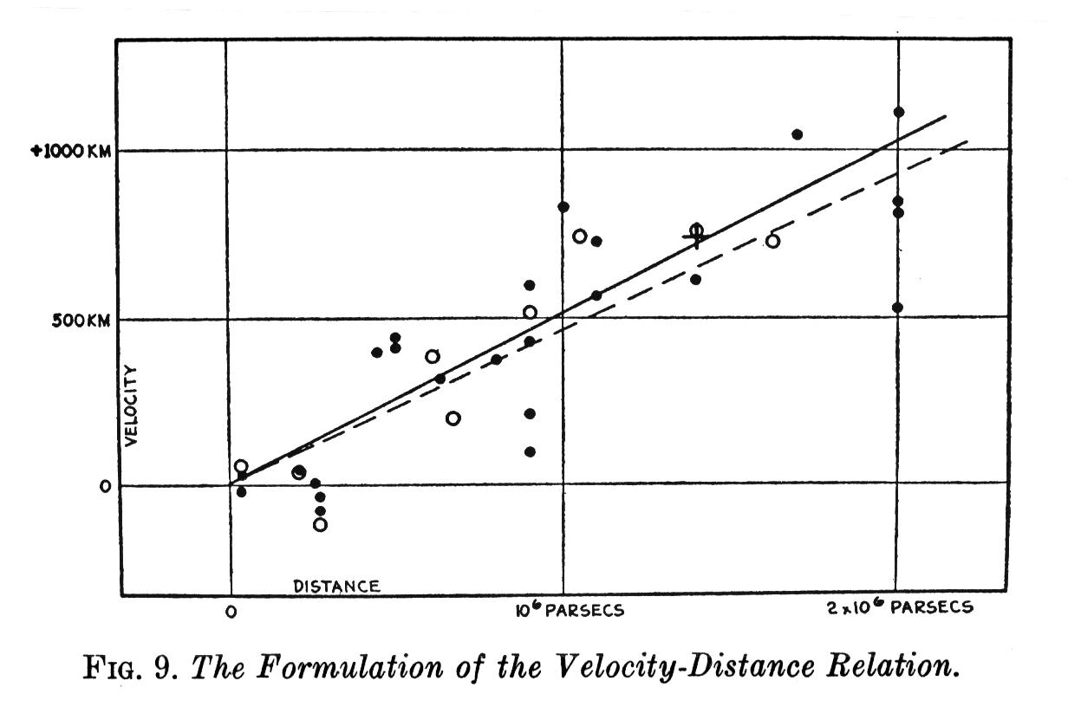
Background
Expanding universe
  → expansion rate critical for cosmic evolution
STScI
Hubble 1929

Slide 4
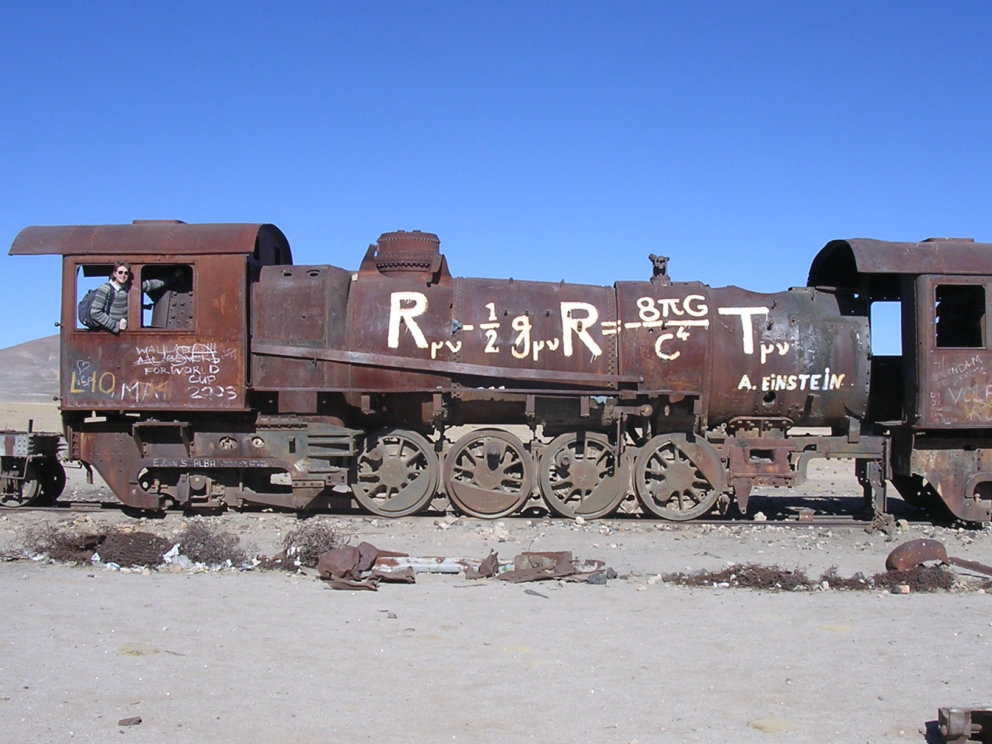
Leading Theory of the Universe

Slide 5
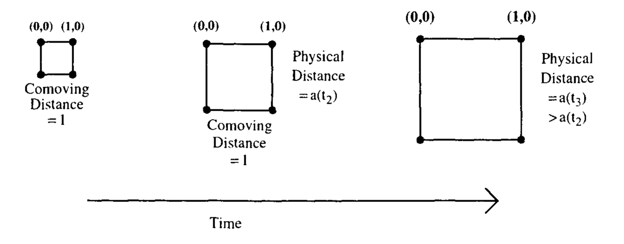
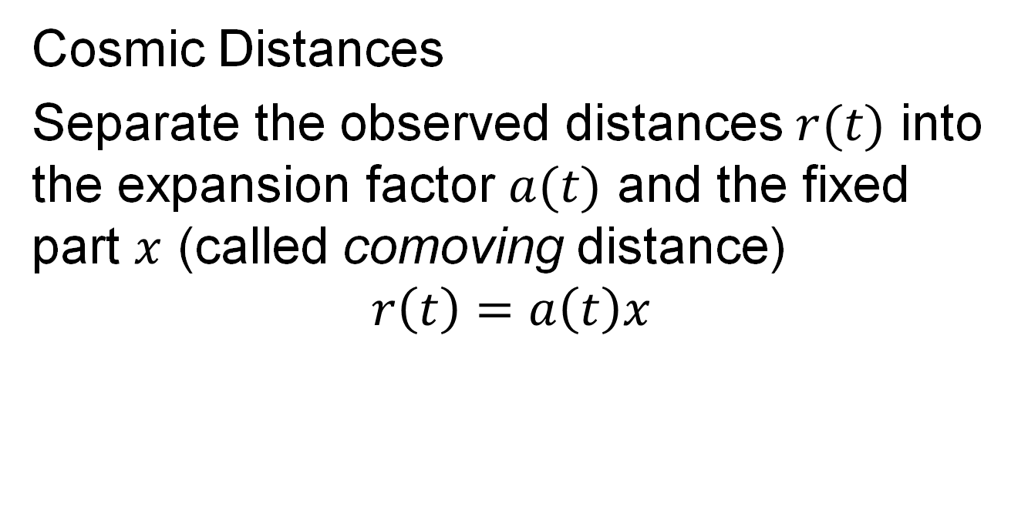
Dealing with an expanding Universe
Cosmic Distances
Separate the observed distances $r(t)$ into the expansion factor $a(t)$ and the fixed part $x$ (called comoving distance)
$$r\left(t\right)=a\left(t\right)x$$
x
x

Slide 6
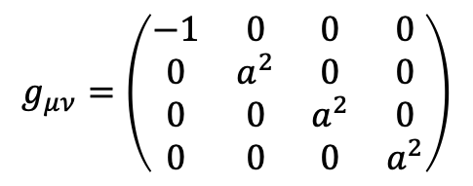
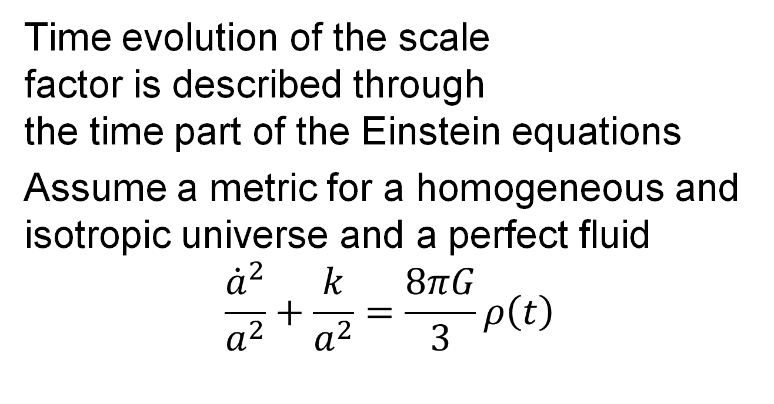
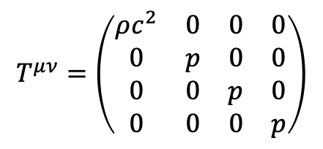
Friedmann Equation
Time evolution of the scale
factor is described through
the time part of the Einstein equations
Assume a metric for a homogeneous and isotropic universe and a perfect fluid
$$\frac{{\dot{a}}^{2}}{a^{2}}+\frac{k}{a^{2}}=\frac{8πG}{3}ρ\left(t\right)$$
$$g_{μν}=\left(\begin{matrix}−1 & 0 & 0 & 0 \\ 0 & a^{2} & 0 & 0 \\ 0 & 0 & a^{2} & 0 \\ 0 & 0 & 0 & a^{2}\end{matrix}\right)$$
$$T^{μν}=\left(\begin{matrix}ρc^{2} & 0 & 0 & 0 \\ 0 & p & 0 & 0 \\ 0 & 0 & p & 0 \\ 0 & 0 & 0 & p\end{matrix}\right)$$

Slide 7
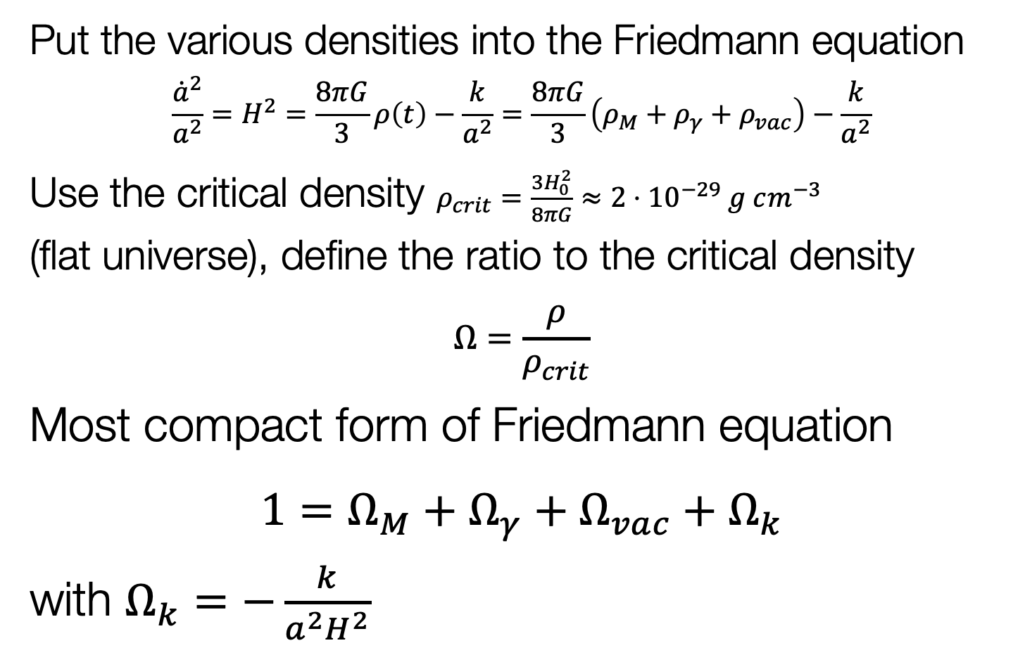
Friedmann Equation
Put the various densities into the Friedmann equation
$$\frac{{\dot{a}}^{2}}{a^{2}}=H^{2}=\frac{8πG}{3}ρ\left(t\right)−\frac{k}{a^{2}}=\frac{8πG}{3}\left(ρ_{M}+ρ_{γ}+ρ_{vac}\right)−\frac{k}{a^{2}}$$
Use the critical density $ρ_{crit}=\frac{3H_{0}^{2}}{8πG}≈{2⋅10}^{−29} g cm^{−3}$
(flat universe), define the ratio to the critical density
$$Ω=\frac{ρ}{ρ_{crit}}$$
Most compact form of Friedmann equation
$1=Ω_{M}+Ω_{γ}+Ω_{vac}+Ω_{k}$
with $Ω_{k}=−\frac{k}{a^{2}H^{2}}$

Slide 8
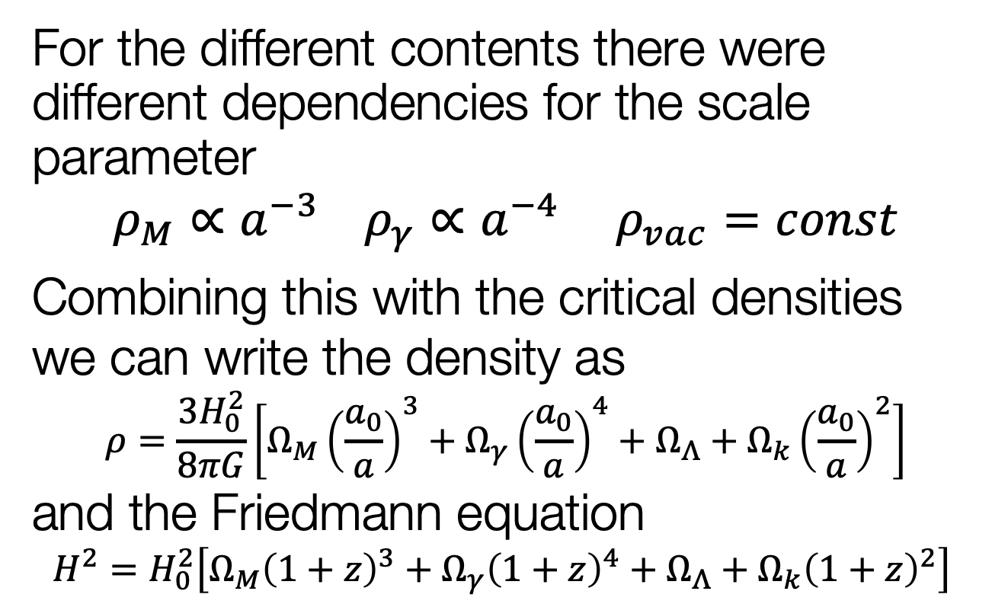
Dependence on Scale Parameter
For the different contents there were different dependencies for the scale parameter
$$ρ_{M}∝a^{−3} ρ_{γ}∝a^{−4} ρ_{vac}=const$$
Combining this with the critical densities we can write the density as
$$ρ=\frac{3H_{0}^{2}}{8πG}\left[Ω_{M}{\left(\frac{a_{0}}{a}\right)}^{3}+Ω_{γ}{\left(\frac{a_{0}}{a}\right)}^{4}+Ω_{Λ}+Ω_{k}{\left(\frac{a_{0}}{a}\right)}^{2}\right]$$
and the Friedmann equation
$$H^{2}=H_{0}^{2}\left[Ω_{M}{\left(1+z\right)}^{3}+Ω_{γ}{\left(1+z\right)}^{4}+Ω_{Λ}+Ω_{k}{\left(1+z\right)}^{2}\right]$$

Slide 9

History of $H0$
Expansion rate by G. Lemaître (1927)
Footnote!

Slide 10
Intermezzo
Age of the Universe
Matter-dominated universe has the following age
  age of the Earth: 4.5⋅10⁹ years
  oldest stars: ~1.2⋅10¹⁰ years
H₀ (km/s/Mpc) | t₀ (yr)
500 | 1.30⋅10⁹
250 | 2.61⋅10⁹
100 | 6.52⋅10⁹
80 | 8.15⋅10⁹
70 | 9.32⋅10⁹
60 | 1.09⋅10¹⁰
50 | 1.30⋅10¹⁰
30 | 2.17⋅10¹⁰

Slide 11
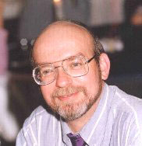



History of $H_{0}$
https://www.cfa.harvard.edu/~dfabricant/huchra/hubble/
$$2.6⋅{10}^{9}years$$
$$6.5⋅{10}^{9}years$$

Slide 12



History of $H_{0}$
$$6.5⋅{10}^{9}years$$
$$13⋅{10}^{9}years$$

Slide 13
History of $H_{0}$
$$6.5⋅{10}^{9}years$$
$$13⋅{10}^{9}years$$

Slide 14
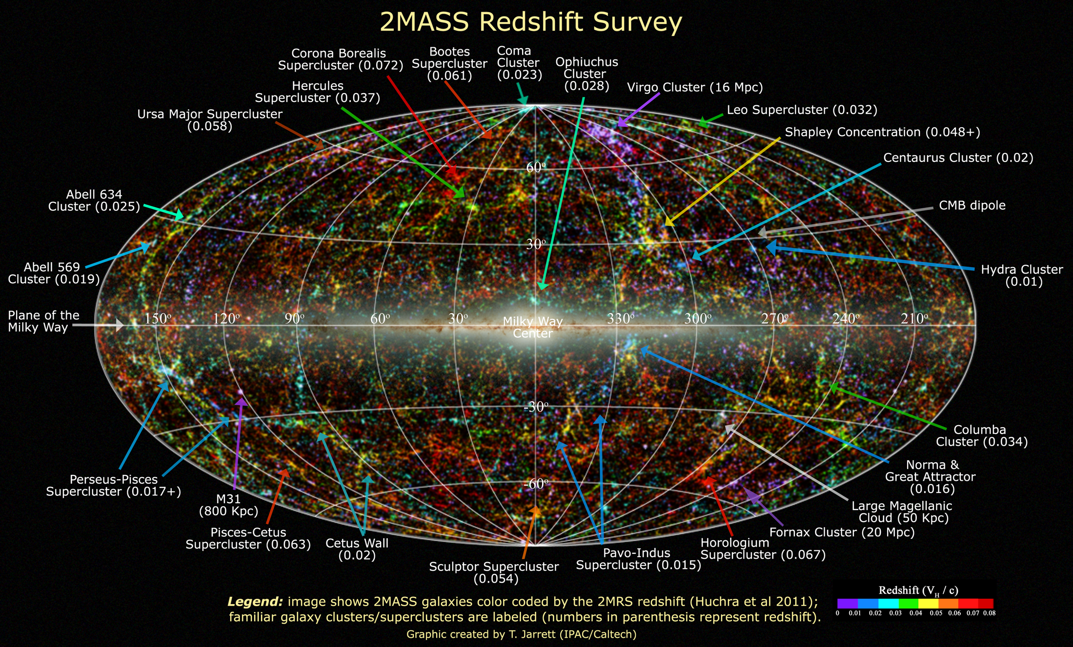
Extragalactic Distances
Required for a 3D picture of the (local) universe

Slide 15
Extragalactic Distances

Slide 16
Local Flows
Inhomogeneous mass distribution in the local Universe
Pomarède et al. 2020

Slide 17
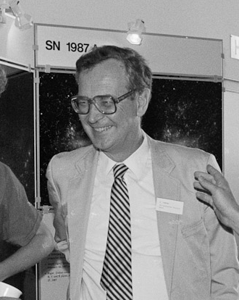

Measuring $H_{0}$
Classical approach
  → distance ladder to reach (smooth) Hubble flow
Sandage & Tammann 1974

Slide 18
Hubble Constant
Three different methods
  Distance ladder
    Calibrate next distance indicator with the previous
  Physical methods
    Determine either luminosity or length through physical quantities
      Sunyaev-Zeldovich effect (galaxy clusters)
      Expanding photosphere method in supernovae
      Physical calibration of thermonuclear supernovae
      Geometric methods, e.g. megamasers
  Global solutions
    Use knowledge of all cosmological parameters
      Cosmic Microwave Background

Slide 19
Classical Distance Ladder
Primary distance indicators (within the
Milky Way)
  trigonometric parallax
  proper motion
  apparent luminosity
    main sequence
    red clump stars
    RR Lyrae stars
    eclipsing binaries
    Cepheid stars
Jacoby et al. 1992

Slide 20
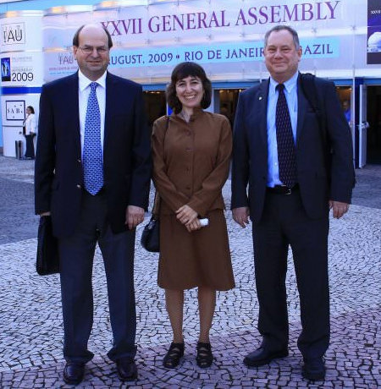
Classical Distance Ladder
Secondary distance indicators (beyond the Local Group)
  Important check
    Large Magellanic Cloud
  Tully-Fisher relation
  Fundamental Plane
  Supernovae (mostly SN Ia)
  Surface Brightness Fluctuations
Gruber Cosmology Prize
Freedman & Madore 2010
Notes:
Jeremy Mould
Wendy Freedman
Robert Kennicutt

Slide 21
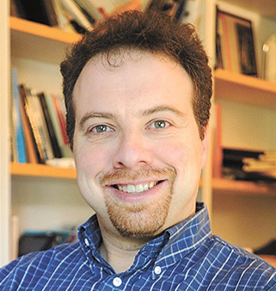
Hubble Constant
Calibration of M(SN Ia @ max)
Distance ladder
Adam Riess

Slide 22
Hubble Constant
Supernova Ia
Hubble diagram

Slide 23

$H_{0}$ with Supernovae
Local calibrators (calibrate the Cepheid L-P rel.)
  Large Magellanic Cloud
    1% accuracy with eclipsing binaries (Pietrzyński et al. (2019)
  Maser in NGC 4258
    3% accuracy (Humphreys et al. 2013)
  geometric distances (parallaxes) to nearby Cepheids
Extinction
  absorption in the Milky Way and the host galaxy
  corrections not always certain
Peculiar velocities of galaxies
  typically around 300 km/s

Slide 24
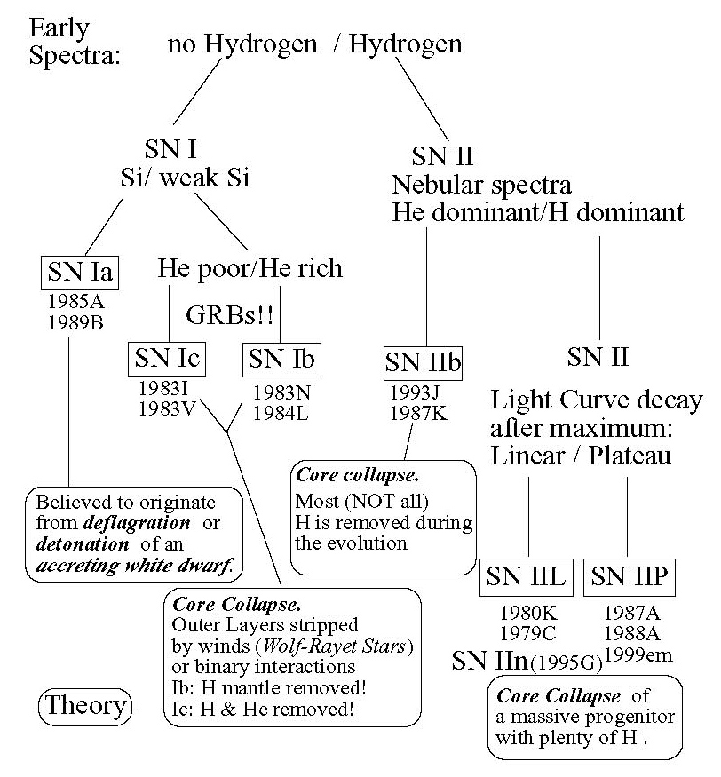
SN Classification

Slide 25
Type Ia Supernovae
Variations on a theme
  critical parameters?
    nickel mass
    ejecta mass
    explosion energy(?)
    explosion mechanism?
    progenitor evolution?
Taubenberger 2017

Slide 26
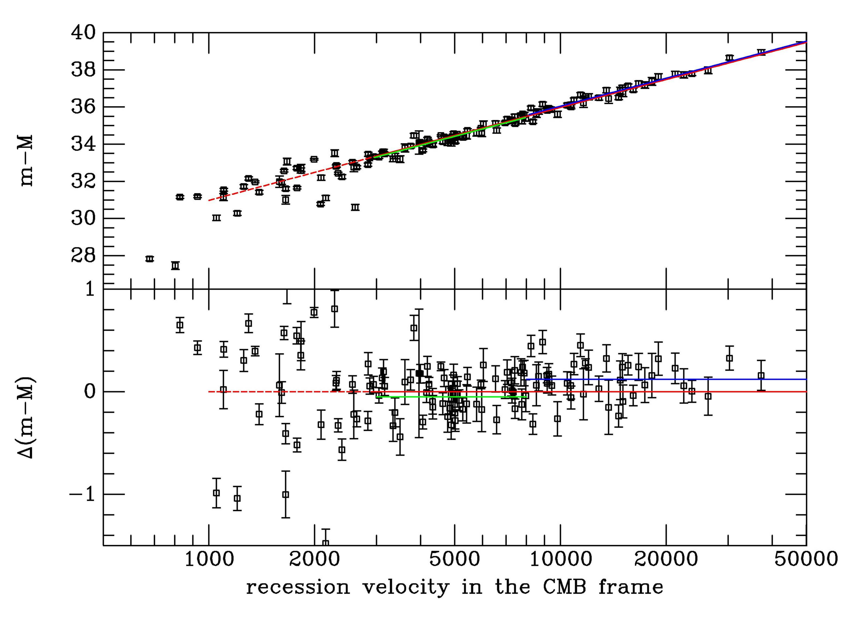

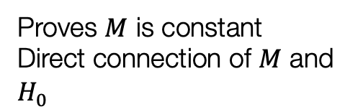
Hubble Constant
SN Hubble diagram
  $$m−M=5\log{v+25−5\log{H_{0}}}$$
Proves $M$ is constant
Direct connection of $M$ and $H_{0}$
Leibundgut

Slide 27

SNe Ia Hubble Diagram (NIR)
9 calibrators + 27 Hubble flow SNe
Dhawan et al. 2018
$$H_{0}=(72.8±1.6\left(stat\right)±2.7 \left(syst\right)) km s^{−1} Mpc^{−1}$$

Slide 28
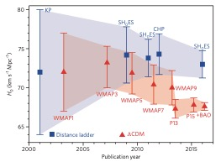
Problem solved?
New discrepancy between the measurements of
the local H₀
(distance ladder)
and early universe (CMB)
Indication of an incomplete model
of cosmology?
Freedman 2017

Slide 29
Gravitational Lenses
Sherry Suyu (J. Wiedersich / TUM)
Time delays in lensed quasars
Wong et al. 2020

Slide 30

$H_{0}$ Summary
Bonvin and Millon
https://doi.org/10.5281/zenodo.3635517

Slide 31
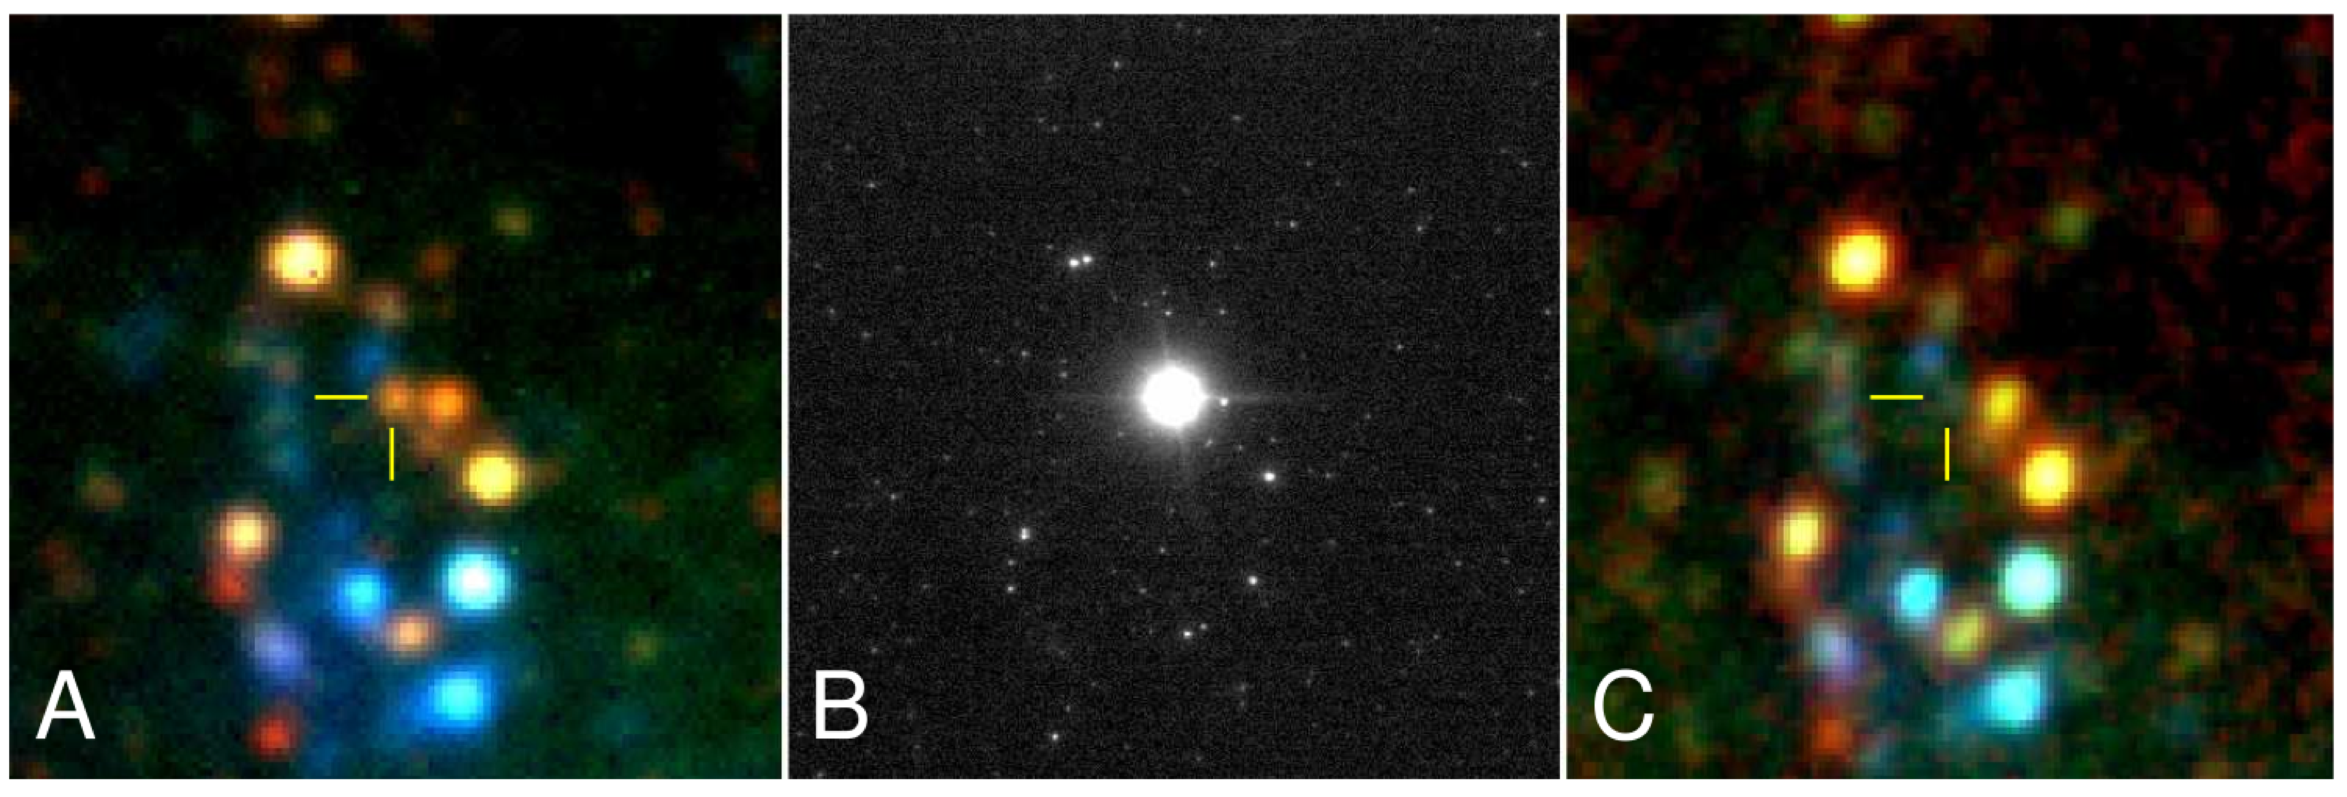

Type II Supernovae
Core-collapse explosions of
massive, red-supergiant stars
Peak absolute mags between -16 and -18
  $→$ observable up to z $≈$ 0.4
Most common type of SN by volume
Mattila et al. 2010

Slide 32
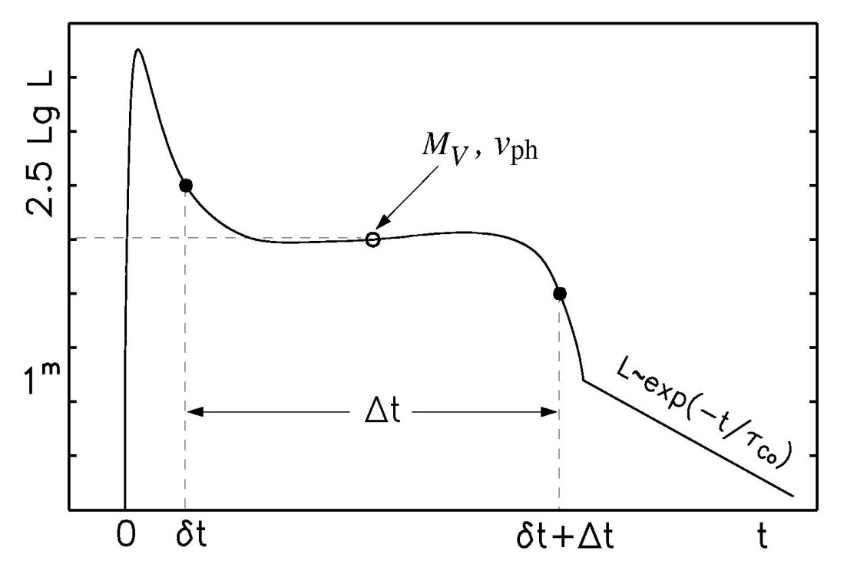
Physical parameters of core collapse SNe
Light curve shape and the velocity evolution can give an indication of the total explosion energy, the mass and the initial radius of the explosion
Observables:
  length of plateau phase Δt
  luminosity of the plateau L_{V}
  velocity of the ejecta v_{ph}
  E ∝Δt⁴·v_{ph}⁵·L⁻¹
  M∝Δt⁴·v_{ph}³·L⁻¹
  R ∝Δt⁻²·v_{ph}⁻⁴·L²

Slide 33
Expanding Photosphere Method
Modification of Baade-Wesselink method for variable stars
Assumes
  Sharp photosphere
  → thermal equilibrium
  Spherical symmetry
  → radial velocity
  Free expansion
Kirshner & Kwan 1974

Slide 34
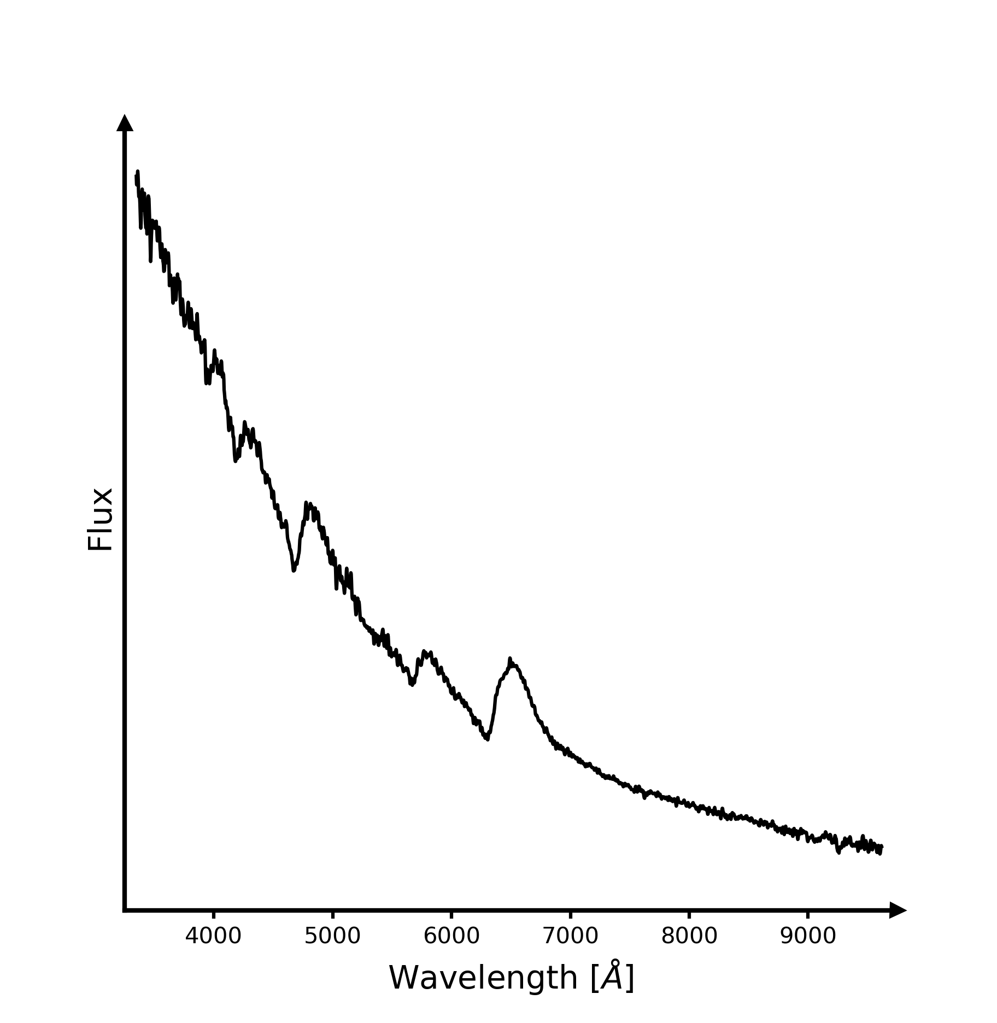
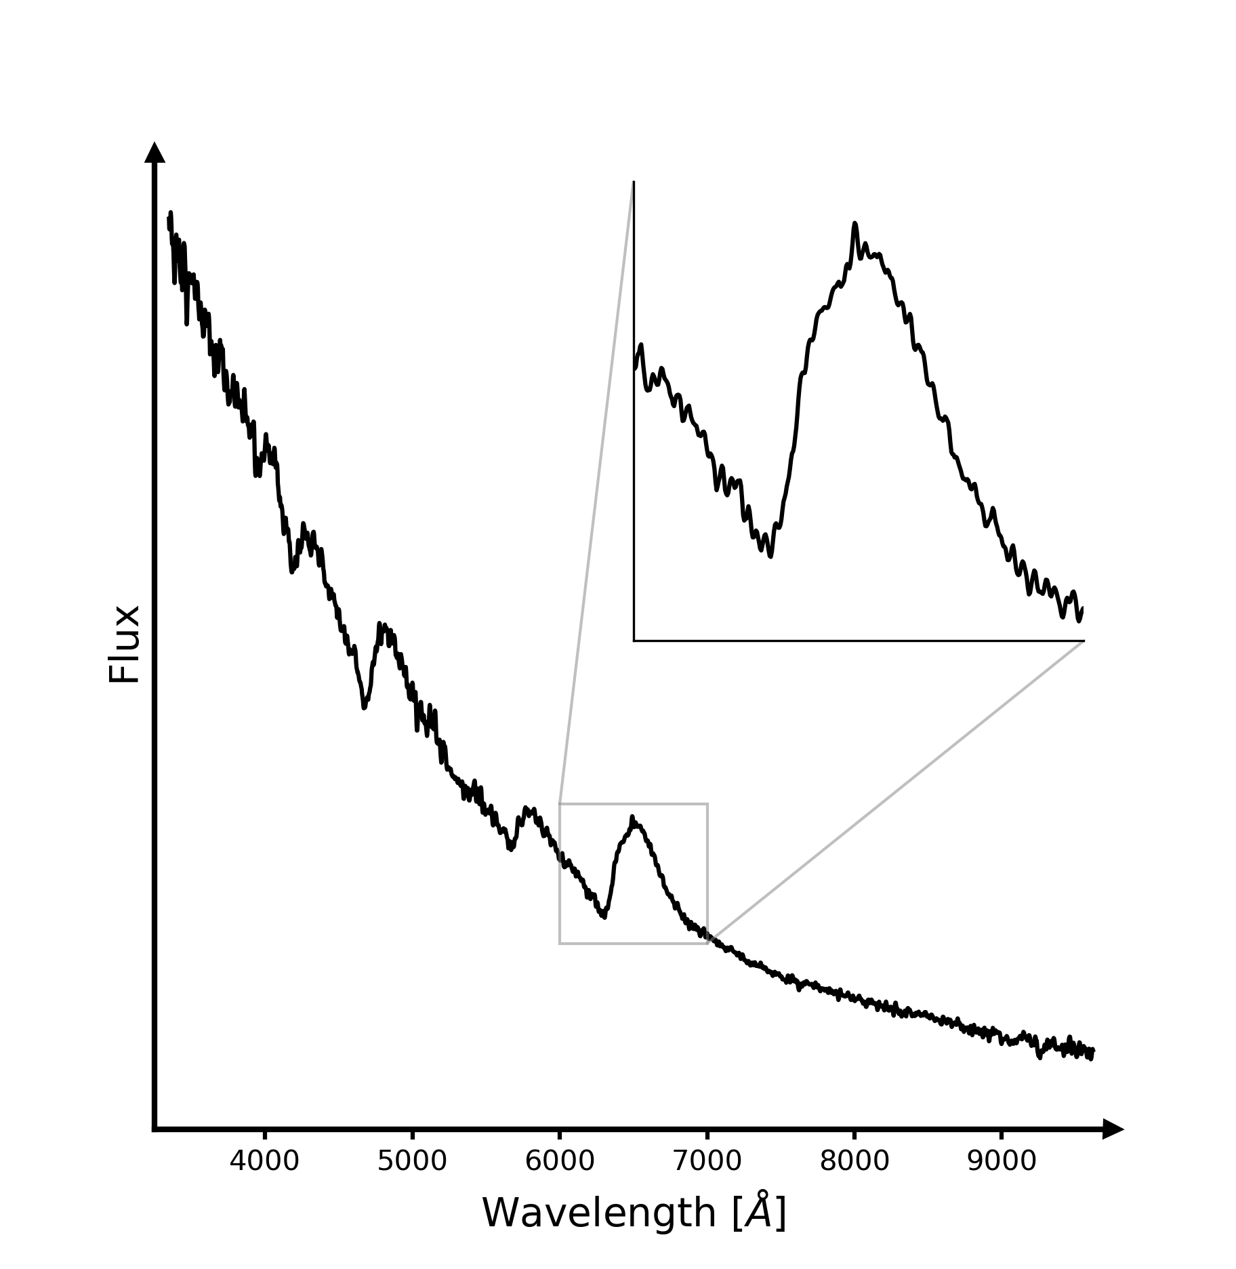
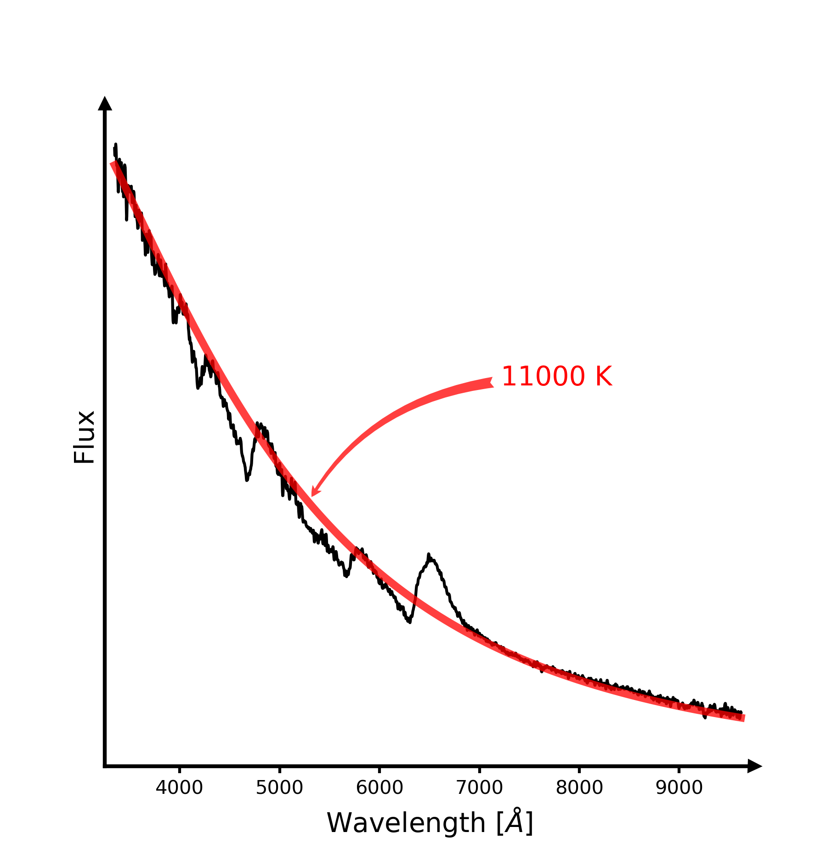
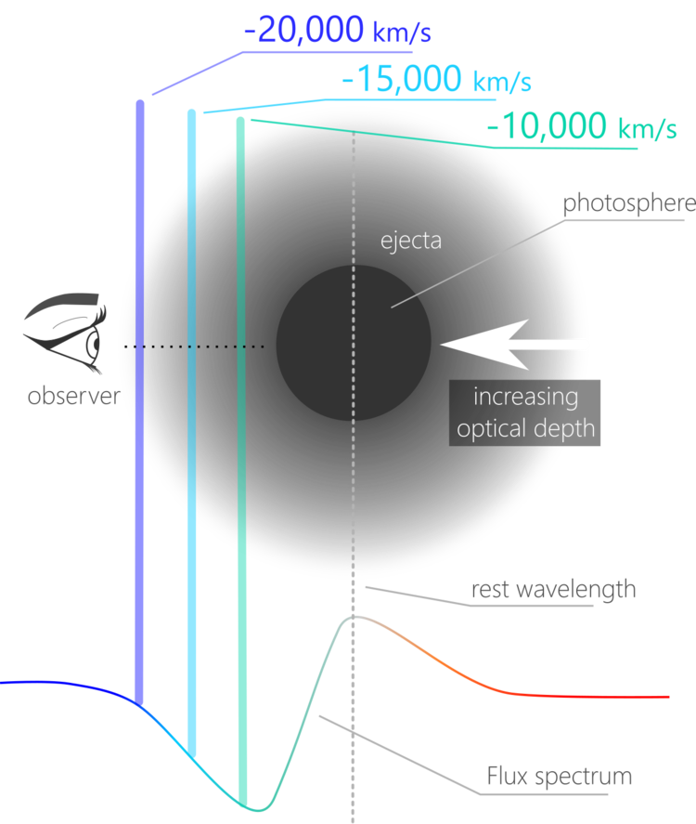
EPM: it’s all in the spectra
C. Vogl
Image: Héloïse Stevance

Slide 35
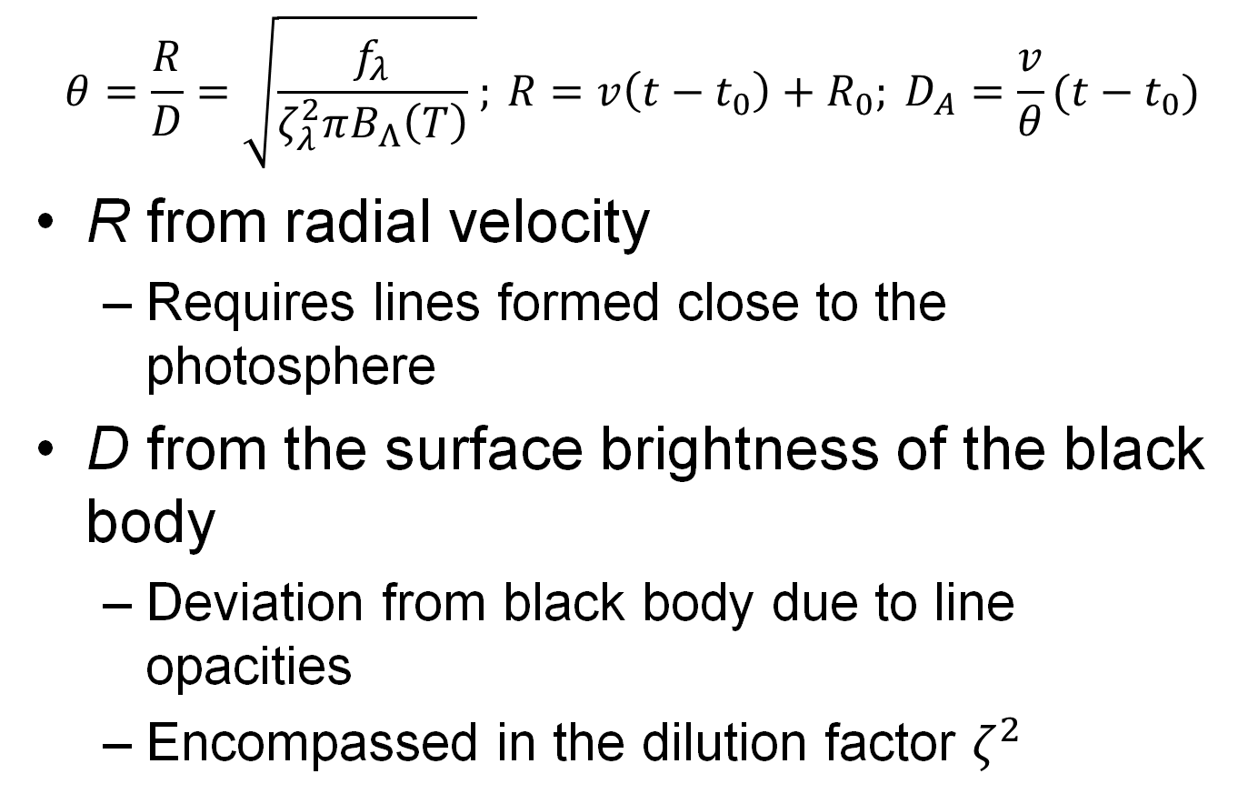
Expanding Photosphere Method
    $$θ=\frac{R}{D}=\sqrt{\frac{f_{λ}}{ζ_{λ}^{2}πB_{Λ}\left(T\right)} }; {R=v\left(t−t_{0}\right)+R_{0}; D}_{A}=\frac{v}{θ}(t−t_{0})$$
R from radial velocity
  Requires lines formed close to the photosphere
D from the surface brightness of the black body
  Deviation from black body due to line opacities
  Encompassed in the dilution factor $ζ^{2}$

Slide 36
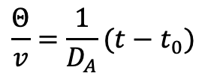


Expanding Photosphere Method
$$\frac{Θ}{v}=\frac{1}{D_{A}}(t−t_{0})$$
Gall et al. 2018
$$Θ/v$$
$$Θ/v$$
t-t₀
t-t₀

Slide 37
Preliminary Results
Consistent results
  not independent as local calibration required
Gall et al. 2018

Slide 38
Expanded Photosphere Method Reloaded
Use individual atmospheric models for the spectral fits
  use of the TARDIS radiation transport model
  absolute flux emitted
Accurate explosion date
  accurate zero point
At least 5 epochs per supernova

Slide 39
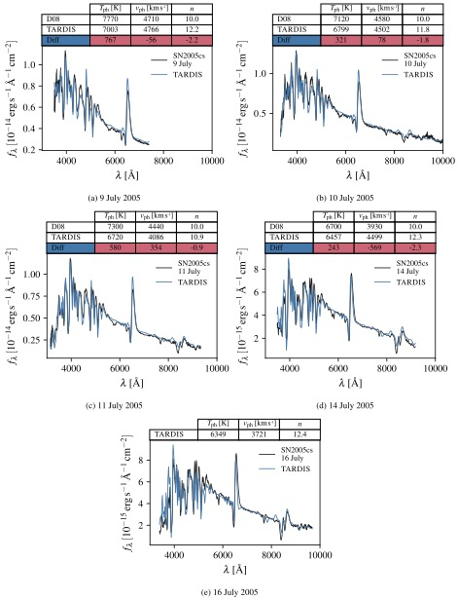
Atmosphere Models
TARDIS fits for different epochs
Vogl et al. 2020

Slide 40
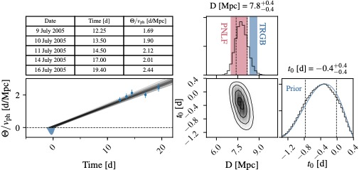

Distance Determination
Slope is inverse distance: $\frac{Θ}{v}=\frac{1}{D_{A}}(t−t_{0})$
Vogl et al. 2020

Slide 41
adH0cc
“accurate determination of H0 with core-collapse supernovae”
(Flörs, Hillebrandt, Kotak, Smartt, Spyromilio, Suyu, Taubenberger, Vogl)
Use the Expanding Photosphere Method to ~30 Type II supernovae in the Hubble flow (0.03<z<0.1)
Independent of distance ladder
  no parallaxes, no Cepheids, no Type Ia supernovae
FORS2 Large Programme over 3 semesters
  6 epochs spectroscopy and photometry per supernova
SNFactory data
  about 15 SNe with 0.01<z<0.05

Slide 42
adH0cc
Critical observables
  time of explosion
  spectral coverage
    before max until
    well into the plateau
  photometry
    simultaneously to spectroscopy
C. Vogl 2020

Slide 43
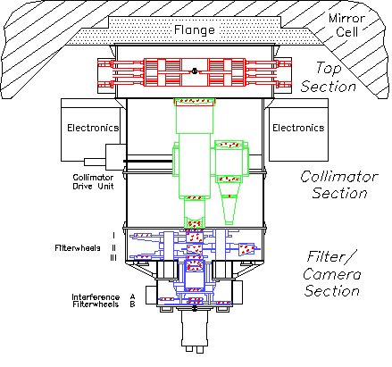

VLT– status
FORS2
C. Vogl (2020)
Image: ESO/Y. Beletsky

Slide 44
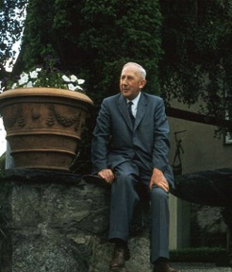
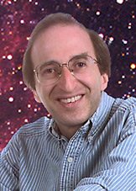

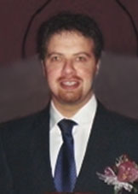
Conclusions
Hubble constant sets absolute scale
(and age) of the universe
  Past conflicts resolved
    Age of Universe is bigger than age of
    the Earth
      recognition of different stellar populations
    Age of Universe bigger than oldest stars
      cosmological constant

Slide 45
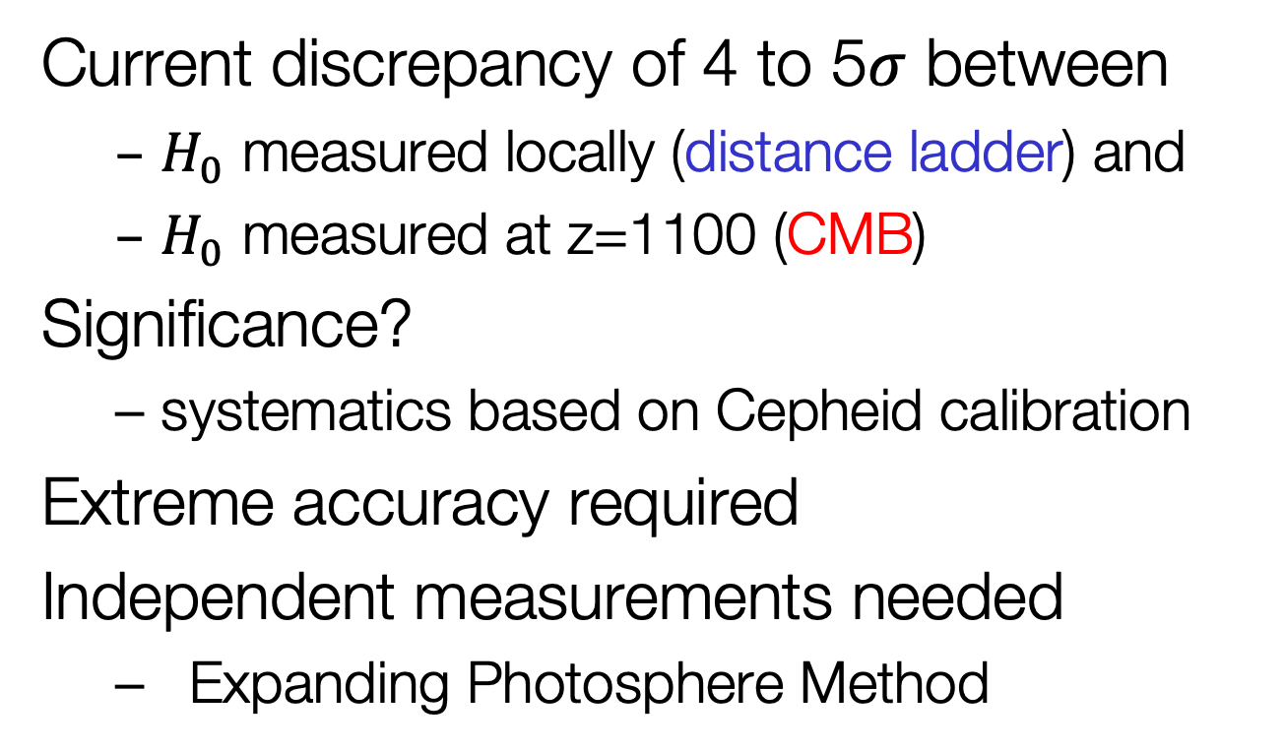
Conclusions
Current discrepancy of 4 to 5$σ$ between
  $H_{0}$ measured locally (distance ladder) and
  $H_{0}$ measured at z=1100 (CMB)
Significance?
  systematics based on Cepheid calibration
Extreme accuracy required
Independent measurements needed
  Expanding Photosphere Method

