Slide 1
Cosmology with Supernovae
Bruno Leibundgut

Slide 2
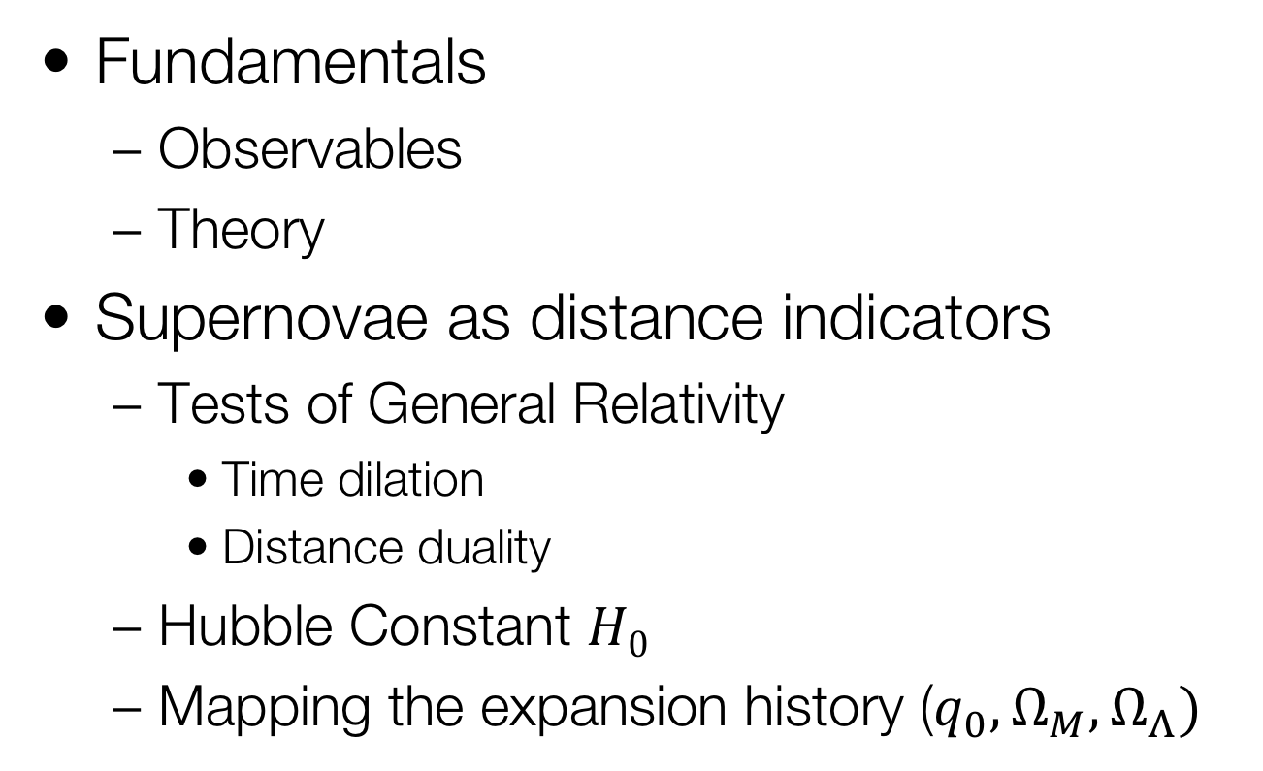
Cosmology with Supernovae
Fundamentals
  Observables
  Theory
Supernovae as distance indicators
  Tests of General Relativity
    Time dilation
    Distance duality
  Hubble Constant $H0$
  Mapping the expansion history ($q_{0}, Ω_{M}, Ω_{Λ})$

Slide 3
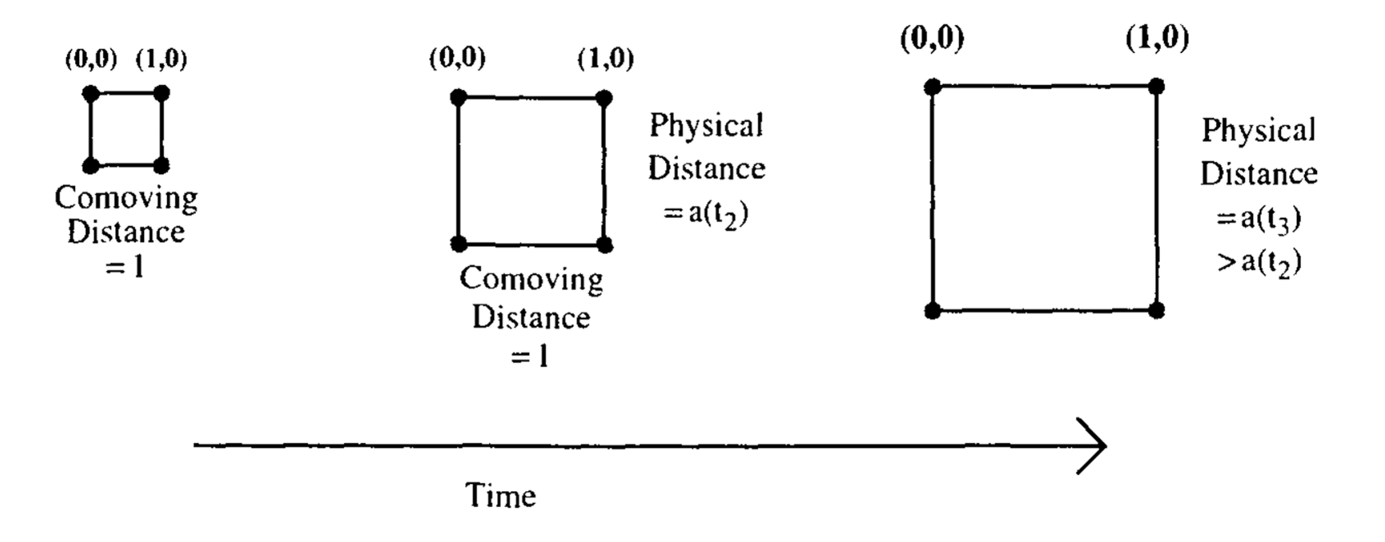

Cosmic Distances
Separate the observed distances $r(t)$ into the expansion factor $a(t)$ and the fixed part $x$ (called comoving distance)
$$r\left(t\right)=a\left(t\right)x$$
x
x

Slide 4
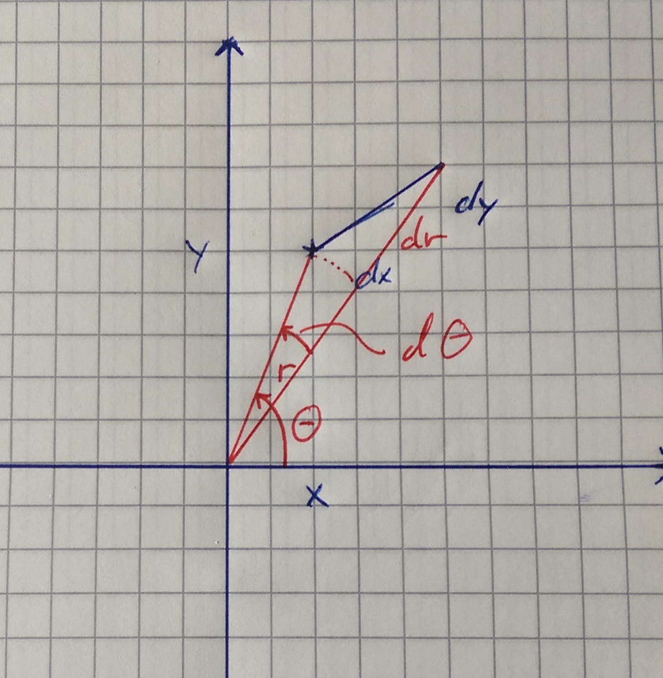
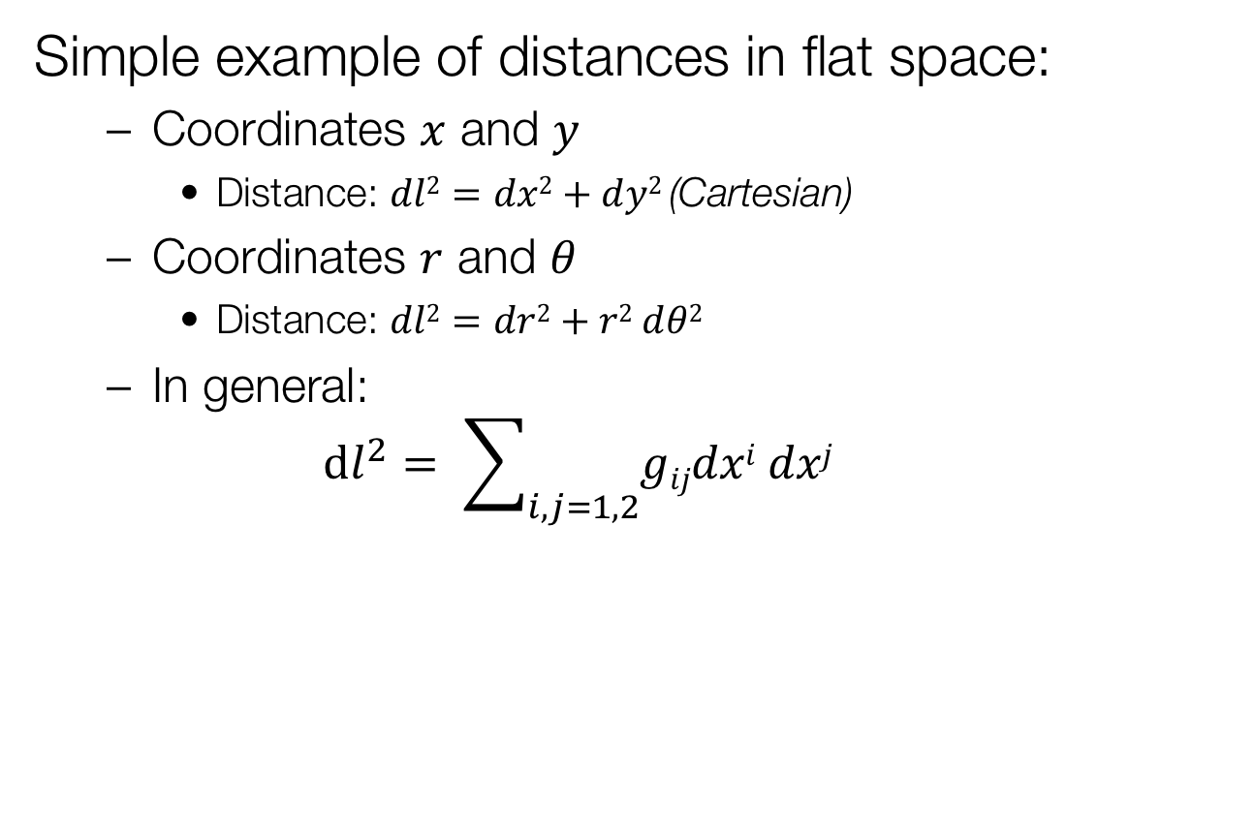
Calculating Distances
Simple example of distances in flat space:
  Coordinates $x$ and $y$
    Distance: $dl2=dx2+dy2$(Cartesian)
  Coordinates $r$ and $θ$
    Distance: $dl2=dr2+r2 dθ2$
  In general:
  $dl^{2}= \sum_{i,j=1,2}{gijdxi dxj}$

Slide 5
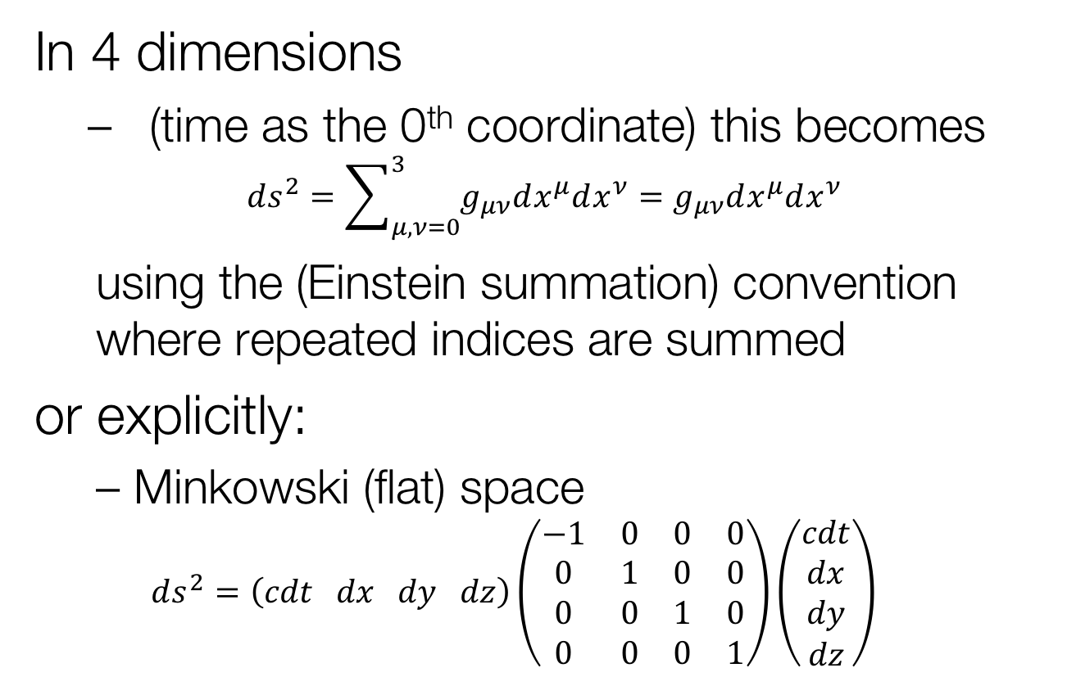
Cosmic Distances
In 4 dimensions
  (time as the 0th coordinate) this becomes
$$ds^{2}=\sum_{μ,ν=0}^{3}{g_{μν}dx^{μ}dx^{ν}=g_{μν}dx^{μ}dx^{ν}}$$
  using the (Einstein summation) convention where repeated indices are summed
or explicitly:
  Minkowski (flat) space
  $$ds^{2}=\left(cdt dx dy dz\right)\left(\begin{matrix}−1 & 0 & 0 & 0 \\ 0 & 1 & 0 & 0 \\ 0 & 0 & 1 & 0 \\ 0 & 0 & 0 & 1\end{matrix}\right)\left(\begin{matrix}cdt \\ dx \\ dy \\ dz\end{matrix}\right)$$

Slide 6
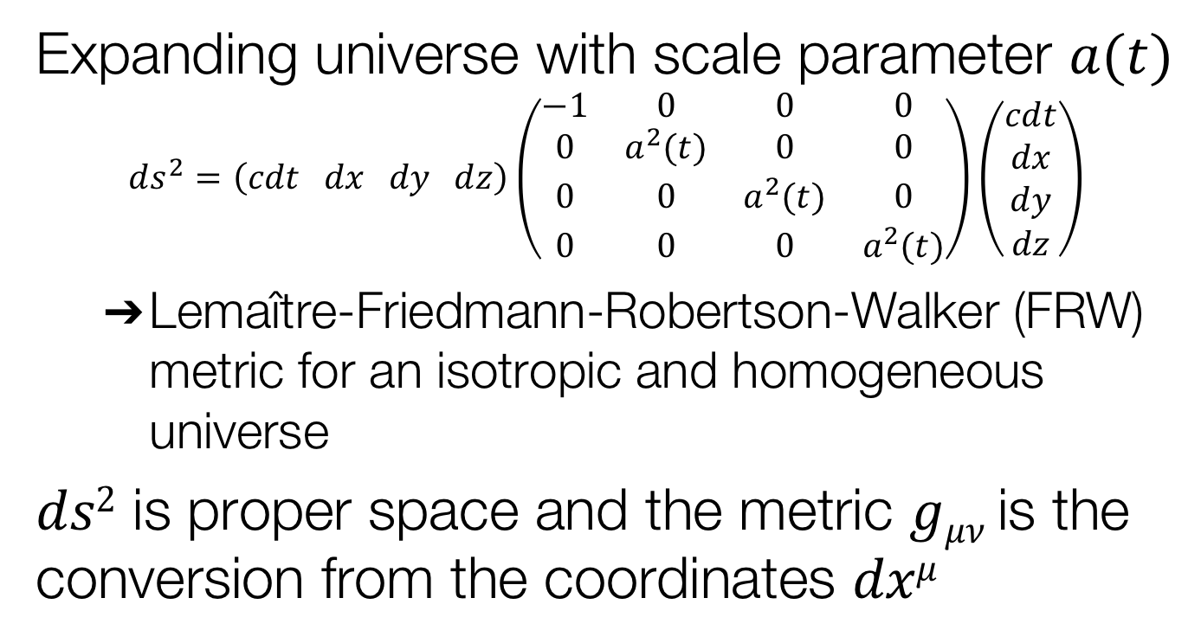
Calculating Distances
Expanding universe with scale parameter $a(t)$
$$ds^{2}=\left(cdt dx dy dz\right)\left(\begin{matrix}−1 & 0 & 0 & 0 \\ 0 & a^{2}(t) & 0 & 0 \\ 0 & 0 & a^{2}(t) & 0 \\ 0 & 0 & 0 & a^{2}(t)\end{matrix}\right)\left(\begin{matrix}cdt \\ dx \\ dy \\ dz\end{matrix}\right)$$
  Lemaître-Friedmann-Robertson-Walker (FRW) metric for an isotropic and homogeneous universe
$ds2$ is proper space and the metric $gμν$ is the conversion from the coordinates $dxμ$

Slide 7
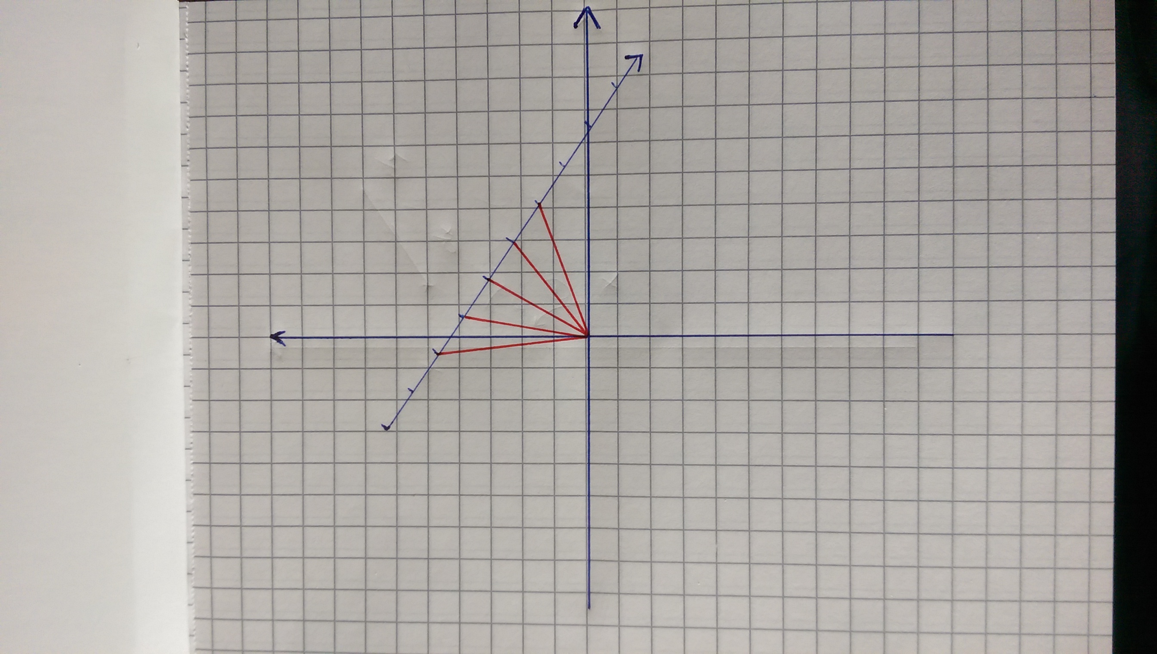
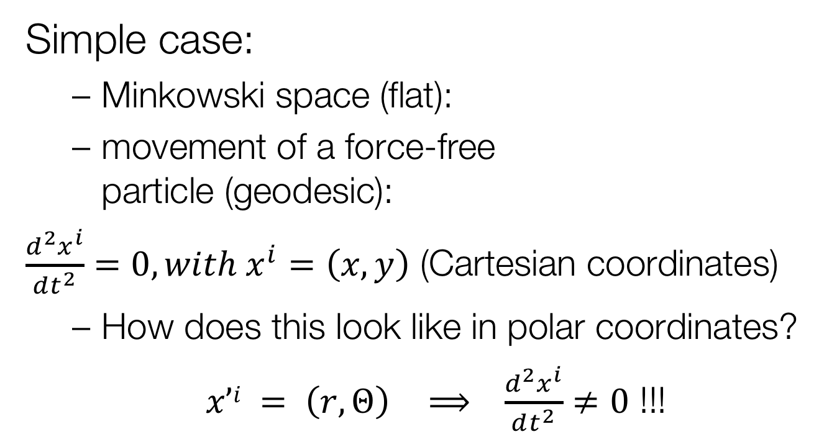
Geodesic and
Coordinate Transformation
Simple case:
  Minkowski space (flat):
  movement of a force-free
  particle (geodesic):
$\frac{d^{2}x^{i}}{dt^{2}}=0, with x^{i}=\left(x,y\right)$ (Cartesian coordinates)
  How does this look like in polar coordinates?
  $x’i = \left(r, Θ\right)$ $⟹ \frac{d^{2}x^{i}}{dt^{2}}≠0$ !!!

Slide 8
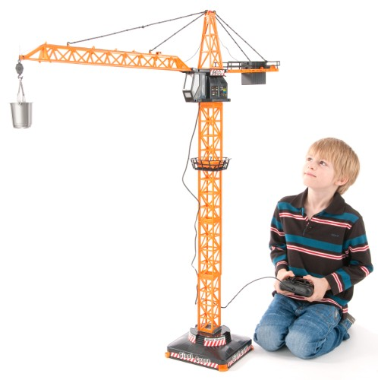

An everyday $rθz$ system

Slide 9
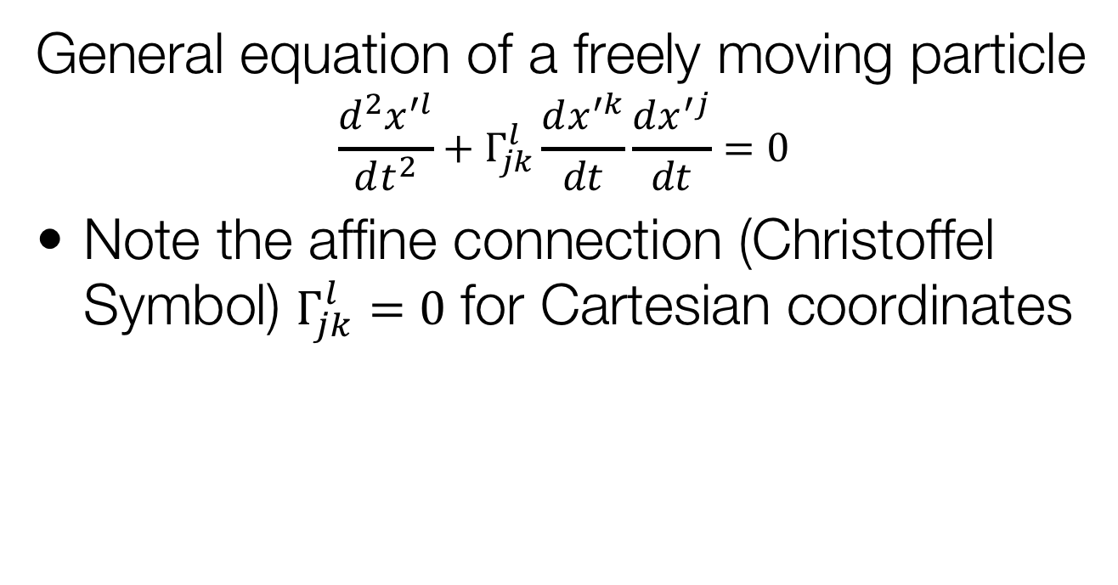
Geodesic
General equation of a freely moving particle
$$\frac{d^{2}x^{′l}}{dt^{2}}+Γ_{jk}^{l}\frac{dx^{′k}}{dt}\frac{dx^{′j}}{dt}=0$$
Note the affine connection (Christoffel Symbol) $Γ_{jk}^{l}=0$ for Cartesian coordinates

Slide 10
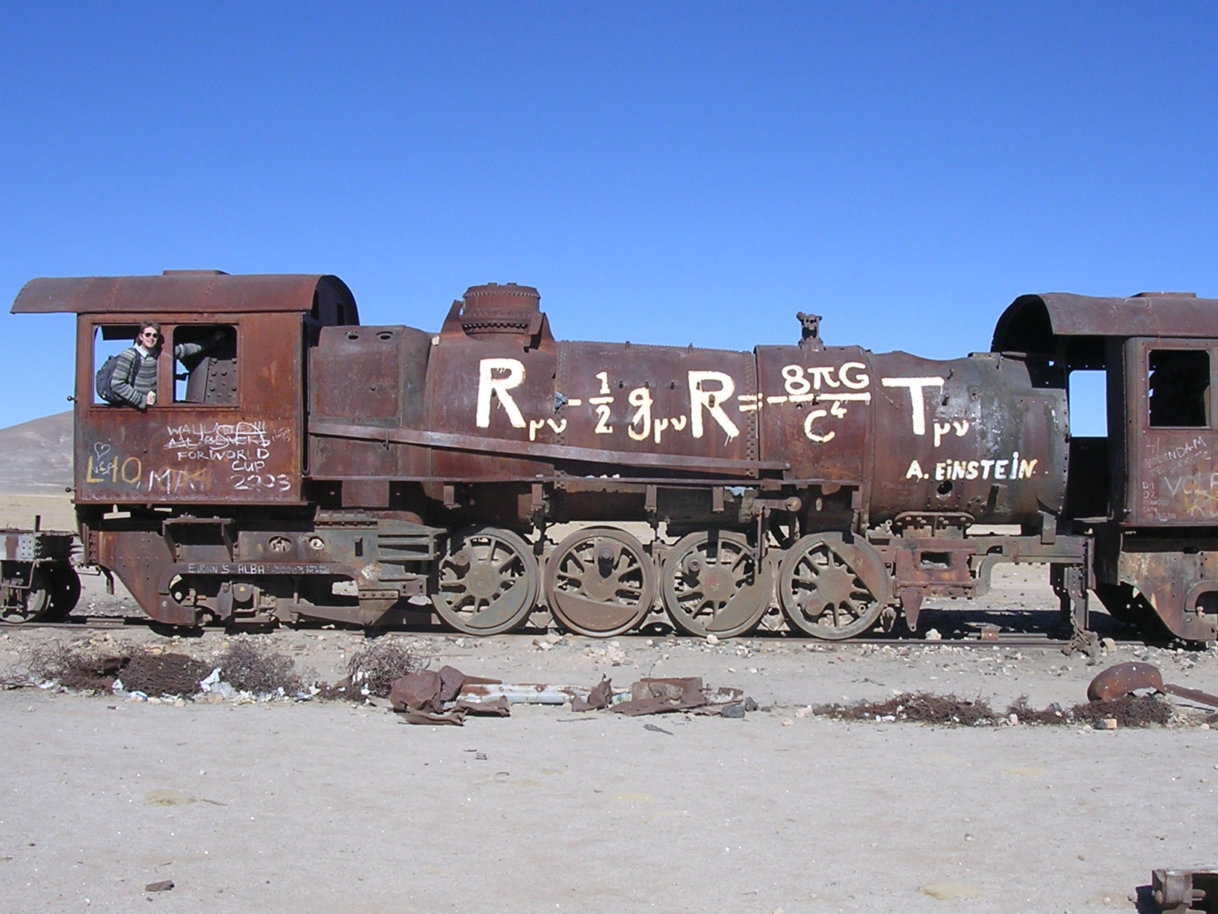

Slide 11
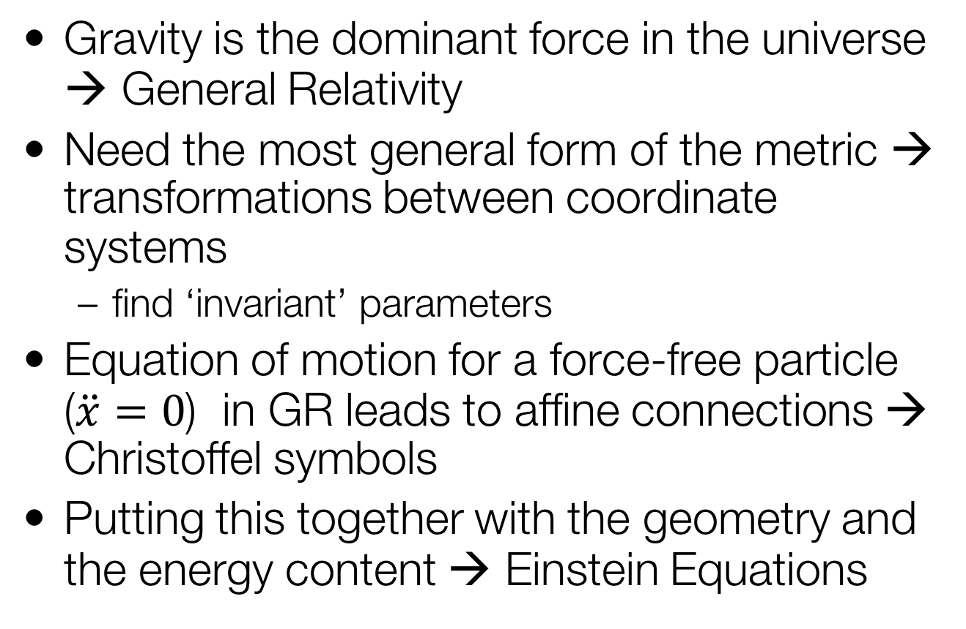
Recap Einstein Equations
Gravity is the dominant force in the universe → General Relativity
Need the most general form of the metric → transformations between coordinate systems
  find ‘invariant’ parameters
Equation of motion for a force-free particle ($\ddot{x}=0$) in GR leads to affine connections → Christoffel symbols
Putting this together with the geometry and the energy content → Einstein Equations

Slide 12
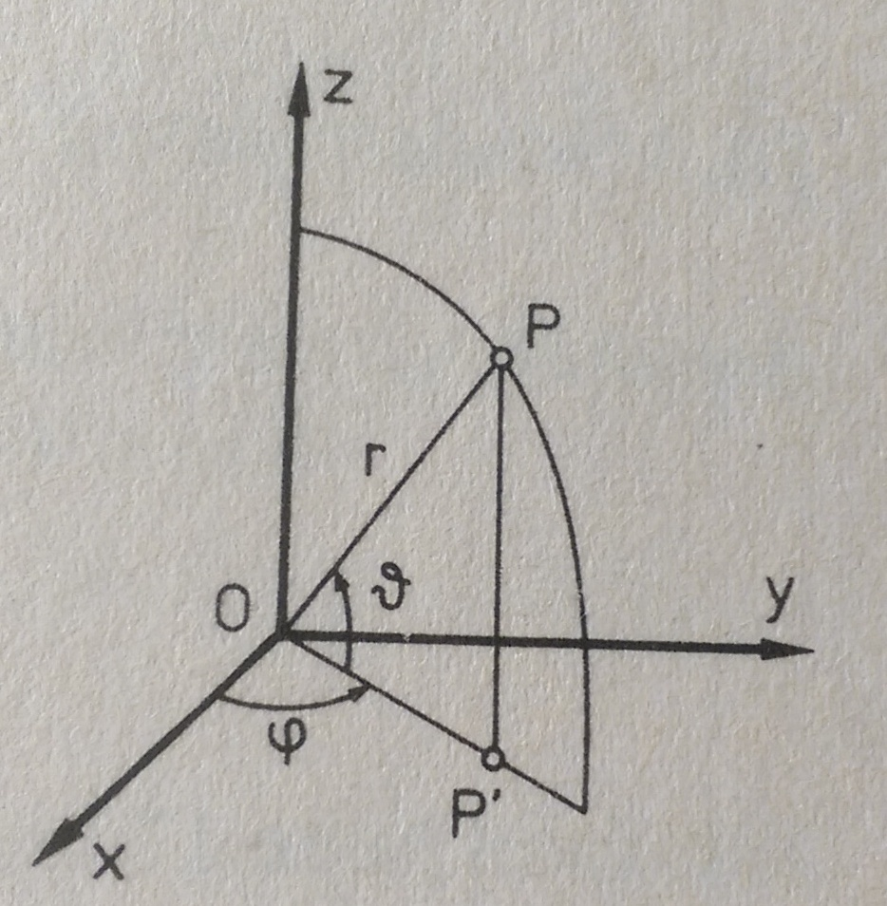
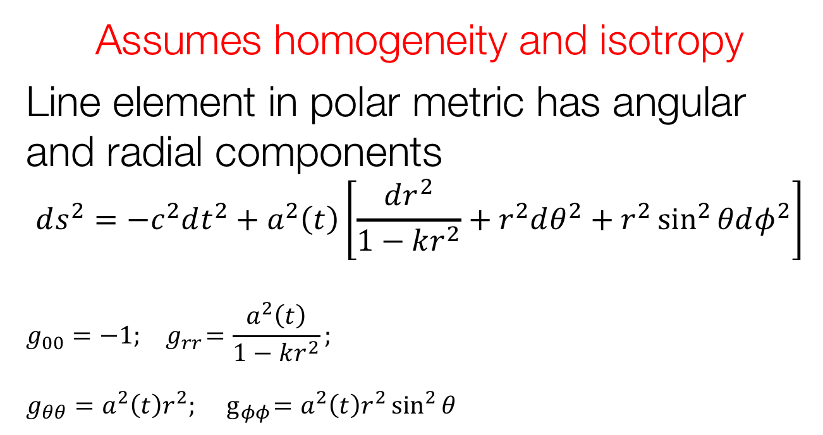
Lemaître Robertson Walker Metric
Assumes homogeneity and isotropy
Line element in polar metric has angular and radial components
$$ds^{2}=−c^{2}dt^{2}+a^{2}\left(t\right)\left[\frac{dr^{2}}{1−kr^{2}}+r^{2}dθ^{2}+r^{2}\sin^{2}{θdφ^{2}}\right]$$
$$g_{00}=−1;{ g}_{rr}=\frac{a^{2}\left(t\right)}{1−kr^{2}};$$
$g_{θθ}=a^{2}\left(t\right)r^{2};{ g}_{φφ}=a^{2}\left(t\right)r^{2}\sin^{2}{θ }$
Φ
θ

Slide 13
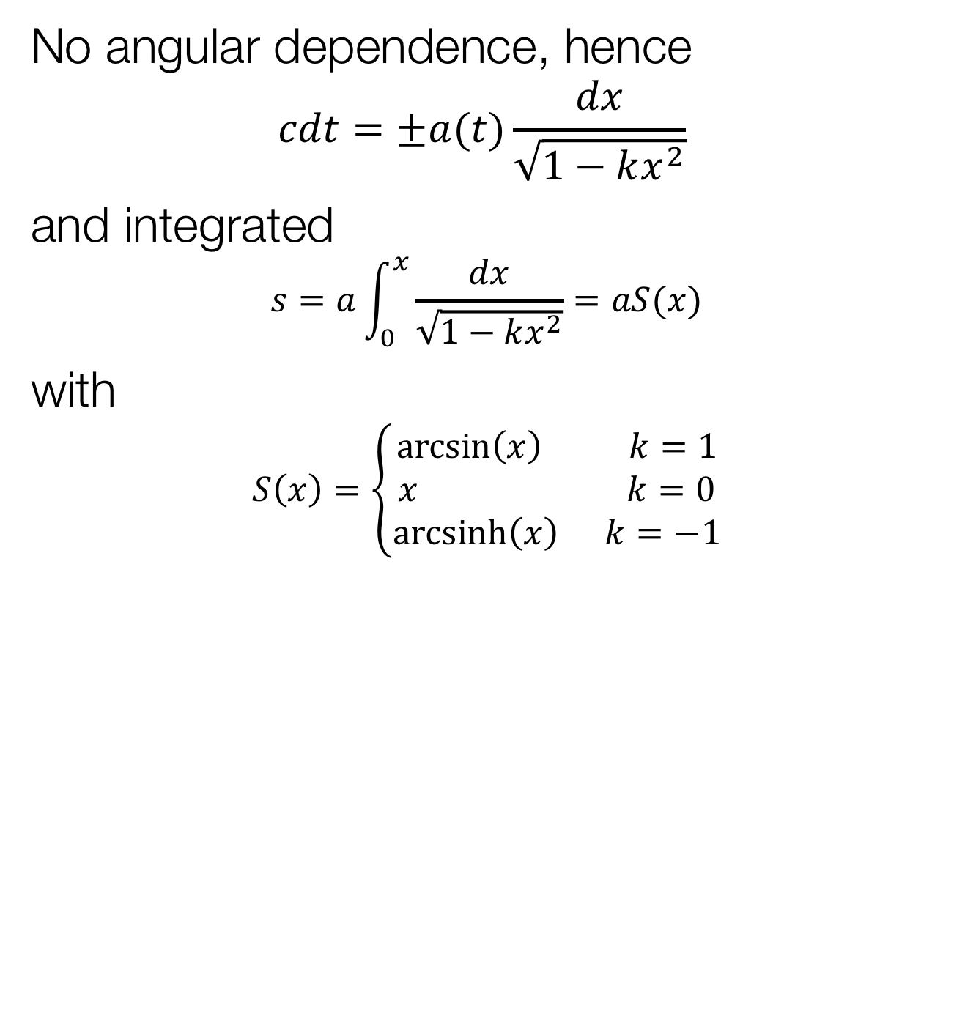
Light ray coming towards us
No angular dependence, hence
$$cdt=±a(t)\frac{dx}{\sqrt{1−kx^{2}}}$$
and integrated
$$s=a\int_{0}^{x}{\frac{dx}{\sqrt{1−kx^{2}}}=aS(x)}$$
with
$$S\left(x\right)=\left\{\begin{aligned}\arcsin\left(x\right) k=1 \\ x k=0 \\ \operatorname{arcsinh}\left(x\right) k=−1\end{aligned}\right.$$

Slide 14
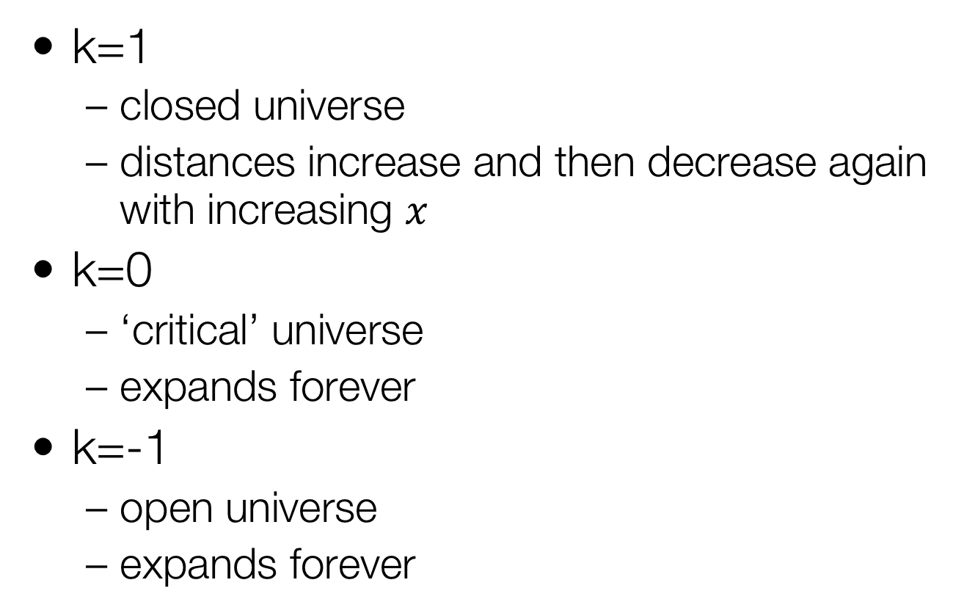
Strange Consequences
k=1
  closed universe
  distances increase and then decrease again with increasing $x$
k=0
  ‘critical’ universe
  expands forever
k=-1
  open universe
  expands forever

Slide 15

The Energy-Momentum Tensor
Use the form for the ‘perfect fluid’
$$T^{μν}=\left(\begin{matrix}ρc^{2} & 0 & 0 & 0 \\ 0 & p & 0 & 0 \\ 0 & 0 & p & 0 \\ 0 & 0 & 0 & p\end{matrix}\right)$$

Slide 16
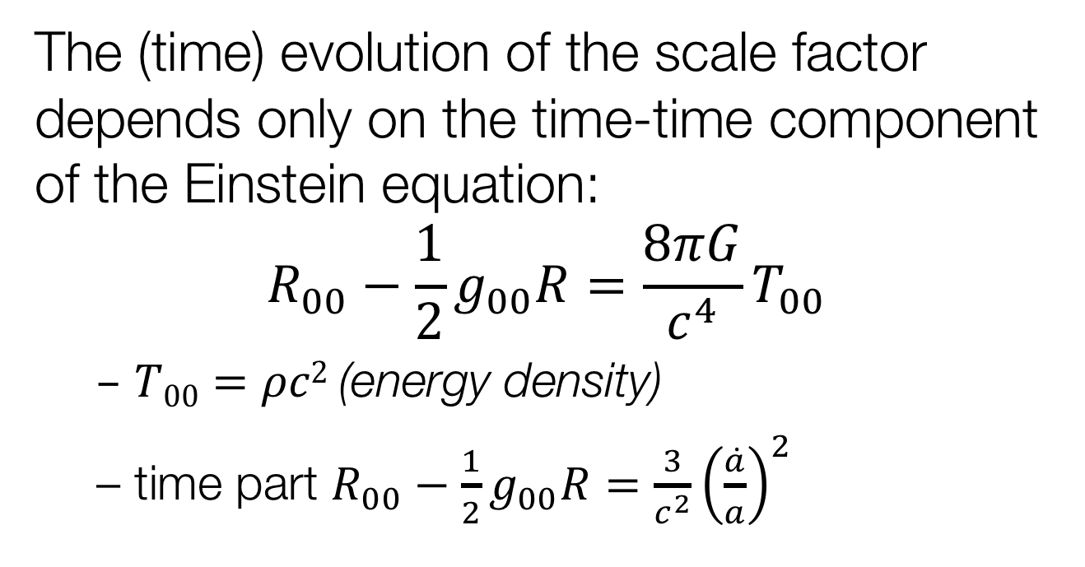
Einstein’s Field Equation
The (time) evolution of the scale factor depends only on the time-time component of the Einstein equation:
$$R_{00}−\frac{1}{2}g_{00}R=\frac{8πG}{c^{4}}T_{00}$$
  $T00=ρc2$(energy density)
  time part $R_{00}−\frac{1}{2}g_{00}R=\frac{3}{c^{2}}{\left(\frac{\dot{a}}{a}\right)}^{2}$

Slide 17
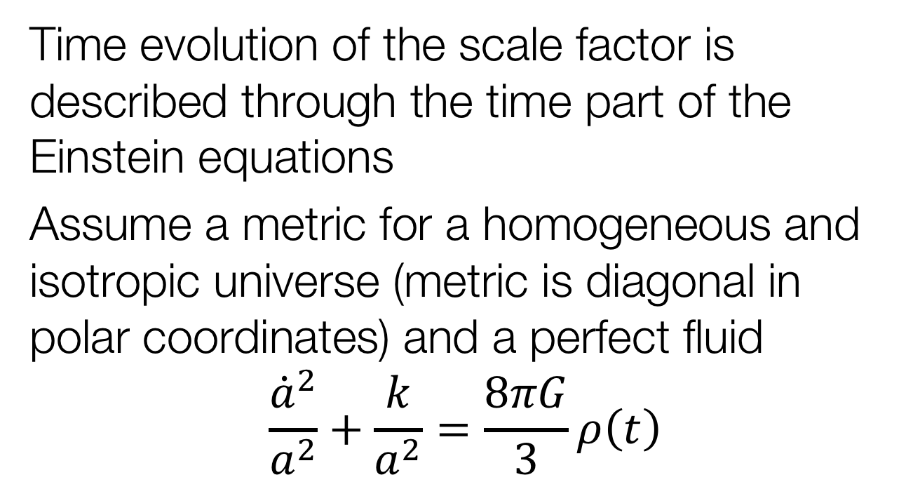
Friedmann Equation
Time evolution of the scale factor is described through the time part of the Einstein equations
Assume a metric for a homogeneous and isotropic universe (metric is diagonal in polar coordinates) and a perfect fluid
$$\frac{{\dot{a}}^{2}}{a^{2}}+\frac{k}{a^{2}}=\frac{8πG}{3}ρ\left(t\right)$$

Slide 18
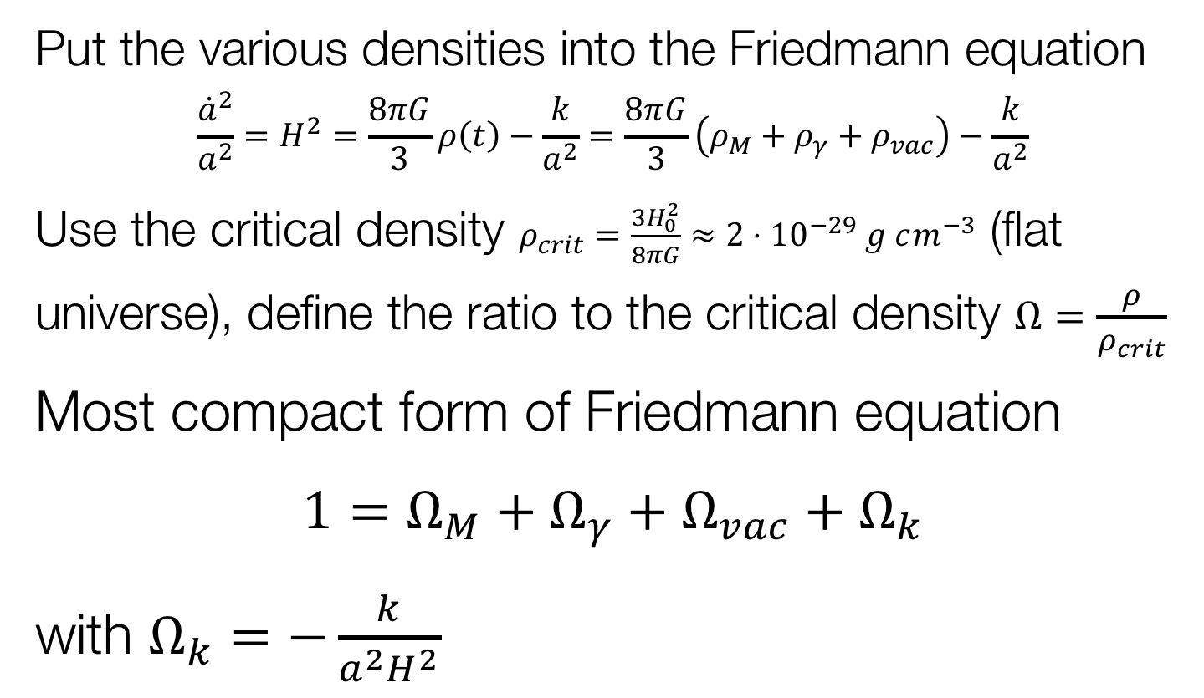
Friedmann Equation
Put the various densities into the Friedmann equation
$$\frac{{\dot{a}}^{2}}{a^{2}}=H^{2}=\frac{8πG}{3}ρ\left(t\right)−\frac{k}{a^{2}}=\frac{8πG}{3}\left(ρ_{M}+ρ_{γ}+ρ_{vac}\right)−\frac{k}{a^{2}}$$
Use the critical density $ρ_{crit}=\frac{3H_{0}^{2}}{8πG}≈{2⋅10}^{−29} g cm^{−3}$ (flat universe), define the ratio to the critical density $Ω=\frac{ρ}{ρ_{crit}}$
Most compact form of Friedmann equation
$1=Ω_{M}+Ω_{γ}+Ω_{vac}+Ω_{k}$
with $Ω_{k}=−\frac{k}{a^{2}H^{2}}$

Slide 19
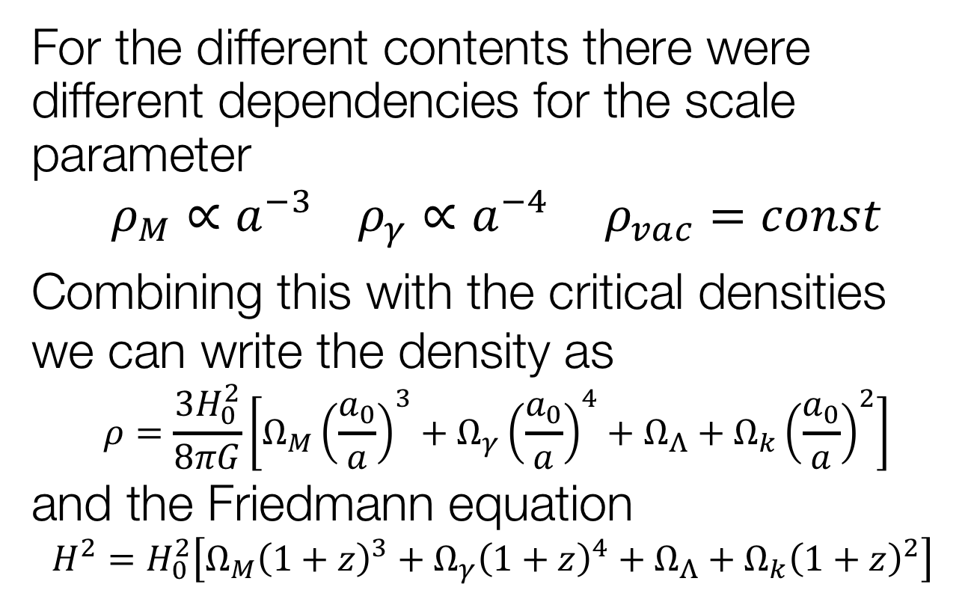
Dependence on Scale Parameter
For the different contents there were different dependencies for the scale parameter
$$ρ_{M}∝a^{−3} ρ_{γ}∝a^{−4} ρ_{vac}=const$$
Combining this with the critical densities we can write the density as
$$ρ=\frac{3H_{0}^{2}}{8πG}\left[Ω_{M}{\left(\frac{a_{0}}{a}\right)}^{3}+Ω_{γ}{\left(\frac{a_{0}}{a}\right)}^{4}+Ω_{Λ}+Ω_{k}{\left(\frac{a_{0}}{a}\right)}^{2}\right]$$
and the Friedmann equation
$$H^{2}=H_{0}^{2}\left[Ω_{M}{\left(1+z\right)}^{3}+Ω_{γ}{\left(1+z\right)}^{4}+Ω_{Λ}+Ω_{k}{\left(1+z\right)}^{2}\right]$$

Slide 20
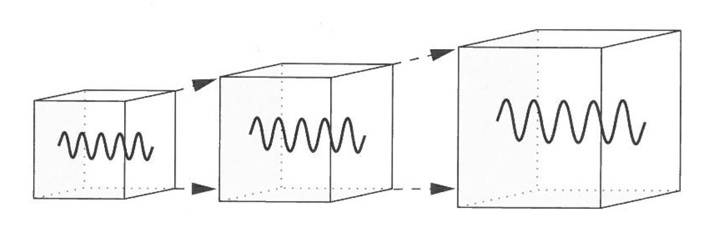
Redshift
Redshift is directly related to the ratio of the scales between emission and absorption of a photon
This is remarkably simple as a measurement in a spectrum tells the scale changes

Slide 21
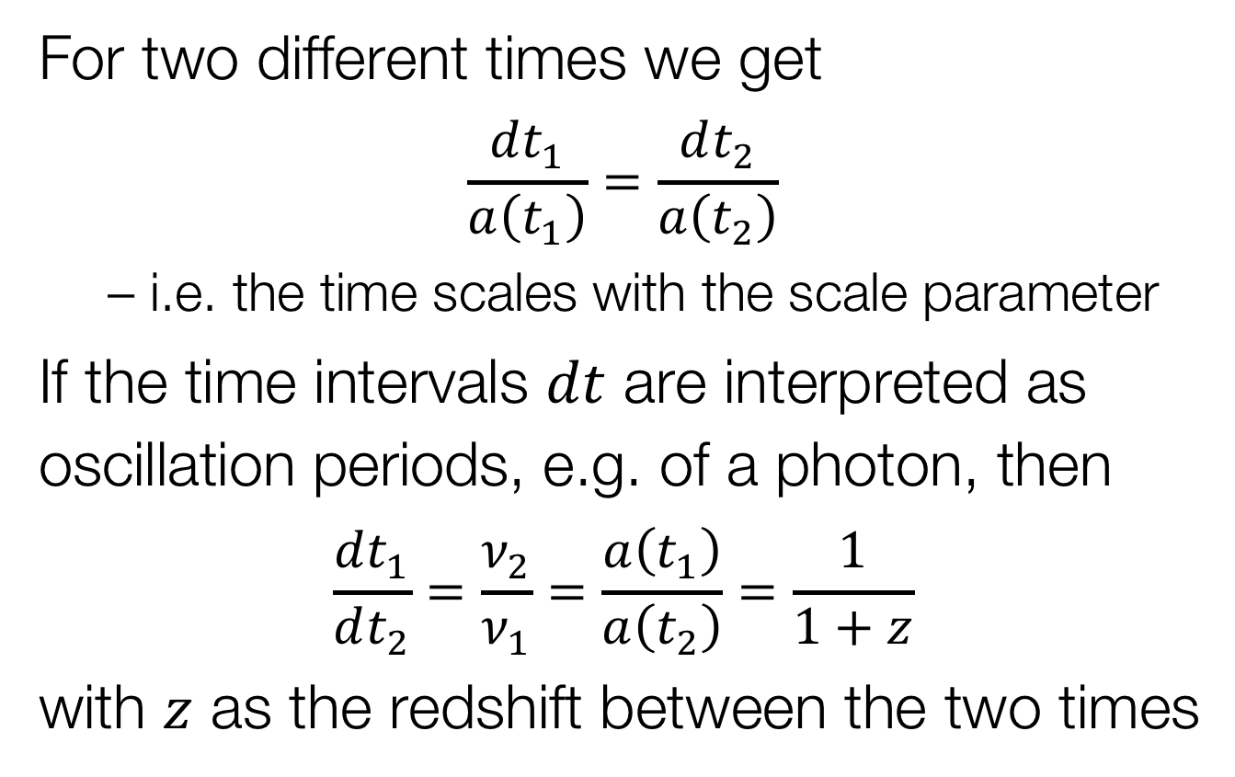
Cosmological Redshift
For two different times we get
$$\frac{dt_{1}}{a\left(t_{1}\right)}=\frac{dt_{2}}{a\left(t_{2}\right)}$$
  i.e. the time scales with the scale parameter
If the time intervals $dt$ are interpreted as oscillation periods, e.g. of a photon, then
$$\frac{dt_{1}}{dt_{2}}=\frac{ν_{2}}{ν_{1}}=\frac{a\left(t_{1}\right)}{a\left(t_{2}\right)}=\frac{1}{1+z}$$
with $z$ as the redshift between the two times

Slide 22
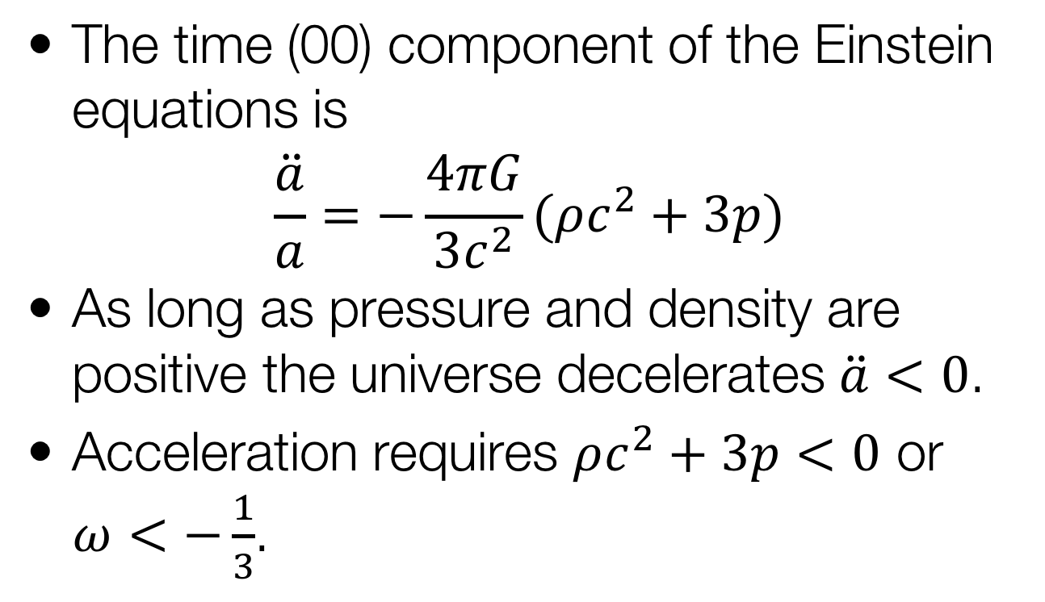
Energy-Momentum Tensor
The time (00) component of the Einstein equations is
$$\frac{\ddot{a}}{a}=−\frac{4πG}{3c^{2}}(ρc^{2}+3p)$$
As long as pressure and density are positive the universe decelerates $\ddot{a}<0$.
Acceleration requires $ρc^{2}+3p<0$ or $ω<−\frac{1}{3}$.

Slide 23
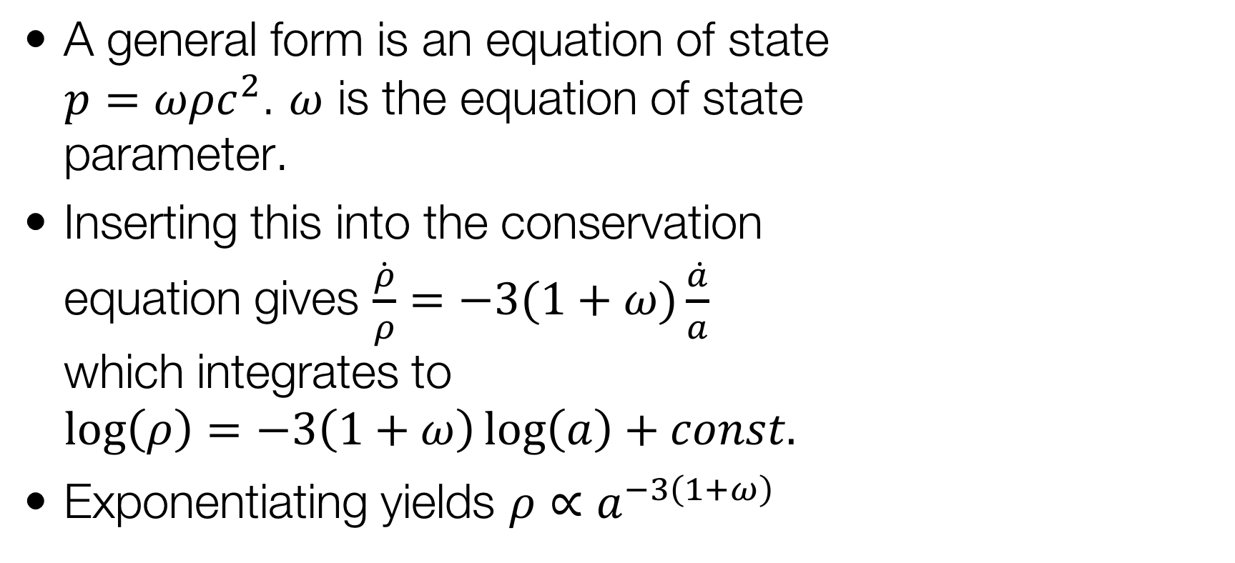
Energy-Momentum Tensor
A general form is an equation of state $p=ωρc^{2}$. $ω$ is the equation of state parameter.
Inserting this into the conservation equation gives $\frac{\dot{ρ}}{ρ}=−3(1+ω)\frac{\dot{a}}{a}$ which integrates to
$\log\left(ρ\right)=−3\left(1+ω\right)\log\left(a\right)+const.$
Exponentiating yields $ρ∝a^{−3\left(1+ω\right)}$

Slide 24
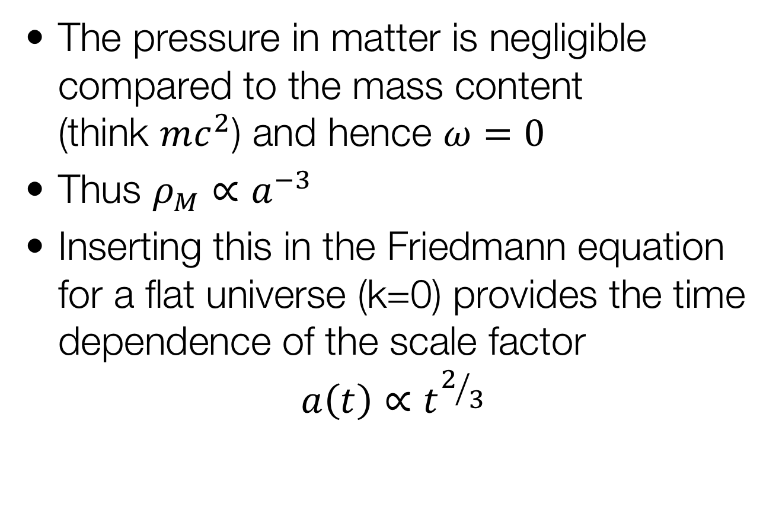
Matter
The pressure in matter is negligible compared to the mass content
(think $mc^{2}$) and hence $ω=0$
Thus $ρ_{M}∝a^{−3}$
Inserting this in the Friedmann equation for a flat universe (k=0) provides the time dependence of the scale factor
$$a\left(t\right)∝t^{2/3}$$

Slide 25
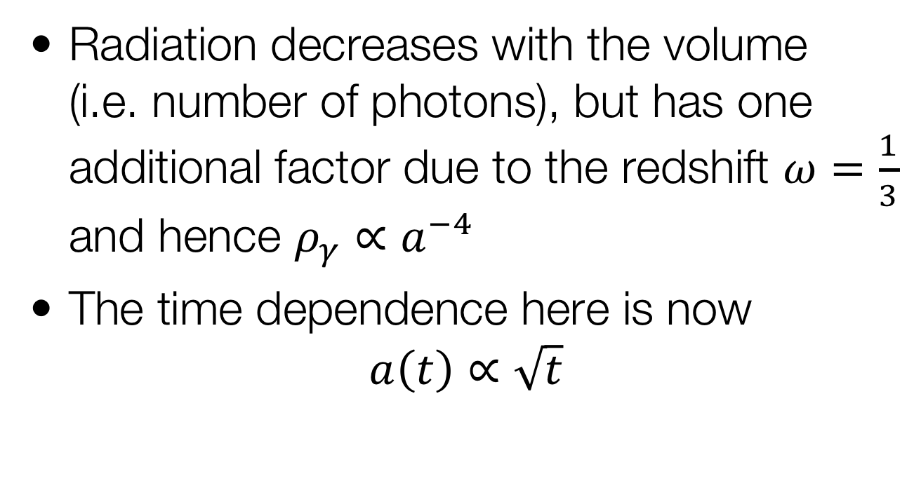
Radiation
Radiation decreases with the volume
(i.e. number of photons), but has one additional factor due to the redshift $ω=\frac{1}{3}$
and hence $ρ_{γ}∝a^{−4}$
The time dependence here is now
$$a\left(t\right)∝\sqrt{t}$$

Slide 26
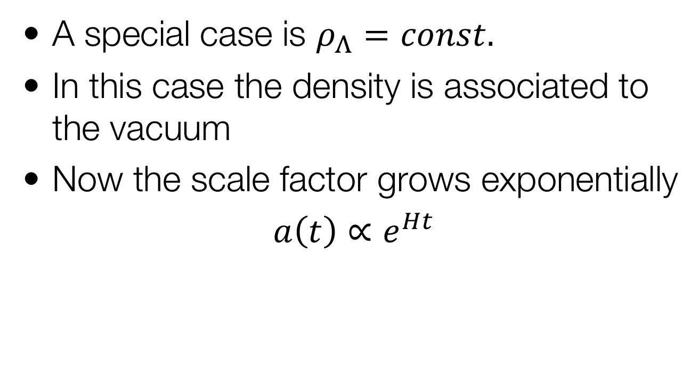
Vacuum energy
A special case is $ρ_{Λ}=const.$
In this case the density is associated to the vacuum
Now the scale factor grows exponentially
$a\left(t\right)∝e^{Ht}$

Slide 27
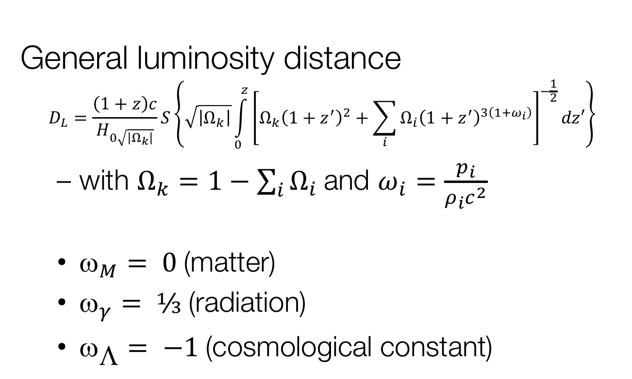
With the equation of state parameter ω
General luminosity distance
$$D_{L}=\frac{\left(1+z\right)c}{H_{0\sqrt{\left|Ω_{k}\right|}}}S\left\{\sqrt{\left|Ω_{k}\right|}\int_{0}^{z}{{\left[Ω_{k}{\left(1+z^{′}\right)}^{2}+\sum_{i}{Ω_{i}{\left(1+z^{′}\right)}^{3\left(1+ω_{i}\right)}}\right]}^{−\frac{1}{2}}}dz′\right\}$$
  with $Ω_{k}=1−\sum_{i}{Ω_{i} }$and $ω_{i}=\frac{p_{i}}{ρ_{i}c^{2}}$
  $_{M}= 0$(matter)
  $_{γ}= ⅓$(radiation)
  $_{☹}= −1$(cosmological constant)

Slide 28
Synopsis
Gravity → Einstein Equations
  ’Contents’ → Energy-momentum tensor
    perfect fluid, density, pressure
    dependence on different contents
      matter, radiation, vacuum, curvature
  FRW metric (isotropy, homogeneity) → different curvature models
Time evolution → Friedmann Equation
  Hubble constant
Redshift → related to scale factor

Slide 29
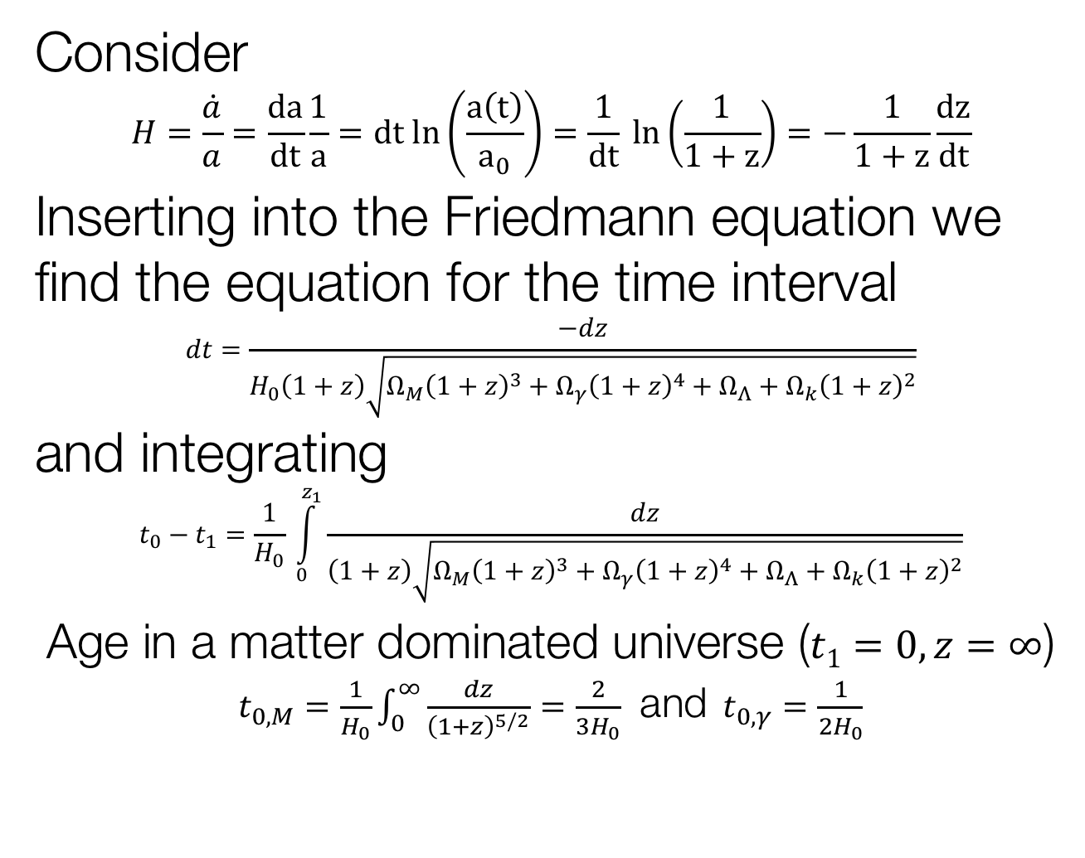
Lookback Time
Consider
$$H=\frac{\dot{a}}{a}=\frac{da}{dt}\frac{1}{a}=dt ln\left(\frac{a\left(t\right)}{a_{0}}\right)=\frac{1}{dt} ln\left(\frac{1}{1+z}\right)=−\frac{1}{1+z}\frac{dz}{dt}$$
Inserting into the Friedmann equation we find the equation for the time interval
$$dt=\frac{−dz}{H_{0}\left(1+z\right)\sqrt{Ω_{M}{\left(1+z\right)}^{3}+Ω_{γ}{\left(1+z\right)}^{4}+Ω_{Λ}+Ω_{k}{\left(1+z\right)}^{2}}}$$
and integrating
$$t_{0}−t_{1}=\frac{1}{H_{0}} \int_{0}^{z_{1}}{\frac{dz}{\left(1+z\right)\sqrt{Ω_{M}{\left(1+z\right)}^{3}+Ω_{γ}{\left(1+z\right)}^{4}+Ω_{Λ}+Ω_{k}{\left(1+z\right)}^{2}}}}$$
Age in a matter dominated universe ($t1=0, z=∞$) $t_{0,M}=\frac{1}{H_{0}}\int_{0}^{∞}{\frac{dz}{{\left(1+z\right)}^{5/2}}=\frac{2}{3H_{0}}}$ and $t_{0,γ}=\frac{1}{2H_{0}}$

Slide 30
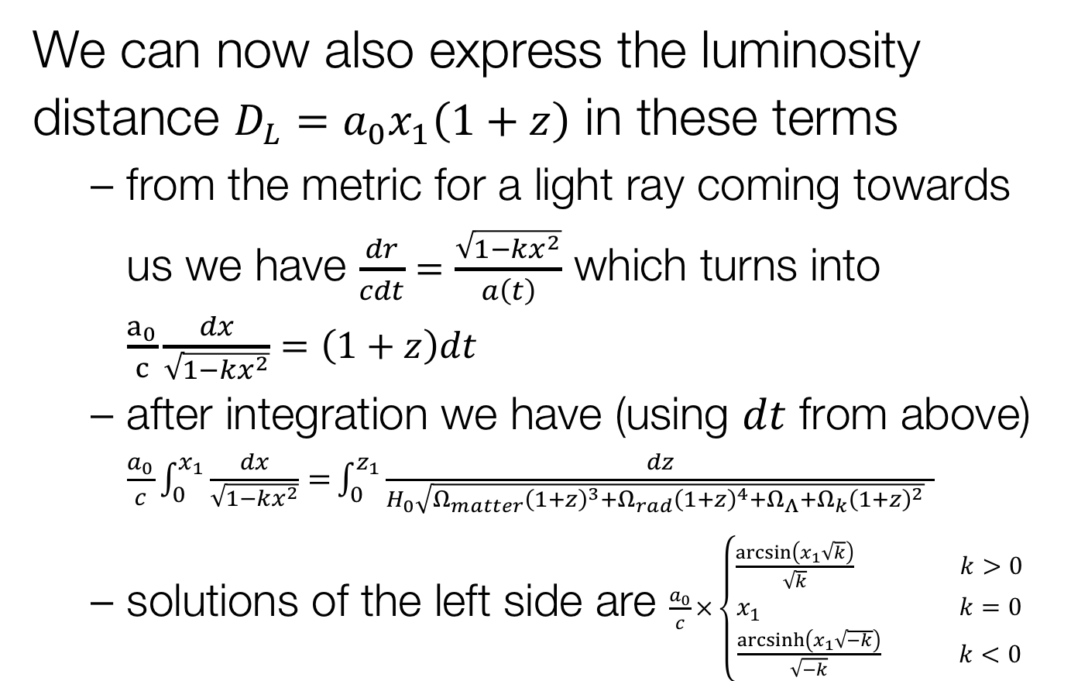
Cosmic Distances
We can now also express the luminosity distance $D_{L}=a_{0}x_{1}\left(1+z\right)$ in these terms
  from the metric for a light ray coming towards us we have $\frac{dr}{cdt}=\frac{\sqrt{1−kx^{2}}}{a\left(t\right)}$ which turns into $\frac{a_{0}}{c}\frac{dx}{\sqrt{1−kx^{2}}}=\left(1+z\right)dt$
  after integration we have (using $dt$ from above) $\frac{a_{0}}{c}\int_{0}^{x_{1}}{\frac{dx}{\sqrt{1−kx^{2}}}=}\int_{0}^{z_{1}}{\frac{dz}{H_{0}\sqrt{Ω_{matter}{\left(1+z\right)}^{3}+Ω_{rad}{\left(1+z\right)}^{4}+Ω_{Λ}+Ω_{k}{\left(1+z\right)}^{2}} }}$
  solutions of the left side are $\frac{a_{0}}{c}×\left\{\begin{aligned}\frac{\arcsin\left(x_{1}\sqrt{k}\right)}{\sqrt{k}} k>0 \\ x_{1} k=0 \\ \frac{\operatorname{arcsinh}\left(x_{1}\sqrt{−k}\right)}{\sqrt{−k}} k<0\end{aligned}\right.$

Slide 31
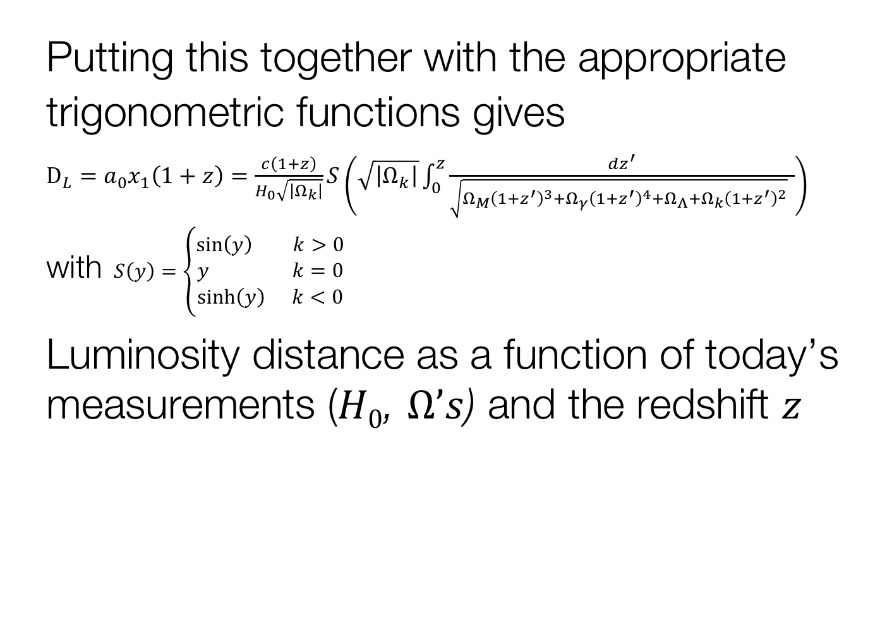
Luminosity Distance
Putting this together with the appropriate trigonometric functions gives
$D_{L}=a_{0}x_{1}\left(1+z\right)=\frac{c\left(1+z\right)}{H_{0}\sqrt{\left|Ω_{k}\right|}}S\left(\sqrt{\left|Ω_{k}\right|}\int_{0}^{z}{\frac{dz^{′}}{\sqrt{Ω_{M}{\left(1+z^{′}\right)}^{3}+Ω_{γ}{\left(1+z^{′}\right)}^{4}+Ω_{Λ}+Ω_{k}{\left(1+z^{′}\right)}^{2}} }}\right)$
with $S\left(y\right)=\left\{\begin{aligned}\sin\left(y\right) k>0 \\ y k=0 \\ \sinh\left(y\right) k<0\end{aligned}\right.$
Luminosity distance as a function of today’s measurements ($H0$, $Ω’s$) and the redshift $z$

Slide 32
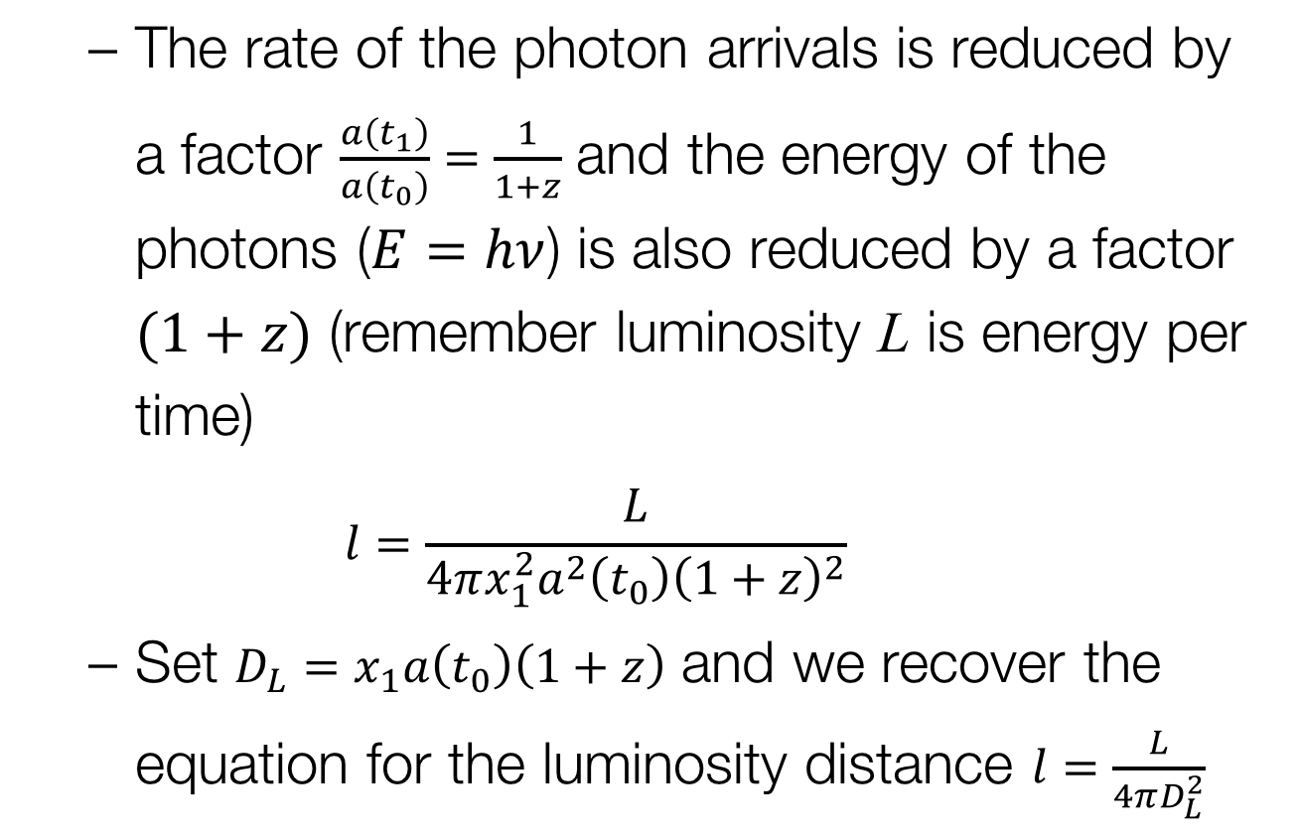
Luminosity Distance
  The rate of the photon arrivals is reduced by a factor $\frac{a\left(t_{1}\right)}{a\left(t_{0}\right)}=\frac{1}{1+z}$ and the energy of the photons ($E=hν$) is also reduced by a factor $(1+z)$ (remember luminosity L is energy per time)
  $$l=\frac{L}{4πx_{1}^{2}a^{2}\left(t_{0}\right){\left(1+z\right)}^{2}}$$
  Set $D_{L}=x_{1}a\left(t_{0}\right)\left(1+z\right)$ and we recover the equation for the luminosity distance $l=\frac{L}{4πD_{L}^{2}}$

Slide 33
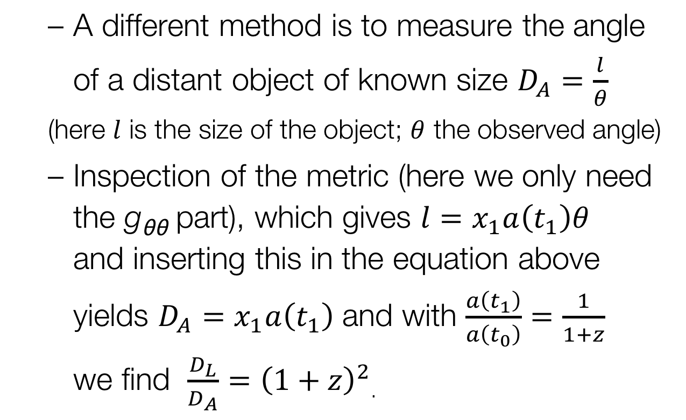
Angular size distance
  A different method is to measure the angle of a distant object of known size $D_{A}=\frac{l}{θ}$
  (here $l$ is the size of the object; $θ$ the observed angle)
  Inspection of the metric (here we only need the g_{θθ} part), which gives $l=x_{1}a\left(t_{1}\right)θ$
  and inserting this in the equation above yields $D_{A}=x_{1}a\left(t_{1}\right)$ and with $\frac{a\left(t_{1}\right)}{a\left(t_{0}\right)}=\frac{1}{1+z}$
  we find $\frac{D_{L}}{D_{A}}={\left(1+z\right)}^{2}$.

Slide 34
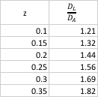
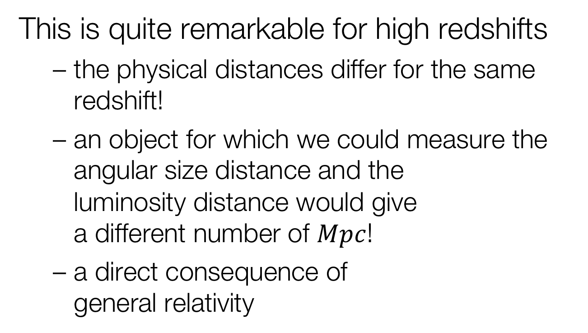
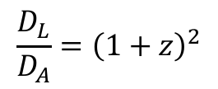
Distance Duality
This is quite remarkable for high redshifts
  the physical distances differ for the same redshift!
  an object for which we could measure the angular size distance and the
  luminosity distance would give
  a different number of $Mpc$!
  a direct consequence of
  general relativity
$$\frac{D_{L}}{D_{A}}={\left(1+z\right)}^{2}$$

Slide 35
Distance Duality
Now measured in several systems
  galaxy clusters
    Sunyaev-Zeldovich effect
    gravitational lenses
Type II Supernovae
  use two different methods to the same object
  Expanding Photosphere Method
    equates luminosity distance with angular size distance
  Standardizable Candle Method
    pure luminosity distance

Slide 36
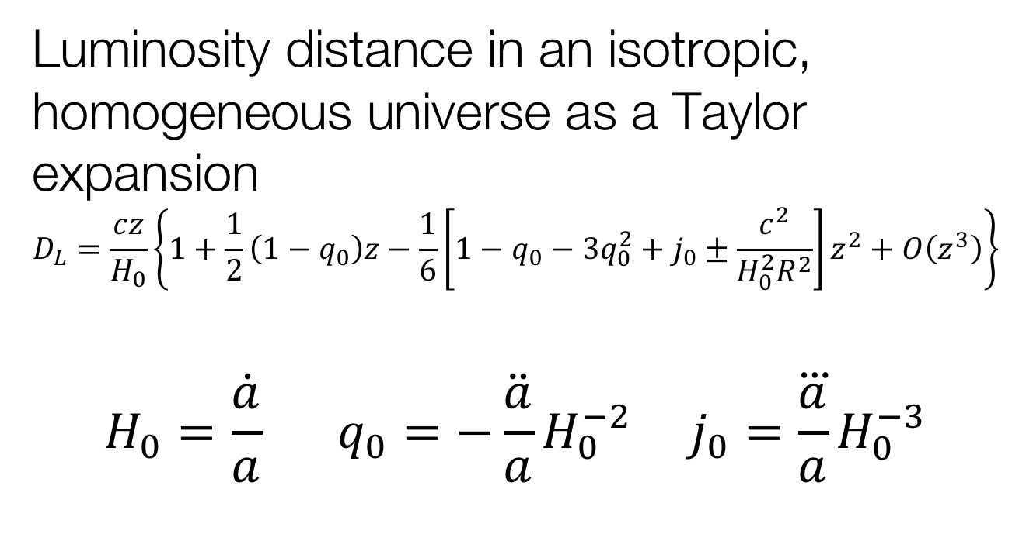
Expansion of the Universe
Luminosity distance in an isotropic, homogeneous universe as a Taylor expansion
$$D_{L}=\frac{cz}{H_{0}}\left\{1+\frac{1}{2}\left(1−q_{0}\right)z−\frac{1}{6}\left[1−q_{0}−3q_{0}^{2}+j_{0}±\frac{c^{2}}{H_{0}^{2}R^{2}}\right]z^{2}+O\left(z^{3}\right)\right\}$$
$$H_{0}=\frac{\dot{a}}{a} q_{0}=−\ddot{\frac{a}{a}}H_{0}^{−2} j_{0}=\frac{\overset{⃛}{a}}{a}H_{0}^{−3}$$
Hubble’s Law
deceleration
jerk/equation of state

Slide 37
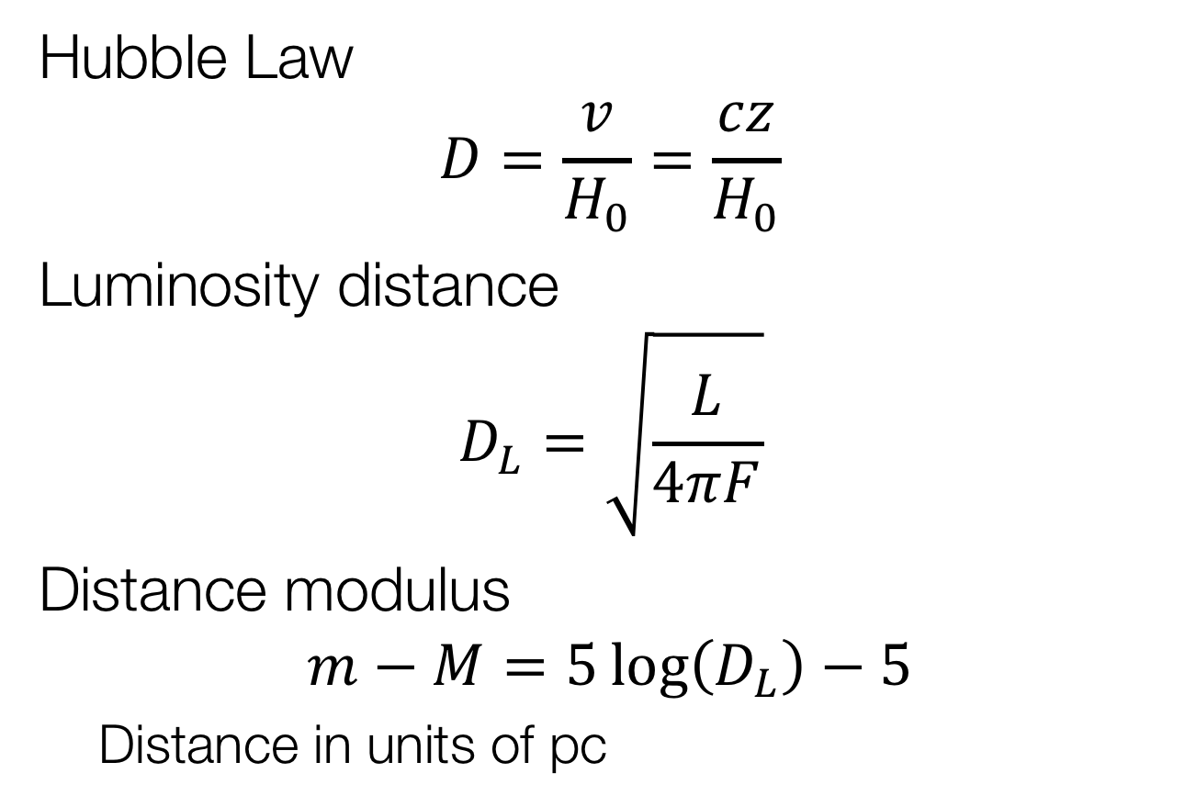

Local Universe ($z≪1$)
Hubble Law
$$D=\frac{v}{H_{0}}=\frac{cz}{H_{0}}$$
Luminosity distance
$$D_{L}=\sqrt{\frac{L}{4πF}}$$
Distance modulus
$$m−M=5\log\left(D_{L}\right)−5$$
  Distance in units of pc

Slide 38
Hubble Constant
Measure cosmic expansion velocity per unit scale length
$H_{0}=\frac{v}{D_{L}}$ (units: $km s^{−1} Mpc^{−1}$)
Ignore higher-order cosmological effects
  de/acceleration
Spectroscopy → redshift → velocity
Photometry → brightness → distance

Slide 39
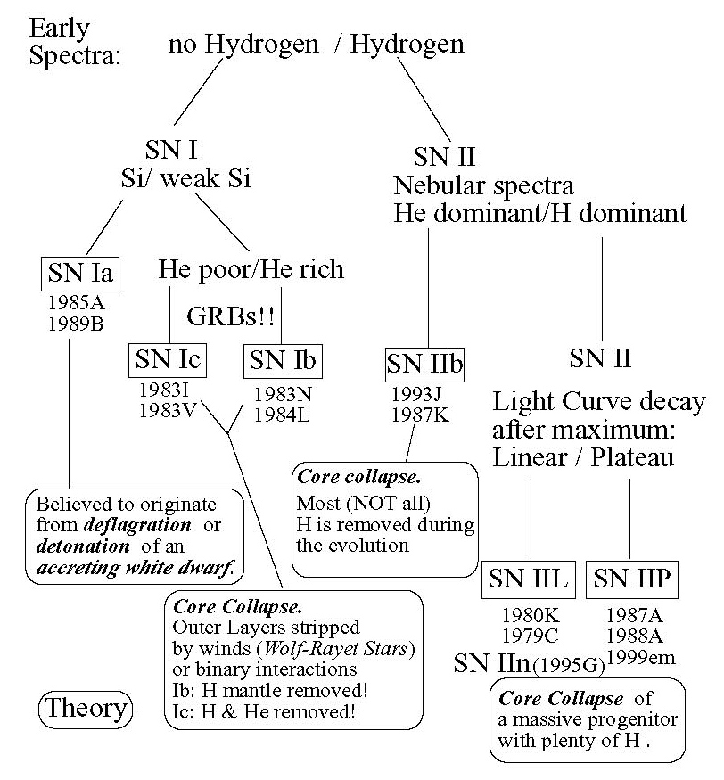
SN Classification

Slide 40
Time Dilation in SNe Ia
Uniform light curve shapes in a given filter
Distant supernovae should show a
‘slower’ light curve
Leibundgut et al. 1996

Slide 41
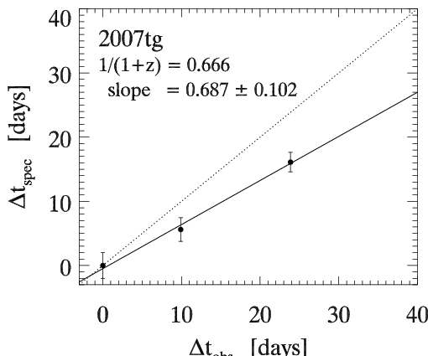
Time dilation
Spectroscopic clock in the distant universe
(z ~ 0.5)
Δt_{obs} [days]
Observed Wavelength [Å]
Blondin et al. (2008)

Slide 42

Time Dilation
‘Tired Light’ can be excluded beyond doubt ($Δχ2=120$)
Blondin et al. (2008)

Slide 43
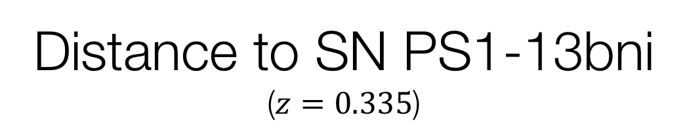
Distance to SN PS1-13bni
($z=0.335$)
Use EPM and CSM to measure distance to same supernova
Gall et al. 2018

Slide 44
Distance Duality
First attempts inconclusive
Gall et al. 2017

Slide 45
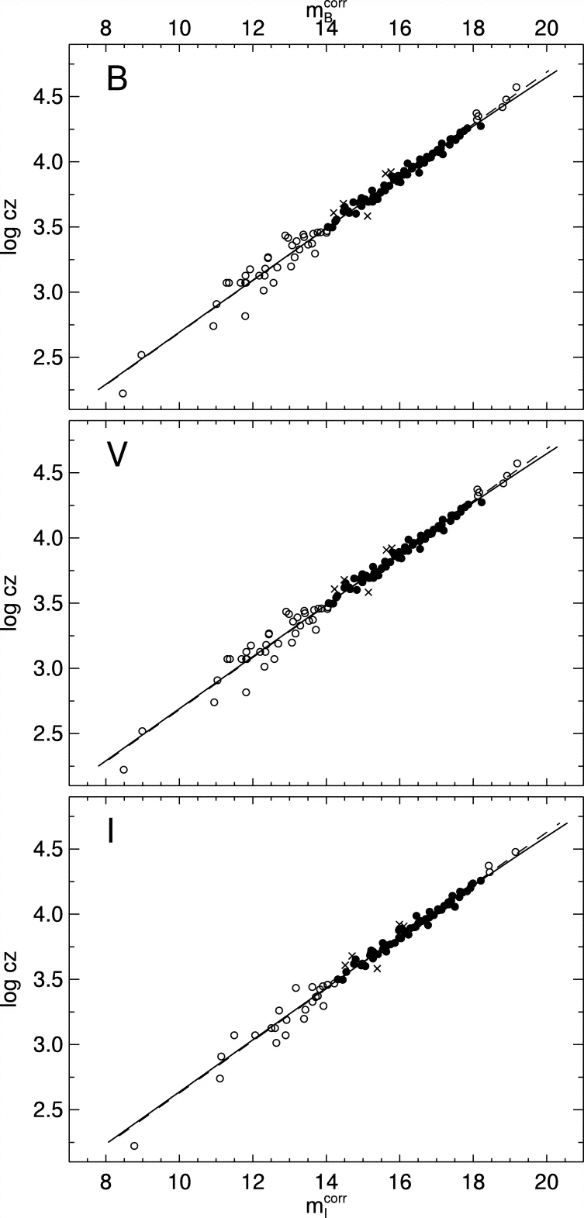
SN Ia Hubble diagram
Excellent distance indicators
Experimentally verified
Work of several decades
Best determination of
the Hubble constant
Reindl et al. 2005

Slide 46
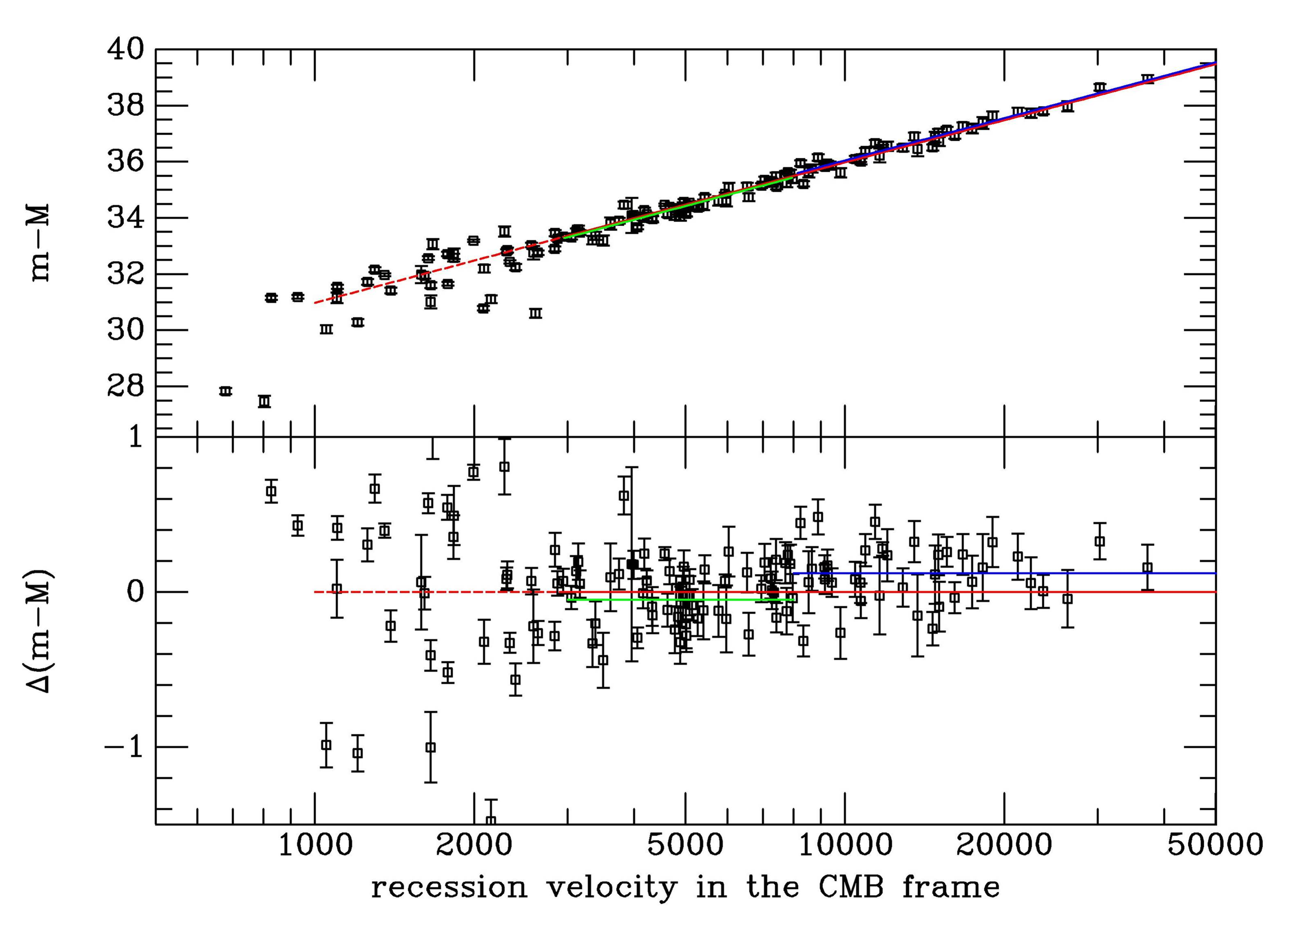
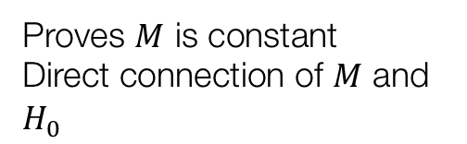
Hubble Constant
SN Hubble diagram
  $$m−M=5\log{v+25−5\log{H_{0}}}$$
Proves $M$ is constant
Direct connection of $M$ and $H_{0}$
Leibundgut

Slide 47
Hubble Constant
Calibration of M(SN Ia @ max)
Distance ladder
Adam Riess

Slide 48
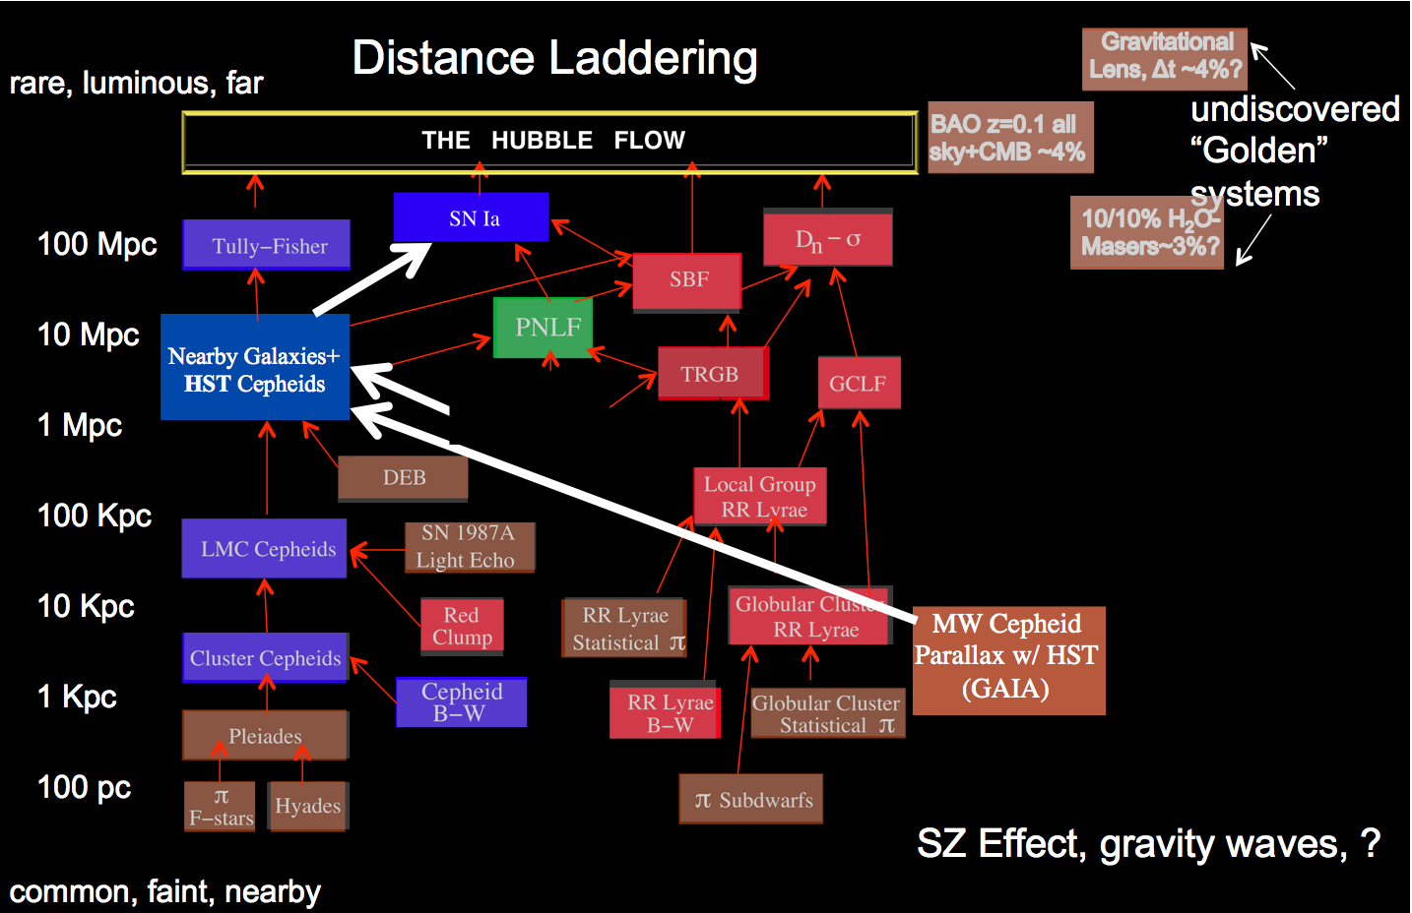
Distance ladder
according to Riess 2014

Slide 49
Cepheid Stars
Period-luminosity relation
Riess et al. 2011
Freedman & Madore 2010

Slide 50
Hubble Constant
Supernova Ia Hubble diagram

Slide 51
Hubble Constant
Caveats
  local calibrators still uncertain
    Large Magellanic Cloud
    Maser in NGC 4258
    in the future geometric distances (parallaxes) to nearby Cepheids
  extinction
    absorption of light by dust in the Milky Way and in the host galaxy
    corrections not always certain
  peculiar velocities of galaxies
    typically around 300 km/s

Slide 52
Current Status (NIR)
9 calibrators + 27 Hubble flow SNe
Dhawan et al. 2018
$$H_{0}=(72.8±1.6\left(stat\right)±2.7 \left(syst\right)) km s^{−1} Mpc^{−1}$$

Slide 53
Foundation Survey
Foley et al. 2018
180 local SNe Ia

Slide 54
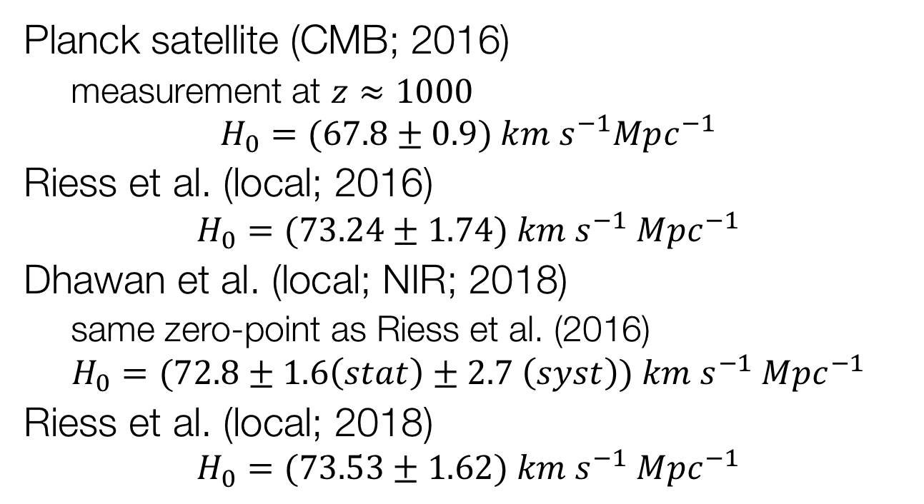
Hubble Constant(s)
Planck satellite (CMB; 2016)
  measurement at $z≈1000$
$$H_{0}=(67.8±0.9) km s^{−1}Mpc^{−1}$$
Riess et al. (local; 2016)
$$H_{0}=(73.24±1.74) km s^{−1} Mpc^{−1}$$
Dhawan et al. (local; NIR; 2018)
  same zero-point as Riess et al. (2016)
$$H_{0}=(72.8±1.6\left(stat\right)±2.7 \left(syst\right)) km s^{−1} Mpc^{−1}$$
Riess et al. (local; 2018)
$$H_{0}=(73.53±1.62) km s^{−1} Mpc^{−1}$$

Slide 55
Hubble Constant
Latest values
Riess et al. 2016

Slide 56

Gaia and $H0$
Calibrate Cepheid distances with parallaxes
  long-period Cepheids so far not accessible
Single step to the SNe Ia
Helps to bypass intermediate steps and calibrators
  reduced uncertainty on H₀
Goal: uncertainty less than 1%

Slide 57
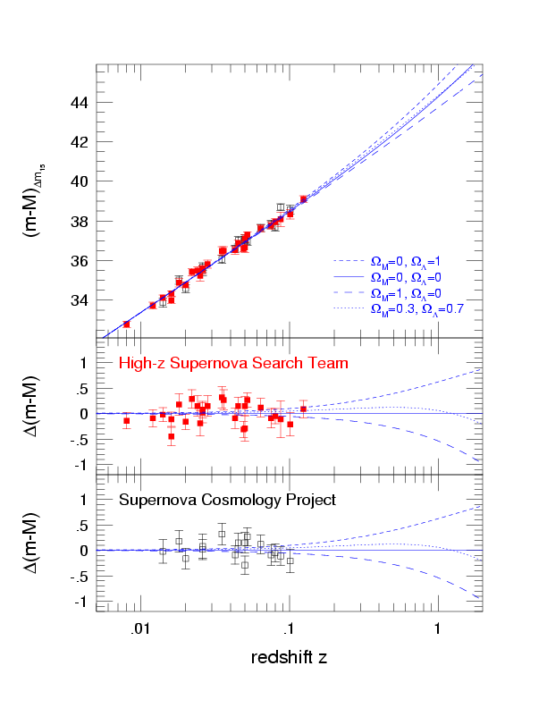



The SN Hubble Diagram

Slide 58

Supernova Cosmology
Goobar & Leibundgut 2011
560 SNe Ia

Slide 59


et voilà ...
10 years of progress
Goobar & Leibundgut 2011

Slide 60
Constant ω firmly established

Slide 61
Status 2014
Betoule et al. 2014

Slide 62
Status 2018
Scolnic et al. 2018

Slide 63
What next?
Already in hand
  >1000 SNe Ia for cosmology
  constant ω determined to 5%
  accuracy dominated by systematic effects
Missing
  good data at z>1
    light curves and spectra
  good infrared data at z>0.5
    cover the restframe B and V filters
    move towards longer wavelengths to reduce absorption effects

Slide 64

Cosmology – more?
Goobar & Leibundgut 2011
(courtesy E. Linder and J. Johansson)

Slide 65




Multi-parameter problem
Ariel Goobar

Slide 66
Speculations
Einstein’s cosmologal constant
  No explanation in particle physics theories
Quintessence
  Quantum mechanical particle field releasing energy into the universe
Signatures of high dimensions
  Gravity is best described in theories with more than four dimensions
Phantom Energy
  Dark Energy dominates and eventually the universe end in a (Big Rip)

