Slide 1
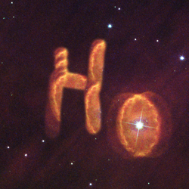
adH0cc
Local H₀ in one step
Status report
Bruno Leibundgut
on behalf of the adH0cc Team

Slide 2


History of H₀
https://www.cfa.harvard.edu/~dfabricant/huchra/hubble/
$$2.6⋅{10}^{9}years$$
$$6.5⋅{10}^{9}years$$

Slide 3


History of H₀
$$6.5⋅{10}^{9}years$$
$$13⋅{10}^{9}years$$

Slide 4
Measuring H₀
Classical approach
  → distance ladder to reach (smooth) Hubble flow
Sandage & Tammann 1974

Slide 5
Classical Distance Ladder
Distance indicators
  trigonometric parallax
  apparent luminosity
    main sequence
    red clump stars
    RR Lyrae stars
    eclipsing binaries
    Cepheid stars
  Galaxy relations
    Tully-Fisher, Faber-Jackson
  SNe Ia
Jacoby et al. 1992

Slide 6
SH₀ES distance ladder

Slide 7
H₀ Status
Bonvin and Millon
https://doi.org/10.5281/zenodo.3635517

Slide 8
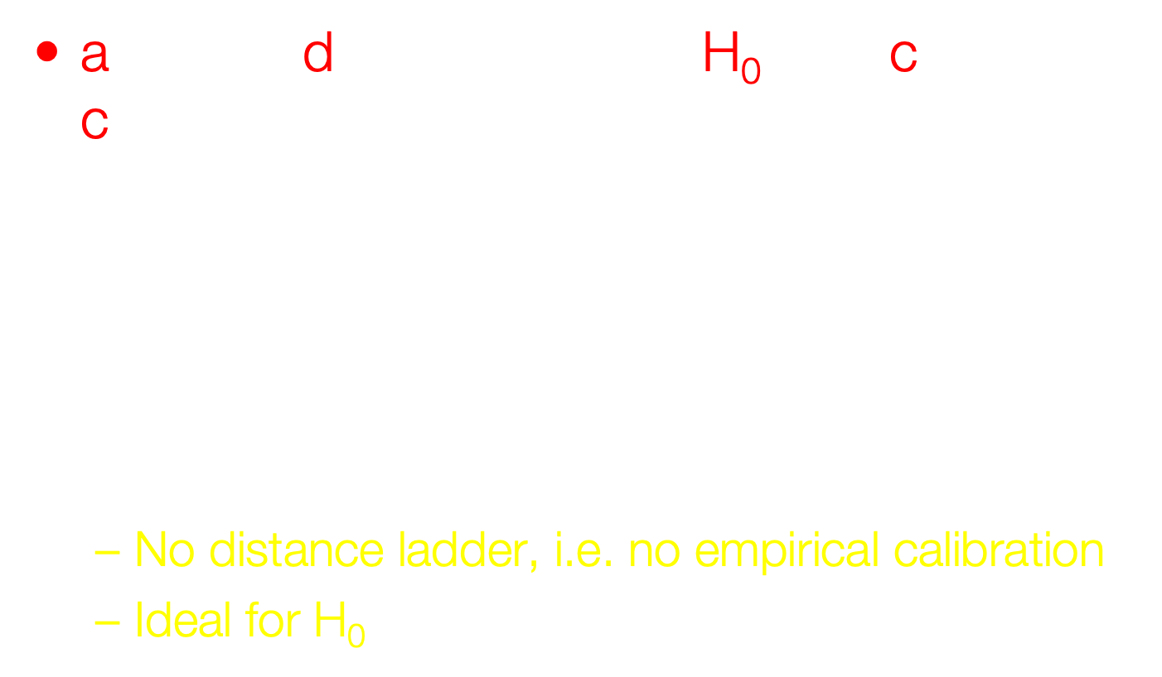
adH0cc – Basics
accurate determination of H₀ with core-collapse (supernovae)
Individual distances (to about 10%) to
Type II supernovae in the Hubble flow
($0.03<z<0.15$)
Distance determination based on calibrated physics
  No distance ladder, i.e. no empirical calibration
  Ideal for H₀

Slide 9
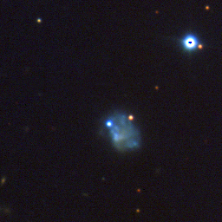
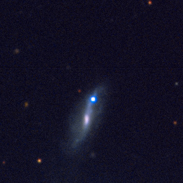
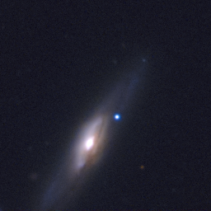
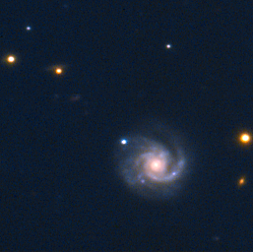
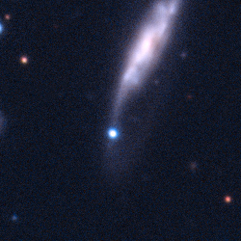
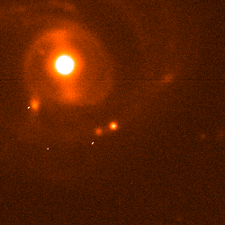
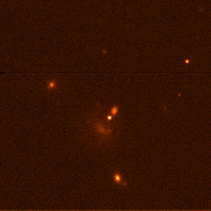
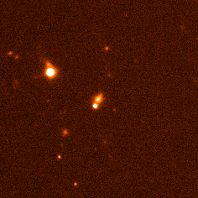
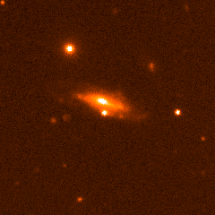
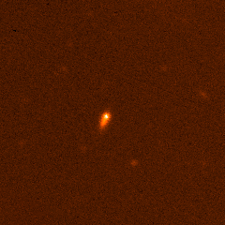
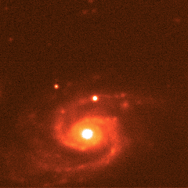
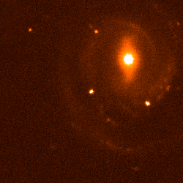
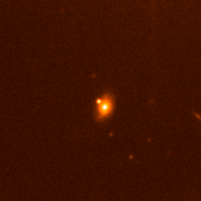
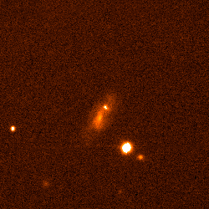
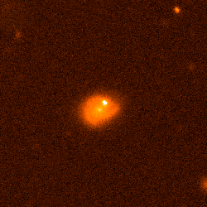
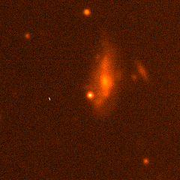
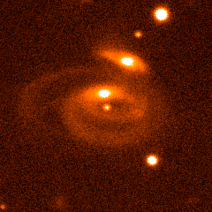
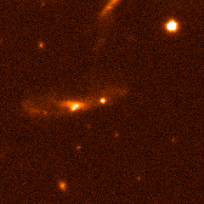
adH0cc – Basics
Collaboration: MPA, ESO, TUM, LAM, GSI, QUB, Turku, Weizmann, EPFL
Web page: https://adh0cc.github.io

Slide 10
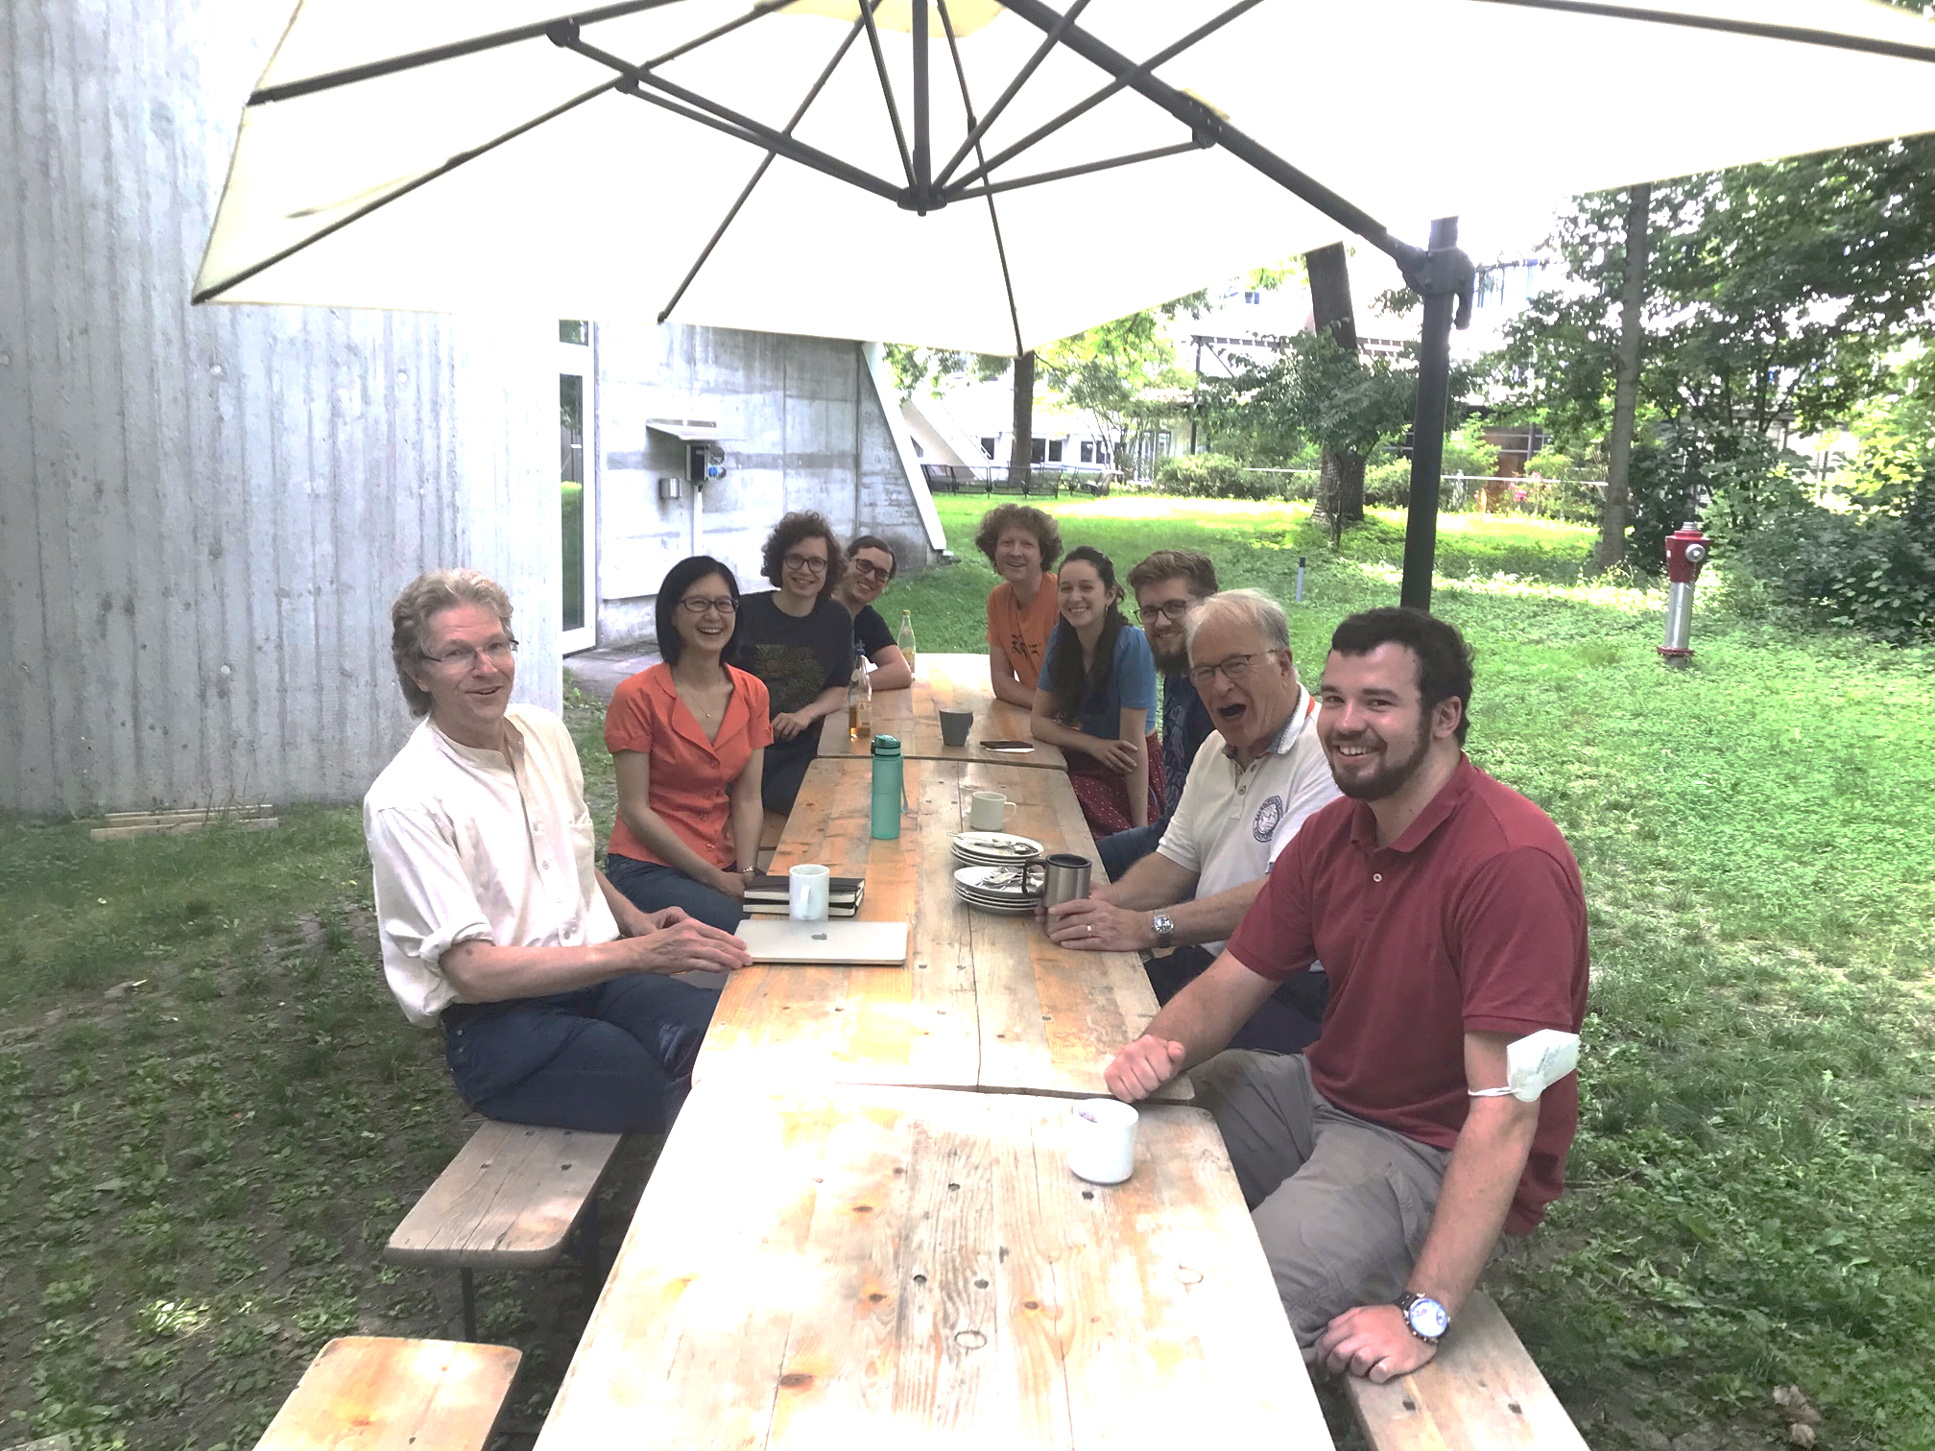





adH₀cc – Team
J. Spyromilio
S. Blondin
B. Leibundgut
S. Suyu
C. Vogl
A. Floers
S. Taubenberger
M. G. Cudmani
A. Holas
W. Hillebrandt
G. Csörnyei
S. Kressierer
S. Smartt
R. Kotak
C. Lemon
A. Gal-Yam
R. Bruch

Slide 11
Expanding Photosphere Method
Modification of Baade-Wesselink method for variable stars
Assumes
  Sharp photosphere
  → thermal equilibrium
  Spherical symmetry
  → radial velocity
  Free expansion
Kirshner & Kwan 1974

Slide 12
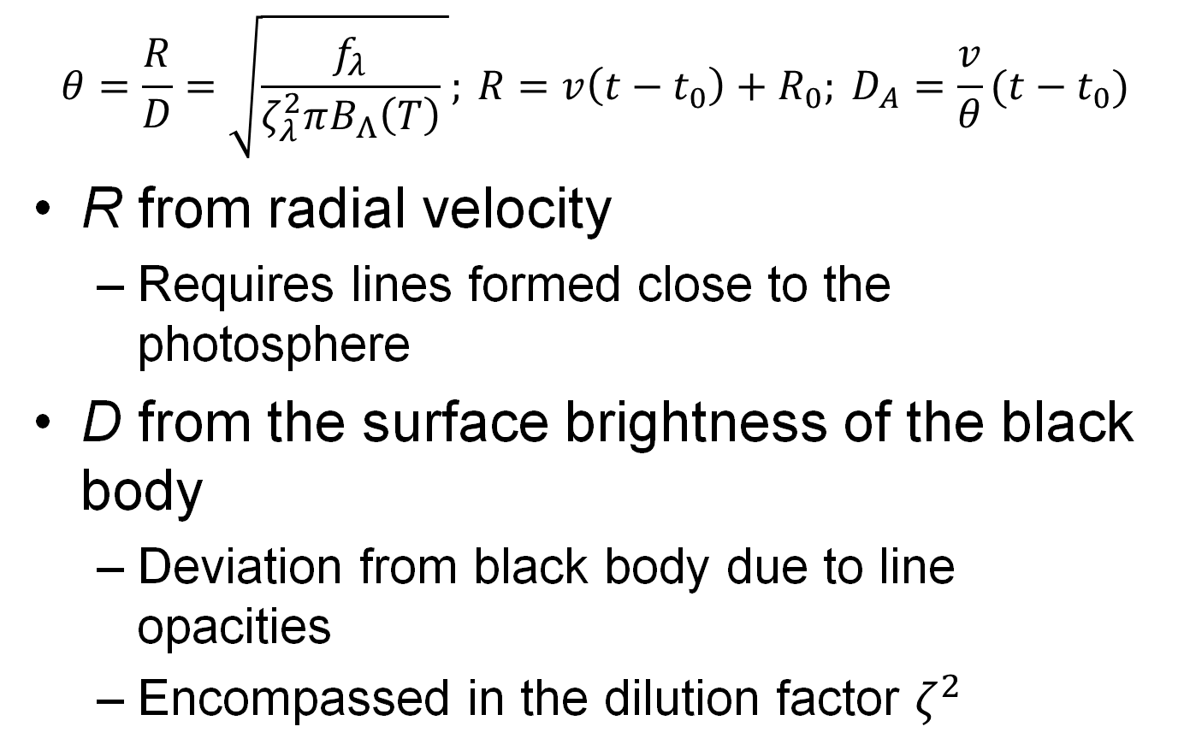
Expanding Photosphere Method
    $$θ=\frac{R}{D}=\sqrt{\frac{f_{λ}}{ζ_{λ}^{2}πB_{Λ}\left(T\right)} }; {R=v\left(t−t_{0}\right)+R_{0}; D}_{A}=\frac{v}{θ}(t−t_{0})$$
R from radial velocity
  Requires lines formed close to the photosphere
D from the surface brightness of the black body
  Deviation from black body due to line opacities
  Encompassed in the dilution factor $ζ^{2}$

Slide 13
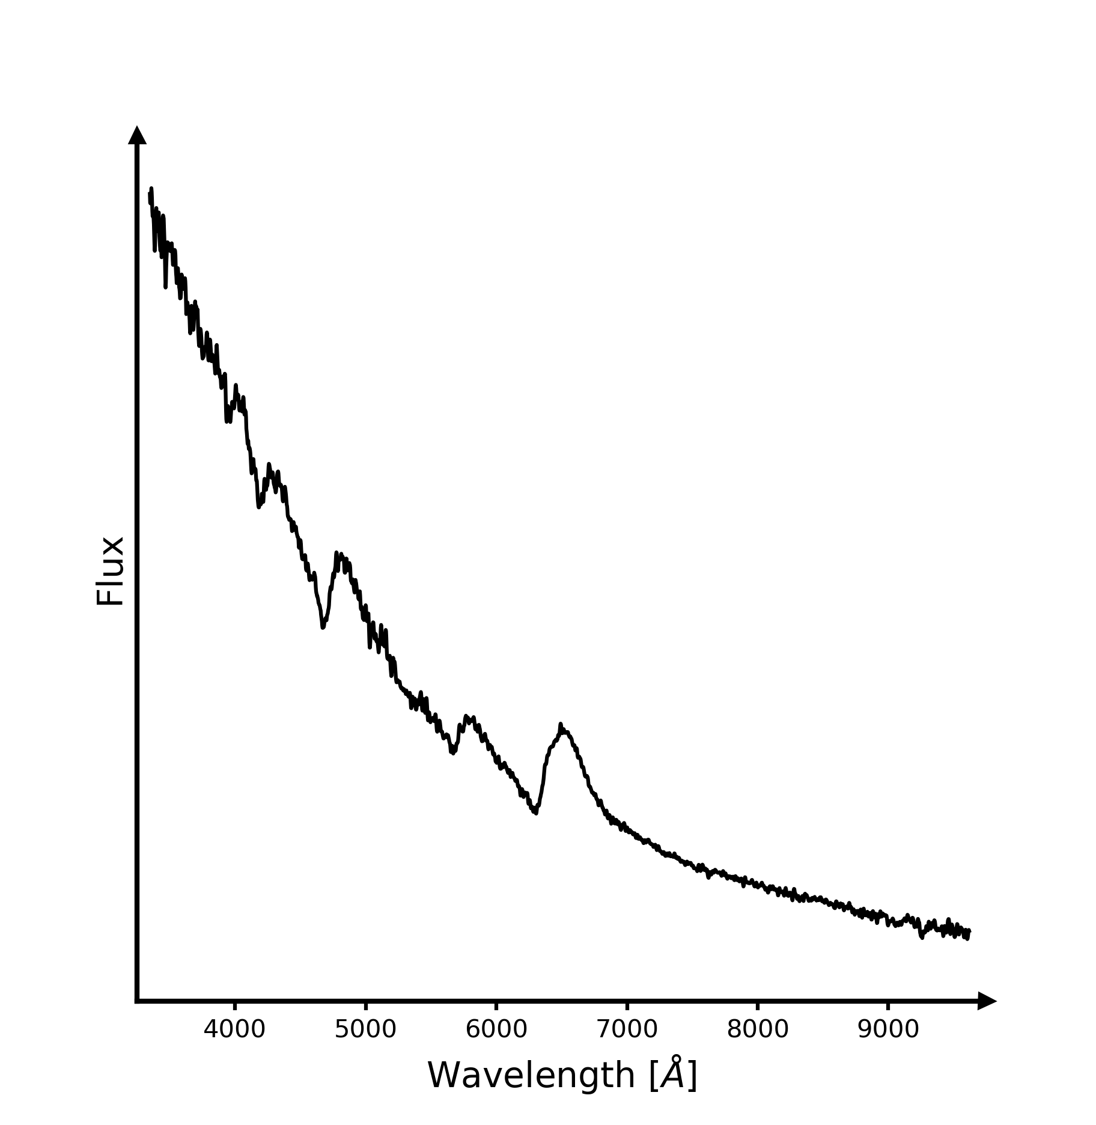
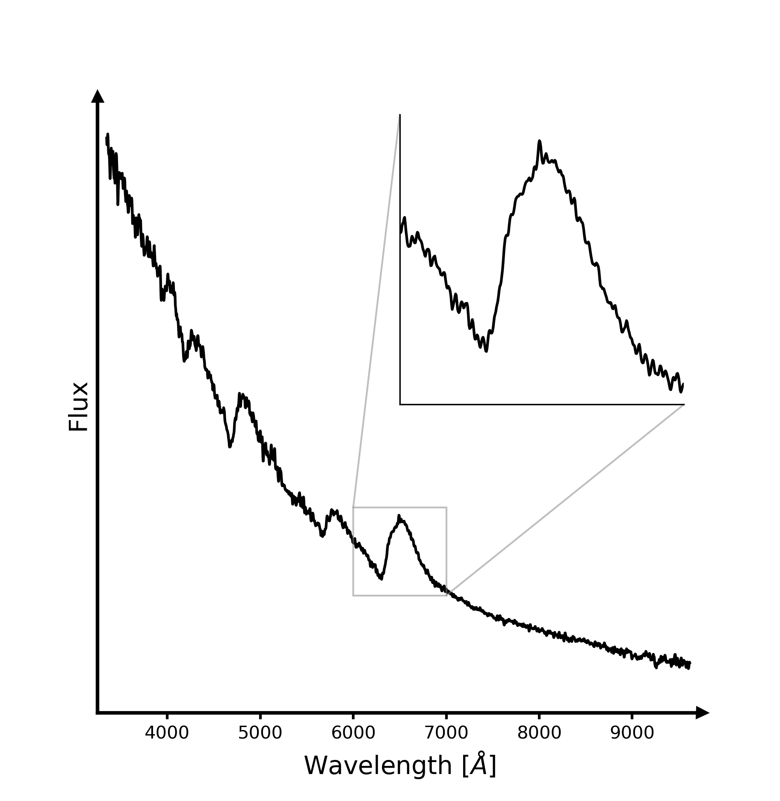
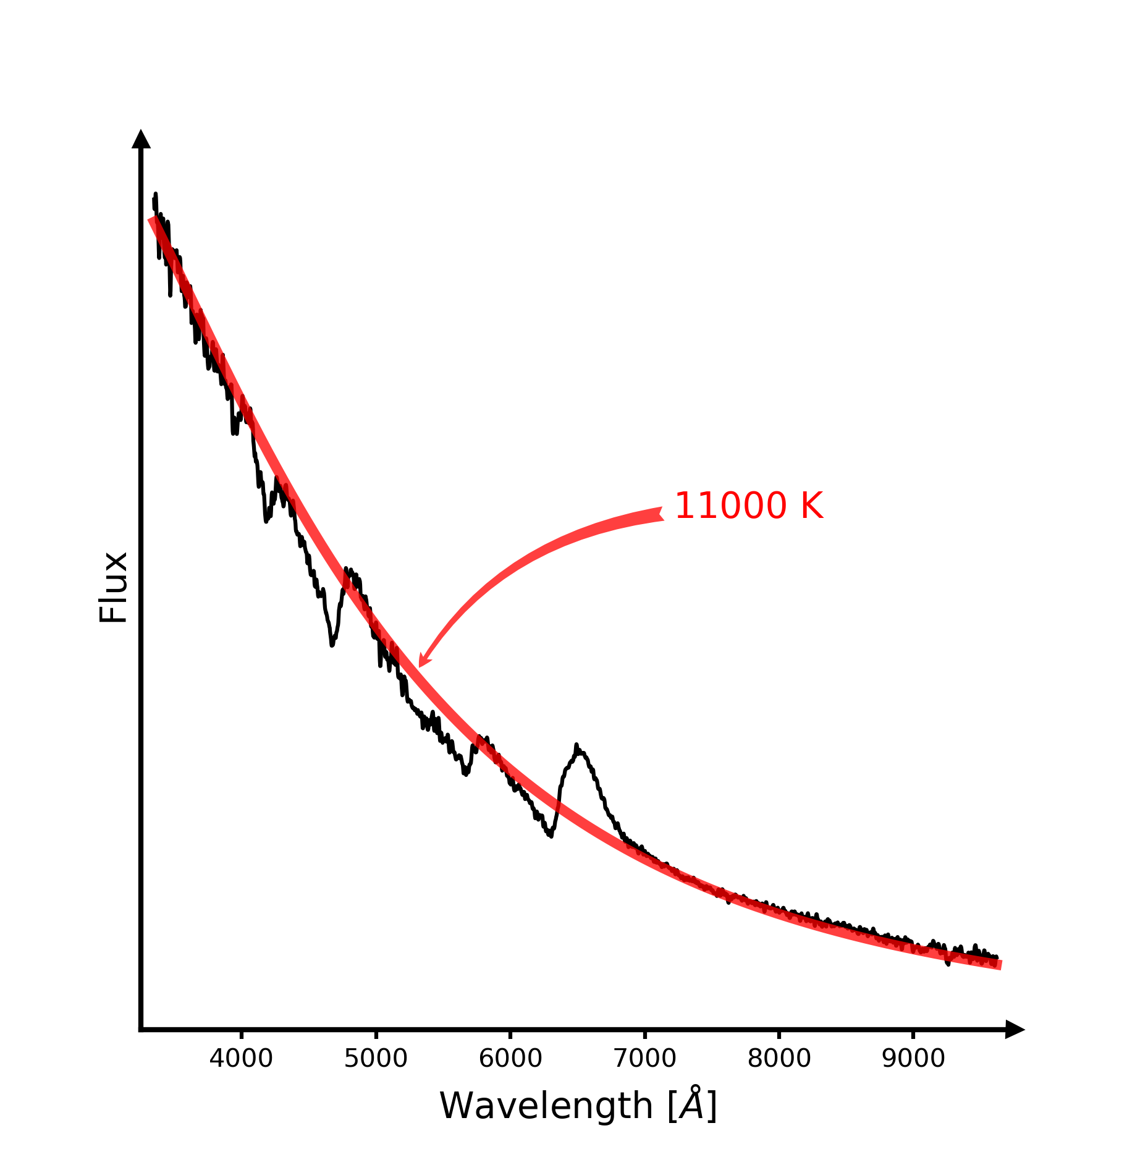
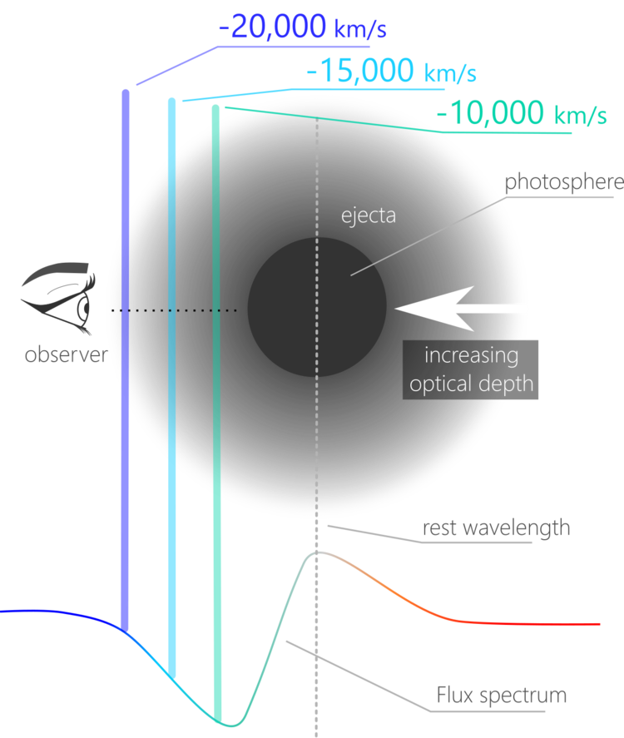
EPM: it’s all in the spectra
C. Vogl
Image: Héloïse Stevance

Slide 14
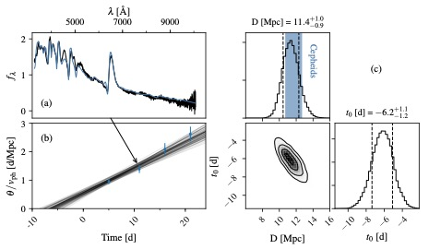
EPM improvements (C. Vogl)
Developed in Christian Vogl’s thesis
  Individual fitting of each SN epoch
  Consistent parameters for the SN atmosphere
  Accurate explosion date from observations
Vogl et al. 2020

Slide 15
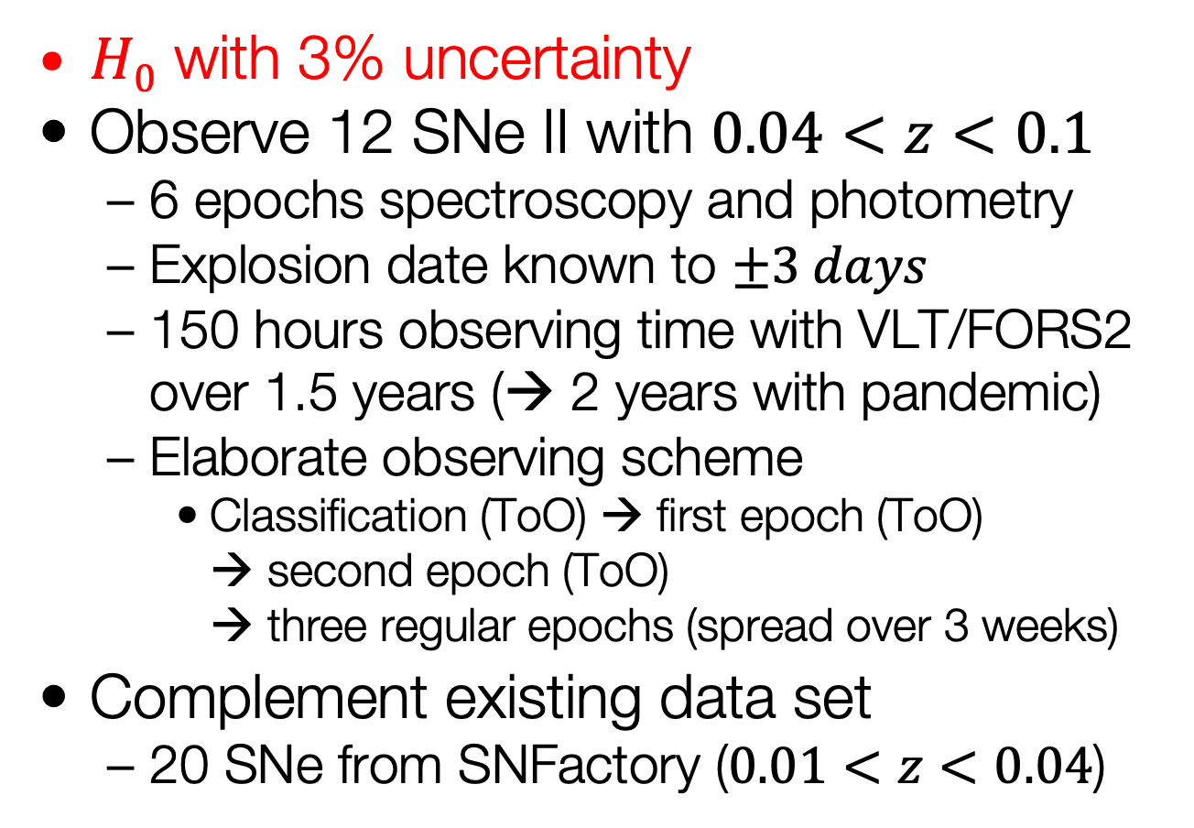
adH0cc – Goal
$H0$ with 3% uncertainty
Observe 12 SNe II with $0.04<z<0.1$
  6 epochs spectroscopy and photometry
  Explosion date known to $±3 days$
  150 hours observing time with VLT/FORS2 over 1.5 years (→ 2 years with pandemic)
  Elaborate observing scheme
    Classification (ToO) → first epoch (ToO)
    → second epoch (ToO)
    → three regular epochs (spread over 3 weeks)
Complement existing data set
  20 SNe from SNFactory ($0.01<z<0.04$)

Slide 16
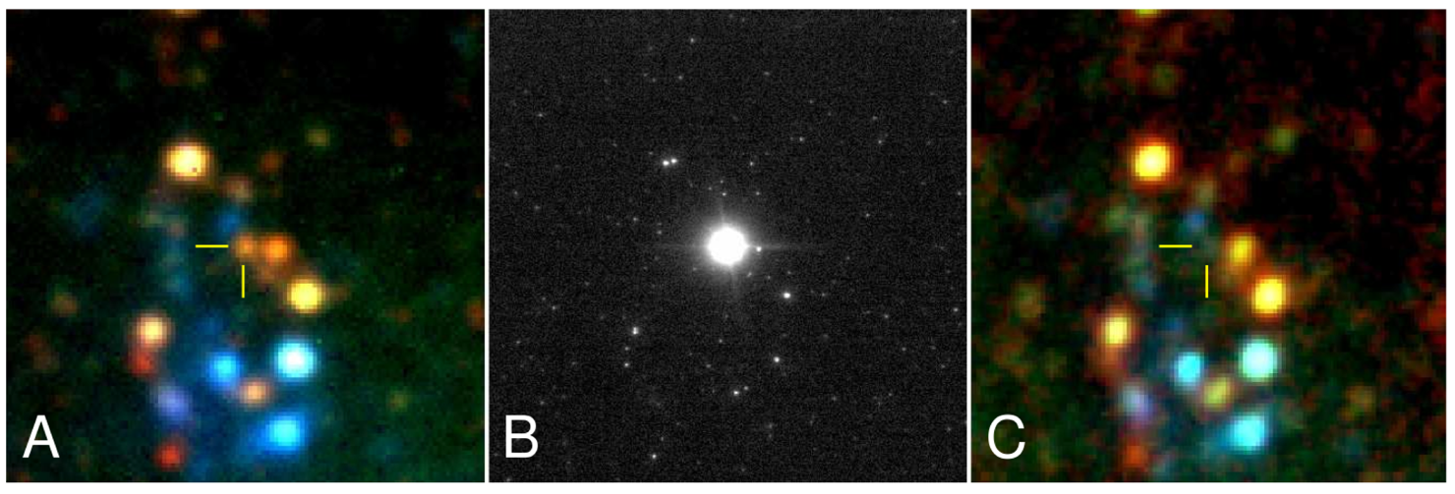

Type II Supernovae
Core-collapse explosions of
massive, red-supergiant stars
Peak absolute mags between -16 and -18
  $→$ observable up to z $≈$ 0.4
Most common supernova type by volume
Mattila et al. 2010

Slide 17
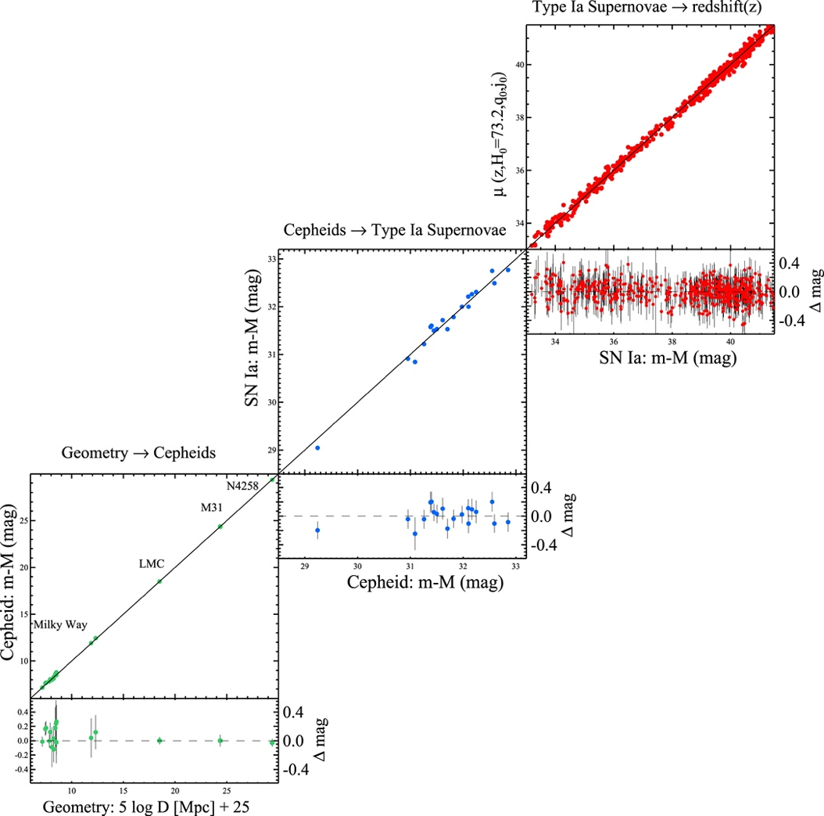
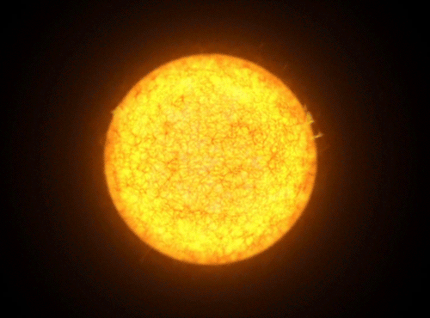
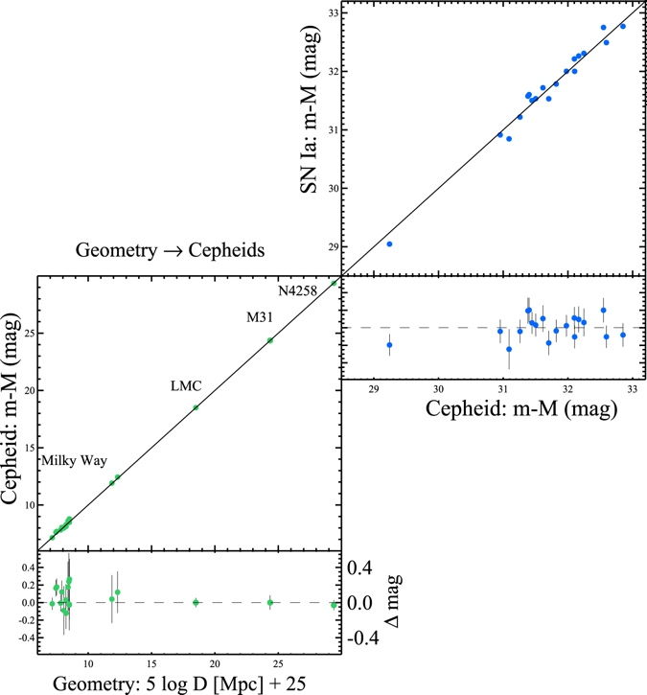
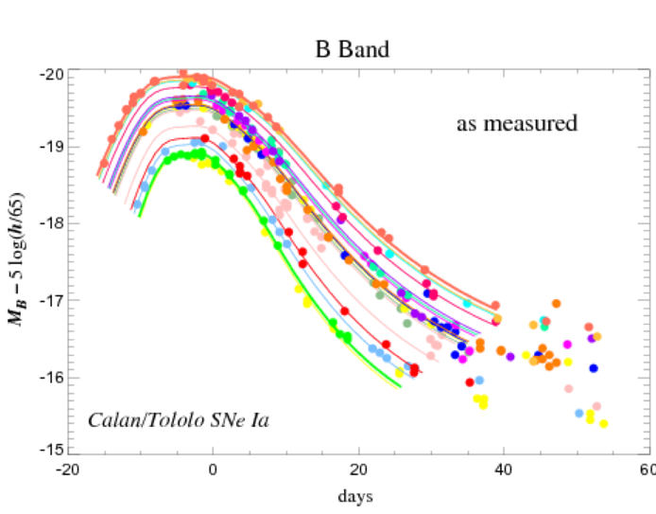
Why type II supernovae?
Christian Vogl
Luminosity ~ Period
Type II supernovae
Type II supernovae:
luminosity directly from models
simple physics
physics based
one-step measurement
Luminosity ~ light curve width
Riess et al. 2016

Slide 18
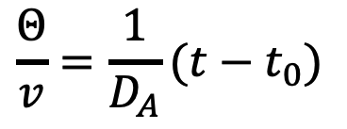




Expanding Photosphere Method
$$\frac{Θ}{v}=\frac{1}{D_{A}}(t−t_{0})$$
Gall et al. 2018
$$Θ/v$$
$$Θ/v$$
$$t−t0$$
$$t−t0$$

Slide 19
Expanded Photosphere Method Reloaded
Use individual atmospheric models for the spectral fits
  use of the TARDIS radiation transport model
  absolute flux emitted
Accurate explosion date
  accurate zero point
At least 5 epochs per supernova

Slide 20
Atmosphere Models
TARDIS fits for different epochs

Slide 21
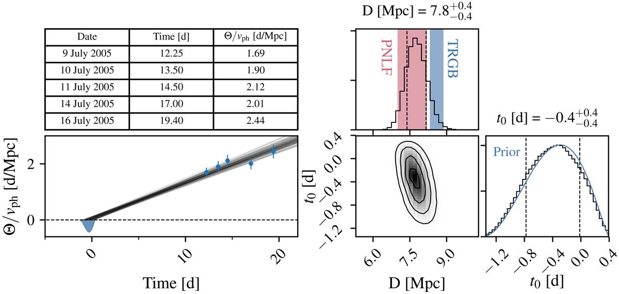

Distance Determination
Slope is inverse distance: $\frac{Θ}{v}=\frac{1}{D_{A}}(t−t_{0})$
Vogl et al. 2020
SN 2005cs

Slide 22
adH0cc – Status
Observations finished – 1 October 2021
44 classifications
  26 SNe II, 12 SNe Ia, 6 other types (Ibc)
    One new type SN Icn (SN 2021ckj)
  20 SNe II with follow-up observations
    Added another six objects not classified by us

Slide 23

adH0cc – Observations

Slide 24
adH0cc – Observations
Distribution on the sky

Slide 25
adH0cc – Status
Data analysis
workshop
  27 Sep – 1 Oct
  at MIAPP
Photometry
  Requires template
  observations one year after SN
Spectroscopy
  Data reductions ongoing
    Two independent data reductions

Slide 26
adH0cc – Status
Discussions of analysis
  Investigations of
  systematics
    Peculiar velocities
    Code comparisons
    Contamination by galaxy light
    Reddening
    Circumstellar interactions
    Asymmetric explosions
  Blinding procedures

Slide 27
adH0cc – Associated projects
Calibrate Standardizable
Candle Method (SCM)
  Same data required
  Replace external calibration
  through Cepheids and/or
  TRGB
First SCM publication by Alexander Holas for the SNFactory data in preparation
  Still based on Cepheid and TRGB calibrations
De Jaeger et al. 2020
EPM → SCM
SNe II (EPM): m-M (mag)

Slide 28
adH0cc – Associated Projects
Sibling supernovae
  Determine EPM distance
  to SNe II in the same
  galaxy
    Internal consistency
    Systematics
      e.g. reddening
    Internal scatter of the
    method
Done for five of six suitable galaxies
by Géza Csörnyei
  To be presented at SuperVirtual workshop
https://aasnova.org/2019/04/22/featured-image-hunting-for-past-fireworks/
NGC 6946;
AAS Nova

Slide 29
adH0cc – Associated Projects
Calibrate SNe Ia with EPM distances
  ‘Siblings of a different kind’
    Galaxies with a SN II and a SN Ia
SN 2003hn
SN 2001el
SNe II (EPM): m-M (mag)
Notes:
SN 2003hn – IIP; SN 2001el - Ia

Slide 30
adH0cc – Summary
All data obtained
  26 SNe II with multiple epochs and good explosion dates
    Analysis ongoing
Individual distances to 10%
  EPM of sibling SNe II independently check method
  Statistical error well below 3%
Systematics most critical

