Slide 1
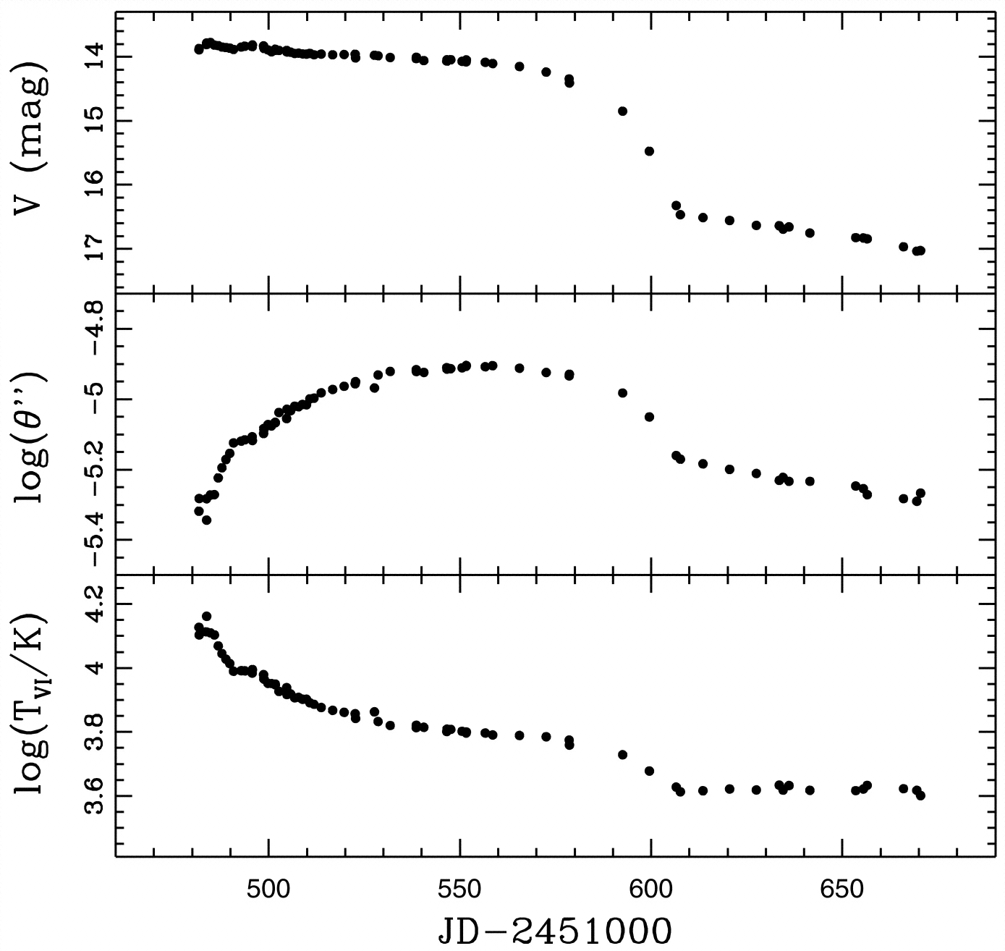

The distance to the Type IIP
SN 2013eq
Hamuy et al. (2001)
Elisabeth Gall (QUB/MPA), Rubina Kotak (QUB), Bruno Leibundgut (ESO),
Stefan Taubenberger (ESO/MPA),
Wolfgang Hillebrandt (MPA),
Markus Kromer (Stockholm)
arXiv:1603.04730

Slide 2
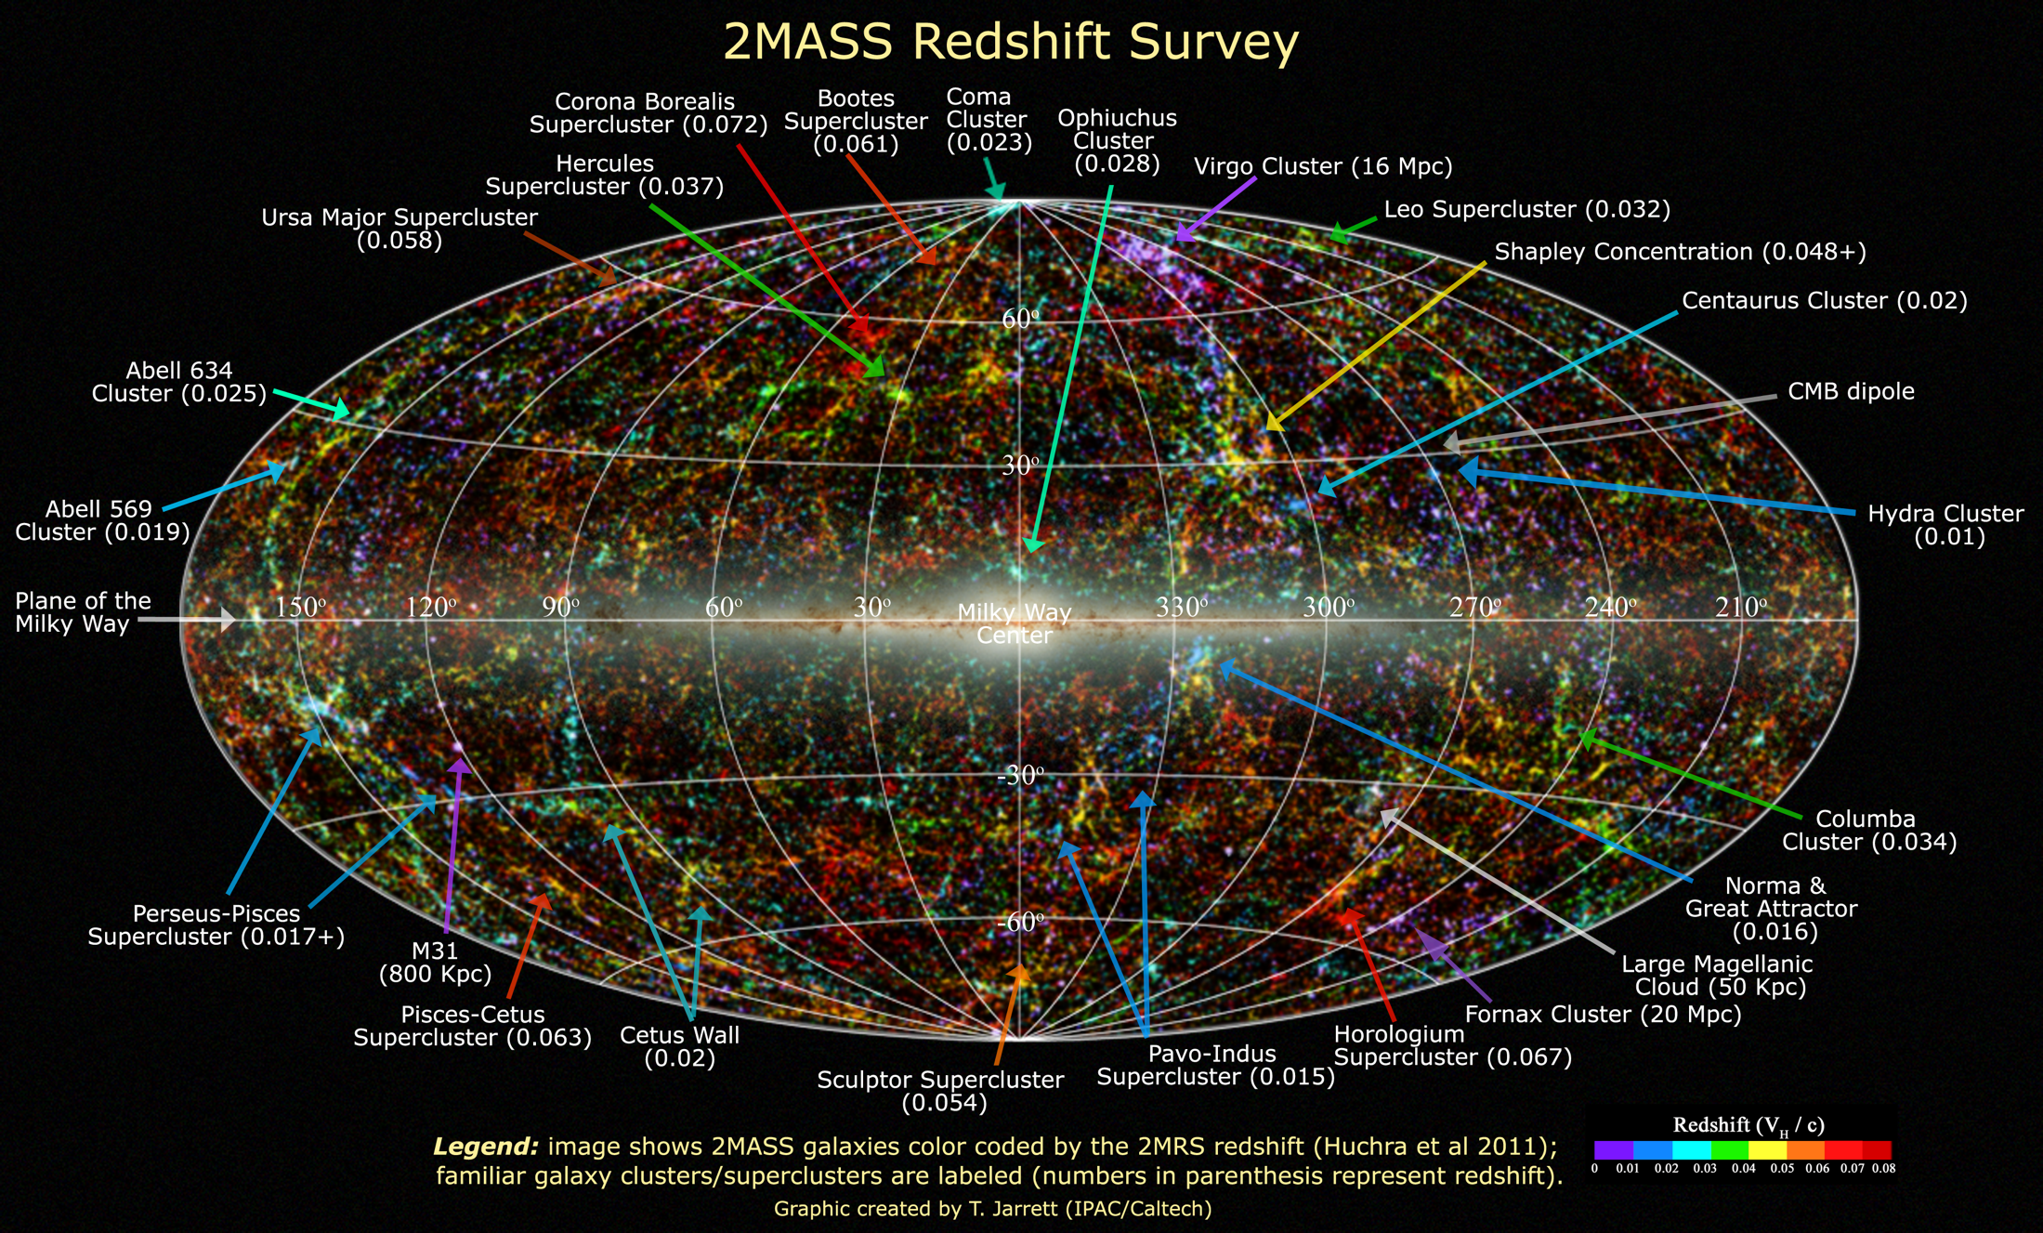
Extragalactic Distances
Required for a 3D picture of the (local) universe

Slide 3
Extragalactic Distances

Slide 4
Extragalactic Distances
Many different methods
  Galaxies
    Mostly statistical
    Secular evolution, e.g. mergers
    Baryonic acoustic oscillations
  Supernovae
    Excellent distance indicators
    Three main methods
      (Standard) luminosity, aka ’standard candle’
      Expanding photosphere method
      Angular size of a known feature

Slide 5
Expanding Photosphere Method
Modification of Baade-Wesselink method for variable stars
Assumes
  Sharp photosphere → thermal equilibrium
  Spherical symmetry → radial velocity
  Free expansion

Slide 6
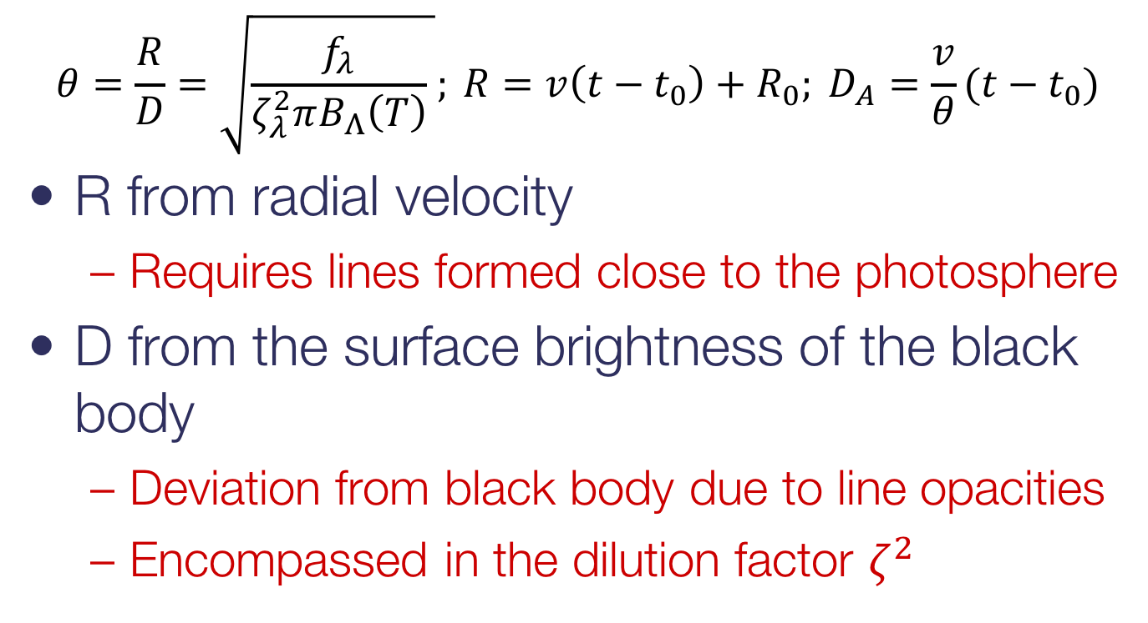
Expanding Photosphere Method
    $$θ=\frac{R}{D}=\sqrt{\frac{f_{λ}}{ζ_{λ}^{2}πB_{Λ}\left(T\right)} }; {R=v\left(t−t_{0}\right)+R_{0}; D}_{A}=\frac{v}{θ}(t−t_{0})$$
R from radial velocity
  Requires lines formed close to the photosphere
D from the surface brightness of the black body
  Deviation from black body due to line opacities
  Encompassed in the dilution factor $ζ^{2}$

Slide 7
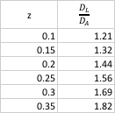
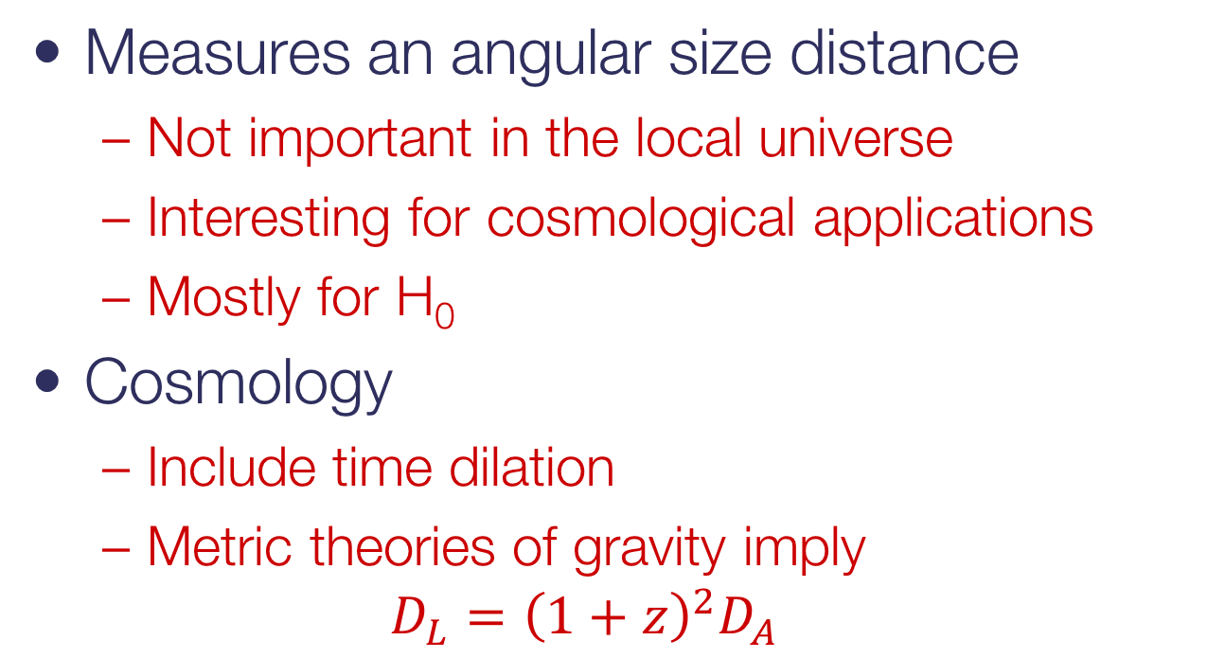
Expanding Photosphere Method
Measures an angular size distance
  Not important in the local universe
  Interesting for cosmological applications
  Mostly for H₀
Cosmology
  Include time dilation
  Metric theories of gravity imply
  $$D_{L}={\left(1+z\right)}^{2}D_{A}$$

Slide 8
Expanding Photosphere Method
Principle difficulties
  Explosion geometry/spherical symmetry
  Uniform dilution factors?
    Develop tailored spectra for each supernova
    → Spectral-fitting Expanding Atmosphere Method (SEAM) – see Christian Vogl’s talk on Friday
  Absorption
Observational difficulties
  Multiple epochs
  Spectroscopy to detect faint lines
  Photometry

Slide 9
SN 2013eq
SN 2013eq
z=0.042
Gall et al. 2016

Slide 10
SN 2013eq
Two different dilution factors applied
  Hamuy et al. 2001 (H01)
  Dessart & Hillier 2005 (D05)
    Both give a good distance to SN 1999em,
    e.g. Jones et al. (2009)
H01
D05

Slide 11
Standardizable Candle Method
Introduced by Hamuy & Pinto (2002)
  Normalised luminosity during the plateau phase of SNe IIP
  Normally at 50 days
  after explosion
Used widely for SNe IIP
  Nugent et al. 2006
  Poznanski et al. 2009
  Olivares et al. 2010
  Maguire et al. 2010
  Polshaw et al. 2015
Hamuy & Pinto 2002

Slide 12
Standardizable Candle Method
Straightforward simple method
  Only few observations required
Issues
  Need to know explosion time
    Often not too obvious from observational data
  Measurement during a ’faint’ epoch
    Plateau and not maximum
  Spectroscopy often difficult
    Faint phase and faint lines
    Attempts to use prominent hydrogen lines

Slide 13
Distance to SN 2013eq
Use EPM and CSM to measure distance to same supernova
EPM provides explosion date to be used by CSM

Slide 14
SN 1987A – recent news
Fransson et al. 2015
Indebetouw et al. 2014
Claes Fransson (Stockholm)
Josefin Larsson (Stockholm)
Jason Spyromilio (ESO)

Slide 15
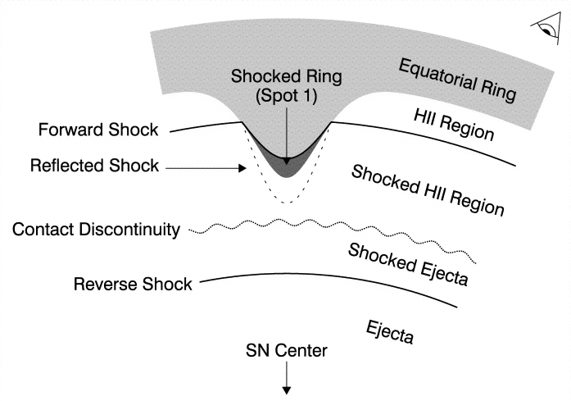
The emission line components
4
Hα
2002
2000
3
Flux
2
1
0
-20000
-15000
-10000
-5000
0
5000
10000
15000
20000
velocity (km/s)
Fransson et al. 2013

Slide 16
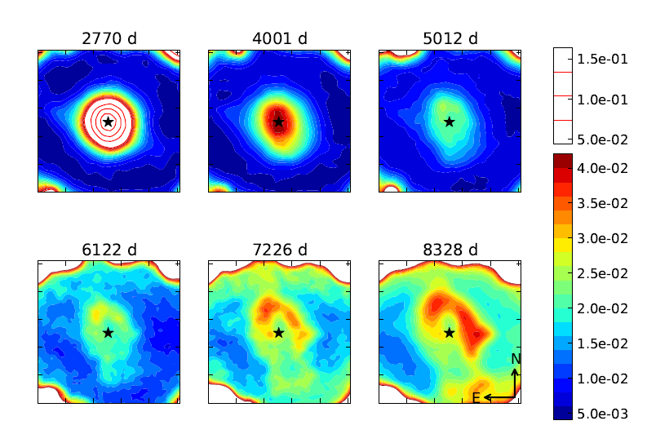
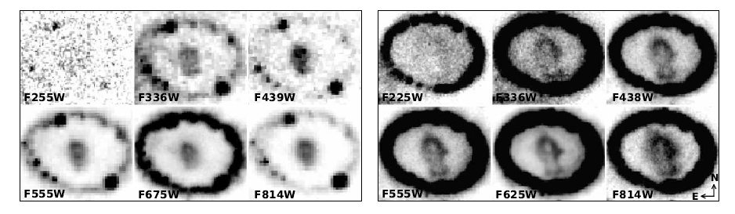
Evolution of the inner ejecta
1994
1998
2000
Clear change in morphology at optical wavelengths
2003
2006
2009
Larsson et al. 2013
13 Nov 2000
12 Dec 2009

Slide 17
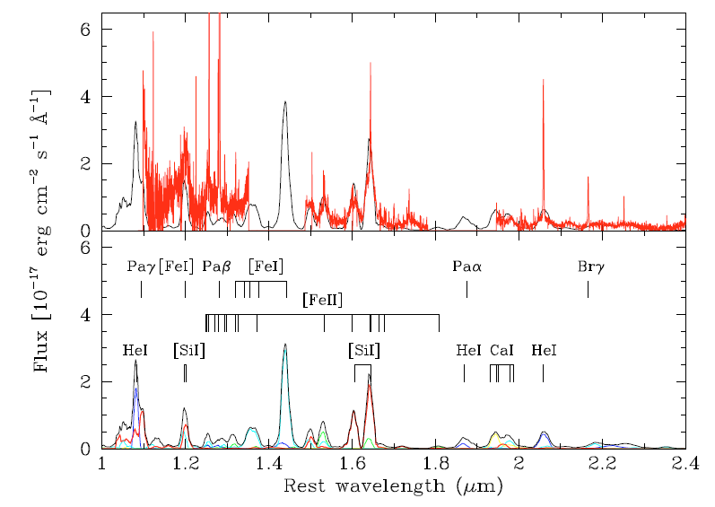
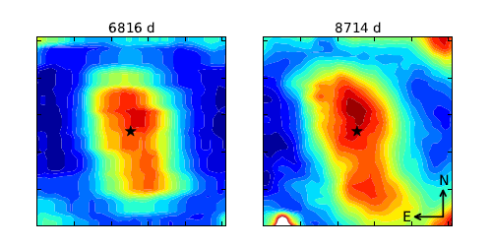
IR observations
[Si I]/[Fe II] 1.644μm
emission
2005
2011

Slide 18
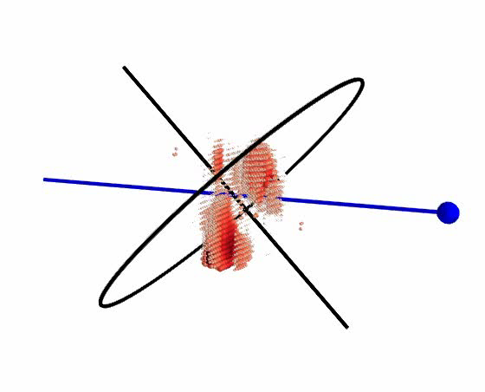
3-dimensional picture
Derived from
[Si I]+[Fe II] 1.644μm emission
Emission in the plane of the equatorial ring
Clumpy distribution
Extending out to
~4500 km s⁻¹
Larsson et al. 2013

Slide 19

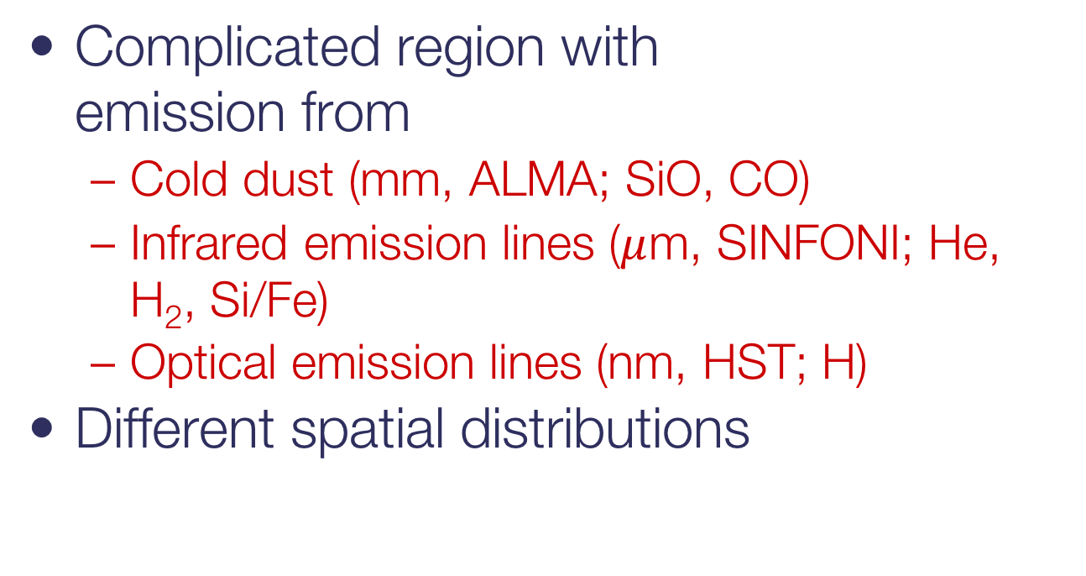
Inner ejecta
Complicated region with
emission from
  Cold dust (mm, ALMA; SiO, CO)
  Infrared emission lines ($μ$m, SINFONI; He, H₂, Si/Fe)
  Optical emission lines (nm, HST; H)
Different spatial distributions
Fransson et al., subm.
2005
H$α$
H₂
He I
[Si I]/[Fe II]

Slide 20
Emission outside the ring
Fransson et al. 2015

Slide 21
Destruction of the ring
Ring emission has peaked
Shock is dissolving the ring between 2020 and 2030
shocked
Fransson et al. 2015
unshocked

Slide 22
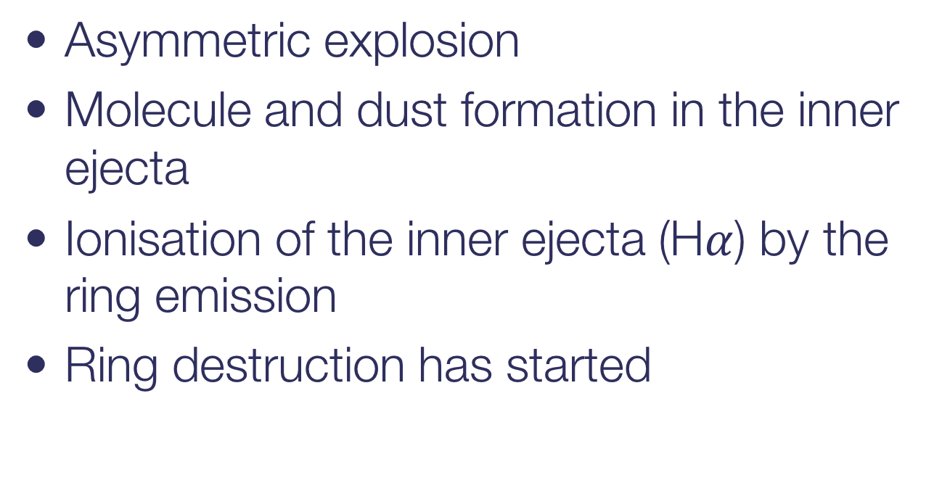
SN 1987A – the supernova that keeps giving
Asymmetric explosion
Molecule and dust formation in the inner ejecta
Ionisation of the inner ejecta (H$α$) by the ring emission
Ring destruction has started

