Slide 1
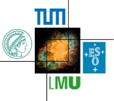

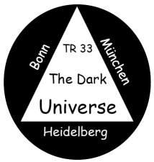
Past Supernova Surveys
What have we learned?
Bruno Leibundgut

Slide 2
Some past supernova surveys
Historical surveys
  Zwicky/Caltech/Palomar/POSS
    first systematic searches with the 18” Schmidt
    only provider of SNe for a long time
  Asiago (Rosino)/Zimmerwald (Wild)
    spawned from the Caltech search
  Rev. Evans, McNaught
    extremely successful amateur searches
  Las Campanas search (Tammann/Sandage – 1984-1986)
    very limited success (20 SNe in 2 years)
    no rate paper every published
  Berkeley automated search
    first automated search (from Leuschner Observatory)
  Calan/Tololo SN search (Maza/Hamuy/Phillips/Suntzeff - 1990s)
    successful search with photographic plates and CCD follow-up observations
    coordinated spectroscopy
    basis for SN cosmology by providing the nearby sample (Hamuy et al. 2006)

Slide 3
Supernova Searches
Early searches
  find supernovae!
    Zwicky, Asiago, Zimmerwald, Rev. Evans
Targeted searches
  Hubble diagram → Hubble constant
    Las Campanas, Calán-Tololo, Berkeley automated search, SN Factory
  Distant supernovae → decelaration
    Danish Search, SCP, High-z SN Search Team, SNLS, ESSENCE, SDSS
Nearby robotic searches
  SN physics
  SN rates
    LOSS, CHASE

Slide 4
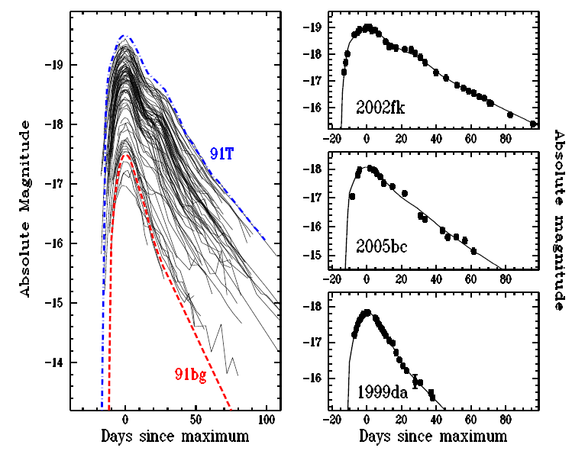
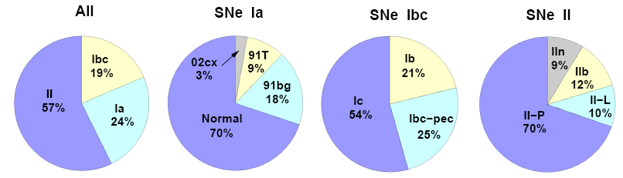
Lick Observatory Supernova Search
Total | Ia | Ibc | II | no classification
929 | 372 | 144 | 399 | 14
 | 40.0% | 15.5% | 42.9% | 1.6%
Optimal sample
726 | 274 | 116 | 324 | 12
 | 37.7% | 16.0% | 44.6% | 1.6%
Volume limited sample (80Mpc – Ia; 60Mpc – Ibc and II)
180 | 74 | 25 | 81
Leaman et al. 2010
Li et al. 2010

Slide 5
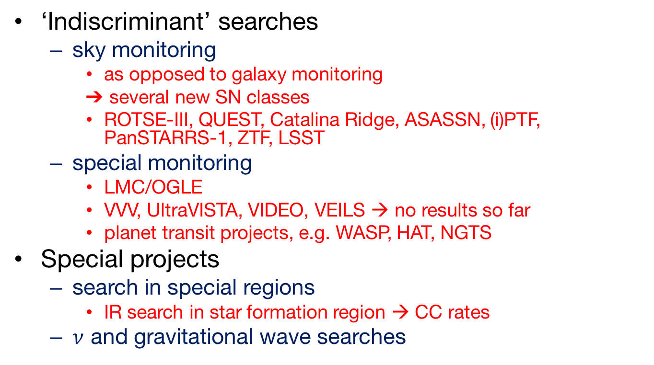
Supernova Searches
‘Indiscriminant’ searches
  sky monitoring
    as opposed to galaxy monitoring
    several new SN classes
    ROTSE-III, QUEST, Catalina Ridge, ASASSN, (i)PTF, PanSTARRS-1, ZTF, LSST
  special monitoring
    LMC/OGLE
    VVV, UltraVISTA, VIDEO, VEILS → no results so far
    planet transit projects, e.g. WASP, HAT, NGTS
Special projects
  search in special regions
    IR search in star formation region → CC rates
  $ν$ and gravitational wave searches

Slide 6
Do we find all nearby SNe?
Searching the local volume
  requires all-sky searches

Slide 7
Nearby supernovae
Decline after 2010
Notes:
From the Asiago catalogue

Slide 8
Nearby Supernovae
As distances

Slide 9
Do we find all nearby SNe?
Ben Shappee, Easter Island

Slide 10
Synoptic Programs
Follow-up
  SN physics
    CfA, CSP, PESSTO
    light curves, spectral series
Search for progenitors
  Imaging of nearby explosion sites
    HST, AO supported (Smartt, van Dyk)
  Radial velocity survey
    Supernova Progenitor surveY (SPY; VLT/UVES), SDSS

Slide 11
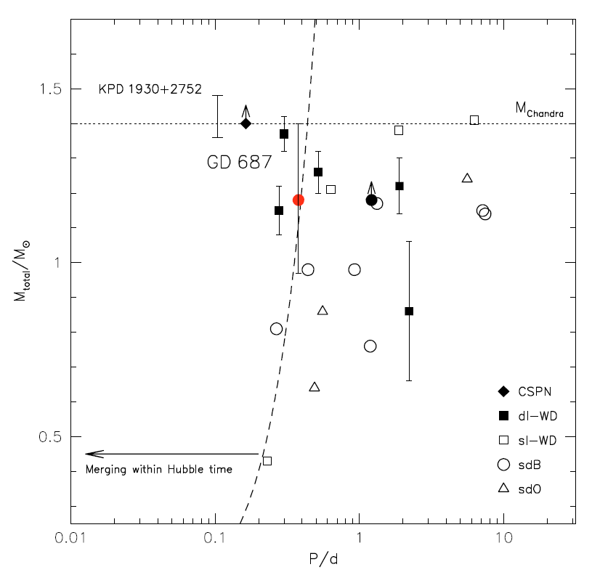
Supernova Progenitor surveY
644 DA white dwarfs checked for radial velocity changes → search close binaries
  are there double
  degenerate white
  dwarfs in the solar
  neighbourhood?
  discovered ~35
  double degenerate
  systems
Napiwotzki et al. 2007
Geier et al. 2010

Slide 12
SPY
Example of the double-lined WDs
Napiwotzki et al., in prep.

Slide 13
Future surveys
Several searches/surveys continue:
  Amateurs, LOSS, CfA, CHASE, New surveys
  SkyMapper
  GAIA transient sources
  Dark Energy Survey
  Zwicky Transient Factory
    Avishay Gal-Yam
  LSST
    Melissa Graham
  EUCLID
    DESIRE → Astier et al. 2014
  WFIRST
    Ryan Foley et al.; Saul Perlmutter et al.

Slide 14
Cosmology - do we need more?
Already in hand
  >1000 SNe Ia for cosmology
  constant ω determined to 5%
  accuracy dominated by systematic effects
    reddening, correlations, local field, evolution
Test for variable ω
  required accuracy ~2% in individual distances
  can SNe Ia provide this?
    can the systematics be reduced to this level?
    homogeneous photometry?
    further parameters (e.g. host galaxy mass, metalicity)

Slide 15
More supernovae
Increase the number of interesting supernovae
  many more general searches
    remove paradigms
  possible through the technological progress
    detectors, data storage, data handling and processing
  Need to keep the overview
  Need to keep the focus on science results
Improved understanding
  hints on explosion physics
  statistical samples → rare objects

Slide 16
Supernovae at ESO
Many long-term programs
  Large Programs before 2010
    Danziger, Turatto, Benetti
  PESSTO (survey) → SOXS in the future
    spectroscopic follow-up with NTT/EFOSC2/SOFI
    focussed on special objects
      superluminous SNe, etc.
  Spectropolarimetry
    Patat, Maund, Baade, Spyromilio
  SN 1987A
    nearly unbroken spectroscopic record
  Monitoring of old supernovae

Slide 17
Supernovae at ESO
Searches
  mostly attached to survey programs
    UltraVISTA, VVV, VIDEO
    no results presented so far
  VEILS
    dedicated IR search in
    connection with DES
    starts next year
  SUDARE
    rates as a function of redshifts
Cappellaro et al. 2015

Slide 18
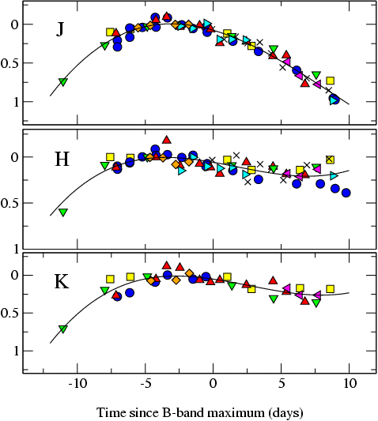
The promise of the (near-)infrared
Extinction is much reduced in the near-IR
  A_{H}/A_{V} ≅ 0.19 (Cardelli et al. 1989)
SNe Ia much better behaved
SN m₁₅(B)
= 1980N (1.29)
= 1986G (1.79)
= 1998bu (1.05)
= 1999aw (0.81)
= 1999ee (0.94)
= 2000ca (1.01)
= 2001el (1.15)
Krisciunas et al. (2004)
Mark Phillips

Slide 19
Others find this too
Light curves in the near-IR very uniform at peak, but large differences at later times
SN 2006mr
SN 2005ke
SN 2007on
Kattner et al. 2012

Slide 20
At least around maximum
Dhawan et al. 2015
Scatter minimal at first maximum in Y (1.04μm), J (1.24μm), H (163μm) and K (2.14μm)
~90 objects in J and H
  70 in Y, 20 in K
Mostly Carnegie SN Project data (Contreras et al. 2010, Stritzinger et al. 2011)
Y
J
H
K

Slide 21
NOT after maximum
4 days
14 days
30 days
Dhawan et al. 2014

Slide 22
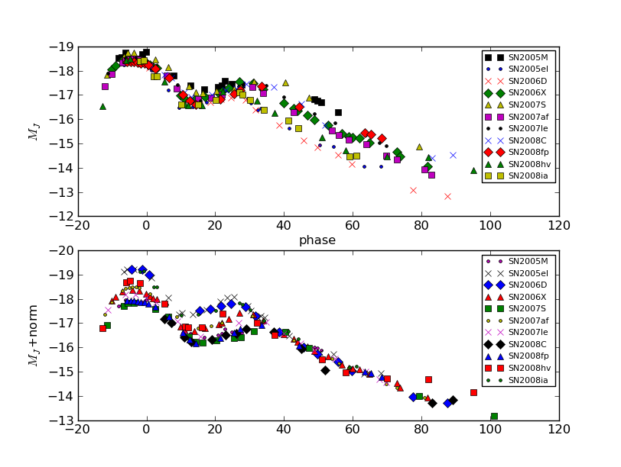
Other light curve parameters
Late decline (t>40 days)
Dhawan et al. 2014

Slide 23
Correlations
Biscardi et al. 2012
IR properties correlate with optical decline rate
Phase of secondary maximum strongly correlated Δm₁₅

Slide 24
Correlations
Dhawan et al. 2015
Second maximum
  phase strongly correlated with Δm₁₅
  strength only weakly correlated

Slide 25
Consistent picture emerging
Second peak in the near-IR is the result of the recombination of Fe⁺⁺ to Fe⁺ (Kasen 2006)
The ejecta structure rather
uniform
  late declines very similar
higher luminosity indicates a higher Ni mass
later secondary peak also indicated higher Ni mass
Ni mass and (optical) light curve parameters correlate (Scalzo et al. 2014)

Slide 26
Luminosity function of SNe Ia
Use the phase of the second maximum to derive the bolometric peak luminosity
  calibrated on a sample of reddening-free SNe Ia
  apply to reddened objects
Dhawan et al. 2016

Slide 27
Luminosity function of SNe Ia
SN 2014J test passed
Potential to determine the luminosity function and Ni distribution

Slide 28
Fast-declining SNe Ia
Two groups?
  separation in
    bolometric luminosity
    phase of NIR first peak
    lack of second second
    NIR maximum
  Suhail Dhawan’s
  talk next week
Dhawan et al., in prep

Slide 29
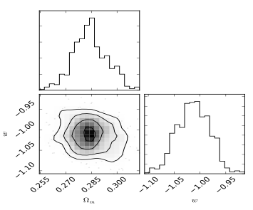
SNe and EUCLID
DESIRE - special SN project as extension of the EUCLID mission
  Astier et al. 2015
  SNe Ia with 0.8<z<1.5
Alternative
  use EUCLID Deep Fields
    NIR light curves (only few points)
    construct NIR Hubble diagram to z<0.8
Dhawan, PhD thesis

Slide 30
SNe and EUCLID
Shadow the EUCLID deep fields at optical wavelengths
  high cadence (every night?)
  provide accurate optical light curves
    important for phase information
  compare optical and NIR Hubble diagrams
    tests systematics
    reddening

