Slide 1
Challenges and Synergies of Ground and Space Astronomy:
The Ground-Based (ESO) View
Bruno Leibundgut

Slide 2
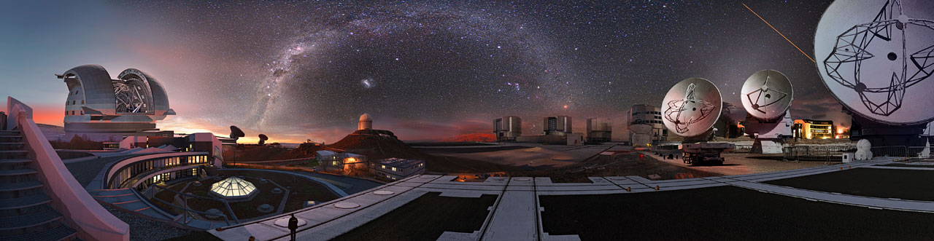
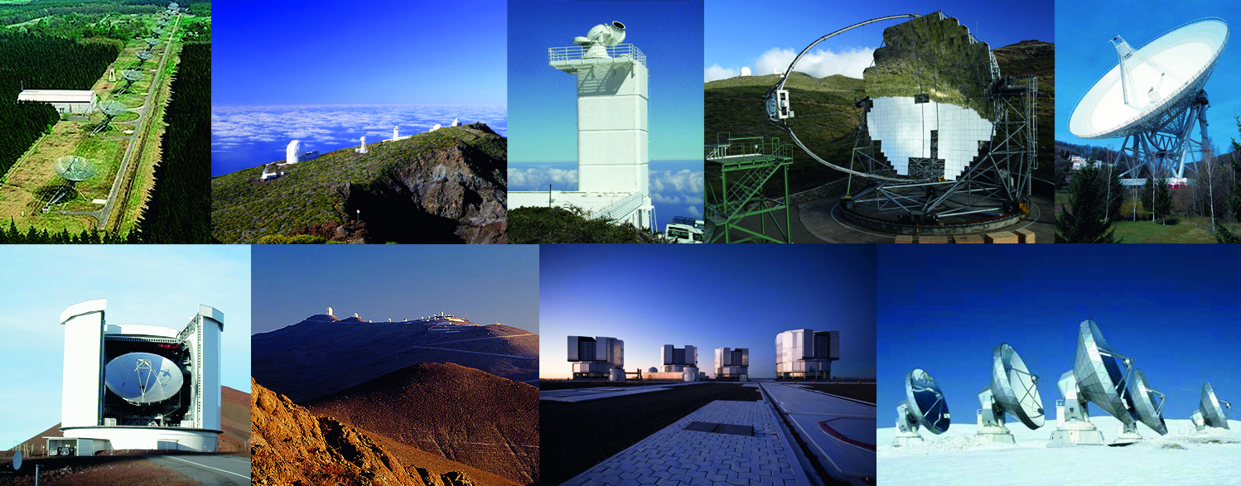
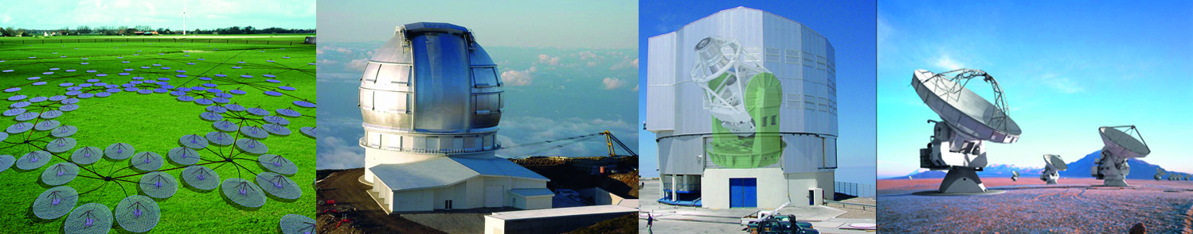
Ground-Based Opportunities

Slide 3
Bright Present and Future
A plethora of facilities
  Optical-Infrared ground-based telescopes up to 40m aperture
    surveys, adaptive optics, interferometry,
    state-of-the-art instrumentation, synoptic programmes
  mm and sub-mm telescopes
    ALMA, NOEMA, SMA, APEX, Planck, Herschel, SOFIA
  Radio telescopes of all sizes covering many frequencies
    EVN/JIVE, LOFAR, VLBA, EHT, MeerKAT, ASKAP, SKA
  Space-based telescopes
    Gaia, HST, JWST, Euclid, Nancy Grace Roman Observatory
    Spitzer, Kepler, CoRoT, Cheops, TESS, PLATO, SVOM, …
  X-ray sky available through
    XMM/Newton, Chandra, eROSITA and Athena
  Gamma-ray sky
    INTEGRAL, Fermi, MAGIC, HESS, VERITAS, CTA

Slide 4
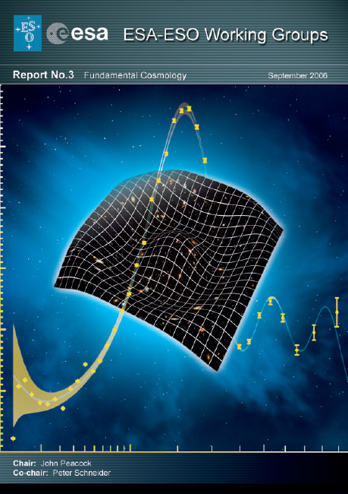
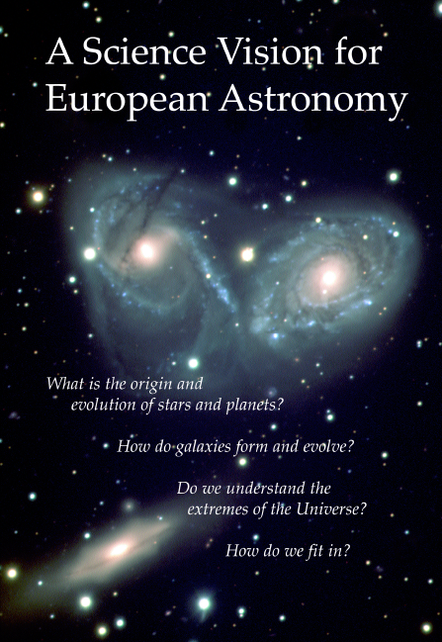
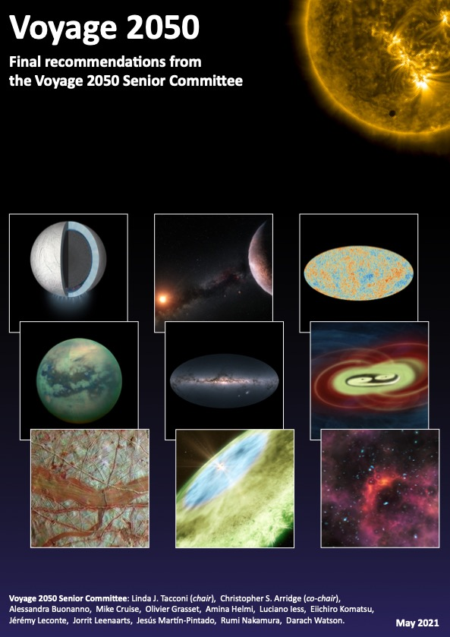
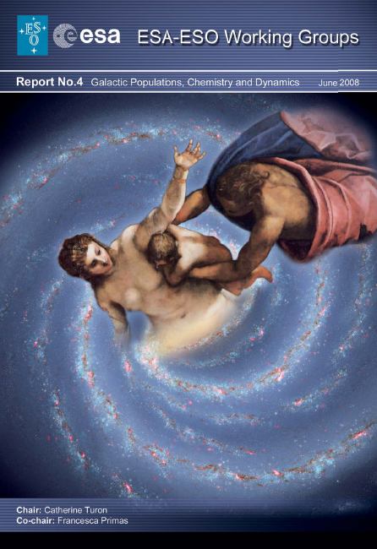
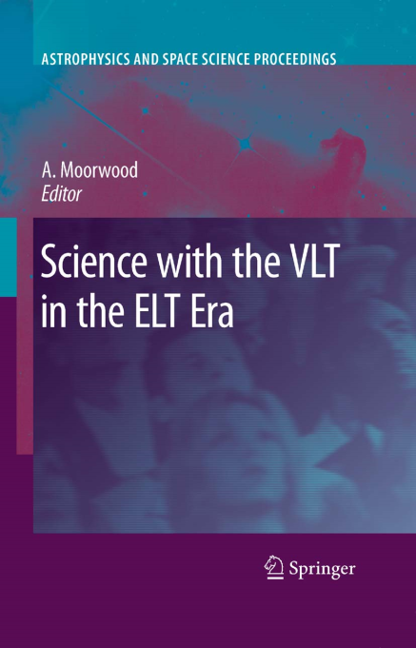
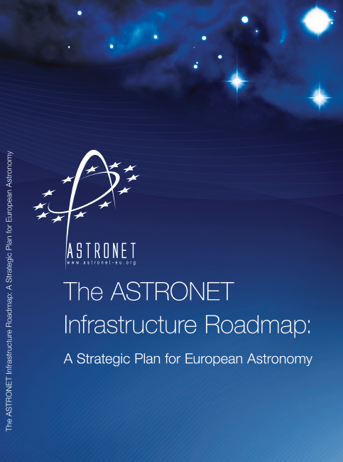
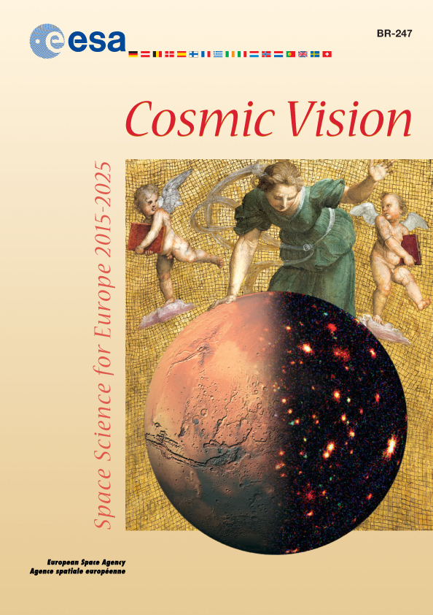
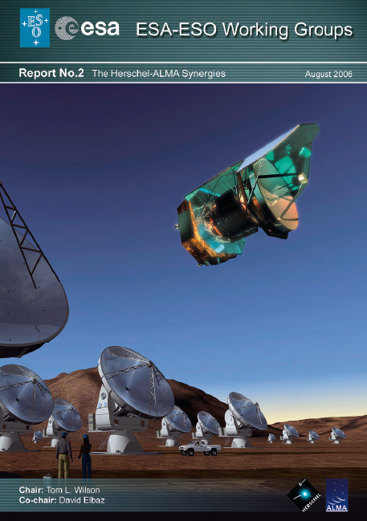
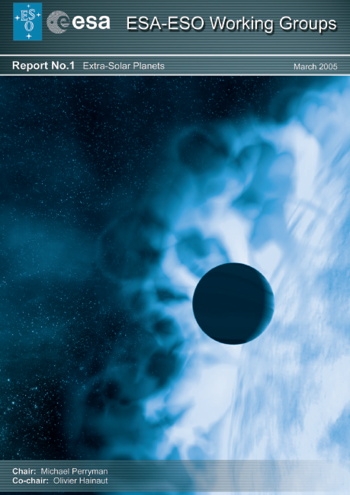
Science Themes
Ewine’s Keynote
Defined in several communities
  Astronet Science Vision (2007) and Roadmap (2008)
  → recent updates (2013 and 2014, respectively)
  → new update under way (2021/22)
  ESA Cosmic Vision and Voyage 2050
  US and other national decadal reviews
  Special publications
    ESA-ESO working group reports
    Specific fields (e.g. Connecting quarks with the Cosmos)
    Various reviews specific by wavelength

Slide 5
Further Challenges
Combine the many opportunities/facilites
  Electromagnetic of all sizes and forms
  Gravitational waves: aLIGO/VIRGO/KAGRA
  Neutrinos: IceCube, KM3NeT
  Cosmic Rays: HAWC, LHAASO,
  AugerPrime
Appec European Astroparticle
Physics Strategy 2017-2026
Astronet Roadmap
  Under community consultation

Slide 6
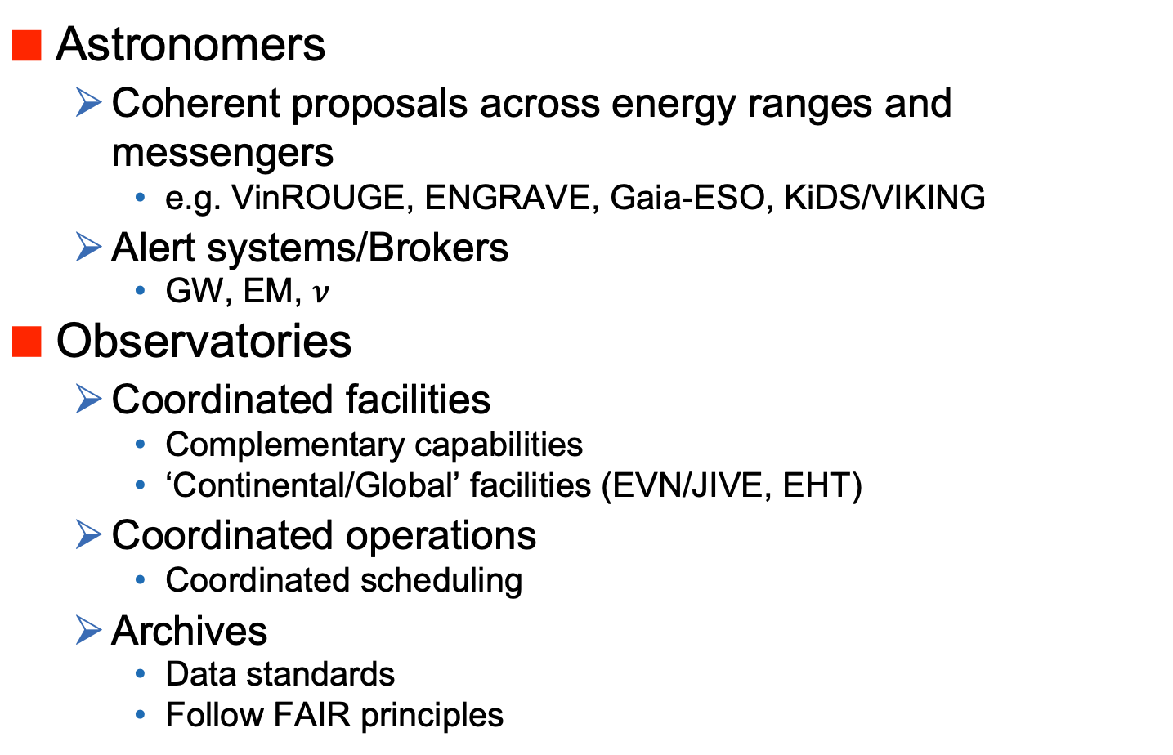
Synergies and Challenges
Astronomers
  Coherent proposals across energy ranges and messengers
    e.g. VinROUGE, ENGRAVE, Gaia-ESO, KiDS/VIKING
  Alert systems/Brokers
    GW, EM, $ν$
Observatories
  Coordinated facilities
    Complementary capabilities
    ‘Continental/Global’ facilities (EVN/JIVE, EHT)
  Coordinated operations
    Coordinated scheduling
  Archives
    Data standards
    Follow FAIR principles
Notes:
LHAASO: Large High Altitude Air Shower Observatory: http://english.ihep.cas.cn/lhaaso/
FAIR: Findable, Accessible, Interoperable, Reusable

Slide 7
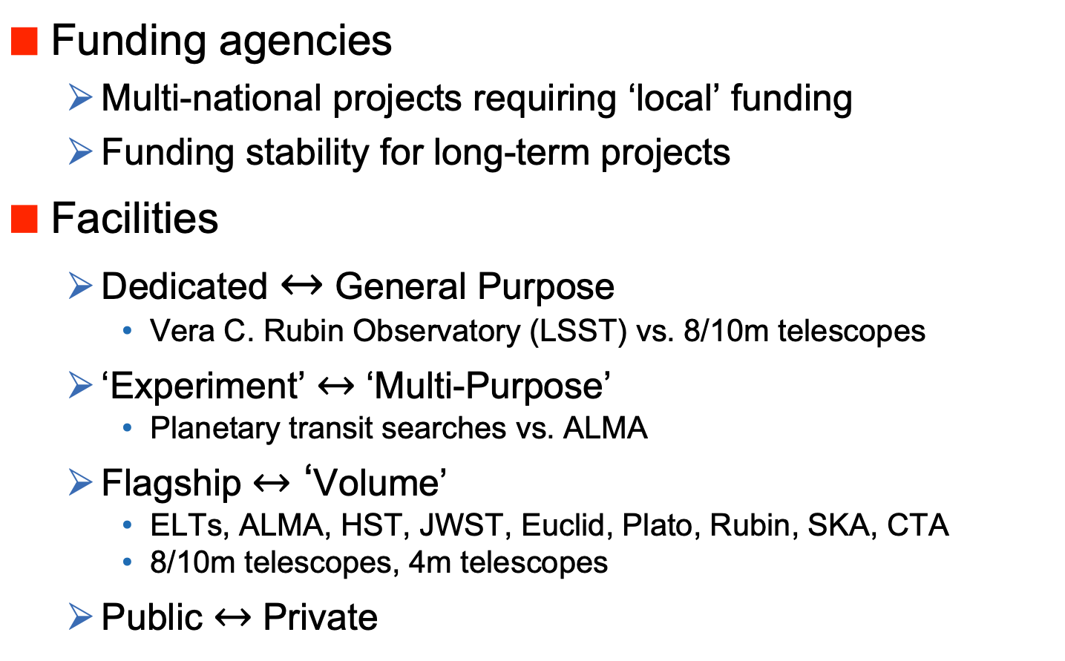
Synergies and Challenges
Funding agencies
  Multi-national projects requiring ‘local’ funding
  Funding stability for long-term projects
Facilities
  Dedicated $↔$ General Purpose
    Vera C. Rubin Observatory (LSST) vs. 8/10m telescopes
  ‘Experiment’ $↔$ ‘Multi-Purpose’
    Planetary transit searches vs. ALMA
  Flagship $↔$ ‘Volume’
    ELTs, ALMA, HST, JWST, Euclid, Plato, Rubin, SKA, CTA
    8/10m telescopes, 4m telescopes
  Public $↔$ Private

Slide 8
Challenges and Synergies
Science exploration
  SCIOPS conferences
    project planning
    project execution
    project support
Coordination of observations
  Examples from the past
    transient objects
    follow-up of gravitational wave events
  Planning the Future
Data curation

Slide 9
ESA-ESO History
Close collaboration on HST
  Space Telescope – European Coordinating Facility
  (ST-ECF) hosted at ESO
    European HST archive
    Development of the ESO archive
    Interaction on definition of VLT operations model
      service observing
Joint observing time VLT – XMM/Newton
Science collaborations
  VST observations of Gaia
  Near-Earth Object coordinated observations
  Gaia-ESO Survey (community driven)

Slide 10
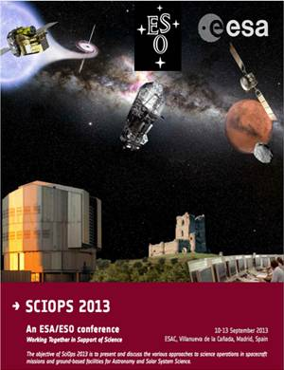
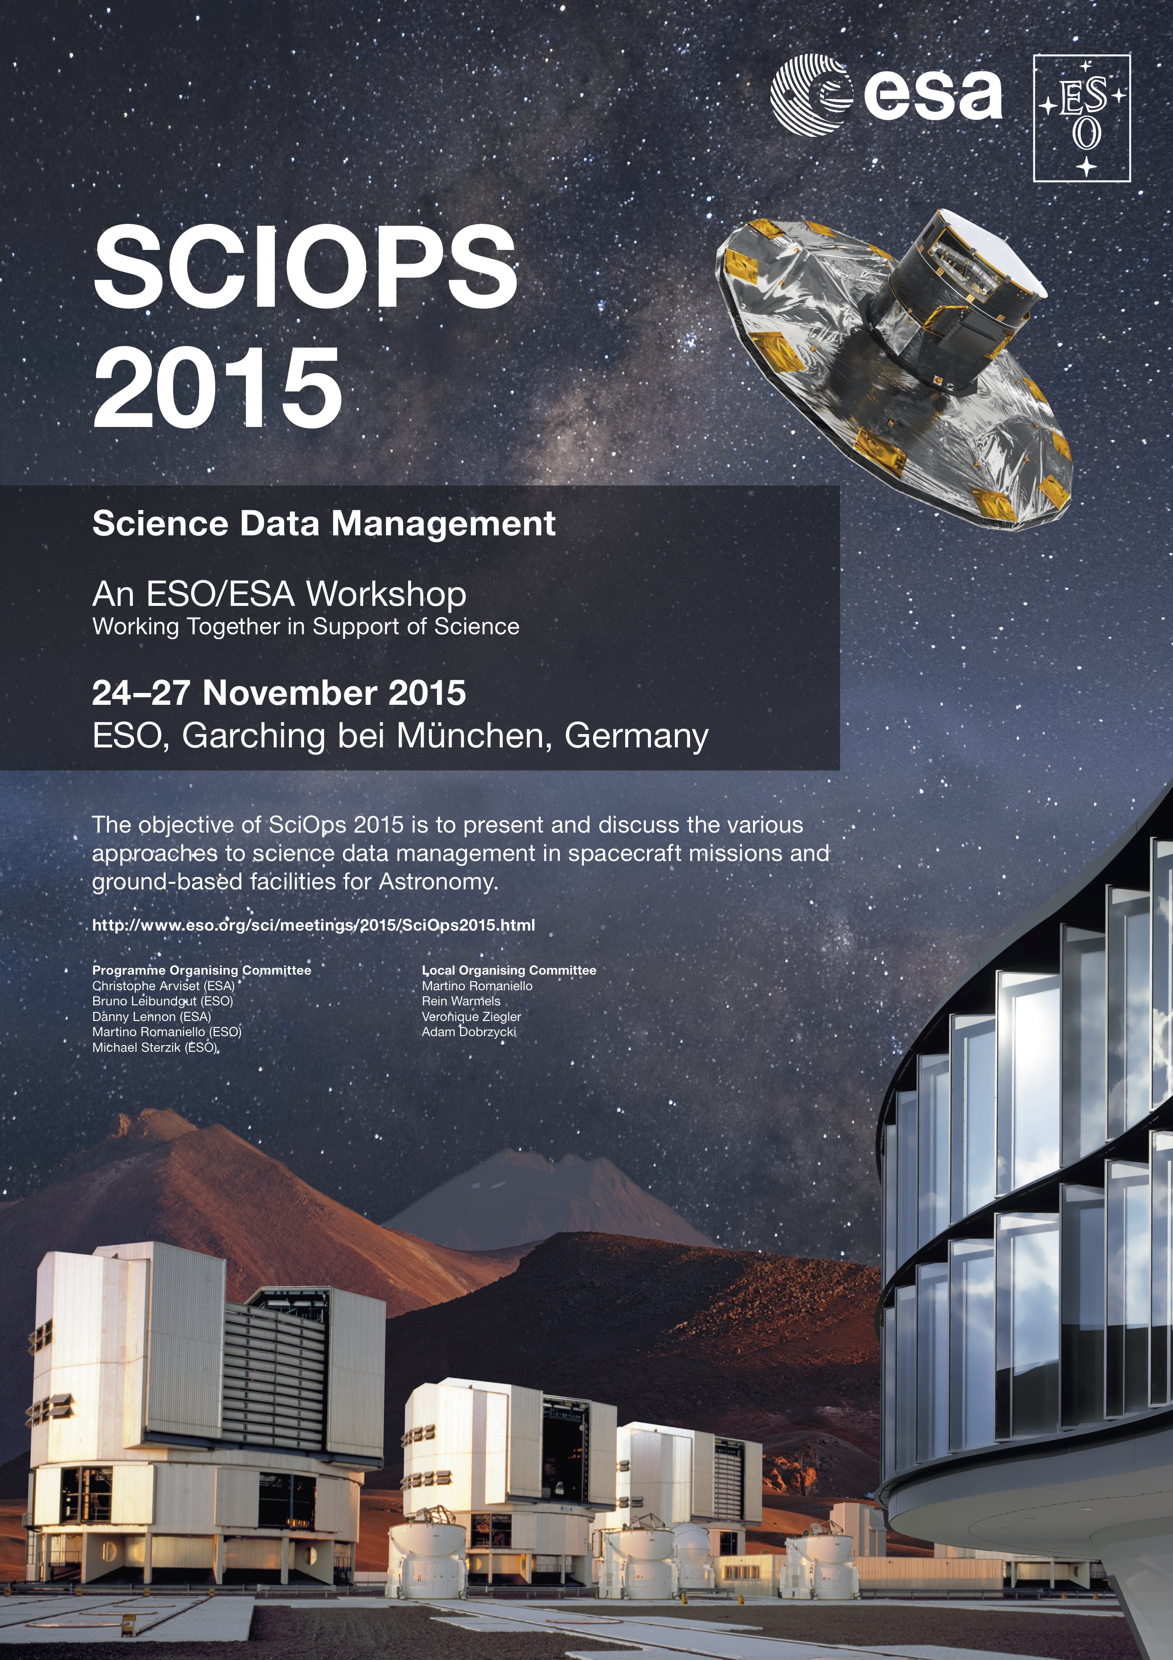
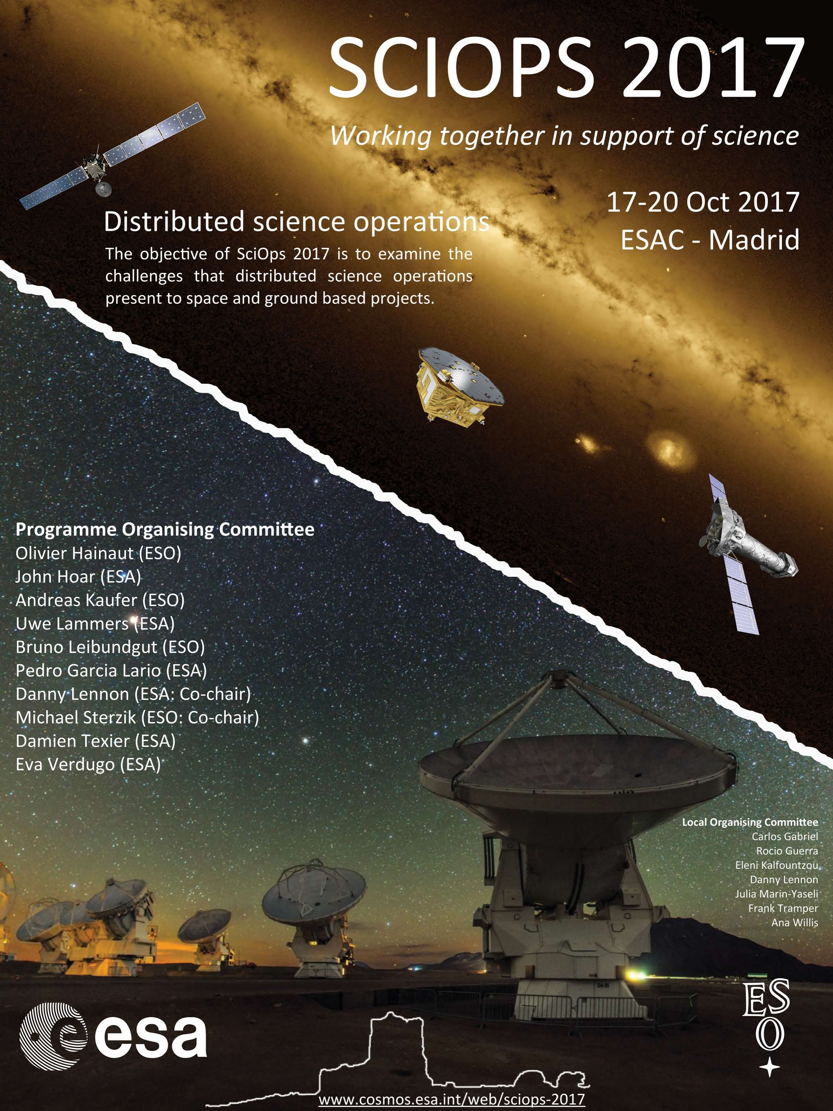
ESA-ESO Operations Conferences

Slide 11
SCIOPS Conferences
2013
  “Working Together in Support of Science”
2015
  Science Data Management
2017
  Distributed Science Operations
2019
  Cross Facilities Collaboration in the Multi-Messenger Era

Slide 12
SCIOPS Conferences
Synergies between space and ground-based missions
  Importance of early planning
    avoid ’blackmailing’ situations
    community involvement/community-driven
      e.g. through regular observing proposals
      prepare relevant complementary instrumentation
        PLATO radial velocities
        EUCLID ground-based calibrations (e.g. redshift surveys)
    how much should be done at corporate level?
  differentiate between mission critical calibrations and scientific harvest
    e.g. monitoring of Gaia position vs. Gaia-ESO survey
  difference between observatory and survey missions

Slide 13
Strategies for the Future
Facilities are part of observational systems
  Ground-space coordination
    Proposals to cover several facilities
    Exchange scheduling information
  Coordinated observations at many telescopes
    Multi-wavelength programmes
      ALMA - optical synergies
        star/planet formation, distant universe
      radio - optical synergies
        non-thermal and thermal universe
    Exo-planet search and characterisation
      transit photometry, spectroscopic monitoring,
      multi-wavelength observations (planet-star contrast!)
    Milky Way structure and local dwarf galaxies
      spectroscopic follow-up of the photometric catalogues
      (SDSS, Gaia-ESO, APOGEE, 4MOST)

Slide 14
Strategies for the Future
“Guidelines” for OIR observatories
  Flexibility
    adapt to new topics and discoveries
  Uniqueness
    explore features of your observatory others don’t have
      e.g. interferometry (VLTI)
    provide unique capabilities for simultaneous coverage of large wavelength ranges
      e.g. observations of Comet Shoemaker-Levy 9 or Hale-Bopp, AT2019gfo/GW170817
  Complementarity
    spectral follow-up of imaging surveys
    monitoring of special objects
    complementarity to space missions
    support observations for other facilities
Coordination

Slide 15
Strategies for the Future
“Internet Astrophysics”
  Most research based on databases
    Products of surveys
  Coordinated programmes produce coherent data
  Context for many new observations
  Open Data proved to be key to success
    SDSS, 2MASS/DENIS, Kepler, eventually LSST
    observatory data archives
Make data available to the whole community
  Easy to find
  Easy to understand
  Easy to use

Slide 16
OIR Observational System of the 2020s
Flagship facilities
  ALMA, ELTs, JWST, LSST, EUCLID, (SKA, ATHENA)
Archives
  Planck, Gaia, HST, Spitzer, Herschel, Kepler, XMM-Newton, INTEGRAL, Chandra, observatory archives
  Literature
General user facilities (with some specialisation?)
  6-10m telescopes (16 ground-based)
    “people’s observatories”
    large variety of instrumentation, also interferometry
    built-in flexibility
    main resource for follow-up work
  2-4m telescopes
    pick your specialisation
    dedicate telescope to specific science question

Slide 17
ESO – an integrated system
ALMA and ELT: flagship facilities
VLT: unique capabilities
    interferometry → VLTI
    large instrument complement, adaptive optics, flexibility,
    modern operations model
La Silla/4m telescopes: dedicated
  Transients: NTT; SOXS
  exo-planets: 3.6m; HARPS/NIRPS
  multi-object spectroscopy: VISTA; 4MOST
  platform for smaller experiments: La Silla
ESO and ALMA Archives
  Rich resource of optical/NIR and sub-mm data
    large coherent data sets from surveys
    advanced data products

Slide 18
Coordinated Observations
Example: gravitational wave events
  Coordinated observing run with the aLIGO science runs
ESO Community organization
  single VLT proposal – ENGRAVE
    following an ESO workshop to discuss coordination

Slide 19
Coordinated Observations
Example: gravitational wave events
  Coordinated observing run with the aLIGO science runs
ESO Community organization
  single VLT proposal – ENGRAVE
    following an ESO workshop to discuss coordination
Preparations of future observatories
  Early interactions to build bridges between the communities

Slide 20
Coordinated Observations
Example: transients/supernovae
  Community organized itself
    HST proposals
    ePESSTO+
    Transient brokers (ANTARES, AMPEL, ALeRCE, Lasair)
    X-ray community
      Leiden workshop 2015
      Paving the way to simultaneous multi-wavelength astronomy
      Middleton et al. 2017, New Astr. Reviews 79, 26
Separate proposals for different observatories
  Often separate research groups

Slide 21
Coordinated Observations
Example: joint proposals VLT/I and ALMA
  Preparations of a workable way forward
    only acceptable to ESO – other ALMA partners will not join
    still need agreement of all ALMA partners, even if only ESO time is affected
    ALMA explores joint proposals with JWST
Future
  Coordination between different observatories
    ESA missions Gaia, EUCLID, PLATO
    left to the community
  Start planning coordination with future observatories
    SKA, CTA, Einstein Observatory,

Slide 22
Data Curation/Archives
Increasing importance of data products
  Community expects uniform data products for surveys
    Legacy
    GAIA, ESO surveys, EUCLID, PLATO
  Archives most useful, when data can be applied to science questions (“science-ready data”)
Data access
  Importance of data discovery
  Synergies between ESA and ESO archives
    ESASky:
    ESO portal to LPO and ALMA data
    Coordination of some developments

Slide 23
Archive – Data Products

Slide 24
Archive – Discovery Tools

Slide 25
Data Curation/Archives
Tools
  Convergent technologies
    ESA and ESO/ESASky and ESO Archive Science Portal
  Code to data
    analysis tools for large data samples/surveys should become available to the community
    Code depositories

Slide 26
Summary
Flexibility
  Astrophysics covers many topics and techniques
  Completeness of instrumentation
  Reaction to interesting new events, object and topics
Coordination
  Instrumentation programmes at different facilities
    either through a large pool or through collaboration between observatories
  Planning between ground and space
  Time allocation between observatories
Operations
  inbuilt flexibility
  archive → open distribution of data

Slide 27
Ground-Based Opportunities

