Slide 1
Supernovae from Massive Stars: light curves and spectral evolution
Bruno Leibundgut
ESO

Slide 2
The core-collapse SN poster child
SN 1987A
the best observed supernova ever
Suntzeff (2003)
(also Fransson et al. 2007)

Slide 3
What do we want to learn about supernovae?
What explodes?
  progenitors, evolution towards explosion
How does it explode?
  explosion mechanisms
Where does it explode?
  environment (local and global)
  feedback
What does it leave behind?
  remnants
  compact remnants
  chemical enrichment
Other use of the explosions
  light beacons
  distance indicators
  chemical factories
deep imaging
late phases?
deep imaging/
integral-field spectroscopy
deep imaging
high resolution spectroscopy
faint object photometry
faint object spectroscopy

Slide 4
Consider
Several channels towards the explosion of a massive star
  electron capture
  iron core collapse
  pair instability
Many ways to ‘dress’ it
  single vs. binary evolution
    envelope stripping
  circumstellar material

Slide 5
Shaping supernova emission
Light curves as tracers of the energy release in supernovae
  energy sources
  photon escape
  modulations
  external effects

Slide 6
Energy sources
shock
  breakout
  kinetic energy
cooling
  due to expansion of the ejecta
radioactivity
  nucleosynthesis
recombination
  of the shock-ionised material

Slide 7
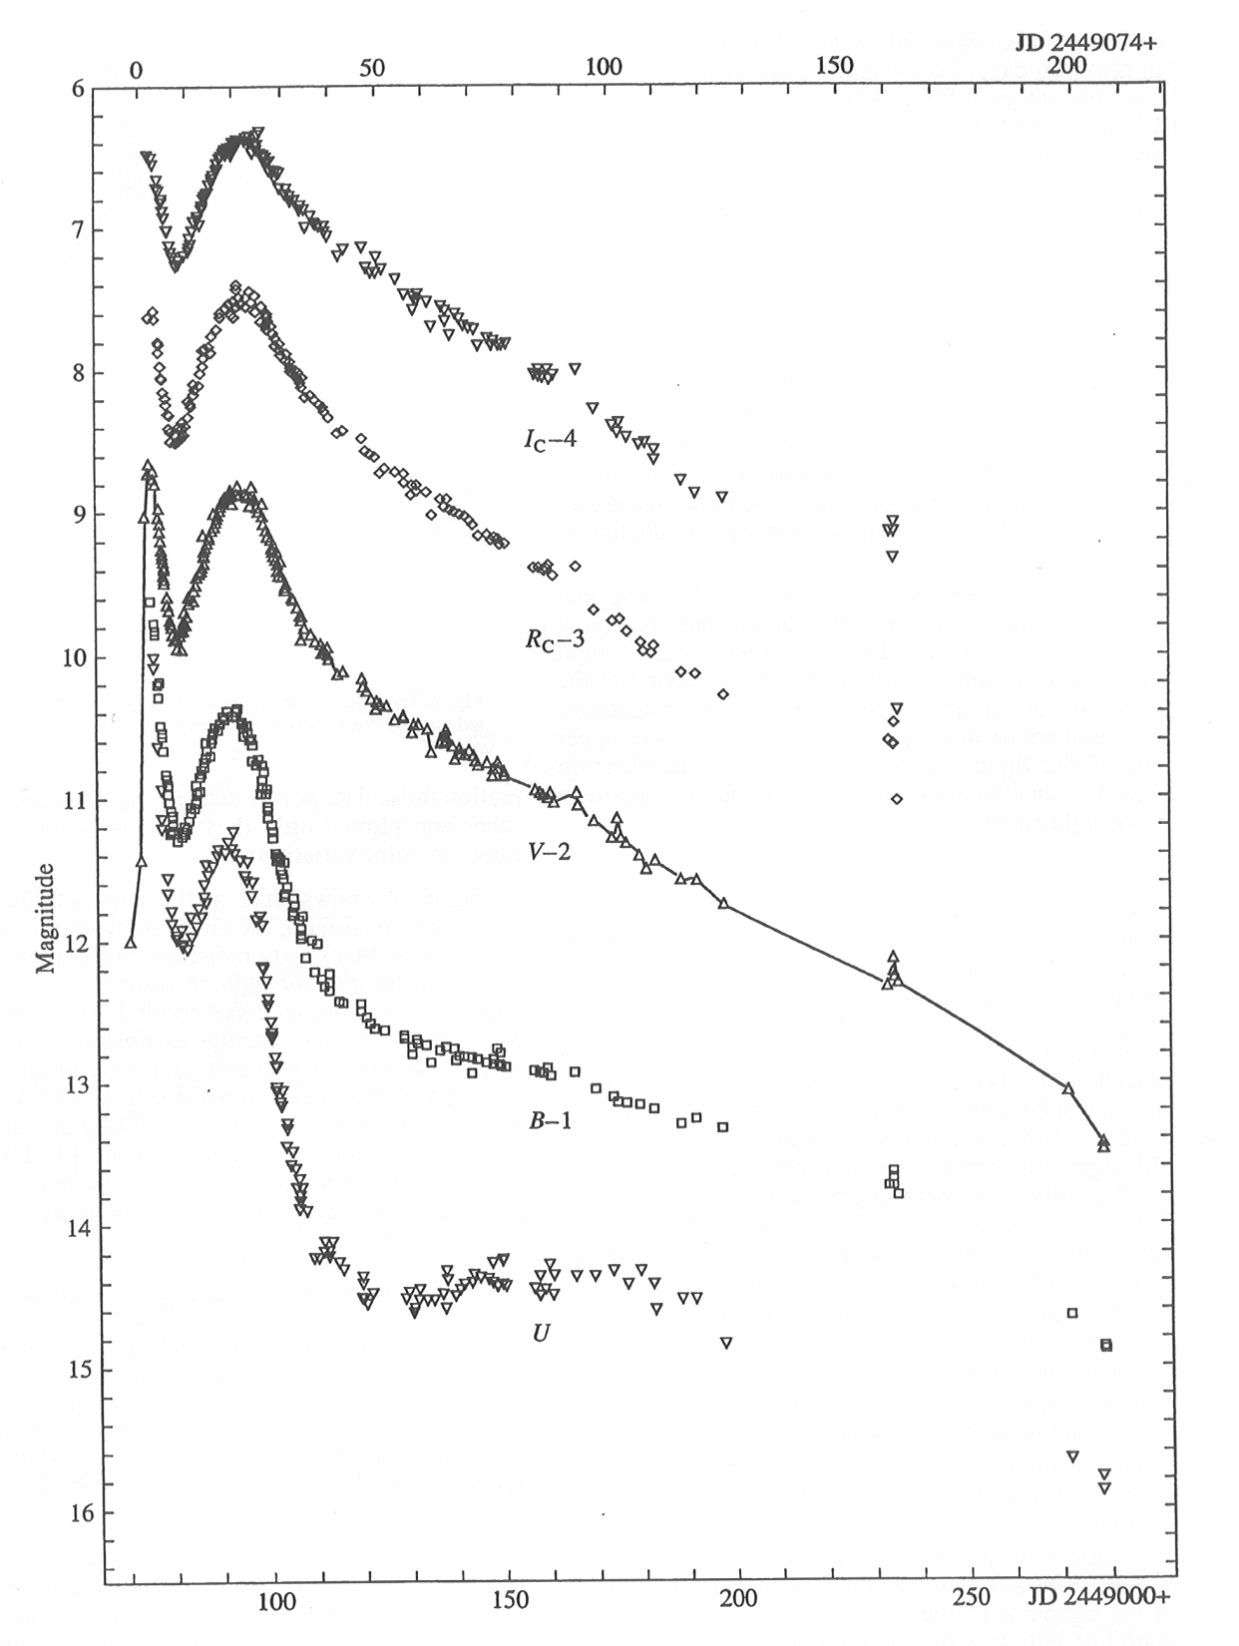
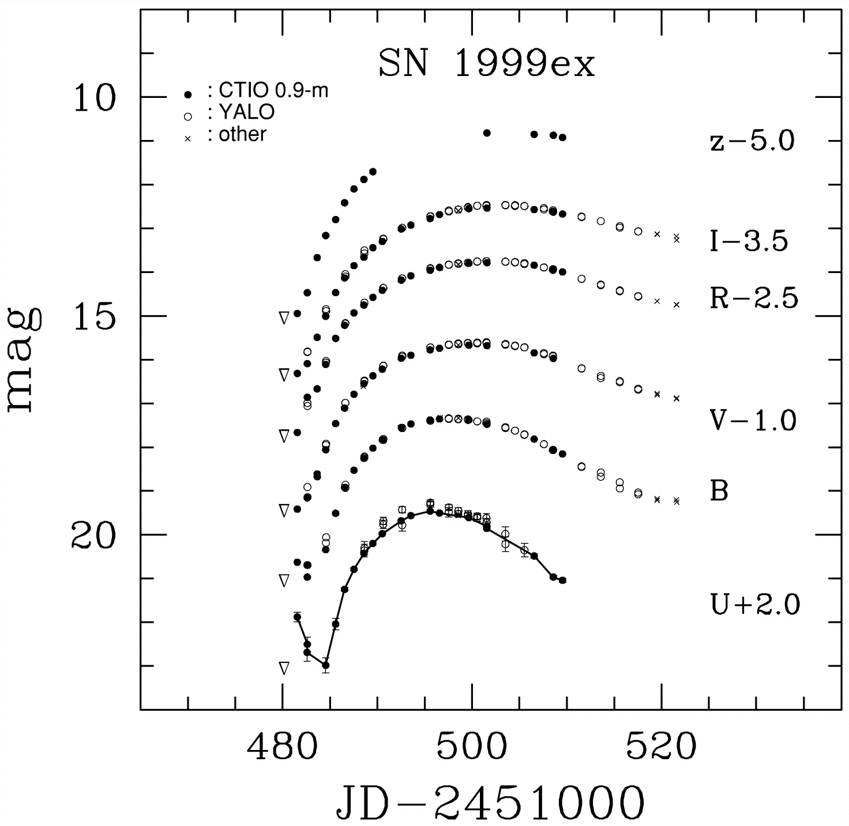
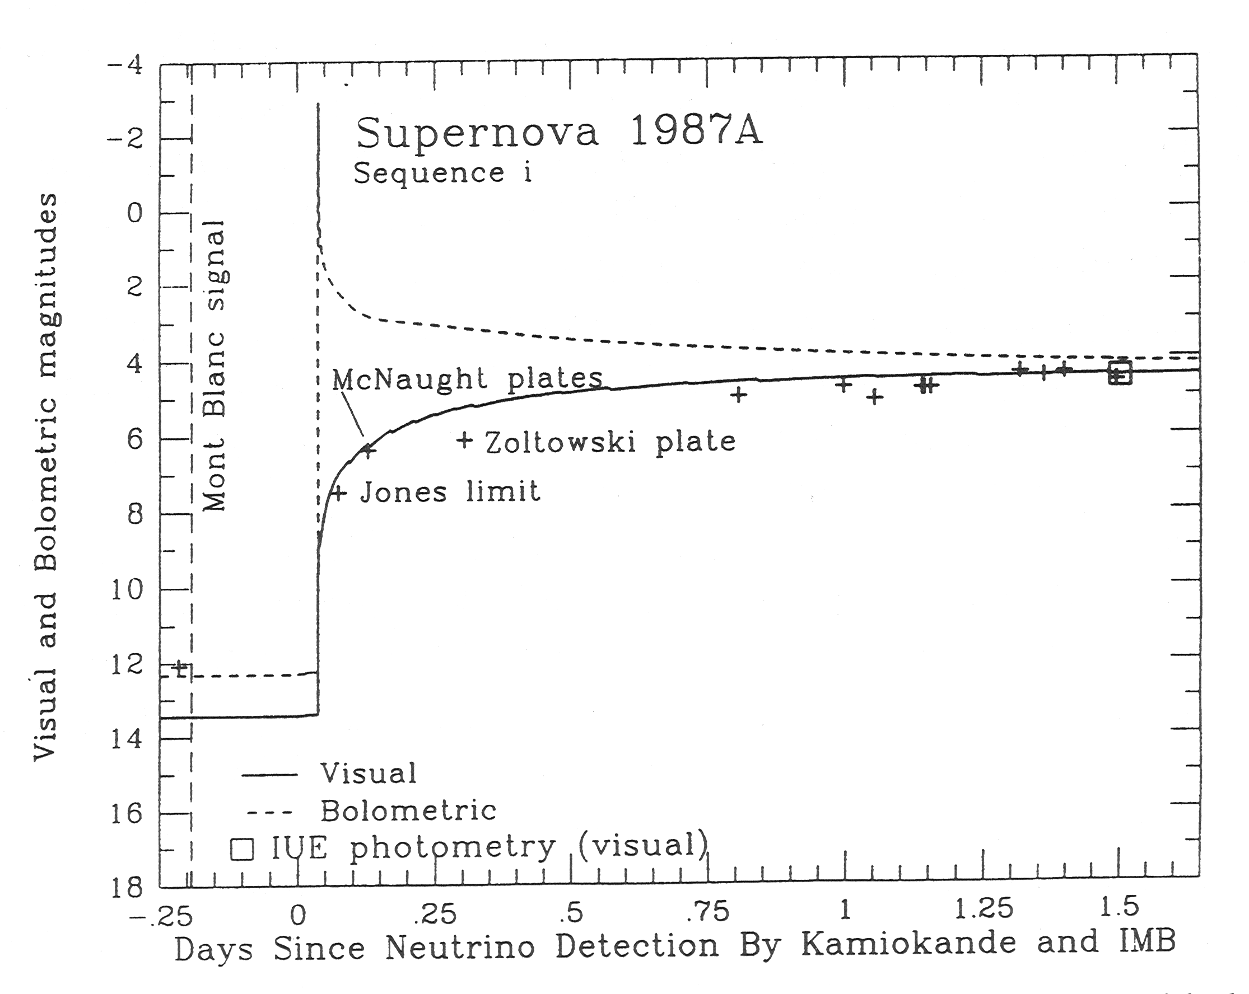
Shock breakout and cooling
depends on the size of the progenitor star
  observed only in core-collapse supernovae
    SN 1987A
    SN 1993J
    SN 1999ex
    SN 2008D
    SN 2011dh
Stritzinger et al. (2002)
Arnett et al. (1989)
Doroshenko et al. (1995)

Slide 8
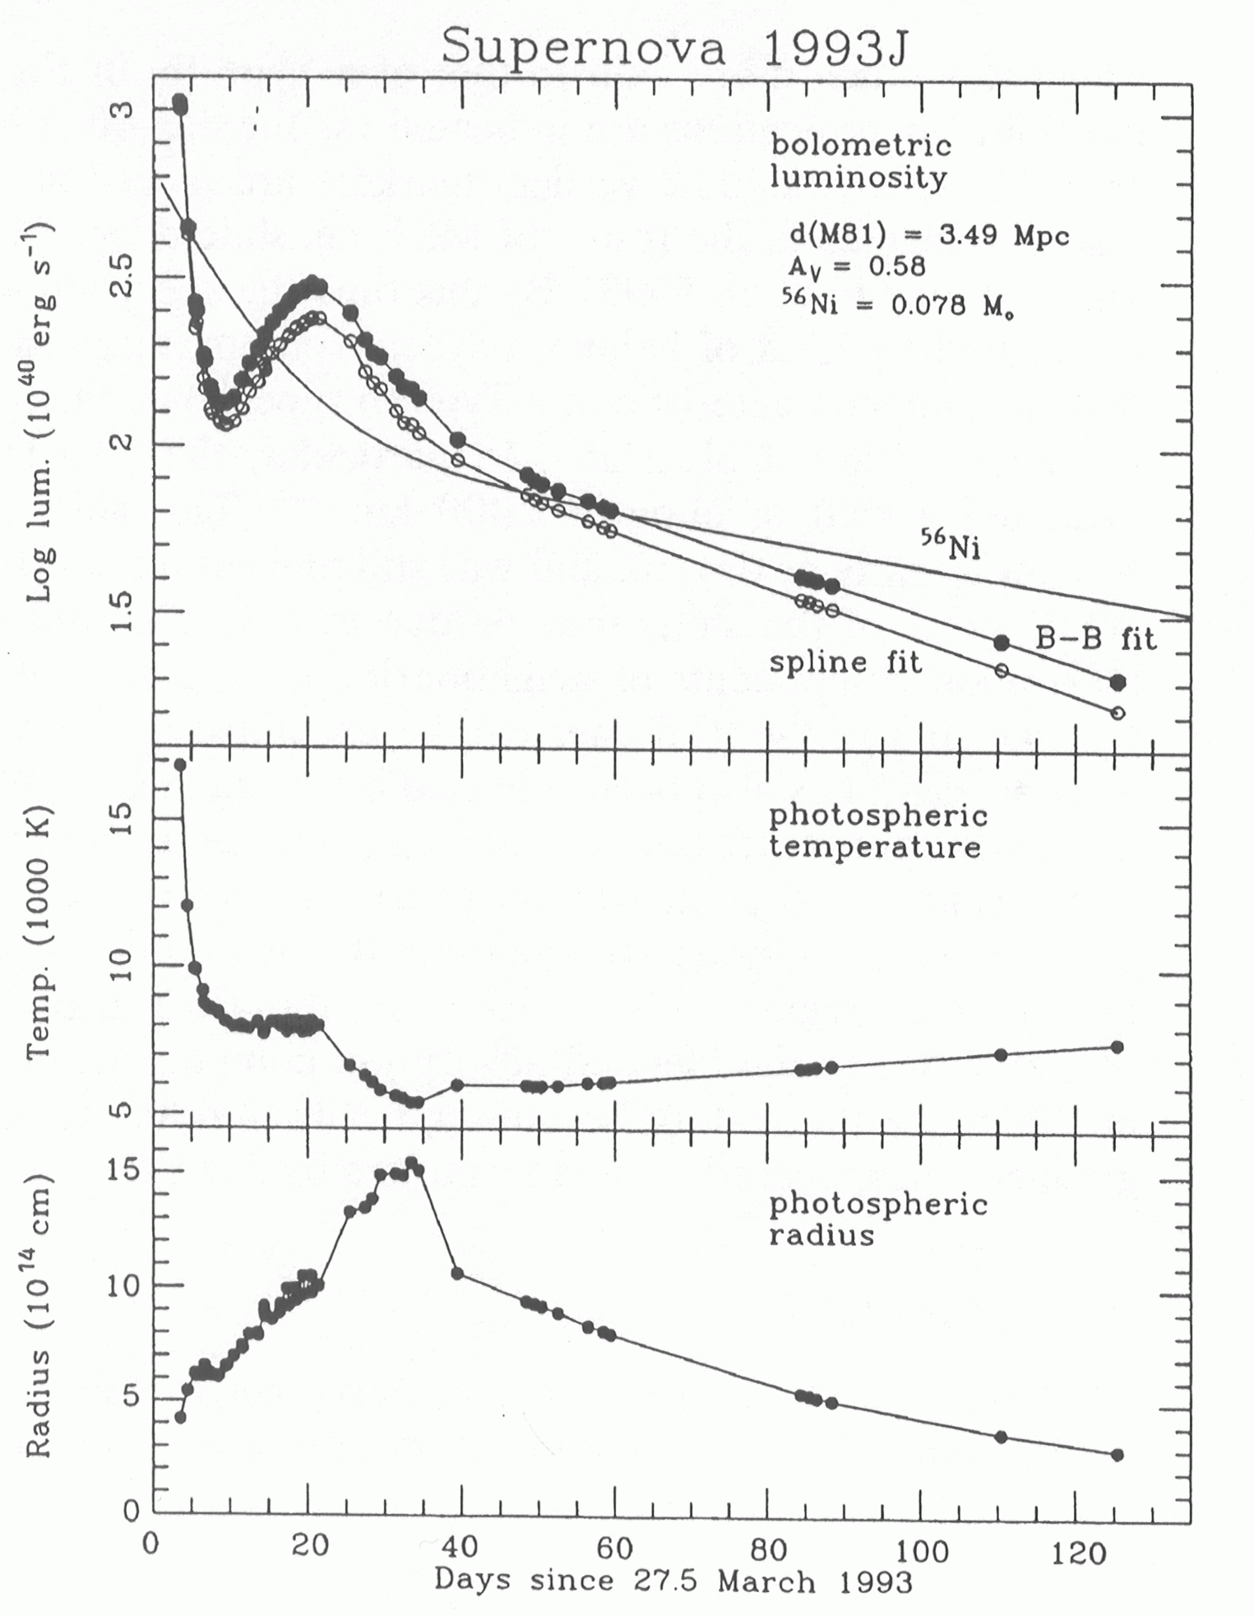
Expansion
Brightness increase
  increased surface area
  slow temperature decrease

Slide 9
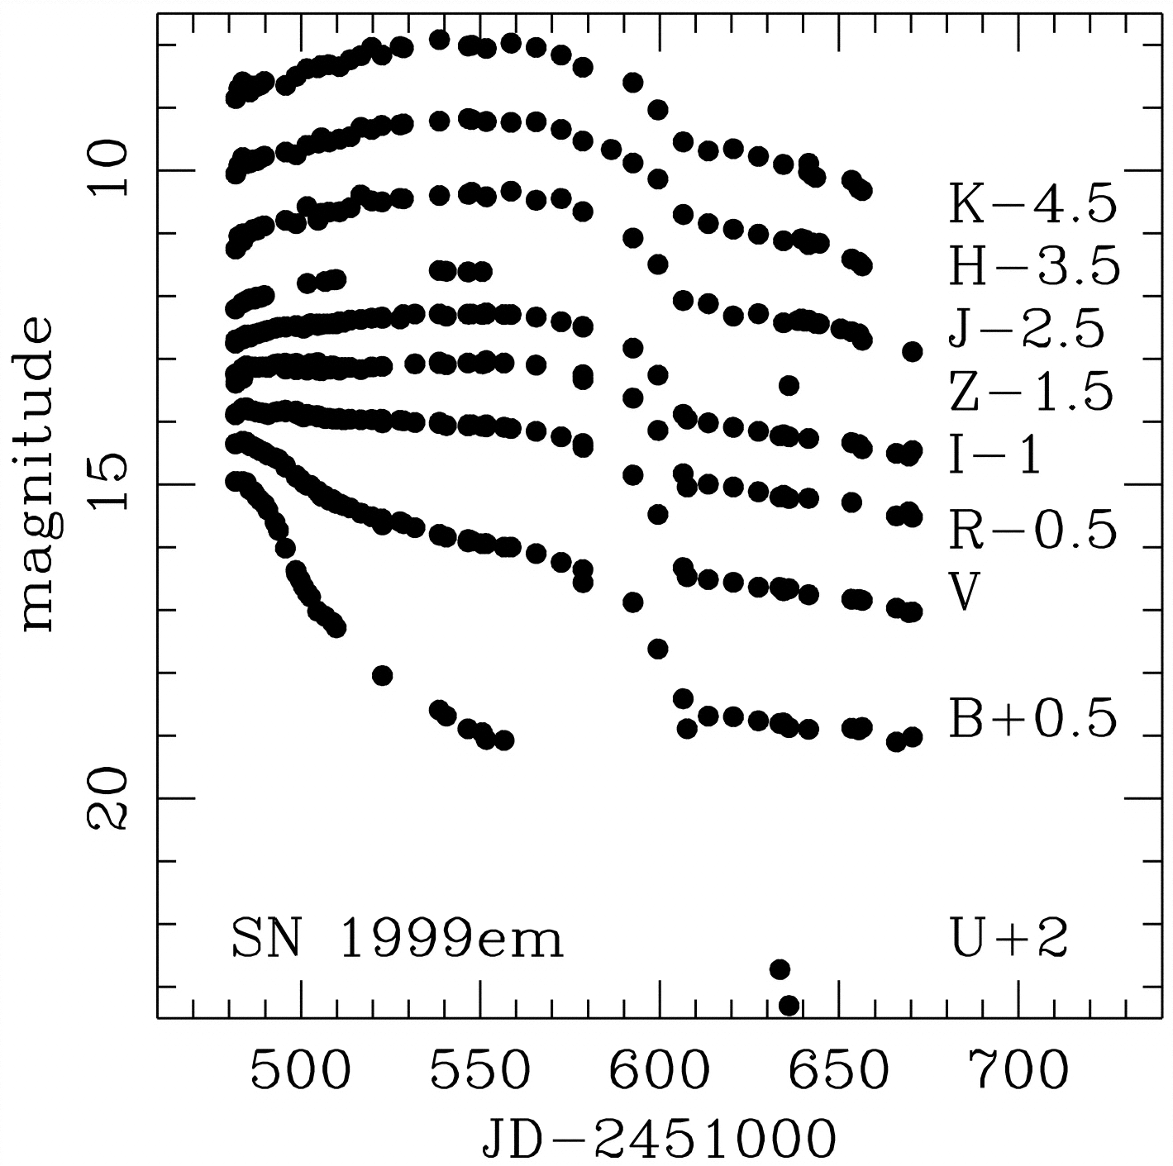
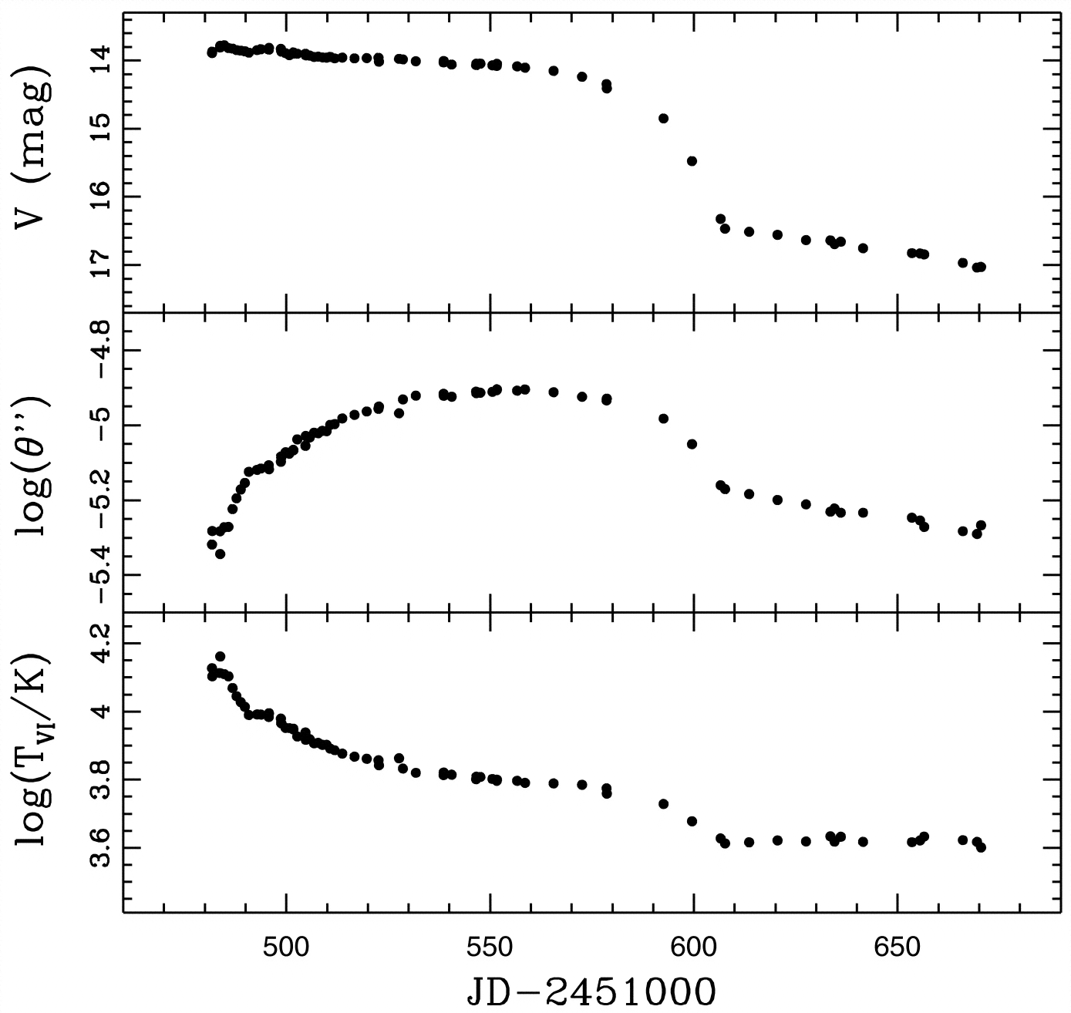
Recombination
Balance of the recombination wave and the expansion of the ejecta
  leads to an extended plateau phase
Hamuy et al. (2001)
Hamuy et al. (2001)

Slide 10
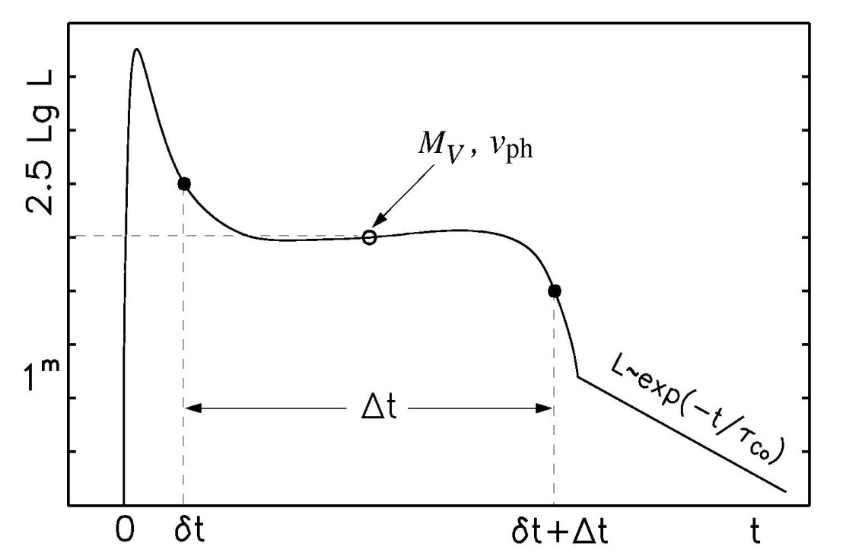
Physical parameters of core collapse SNe
Light curve shape and the velocity evolution can give an indication of the total explosion energy, the mass and the initial radius of the explosion
Observables:
  length of plateau phase Δt
  luminosity of the plateau M_{V}
  velocity of the ejecta v_{ph}
  E ∝Δt⁴·v_{ph}⁵·L⁻¹
  M∝Δt⁴·v_{ph}³·L⁻¹
  R ∝Δt⁻²·v_{ph}⁻⁴·L²

Slide 11
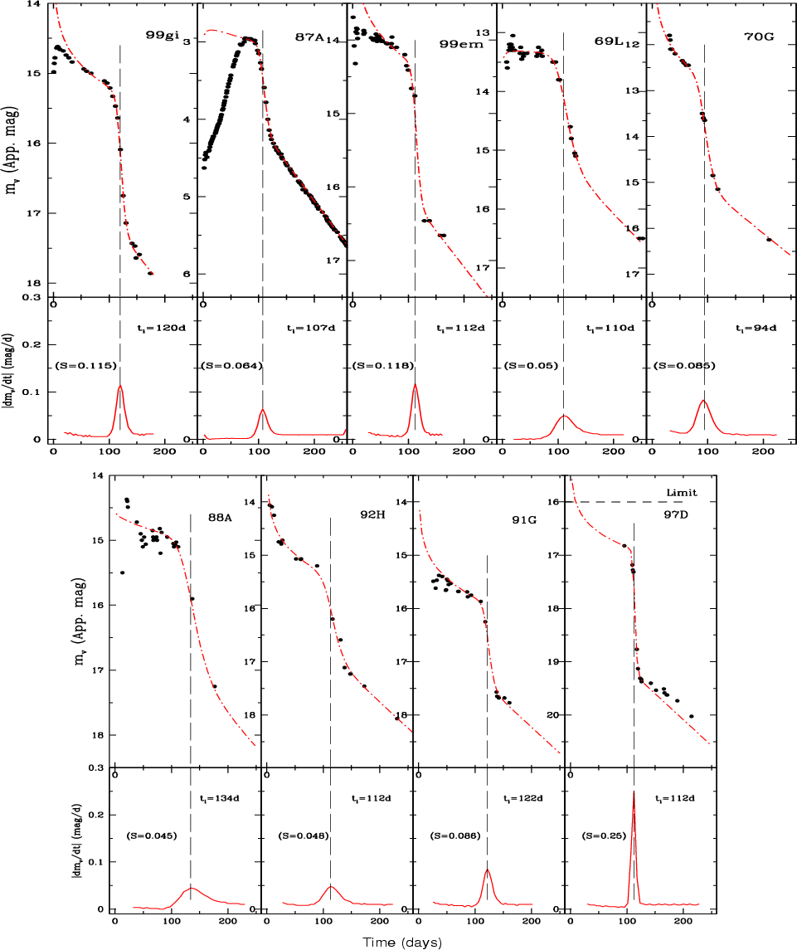
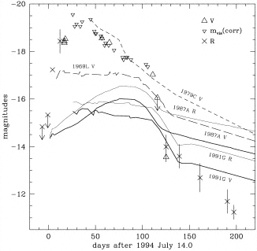
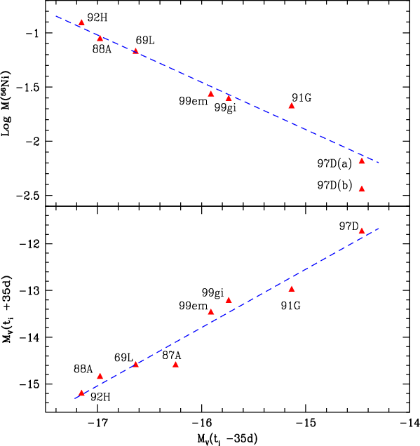
The importance of the tail
Elmhamdi et al. 2003
Attempt to determine the transition from the plateau phase to the radioactive tail
dust formation?
black hole?
SN 1994W
Sollerman et al. 1998

Slide 12
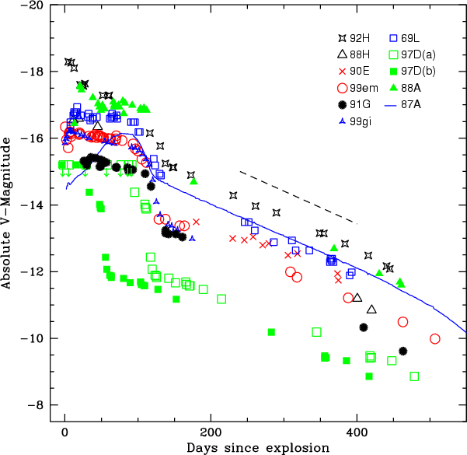
Nickel in core-collapse SNe
Late decline of the bolometric light curve is a direct measure of the nickel mass!
Elmhamdi et al. 2003

Slide 13
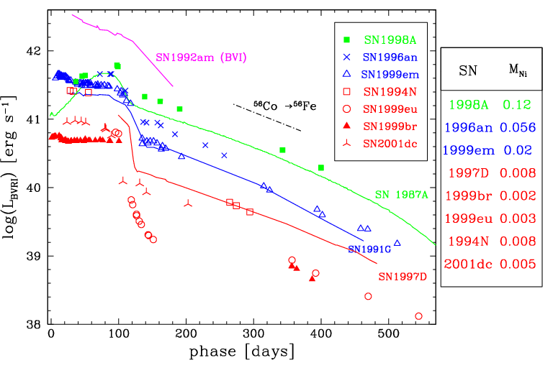
Nickel in core-collapse SNe
Pastorello et al. (2003)

Slide 14
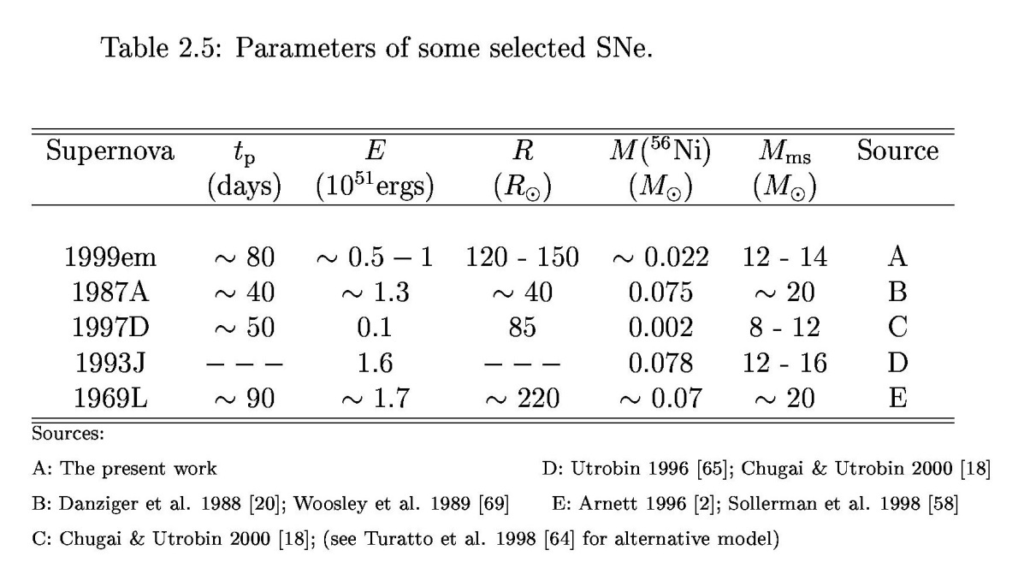
Parameters for SNe II
For typical values
  Δt ≈70 days
  v_{ph} ≈ 7000 km/s
  L ≈ 10⁴³ erg/s
we find
  E ≈ 1.8·10⁵¹ erg
  M ≈ 6.7 M
  R ≈ 400 R typical for a red supergiant
Elmhamdi 2005

Slide 15
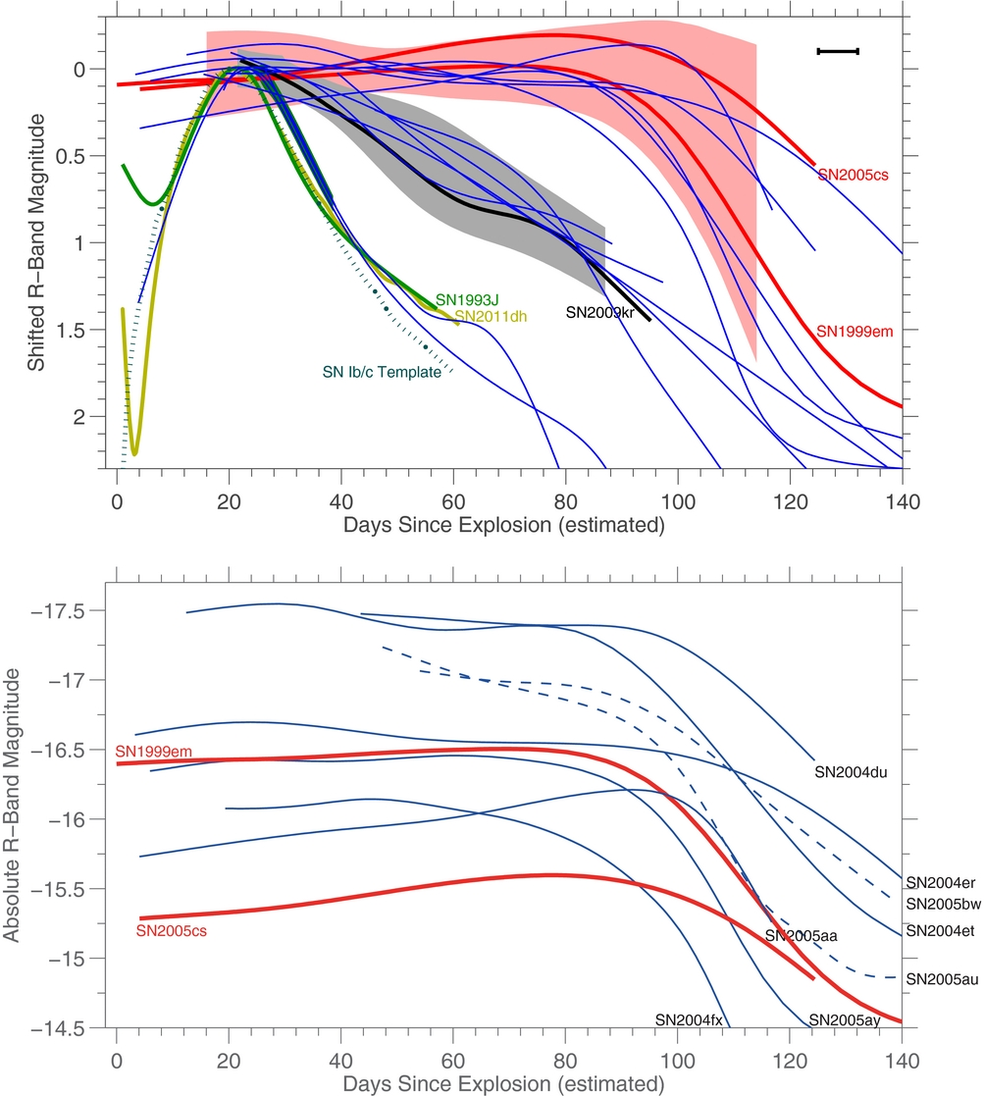
A family of light curves?
R-band light curves
  Fast declines all SNe IIb
Arcavi et al. 2012

Slide 16
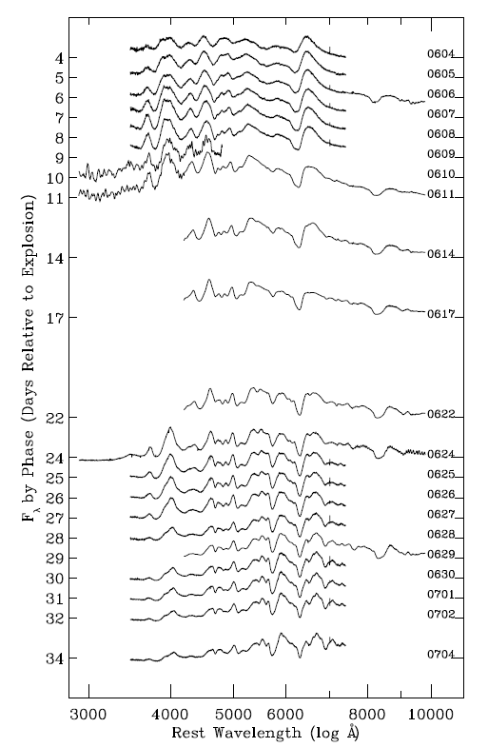
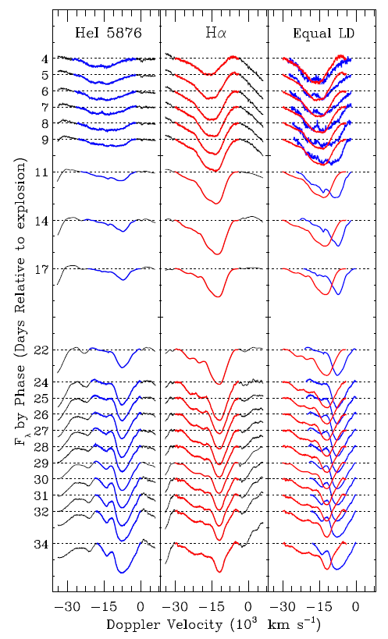
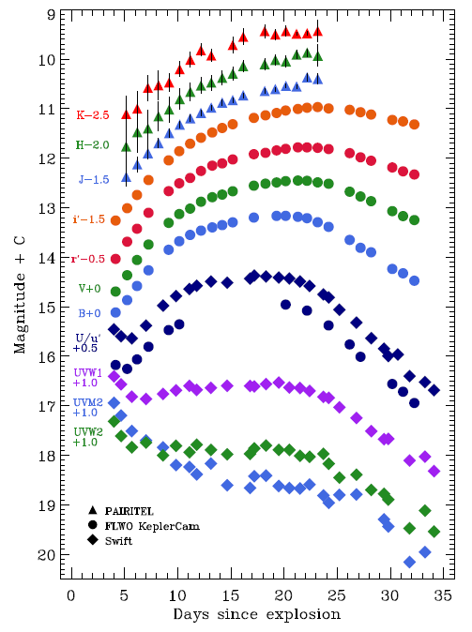
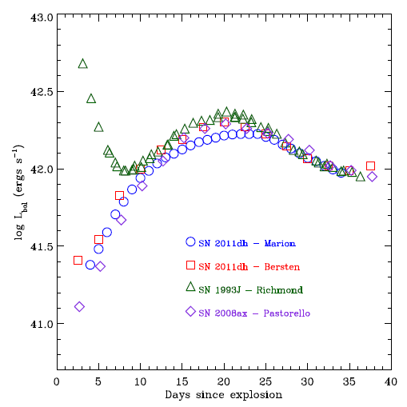
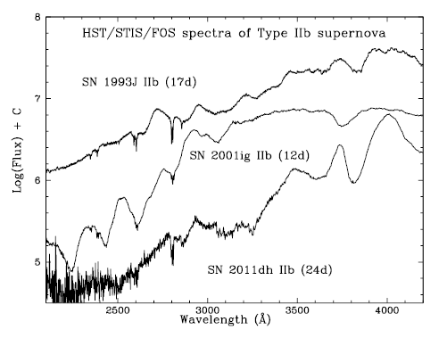
SN 2011dh
Type IIb in M51
Full λ coverage
Composition and kinematics from line profiles
H and He layers separated by ~4000 km/s
Progenitors within H shell similar
Marion et al. 2013

Slide 17
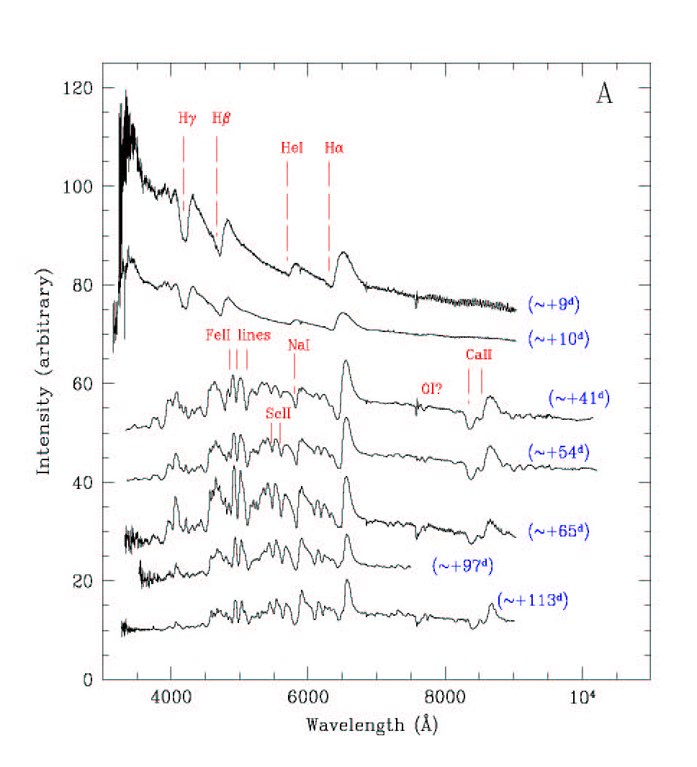
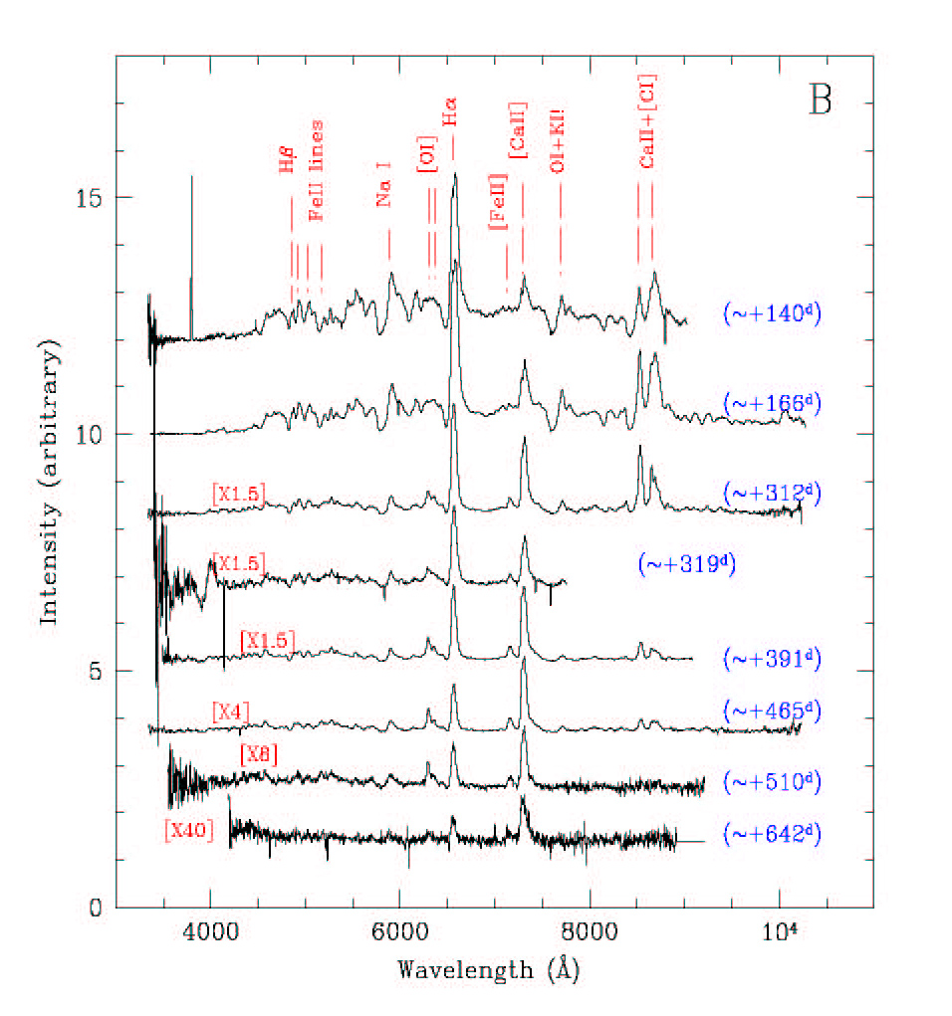
Spectral evolution
SN 1999em
Elmhamdi et al. 2003

Slide 18
SNe II near maximum
different lines
different shapes
different velocities
Hamuy 2001

Slide 19
SNe II one month past max
different evolution

Slide 20
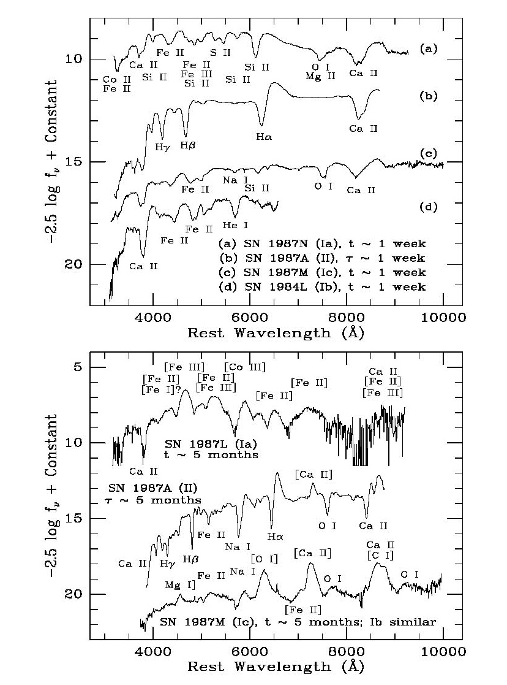
Supernova classification
Filippenko 1997

Slide 21
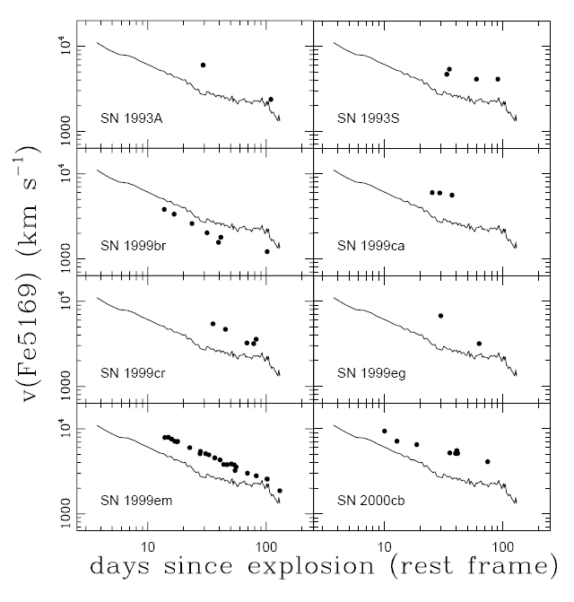
Expansion velocity
rapid decline in expansion velocity observed in the spectra

Slide 22
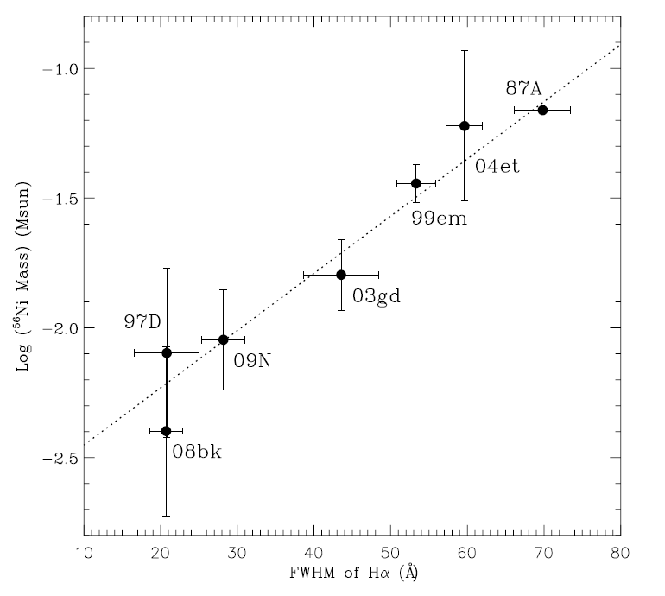
Correlation between ⁵⁶Ni and expansion velocity?
Maguire et al. 2012

Slide 23
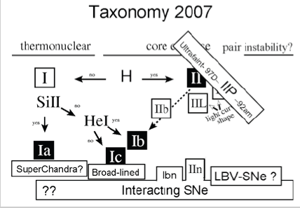
Supernova classification
Turatto et al. 2003
Turatto et al. 2007

Slide 24
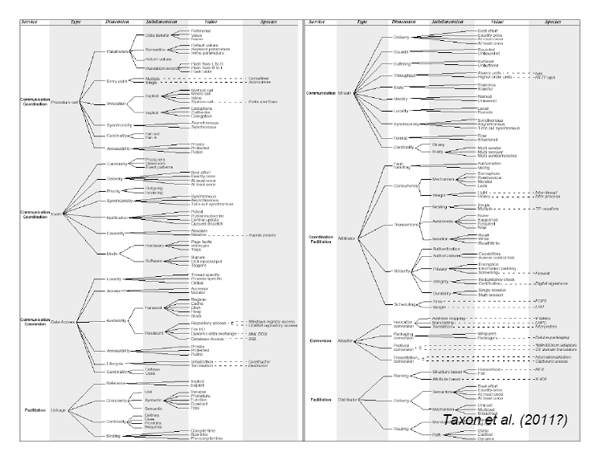

Slide 25
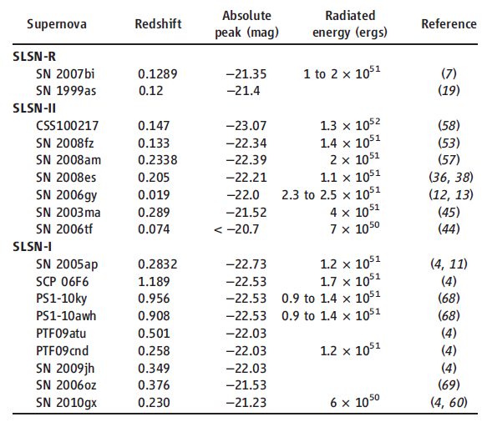
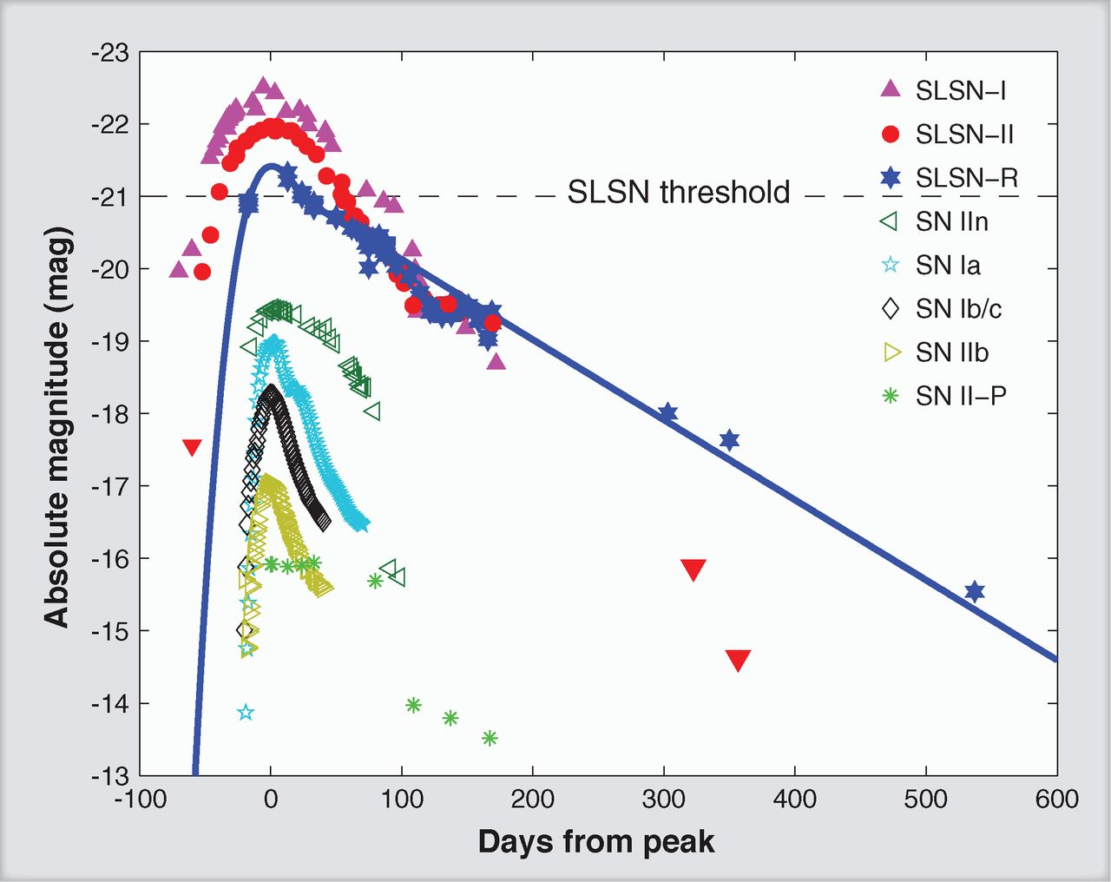
And then this …
Several supernovae with extreme luminosities
  H-rich
  H-poor
  high-energy
  SNe
Gal-Yam 2012

Slide 26
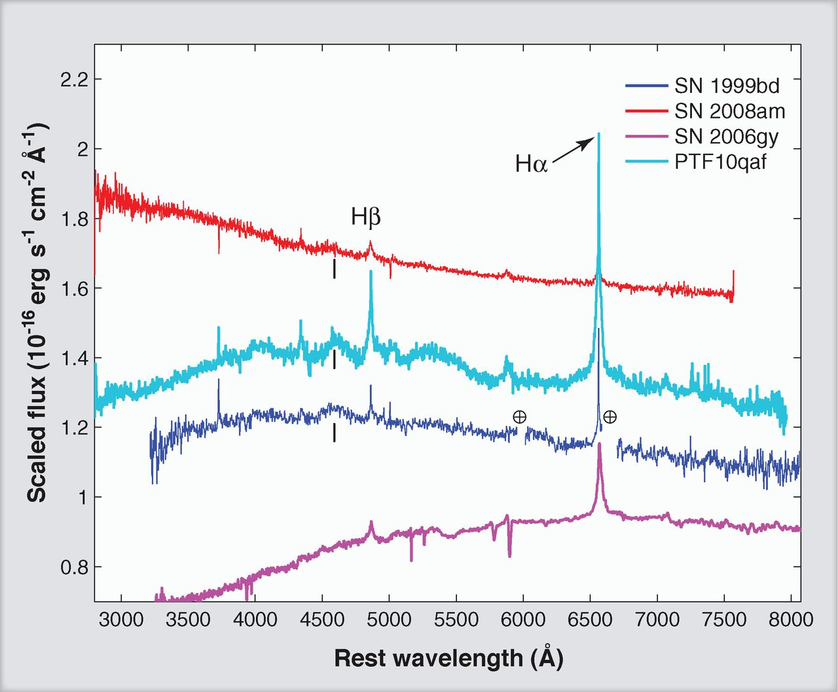
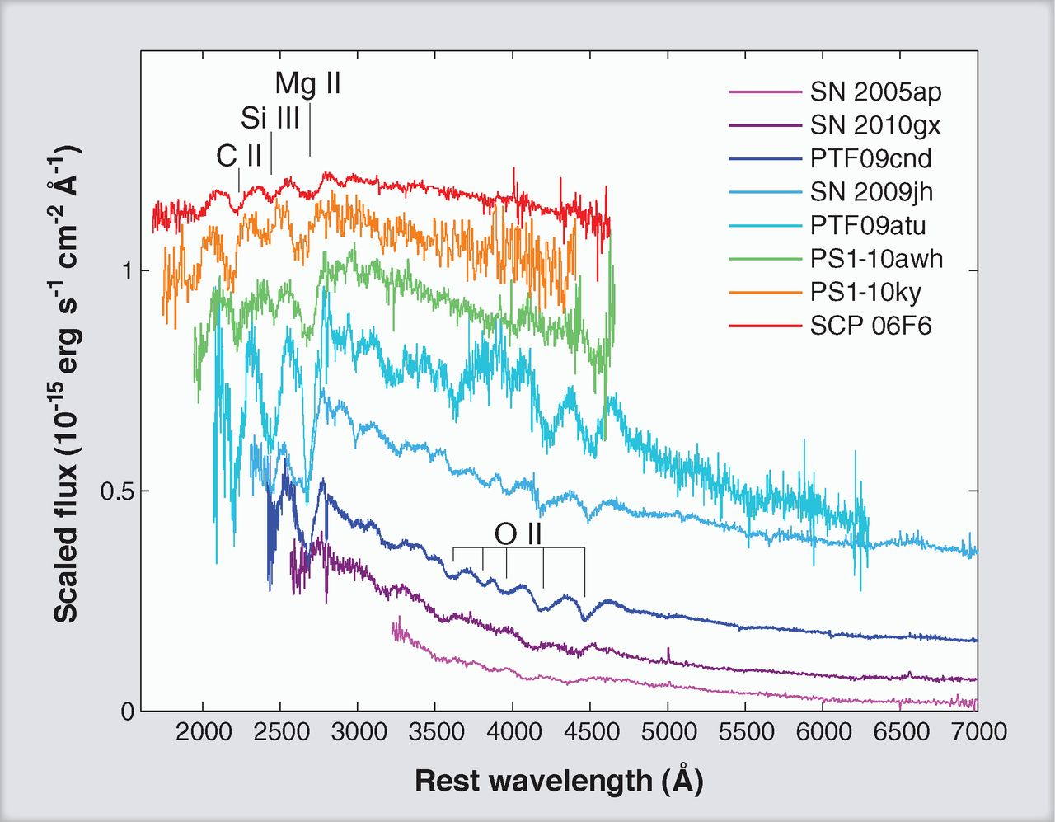
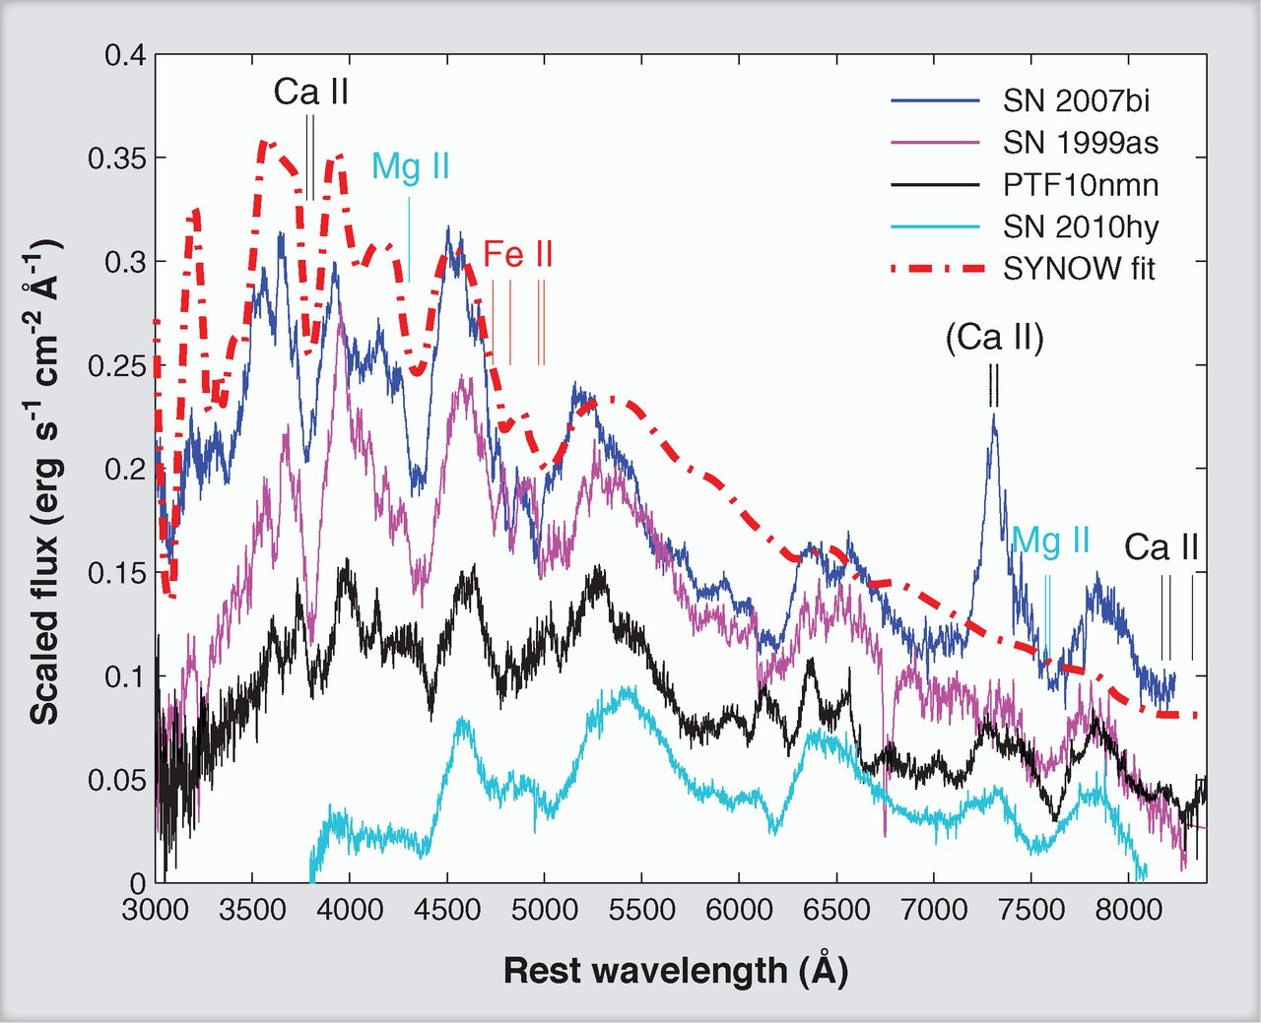
Spectroscopy

Slide 27
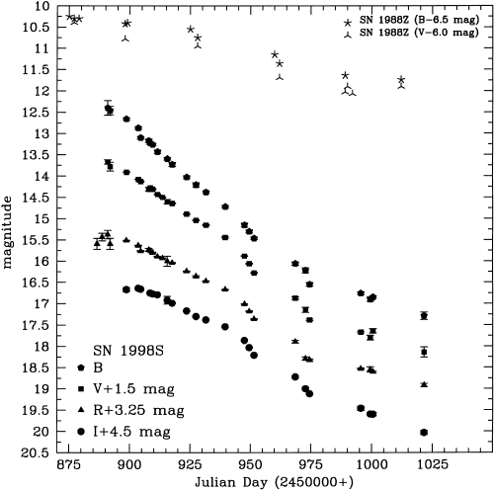
Circumstellar interaction
shock interaction with the remnant of the stellar wind
    SN 1957D, SN 1978K, SN 1986J, SN 1987A,
    SN 1988Z, SN 1995N,
    SN 1998S
conversion of kinetic
energy into radiation
    10⁵¹ erg !
Fassia et al. (2000)

Slide 28
SN 1986J – early spectroscopy
Unusual optical spectrum
  dominating Hα
  narrow emission lines (<700 km/s)
1989
1986
Leibundgut et al. 1991

Slide 29
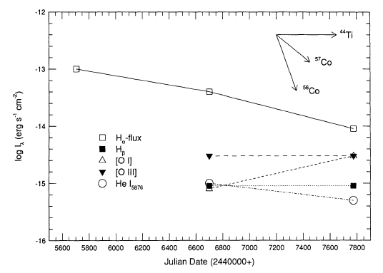
SN 1986J – strange evolution
Strange temporal evolution of the lines

Slide 30
SN 1986J @ 24 years
New data from 2007
  MDM 2.5m with spectrograph
  HST archival images
Milisavljevic et al. 2008

Slide 31
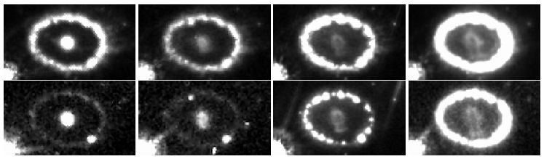
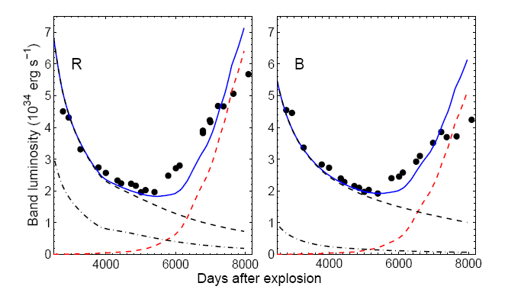
The next surprise
X-raying the ejecta of SN 1987A
  Larsson et al. 2011
  flux of the inner
  ejecta has increase
  again (starting at
  about 13.5 years)
  sign of additional
  energy input
1994
1999
2003
2009
R
B

Slide 32
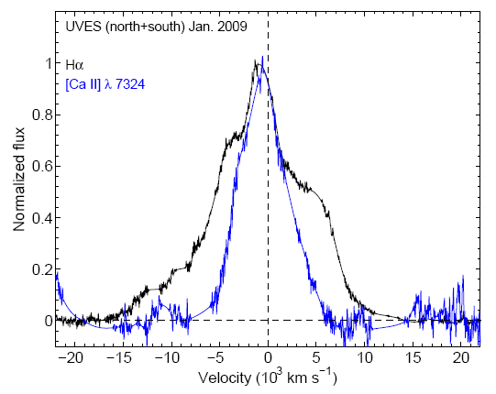
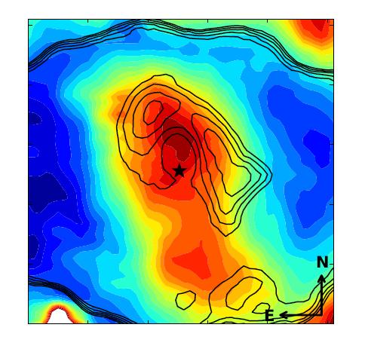
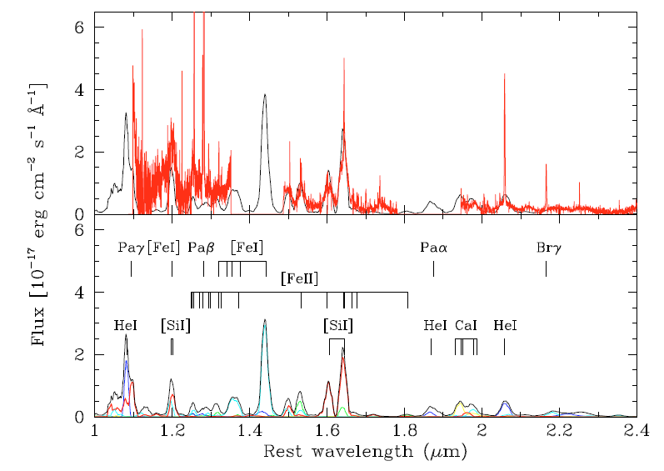
Complementary optical and IR observations
Optical and IR emission
clearly different IR
  [Si I]+[Fe II]
  concentrated
  towards the center
  Optical (Hα) in a
  ‘shell’
Different
energy
sources

Slide 33
Summary
Current transient surveys find large numbers of supernovae
  Palomar Transient Survey; PanSTARRS; PESSTO; Dark Energy Survey
Many special objects
  Sometimes types unclear; explosion mechanisms unknown
  Need to shift paradigms?
  state of confusion

Slide 34
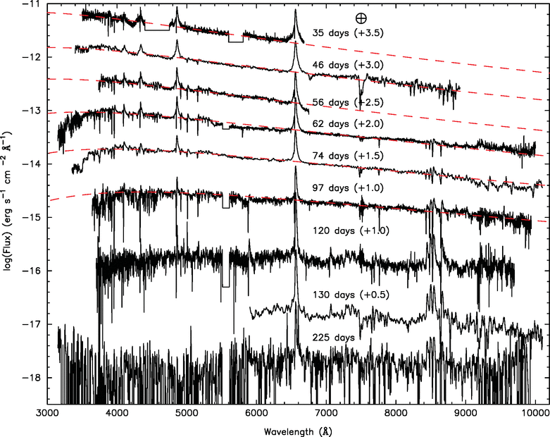
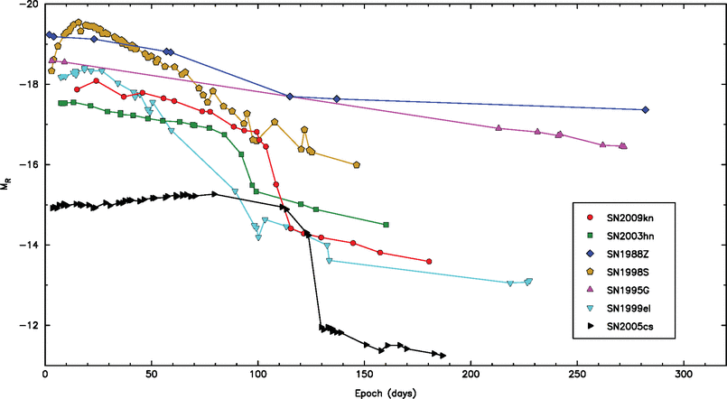
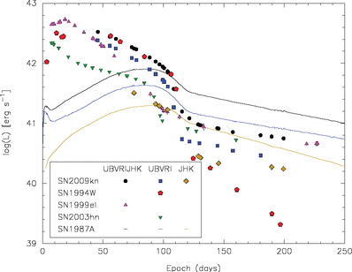
Summary
Exciting physics to be learned
Difficulty to separate different effects
  Explosion type; ⁵⁶Ni production; progenitor and progenitor evolution; circumstellar interaction
Some events defy the current explanations
  SN 2009kn
Kankare et al. 2012

