Slide 1


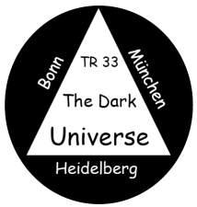
What are Type Ia Supernovae?
Bruno Leibundgut

Slide 2

The SN Ia variety
M_{B,max}
Taubenberger 2017
$Δ$m₁₅(B)

Slide 3
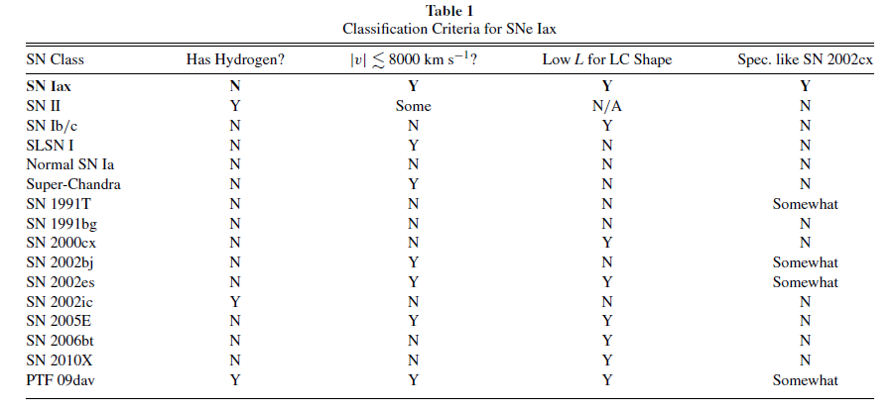
What is a SN Ia?
Foley et al. 2013

Slide 4
Progenitors
Direct detection
  white dwarfs about 30 magnitudes fainter than supernova → direct detection unlikely
  look for companions (binaries!)
  possible detection for
  a SN Iax
Bloom et al. 2012
McCully et al. 2015

Slide 5
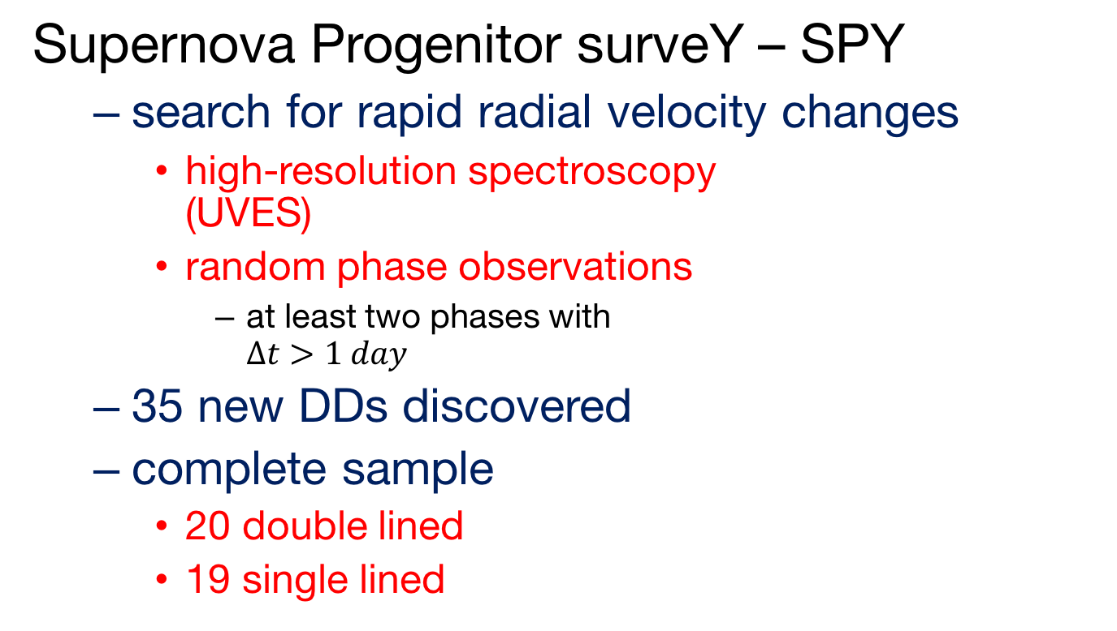
Search for double degenerate systems - SPY
Supernova Progenitor surveY – SPY
  search for rapid radial velocity changes
    high-resolution spectroscopy
    (UVES)
    random phase observations
      at least two phases with
      $Δt>1 day$
  35 new DDs discovered
  complete sample
    20 double lined
    19 single lined
Napiwotzki et al., submitted

Slide 6
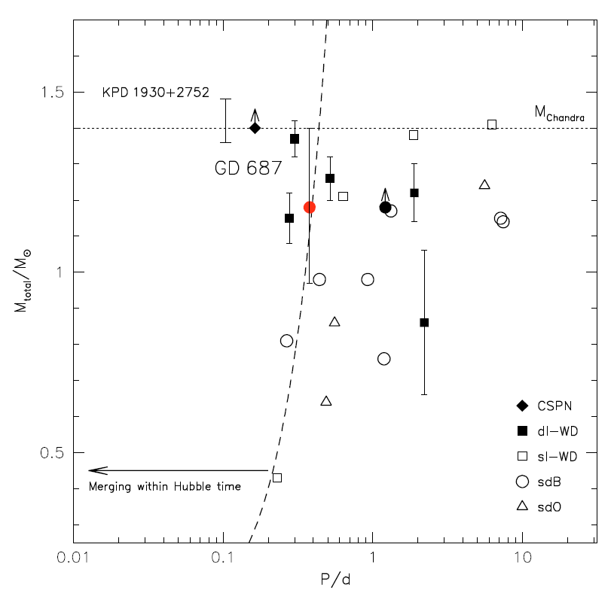
Supernova Progenitor surveY
644 DA white dwarfs checked for radial velocity changes
  are there double
  degenerate white
  dwarfs in the solar
  neighbourhood?
Napiwotzki et al. 2007
Geier et al. 2010

Slide 7
SPY results
Several massive DDs approaching M_{Chand}
Napiwotzki et al. 2017

Slide 8
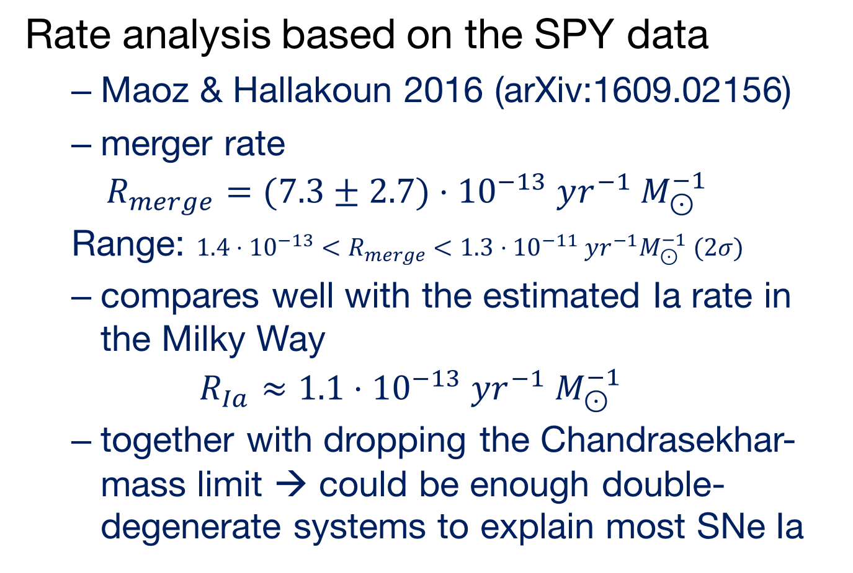
Separate analysis
Rate analysis based on the SPY data
  Maoz & Hallakoun 2016 (arXiv:1609.02156)
  merger rate
  $$R_{merge}=(7.3±2.7)⋅{10}^{−13} yr^{−1} M_{⊙}^{−1}$$
  Range: $1.4⋅{10}^{−13}<R_{merge}<1.3⋅{10}^{−11} yr^{−1}M_{⊙}^{−1} (2σ)$
  compares well with the estimated Ia rate in the Milky Way
  $$R_{Ia}≈1.1⋅{10}^{−13} yr^{−1} M_{⊙}^{−1}$$
  together with dropping the Chandrasekhar-mass limit → could be enough double-degenerate systems to explain most SNe Ia

Slide 9
Type Ia Supernovae
Variations on a theme
  critical parameters?
    nickel mass
    ejecta mass
    explosion energy(?)
    explosion mechanism?
    progenitor evolution?
Taubenberger 2017

Slide 10
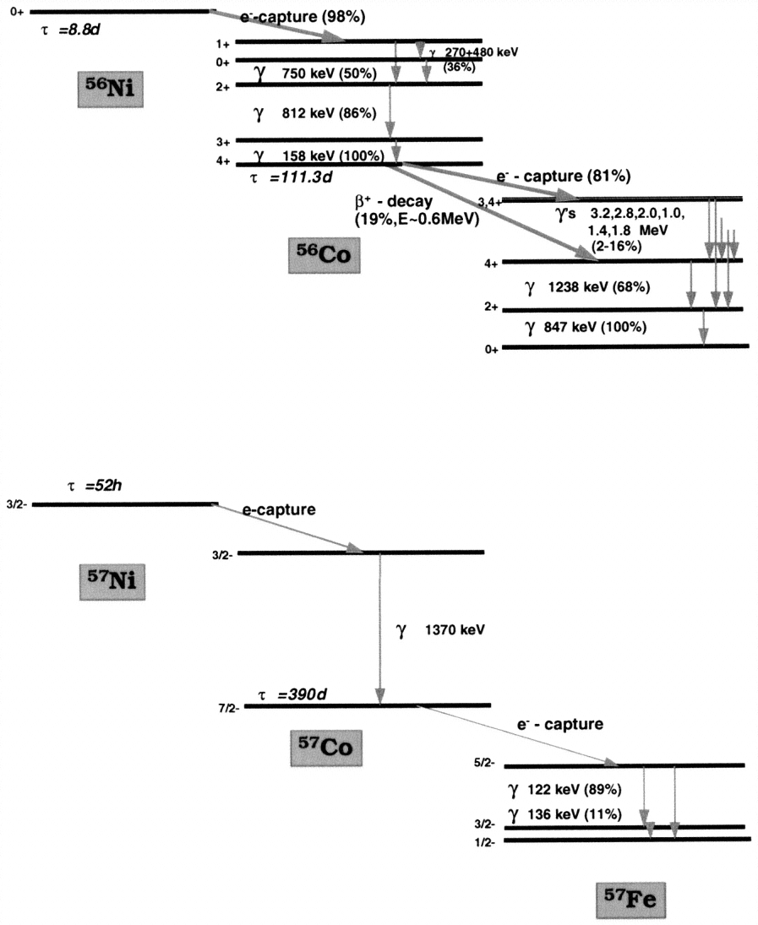
Radioactivity
Isotopes of Ni and other elements
  conversion of γ-rays and positrons into heat and optical photons
Contardo (2001)
Diehl and Timmes (1998)

Slide 11
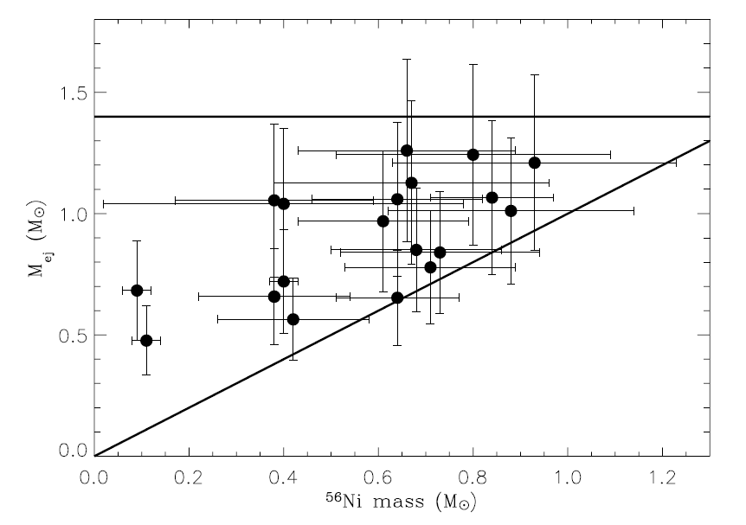
Ejecta masses
Large range in nickel and ejecta masses
  no ejecta mass at 1.4M
  factor of 2 in ejecta masses
  some rather small
  differences
  between
  nickel and ejecta
  mass
Stritzinger et al. 2006

Slide 12
Ejecta masses
Scalzo et al. 2014

Slide 13
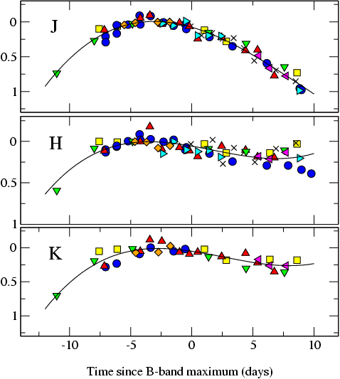
The promise of the (near-)infrared
Extinction is much reduced in the near-IR
  A_{H}/A_{V} ≅ 0.19 (Cardelli et al. 1989)
SNe Ia much better behaved
SN m₁₅(B)
= 1980N (1.29)
= 1986G (1.79)
= 1998bu (1.05)
= 1999aw (0.81)
= 1999ee (0.94)
= 2000ca (1.01)
= 2001el (1.15)
Krisciunas et al. (2004)
Mark Phillips

Slide 14
Others find this too
Light curves in the near-IR very uniform at peak, but large differences at later times
SN 2006mr
SN 2005ke
SN 2007on
Kattner et al. 2012

Slide 15
Large literature sample
Scatter minimal at first maximum in
Y (1.04μm), J (1.24μm),
H (1.63μm) and
K (2.14μm)
~90 objects in J and H
  58in Y, 22 in K
Mostly Carnegie SN Project data
(Contreras et al. 2010, Stritzinger et al. 2011)
Dhawan et al. 2015

Slide 16
Infrared light curves
Dhawan et al. 2015

Slide 17
NOT after maximum
4 days
14 days
30 days
Dhawan et al. 2015
maximum
minimum
second maximum

Slide 18
Late decline (t>40 days)
Dhawan et al. 2015

Slide 19
Correlations
Phase of the second maximum appears to be a strong discriminator among SNe Ia
Dhawan et al. 2015

Slide 20
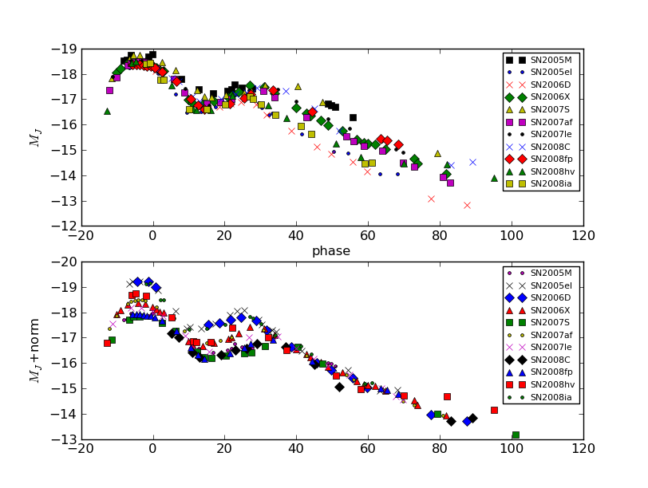
Correlations
Luminosity of late decline and the phase of the second maximum are linked

Slide 21
Correlations with the optical
Biscardi et al. 2012
IR properties correlate with optical decline rate
Phase of secondary maximum strongly correlated Δm₁₅
Dhawan et al. 2015

Slide 22
Correlations
Note very only weak correlation with the peak magnitude!
Dhawan et al. 2015

Slide 23
Correlation with optical colour
Phase of second maximum and beginning of the Lira relation are also tightly linked
Dhawan et al. 2015
Phillips et al. 1999

Slide 24
Summary
Dhawan et al. 2015

Slide 25
SNe Ia in the NIR
Consistent picture emerging
  Second peak in the near-IR is the result of the recombination of Fe⁺⁺ to Fe⁺ (Kasen 2006)
  Uniform ejecta structure
    late declines very similar
  higher luminosity indicates higher ⁵⁶Ni mass
  later secondary peak also indicates higher Fe/Ni mass
  Ni mass and (optical) light curve parameters correlate (Scalzo et al. 2014)

Slide 26
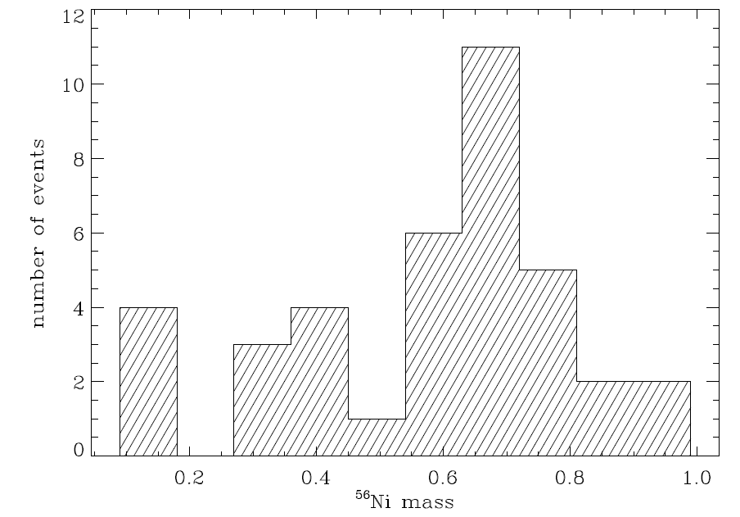
Nickel masses directly?
Correlate phase of second maximum with observed nickel masses
  avoid ‘detour’ through optical light curve shape parameter (Δm₁₅)
Stritzinger 2005
38 well-observed SNe Ia
Scalzo et al. 2014
SNFactory

Slide 27
Luminosity function of SNe Ia
Use the phase of the second maximum to derive the bolometric peak luminosity
  calibrated on a sample
  of reddening-free SNe Ia
    SNe with E(B-V)<0.1
    pseudo-bolometric light curves (UBVRIYJH)
  apply to reddened objects
Dhawan et al. 2016

Slide 28
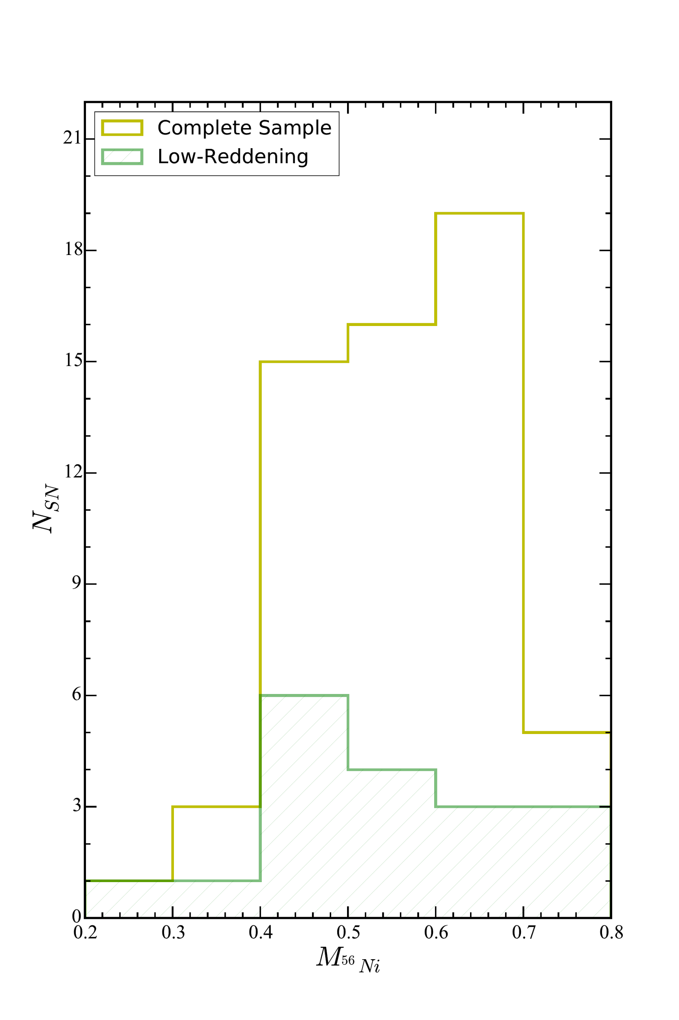
Luminosity function of SNe Ia
SN 2014J test passed
Potential to determine the luminosity function and Ni distribution
Dhawan et al. 2016

Slide 29
Nickel masses
Using a timing parameter for nickel masses
  completely independent on reddening and multiple light curves
Explore different methods to calculate the nickel mass
(currently still all Chandrasekhar-mass progenitors
Dhawan et al. 2016

Slide 30

Fast-declining SNe Ia
Two groups?
  selected SNe Ia with
  $Δm_{15}\left(B\right)>1.6$
  separation in
    bolometric luminosity
    phase of NIR first peak
    luminosity of NIR first
    peak
    lack of second second
    NIR maximum
    SN 1991bg-like spectrum
Dhawan et al., submitted

Slide 31
Fast-declining SNe Ia
Phase of first NIR peak
Dhawan et al., submitted

Slide 32
Implications for the explosions
Nickel and ejecta
mass
  clear indication
  of sub-Chandra
  explosions
Dhawan et al., submitted

Slide 33
Summary
Double-degenerate WDs promising progenitor channel
  SN 2011fe, DD statistics, explosion models
  some probably through other channels
Nickel shapes most SNe Ia
Ejecta mass varies
Different explosion mechanisms?

